Slide 1
A Closer Look at the Database with Revit API
Mikako Harada
AEC Workgroup Technical Lead
Developer Technical Services
Autodesk

Slide 2
About the Speaker:
Mikako works as a consultant for the Developer Technical Services Team at Autodesk, providing API technical support to Autodesk Developer Network members worldwide for AEC products -- primarily AutoCAD Architecture and Revit Architecture. Prior to joining Autodesk, Mikako was a researcher at universities and private research labs and worked in the areas of interactive techniques, optimization and layout synthesis.

Slide 3
Goal and Motivation
Goal
have a better understanding of Revit API by take a closer look at Revit project database and forming a big picture
Motivation
Lack of documentation
all elements are bundled together and accessible via Document's ElementIterator
There are thousands of elements in the list
How can we access to what we are looking for?
What’s the logic behind really?
Share my own experience
Notes:
Goal:
- Spend the next 90 min. taking a closer look at the Revit Project database and have a better understanding of Revit API. After sitting here for the next 90 min today with me, I hope you will have a bigger “picture” of how you can tackle with elements list.
Motivation:
- In Revit, all elements are bundled together and accessible via Document's ElementIterator
- Thousands (2000) of elements in the lists even with a project starting from scratch (2000) – that is more than we can use our educated guess.
We can get a wall checking wall type, but there is not door class.
What’s the logic behind?
This is talk is about sharing my experience. I myself have been supporting Revit API since the day1 of Revit API debuit, I myself have struggled a lot with those.

Slide 4
Agenda
Element list in Revit
RvtMgdDbg - “snoop” tools
Closer look at Revit element list
Identifying elements
Identifying symbols
UI and Elements list
Built-in parameters
Test Framework
Notes:
Mysterious element list

Slide 5
Element list in Revit
How can we access the Revit elements from an external command?
Two ways:
Select objects → commandData.Application.ActiveDocument.Selection.Elements
Go through commandData.Application.ActiveDocument.Elements
ExternalCommandData
Application
ActiveDocument
Elements
Selection
Elements

Slide 6
Accessing Revit Elements
Two “Elements” return in different form
Document.Selection.Elements
Returns ElementSet
We can use ForEach (or foreach), Size, Contains test
Document.Elements
Returns ElementIterator
We go through iterator.MoveNext() and iterator.Current()
(We often put in the ElementSet for easier manipulation)
This is the one we want to take a look today

Slide 7
Identifying Revit Elements
Identifying Revit elements can be brain twisting
Normally, we can determine objects by object types or classes
Does this apply to Revit?
Notes:
Identifying Revit elements can be brain twisting . Normally, we can determine objects by object types or classes… But with Revit, it is not the case.
Let’s first look at the classes defined for Revit.

Slide 8
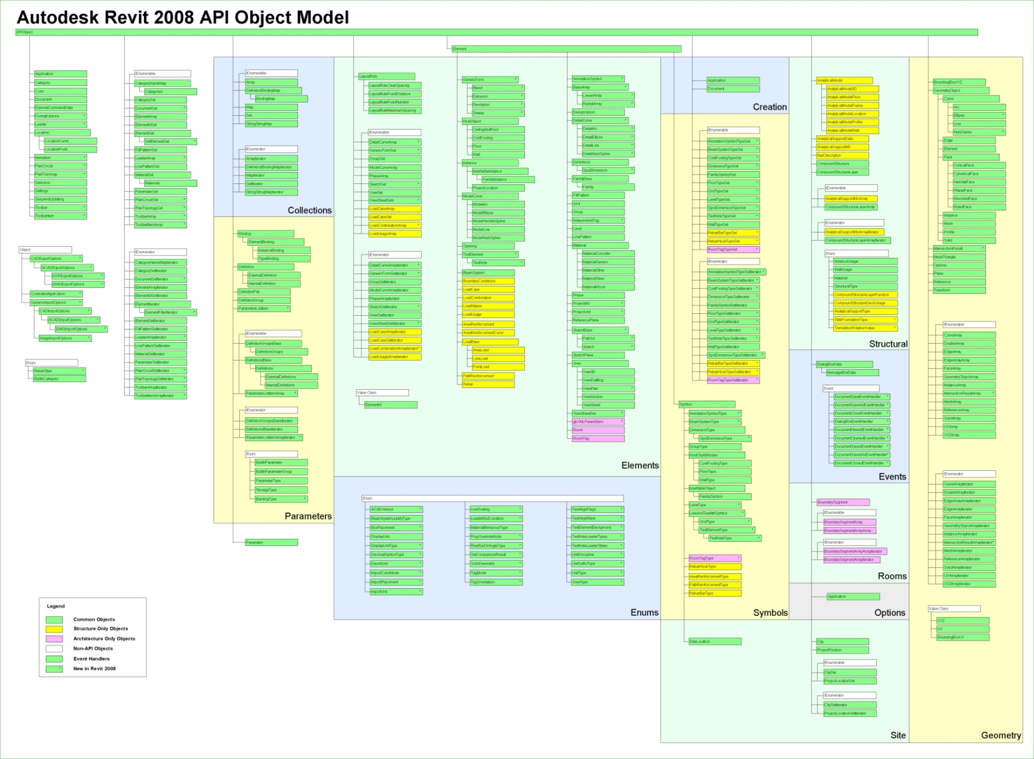
Revit Object Model
Notes:
Here is an overview of the Revit classes provided by the API, in "Revit API Diagram.rvt".
The model is rather large ... and unreadable ... so let us look at a subset of interesting classes and highlight some of them.

Slide 9
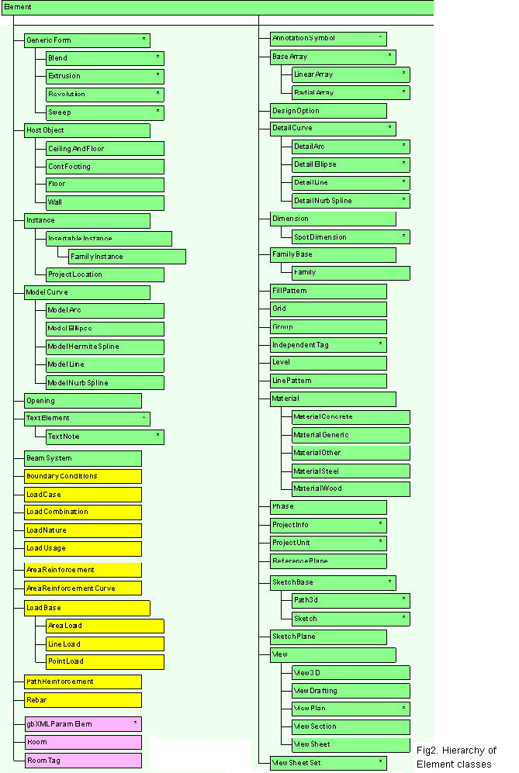
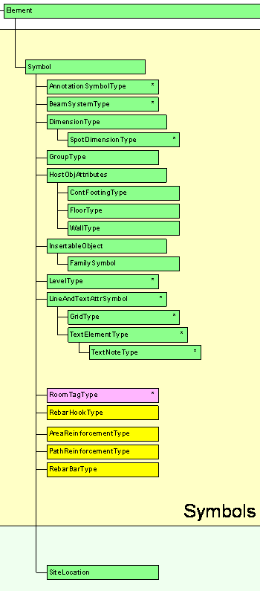
Notes:
Here is an overview of the Revit classes provided by the API, in "Revit API Diagram.rvt".
The model is rather large ... and unreadable ... so let us look at a subset of interesting classes and highlight some of them.

Slide 10
Subset of Object Model
APIObject
Application
Document
ExternalCommandData
ElementSet
ParameterSet
Parameter
Element
Symbol
GeometryObject
# RST:
AnalyticalModel
AnalyticalModelFloor
AnalyticalModelWall
Creation
APIObject
Application
Document
GeometryObject
Curve
Arc
Ellipse
Line
NurbSpline
Edge
Face
ConicalFace
CylindricalFace
HermiteFace
PlanarFace
ResolvedFace
RuldeFace
Instance
Mesh
Profile
Solid
Plane
Reference
Transform
Element
HostObject
CeilingAndFloor
ContFooting
Floor
Wall
Instance
Opening
TextElement
BeamSystem
Dimension
SpotDimension
FamilyBase
Family
Level
Phase
ProjectInfo
# RST:
BoundaryConditions
LoadCase, Combination, Nature, Usage
AreaReinforcement
AreaReinforcementCurve
LoadBase
AreaLoad
LineLoad
PointLoad
PathReinforcement
Rebar
# end of RST
Symbol
Symbol
AnnotationSymbolType
BeamSystemType
HostObjAttributes
ContFootingType
FloorType
WallType
InsertableObject
FamilySymbol
RoomTagType # RAC
RebarTagType # RST
Notes:
This is a subset selected from the Revit object model.
Some of the interesting classes have been highlighted, and the list has been split into several sublists at crucial points.
It shows that some objects are available only in the RAC or only in the RST environment, such as RommTagType in RAC, RebarTagType, the analytical model and the loads and boundary conditions in RST.
Everything is derived from APIObject.
All physical BIM objects are derived from Element.
A separate version of Application and Document is provided in the Creation namespace, for creating new elements.

Slide 11
Subset of Object Model
API Object
Symbol
AnnotationSymbolType
BeamSystemType
HostObjAttributes
ContFootingType
FloorType
WallType
InsertableObject
FamilySymbol
RoomTagType # RAC
RebarTagType # RST
Element
Instance
Family Base
Group
Symbol
HostObject
Insertable Instance
Family
Group Type
HostObject Attributes
Insertable Object
Wall
Floor
Family Instance
Family Symbol
Cont. Footing
Wall Type
Floor Type
Cont. Footing Type
Ceiling & Floor
Roof
Notes:
This is a subset selected from the Revit object model.
Some of the interesting classes have been highlighted, and the list has been split into several sublists at crucial points.
It shows that some objects are available only in the RAC or only in the RST environment, such as RommTagType in RAC, RebarTagType, the analytical model and the loads and boundary conditions in RST.
Everything is derived from APIObject.
All physical BIM objects are derived from Element.
A separate version of Application and Document is provided in the Creation namespace, for creating new elements.

Slide 12
Revit Database Structure
?!
Notes:
All clear? Not really, right? Today we want to step back a little bit and look at the list of elements a bit more carefuly to get a bigger picture of what’s in element list. To aid this goal, we use a tool called RvtMgdDbg.

Slide 13
RvtMgdDbg – “Snoop” Tools
Comprehensive test of the Revit API
Sample code and utility classes
Scaffolding for quick tests
Aid learning Revit API
Explore:
Application
Document
Current selection
Reflection
Events
Tests
Notes:
RvtMgdDbg is a utility similar to the well-known ArxDbg and MgdDbg utilities provided for AutoCAD, written by the same author and his team.
It is a Revit extension application which defines its own menu and toolbar.

Slide 14
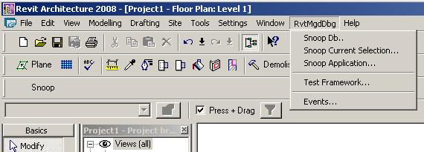
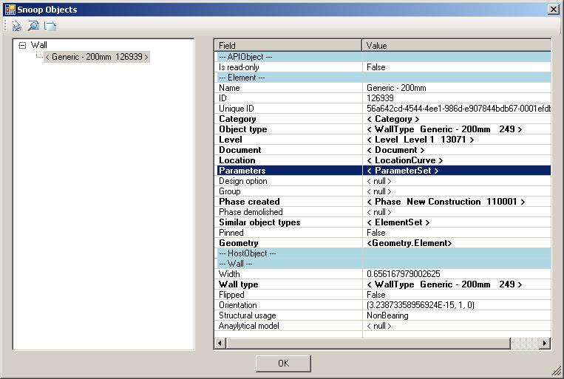
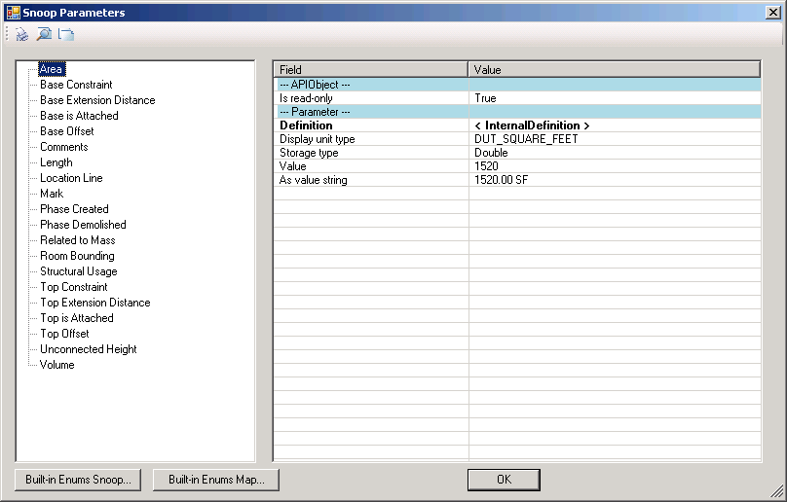
RvtMgdDbg Demo
Notes:
RvtMgdDbg is implemented as an external application, so it installs its own menu ‘RvtMgdDbg‘ and toolbar with the entry ‘Snoop’ for quick access to the ‘Snoop Db..’ menu entry.

Slide 15
Closer Look at Element List Element classes
What kind of classes are there?
There are 109 classes derived from Revit.Elements
RevitAPI Help.chm → Autodesk.Revit.Elements

Slide 16
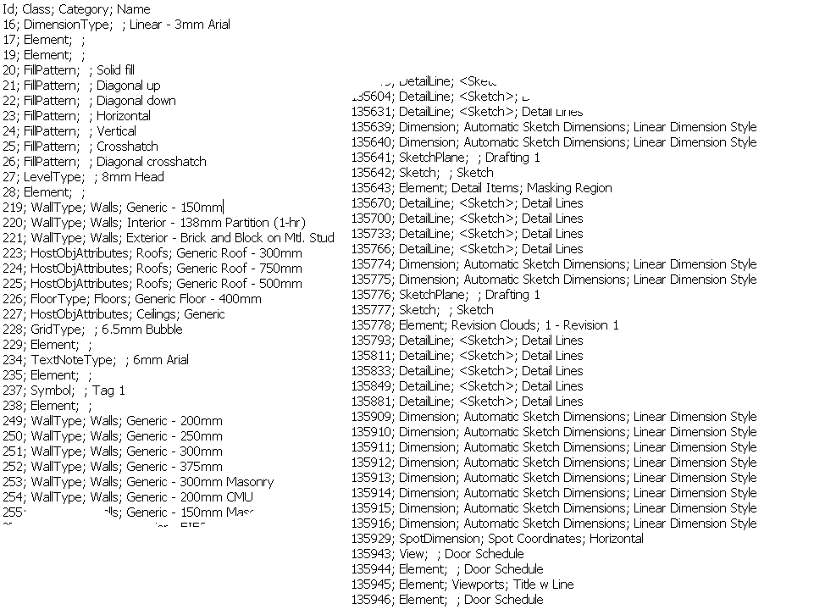
Closer Look at Element List Raw Data
Notes:
Go to the Excel files. 2267 count with a LittleHouse.rvt sample drawing.

Slide 17
Closer Look at Element List Obsession…
From a simple test drawing of 20~30 elements (LittleHouse.rvt)
Element | 1509 | 66.56%
FamilySymbol | 111 | 4.90%
MaterialOther | 101 | 4.46%
Symbol | 91 | 4.01%
Dimension | 90 | 3.97%
Family | 56 | 2.47%
FillPattern | 47 | 2.07%
ModelLine | 45 | 1.99%
WallType | 26 | 1.15%
DetailLine | 25 | 1.10%
SketchPlane | 25 | 1.10%
HostObjAttributes | 18 | 0.79%
LinePattern | 17 | 0.75%
FamilyInstance | 10 | 0.44%
Sketch | 9 | 0.40%
DimensionType | 8 | 0.35%
SpotDimensionType | 8 | 0.35%
View | 8 | 0.35%
TextNoteType | 7 | 0.31%
FloorType | 5 | 0.22%
ViewPlan | 5 | 0.22%
GroupType | 4 | 0.18%
Wall | 4 | 0.18%
RoomTagType | 3 | 0.13%
AnnotationSymbolType | 2 | 0.09%

Slide 18
Closer Look at Element List Elements vs Symbols
Non Symbol Element | View | View
 |  | View3D
 |  | ViewDrafting
 |  | ViewPlan
 | Settings | FillPattern
 |  | gbXMLParamElem
 |  | LinePattern
 |  | MaterialOther
 |  | MaterialSteel
 |  | Phase
 |  | ProjectInfo
 |  | ProjectLocation
 |  | ProjectUnit
 | Modeling | FamilyInstance
 |  | Floor
 |  | ModelLine
 |  | Opening
 |  | Wall
 | Group | Group
 | Families | Family
 | Drafting | AnnotationSymbol
 |  | DetailArc
 |  | DetailLine
 |  | DetailNurbSpline
 |  | Dimension
 |  | Grid
 |  | IndependentTag
 |  | Level
 |  | ReferencePlane
 |  | Room
 |  | RoomTag
 |  | SpotDimension
 |  | TextNote
 | Not Exposed | Element
 | Supporting Element? | Sketch
 |  | SketchPlane
Symbol | System Family Type (end with type) | AnnotationSymbolType
 |  | BeamSystemType
 |  | ContFootingType
 |  | DimensionType
 |  | FloorType
 |  | GridType
 |  | GroupType
 |  | LevelType
 |  | RoomTagType
 |  | SpotDimensionType
 |  | TextNoteType
 |  | WallType
 | Settings Type | SiteLocation
 | Component Family type | FamilySymbol
 | Not exposed yet | HostObjAttributes
 |  | Symbol

Slide 19
Closer Look at Element List Element types and category
Kind of Element in UI | Derived from Element/TypeOf | Category
Wall | HostObject/Wall | Walls
Door | Instance/InsertableInstance/FamilyInstance | Doors
Door Tag | IndependentTag | Door Tags
Window | Instance/InsertableInstance/FamilyInstance | Windows
WindowTag | IndependentTag | Window Tags
Opening | Opening | < null >
Floor | HostObject/Floor | Floors
Ceiling | Element | Ceilings
Roof | Element | Roofs
Column | Instance/InsertableInstance/FamilyInstance | Columns
Component (Desk) | Instance/InsertableInstance/FamilyInstance | Furniture
Stair | Element | Stairs
Railing | Element | Railings
Room | Room | Rooms
Room Tag | RoomTag | Room Tags
Grid | Grid | Grids
Lines | ModelCurve/ModelLine | Lines
Ref Plane | ReferencePlane | Reference Planes
Dimension | Dimension | Dimensions
Section | Element | < null >
Text | TextElement/TextNote | Text Notes
Level | Level | Levels
Model Group | Group | < null >
Create…/Walls | Instance/InsertableInstance/FamilyInstance | Walls
Notes:
There are two ways to look at Revit elements. From the type or class of the object, and from Category. In fact, we need to use both (in some cases more than two); there is no single, reliable way to determine what object it is in Revit.

Slide 20
Families and Types
Also know as symbols
Standard (or Component) versus system families
Using loaded families and symbols
Loading new families and symbols
Determining and changing element's type
(for standard and system families)
Notes:
In order to insert the column in the last example, we already had the need to determine a suitable family type for it.
If the family or that specific type was not available, we had to prompt the user to load it manually.
This procedure can be automated.
In this section, we explore the handling of families and types in more detail.

Slide 21
Closer Look at Element List Element vs. Symbol
Element |  |  |  | Symbol
Kind of Element in UI | Derived from Element/TypeOf | Category |  | Derived from Symbol/TypeOf | Category
Wall | HostObject/Wall | Walls |  | HostObjAttributes/WallType | Walls
Door | Instance/InsertableInstance/FamilyInstance | Doors |  | InsertableObject /FamilySymbol | Doors
Door Tag | IndependentTag | Door Tags |  | InsertableObject /FamilySymbol | Door Tags
Window | Instance/InsertableInstance/FamilyInstance | Windows |  | InsertableObject /FamilySymbol | Windows
WindowTag | IndependentTag | Window Tags |  | InsertableObject /FamilySymbol | Window Tags
Opening | Opening | < null > |  | < null > | ---
Floor | HostObject/Floor | Floors |  | HostObjAttributes/FloorType | Floors
Ceiling | < Element > | Ceilings |  | HostObjAttributes | Ceilings
Roof | < Element > | Roofs |  | HostObjAttributes | Roofs
Column | Instance/InsertableInstance/FamilyInstance | Columns |  | InsertableObject /FamilySymbol | Columns
Component (Desk) | Instance/InsertableInstance/FamilyInstance | Furniture |  | InsertableObject /FamilySymbol | Furniture
Component (Tree) | Instance/InsertableInstance/FamilyInstance | Planting |  | InsertableObject /FamilySymbol | Planting
Stairs | < Element > | Stairs |  | < Symbol > | Staies
Railing | < Element > | Railings |  | < Symbol > | Railings
Room | Room | Rooms |  | < null > | ---
Room Tag | RoomTag | Room Tags |  | < Symbol > | Room Tags
Grid | Grid | Grids |  | LineAndTextAttrSymbol/GridType | < null >
Lines | ModelCurve/ModelLine | Lines |  | < null > | ---
Ref Plane | ReferencePlane | Reference Planes |  | < null > | ---
Dimension | Dimension | Dimensions |  | DimensionType | < null >
Section | < Element > | < null > |  | < Symbol > | < null >
Text | TextElement/TextNote | Text Notes |  | LineAndTextAttrSymbol/TextElementType/TextNoteType | < null >
Level | Level | Levels |  | LevelType | < null >
Model Group | Group | < null > |  | GroupType | < null >
Create…/Walls | Instance/InsertableInstance/FamilyInstance | Walls |  | InsertableObject /FamilySymbol | Walls
Notes:
Elements and Symbols use the same category name.

Slide 22
Identifying Revit Elements
An object can be determined by:
Object Types (i.e., class) or TypeOf
Category (not always defined).
Derived from Element or Element/Symbol
We will need to use combination of these
Sometimes additional checks are needed (e.g., Family and Symbols, geometry)
“Name” property has some meaningful string in a specific context (not always defined. i.e. shows as “???”).
Notes:
Going back to the previous slide –
Snoop tool makes a tree view categorized by object classes.

Slide 23
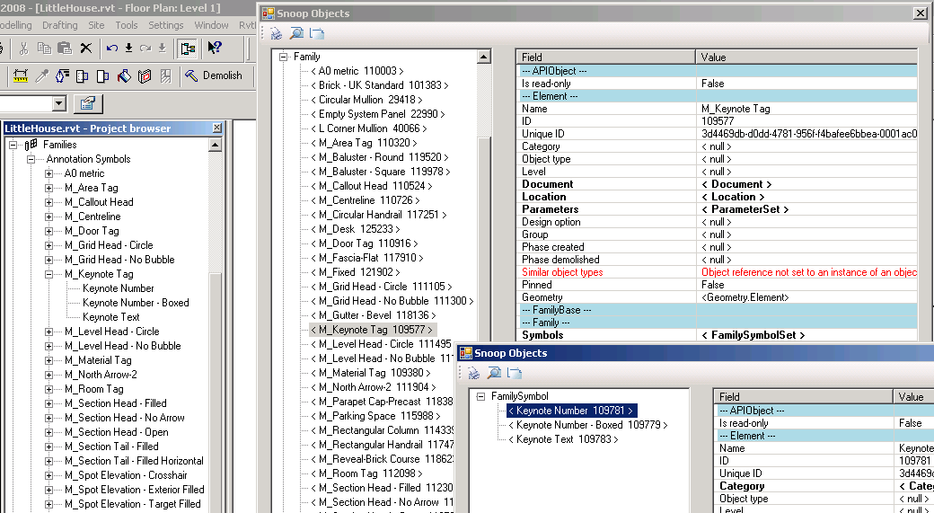
Component Families and Types
Family has no Category; Check one of the member FamilySymbol under Symbols property

Slide 24
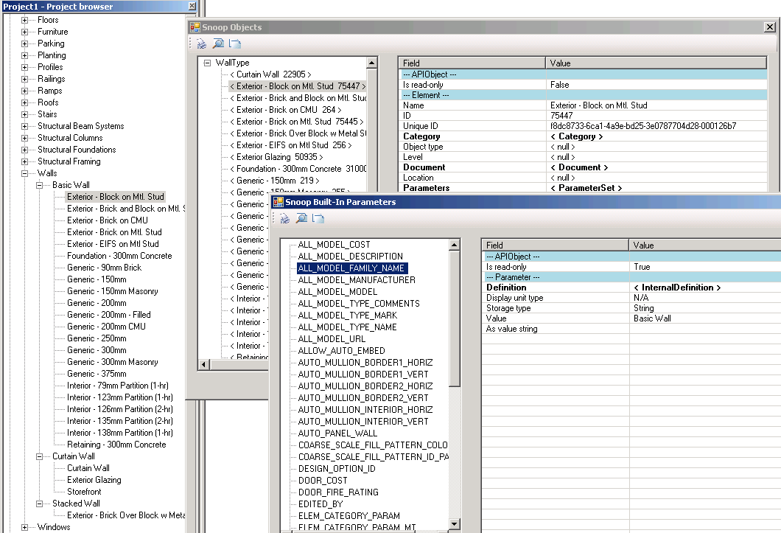
System Families and Types
Not listed under Family;
Notes:
System families are not listed under Family.
To find the name of a family, look up ALL_MODEL_FAMILY_NAME built-in parameter of the given type.

Slide 25
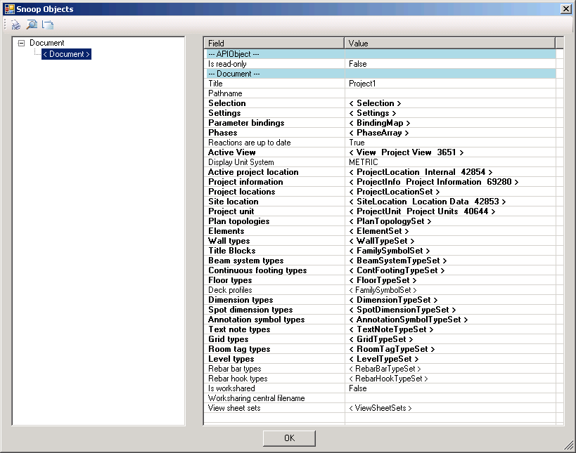
Accessing Family Types
Some of family types are accessible through Document (but not all)

Slide 26
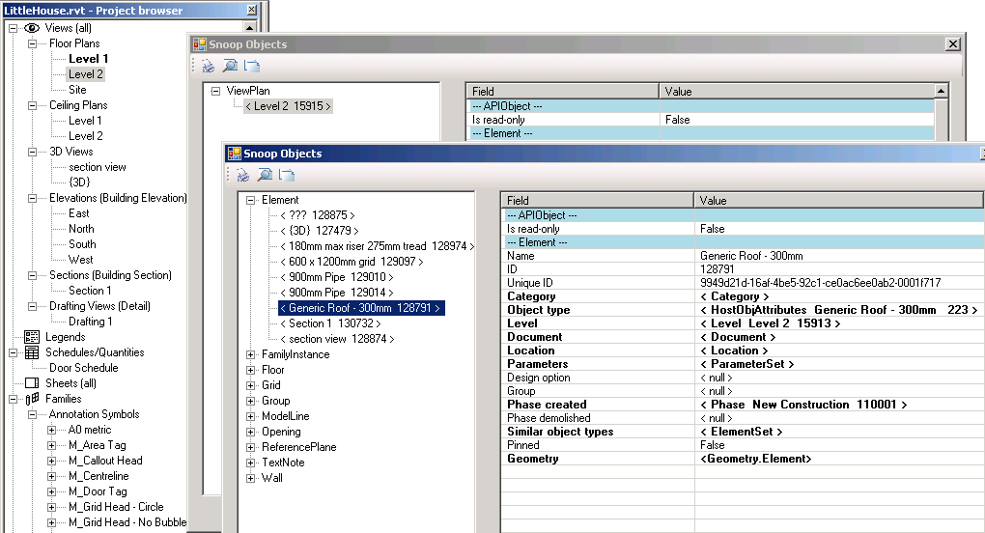
Instances
One way to access instances is through View.Elements
View specific Instance only

Slide 27
Parameters
Accessing element parameters
Built-in versus shared parameters
Exchanging data with external applications
Strategy for storing custom per-element data
Manipulating shared parameters' file and groups
Hidden parameters
Strategy for storing per-document (per-model) data
SDK sample FireRating
Notes:
In Revit, a lot of important data is stored in element parameters.
In this section, we explore different methods of accessing and modifying parameters, exporting them to external applications, importing modified data back in again, and handling shared, hidden, and per-document parameters.

Slide 28
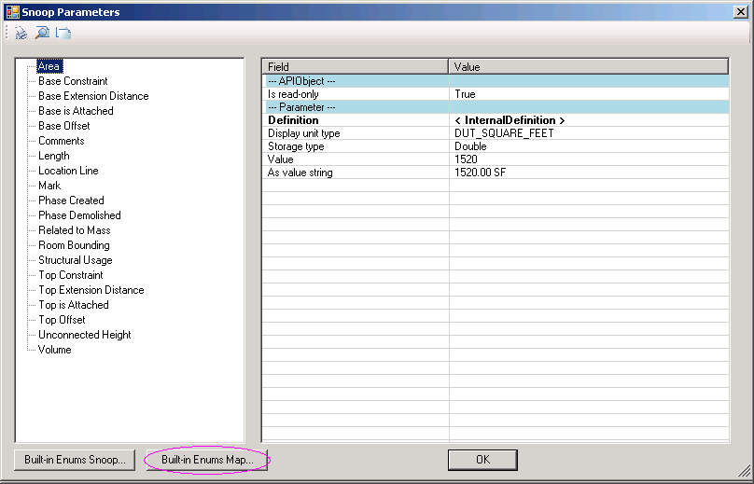
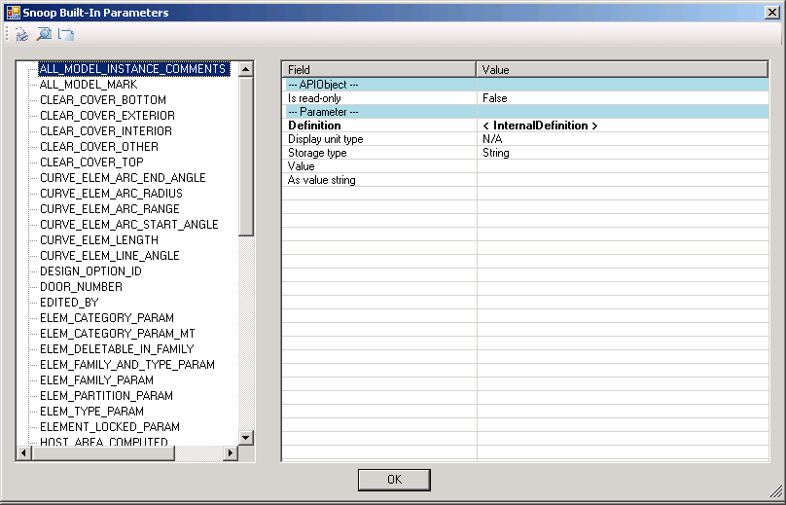
Snoop Parameters

Slide 29
Geometry
Visualization is still the best in most cases
Revit SDK sample viewers
RevitViewer
A simple geometry viewer helper class
Used by the other viewer samples
ElementViewer
Display wireframe model of one or more selected elements
RoomViewer
Wireframe viewer of the selected room
AnalyticalViewer
Display analytical model of one or more selected elements
Snooping Geometry info. In RvtMgdDbg

Slide 30
Test Framework
RvtMgdDbg includes quite a few test functions
Some are from Revit SDK samples
No need to re-reference, re-build and add to .ini file for each one of them
If you want to go beyond what we have…
you can also add your own functions and commands
Derive a function class from RvtMgdDbgTestFuncs
Add in TestCmds.cs → CmdTestShell → CreateAndAddTests().
As this is an experimental tool, may change the usage in future.
You can also add and command to the menu. (see. app.cs)
Notes:
This is intended for a collection of small functions for a quick test.
Please see TestCmds.cs --> CmdTestShell --> CreateAndAddTests(), where this class is hooked to the CmdTest framework.
Use m_revitApp to access the application object.

Slide 31
Other Resources
Developer Center
http://www.autodesk.com/developer
Revit API Discussion Group
http://discussion.autodesk.com/forum.jspa?forumID=160
Training schedule found at:
http://usa.autodesk.com/adsk/servlet/index?siteID=123112&id=780161
If you leave your business card with me today, you can join one of the scheduled class room trainings free.

Slide 32
Summary
Element list in Revit
RvtMgdDbg - “snoop” tools
Closer look at Revit element list
Identifying elements
Identifying symbols
UI and Elements list
Built-in parameters
Test Framework

Slide 33
Acknowledgement
Special thanks to Jim Awe and Arjun Ayyar of Advanced Development Team.
RvtMgdDbg was developed by Jim Awe and his team originally intended for internal use. They have been continuously improving the tool, and making it available for the developer community.

Slide 34
Thank you very much!

Slide 35


