Slide 1





Getting Started with the Revit API Jeremy Tammik Consulting Analyst
Image Courtesy of RTKL Associates Inc

Slide 2
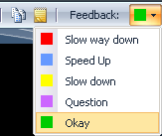
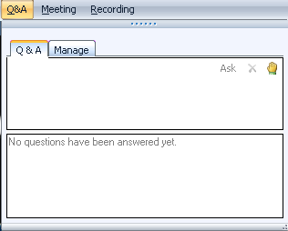
Before we start LiveMeeting and conference call – how to
Introduction
Full Screen Mode
Provide feedback
Real-time Q&A
Mute phone *6
Expand to full screen mode
Press ESC to return
Notes:
This conference is muted, so you cannot hear anybody else than me talking, and cannot provide feedback through the phone conference. We will unmute it and open it up for general discussion and questions and answers at the end. Meanwhile, written questions can be entered in the live meeting console and will be answered in real-time during the presentation by my colleagues. Thank you very much for that support! Since I will be switching back and forth between these slides and live demonstrations in Revit and Visual Studio, I will set my computer to low resolution and full screen mode to reduce bandwidth and speed up the display. This means I will not see the live meeting console and the feedback panel. My colleagues will be monitoring the livemeeting console and also answering questions online. We will post the materials from this presentation together with the audio recording.

Slide 3

About the Presenter
Introduction
Jeremy Tammik
Developer Technical Services
EMEA
Autodesk SARL
Jeremy is a member of the AEC workgroup of the DevTech team, providing developer support, training, and conferences to the Autodesk Developer Network ADN. He originally joined Autodesk in 1988 as the technology evangelist responsible for European developer support. In this capacity, he wrote articles, consulted, lectured on AutoCAD application programming techniques, and supported AutoCAD application developers in Europe, the U.S., Australia, and Africa. He was a cofounder of ADGE, the AutoCAD Developer Group Europe, and a prolific author on AutoCAD application development. He left Autodesk in 1994 to work as an HVAC application developer, and then rejoined the company in 2005.
Jeremy graduated with a MA in mathematics and physics in Marburg, Germany, in 1984, and worked first as a teacher and translator of both computer and human languages, then as a C++ programmer on early GUI and multitasking projects. He is fluent in five European languages, vegetarian, has four kids, plays the flute, likes reading, travelling, theatre improvisation and carpentry, loves mountains, oceans, sports and especially climbing.
Notes:
It is my pleasure to work in the AEC workgroup of the DevTech team supporting the Autodesk Developer Network ADN.

Slide 4
Agenda
Introduction
Introduction
Product, SDK, documentation and samples
Getting Started and Hello World
Development environment, external command and application interfaces, modifying Revit.ini, using RvtSamples and RvtMgdDbg
Database and Elements
Identifying an element, getting all model elements, filtering, manipulation
Families and Types
Standard versus system families, loading, changing type
Parameters
Access, built-in versus shared, exchange with external applications, hidden, per-doc data
Geometry and Groups
2D and 3D geometry, rooms, groups
What's New: Revit 2009 SDK samples and VSTA!
Samples section moved to DE101-3_Revit_SDK_Samples.pptx
Notes:
What are the initial steps in creating a Revit application? The first thing is to understand is what material is provided by the SDK, the API architecture, and where to obtain more information. Then we explore how to set up the development environment and create a first "Hello world" type application. After that, we will look into the Revit database structure and its data and elements. The samples provide a valuable knowledgebase on how to solve Revit programming tasks.

Slide 5
Acronyms
Introduction
ADN Autodesk Developer Network
AEC Architecture, Engineering, Construction
API Application Programming Interface
BIM Building Information Model
MEP Mechanical, Electrical, Plumbing
RAC Revit Architecture
RME Revit MEP
RST Revit Structure
SDK Software Development Kit

Slide 6
Revit Products
Introduction
Revit in three flavours
Revit Architecture
Previously known as Autodesk Revit Building
Revit MEP, Mechanical, Electrical, Plumbing
Previously Autodesk Revit Systems
Revit Structure
Product build and distribution
DVD version posted to ADN member web site
Software & Support > Revit > Downloads
Web version on Autodesk home page
Products > Revit Architecture, MEP, Structure > Product Download
Latest download version from the public product site
Fixes are constantly applied, no separate SP

Slide 7
Revit API and SDK
Introduction
The SDK is provided with the product
DVD version
\Utilities\Common\Software Development Kit\Revit 2009 SDK.zip
Web version
<Revit>\Download\Utilities\Common\Software Development Kit\Revit 2009 SDK.zip
RevitAPI.dll is present in every Revit installation
Notes:
The Revit SDK is basically purely for support and documentation purposes. All you actually need to develop a Revit add-in is the development environment and the RevitAPI.dll, nothing else.

Slide 8
SDK Documentation
Introduction
Read Me First.doc
Getting Started Revit API 2009.doc
Revit 2009 API Developer Guide.pdf
Revit API Diagram.dwf
RevitAPI.chm
Add-In Manager
Revit Structure
Separate directory
API Changes
Added.xml with an xslt Transformation generated view
Samples
Converting 2008 applications to Revit 2009 API.doc
Revit 2009 New Samples.doc
SamplesReadMe.htm
SDKSamples2009.sln
VSTA Samples
Revit VSTA User Manual.pdf
Notes:
Here are the top level contents of the SDK. A very useful comprehensive document is Revit 2009 API Developer Guide.pdf. It was added during the 2009 release cycle in one of the updates. You can also download the 2008 version from
http://adn.autodesk.com/adn/servlet/item?siteID=4814862&id=10236013&linkID=4901650
The Revit API diagram provides an object model, actually the class hierarchy, including the relationships between over 400 classes. Revit Structure information is placed in a separate subdirectory. XSLT stands for XSL Transformation or eXtensible Stylesheet Language Transformation. An XSL stylesheet transforms the XML data into a specific view in the browser. The Revit SDK samples provide the largest knowledgebase on how to address specific programming tasks using the Revit API. The API documentation in the help file lists all the classes and their methods and properties, but does not explain how they work together to solve specific tasks. For this, the current main source of information is the samples collection.

Slide 9
Revit API History
Introduction
5, 6, 7 had no API and no verticals
8.0 first public API for Building and Structure
9.0 many new objects and creation methods
9.1 journal, units, new creation methods
2008 major new features
2008.2 includes an SDK update and new samples
2009 filtering facilities, data access, samples, VSTA
API size doubled in every release
Long term target is API and kernel-based application
Still evolving ...
Notes:
First, a little bit on the history of the Revit API. The API has been and still is evolving very strongly, since Revit 8.0, and has also reached a certain maturity now. We are in the long-term process of restructuring Revit to make it more API driven, i.e. create a kernel providing the API on top of which the various Revit flavours can be implemented, instead of implementing the API as the outermost layer on top of the completed product.

Slide 10
Getting Started
First Steps up to Hello World
Notes:
That concludes the introduction. Now let us start looking at real development issues and take our first steps up to a simple “Hello World” example.
The accompanying labs demonstrate the concepts discussed. They can also be used for self-learning, and as a reference to answer the most common Revit API beginner’s questions.

Slide 11
Getting Started
Getting Started
Ways to extend Revit
Development environment
.NET class modules
IExternalCommand interface
Modifying Revit.ini file to add a command
IExternalApplication interface
External application user interface
Modifying Revit.ini file to add an external application
External tools commands
Input and output arguments
Important additional tools
RvtSamples to explore all samples without need to modify Revit.ini
RvtMgdDbg to explore the Revit database and API possibilities
Notes:
The recommended development environment is Microsoft Visual Studio 2005 and C# or VB.NET. Actually, in the getting started document, it says "The Autodesk Revit API requires the Microsoft .NET Framework v2.0 and Microsoft Developer Studio 2005." More detailed setup information is provided there. Other languages can be used, of course, since the .NET framework is language independent. A Revit application consists of one or more .NET assemblies implementing a certain interface. To make it known to Revit, some information needs to be added to Revit.ini. In this section, we will look at the topics listed above in more detail. These commands defined by Lab 1 are simple 'hello world' style commands to ensure that the development environment and Revit.ini is correctly set up, and to examine the external command input and output.

Slide 12
Extending Revit
Getting Started
Ways to extend Revit
1. Add an external command
Implement IExternalCommand
Commands are added to the menu
Tools > External Tools
2. Define an external application
Implement IExternalApplication
Applications can add menus and toolbars
External application makes use of external commands, so 1. is a subset of 2.
Both are listed in Revit.ini
3. Implement a VSTA (Visual Studio Tools for Application) macro
Two types of macros: application and document level
Almost identical syntax and functionality as external command with few exceptions
Access from Revit menu > Tools > Macro, IDE included in product, extra install step
More on this later ...
Notes:
We have two flavours of Revit add-in, the external command and the external application.
An external application can define a user interface by adding new elements to the Revit framework: new top-level menus, menu entries, toolbars and toolbar buttons. The widgets are then hooked up with external commands which implement the application functionality.
An external command listed in Revit.ini is always added to the specific Revit submenu Tools > External Tools.

Slide 13
Revit API DLL
Getting Started
.NET API
Microsoft Visual Studio 2005
Microsoft .NET Framework 2.0
Reference "[Revit Xyz YYYY]\Program\RevitAPI.dll"
Remember 'Copy Local' False
C# or VB.NET, managed C++, any .NET compliant language
Revit Architecture, Structure and MEP flavours
Same API DLL
Certain functionality only in Architecture, MEP or Structure
Notes:
For instance, room-related functionality is available in RAC only, the analytical model only in RST, systems only in RME

Slide 14
C# or VB.NET
Getting Started
C# and VB.NET are equivalent
The intermediate language, IL code generated is identical
Automatic translators are available
Google for "c# vb.net translator"
Reflector decompiles IL into C#, VB and also managed C++
Many SDK samples are in C#
Some SDK samples are in VB.NET
Presentation labs are in both C# and VB.NET
Obfuscation

Slide 15
External Command
Getting Started
Implement Autodesk.Revit.IExternalCommand interface
Implement IExternalCommand.Execute method
Public Class ApplyParameter _
Implements Autodesk.Revit.IExternalCommand
Public Function Execute( _
ByVal commandData As Autodesk.Revit.ExternalCommandData, _
ByRef message As String, _
ByVal elements As Autodesk.Revit.ElementSet) _
As Autodesk.Revit.IExternalCommand.Result _
Implements Autodesk.Revit.IExternalCommand.Execute
'...
In VB.NET
Notes:
Each command is implemented in an own class. The class derives from IExternalCommand. It implements the method Execute(). This method is called when the command is invoked. It takes one input and two output parameters and returns a result signalling success, cancel or failure.
The input argument is an ExternalCommandData instance, which gives the application access to the Revit application and documents and so on, as we will see further on.
The two return arguments are only used in case the method returns a failure code, in which case the string message is displayed to the user in a standard Revit error message dialogue, and the ElementSet elements are highlighted, to enable the application to show the user which objects may be causing a problem.

Slide 16
Command Return Values
Getting Started
public class Command : IExternalCommand
{
public IExternalCommand.Result Execute(
ExternalCommandData commandData,
ref string message,
ElementSet elements )
{
try
{
// . . .
}
catch( Exception ex )
{
message = ex.ToString();
return IExternalCommand.Result.Failed;
}
return IExternalCommand.Result.Succeeded;
}
}
In C#
Notes:
The second and third parameters to an external command are for passing back an error message and a set of elements to highlight to the user. They are only displayed in the Revit UI if the command returns 'Failed'.

Slide 17
Modify Revit.ini for EC
Getting Started
[ExternalCommands]
ECCount = 3
ECName1 = ApplyParameter
ECClassName1 = Revit.SDK.Samples.FireRating.VB.NET.ApplyParameter
ECAssembly1 = FireRating.dll
ECDescription1 = Add a new shared parameter to revit and apply it to all doors
ECName2 = ExportFireRating
ECClassName2 = Revit.SDK.Samples.FireRating.VB.NET.ExportFireRating
ECAssembly2 = FireRating.dll
ECDescription2 = Export fire rating values to an Excel file
ECName3 = ImportFireRating
ECClassName3 = Revit.SDK.Samples.FireRating.VB.NET.ImportFireRating
ECAssembly3 = FireRating.dll
ECDescription3 = Import fire rating values from the Excel file and apply them to doors
Notes:
Once we have created the application and/or command assemblies, we need to make them known to Revit. This is achieved by adding some information to Revit.ini. An external command appears in the external tools menu if listed. It can also be accessed through an external application, with no such entry, or both.

Slide 18
External Application
Getting Started
Implement Autodesk.Revit.IExternalApplication interface
Implement OnStartup() and OnShutdown() methods
public class App : IExternalApplication
{
public IExternalApplication.Result
OnStartup( ControlledApplication application )
{
AddMenu( application );
AddToolbar( application );
return IExternalApplication.Result.Succeeded;
}
public IExternalApplication.Result
OnShutdown( ControlledApplication application )
{
return IExternalApplication.Result.Succeeded;
}
}
In C#
Notes:
An external application does not automatically appear anywhere in the Revit UI. It can define menu entries and custom toolbars as it likes. The objects are hooked up with external command implementations which are invoked and receive the same input and output parameters as normal external commands added to the external tools menu.

Slide 19
Application Menu and Command
Getting Started
OnStartup() adds UI elements and hooks them up to IExternalCommand implementations
Input similar to Revit.ini EC items: name, assembly path, compete class name
Description is accessible through StatusbarTip property
/// <summary>
/// Add this external application's menu to the Revit menu.
/// </summary>
private static void AddMenu( ControlledApplication app )
{
const string m = "mep.Cmd"; // namespace and command prefix
string path = System.Reflection.Assembly.GetExecutingAssembly().Location;
Autodesk.Revit.MenuItem rootMenu = app.CreateTopMenu( "ME&P API Samples" );
//bool success = rootMenu.AddToExternalTools();
MenuItem.MenuType mt = MenuItem.MenuType.BasicMenu;
rootMenu.Append( mt, "&Do Something", path, m + "Do" );
rootMenu.Append( mt, "A&bout...", path, m + "About" );
}
Menu type can be basic, popup menu, or separator
In C#
Notes:
Here is some code creating a new top level menu and some entries in it, and using the external application assembly path to determine the path of the external commands to hook up to the menu entries.

Slide 20
Application Toolbar and Command
Getting Started
OnStartup() adds UI elements and hooks them up to IExternalCommand implementations
OnStartup( ControlledApplication application )
{
string appAssemblyName = "RSLinkRevitApp";
string appDllName = appAssemblyName + ".dll";
string cmdNamespace = "RSLinkRevitClient";
string appPath = this.GetType().Assembly.Location;
string cmdPath = appPath.Replace( appDllName, cmdDllName );
string imgPath = appPath.Replace( appDllName, "toolbar.bmp" );
//
// create a custom tool bar and set its image path:
//
Autodesk.Revit.Toolbar toolBar = application.CreateToolbar();
toolBar.Image = imgPath;
toolBar.Name = Title;
//
// add export button:
//
ToolbarItem item = toolBar.AddItem( cmdPath, cmdNamespace + ".RSLinkExport" );
item.ItemType = ToolbarItem.ToolbarItemType.BtnRText;
item.ItemText = "Export";
item.StatusbarTip = item.ToolTip = "Export analytical data from Revit";
}
In C#
Notes:
Here is an example of how the a toolbar entry is hooked up with an external command. The command is implemented in a different assembly, so we are juggling three different paths here: the application and command assemblies and the toolbar button images paths.

Slide 21
Modify Revit.ini for EA
Getting Started
[ExternalApplications]
EACount = 2
EAClassName1 = RSLinkRevitApp.RsApp
EAAssembly1 = C:\a\j\adn\rst\rst_api\RSLinkRevitApp\bin\Debug\RSLinkRevitApp.dll
EAClassName2 = RvtMgdDbg.App
EAAssembly2 = C:\Program Files\Revit Architecture 2008\Program\RvtMgdDbg.dll
Notes:
Once we have created the application, we need to make it known to Revit. This is achieved by adding some information to Revit.ini.

Slide 22
Getting Started
Getting Started
External commands: HelloRevit and HelloWorld
External applications: APIAppStartup, Toolbar
"Hello World" basic sample
Lab 1-1
What arguments are passed to the command?
What can the command return?
Lab 1-2
Notes:
Now we are ready for our “Hello World” demonstration. Here are some SDK samples and labs for getting started. Lab 1-1 demonstrates a minimal “Hello World” command. Lab 1-2 explores the command argument issues.

Slide 23
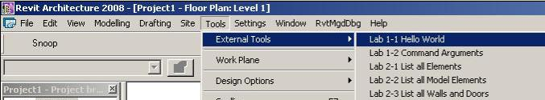
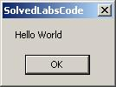
Minimal Command
Getting Started
Public Function Execute( _
ByVal commandData As Autodesk.Revit.ExternalCommandData, _
ByRef message As String, _
ByVal elements As Autodesk.Revit.ElementSet ) _
_
As Autodesk.Revit.IExternalCommand.Result _
Implements Autodesk.Revit.IExternalCommand.Execute
MsgBox("Hello World")
Return IExternalCommand.Result.Succeeded
End Function
In VB.NET
Notes:
You cannot get much more minimal than this.

Slide 24
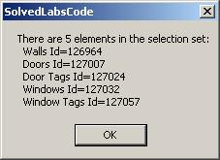
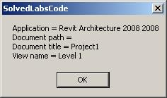
Command Input Argument
Getting Started
' List the app, doc and view data
Dim revitApp As Revit.Application = commandData.Application
Dim doc As Revit.Document = revitApp.ActiveDocument
Dim view As Revit.Elements.View = commandData.View
Dim sMsg As String = "Application = " & revitApp.VersionName & " " _
& revitApp.VersionNumber & vbCrLf
sMsg += "Document path = " & doc.PathName & vbCrLf ' Empty if not saved yet
sMsg += "Document title = " & doc.Title & vbCrLf
sMsg += "View name = " & view.Name
MsgBox(sMsg)
' List the current selection set
Dim sel As Selection = doc.Selection
sMsg = "There are " & sel.Elements.Size & " elements in the selection set:"
Dim elem As Revit.Element
For Each elem In sel.Elements
sMsg += vbCrLf & " " & elem.Category.Name & " Id=" & elem.Id.Value.ToString
Next
MsgBox(sMsg)
In VB.NET
Notes:
Display some application and document properties, retrieved from the command data input argument.

Slide 25
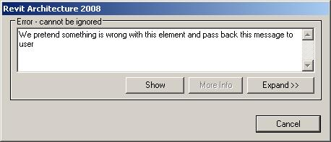
Command Output Arguments
Getting Started
' We pretend that something is wrong with the first element in the selection
' We pass the message back to Revit user and indicate the error result
If Not sel.Elements.IsEmpty Then
Dim iter As ElementSetIterator = sel.Elements.ForwardIterator
iter.MoveNext()
Dim errElem As Revit.Element = iter.Current
elements.Clear()
elements.Insert(errElem)
message = "We pretend something is wrong with this element and pass back this message to user"
Return IExternalCommand.Result.Failed
Else
Return IExternalCommand.Result.Succeeded
End If
Notes:
Check the document selection set contents. Return an error code to see the message displayed and the element highlighted. So, that is really all there is to say about the Revit add-in architecture, the external application and command interfaces, and their arguments. In the next section, we will start exploring the contents of the Revit database.

Slide 26
Application Installation
Getting Started
Installer will generally modify Revit.ini
Recommend placing application into Revit Program folder
Due to .NET framework restrictions, Load() versus LoadFrom()
MidasLink sample application includes setup source

Slide 27
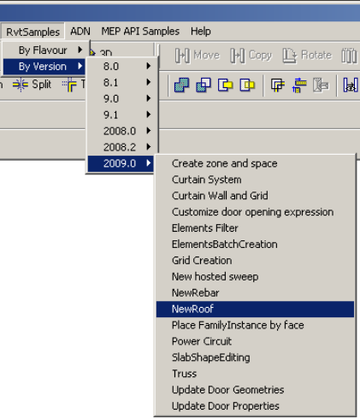
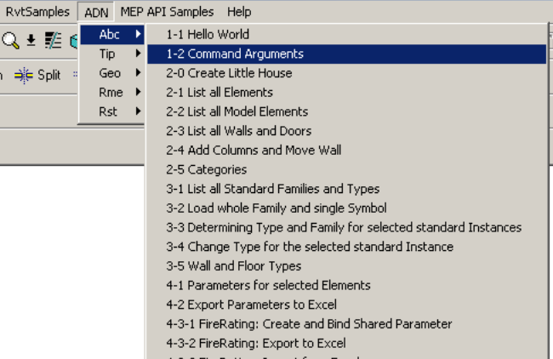
RvtSamples
Getting Started
So every external command needs to be added to Revit.ini?
Not using the SDK sample application RvtSamples!
Includes RvtSamples.txt listing all SDK samples
Adds them all to an own menu entry
Add four lines to Revit.ini and never touch it again
You can add your own entries to RvtSamples.txt
Define your own menus as well
Example
AdnSamples.txt
Provided with labs
... so, SDKSamples2009.sln provides accesss to search and debug all sample source code, and RvtSamples enables running every single sample
Notes:
The RvtSamples application and RvtSamples.txt is included in the Revit SDK ... show contents on screen in explorer.

Slide 28
RvtMgdDbg
Getting Started
Available from ADN web site, search for "RvtMgdDbg"
Comprehensive test of the Revit API
Sample code and utility classes
Scaffolding for quick tests
Aid learning Revit API
Explore
Application
Document
Current selection
Reflection
Events
Tests
Notes:
RvtMgdDbg is a utility similar to the well-known ArxDbg and MgdDbg utilities provided for AutoCAD, written by the same author and his team. It is a Revit extension application which defines its own menu and toolbar. It is available as a separate download from the ADN web site.

Slide 29
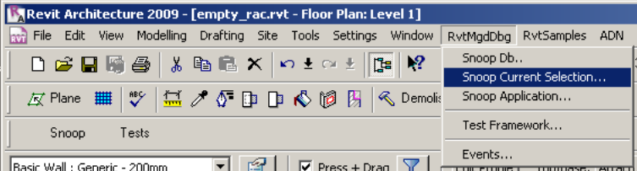
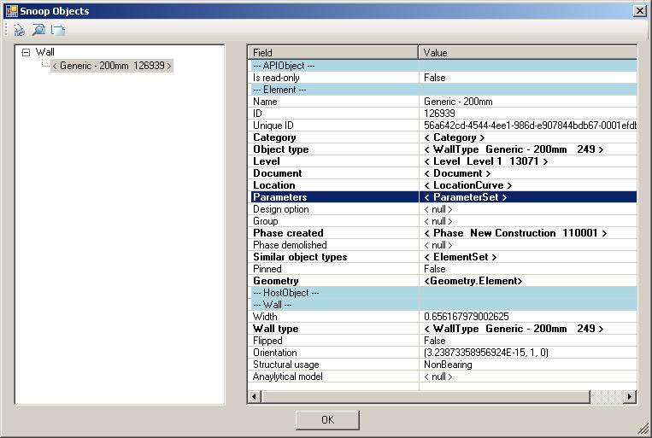
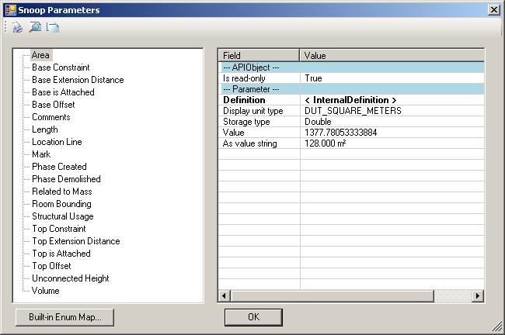
RvtMgdDbg Demo
Getting Started
Notes:
RvtMgdDbg is implemented as an external application, so it installs its own menu ‘RvtMgdDbg‘ and toolbar with the entry ‘Snoop’ for quick access to the ‘Snoop Db..’ menu entry.

Slide 30
Hands On
Getting Started
Install SDK
Look at RevitAPI.chm and Revit API user manual
Run through Hello World sample
New class library solution
Reference RevitAPI.dll
IExternalCommand implementation
Edit Revit.ini
Debug
RvtMgdDbg
Install SDK
Open SDKSamples2009.sln, update references, jhint.exe
Compile SDK samples
RvtSamples

Slide 31
Sample
Getting Started
Select and list all wall element areas in database
Determine openings hosted by walls
Invert relationship

Slide 32
Database and Elements
Analyse the contents of the Revit database.
Iterate and filter for specific elements.
Make use of RvtMgdDbg.
Notes:
Now that we understand how to create the bare bones of our add-in and how it sets up its initial communication with the Revit application, let us explore and analyse the contents of the Revit database.

Slide 33
Elements Collection
Elements Collection
Object model
Database structure
Types of elements
Accessing and identifying elements
Filtering for types and categories
Getting all model elements
Model elements' manipulation
Notes:
We saw that the only input to the external command is the external command data argument. We will explore how to access the application, current document and their properties through this command data argument passed in to an external command. Then we will explore more detailed access to the Revit BIM and its data. The entire content of the Revit BIM is stored in a database and accessed through the Revit Document. Most of the objects are accessible through the document Elements collection property. Often, one is interested in elements of a particular type, so a common task is iterating over the elements collection and filtering for a specific type and/or property.

Slide 34
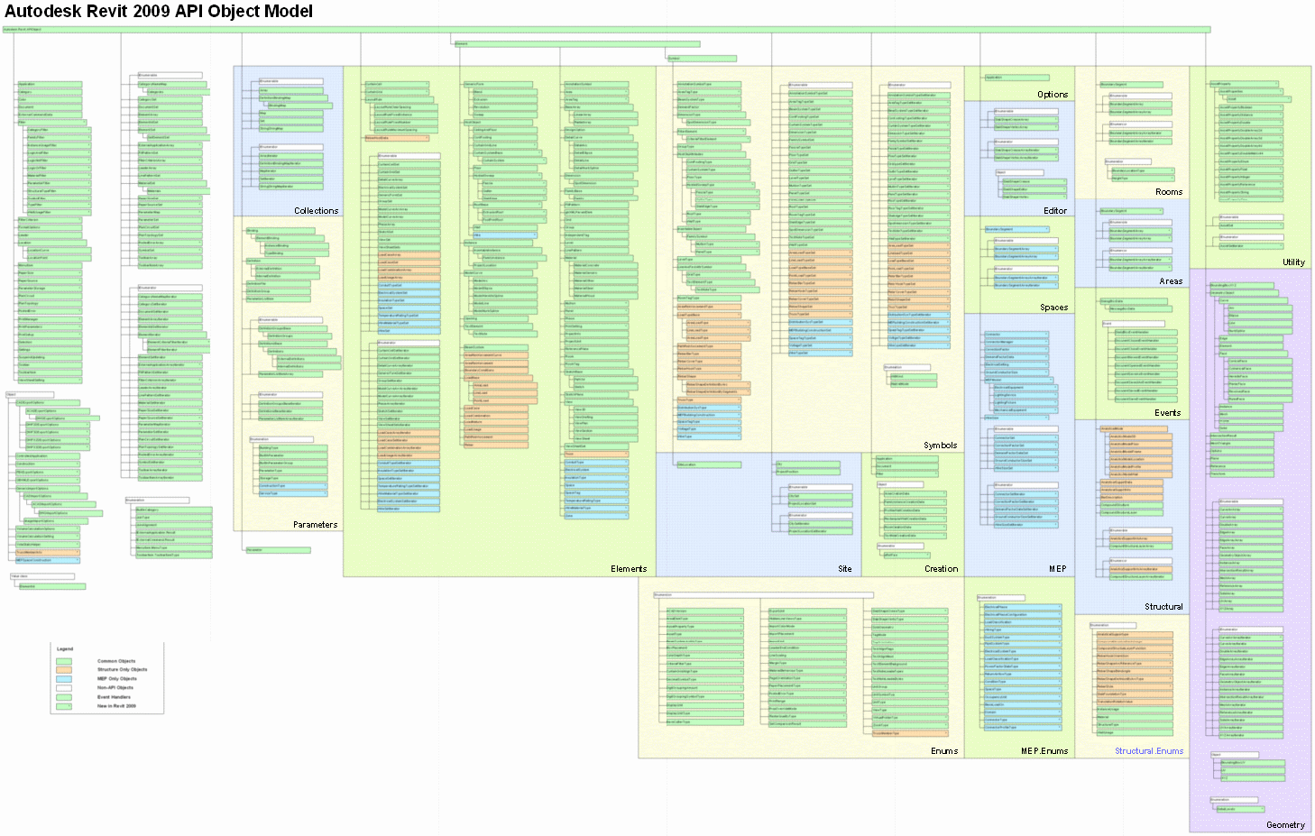
Revit Object Model
Elements Collection
Revit API Diagram.dwf
Notes:
Here is an overview of the Revit classes provided by the API, in "Revit API Diagram.rvt". The model is rather large ... and unreadable ... so let us look at a subset of interesting classes and highlight some of them.

Slide 35
Subset of Object Model
Elements Collection
APIObject
Application
Document
ExternalCommandData
ElementSet
ParameterSet
Parameter
Element
Symbol
GeometryObject
# RST:
AnalyticalModel
AnalyticalModelFloor
AnalyticalModelWall
Creation
APIObject
Application
Document
GeometryObject
Curve
Arc
Ellipse
Line
NurbSpline
Edge
Face
ConicalFace
CylindricalFace
HermiteFace
PlanarFace
ResolvedFace
RuldeFace
Instance
Mesh
Profile
Solid
Plane
Reference
Transform
Element
HostObject
CeilingAndFloor
ContFooting
Floor
Wall
Instance
Opening
TextElement
BeamSystem
Dimension
SpotDimension
FamilyBase
Family
Level
Phase
ProjectInfo
# RST:
BoundaryConditions
LoadCase, Combination, Nature, Usage
AreaReinforcement
AreaReinforcementCurve
LoadBase
AreaLoad
LineLoad
PointLoad
PathReinforcement
Rebar
# end of RST
Symbol
Symbol
AnnotationSymbolType
BeamSystemType
HostObjAttributes
ContFootingType
FloorType
WallType
InsertableObject
FamilySymbol
RoomTagType # RAC
RebarTagType # RST
Notes:
This is a subset selected from the Revit object model. Some of the interesting classes have been highlighted, and the list has been split into several sublists at crucial points. It shows that some objects are available only in the RAC or only in the RST environment, such as RommTagType in RAC, RebarTagType, the analytical model and the loads and boundary conditions in RST.
Everything is derived from APIObject. All physical BIM objects are derived from Element. A separate version of Application and Document is provided in the Creation namespace, for creating new elements.

Slide 36
Important Parent Classes
Elements Collection
APIObject – root object
Element – BIM elements
Symbol – type definition
GeometryObject – abstract geometry
Notes:
Here are some of the important tree nodes and parent classes in the Revit object model. Some objects are available only in the RAC or only in the RST environments, such as RoomTagType in RAC, RebarTagType, the analytical model and the loads and boundary conditions in RST.
Everything is derived from APIObject. All physical BIM objects are derived from Element. Geometry objects are in memory only, not stored in the database, created on the fly. A separate version of Application and Document is provided in the Creation namespace, for creating new elements.

Slide 37
Subsubset of Object Model
Elements Collection
API Object
Element
Family Base
Symbol
Group
Instance
HostObject
Family
Group Type
HostObject Attributes
Insertable Object
Insertable Instance
Wall
Floor
Family Symbol
Family Instance
Clg. & Flr
Wall Type
Floor Type
Cont. Footing Type
Cont. Footing
RoofBase
Families and types, aka symbols
Host and component objects, standard and system
Notes:
Here is a smaller subset of the most important database classes, i.e. non-geometrical classes, that appear in a typical Revit model programming task. The red classes are the most commonly used. The RoofBase class and its derived types FootPrintRoof and ExtrusionRoof were added in Revit 2009. In the model, we see the host and component objects, such as windows and doors. These are actually instances of types. The family base and family are used to manage collections of related types. Symbol is a base class for all types, also known as symbols. Family symbol is the generic class for these, whereas wall and floor type are more specialised classes. Family instance represents an occurrence or usage instance of a generic family symbol, whereas wall and floor represent the same for a wall or floor type.

Slide 38
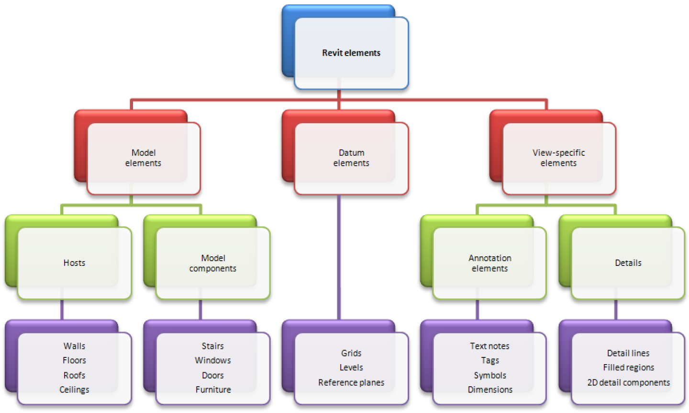
Some Visible Elements
Elements Collection
Notes:
Here is another classification of some of the typical visible elements in a model.

Slide 39
Accessing Current Revit Element Selection
Elements Collection
How to access the Revit data from an external command?
Current selection is member of document class
ExternalCommandData.Application.ActiveDocument.Selection.Elements
Input argument provides ExternalCommandData
Selection sel = doc.Selection;
sMsg = "There are " + sel.Elements.Size + " elements in the selection set:";
foreach( Element elem in sel.Elements )
{
string s = (null == elem.Category) ? elem.GetType().Name : elem.Category.Name;
sMsg += "\r\n " + s + " Id=" + elem.Id.Value.ToString();
}
// from Lab1_2_CommandArguments
Application
ActiveDocument
Elements
Selection
Elements
Notes:
So, how do we access all these objects? We start off with the external command data argument passed in to the external command.

Slide 40
Accessing Revit Database Elements
Elements Collection
How to access the Revit data from an external command?
Document class provides access to complete element collection
Elements – access to all elements
Elements(Type) – access elements of specified type
Elements(Filter) – access elements satisfing filter
Elements(Type, ICollection<Element>) – collect elements of specified type
Elements(Filter, ICollection<Element>) – collect elements satisfing filter
Application
ActiveDocument
Elements
Selection
Elements
Notes:
Revit 2009 API makes use of generic collections and introduces optimised filtered element access.

Slide 41
Accessing Revit Elements
Elements Collection
Document.Elements taking one argument
Returns ElementIterator
Go through iterator.MoveNext(), iterator.Current()
Document.Elements taking two arguments
New in Revit 2009 API
Second argument is generic collection return value
List<Element> in C#
List(Of Element) in VB.NET
Use standard container access, e.g. foreach, Count, Contains
Document.Selection.Elements
Returns ElementSet
Use foreach, Size, Contains

Slide 42
Elements Collection
Elements Collection
In the Revit API, everything is an APIObject
In the Revit BIM, everything is an Element
All are bundled together in the Elements collection
Search for ElementIterator and ElementFilterIterator in the SDK samples, and for get_Elements() in the labs
Lab 2-1
Notes:
ElementIterator and ElementFilterIterator occur in many of the SDK samples. The command defined in Lab 2-1 iterates over commandData.Application.ActiveDocument.Elements and prints out a line for each element encountered to C:\tmp\RevitElements.txt.

Slide 43
List all Elements
Elements Collection
// *ALL* elements are bundled together and accessible via Document's ElementIterator
string line;
Element elem;
ElementIterator iter = commandData.Application.ActiveDocument.Elements;
while( iter.MoveNext() )
{
elem = iter.Current as Element;
line = "Id=" + elem.Id.Value.ToString(); // Element Id
line += "; Class=" + elem.GetType().Name; // Element class (System.Type)
// Element Category, not implemented for all classes, may return null:
line += "; Category=" + ( null == elem.Category ? string.Empty : elem.Category.Name );
// Element Name (different meaning for different classes, but mostly implemented logically")
// Later, we'll see that more precise info on elements can be obtained in class-specific ways...
line += "; Name=" + elem.Name;
sw.WriteLine( line );
}
Id=16; Class=DimensionType; Category=; Name=Linear - 3mm Arial
Id=17; Class=Element; Category=; Name=
Id=19; Class=Element; Category=; Name=
Id=20; Class=FillPattern; Category=; Name=Solid fill
. . .
Id=126907; Class=Element; Category=; Name=M_W-Wide Flange
Id=126908; Class=Element; Category=; Name=W310X38.7
Id=126933; Class=Element; Category=; Name=Section Boxes
Id=126939; Class=Wall; Category=Walls; Name=Generic - 200mm
Notes:
Note that the result of this iteration is large. There are a lot of predefined elements and properties in the Revit database, even before we start adding our own. Once we have added a few elements, note that these are listed at the end, sequentially. From Revit 2009 onwards, you will probably seldom iterate over all elements, but use filtering to effectively pick out specific subsets instead. The element category is not implemented for all classes, it may return null; for Family elements, one can sometimes use the FamilyCategory property instead.

Slide 44
Identifying Revit Elements
Elements Collection
Normal OO approach uses object type or class
Identifying Revit elements can be brain twisting
An object can be identified by
Category
Object type or class, i.e. .NET System.Type
Specific parameter values
We use a combination of different criteria
Sometimes additional checks are needed
In Revit 2009, many combinations can be encoded into the filtering mechanism and execute extremely efficiently
Notes:
The identification of elements and determining what type they have, or iterating the entire building model and extracting the specific instances that we are interested in, depends on the objects type. In some cases, we use standard object oriented techniques, simply querying their type or class. In others, we use the object category, which is a Revit API element property. Sometimes, a combination of the two is used, or additional parameters are queried.
More details on this are discussed in the separate presentation DE305-1 A Closer Look at the Database with the Revit API.

Slide 45
Identifying Revit Elements
Elements Collection
Kind of Element in UI | Derived from Element/TypeOf | Category
Wall | HostObject/Wall | Walls
Door | Instance/InsertableInstance/FamilyInstance | Doors
Door Tag | IndependentTag | Door Tags
Window | Instance/InsertableInstance/FamilyInstance | Windows
WindowTag | IndependentTag | Window Tags
Opening | Opening | < null >
Floor | HostObject/Floor | Floors
Ceiling | Element | Ceilings
Roof | HostObject/RoofBase/FootPrintRoof, ExtrusionRoof | Roofs
Column | Instance/InsertableInstance/FamilyInstance | Columns
Component (Desk) | Instance/InsertableInstance/FamilyInstance | Furniture
Stair | Element | Stairs
Railing | Element | Railings
Room | Room | Rooms
Room Tag | RoomTag | Room Tags
Grid | Grid | Grids
Lines | ModelCurve/ModelLine | Lines
Ref Plane | ReferencePlane | Reference Planes
Dimension | Dimension | Dimensions
Section | Element | < null >
Text | TextElement/TextNote | Text Notes
Level | Level | Levels
Model Group | Group | < null >
Create…/Walls | Instance/InsertableInstance/FamilyInstance | Walls

Slide 46
Element versus Symbol
Elements Collection
Element |  |  |  | Symbol
Kind of Element in UI | Derived from Element/TypeOf | Category |  | Derived from Symbol/TypeOf | Category
Wall | HostObject/Wall | Walls |  | HostObjAttributes/WallType | Walls
Door | Instance/InsertableInstance/FamilyInstance | Doors |  | InsertableObject /FamilySymbol | Doors
Door Tag | IndependentTag | Door Tags |  | InsertableObject /FamilySymbol | Door Tags
Window | Instance/InsertableInstance/FamilyInstance | Windows |  | InsertableObject /FamilySymbol | Windows
WindowTag | IndependentTag | Window Tags |  | InsertableObject /FamilySymbol | Window Tags
Opening | Opening | < null > |  | < null > | ---
Floor | HostObject/Floor | Floors |  | HostObjAttributes/FloorType | Floors
Ceiling | < Element > | Ceilings |  | HostObjAttributes | Ceilings
Roof | HostObject/RoofBase/FootPrintRoof,ExtrusionRoof | Roofs |  | HostObjAttributes/RoofType | Roofs
Column | Instance/InsertableInstance/FamilyInstance | Columns |  | InsertableObject /FamilySymbol | Columns
Component (Desk) | Instance/InsertableInstance/FamilyInstance | Furniture |  | InsertableObject /FamilySymbol | Furniture
Component (Tree) | Instance/InsertableInstance/FamilyInstance | Planting |  | InsertableObject /FamilySymbol | Planting
Stairs | < Element > | Stairs |  | < Symbol > | Staies
Railing | < Element > | Railings |  | < Symbol > | Railings
Room | Room | Rooms |  | < null > | ---
Room Tag | RoomTag | Room Tags |  | < Symbol > | Room Tags
Grid | Grid | Grids |  | LineAndTextAttrSymbol/GridType | < null >
Lines | ModelCurve/ModelLine | Lines |  | < null > | ---
Ref Plane | ReferencePlane | Reference Planes |  | < null > | ---
Dimension | Dimension | Dimensions |  | DimensionType | < null >
Section | < Element > | < null > |  | < Symbol > | < null >
Text | TextElement/TextNote | Text Notes |  | LineAndTextAttrSymbol/TextElementType/TextNoteType | < null >
Level | Level | Levels |  | LevelType | < null >
Model Group | Group | < null > |  | GroupType | < null >
Create…/Walls | Instance/InsertableInstance/FamilyInstance | Walls |  | InsertableObject /FamilySymbol | Walls

Slide 47
3D or Model Elements
Elements Collection
Often one is interested in 3D elements only
LabUtils.GetAllModelElements()
Input Revit.Application
Output ElementSet
Predicates
Type is not Symbol or FamilyBase
Category is not null
Geometry is not null
Lab 2-2
Notes:
Lab 2-2 demonstrates how to extract all elements with a 3D geometry, i.e. visible objects like walls, doors, windows, furniture, etc. This lab iterates over the active document elements collection, like before, and picks out relevant ones. This is a common operation in Revit programming. The utility function LabUtils.GetAllModelElements() implements this. Its input and output are as defined above. It identifies model elements by applying the checks listed above.

Slide 48
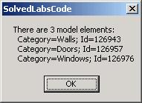

3D or Model Elements
Elements Collection
public static ElementSet GetAllModelElements( Application app )
{
ElementSet elems = app.Create.NewElementSet();
Geo.Options opt = app.Create.NewGeometryOptions(); // this is ok
ElementIterator iter = app.ActiveDocument.Elements;
while( iter.MoveNext() )
{
Autodesk.Revit.Element elem = iter.Current as Autodesk.Revit.Element;
if( !( elem is Symbol || elem is FamilyBase ) )
{
if( null != elem.Category )
{
if( null != elem.get_Geometry( opt ) )
{
elems.Insert( elem );
}
}
}
}
return elems;
}

Slide 49
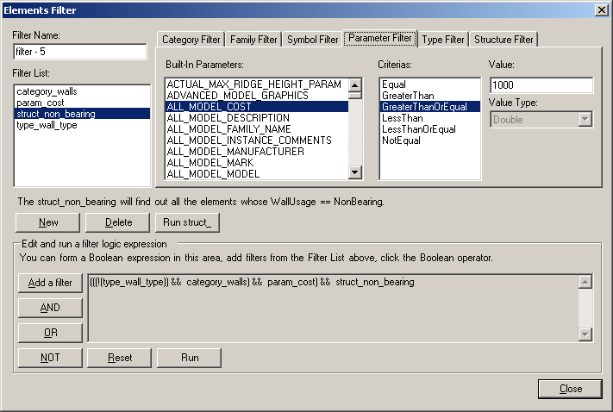
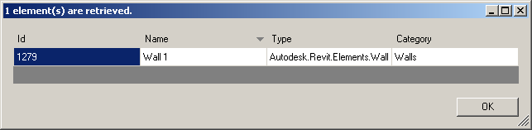
Revit 2009 Element Filtering
Elements Collection
Retrieve elements from database using atomic filters
category name, built-in category, family name, symbol name, type, structural classification, parameter value eq, gt, ge, lt, le, ne
Boolean combinations of atomic filters
and, or, not
SDK sample ElementsFilter
demonstrates how to use
provides testing framework
Notes:
The new Revit 2009 element filtering provides filtered access to elements. Several different types of filters are available. Filters can be atomic, based on category name, built-in category, family name, symbol name, type, structural classification, or parameter value. When searching for elements based on parameter value, the comparison criterion can be specified as equal, gt, ge, lt, le, ne, etc. The execution speed of the new element filtering is significantly higher than the element iteration in previous versions. All aspects of the functionality are demonstrated by the new SDK sample application ElementsFilter.

Slide 50
Element Filtering Quotes
Elements Collection
“I've just finished profiling a huge number of combinations using the new element filtering functionality to see how it performs against real projects. WOW!!!
What a stellar increase in speed achieved with filters. On real projects I'm seeing a ~1000% increase in speeds, i.e. 12 seconds becomes 1.2 seconds. As impressive is the small drop in performance when using logical filters.
Fantastic work!!!!!
I reworked the logic of a command for a project to remove what are now bottlenecks. Redone the filters . This is a RAC2008 107Mb project that was taking approx 120 sec to process in RAC2008......
Now, in RAC2009........ 2.1 seconds !!!!!!!!!!
... That's a 5700% improvement. And the RAc2008 command was pretty damn good for a RAc2008 command. Oh my god!!!!!!!! Absolutely incredible stuff from the API team.”

Slide 51
Element Filtering Comparison
Elements Collection
2008
public static ElementSet GetAllWalls_2008( Application app )
{
ElementSet elems = app.Create.NewElementSet();
ElementIterator iter = app.ActiveDocument.Elements;
while( iter.MoveNext() )
{
Element elem = iter.Current as Element;
if( elem is Wall )
{
elems.Insert( elem );
}
}
return elems;
}
2009
public static List<Element> GetAllWalls( Application app )
{
List<Element> elements = new List<Element>();
Filter filterType = app.Create.Filter.NewTypeFilter( typeof( Wall ) );
app.ActiveDocument.get_Elements( filterType, elements );
return elements;
}
Notes:
Here is a very simple example of using the new filtering feature, selecting all walls from the Revit database. In 2008, one would have used a loop to pick out the walls from the collection of all document elements. In 2009, using filtering, this method is more concise, no loop is required, and only wall elements are returned.

Slide 52
VB Element Filtering Comparison
Elements Collection
2008
Shared Function GetAllWalls_2008(ByVal app As Revit.Application) As ElementSet
Dim elems As ElementSet = app.Create.NewElementSet
Dim iter As IEnumerator = app.ActiveDocument.Elements
Do While (iter.MoveNext())
Dim elem As Revit.Element = iter.Current
If TypeOf elem Is Wall Then
elems.Insert(elem)
End If
Loop
Return elems
End Function
2009
Shared Function GetAllWalls(ByVal app As Revit.Application) As List(Of Element)
Dim elements As New List(Of Element)
Dim filterType As Filter = app.Create.Filter.NewTypeFilter(GetType(Wall))
Dim n As Integer = app.ActiveDocument.Elements(filterType, elements)
Return elements
End Function
Notes:
Here is the same example in VB syntax.

Slide 53
Boolean Element Filtering Example
Elements Collection
C#
public static List<Element> GetAllModelGroupTypes( Application app )
{
List<Element> elements = new List<Element>();
Filter filterType = app.Create.Filter.NewTypeFilter( typeof( GroupType ) );
Filter filterParam = app.Create.Filter.NewParameterFilter(
BuiltInParameter.SYMBOL_FAMILY_NAME_PARAM, CriteriaFilterType.Equal,
"Model Group" );
Filter filterAnd = app.Create.Filter.NewLogicAndFilter( filterType, filterParam );
app.ActiveDocument.get_Elements( filterAnd, elements );
return elements;
}
VB
Shared Function GetAllModelGroupTypes(ByVal app As Revit.Application) As List(Of Element)
Dim elements As New List(Of Element)
Dim filterType As Filter = app.Create.Filter.NewTypeFilter(GetType(GroupType))
Dim filterParam = app.Create.Filter.NewParameterFilter( _
BuiltInParameter.SYMBOL_FAMILY_NAME_PARAM, _
CriteriaFilterType.Equal, "Model Group")
Dim filter As Filter = app.Create.Filter.NewLogicAndFilter(filterType, filterParam)
Dim n As Integer = app.ActiveDocument.Elements(filter, elements)
Return elements
End Function
Notes:
Here is a slightly more complex example, which includes filtering for a specific parameter value. Here we are selecting all model group types in the database. In 2008, this involves iterating over all elements, selecting GroupType objects, and then checking a parameter for a specific value. In 2009, this can all be achieved more concisely and efficiently using filtering, by combining a type and a parameter filter with a Boolean and filter.

Slide 54
Specific Element Classes
Elements Collection
How do we get e.g. all Doors or Walls?
Wall is a separate class
APIObject ← Element ← HostObject ← Wall
(An in-place family wall is a FamilyInstance)
Filter for Wall System.Type
Door can be identified by its category
System.Type is a generic FamilyInstance
Use BuiltInCategory enum for language independence
Filter for FamilyInstance System.Type and door category
Lab 2-3
Notes:
Lab 2-3 extracts walls by checking for each element for its class, and doors by checking its category. This is similar to Lab 2-2, but now we check for a an even more specific type or a built-in category.

Slide 55
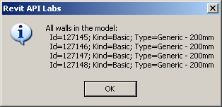
Get all Walls
Elements Collection
public static List<Element> GetAllWalls( Application app )
{
List<Element> elements = new List<Element>();
Filter filterType = app.Create.Filter.NewTypeFilter( typeof( Wall ) );
app.ActiveDocument.get_Elements( filterType, elements );
return elements;
}

Slide 56
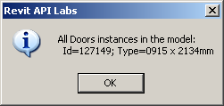
Get all Doors
Elements Collection
public static List<Element> GetAllStandardFamilyInstancesForACategory(
Application app,
BuiltInCategory bic )
{
List<Element> elements = new List<Element>();
Filter filterType = app.Create.Filter.NewTypeFilter( typeof( FamilyInstance ) );
Filter filterCategory = app.Create.Filter.NewCategoryFilter( bic );
Filter filterAnd = app.Create.Filter.NewLogicAndFilter( filterType, filterCategory );
app.ActiveDocument.get_Elements( filterAnd, elements );
return elements;
}

Slide 57
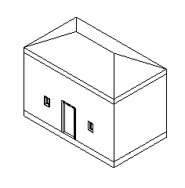
Adding Elements
Elements Collection
Adding
Over 120 methods defined by Autodesk.Revit.Creation.Document
Over 40 object types supported
e.g. Walls, Floors
NewWall( CurveArray profile, bool structural ); // + 4 overloads
NewSlab( CurveArray profile, Level, Line slopedArrow, double angle, bool isImperial, bool isStructural );
Still some objects missing ...
Lab 2-0
Deleting
Revit SDK Samples DeleteDimensions, DeleteObject

Slide 58
Element manipulation
Elements Collection
Select a wall
Extract wall from current selection
Obtain wall top and bottom level constraints
Calculate geometry from levels and wall curve
Obtain family symbol for column type
Insert columns at start, mid and end
Move wall away from the columns
Lab 2-4
Prerequisites
Wall constrained at top
"M_Wood Timber Column" type loaded
Notes:
To run Lab 2-4, select a wall. It must be constrained to a level at the top: Element Properties... > Constraints > Top Constraint, otherwise an error message is displayed. Load the column family named "M_Wood Timber Column" and the type named "191 x 292mm" prior to running the command, or else highlight the error message displayed, or modify the names to refer to some family type that is loaded. The selected wall is used to define three columns at its end and mid points, then the wall is moved out of the way to clearly display the columns.

Slide 59
Selecting the Wall
Elements Collection
Dim doc As Revit.Document = commandData.Application.ActiveDocument
Dim ss As ElementSet = doc.Selection.Elements
' must have single element only
If Not ss.Size = 1 Then
MsgBox( "You must pre-select a single element!" )
Return IExternalCommand.Result.Cancelled
End If
' must be a wall
Dim iter As ElementSetIterator = ss.ForwardIterator
iter.MoveNext()
Dim elem As Revit.Element = iter.Current
If Not TypeOf elem Is Wall Then
MsgBox( "Selected element is NOT a wall!" )
Return IExternalCommand.Result.Cancelled
End If
Dim wall As Wall = elem

Slide 60
Wall Top and Bottom
Elements Collection
' wall must be constrained to a Level at the top (more on Parameters later...)
Dim topLev As Level = Nothing
Try
topLev = doc.Element(wall.Parameter(BuiltInParameter.WALL_HEIGHT_TYPE).AsElementId)
Catch
topLev = Nothing
End Try
If topLev Is Nothing Then
MsgBox( "Selected Wall is NOT constrained to a Level at the Top!" )
Return IExternalCommand.Result.Cancelled
End If
' get the bottom Level as well (this should never fail)
Dim botLev As Level = Nothing
Try
botLev = doc.Element(wall.Parameter(BuiltInParameter.WALL_BASE_CONSTRAINT).AsElementId)
Catch
botLev = Nothing
End Try
If botLev Is Nothing Then
MsgBox( "Selected Wall is NOT constrained to a Level at the Bottom?!" )
Return IExternalCommand.Result.Cancelled
End If

Slide 61
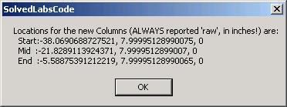
Column Geometry
Elements Collection
' Calculate the location points for the 3 columns (assuming straight wall)
Dim locations As New XYZArray()
Dim locCurve As LocationCurve = wall.Location
Dim ptStart As XYZ = locCurve.Curve.EndPoint(0)
Dim ptEnd As XYZ = locCurve.Curve.EndPoint(1)
Dim ptMid As New XYZ((ptStart.X + ptEnd.X) / 2, (ptStart.Y + ptEnd.Y) / 2, (ptStart.Z + ptEnd.Z) / 2)
locations.Append(ptStart)
locations.Append(ptMid)
locations.Append(ptEnd)
Dim sMsg As String = "Locations for the new Columns (ALWAYS reported 'raw', in inches!) are:"
sMsg += vbCrLf & " Start:" & ptStart.X & ", " & ptStart.Y & ", " & ptStart.Z
sMsg += vbCrLf & " Mid :" & ptMid.X & ", " & ptMid.Y & ", " & ptMid.Z
sMsg += vbCrLf & " End :" & ptEnd.X & ", " & ptEnd.Y & ", " & ptEnd.Z
MsgBox(sMsg)

Slide 62
Column Type
Elements Collection
/// Helper to get specified Type for specified Family as FamilySymbol object
public static FamilySymbol GetFamilySymbol(
Application app,
string familyName,
string typeName )
{
Filter filterType = app.Create.Filter.NewTypeFilter( typeof( FamilySymbol ) );
Filter filterFamilyName = app.Create.Filter.NewFamilyFilter( familyName );
Filter filter = app.Create.Filter.NewLogicAndFilter( filterType, filterFamilyName );
List<Element> elementList = new List<Element>();
int n = app.ActiveDocument.get_Elements( filter, elementList );
// we have a list of symbols for a given family.
// loop through the list and find a match
foreach( Element e in elementList )
{
if( e.Name.Equals( typeName ) )
{
return e as FamilySymbol;
}
}
return null;
}
' Get Family Type for the new instances.
' Names must match a column type available in the model
Dim sFamilyName As String = "M_Wood Timber Column"
Dim sTypeName As String = "191 x 292mm"
Dim symbol As FamilySymbol = LabUtils.GetFamilySymbol( _
doc, sFamilyName, sTypeName)
If symbol Is Nothing Then
MsgBox("Cannot find Family=" & sFamilyName & " Type=" & sTypeName _
& " in the model - load it first!")
Return IExternalCommand.Result.Cancelled
End If
Notes:
The GetFamilySymbol() helper method iterates over all elements and searches for the named family. Within that family’s symbols, it searches for the named type and returns that element instance.

Slide 63
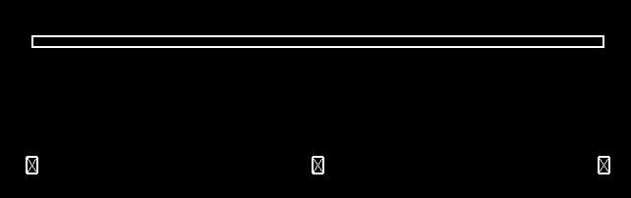
Insert Column and Move Wall
Elements Collection
' Insert Columns as FamilyInstances
Dim pt As XYZ
For Each pt In locations
Try
Dim column As FamilyInstance = doc.Create.NewFamilyInstance(pt, symbol, botLev, Structural.Enums.StructuralType.NonStuctural)
Dim paramTopLevel As Parameter =
column.Parameter(BuiltInParameter.FAMILY_TOP_LEVEL_PARAM)
paramTopLevel.Set(topLev.Id)
Catch e As Exception
MsgBox("Failed to create or adjust this column!?")
End Try
Next
' Finally, move the wall so the columns are surely visible. For simplicity,
' move the wall "perpendicularly" to the Location curve by its length
Dim wallPerpAxis As New XYZ(-(ptEnd.Y - ptStart.Y), ptEnd.X - ptStart.X, 0)
If Not CType(wall.Location.Move(wallPerpAxis), Boolean) Then
MsgBox("Failed to Move the wall!?")
End If

Slide 64
Categories
Elements Collection
List all built-in categories and the entire category tree
Not all built-in categories have a corresponding document category
Not all document categories have a corresponding built-in category
There are 645 (2008: 598) built-in categories
419 (397) of them have associated document categories
199 (190) of these are top level parents
These lead to 445 (423) top-level and children categories
Lab 2-5

Slide 65

Time Out
We are taking a 5 minute break
Introduction
Getting Started
Database Elements
Break
Families and Types
Parameters
What's New

Slide 66
Families and Types
Notes:
As we saw above, many visible objects in the Revit BIM are instances of symbols or types. These types are grouped into families. Each family defines a number of symbols or types. When an element is inserted into the model, the user specifies which family it belongs to, and which specific type it has, so the inserted object is an instance of this family and type. If it is a component family, its class is FamilyInstance. In this section, we discuss the management of families and types.

Slide 67
Families and Types
Families and Types
Also know as symbols
Standard versus system families
Using loaded families and symbols
Loading new families and symbols
Determining and changing element's type
Standard and system families
Notes:
In order to insert the column in the last example, we already had the need to determine a suitable family type for it. If the family or that specific type was not available, we had to prompt the user to load it manually. This procedure can be automated. In this section, we explore the handling of families and types in more detail.
There are two types of families: standard ones, which are stored in external Revit family files with the extension *.rfa, and built-in system families.

Slide 68
Listing Families and Types
Families and Types
One will frequently need to determine
Which standard families and symbols are loaded in a model
Which category do they belong to
Lab 3-1

Slide 69
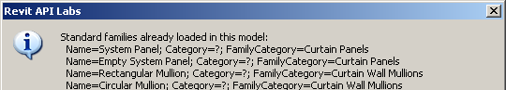
Family Iteration
Families and Types
List<Element> families = new List<Element>();
Filter filterFamily = app.Create.Filter.NewTypeFilter( typeof( Family ) );
doc.get_Elements( filterFamily, families );
string sMsg = "Standard families already loaded in this model:";
foreach( Family f in families )
{
// Get its category name; notice that the Category property is not
// implemented for the Family class; use FamilyCategory instead;
// notice that that is also not always implemented; in that case,
// use the workaround demonstrated below, looking at the contained
// family symbols' category:
sMsg += "\r\n Name=" + f.Name
+ "; Category=" + ( ( null == f.Category ) ? "?" : f.Category.Name )
+ "; FamilyCategory=" + ( ( null == f.FamilyCategory ) ? "?" : f.FamilyCategory.Name );
}
LabUtils.InfoMsg( sMsg );
The Category property is always unimplemented
The FamilyCategory is sometimes unimplemented
Notes:
We iterate over the document elements in two loops. In the first, we simple determine all the families. The Category property is NOT implemented for the Family class. Therefore, in the second loop, we retrieve and list all the symbols of each family, and retrieve the family category from the first of its symbols.

Slide 70
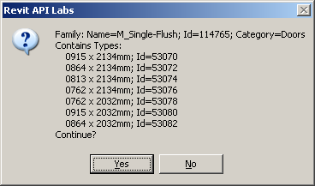
Family Symbol Iteration
Families and Types
// Loop through the collection of families, and now look at
// the child symbols (types) as well. These symbols can be
// used to determine the family category.
foreach( Family f in families )
{
string catName;
bool first = true;
// Loop all contained symbols (types)
foreach( FamilySymbol symb in f.Symbols )
{
// you can determine the family category
// from its first symbol.
if( first )
{
first = false;
catName = symb.Category.Name;
sMsg = "Family: Name=" + f.Name
+ "; Id=" + f.Id.Value.ToString()
+ "; Category=" + catName
+ "\r\nContains Types:";
}
sMsg += "\r\n " + symb.Name + "; Id=" + symb.Id.Value.ToString();
}
// Show the symbols for this family and allow user to proceed
// to the next family (OK) or cancel (Cancel)
sMsg += "\r\nContinue?";
if( !LabUtils.QuestionMsg( sMsg ) )
{
break;
}
}
Notes:
Here, in the second loop, we retrieve and list all the symbols of each family, and retrieve the family category from the first of its symbols. We can cancel out of this loop once we have seen enough.

Slide 71
Loading Families and Types
Families and Types
Load additional standard families and symbols from RFA files
doc.LoadFamily()
doc.LoadFamilySymbol()
Dim doc As Revit.Document = commandData.Application.ActiveDocument
'Load a whole Family
If Not CType(doc.LoadFamily(familyFilename), Boolean) Then
MsgBox( "ERROR in loading Family " & familyFilename & "?" )
Else
MsgBox( "Successfully loaded Family " & familyFilename & "!" )
End If
'Load only a specific Symbol (Type)
' The symbol MUST exist in the corresponding catalog (TXT) file - same as in the UI
If Not CType(doc.LoadFamilySymbol(familyFilename, symbolName), Boolean) Then
MsgBox( "ERROR in loading FamilySymbol " & familyFilename & " : " & symbolName & "?" )
Else
MsgBox( "Successfully loaded FamilySymbol " & familyFilename & " : " & symbolName & "!" )
End If
Lab 3-2
Notes:
This is demonstrated in Lab 3-2. This lab loads an entire family and a single symbol from another family, determined by the global variables gsWholeFamilyFileToLoad1, gsWholeFamilyFileToLoad2, gsFamilyFileToLoadSingleSymbol, gsSymbolName.

Slide 72
Determining Standard Family and Type
Families and Types
Determine the standard family and type of an element
Select a window
List all windows symbols
List the selected window’s family symbol and family
Lab 3-3
Notes:
Lab 3-3 shows how to determine the Family and Type of an element, and how to list all the symbols applicable to a specific category, such as Windows.
Before running this command, create a wall with a window in it and select the window. First of all, all the loaded window types are determined, i.e. all the symbols defined by the window family. This is done by iterating over all elements and determining all FamilySymbol instances whose category equals the windows one. Secondly, the selected window's family symbol and from that the family itself is queried and displayed.

Slide 73
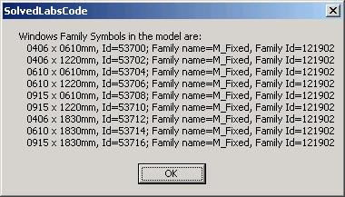
List Window Symbols
Families and Types
BuiltInCategory bic = BuiltInCategory.OST_Windows;
Filter filterCategory = app.Create.Filter.NewCategoryFilter( bic );
Filter filterType = app.Create.Filter.NewTypeFilter( typeof( FamilySymbol ) );
Filter filterAnd = app.Create.Filter.NewLogicAndFilter( filterCategory, filterType );
List<Element> familySymbols = new List<Element>();
app.ActiveDocument.get_Elements( filterAnd, familySymbols );
string sMsg = "The loaded windows family symbols in the model are:";
foreach( Element e in familySymbols )
{
FamilySymbol symb = e as FamilySymbol;
sMsg += "\r\n " + symb.Name + ", Id=" + symb.Id.Value.ToString();
Family fam = symb.Family;
sMsg += "; Family name=" + fam.Name + ", Family Id=" + fam.Id.Value.ToString();
}
Notes:
Here is an example of determining all the loaded window types, i.e. all the symbols defined by the window family. This is done by iterating over all elements and determining all FamilySymbol instances whose category equals the windows one.
Note that the category can be checked and compared in several different ways. In general, the best way is to make use of the language independent BuiltInCategory enumeration and avoid using the language dependent Name property for comparison, since the category objects themselves can be compared directly.

Slide 74
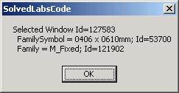
Get Family and Symbol
Families and Types
' Now loop the selection set and check for standard
' Family Instances of "Windows" category
For Each elem In doc.Selection.Elements
If TypeOf elem Is FamilyInstance Then
Dim inst As FamilyInstance = elem
Dim catInst As Category = Nothing
Try ' just in case
catInst = inst.Category
Catch
End Try
If (Not catInst Is Nothing) AndAlso catInst.Equals(catWindows) Then
sMsg = "Selected Window Id=" & elem.Id.Value.ToString & vbCrLf
Dim fs1 As FamilySymbol = inst.Symbol
sMsg += " FamilySymbol = " & fs1.Name & "; Id=" _
& fs1.Id.Value.ToString & vbCrLf
Dim f1 As Family = fs1.Family
sMsg += " Family = " & f1.Name & "; Id=" & f1.Id.Value.ToString
End If
End If
' Report each Window data
MsgBox(sMsg)
Next
Notes:
We can query and display the selected window's family symbol and from that the family itself. The family and symbol assigned to a specific family instance are available as properties on the given element and its symbol. For instance, to determine a selected window’s family and type, we read the Symbol property of the given element and its symbol’s Family property.

Slide 75
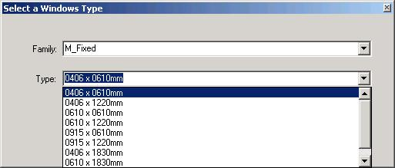
Change Family Instance Type
Families and Types
A simple dialog to change the type of a family instance
Determine family instance category, e.g. Windows
Assemble a list of all applicable symbols
Iterate over all elements, check each family category
If it matches, include all its symbols
Display dialogue with list box
Assign selected symbol
Lab 3-4
Notes:
The family type of a family instance can also be changed by modifying its Symbol property. Before running this command, create a wall with a window in it, load some additional window families so there is some material to play with, and select the window. Any other symbol instance can also be selected. First the selected symbol instance category is determined. From that, a list of all other applicable types is determined by iterating over all elements and assembling a dictionary of them. This is a two-step process, identifying the matching families first, and then for each matching family adding all its symbols. With this information in place, a dialogue is displayed allowing the user to select any one of the applicable symbols. If one is selected, it is applied to the selected instance, changing its symbol.

Slide 76
Determine Selected Instance Category
Families and Types
Dim inst As FamilyInstance
Dim instCat As Category
Dim ss As ElementSet = doc.Selection.Elements
' Make sure we have a single FamilyInstance selected
If Not ss.Size = 1 Then
MsgBox("You must pre-select a single element!")
Return IExternalCommand.Result.Cancelled
Else
Dim itTmp As ElementSetIterator = ss.ForwardIterator
itTmp.MoveNext()
Dim elTmp As Revit.Element = itTmp.Current
If Not TypeOf elTmp Is FamilyInstance Then
MsgBox("Selected element is NOT a standard family instance!")
Return IExternalCommand.Result.Cancelled
Else
inst = elTmp
instCat = inst.Category
End If
End If
Notes:
We ensure a single element is selected, that it is a family instance, and determine its category.

Slide 77
List all Symbols for Category
Families and Types
Dim dictFamilyToSymbols As New Dictionary(Of String, ArrayList)
' using Revit 2009 element filtering
Dim families As List(Of Revit.Element) = New List(Of Revit.Element)
Dim filter As Revit.Filter = app.Create.Filter.NewTypeFilter(GetType(Family))
Dim nRetVal = doc.Elements(filter, families)
Dim f As Family
Dim categoryMatches = False
For Each f In families
categoryMatches = False
If (f.FamilyCategory Is Nothing) Then ' not always implemented
For Each sym As FamilySymbol In f.Symbols _
categoryMatches = sym.Category.Id.Equals(instCat.Id)
Exit For
Next
Else
categoryMatches = f.FamilyCategory.Id.Equals(instCat.Id)
End If
If (categoryMatches) Then
Dim familySymbols As New ArrayList
For Each sym As FamilySymbol In f.Symbols
familySymbols.Add(sym)
Next
dictFamilyToSymbols.Add(f.Name, familySymbols)
End If
Next
Notes:
For the selected symbol instance category, a list of all applicable types is determined by iterating over all elements and assembling a dictionary of them. There are many ways how to store the matching objects, but we choose whatever is most suitable for the relevant UI: We could use Revit's generic Map class, but it is probably more efficient to use the new 2005 .NET strongly-typed Dictionary with KEY = Family name (String) and VALUE = ArrayList (implements iList so we can elegantly bind it to combobox) of corresponding FamilySymbol obects. This is a two-step process, identifying the matching families first, and then for each matching family adding all its symbols. With this information in place, a dialogue is displayed allowing the user to select any one of the applicable symbols. If one is selected, it is applied to the selected instance, changing its symbol.

Slide 78
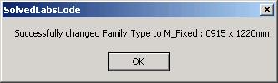
Assign new Type
Families and Types
' Display the form and change the type
Dim frm As New Lab3_4_Form(dictFamilyToSymbols)
If frm.ShowDialog = Windows.Forms.DialogResult.OK Then
Try
inst.Symbol = frm.cmbType.SelectedItem
MsgBox("Successfully changed Family:Type to " _
& frm.cmbFamily.Text & " : " & frm.cmbType.Text)
Catch
End Try
End If
Notes:
With this information in place, a dialogue is displayed allowing the user to select any one of the applicable symbols.
If one is selected, it is applied to the selected instance, changing its symbol.

Slide 79
System Families and Types
Families and Types
Simpler to manipulate than generic standard ones
Dedicated classes derived typically from HostObject
Wall and Floor classes well-exposed
New: RoofBase, FootPrintRoof and ExtrusionRoof
Lab 3-5
List all Wall types, save last one: use Document property WallTypes
List all Floor types, save last one
Change all selected Walls’ and Floors’ type
Notes:
Above, we discussed listing and manipulating standard families and types and family instances. Similar principles apply when working with system families.
Before running this command, draw four walls and a floor and select them all. First, all wall types defined in the current document are listed and the last one is stored for later use. Then all floor types including foundations (slab) defined in the current document are listed and the last one is stored for later use. Finally, all the selected wall and floor types are changed to the stored ones.

Slide 80
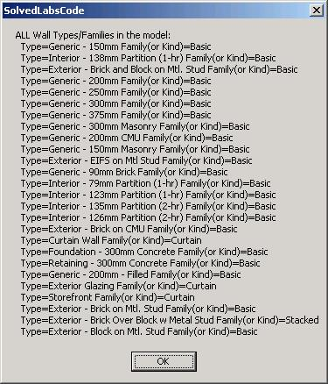
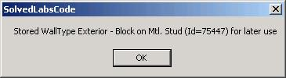
List all Wall Types
Families and Types
' Find ALL Wall Types and their System Families (or Kinds)
Dim newWallType As WallType = Nothing ' store the last one
Dim sMsg As String = "ALL Wall Types/Families in the model:"
' We could again iterete all elements and check for WallType class,
' but it's simpler directly from the doc:
Dim doc As Revit.Document = commandData.Application.ActiveDocument
For Each wt As WallType In doc.WallTypes
sMsg += vbCrLf & " Type=" & wt.Name & " Family(or Kind)=" & wt.Kind.ToString
newWallType = wt
Next
MsgBox(sMsg)
MsgBox( "Stored WallType " & newWallType.Name _
& " (Id=" & newWallType.Id.Value.ToString & ") for later use" )
Notes:
All wall types defined in the current document are listed and the last one is stored for later use.

Slide 81
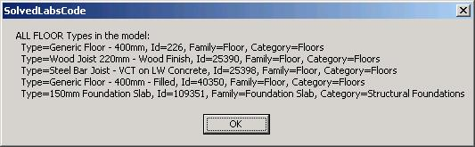
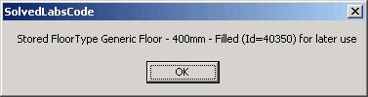
List all Floor Types
Families and Types
' Find ALL Floor Types ... see updated code and more comments for Revit 2009 API in Labs code
Dim newFloorType As FloorType = Nothing ' at the same time store the last one to use to change the floor type later
sMsg = "ALL FLOOR Types in the model:"
' There is no dedicated property to get floor types, so need to iterate all elements again
Dim iter As ElementIterator = doc.Elements
Do While (iter.MoveNext())
Dim elem As Revit.Element = iter.Current
If TypeOf elem Is Symbols.FloorType Then
Dim ft As Symbols.FloorType = elem
sMsg += vbCrLf & " Type=" & ft.Name & ", Id=" & ft.Id.Value.ToString
' In 9.0, it looks like "Foundation Slab" system family from "Structural Foundations" category
' ALSO contains FloorType class instances. Exclude those as choices for standard floor types
Dim famName As String
Try
famName = ft.Parameter(Parameters.BuiltInParameter.SYMBOL_FAMILY_NAME_PARAM).AsString
Catch
famName = "?"
End Try
Dim cat As Category = ft.Category
sMsg += ", Family=" & famName & ", Category=" & cat.Name
' store only if proper Floors category
If doc.Settings.Categories.Item(BuiltInCategory.OST_Floors).Equals(cat) Then
newFloorType = ft
End If
End If
Loop
MsgBox(sMsg)
MsgBox( "Stored FloorType " & newFloorType.Name & " (Id=" & newFloorType.Id.Value.ToString & ") for later use")
Notes:
All floor types including foundations (slab) defined in the current document are listed and the last one is stored for later use.

Slide 82
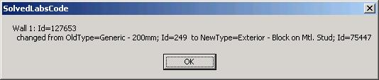
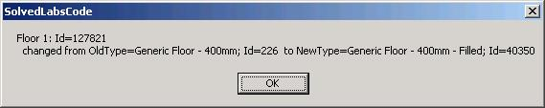
Change Wall and Floor Type
Families and Types
' Change the Type for selected Walls and Floors
Dim sel As ElementSet = doc.Selection.Elements
Dim iWall As Integer
Dim el As Revit.Element
For Each el In sel
If TypeOf el Is Wall Then ' Check for walls
Dim wall As Wall = el
iWall += 1
Dim oldWallType As WallType = wall.WallType
wall.WallType = newWallType
MsgBox("Wall " & iWall.ToString & ": Id=" & wall.Id.Value.ToString & vbCrLf & _
" changed from OldType=" & oldWallType.Name & "; Id=" & oldWallType.Id.Value.ToString & _
" to NewType=" & wall.WallType.Name & "; Id=" & wall.WallType.Id.Value.ToString)
ElseIf TypeOf el Is Floor Then
Dim f As Floor = el
iFloor += 1
Dim oldFloorType As FloorType = f.FloorType
f.FloorType = newFloorType
MsgBox("Floor " & iFloor.ToString & ": Id=" & f.Id.Value.ToString & vbCrLf & _
" changed from OldType=" & oldFloorType.Name & "; Id=" & oldFloorType.Id.Value.ToString & _
" to NewType=" & f.FloorType.Name & "; Id=" & f.FloorType.Id.Value.ToString)
End If
Next
Notes:
Finally, all the selected wall and floor types are changed to the stored ones.

Slide 83
Duplicate a Symbol
Families and Types
Symbol.Duplicate
Lab 3-6
Notes:
Above, we discussed listing and manipulating standard families and types and family instances. Similar principles apply when working with system families.
Before running this command, draw four walls and a floor and select them all. First, all wall types defined in the current document are listed and the last one is stored for later use. Then all floor types including foundations (slab) defined in the current document are listed and the last one is stored for later use. Finally, all the selected wall and floor types are changed to the stored ones.

Slide 84
Parameters
Notes:
The main data container on every Revit building element is its collection of parameters. This section explores these parameters.

Slide 85
Parameters
Parameters
Accessing element parameters
Built-in versus shared parameters
Exchanging data with external applications
Strategy for storing custom per-element data
Manipulating shared parameters' file and groups
Hidden parameters
Strategy for storing per-document (per-model) data
SDK sample FireRating
Notes:
We explore different methods of accessing and modifying parameters, exporting them to external applications, importing modified data back in again, and handling shared, hidden, and per-document parameters.
The SDK sample FireRating demonstrates a full parameter manipulion use case by implementing a suite of three commands for adding a new shared ‘fire rating’ parameter to all door objects in the Revit model, exporting the current door fire ratings to an external application, and importing the externally modified values back into the Revit model.

Slide 86
Accessing Parameters
Parameters
How do we access element parameters?
Loop through Element.Parameters
If name, built-in parameter enum, definition or GUID is known, get it directly
Parameter(Guid) – Retrieve parameter given a shared parameter GUID
Parameter(String) – Retrieve parameter from parameter name
Parameter(Definition) – Retrieve parameter based on its definition
Parameter(BuiltInParameter) – Retrieve parameter given a parameter id
Lab 4-1
Notes:
Individual parameters can be accessed in different ways: by localised name, by built-in parameter id, by definition or by GUID. You can also loop over the entire element Parameters collection. Lab 4-1 lists all selected elements' parameters. In addition, it demonstrates retrieving a built-in parameter as well as a parameter by localised name, BuiltInParameter.FAMILY_BASE_LEVEL_OFFSET_PARAM and "Base Offset" respectively. Select a column to display both of these.

Slide 87
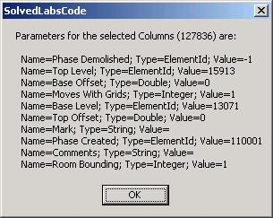
Loop all Element Parameters
Parameters
' List all UI-visible Params
Dim sMsg As String = "Parameters for the selected " & elem.Category.Name & " (" & elem.Id.Value.ToString & ") are:" & vbCrLf
Dim param As Parameter
For Each param In elem.Parameters
Dim paramName As String = param.Definition.Name
Dim paramType As String = param.StorageType.ToString
Dim paramValue As String = LabUtils.GetParamAsString(param)
sMsg += " Name=" & paramName & "; Type=" & paramType & "; Value=" & paramValue
Next
MsgBox(sMsg)
Public Shared Function GetParamAsString(ByVal param As Parameter) As String
Dim str As String
Select Case param.StorageType
Case StorageType.Double
str = param.AsDouble.ToString
Case StorageType.Integer
str = param.AsInteger.ToString
Case StorageType.String
str = param.AsString
Case StorageType.ElementId
str = param.AsElementId.Value.ToString
End Select
Return str
End Function
Notes:
Loop over the entire Parameters collection of an element.

Slide 88
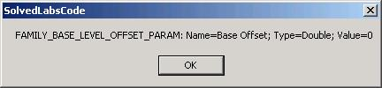
Access Built-in Parameter
Parameters
' If we know WHICH param we are looking for, then:
' A) a standard parameter, can be got via BuiltInParam signature of Parameter method:
Dim parInBuilt As Parameter
Try
parInBuilt = elem.Parameter(BuiltInParameter.FAMILY_BASE_LEVEL_OFFSET_PARAM)
If Not parInBuilt Is Nothing Then
Dim parInBuiltName As String = parInBuilt.Definition.Name
Dim parInBuiltType As String = LabUtils.GetParamStorageType(parInBuilt).ToString
Dim parInBuiltValue As String = LabUtils.GetParamAsString(parInBuilt)
MsgBox("FAMILY_BASE_LEVEL_OFFSET_PARAM: Name=" & parInBuiltName _
& "; Type=" & parInBuiltType & "; Value=" & parInBuiltValue)
Else
MsgBox("FAMILY_BASE_LEVEL_OFFSET_PARAM is NOT available for this element")
End If
Catch
MsgBox("FAMILY_BASE_LEVEL_OFFSET_PARAM is NOT available for this element")
End Try
Notes:
Access a specific built-in element parameter.

Slide 89
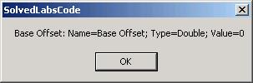
Access Named Parameter
Parameters
'Helper to get *specific* parameter by name
Shared Function GetElemParam(ByVal elem As Revit.Element, ByVal name As String) As Parameter
Dim parameters As Autodesk.Revit.ParameterSet = elem.Parameters
Dim parameter As Autodesk.Revit.Parameter
For Each parameter In parameters
If (parameter.Definition.Name = name) Then
Return parameter
End If
Next
Return Nothing
End Function
' C) use GetElemParam utilty to get it by hard coded-name
' (this works for either standard or shared!):
Const csParamToFind As String = "Base Offset"
Dim parByName As Parameter = LabUtils.GetElemParam(elem, csParamToFind)
If parByName Is Nothing Then
MsgBox(csParamToFind & " is NOT available for this element")
Else
Dim parByNameName As String = parByName.Definition.Name
Dim parByNameType As String = LabUtils.GetParamStorageType(parByName).ToString
Dim parByNameValue As String = LabUtils.GetParamAsString(parByName)
MsgBox(csParamToFind & ": Name=" & parByNameName & "; Type=" & parByNameType & "; Value=" & parByNameValue)
End If
Notes:
Access a specific named element parameter. This kind of access is language dependent!

Slide 90
Parameters Collection is Incomplete
Parameters
Most elements have more parameters than those listed in the Parameters collection
One way to find more is to attempt to retrieve a parameter for each one of the 2277 built-in parameters enum values
This is implemented by the BuiltInParamsChecker and also by RvtMgdDbg 'Built-in Enums Snoop...'
For instance, every family instance has a Room property represented by the ELEM_ROOM_ID built-in parameter, which is not listed in the Parameters collection on a door element

Slide 91
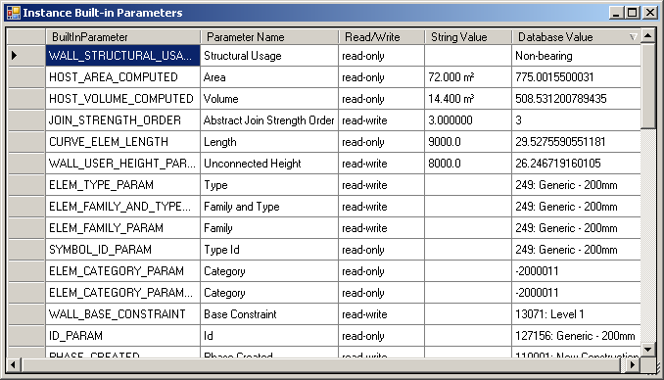
BuiltInParamsChecker
Parameters
Determine all valid built-in parameters for a selected element
Loop through all built-in parameter enums
Try to obtain a valid parameter for each
Sortable results using DataGridView
Notes:
The parameters returned in an element’s Parameters collection sometimes differs from the list of parameters that can be queried individually from the element by using the individual built-in parameter access. Therefore, it is useful to be able to determine all valid built-in parameters for a selected element. This is implemented by the BuiltInParamsChecker utility included in the labs, also described in a devnote or technical solution TS87913 on the ADN site. For a selected element, it loops through all the built-in parameter enums and tries to obtain a valid parameter for each, printing out the list of valid results. Currently, the built-in parameters and their meanings are not documented, so you have to find them out by trial and error.

Slide 92
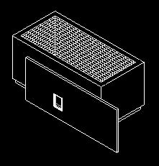
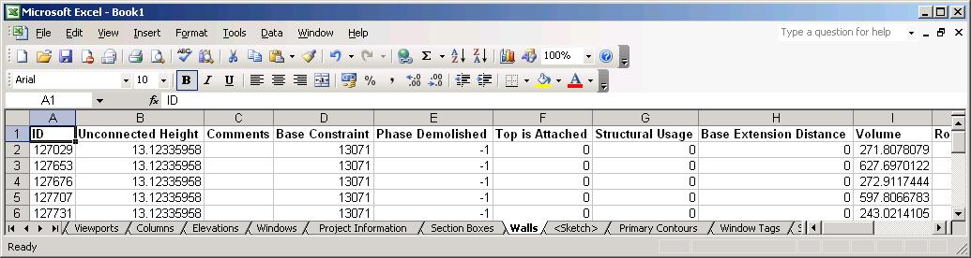
Exporting Parameters
Parameters
Exporting Revit BIM data to an external application
How do we use COM Interop in .NET to access e.g. MS Excel from Revit?
Lab 4-2
Out-of-process client
Create a map containing all non-symbol elements which have a valid category, sorted into separate sets for each category
Start up Excel and create a new workbook
For each category, add a worksheet
Iterate over all elements in the set for that category and determine all the parameter names used
Add a title row listing the parameter names, and then one row for each element listing all its parameters

Slide 93
Create Map of all Elements
Parameters
' First extract and group the data from Revit in a convenient Map class:
' (Key=category name, Val=Set of Elements)
' In Revit 2009, we use an element filter instead ... see updated Labs code
Dim sortedElements As Autodesk.Revit.Collections.Map = revitApp.Create.NewMap()
Dim iter As IEnumerator = doc.Elements
Do While (iter.MoveNext())
' We look for all non-Symbol Elements which have a Category
Dim element As Revit.Element = iter.Current
If Not (TypeOf element Is Symbol) Then
Dim category As Category = element.Category
If Not (category Is Nothing) Then
Dim elementSet As ElementSet
' If we already have this Key, get its Value (Set)
' Otherwise, create the new Key and Value
If sortedElements.Contains(category.Name) Then
elementSet = sortedElements.Item(category.Name)
Else
elementSet = revitApp.Create.NewElementSet()
sortedElements.Insert(category.Name, elementSet)
End If
' Add the elemnt to the Set
elementSet.Insert(element)
End If
End If
Loop
Notes:
Iterate over all document elements and sort them into separate collections for each category. At the end, we will have separate collections for doors, walls, windows, etc.

Slide 94
Launch Excel, Add Workbook
Parameters
Imports MsExcel = Microsoft.Office.Interop.Excel
' Launch/Get Excel (via COM Interop)
Dim excel As MsExcel.Application = New MsExcel.ApplicationClass()
If (excel Is Nothing) Then
MsgBox("Failed to get or start Excel!?")
Return IExternalCommand.Result.Failed
End If
excel.Visible = True ' Make it visible "live" to the user
' Add a new work-book and delete the default work-sheets
Dim workbook As MsExcel.Workbook = excel.Workbooks.Add()
Dim worksheet As MsExcel.Worksheet
Do While workbook.Sheets.Count > 1
worksheet = workbook.Sheets.Item(1)
worksheet.Delete()
Loop
' Loop all collected Categories and create one worksheet for each
Dim mapIter As Autodesk.Revit.Collections.MapIterator = sortedElements.ForwardIterator
Do While (mapIter.MoveNext())
' retrieve stored category and ElementSet
Dim categoryName As String = mapIter.Key
Dim elementSet As Autodesk.Revit.ElementSet = mapIter.Current
' create and name the worksheet
worksheet = excel.Worksheets.Add()
worksheet.Name = categoryName
Notes:
Launch Excel through .NET COM interop, add a new workbook, and add a new sheet for each of the categories we found.

Slide 95
Determine all Table Headers
Parameters
Dim allParamNamesEncountered As Autodesk.Revit.Collections.Set _
= revitApp.Create.NewSet()
' loop through all the elements passed to the method
Dim setIter As IEnumerator = elementSet.ForwardIterator
Do While (setIter.MoveNext())
Dim el As Autodesk.Revit.Element = setIter.Current
Dim parameters As Autodesk.Revit.ParameterSet = el.Parameters
If Not (parameters.IsEmpty) Then
‘ Another way to loop the parameters is via ParameterSetIterator:
Dim definitionNames As Autodesk.Revit.Collections.Set _
= revitApp.Create.NewSet()
Dim paramIter As Autodesk.Revit.ParameterSetIterator _
= parameters.ForwardIterator
Do While paramIter.MoveNext()
Dim parameter As Autodesk.Revit.Parameter = paramIter.Current
Dim name As String = parameter.Definition.Name
If Not allParamNamesEncountered.Contains(name) Then
allParamNamesEncountered.Insert(name)
End If
Loop
End If
Loop
Notes:
For each category, i.e. worksheet, use the Revit parameter definition names to create the worksheet headers. Loop through all the elements in the current category and determine all parameters for each. 'For each parameter in Parameters' is one way to iterate, the ParameterSetIterator is another.

Slide 96
Create Table Headers
Parameters
' add the HEADER row in Bold
worksheet.Cells(1, 1).Value = "ID"
Dim paramName As String
Dim column As Integer = 2
For Each paramName In allParamNamesEncountered
worksheet.Cells(1, column).Value = paramName
excel.Columns(column).EntireColumn.AutoFit()
column = column + 1
Next
excel.Rows("1").Font.Bold = True
Notes:
Create the table headers in the current sheet.

Slide 97
Export Parameters to Excel
Parameters
' export one row for each element that belongs to the category
Dim elem As Revit.Element
Dim row As Integer = 2
For Each elem In elementSet
' first column is the element id (display it as an integer)
worksheet.Cells(row, 1).Value = elem.Id.Value
' the other columns are parameter values
column = 2
For Each paramName In allParamNamesEncountered
Dim paramValue As String
Try
paramValue = LabUtils.GetParamAsString( LabUtils.GetElemParam( _
elem, paramName ) )
Catch
paramValue = "*NA*"
End Try
worksheet.Cells(row, column).Value = paramValue
column = column + 1
Next
row = row + 1
Next 'row
Loop 'categories (worksheets)
Notes:
Iterate over all the elements in the current category. For each element, iterate over all the parameters we have determined for this category, get their values from the Revit element and write them to the worksheet cells.

Slide 98
Shared Parameters
Parameters
Use shared parameters to add per-element data to Revit elements
Export and import these parameters to and from third party applications
Lab 4-3 (3 commands)
Similar to the SDK Sample FireRating
Create shared parameter for all doors
Export shared parameter data to Excel
Import shared parameter data from Excel
Notes:
Create a wall with a door in it, at least, before running this command. Also, you may need to set the full path defned in GetSharedParamsFile(). It is currently "C:\tmp\Labs-4-3-1.txt". After running the second command, show the excel spreadsheet, update the value of "API FireRating", and save the file, noting its name and location. In the third step, reopen the recently saved file. Note that the parameter of the door is updated from the Excel file.

Slide 99
Create Shared Parameter
Parameters
Get shared parameters definition file
Class Parameters.DefinitionFile
Application.Options.SharedParametersFilename
Application.OpenSharedParameterFile
Get shared parameters group
Class Autodesk.Revit.Parameters.DefinitionGroup
DefinitionFile.Groups
DefinitionFile.Groups.Create
Get shared parameters definition
Class Parameters.Definition
DefinitionGroup.Definitions
DefinitionGroup.Definitions.Create
Create category set for binding to 'Doors‘
CategorySet = revitApp.Create.NewCategorySet()
catSet.Insert( doc.Settings.Categories.Item( BuiltInCategory.OST_Doors ) )
Bind the parameter
Dim binding As Parameters.Binding = revitApp.Create.NewInstanceBinding( catSet )
doc.ParameterBindings.Insert( fireRatingParamDef, binding )

Slide 100
Export Shared Parameter
Parameters
Start up Excel
Get all standard family instances for the given category ‘Doors’
Determine the shared parameter GUID for accessing values
Dim guid As Guid = guid.Empty
Dim file As Parameters.DefinitionFile = revitApp.OpenSharedParameterFile
Dim group As Parameters.DefinitionGroup = file.Groups.Item(defGroup)
Dim definition As Parameters.Definition = group.Definitions.Item(defName)
Dim externalDefinition As Parameters.ExternalDefinition = definition
guid = externalDefinition.GUID
Loop all doors and export each to an Excel row
id, level, tag, fire rating
worksheet.Cells(row, 1).Value = door.Id.Value
worksheet.Cells(row, 2).Value = door.Level.Name
Dim tagParameter As Parameter = door.Parameter( BuiltInParameter.ALL_MODEL_MARK )
worksheet.Cells(row, 3).Value = tagParameter.AsString
Dim parameter As Parameter = door.Parameter( paramGuid )
worksheet.Cells(row, 4).Value = parameter.AsDouble
row = row + 1

Slide 101
Import Shared Parameter
Parameters
Select file, start up Excel, open file
Import data
Dim id As Integer
Dim fireRatingValue As Double
Dim row As Integer = 2
Do
' Extract relevant XLS values
id = worksheet.Cells(row, 1).Value
If id <= 0 Then Exit Do
fireRatingValue = worksheet.Cells(row, 4).Value
' Get document's door element via Id
Dim elementId As Autodesk.Revit.ElementId
elementId.Value = id
Dim door As Autodesk.Revit.Element = revitApp.ActiveDocument.Element( elementId )
' Set the param
If Not (door Is Nothing) Then
Dim parameter As Parameter = LabUtils.GetElemParam( door, sharedParamName )
parameter.Set( fireRatingValue )
End If
row = row + 1
Loop
Notes:
We retrieve the door id and the updated fire rating value from the Excel file, get the door element from Revit, get its shared parameter and update its value.

Slide 102
Model Shared Parameters
Parameters
How do we store per-document (per-model) data using shared parameters?
Bind hidden shared parameters to the singleton element of 'Project Information' category
The shared parameter definition uses ExternalDefinition, which has an attribute 'Visible'

Slide 103
Geometry and Groups
Notes:
Revit provides full access to the element geometry. The geometrical objects used are transient. They are generated on the fly by the API or an application and used to query or define element properties. They live in a separate namespace Autodesk.Revit.Geometry.

Slide 104
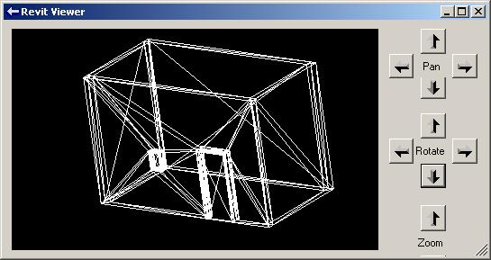
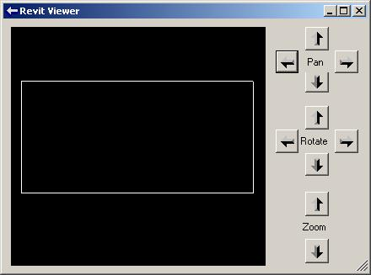
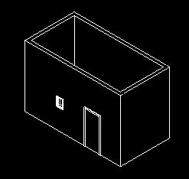
Access 3D Geometry
Geometry and Groups
Revit SDK sample viewers
RevitViewer
A simple geometry viewer helper class
Used by the other viewer samples
ElementViewer
Display wireframe model of one or more selected elements
RoomViewer
Wireframe viewer of the selected room
AnalyticalViewer
Display analytical model of one or more selected elements
ObjectViewer
Display analytical or physical model and set parameter of selected elements
FamilyExplorer
Profiles

Slide 105
Obtain 3D Element Geometry
Geometry and Groups
Private mOptions As Autodesk.Revit.Geometry.Options
mOptions = app.Create.NewGeometryOptions
mOptions.DetailLevel = Geometry.Options.DetailLevels.Fine
For Each elem In selSet
Dim geom As Autodesk.Revit.Geometry.Element = elem.Geometry(mOptions)
DrawElement(geom)
Next
If selSet.Size > 0 Then
mViewer.ShowModal()
End If
Specify level of detail of element geometry
Coarse, Medium, or Fine
All that remains is to display the geometry
Notes:
Each element may have geometery associated with it. The element geometry is returned by its Geometry method, which takes an argument specifying the required detail level: Coarse, Medium, or Fine. Here is code from the ElementViewer sample queriying each element in the selection set for its geometry and passing it into a drawing routine.

Slide 106
Display Element Geometry
Geometry and Groups
Private Sub DrawElement(ByVal elementGeom As Geometry.Element)
Dim geomObject As Autodesk.Revit.Geometry.GeometryObject
For Each geomObject In elementGeom.Objects
If (TypeOf geomObject Is Autodesk.Revit.Geometry.Curve) Then
DrawCurve(geomObject)
ElseIf (TypeOf geomObject Is Autodesk.Revit.Geometry.Instance) Then
DrawInstance(geomObject)
ElseIf (TypeOf geomObject Is Autodesk.Revit.Geometry.Mesh) Then
DrawMesh(geomObject)
ElseIf (TypeOf geomObject Is Autodesk.Revit.Geometry.Solid) Then
DrawSolid(geomObject)
End If
Next
End Sub
Private Sub DrawCurve(ByVal geomCurve As Geometry.Curve)
DrawPoints(geomCurve.Tessellate)
End Sub
Notes:
Iterate over the element geometry, which in turn is a Geometry.Element instance containing curve, instance, mesh and solid objects which in turn are broken down into line segments for the viewer. For more details, please refer to the SDK sample source code.

Slide 107
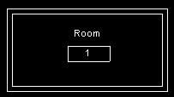
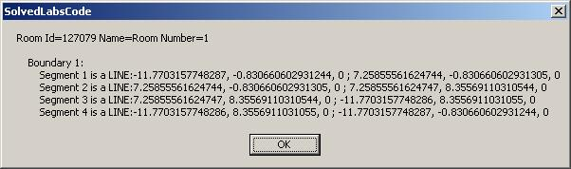
Access to 2D Geometry
Geometry and Groups
Display room id, name and number
Iterate over room boundary lines
See also SDK sample RoomViewer
Lab 5-3
Notes:
Rooms also have geometry associated with them. In this case, the geometry is the 2D room boundary lines. This is demonstrated by Lab 5-3. In order to explore lab 5-3, create four walls and a room. The room id, name and number as well as the geometrical coordinates of its boundary lines are displayed. RoomViewer displays the room boundary graphically in its own embedded viewer.

Slide 108
Iterate Room Boundary
Geometry and Groups
Dim boundaries As BoundarySegmentArrayArray = room.Boundary
Dim boundary As BoundarySegmentArray
Dim iB As Integer = 0
For Each boundary In boundaries
iB += 1
sMsg += vbCrLf & " Boundary " & iB & ":"
Dim iSeg As Integer = 0
Dim segment As BoundarySegment
For Each segment In boundary
iSeg += 1
Dim crv As Geometry.Curve = segment.Curve
If TypeOf crv Is Geometry.Line Then ' LINE
Dim line As Line = crv
Dim ptS As XYZ = line.EndPoint(0)
Dim ptE As XYZ = line.EndPoint(1)
sMsg += vbCrLf & " Segment " & iSeg & " is a LINE:" & _
ptS.X & ", " & ptS.Y & ", " & ptS.Z & " ; " & _
ptE.X & ", " & ptE.Y & ", " & ptE.Z
ElseIf TypeOf crv Is Geometry.Arc Then ' ARC
Dim arc As Arc = crv
Dim ptS As XYZ = arc.EndPoint(0)
Dim ptE As XYZ = arc.EndPoint(1)
Dim r As Double = arc.Radius
sMsg += vbCrLf & " Segment " & iSeg & " is an ARC:" & _
ptS.X & ", " & ptS.Y & ", " & ptS.Z & " ; " & _
ptE.X & ", " & ptE.Y & ", " & ptE.Z & " ; R=" & r
End If
Next
Next
Notes:
The room boundary is accessible through the property Boundary, which returns a BoundarySegmentArrayArray, i.e. a collection of arrays of boundary segments. Each array of boundary segments is one boundary, and each boundary segment has a curve, which can be a line or an arc, for instance.

Slide 109
Groups
Geometry and Groups
Determining types available in the model
Determining elements' containment
Manipulating group instance types

Slide 110
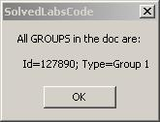
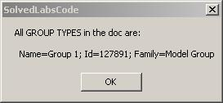
List Groups and GroupTypes
Geometry and Groups
Standard element filtering for Group or GroupType
List<Element> elements = new List<Element>();
Filter filterType = app.Create.Filter.NewTypeFilter( typeof( Group ) );
app.ActiveDocument.get_Elements( filterType, elements );
Lab 5-1
Notes:
Determining all the groups and group types in the model is a standard element iteration, checking for the System.Type Group or GroupType. This is demonstrated by Lab 5-1. Before running Lab 5-1, create at least one model group. Pick Edit > Group > Create Group or use the GP shortcut, then add some model elements such as walls and floors.

Slide 111
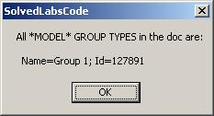
List Model Groups
Geometry and Groups
Standard element filtering
Add check for SYMBOL_FAMILY_NAME_PARAM
List<Element> elements = new List<Element>();
Filter filterType = app.Create.Filter.NewTypeFilter( typeof( GroupType ) );
Filter filterParam = app.Create.Filter.NewParameterFilter(
BuiltInParameter.SYMBOL_FAMILY_NAME_PARAM, CriteriaFilterType.Equal,
"Model Group" ); // BEWARE: In the browser, it says only "Model"
Filter filterAnd = app.Create.Filter.NewLogicAndFilter( filterType, filterParam );
app.ActiveDocument.get_Elements( filterAnd, elements );
Lab 5-1

Slide 112
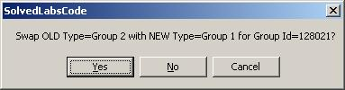
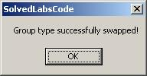
Swap Group Type
Geometry and Groups
Set GroupType property on Group object
Dim gp As Group = elem
Dim gt As GroupType
gp.GroupType = gt
Lab 5-2
Notes:
Swapping the group type of a group is achieved by setting its GroupType property. This is demonstrated in Lab 5-2. Before running Lab 5-2, create at least one model group. Pick Edit > Group > Create Group or use the GP shortcut, then add some model elements such as walls and floors. Then, select an element before running the command.

Slide 113
VSTA
Visual Studio Tools for Applications

Slide 114



VSTA (Visual Studio Tools for Applications)
Successor of VBA (Visual Basic for Applications)
.NET Framework supporting C# and VB.NET

Slide 115
Revit VSTA
Two levels of macros
Document level – embedded in .rvt file and can pass to anybody who uses Revit
Application level - saved under: <Revit install>\Program\VstaMacros\AppAddIns
*Almost* same syntax as external command with a few exceptions
Installation
Under “Install Tools and Utilities” in the setup dialog, so run the installer twice
For each Revit flavour
No need for full MSVS
Documentation
Revit Architecture 2009 User's Guide > Creating Macros with Revit VSTA
Revit SDK > Revit VSTA User Manual.pdf (pdf version of above, slightly old)
Samples
Revit SDK > “VSTA Samples” folder
15 document add-ins in .rvt
2 application add-ins
In C# and VB.NET

Slide 116
Revit VSTA
Differences between VSTA and External Command
Reference
External command – RevitAPI.dll
VSTA – RevitProxy.dll (automatically referenced)
No need to modify Revit.ini
Declaration:
External command – implement IExternalCommand interface and Execute method
VSTA – declare a public method with no parameters and void return type in the ThisApplication or ThisDocument class
Application object access
External command – through externalCommandData.Application
VSTA – use this keyword in C# and the Me keyword in VB.NET, which points to the Application object for Application-level macros or Document object for Document-level ones. For Document-level macros, this.Application or Me.Application points to the Application object.

Slide 117
Revit VSTA
More differences between VSTA and External Command
“new” operator:
External command – Some Revit API objects can be created directly by new operator, e.g. Geometry.XYZ as in XYZ a = new XYZ(1.0, 0.0, 0.0)
VSTA – no new to create object. Must be created by Application.Create.NewXXX methods, e.g., this.Application.Create.NewXYZ(1.0, 0.0, 0.0) in C# or Me.Application.Create.NewXYZ(1.0, 0.0, 0.0) in VB.NET
Curve end point access in VB.NET
External command – through Curve.EndPoint property
VSTA – through Curve.get_EndPoint method
May encounter other small differences like this
No menus and toolbars in VSTA

Slide 118
Revit VSTA
Demo

Slide 119
VSTA
Visual Studio Tools for Applications
Microsoft technology
Provides Application Extensibility
Built on Visual Studio and the .NET Framework
Can be integrated into an application
A standardized toolset and a managed extensibility environment
VSTA projects open in full Visual Studio
Will continue to inherit innovations in Visual Studio and .NET
The next evolution of VBA (Visual Basic for Applications) in some Autodesk applications.

Slide 120
VSTA in Revit
Differences from Revit API
Provided by an “add-in” called Revit VSTA
Install Tools and Utilities (from the setup window)
-> Revit VSTA for (Architecture) 2009 (option)
No need to register the macros in Revit.ini
No need to add RevitAPI.dll as a reference
No need to implement the external command interface
Access to the Application and Document with This or Me
No access to menu and toolbar UI functionalities
Must use Create method to create objects

Slide 121
VSTA in Revit
Document level macros
Revit_VSTA_Samples.rvt
15 C# macros
15 VB.NET macros
Application level macros
GetTimeElapsedSinceLastSave
Rooms

Slide 122
VSTA in Revit
Documentation
Revit VSTA User Manual.pdf in the SDK
Revit (Architecture) 2009 Help item in help menu
Creating Macros with Revit VSTA
Getting Started with Macros
Using Macro Manager and the Revit VSTA IDE
Revit SDK, API Reference Documentation, VSTA Samples
Using the Revit VSTA Samples from SDK
Integrating Macros into Revit VSTA
Revit API Differences
Migrating SDK Samples to Revit VSTA
Revit Macros FAQ
Related Information about Revit Macros
Notes:
They are pretty similar to each other. The former is a single file but the latter is well structured.

Slide 123

VSTA in Revit - Commands

Slide 124

VSTA in Revit – Macro Manager

Slide 125

VSTA in Revit - IDE

Slide 126
VSTA in Revit
Live Demo
Run a few document level macros provided by the SDK
Create a document level macro on the fly
Create an application level macro on the fly
Merge a SDK VSTA sample into the VSTA IDE on the fly

Slide 127
Learning More
Online Help and SDK Samples
DevTV Introduction to Revit 2008 Programming
http://adn.autodesk.com/adn/servlet/item?siteID=4814862&id=10194238&linkID=4901650
Recording of Revit 2009 Programming Introduction Webcast
http://adn.autodesk.com/adn/servlet/index?siteID=4814862&id=5475217&linkID=4901650
http://www.adskconsulting.com/adn/cs/api_course_sched.php
Discussion Groups
http://discussion.autodesk.com > Revit API
API Training Classes
http://www.autodesk.com/apitraining
Autodesk Developer Network
http://www.autodesk.com/joinadn
DevHelp Online for ADN members
http://adn.autodesk.com
The Building Coder, a Revit API Blog
http://thebuildingcoder.typepad.com

Slide 128
Thank you!
Thank you very much for your interest and attention!
Much success with the Revit API and your application development!

Slide 129

End of Presentation

Slide 130
Next Steps
Verona
Database structure, parameters
No way to access to painted face on wall face
Boolean operations in family editor
Example making use of FamilyInstance.AddCoping: CutBeam
Calculate the volumes of the individual layers of a compound wall
Revit Structure API: Link and Rebar Detailing
Create a Steel-Graphics Import-Export skeleton?
Load family, create a new type, and insert column and beam instances
Language independent category comparison
Improved filtering for FrameBuilder sample

