Slide 1

Revit Programming Introduction
Jeremy Tammik
Developer Technical Services
Notes:
Welcome, to this introduction to Revit programming. First, let me briefly present myself. Then, before I get into the meat of the presentation, a word or two on the live meeting technology and how to use it.

Slide 2

About the Presenter
Introduction
Jeremy Tammik
Developer Technical Services
EMEA
Autodesk SARL
Jeremy originally joined Autodesk in 1988 as the technology evangelist responsible for European developer support. In this capacity, he wrote articles, consulted, lectured on AutoCAD application programming techniques, and supported AutoCAD application developers in Europe, the U.S., Australia, and South Africa. He was a cofounder of ADGE (AutoCAD Developer Group Europe) and a prolific author on AutoCAD application development. He left Autodesk in 1994 to work as an HVAC application developer, then rejoined the company in 2005.
Jeremy graduated with a MA in mathematics and physics in Marburg, Germany, in 1984, and worked first as a teacher and translator of both computer and human languages, then as a C++ programmer. He is fluent in five European languages, vegetarian, has four kids, plays the flute, likes theatre improvisation and loves sports and climbing.
Notes:
It is my pleasure to work in for the Autodesk Developer Network ADN in the AEC workgroup.

Slide 3


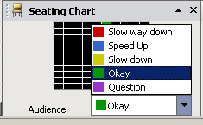
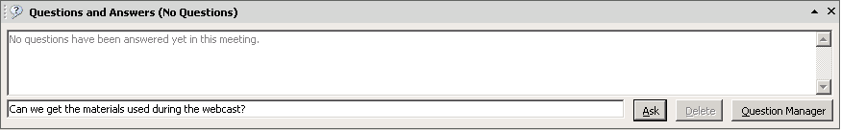
Before we start LiveMeeting – how to
Introduction
Full Screen Mode
Provide feedback
Realtime Q&A
Expand to full screen mode
Press ESC to return
Notes:
This conference is muted, so you cannot hear anybody else than me talking, and cannot provide feedback through the phone conference. We will unmute it and open it up for general discussion and questions and answers at the end. Meanwhile, written questions can be entered in the live meeting console and will be answered in realtime during the presentation by my colleagues. Thank you very much for that support! Since I will be switching back and forth between these slides and live demonstrations in Revit and Visual Studio, I will set my computer to low resolution and full screen mode to reduce bandwidth and speed up the display. This means I will not see the live meeting console and the feedback panel. My colleagues will be monitoring the livemeeting console and also answering questions online. We will post the materials from this presentation together with the audio recording.

Slide 4
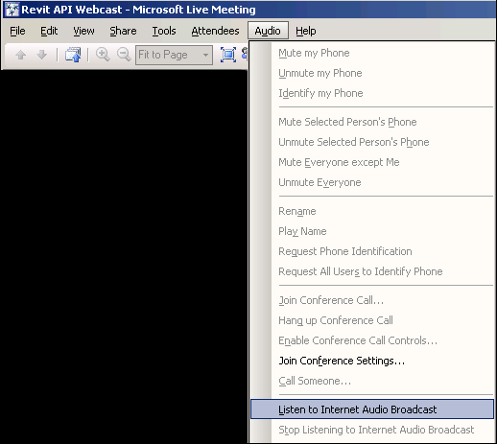
Before we start… Audio option
Introduction
Either dial in to the phone conference ... or
Find no convenient number to call?
Use "Audio" > "Listen to Internet Audio Broadcast" Option
Notes:
You can either dial in to the telephone conference numbers, or listen to the internet audio broadcast through your computer.

Slide 5
Before we start… Experience and Expectations
Introduction
Name, Company?
Background (IT/programming/structure engineering)?
Revit Architecture/Structure/MEP?
Revit API?
VB.NET? C#?
AutoCAD, AutoCAD Architecture, etc. APIs?
ADN member?

Slide 6
Agenda
Introduction
Introduction
Product, SDK, documentation and samples
Getting Started and Hello World
Development environment, external command and application interfaces, modifying Revit.ini
Elements Collection
Identifying an element, getting all model elements, filtering, manipulation
Families and Types
Standard versus system families, loading, changing type
Parameters
Access, built-in versus shared, exchange with external applications, hidden, per-doc data
Geometry, Other API Areas
2D and 3D geometry, groups, rooms
Notes:
We are running in low resolution today, so that we can switch back and forth between the presentation and live demos. So, what are the initial steps in creating a Revit application? The first thing is to understand is what is installed, the API architecture, the information provided and where to obtain more information. Then we explore how to set up the development environment and create a first "Hello world" type application. After that, we will look into the Revit database structure and its data and elements. The samples provide a valuable knowledgebase on how to solve Revit programming tasks. For the people who attended the recent webcast on the Revit Structure API on May 3rd, the current presentation covers the first half of that, all the generic material.

Slide 7
Poll 1
Introduction
Do you already have any experience with Revit programming?
None
I have looked at the SDK but not implemented any own applications
I am working on one or more own Revit applications
I am already selling my own Revit applications
Notes:
Before we start discussing the Revit SDK material, let us get a quick snapshot of where the participants are in terms of experience and expectations.

Slide 8
Materials Provided
Introduction
This presentation
The accompanying labs and instructions
The Revit SDK
Debugging utilities
Notes:
Here is an overview of the material we are providing to accompany this presentation.

Slide 9
Acronyms
Introduction
ADN Autodesk Developer Network
AEC Architecture, Engineering, Construction
API Application Programming Interface
BIM Building Information Model
MEP Mechanical, Electrical, Plumbing
RAC Revit Architecture
RME Revit MEP
RST Revit Structure
SDK Software Development Kit

Slide 10
Revit Products
Introduction
Autodesk Revit in three flavours
Architecture, previously Building
MEP, previously Systems
Structure
Product build and distribution
DVD version posted to ADN
Software & Support > Revit > Downloads
Web version
Products > Revit Architecture > Product Download
Latest download version from the public product site
Fixes are constantly applied, no separate SP
Revit Architecture
http://usa.autodesk.com/adsk/servlet/item?siteID=123112&id=9408083
Revit Structure
http://usa.autodesk.com/adsk/servlet/item?siteID=123112&id=9281007
Revit MEP
http://usa.autodesk.com/adsk/servlet/index?siteID=123112&id=9262907
Notes:
Where can I obtain the Revit products and the accompanying Software Development Kit SDK? There are two different Revit download locations. One is posted on ADN and includes the SDK. The other is the continually updated product version. The SDK is provided in a zip file SDK.ZIP, which is downloadable from ADN as well as being located under <DVD_Drive>:\COMMON\Revit SDK.

Slide 11
Revit SDK
Introduction
DVD version
\Utilities\Common\Software Development Kit\Revit 2008 SDK.zip
Web version
<Revit install>\Download\Utilities\Common\Software Development Kit\Revit 2008 SDK.zip
Autodesk Revit Developer Center
http://usa.autodesk.com/adsk/servlet/index?siteID=123112&id=248497
ADN site
Software & Support > Revit > Knowledgebase > Code Samples > Revit 2008 SDK
http://adn.autodesk.com/adn/servlet/item?siteID=4814862&id=9550723&linkID=4901650
RevitAPI.dll is present in every Revit installation

Slide 12
SDK Documentation
Introduction
Read Me First.doc
Getting Started Revit 2008.doc
What's New in Revit Architecture 2008.pdf
Revit API Diagram.rvt
RevitAPI 2008.chm
Revit Structure
Separate directory
API Changes
Added.xml and Removed.xml
xslt Transformation
Samples
Converting 9.1 applications to Revit 2008 API.doc
Revit 2008 New Samples.doc
Notes:
Here are the top level contents of the SDK. Revit Structure information is placed in a separate subdirectory. Revit API Diagram.rvt provides an object model, actually the class hierarchy, including the relationships between over 400 classes.

Slide 13
Revit API History
Introduction
5, 6, 7 no API and no verticals
8.0 first public API for Building and Structure
8.1 "first and a half release"
9.0 many new objects and creation methods
9.1 journal, units, new creation methods
2008 major new features
2008.2 includes an SDK update and new samples
API size has doubled in every single release
Target is API and kernel-based application
Still evolving ...
Notes:
First, a little bit on the history of the Revit API. The API has been and still is evolving, since Revit 8.0, has reached a certain maturity now, and is still evolvng very strongly. We are in the process of restructuring Revit to make it more API driven, i.e. create a kernel providing the API on top of which the various Revit flavours can be implemented, instead of implementing the API as the outermost layer on top of the completed product.

Slide 14
Getting Started

Slide 15
Getting Started
Getting Started
Development environment
.NET class modules
IExternalApplication interface
IExternalCommand interface
Modifying Revit.ini file
External application user interface
External tools commands
Input and output arguments
Notes:
That concludes the introduction. Now let us start looking at real development issues. The recommended development environment is Microsoft Visual Studio 2005 and C# or VB.NET. Actually, in the getting started document, it says "The Autodesk Revit API requires the Microsoft .NET Framework v2.0 and Microsoft Developer Studio 2005." More detailed setup information is provided there. Other languages can be used, of course, since the .NET framework is language independent. A Revit application consists of one or more .NET assemblies implementing a certain interface. To make it known to Revit, some information needs to be added to Revit.ini. In this section, we will look at the topics listed above in more detail. These commands defined by Lab 1 are simple 'hello world' style commands to ensure that the development environment and Revit.ini is correctly set up, and to examine the external command input and output.

Slide 16
Revit API DLL
Getting Started
.NET API
Microsoft Visual Studio 2005
Microsoft .NET Framework 2.0
Reference "[Revit XXX n.m]\Program\RevitAPI.dll"
C# or VB.NET
Revit Architecture, Structure and MEP
Same API DLL
Certain functionality only in Architecture or Structure
No MEP specific API
Notes:
For instance, room-related functionality is available in RAC only, the analytical model only in RST.

Slide 17
C# or VB.NET
Getting Started
C# and VB.NET are equivalent
The IL code generated is identical
Automatic translators are available
Google for "c# vb.net translator"
Many SDK samples are C#
Some SDK samples are VB.NET
Presentation labs are in both C# and VB.NET

Slide 18
Extending Revit
Getting Started
Two ways to extend Revit
1. Add an external command
Implement IExternalCommand
Commands are added to the menu
Tools > External Tools
2. Define an external application
Implement IExternalApplication
Applications can add menus and toolbars
External application makes use of commands
Both are listed in Revit.ini
Notes:
We now have two ways to extend Revit, the traditional external command as well as the new external application.

Slide 19
External Command
Getting Started
Implement Autodesk.Revit.IExternalCommand interface
Implement IExternalCommand.Execute method
Public Class ApplyParameter
Implements Autodesk.Revit.IExternalCommand
Public Function Execute( _
ByVal commandData As Autodesk.Revit.ExternalCommandData, _
ByRef message As String, _
ByVal elements As Autodesk.Revit.ElementSet) _
As Autodesk.Revit.IExternalCommand.Result _
Implements Autodesk.Revit.IExternalCommand.Execute
'...
In VB.NET
Notes:
Each command is implemented in an own class. The class derives from IExternalCommand. It implements the method Execute(). This method is called when the command is invoked. It takes one input and two output parameters and returns a result signalling success, cancel or failure.

Slide 20
Command Return Values
Getting Started
public class Command : IExternalCommand
{
public IExternalCommand.Result Execute(
ExternalCommandData commandData,
ref string message,
ElementSet elements )
{
try
{
// . . .
}
catch( Exception ex )
{
message = ex.ToString();
return IExternalCommand.Result.Failed;
}
return IExternalCommand.Result.Succeeded;
}
}
In C#
Notes:
The second and third parameters to an external command are for passing back an error message and a set of elements to highlight to the user. They are only displayed in the Revit UI if the command returns 'Failed'.

Slide 21
External Application
Getting Started
Implement Autodesk.Revit.IExternalApplication interface
Implement OnStartup() and OnShutdown() methods
public class App : IExternalApplication
{
public IExternalApplication.Result
OnStartup( ControlledApplication application )
{
AddMenu( application );
AddToolbar( application );
return IExternalApplication.Result.Succeeded;
}
public IExternalApplication.Result
OnShutdown( ControlledApplication application )
{
return IExternalApplication.Result.Succeeded;
}
}
In C#
Notes:
An external application does not automatically appear anywhere in the Revit UI. It can define menu entries and custom toolbars as it likes. The objects are hooked up with external command implementations which are invoked and receive the same input and output parameters as normal external commands added to the external tools menu.

Slide 22
Application and Command
Getting Started
OnStartup() adds UI elements and hooks them up to IExternalCommand implementations
OnStartup( ControlledApplication application )
{
string appAssemblyName = "RSLinkRevitApp";
string appDllName = appAssemblyName + ".dll";
string cmdNamespace = "RSLinkRevitClient";
string appPath = this.GetType().Assembly.Location;
string cmdPath = appPath.Replace( appDllName, cmdDllName );
string imgPath = appPath.Replace( appDllName, "toolbar.bmp" );
//
// create a custom tool bar and set its image path:
//
Autodesk.Revit.Toolbar toolBar = application.CreateToolbar();
toolBar.Image = imgPath;
toolBar.Name = Title;
//
// add export button:
//
ToolbarItem item = toolBar.AddItem( cmdPath, cmdNamespace + ".RSLinkExport" );
item.ItemType = ToolbarItem.ToolbarItemType.BtnRText;
item.ItemText = "Export";
item.StatusbarTip = item.ToolTip = "Export analytical data from Revit";
}
In C#
Notes:
Here we see an example of how the a toolbar entry is hooked up with an external command. The command is implemented in a different assembly, so we are juggling three different paths here: the application and command assemblies and the toolbar button images paths.

Slide 23
Modify Revit.ini
Getting Started
[ExternalCommands]
ECCount=<n>
ECName<i> = Export Fire Rating
ECDescription<i> = Export fire rating values to an Excel file
ECClassName<i> = Revit.SDK.Samples.FireRating.VB.NET.ExportFireRating
ECAssembly<i> = C:\Revit\SDK\Samples\FireRating\VB.NET\bin\Debug\FireRating.dll
...
[ExternalApplications]
EACount=2
EAName1=Revit Structure Link
EAClassName1=RSLinkRevitApp.RsApp
EAAssembly1=C:\a\j\adn\rst\rst_api\RSLinkRevitApp\bin\Debug\RSLinkRevitApp.dll
EADescription1=Revit Structure Link Sample
EAClassName2=RvtMgdDbg.App
EAAssembly2=C:\Program Files\Revit Architecture 2008\Program\RvtMgdDbg.dll
Notes:
Once we have created the application and/or command assemblies, we need to make them known to Revit. This is achieved by adding some information to Revit.ini. So an external command appears in the external tools menu if listed. It can also be accessed through an external application, with no such entry. Or both.

Slide 24
Getting Started
Getting Started
External commands: HelloRevit and HelloWorld
External applications: APIAppStartup, Toolbar
"Hello World" basic sample
Lab 1-1
What arguments are passed to the command?
What can the command return?
Lab 1-2
Notes:
Here are some SDK samples and labs for getting started.

Slide 25
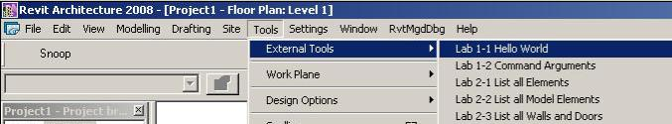
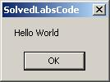
Minimal Command
Getting Started
Public Function Execute( _
ByVal commandData As Autodesk.Revit.ExternalCommandData, _
ByRef message As String, _
ByVal elements As Autodesk.Revit.ElementSet ) _
_
As Autodesk.Revit.IExternalCommand.Result _
Implements Autodesk.Revit.IExternalCommand.Execute
MsgBox("Hello World")
Return IExternalCommand.Result.Succeeded
End Function
In VB.NET
Notes:
You cannot get much more minimal than this.

Slide 26
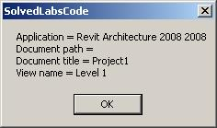
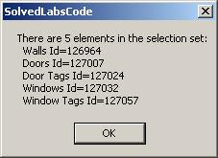
Command Input Argument
Getting Started
' List the app, doc and view data
Dim revitApp As Revit.Application = commandData.Application
Dim doc As Revit.Document = revitApp.ActiveDocument
Dim view As Revit.Elements.View = commandData.View
Dim sMsg As String = "Application = " & revitApp.VersionName & " " _
& revitApp.VersionNumber & vbCrLf
sMsg += "Document path = " & doc.PathName & vbCrLf ' Empty if not saved yet
sMsg += "Document title = " & doc.Title & vbCrLf
sMsg += "View name = " & view.Name
MsgBox(sMsg)
' List the current selection set
Dim sel As Selection = doc.Selection
sMsg = "There are " & sel.Elements.Size & " elements in the selection set:"
Dim elem As Revit.Element
For Each elem In sel.Elements
sMsg += vbCrLf & " " & elem.Category.Name & " Id=" & elem.Id.Value.ToString
Next
MsgBox(sMsg)
In VB.NET
Notes:
Display some application and document properties, retrieved from the command data input argument. Check the document selection set contents. Return an error code to see the message displayed and the element highlighted. So, that is really all there is to say about the Revit add-in architecture, the external application and command interfaces, and their arguments. In the next section, we will start exploring the contents of the Revit database.

Slide 27
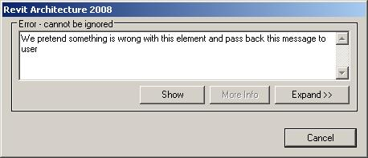
Command Output Arguments
Getting Started
' We pretend that something is wrong with the first element in the selection
' We pass the message back to Revit user and indicate the error result
If Not sel.Elements.IsEmpty Then
Dim iter As ElementSetIterator = sel.Elements.ForwardIterator
iter.MoveNext()
Dim errElem As Revit.Element = iter.Current
elements.Clear()
elements.Insert(errElem)
message = "We pretend something is wrong with this element and pass back this message to user"
Return IExternalCommand.Result.Failed
Else
Return IExternalCommand.Result.Succeeded
End If

Slide 28
Elements

Slide 29
Elements Collection
Elements Collection
Object model
Database structure
Types of elements
Accessing and identifying elements
Filtering for types and categories
Getting all model elements
Model elements' manipulation
Notes:
We saw that the only input to the external command in the command data parameter. We will explore how to access the application, current document and their properties through this command data argument passed in to an external command. Then we will explore more detailed access to the Revit BIM and its data. The entire content of the Revit BIM is stored in a database and accessed through the Revit Document. Most of the objects are accessible through the document Elements collection property. Often, one is interested in elements of a particular type, so a common idiom is iterating over the elements collection and filtering for a specific type and/or property.

Slide 30
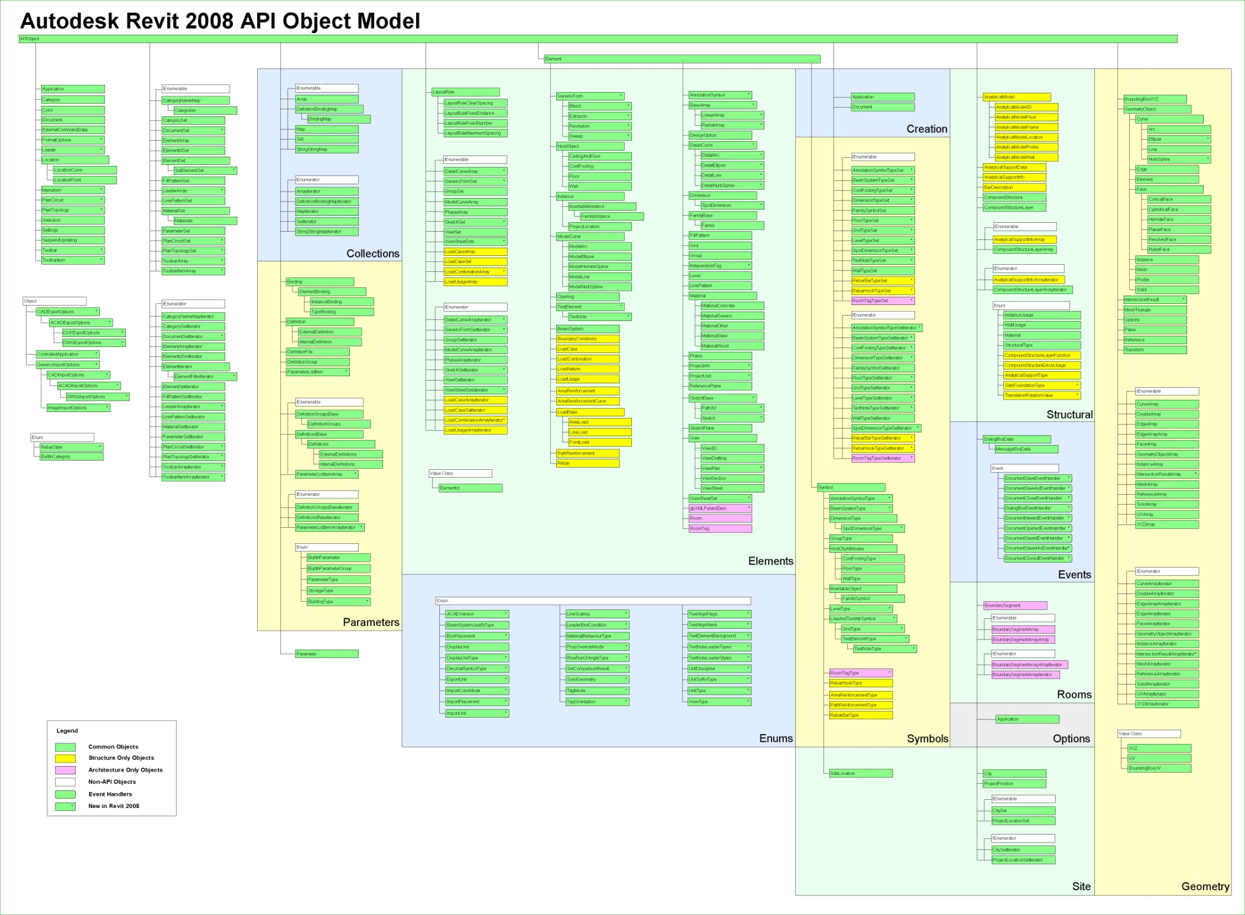
Revit Object Model
Elements Collection
Revit API Diagram.rvt
Notes:
Here is an overview of the Revit classes provided by the API, in "Revit API Diagram.rvt". The model is rather large ... and unreadable ... so let us look at a subset of interesting classes and highlight some of them.

Slide 31
Subset of Object Model
Elements Collection
APIObject
Application
Document
ExternalCommandData
ElementSet
ParameterSet
Parameter
Element
Symbol
GeometryObject
# RST:
AnalyticalModel
AnalyticalModelFloor
AnalyticalModelWall
Creation
APIObject
Application
Document
GeometryObject
Curve
Arc
Ellipse
Line
NurbSpline
Edge
Face
ConicalFace
CylindricalFace
HermiteFace
PlanarFace
ResolvedFace
RuldeFace
Instance
Mesh
Profile
Solid
Plane
Reference
Transform
Element
HostObject
CeilingAndFloor
ContFooting
Floor
Wall
Instance
Opening
TextElement
BeamSystem
Dimension
SpotDimension
FamilyBase
Family
Level
Phase
ProjectInfo
# RST:
BoundaryConditions
LoadCase, Combination, Nature, Usage
AreaReinforcement
AreaReinforcementCurve
LoadBase
AreaLoad
LineLoad
PointLoad
PathReinforcement
Rebar
# end of RST
Symbol
Symbol
AnnotationSymbolType
BeamSystemType
HostObjAttributes
ContFootingType
FloorType
WallType
InsertableObject
FamilySymbol
RoomTagType # RAC
RebarTagType # RST
Notes:
This is a subset selected from the Revit object model. Some of the interesting classes have been highlighted, and the list has been split into several sublists at crucial points. It shows that some objects are available only in the RAC or only in the RST environment, such as RommTagType in RAC, RebarTagType, the analytical model and the loads and boundary conditions in RST.
Everything is derived from APIObject. All physical BIM objects are derived from Element. A separate version of Application and Document is provided in the Creation namespace, for creating new elements.

Slide 32
Subsubset of Object Model
Elements Collection
API Object
Element
Instance
Family Base
Group
Symbol
HostObject
Insertable Instance
Family
Group Type
HostObject Attributes
Insertable Object
Wall
Floor
Family Instance
Family Symbol
Clg. & Flr
Wall Type
Floor Type
Cont. Footing Type
Cont. Footing
Cont. Footing
Roof
Notes:
Here is a yet smaller subset of the most important classes that one may have to deal with in a typical Revit programming task.
The red classes are the most commonly used, the green Roof class does actually not exist.

Slide 33
Accessing Revit Elements
Elements Collection
How to access the Revit data from an external command?
Two ways
Complete collection
ExternalCommandData.Application.ActiveDocument.Elements
Current selection
ExternalCommandData.Application.ActiveDocument.Selection.Elements
Input argument provides ExternalCommandData
Application
ActiveDocument
Elements
Selection
Elements
Notes:
So, how do we access all these objects? We start off with the external command data argument passed in to the external command.

Slide 34
Accessing Revit Elements
Elements Collection
Document.Elements
Returns ElementIterator
Go through iterator.MoveNext() and iterator.Current()
Can be saved in an ElementSet for easier manipulation
Document.Selection.Elements
Returns ElementSet
Use foreach, Size, Contains

Slide 35
Identifying Revit Elements
Elements Collection
Normal OO approach uses object type or class
Identifying Revit elements can be brain twisting
An object can be identified by
Category
Object type or class, i.e. .NET System.Type
Derived from Element or Element/Symbol
We will need to use combination of those
Sometimes additional checks are needed

Slide 36
Identifying Revit Elements
Elements Collection
Kind of Element in UI | Derived from Element/TypeOf | Category
Wall | HostObject/Wall | Walls
Door | Instance/InsertableInstance/FamilyInstance | Doors
Door Tag | IndependentTag | Door Tags
Window | Instance/InsertableInstance/FamilyInstance | Windows
WindowTag | IndependentTag | Window Tags
Opening | Opening | < null >
Floor | HostObject/Floor | Floors
Ceiling | Element | Ceilings
Roof | Element | Roofs
Column | Instance/InsertableInstance/FamilyInstance | Columns
Component (Desk) | Instance/InsertableInstance/FamilyInstance | Furniture
Stair | Element | Stairs
Railing | Element | Railings
Room | Room | Rooms
Room Tag | RoomTag | Room Tags
Grid | Grid | Grids
Lines | ModelCurve/ModelLine | Lines
Ref Plane | ReferencePlane | Reference Planes
Dimension | Dimension | Dimensions
Section | Element | < null >
Text | TextElement/TextNote | Text Notes
Level | Level | Levels
Model Group | Group | < null >
Create…/Walls | Instance/InsertableInstance/FamilyInstance | Walls

Slide 37
Element versus Symbol
Elements Collection
Element |  |  |  | Symbol
Kind of Element in UI | Derived from Element/TypeOf | Category |  | Derived from Symbol/TypeOf | Category
Wall | HostObject/Wall | Walls |  | HostObjAttributes/WallType | Walls
Door | Instance/InsertableInstance/FamilyInstance | Doors |  | InsertableObject /FamilySymbol | Doors
Door Tag | IndependentTag | Door Tags |  | InsertableObject /FamilySymbol | Door Tags
Window | Instance/InsertableInstance/FamilyInstance | Windows |  | InsertableObject /FamilySymbol | Windows
WindowTag | IndependentTag | Window Tags |  | InsertableObject /FamilySymbol | Window Tags
Opening | Opening | < null > |  | < null > | ---
Floor | HostObject/Floor | Floors |  | HostObjAttributes/FloorType | Floors
Ceiling | < Element > | Ceilings |  | HostObjAttributes | Ceilings
Roof | < Element > | Roofs |  | HostObjAttributes | Roofs
Column | Instance/InsertableInstance/FamilyInstance | Columns |  | InsertableObject /FamilySymbol | Columns
Component (Desk) | Instance/InsertableInstance/FamilyInstance | Furniture |  | InsertableObject /FamilySymbol | Furniture
Component (Tree) | Instance/InsertableInstance/FamilyInstance | Planting |  | InsertableObject /FamilySymbol | Planting
Stairs | < Element > | Stairs |  | < Symbol > | Staies
Railing | < Element > | Railings |  | < Symbol > | Railings
Room | Room | Rooms |  | < null > | ---
Room Tag | RoomTag | Room Tags |  | < Symbol > | Room Tags
Grid | Grid | Grids |  | LineAndTextAttrSymbol/GridType | < null >
Lines | ModelCurve/ModelLine | Lines |  | < null > | ---
Ref Plane | ReferencePlane | Reference Planes |  | < null > | ---
Dimension | Dimension | Dimensions |  | DimensionType | < null >
Section | < Element > | < null > |  | < Symbol > | < null >
Text | TextElement/TextNote | Text Notes |  | LineAndTextAttrSymbol/TextElementType/TextNoteType | < null >
Level | Level | Levels |  | LevelType | < null >
Model Group | Group | < null > |  | GroupType | < null >
Create…/Walls | Instance/InsertableInstance/FamilyInstance | Walls |  | InsertableObject /FamilySymbol | Walls

Slide 38
Elements Collection
Elements Collection
In the Revit API, everything is an APIObject
In the Revit BIM, everything is an Element
All are bundled together within and almost exclusively accessed via Elements collection
Search for ElementIterator in the SDK samples; 58 occurences in 42 files, many examples
Lab 2-1
Notes:
ElementIterator occurs 58 times in 42 files in the SDK samples. This command defined in Lab 2-1 iterates over commandData.Application.ActiveDocument.Elements and prints out a line for each element encountered to C:\tmp\RevitElements.txt.

Slide 39
List all Elements
Elements Collection
' *ALL* elements are bundled together and accessible via Document's ElementIterator
Dim sLine As String
Dim elem As Revit.Element
Dim iter As ElementIterator = commandData.Application.ActiveDocument.Elements
Do While (iter.MoveNext)
elem = iter.Current ' current Element
sLine = "Id=" & elem.Id.Value.ToString ' Element Id
sLine += "; Class=" & elem.GetType.Name ' Element class (System.Type)
Dim sCatName As String ' Element Category (not implemented for all classes!)
Try
sCatName = elem.Category.Name
Catch
sCatName = ""
End Try
sLine += "; Category=" & sCatName
' Element Name with different meaning for different classes
' more precise info on elements can be obtained in class-specific ways.
Dim sName As String
Try
sName = elem.Name
Catch
sName = ""
End Try
sLine += "; Name=" & sName
sw.WriteLine(sLine)
Loop
Id=16; Class=DimensionType; Category=; Name=Linear - 3mm Arial
Id=17; Class=Element; Category=; Name=
Id=19; Class=Element; Category=; Name=
Id=20; Class=FillPattern; Category=; Name=Solid fill
. . .
Id=126907; Class=Element; Category=; Name=M_W-Wide Flange
Id=126908; Class=Element; Category=; Name=W310X38.7
Id=126933; Class=Element; Category=; Name=Section Boxes
Id=126939; Class=Wall; Category=Walls; Name=Generic - 200mm

Slide 40
3D or Model Elements
Elements Collection
Many times, one is interested in 3D Elements only
LabUtils.GetAllModelElements()
Input Revit.Application
Output ElementSet
Type is not Symbol or FamilyBase
Category is not null
Geometry is not null
Lab 2-2

Slide 41
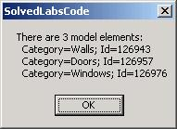
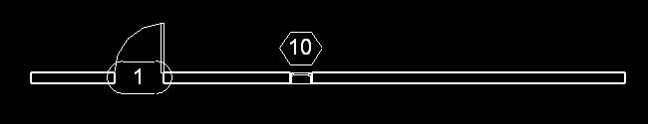
3D or Model Elements
Elements Collection
Shared Function GetAllModelElements(ByVal revitApp As Revit.Application) As ElementSet
Dim elems As ElementSet = revitApp.Create.NewElementSet
Dim opt As Geometry.Options = revitApp.Create.NewGeometryOptions
opt.DetailLevel = Geometry.Options.DetailLevels.Fine
Dim iter As ElementIterator = revitApp.ActiveDocument.Elements
Do While (iter.MoveNext())
Dim elem As Revit.Element = iter.Current
If Not (TypeOf elem Is Symbol OrElse TypeOf elem Is FamilyBase) Then
If Not (elem.Category Is Nothing) Then
Dim geo As Geometry.Element = elem.Geometry(opt)
If Not (geo Is Nothing) Then
elems.Insert(elem)
End If
End If
End If
Loop
Return elems
End Function
Dim modelElems As ElementSet = LabUtils.GetAllModelElements(commandData.Application)
Dim sMsg As String = "There are " & modelElems.Size & " model elements:"
Dim elem As Revit.Element
For Each elem In modelElems
sMsg += vbCrLf & " Category=" & elem.Category.Name & "; Id=" & elem.Id.Value.ToString
Next
MsgBox(sMsg)
Notes:
This lab iterates over the active document elements collection, like before, and picks out relevant ones. This is a very common operation in Revit programming. The utility function LabUtils.GetAllModelElements() implements this. Its input and out put are as defined above. It identifies model elements by applying the checks listed above.

Slide 42
Specific Element Classes
Elements Collection
How do we get i.e. all Doors or Walls?
Wall is a separate class
APIObject ← Element ← HostObject ← Wall
Door can be identified by its category
Use BuiltInCategory for language independence
Lab 2-3
Notes:
Same as in Lab 2-2, but now we can check for a an even more specific type or a built-in category.

Slide 43
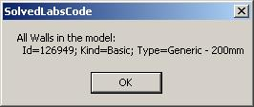
Get all Walls
Elements Collection
Shared Function GetAllWalls(ByVal revitApp As Revit.Application) As ElementSet
Dim elems As ElementSet = revitApp.Create.NewElementSet
Dim iter As IEnumerator = revitApp.ActiveDocument.Elements
Do While (iter.MoveNext())
Dim elem As Revit.Element = iter.Current
' For Wall (one of the Host objects), there is a specific class!
If TypeOf elem Is Wall Then
elems.Insert(elem)
End If
Loop
Return elems
End Function

Slide 44
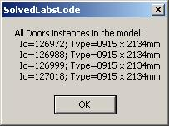
Get all Doors
Elements Collection
' get all Doors (you can change it to eg Furniture or Windows...)
' NOTE: Before 9.0, one had to hard-code the name which wouldn't work in other locales!
'Dim catName As String = "Doors"
' From 9.0, there is enumeration which should work with ALL locales
Dim catName As String = revitApp.ActiveDocument.Settings.Categories.Item(BuiltInCategory.OST_Doors).Name
Dim familyInstances As ElementSet = LabUtils.GetAllStandardFamilyInstancesForACategory(revitApp, catName)
Dim inst As FamilyInstance
sMsg = "All " & catName & " instances in the model:"
For Each inst In familyInstances
sMsg += vbCrLf & " Id=" & inst.Id.Value.ToString & "; Type=" & inst.Name
Next
MsgBox(sMsg)
. . .
If TypeOf elem Is FamilyInstance Then
Try
If elem.Category.Name.Equals(catName) Then
elems.Insert(elem)
End If
Catch
End Try
End If

Slide 45
Element manipulation
Elements Collection
Adding
74 methods defined by Autodesk.Revit.Creation.Document
44 object types supported
e.g. Walls, Floors
NewWall( CurveArray profile, bool structural ); // + 4 overloads
NewSlab( CurveArray profile, Level, Line slopedArrow, double angle, bool isImperial, bool isStructural );
Still some objects missing ...
Editing
Rather comprehensive
Deleting
Samples DeleteDimensions, DeleteObject

Slide 46
Element manipulation
Elements Collection
Select a wall
Extract wall from current selection
Obtain wall top and bottom level contraints
Calculate geometry from levels and wall curve
Obtain family symbol for column type
Insert columns at start, mid and end
Move wall away from the columns
Lab 2-4
Prerequisites
Wall constrained at top
"M_Wood Timber Column" type loaded
Notes:
To run Lab 2-4, select a wall. It must be constrained to a level at the top: Element Properties... > Constraints > Top Constraint, otherwise an error message is displayed. Load the column family named "M_Wood Timber Column" and the type named "191 x 292mm" prior to running the command, or else highlight the error message displayed, or modify the names to refer to some family type that is loaded. The selected wall is used to define three columns at its end and mid points, then the wall is moved out of the way to clearly display the columns.

Slide 47
Selecting the Wall
Elements Collection
Dim doc As Revit.Document = commandData.Application.ActiveDocument
Dim ss As ElementSet = doc.Selection.Elements
' must have single element only
If Not ss.Size = 1 Then
MsgBox( "You must pre-select a single element!" )
Return IExternalCommand.Result.Cancelled
End If
' must be a wall
Dim iter As ElementSetIterator = ss.ForwardIterator
iter.MoveNext()
Dim elem As Revit.Element = iter.Current
If Not TypeOf elem Is Wall Then
MsgBox( "Selected element is NOT a wall!" )
Return IExternalCommand.Result.Cancelled
End If
Dim wall As Wall = elem

Slide 48
Wall Top and Bottom
Elements Collection
' wall must be constrained to a Level at the top (more on Parameters later...)
Dim topLev As Level = Nothing
Try
topLev = doc.Element(wall.Parameter(BuiltInParameter.WALL_HEIGHT_TYPE).AsElementId)
Catch
topLev = Nothing
End Try
If topLev Is Nothing Then
MsgBox( "Selected Wall is NOT constrained to a Level at the Top!" )
Return IExternalCommand.Result.Cancelled
End If
' get the bottom Level as well (this should never fail)
Dim botLev As Level = Nothing
Try
botLev = doc.Element(wall.Parameter(BuiltInParameter.WALL_BASE_CONSTRAINT).AsElementId)
Catch
botLev = Nothing
End Try
If botLev Is Nothing Then
MsgBox( "Selected Wall is NOT constrained to a Level at the Bottom?!" )
Return IExternalCommand.Result.Cancelled
End If

Slide 49
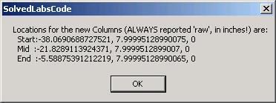
Column Geometry
Elements Collection
' Calculate the location points for the 3 columns (assuming straight wall)
Dim locations As New XYZArray()
Dim locCurve As LocationCurve = wall.Location
Dim ptStart As XYZ = locCurve.Curve.EndPoint(0)
Dim ptEnd As XYZ = locCurve.Curve.EndPoint(1)
Dim ptMid As New XYZ((ptStart.X + ptEnd.X) / 2, (ptStart.Y + ptEnd.Y) / 2, (ptStart.Z + ptEnd.Z) / 2)
locations.Append(ptStart)
locations.Append(ptMid)
locations.Append(ptEnd)
Dim sMsg As String = "Locations for the new Columns (ALWAYS reported 'raw', in inches!) are:"
sMsg += vbCrLf & " Start:" & ptStart.X & ", " & ptStart.Y & ", " & ptStart.Z
sMsg += vbCrLf & " Mid :" & ptMid.X & ", " & ptMid.Y & ", " & ptMid.Z
sMsg += vbCrLf & " End :" & ptEnd.X & ", " & ptEnd.Y & ", " & ptEnd.Z
MsgBox(sMsg)

Slide 50
Column Type
Elements Collection
‘ Helper to get specified Type for specified Family as FamilySymbol object
Shared Function GetFamilySymbol(ByVal doc As Revit.Document, ByVal familyName As String, ByVal typeName As String) _
As FamilySymbol
Dim iter As ElementIterator = doc.Elements
Do While (iter.MoveNext())
Dim elem As Revit.Element = iter.Current
' We got a Family
If TypeOf elem Is Family Then
Dim fam As Family = elem
' If we have a match on family name, loop all its types for the other match
If fam.Name.Equals(familyName) Then
Dim sym As FamilySymbol
For Each sym In fam.Symbols
If sym.Name.Equals(typeName) Then
Return sym
End If
Next
End If
End If
Loop
' if here - haven't got it!
Return Nothing
End Function
'Get Family Type for the new instances.
' If needed, change the names to match a Column type available in the model
Dim sFamilyName As String = "M_Wood Timber Column"
Dim sTypeName As String = "191 x 292mm"
Dim symbol As FamilySymbol = LabUtils.GetFamilySymbol(doc, sFamilyName, sTypeName)
If symbol Is Nothing Then
MsgBox("Cannot find Family=" & sFamilyName & " Type=" & sTypeName _
& " in the model - load it first!")
Return IExternalCommand.Result.Cancelled
End If
Notes:
The GetFamilySymbol() helper method iterates over all elements and searches for the named family. Within that family’s symbols, it searches for the named type and returns that element instance.

Slide 51
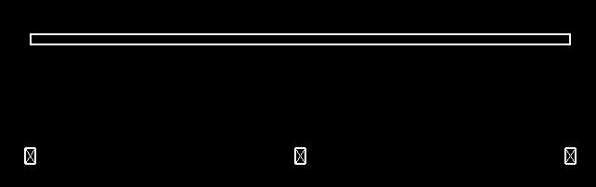
Insert Column and Move Wall
Elements Collection
' Insert Columns as FamilyInstances
Dim pt As XYZ
For Each pt In locations
Try
Dim column As FamilyInstance = doc.Create.NewFamilyInstance(pt, symbol, botLev, Structural.Enums.StructuralType.NonStuctural)
Dim paramTopLevel As Parameter =
column.Parameter(BuiltInParameter.FAMILY_TOP_LEVEL_PARAM)
paramTopLevel.Set(topLev.Id)
Catch e As Exception
MsgBox("Failed to create or adjust this column!?")
End Try
Next
' Finally, move the wall so the columns are surely visible. For simplicity,
' move the wall "perpendicularly" to the Location curve by its length
Dim wallPerpAxis As New XYZ(-(ptEnd.Y - ptStart.Y), ptEnd.X - ptStart.X, 0)
If Not CType(wall.Location.Move(wallPerpAxis), Boolean) Then
MsgBox("Failed to Move the wall!?")
End If

Slide 52
Families and Types

Slide 53
Families and Types
Families and Types
Also know as symbols
Standard versus system families
Using loaded families and symbols
Loading new families and symbols
Determining and changing element's type
(for standard and system families)
Notes:
In order to insert the column in the last example, we already had the need to determine a suitable family type for it. If the family or that specific type was not available, we had to prompt the user to load it manually. This procedure can be automated. In this section, we explore the handling of families and types in more detail.

Slide 54
Listing Families and Types
Families and Types
One will frequently need to determine
Which standard families and symbols are already loaded in a model
Which category do they belong to
Lab 3-1

Slide 55
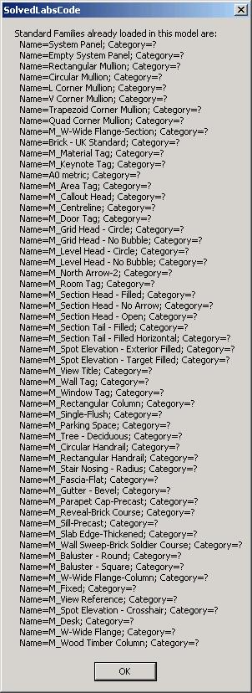
Family Iteration
Families and Types
Dim sMsg As String = "Standard Families already loaded in this model are:"
Dim elem As Revit.Element
Dim iter As ElementIterator = doc.Elements
Do While (iter.MoveNext)
elem = iter.Current
' Got Family
If TypeOf elem Is Family Then
Dim fam As Family = elem
' Try to get its Category name (as we will see later from the message box,
' Category property is NOT implemented for the Family class!)
Dim famCatName As String
Try
famCatName = fam.Category.Name
Catch
famCatName = "?"
End Try
sMsg += vbCrLf & " Name=" & fam.Name & "; Category=" & famCatName
End If
Loop
MsgBox(sMsg)
The Category property is unimplemented
Notes:
We iterate over the document elements in two loops. In the first, we simple determine all the families. The Category property is NOT implemented for the Family class. Therefore, in the second loop, we retrieve and list all the symbols of each family, and retrieve the family category from the first of its symbols. We can cancel out of this loop once we have seen enough.

Slide 56
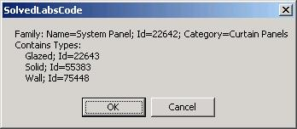
Family Symbol Iteration
Families and Types
' Let's do a similar Loop, but now get all the child Symbols (Types) as well.
' These Symbols can also be used to determine the category!
iter = doc.Elements
Do While (iter.MoveNext)
elem = iter.Current
If TypeOf elem Is Family Then
Dim fam As Family = elem
Dim catName As String
Dim first As Boolean = True
Dim symb As FamilySymbol
For Each symb In fam.Symbols
' Determine the category via first symbol
If first Then
first = False
Try
catName = symb.Category.Name
Catch
catName = "?" ' Still happens for *some* Symbols (Profiles?)
End Try
sMsg = "Family: Name=" & fam.Name & "; Id=" & fam.Id.Value.ToString
& "; Category=" & catName & vbCrLf & "Contains Types:"
End If
sMsg += vbCrLf & " " & symb.Name & "; Id=" & symb.Id.Value.ToString
Next
' Show the symbols for this family, proceed to the next family or cancel
If MsgBox(sMsg, MsgBoxStyle.OkCancel) = MsgBoxResult.Cancel Then
Exit Do
End If
End If
Loop
Notes:
Here, in the second loop, we retrieve and list all the symbols of each family, and retrieve the family category from the first of its symbols.

Slide 57
Loading Families and Types
Families and Types
Load additional standard families and symbols from RFA files
doc.LoadFamily()
doc.LoadFamilySymbol()
Dim doc As Revit.Document = commandData.Application.ActiveDocument
'Load a whole Family
If Not CType(doc.LoadFamily(familyFilename), Boolean) Then
MsgBox( "ERROR in loading Family " & familyFilename & "?" )
Else
MsgBox( "Successfully loaded Family " & familyFilename & "!" )
End If
'Load only a specific Symbol (Type)
' The symbol MUST exist in the corresponding catalog (TXT) file - same as in the UI
If Not CType(doc.LoadFamilySymbol(familyFilename, symbolName), Boolean) Then
MsgBox( "ERROR in loading FamilySymbol " & familyFilename & " : " & symbolName & "?" )
Else
MsgBox( "Successfully loaded FamilySymbol " & familyFilename & " : " & symbolName & "!" )
End If
Lab 3-2
Notes:
This lab loads an entire family and a single symbol from another family, determined by the global variables gsWholeFamilyFileToLoad1, gsWholeFamilyFileToLoad2, gsFamilyFileToLoadSingleSymbol, gsSymbolName.

Slide 58
Determining Family and Type
Families and Types
Determine the Family and Type of an element
Select a window
List all windows symbols
List the selected window’s family symbol and family
Lab 3-3
Notes:
Before running this command, create a wall with a window in it and select the window. First of all, all the loaded window types are determined, i.e. all the symbols defined by the window family. This is done by iterating over all elements and determining all FamilySymbol instances whose category equals the windows one. Secondly, the selected window's family symbol and from that the family itself is queried and displayed.

Slide 59
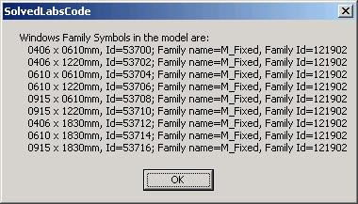
List Window Symbols
Families and Types
' Loop the model to report all FamilySymbol objects of "Windows" category.
Dim catWindows As Category = doc.Settings.Categories.Item(BuiltInCategory.OST_Windows)
Dim sMsg As String = " Windows Family Symbols in the model are:"
Dim elem As Revit.Element
Dim iter As ElementIterator = doc.Elements
Do While (iter.MoveNext)
elem = iter.Current
If TypeOf elem Is FamilySymbol Then
Dim symb As FamilySymbol = elem
Try
Dim catFS As Category = symb.Category ' for "Profiles" it fails
If Not catFS Is Nothing Then
' Either of these comparisons will do :
'If catFS.Id.Value.Equals(catWindows.Id.Value) Then
'If catFS.Id.Equals(catWindows.Id) Then
'If catFS.Name.Equals(catWindows.Name) Then
If catFS.Equals(catWindows) Then
sMsg += vbCrLf & " " & symb.Name & ", Id=" & symb.Id.Value.ToString
Try
Dim fam As Family = symb.Family
sMsg += "; Family name=" & fam.Name & ", Family Id=" & fam.Id.Value.ToString
Catch
End Try
End If
End If
Catch
End Try
End If
Loop
Notes:
Here, all the loaded window types are determined, i.e. all the symbols defined by the window family. This is done by iterating over all elements and determining all FamilySymbol instances whose category equals the windows one.

Slide 60
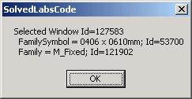
Get Family and Symbol
Families and Types
' Now loop the selection set and check for standard
' Family Instances of "Windows" category
For Each elem In doc.Selection.Elements
If TypeOf elem Is FamilyInstance Then
Dim inst As FamilyInstance = elem
Dim catInst As Category = Nothing
Try ' just in case
catInst = inst.Category
Catch
End Try
If (Not catInst Is Nothing) AndAlso catInst.Equals(catWindows) Then
sMsg = "Selected Window Id=" & elem.Id.Value.ToString & vbCrLf
Dim fs1 As FamilySymbol = inst.Symbol
sMsg += " FamilySymbol = " & fs1.Name & "; Id=" _
& fs1.Id.Value.ToString & vbCrLf
Dim f1 As Family = fs1.Family
sMsg += " Family = " & f1.Name & "; Id=" & f1.Id.Value.ToString
End If
End If
' Report each Window data
MsgBox(sMsg)
Next
Notes:
Query and display the selected window's family symbol and from that the family itself.

Slide 61
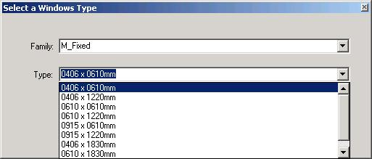
Change Family Instance Type
Families and Types
A simple dialog to change the type of a family instance
Determine family instance category, e.g. Windows
Assemble a list of all applicable symbols
Iterate over all elements, check each family category
If it matches, include all its symbols
Display dialogue with list box
Assign selected symbol
Lab 3-4
Notes:
Before running this command, create a wall with a window in it, load some additional window families so there is some material to play with, and select the window. Any other symbol instance can also be selected. First the selected symbol instance category is determined. From that, a list of all other applicable types is determined by iterating over all elements and assembling a dictionary of them. This is a two-step process, identifying the matching families first, and then for each matching family adding all its symbols. With this information in place, a dialogue is displayed allowing the user to select any one of the applicable symbols. If one is selected, it is applied to the selected instance, changing its symbol.

Slide 62
Determine Category
Families and Types
Dim revitApp As Revit.Application = commandData.Application
Dim doc As Revit.Document = revitApp.ActiveDocument
Dim inst As FamilyInstance
Dim instCat As Category
Dim ss As ElementSet = doc.Selection.Elements
' Make sure we have a single FamilyInstance selected
If Not ss.Size = 1 Then
MsgBox("You must pre-select a single element!")
Return IExternalCommand.Result.Cancelled
Else
Dim itTmp As ElementSetIterator = ss.ForwardIterator
itTmp.MoveNext()
Dim elTmp As Revit.Element = itTmp.Current
If Not TypeOf elTmp Is FamilyInstance Then
MsgBox("Selected element is NOT a standard family instance!")
Return IExternalCommand.Result.Cancelled
Else
inst = elTmp
instCat = inst.Category
End If
End If
Notes:
We ensure a single element is selected, that it is a family instance, and determine its category.

Slide 63
List all Symbols for Category
Families and Types
' Create collection of all loaded Families for this category and for each one,
' a dictionary of all loaded Types (Symbols) with key=family name,
' value=ArrayList of Symbol instances:
Dim dictFamilyToSymbols As New Dictionary(Of String, ArrayList)
Dim iter As ElementIterator = doc.Elements
Dim elem As Revit.Element
Do While (iter.MoveNext)
elem = iter.Current
If TypeOf elem Is Family Then
Dim fam As Family = elem
Dim symb As FamilySymbol
Dim ifCatMatch As Boolean = False
' .Category is not implemented for Family class, use first Symbol to check category
For Each symb In fam.Symbols
Try
If symb.Category.Equals(instCat) Then ifCatMatch = True
Catch
End Try
Exit For ' only first one needed
Next
' If match, store the data!
If ifCatMatch Then
' New ArrayList for the Value
Dim familySymbols As New ArrayList
'Loop all Symbols
For Each symb In fam.Symbols
familySymbols.Add(symb)
Next
' Add the Key-Value pair to the dictionary
dictFamilyToSymbols.Add(fam.Name, familySymbols)
End If
End If ' Got Family
Loop ' All elements
Notes:
For the selected symbol instance category, a list of all applicable types is determined by iterating over all elements and assembling a dictionary of them. There are many ways how to store the matching objects, but we choose whatever is most suitable for the relevant UI: We could use Revit's generic Map class, but it is probably more efficient to use the new 2005 .NET strongly-typed Dictionary with KEY = Family name (String) and VALUE = ArrayList (implements iList so we can elegantly bind it to combobox) of corresponding FamilySymbol obects. This is a two-step process, identifying the matching families first, and then for each matching family adding all its symbols. With this information in place, a dialogue is displayed allowing the user to select any one of the applicable symbols. If one is selected, it is applied to the selected instance, changing its symbol.

Slide 64
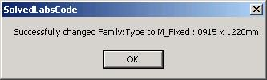
Assign new Type
Families and Types
' Display the form and change the type
Dim frm As New Lab3_4_Form(dictFamilyToSymbols)
If frm.ShowDialog = Windows.Forms.DialogResult.OK Then
Try
inst.Symbol = frm.cmbType.SelectedItem
MsgBox("Successfully changed Family:Type to " _
& frm.cmbFamily.Text & " : " & frm.cmbType.Text)
Catch
End Try
End If
Notes:
With this information in place, a dialogue is displayed allowing the user to select any one of the applicable symbols.
If one is selected, it is applied to the selected instance, changing its symbol.

Slide 65
System Families and Types
Families and Types
Simpler to manipulate than generic standard ones
Dedicated classes derived typically from Host
Wall and Floor classes well-exposed
No Roof yet
Some properties are accessible via Element base class
Lab 3-5
List all Wall types, save last one: use Document property WallTypes
List all Floor types, save last one
Change all selected Walls’ and Floors’ type
Notes:
Before running this command, draw four walls and a floor and select them all. First, all wall types defined in the current document are listed and the last one is stored for later use. Then all floor types including foundations (slab) defined in the current document are listed and the last one is stored for later use. Finally, all the selected wall and floor types are changed to the stored ones.

Slide 66
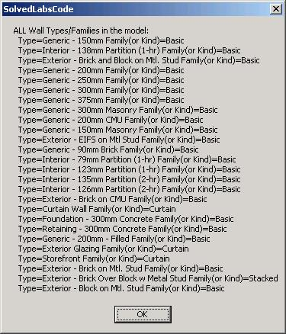
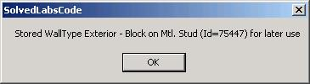
List all Wall Types
Families and Types
' Find ALL Wall Types and their System Families (or Kinds)
Dim newWallType As WallType = Nothing ' store the last one
Dim sMsg As String = "ALL Wall Types/Families in the model:"
' We could again iterete all elements and check for WallType class,
' but it's simpler directly from the doc:
Dim doc As Revit.Document = commandData.Application.ActiveDocument
For Each wt As WallType In doc.WallTypes
sMsg += vbCrLf & " Type=" & wt.Name & " Family(or Kind)=" & wt.Kind.ToString
newWallType = wt
Next
MsgBox(sMsg)
MsgBox( "Stored WallType " & newWallType.Name _
& " (Id=" & newWallType.Id.Value.ToString & ") for later use" )
Notes:
Here, all wall types defined in the current document are listed and the last one is stored for later use.

Slide 67
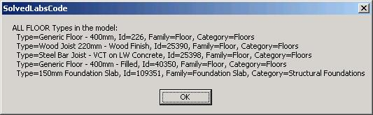
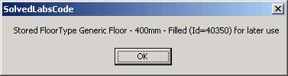
List all Floor Types
Families and Types
' Find ALL Floor Types
Dim newFloorType As FloorType = Nothing 'at the same time store the last one to use to change the floor type later
sMsg = "ALL FLOOR Types in the model:"
' There is no dedicated property to get floor types, so need to iterate all elements again
Dim iter As ElementIterator = doc.Elements
Do While (iter.MoveNext())
Dim elem As Revit.Element = iter.Current
If TypeOf elem Is Symbols.FloorType Then
Dim ft As Symbols.FloorType = elem
sMsg += vbCrLf & " Type=" & ft.Name & ", Id=" & ft.Id.Value.ToString
' In 9.0, it looks like "Foundation Slab" system family from "Structural Foundations" category
' ALSO contains FloorType class instances. Exclude those as choices for standard floor types
Dim famName As String
Try
famName = ft.Parameter(Parameters.BuiltInParameter.SYMBOL_FAMILY_NAME_PARAM).AsString
Catch
famName = "?"
End Try
Dim cat As Category = ft.Category
sMsg += ", Family=" & famName & ", Category=" & cat.Name
' store only if proper Floors category
If doc.Settings.Categories.Item(BuiltInCategory.OST_Floors).Equals(cat) Then
newFloorType = ft
End If
End If
Loop
MsgBox(sMsg)
MsgBox( "Stored FloorType " & newFloorType.Name & " (Id=" & newFloorType.Id.Value.ToString & ") for later use")
Notes:
Here, all floor types including foundations (slab) defined in the current document are listed and the last one is stored for later use.

Slide 68
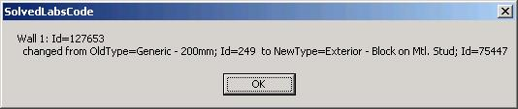
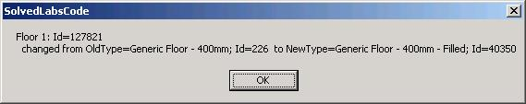
Change Wall and Floor Type
Families and Types
' Change the Type for selected Walls and Floors
Dim sel As ElementSet = doc.Selection.Elements
Dim iWall As Integer
Dim el As Revit.Element
For Each el In sel
If TypeOf el Is Wall Then ' Check for walls
Dim wall As Wall = el
iWall += 1
Dim oldWallType As WallType = wall.WallType
wall.WallType = newWallType
MsgBox("Wall " & iWall.ToString & ": Id=" & wall.Id.Value.ToString & vbCrLf & _
" changed from OldType=" & oldWallType.Name & "; Id=" & oldWallType.Id.Value.ToString & _
" to NewType=" & wall.WallType.Name & "; Id=" & wall.WallType.Id.Value.ToString)
ElseIf TypeOf el Is Floor Then
Dim f As Floor = el
iFloor += 1
Dim oldFloorType As FloorType = f.FloorType
f.FloorType = newFloorType
MsgBox("Floor " & iFloor.ToString & ": Id=" & f.Id.Value.ToString & vbCrLf & _
" changed from OldType=" & oldFloorType.Name & "; Id=" & oldFloorType.Id.Value.ToString & _
" to NewType=" & f.FloorType.Name & "; Id=" & f.FloorType.Id.Value.ToString)
End If
Next
Notes:
Finally, all the selected wall and floor types are changed to the stored ones.

Slide 69

Time Out
We are taking a 3 minute break
Introduction
Getting Started
Elements Collection
Families and Types
Break
Parameters
Samples and Utilities
What's New

Slide 70
Parameters

Slide 71
Parameters
Parameters
Accessing element parameters
Built-in versus shared parameters
Exchanging data with external applications
Strategy for storing custom per-element data
Manipulating shared parameters' file and groups
Hidden parameters
Strategy for storing per-document (per-model) data
SDK sample FireRating
Notes:
In Revit, a lot of important data is stored in element parameters. In this section, we explore different methods of accessing and modifying parameters, exporting them to external applications, importing modified data back in again, and handling shared, hidden, and per-document parameters.

Slide 72
Accessing Parameters
Parameters
How do we access element parameters?
Loop through Element.Parameters
If built-in parameter, definition or GUID is known, get it from one of the three Element.Parameter overloads
Parameter( parameterId As Parameters.BuiltInParameter )
Parameter( definition As Parameters.Definition )
Parameter( guid As System.Guid )
Get parameter by localised name by looping until found
LabUtils.GetElemParam()
A shared parameter GUID can be retrieved from its external definition
LabUtils.SharedParamGUID()
Lab 4-1
Notes:
Individual parameters can be accessed in different ways: by localised name, by built-in parameter id, by definition or by GUID. You can also loop over the entire element Parameters collection. In this lab, all selected elements' parameters are listed. In addition, this lab demonstrates retrieving a built-in parameter as well as a parameter by localised name, BuiltInParameter.FAMILY_BASE_LEVEL_OFFSET_PARAM and "Base Offset" respectively. Select a column to display both of these.

Slide 73
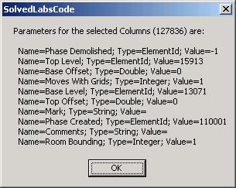
Loop all Element Parameters
Parameters
' List all UI-visible Params
Dim sMsg As String = "Parameters for the selected " & elem.Category.Name & " (" & elem.Id.Value.ToString & ") are:" & vbCrLf
Dim param As Parameter
For Each param In elem.Parameters
Dim paramName As String = param.Definition.Name
Dim paramType As String = param.StorageType.ToString
Dim paramValue As String = LabUtils.GetParamAsString(param)
sMsg += " Name=" & paramName & "; Type=" & paramType & "; Value=" & paramValue
Next
MsgBox(sMsg)
Public Shared Function GetParamAsString(ByVal param As Parameter) As String
Dim str As String
Select Case param.StorageType
Case StorageType.Double
str = param.AsDouble.ToString
Case StorageType.Integer
str = param.AsInteger.ToString
Case StorageType.String
str = param.AsString
Case StorageType.ElementId
str = param.AsElementId.Value.ToString
End Select
Return str
End Function
Notes:
Here we loop over the entire element Parameters collection.

Slide 74
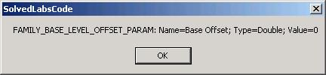
Access Built-in Parameter
Parameters
' If we know WHICH param we are looking for, then:
' A) a standard parameter, can be got via BuiltInParam signature of Parameter method:
Dim parInBuilt As Parameter
Try
parInBuilt = elem.Parameter(BuiltInParameter.FAMILY_BASE_LEVEL_OFFSET_PARAM)
If Not parInBuilt Is Nothing Then
Dim parInBuiltName As String = parInBuilt.Definition.Name
Dim parInBuiltType As String = LabUtils.GetParamStorageType(parInBuilt).ToString
Dim parInBuiltValue As String = LabUtils.GetParamAsString(parInBuilt)
MsgBox("FAMILY_BASE_LEVEL_OFFSET_PARAM: Name=" & parInBuiltName _
& "; Type=" & parInBuiltType & "; Value=" & parInBuiltValue)
Else
MsgBox("FAMILY_BASE_LEVEL_OFFSET_PARAM is NOT available for this element")
End If
Catch
MsgBox("FAMILY_BASE_LEVEL_OFFSET_PARAM is NOT available for this element")
End Try
Notes:
Here we access a specific built-in element parameter.

Slide 75
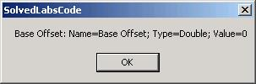
Access Named Parameter
Parameters
'Helper to get *specific* parameter by name
Shared Function GetElemParam(ByVal elem As Revit.Element, ByVal name As String) As Parameter
Dim parameters As Autodesk.Revit.ParameterSet = elem.Parameters
Dim parameter As Autodesk.Revit.Parameter
For Each parameter In parameters
If (parameter.Definition.Name = name) Then
Return parameter
End If
Next
Return Nothing
End Function
' C) use GetElemParam utilty to get it by hard coded-name
' (this works for either standard or shared!):
Const csParamToFind As String = "Base Offset"
Dim parByName As Parameter = LabUtils.GetElemParam(elem, csParamToFind)
If parByName Is Nothing Then
MsgBox(csParamToFind & " is NOT available for this element")
Else
Dim parByNameName As String = parByName.Definition.Name
Dim parByNameType As String = LabUtils.GetParamStorageType(parByName).ToString
Dim parByNameValue As String = LabUtils.GetParamAsString(parByName)
MsgBox(csParamToFind & ": Name=" & parByNameName & "; Type=" & parByNameType & "; Value=" & parByNameValue)
End If
Notes:
Here we access a specific named element parameter. This kind of access is language dependent!

Slide 76
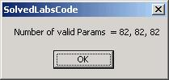
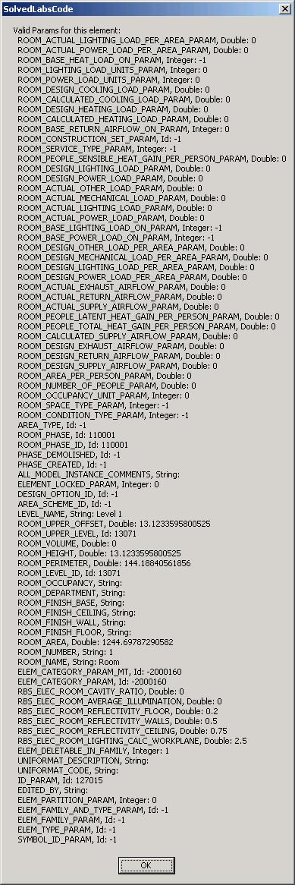
BuiltInParamsChecker
Parameters
Determine all valid built-in parameters for a selected element
Implementation, DevNote TS87913
Loop through all built-in parameter enums
Try to obtain a valid parameter for each
Notes:
This useful utility determines all built-in parameters that can be retrieved from a selected element. Combine this with the loop through the element’s own parameters collection. The three separate counts are for the three separate arrays of parameter enums, types and values.

Slide 77
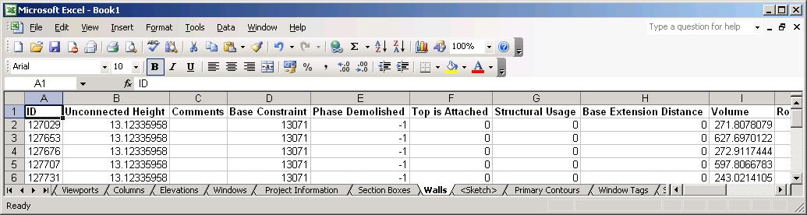
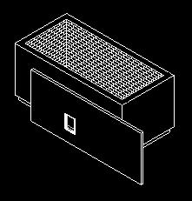
Exporting Parameters
Parameters
Frequently, users will want to export Revit BIM data to external applications like MS Office products
How do we use COM Interop in .NET to access eg MS Excel as an out-of-process client from Revit?
Lab 4-2
Create a map containing all non-symbol elements which have a valid category, sorted into separate sets for each category
Start up Excel and create a new workbook
For each category, add a sheet
Iterate over all elements in the set for that category and determine all the parameter names used
Add a title row listing the parameter names, and then one row for each element listing all its parameters

Slide 78
Create Map of all Elements
Parameters
' First extract and group the data from Revit in a convenient Map class:
' (Key=category name, Val=Set of Elements)
Dim sortedElements As Autodesk.Revit.Collections.Map = revitApp.Create.NewMap()
Dim iter As IEnumerator = doc.Elements
Do While (iter.MoveNext())
' We look for all non-Symbol Elements which have a Category
Dim element As Revit.Element = iter.Current
If Not (TypeOf element Is Symbol) Then
Dim category As Category = element.Category
If Not (category Is Nothing) Then
Dim elementSet As ElementSet
' If we already have this Key, get its Value (Set)
' Otherwise, create the new Key and Value
If sortedElements.Contains(category.Name) Then
elementSet = sortedElements.Item(category.Name)
Else
elementSet = revitApp.Create.NewElementSet()
sortedElements.Insert(category.Name, elementSet)
End If
' Add the elemnt to the Set
elementSet.Insert(element)
End If
End If
Loop

Slide 79
Launch Excel, Add Workbook
Parameters
Imports MsExcel = Microsoft.Office.Interop.Excel
' Launch/Get Excel (via COM Interop)
Dim excel As MsExcel.Application = New MsExcel.ApplicationClass()
If (excel Is Nothing) Then
MsgBox("Failed to get or start Excel!?")
Return IExternalCommand.Result.Failed
End If
excel.Visible = True ' Make it visible "live" to the user
' Add a new work-book and delete the default work-sheets
Dim workbook As MsExcel.Workbook = excel.Workbooks.Add()
Dim worksheet As MsExcel.Worksheet
Do While workbook.Sheets.Count > 1
worksheet = workbook.Sheets.Item(1)
worksheet.Delete()
Loop
' Loop all collected Categories and create one worksheet for each
Dim mapIter As Autodesk.Revit.Collections.MapIterator = sortedElements.ForwardIterator
Do While (mapIter.MoveNext())
' retrieve stored category and ElementSet
Dim categoryName As String = mapIter.Key
Dim elementSet As Autodesk.Revit.ElementSet = mapIter.Current
' create and name the worksheet
worksheet = excel.Worksheets.Add()
worksheet.Name = categoryName

Slide 80
Determine all Table Headers
Parameters
Dim allParamNamesEncountered As Autodesk.Revit.Collections.Set _
= revitApp.Create.NewSet()
' loop through all the elements passed to the method
Dim setIter As IEnumerator = elementSet.ForwardIterator
Do While (setIter.MoveNext())
Dim el As Autodesk.Revit.Element = setIter.Current
Dim parameters As Autodesk.Revit.ParameterSet = el.Parameters
If Not (parameters.IsEmpty) Then
‘ Another way to loop the parameters is via ParameterSetIterator:
Dim definitionNames As Autodesk.Revit.Collections.Set _
= revitApp.Create.NewSet()
Dim paramIter As Autodesk.Revit.ParameterSetIterator _
= parameters.ForwardIterator
Do While paramIter.MoveNext()
Dim parameter As Autodesk.Revit.Parameter = paramIter.Current
Dim name As String = parameter.Definition.Name
If Not allParamNamesEncountered.Contains(name) Then
allParamNamesEncountered.Insert(name)
End If
Loop
End If
Loop
Notes:
We use the Revit parameter definition name to create the excel workbook header. We loop through all the elements in the current category and determine all parameters for each. 'For each parameter in Parameters' is one way to iterate, the ParameterSetIterator is another.

Slide 81
Create Table Headers
Parameters
' add the HEADER row in Bold
worksheet.Cells(1, 1).Value = "ID"
Dim paramName As String
Dim column As Integer = 2
For Each paramName In allParamNamesEncountered
worksheet.Cells(1, column).Value = paramName
excel.Columns(column).EntireColumn.AutoFit()
column = column + 1
Next
excel.Rows("1").Font.Bold = True

Slide 82
Export Parameters to Excel
Parameters
' export one row for each element that belongs to the category
Dim elem As Revit.Element
Dim row As Integer = 2
For Each elem In elementSet
' first column is the element id (display it as an integer)
worksheet.Cells(row, 1).Value = elem.Id.Value
' the other columns are parameter values
column = 2
For Each paramName In allParamNamesEncountered
Dim paramValue As String
Try
paramValue = LabUtils.GetParamAsString( LabUtils.GetElemParam( _
elem, paramName ) )
Catch
paramValue = "*NA*"
End Try
worksheet.Cells(row, column).Value = paramValue
column = column + 1
Next
row = row + 1
Next 'row
Loop 'categories (worksheets)

Slide 83
Shared Parameters
Parameters
How can we use shared parameters to add per-element data to Revit Elements?
Export and import these parameters to and from third party applications
Lab 4-3 (3 commands)
Similar to the SDK Sample FireRating
Create shared parameter for all doors
Export shared parameter data to Excel
Import shared parameter data from Excel
Notes:
Create a wall with a door in it, at least, before running this command. Also, you may need to set the full path defned in GetSharedParamsFile(). It is currently "C:\tmp\Labs-4-3-1.txt". After running the second command, show the excel spreadsheet, update the value of "API FireRating", and save the file, noting its name and location. In the third step, reopen the recently saved file. Note that the parameter of the door is updated from the Excel file.

Slide 84
Create Shared Parameter
Parameters
Get shared parameters definition file
Class Parameters.DefinitionFile
Application.Options.SharedParametersFilename
Application.OpenSharedParameterFile
Get shared parameters group
Class Autodesk.Revit.Parameters.DefinitionGroup
DefinitionFile.Groups
DefinitionFile.Groups.Create
Get shared parameters definition
Class Parameters.Definition
DefinitionGroup.Definitions
DefinitionGroup.Definitions.Create
Create category set for binding to 'Doors‘
CategorySet = revitApp.Create.NewCategorySet()
catSet.Insert( doc.Settings.Categories.Item( BuiltInCategory.OST_Doors ) )
Bind the parameter
Dim binding As Parameters.Binding = revitApp.Create.NewInstanceBinding( catSet )
doc.ParameterBindings.Insert( fireRatingParamDef, binding )

Slide 85
Export Shared Parameter
Parameters
Start up Excel
Get all standard family instances for the given category ‘Doors’
Determine the shared parameter GUID for accessing values
Dim guid As Guid = guid.Empty
Dim file As Parameters.DefinitionFile = revitApp.OpenSharedParameterFile
Dim group As Parameters.DefinitionGroup = file.Groups.Item(defGroup)
Dim definition As Parameters.Definition = group.Definitions.Item(defName)
Dim externalDefinition As Parameters.ExternalDefinition = definition
guid = externalDefinition.GUID
Loop all doors and export each to an Excel row: id, level, tag, fire rating
worksheet.Cells(row, 1).Value = door.Id.Value
worksheet.Cells(row, 2).Value = door.Level.Name
Dim tagParameter As Parameter = door.Parameter( BuiltInParameter.ALL_MODEL_MARK )
worksheet.Cells(row, 3).Value = tagParameter.AsString
Dim parameter As Parameter = door.Parameter( paramGuid )
worksheet.Cells(row, 4).Value = parameter.AsDouble
row = row + 1

Slide 86
Import Shared Parameter
Parameters
Select file, start up Excel, open file
Import data
Dim id As Integer
Dim fireRatingValue As Double
Dim row As Integer = 2
Do
' Extract relevant XLS values
id = worksheet.Cells(row, 1).Value
If id <= 0 Then Exit Do
fireRatingValue = worksheet.Cells(row, 4).Value
' Get document's door element via Id
Dim elementId As Autodesk.Revit.ElementId
elementId.Value = id
Dim door As Autodesk.Revit.Element = revitApp.ActiveDocument.Element( elementId )
' Set the param
If Not (door Is Nothing) Then
Dim parameter As Parameter = LabUtils.GetElemParam( door, sharedParamName )
parameter.Set( fireRatingValue )
End If
row = row + 1
Loop
Notes:
We retrieve the door id and the updated fire rating value from the excel file, get the door element from revit, get its shared parameter and update its value.

Slide 87
Model Shared Parameters
Parameters
How do we store per-document (per-model) data using shared parameters?
Bind hidden shared parameters to the singleton element of "Project Information" category
The shared parameter definition uses ExternalDefinition, which has Visible attribute
Notes:
No solved lab code provided, no sample, see the instructions in "Lab 4.4 (instructions for students - no code).doc".

Slide 88
Geometry

Slide 89
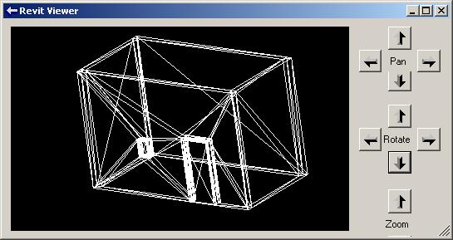
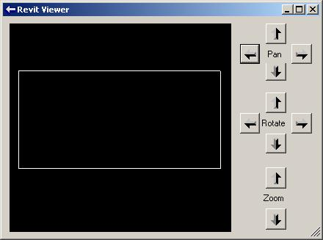
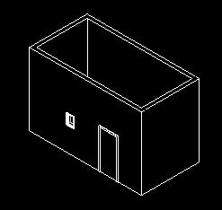
Access 3D Geometry
Geometry
Revit SDK sample viewers
RevitViewer
A simple geometry viewer helper class
Used by the other viewer samples
ElementViewer
Display wireframe model of one or more selected elements
RoomViewer
Wireframe viewer of the selected room
AnalyticalViewer
Display analytical model of one or more selected elements

Slide 90
Obtain 3D Element Geometry
Geometry
Private mOptions As Autodesk.Revit.Geometry.Options
mOptions = app.Create.NewGeometryOptions
mOptions.DetailLevel = Geometry.Options.DetailLevels.Fine
For Each elem In selSet
Dim geom As Autodesk.Revit.Geometry.Element = elem.Geometry(mOptions)
DrawElement(geom)
Next
If selSet.Size > 0 Then
mViewer.ShowModal()
End If
Specify level of detail of element geometry
Coarse, Medium, Fine, MAX, Undefined
All that remains is to display the geometry
Notes:
Each element may have geometery associated with it, defined separately for various levels of detail: Coarse, Medium, Fine, MAX, Undefined.

Slide 91
Display Element Geometry
Geometry
Private Sub DrawElement(ByVal elementGeom As Geometry.Element)
Dim geomObject As Autodesk.Revit.Geometry.GeometryObject
For Each geomObject In elementGeom.Objects
If (TypeOf geomObject Is Autodesk.Revit.Geometry.Curve) Then
DrawCurve(geomObject)
ElseIf (TypeOf geomObject Is Autodesk.Revit.Geometry.Instance) Then
DrawInstance(geomObject)
ElseIf (TypeOf geomObject Is Autodesk.Revit.Geometry.Mesh) Then
DrawMesh(geomObject)
ElseIf (TypeOf geomObject Is Autodesk.Revit.Geometry.Solid) Then
DrawSolid(geomObject)
End If
Next
End Sub
Private Sub DrawCurve(ByVal geomCurve As Geometry.Curve)
DrawPoints(geomCurve.Tessellate)
End Sub
Notes:
Iterate over the element geometry, which in turn is a Geometry.Element instance containing curve, instance, mesh and solid objects which in turn are broken down into line segments for the viewer. For more details, please refer to the SDK sample source code.

Slide 92
Other API Areas

Slide 93
Other API Areas
Other API Areas
Groups
Determining types available in the model
Determining elements' containment
Manipulating group instance types
Rooms
Accessing objects and boundaries

Slide 94
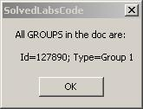
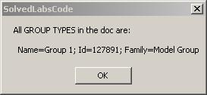
List Groups and GroupTypes
Other API Areas
Standard Elements iteration
Dim elems As ElementSet = revitApp.Create.NewElementSet
Dim iter As IEnumerator = revitApp.ActiveDocument.Elements
Do While (iter.MoveNext())
Dim elem As Revit.Element = iter.Current
If TypeOf elem Is Group Then
elems.Insert(elem)
End If
Loop
Lab 5-1
Group
GroupType
Notes:
Before running Lab 5-1, create at least one model group. Pick Edit > Group > Create Group or use the GP shortcut, then add some model elements such as walls and floors.

Slide 95
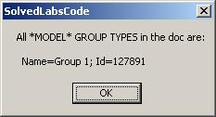
List Model Groups
Other API Areas
Standard Elements iteration
Check SYMBOL_FAMILY_NAME_PARAM
'BEWARE: In the browser, it says only "Model"
Public Const gsGroupTypeModel As String = "Model Group"
If TypeOf elem Is GroupType Then
' Need additional check for the group type
Dim gt As GroupType = elem
Try
If gt.Parameter( BuiltInParameter.SYMBOL_FAMILY_NAME_PARAM ) _
.AsString.Equals( gsGroupTypeModel ) Then
elems.Insert(elem)
End If
Catch
End Try
End If
Lab 5-1

Slide 96
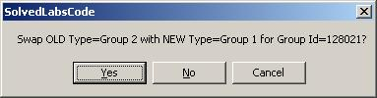
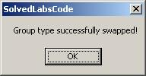
Swap Group Type
Other API Areas
Set GroupType property on Group object
Dim gp As Group = elem
Dim gt As GroupType
gp.GroupType = gt
Lab 5-2
Notes:
Before running Lab 5-2, create at least one model group. Pick Edit > Group > Create Group or use the GP shortcut, then add some model elements such as walls and floors. Then, select an element before running the command.

Slide 97
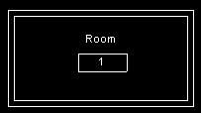
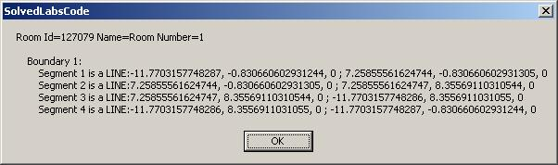
Access to 2D Geometry
Other API Areas
Display room id, name and number
Iterate over room boundary lines
See also SDK sample RoomViewer
Lab 5-3
Notes:
In order to explore lab 5-3, create four walls and a room. The room id, name and number as well as the geometry of its boundary lines are displayed. RoomViewer displays the room boundary graphically in its own embedded viewer.

Slide 98
Iterate Room Boundary
Other API Areas
Dim boundaries As BoundarySegmentArrayArray = room.Boundary
Dim boundary As BoundarySegmentArray
Dim iB As Integer = 0
For Each boundary In boundaries
iB += 1
sMsg += vbCrLf & " Boundary " & iB & ":"
Dim iSeg As Integer = 0
Dim segment As BoundarySegment
For Each segment In boundary
iSeg += 1
Dim crv As Geometry.Curve = segment.Curve
If TypeOf crv Is Geometry.Line Then ' LINE
Dim line As Line = crv
Dim ptS As XYZ = line.EndPoint(0)
Dim ptE As XYZ = line.EndPoint(1)
sMsg += vbCrLf & " Segment " & iSeg & " is a LINE:" & _
ptS.X & ", " & ptS.Y & ", " & ptS.Z & " ; " & _
ptE.X & ", " & ptE.Y & ", " & ptE.Z
ElseIf TypeOf crv Is Geometry.Arc Then ' ARC
Dim arc As Arc = crv
Dim ptS As XYZ = arc.EndPoint(0)
Dim ptE As XYZ = arc.EndPoint(1)
Dim r As Double = arc.Radius
sMsg += vbCrLf & " Segment " & iSeg & " is an ARC:" & _
ptS.X & ", " & ptS.Y & ", " & ptS.Z & " ; " & _
ptE.X & ", " & ptE.Y & ", " & ptE.Z & " ; R=" & r
End If
Next
Next

Slide 99
Debugging Tool
Separate Presentation by Mikako Harada

Slide 100
RvtMgdDbg
Debugging Tool
Comprehensive test of the Revit API
Sample code and utility classes
Scaffolding for quick tests
Aid learning Revit API
Explore
Application
Document
Current selection
Reflection
Events
Tests
Notes:
RvtMgdDbg is a utility similar to the well-known ArxDbg and MgdDbg utilities provided for AutoCAD, written by the same author and his team. It is a Revit extension application which defines its own menu and toolbar.

Slide 101
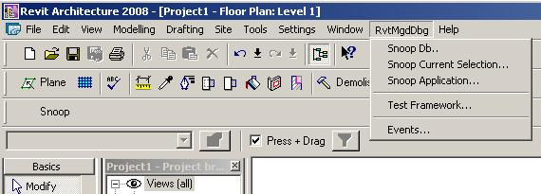
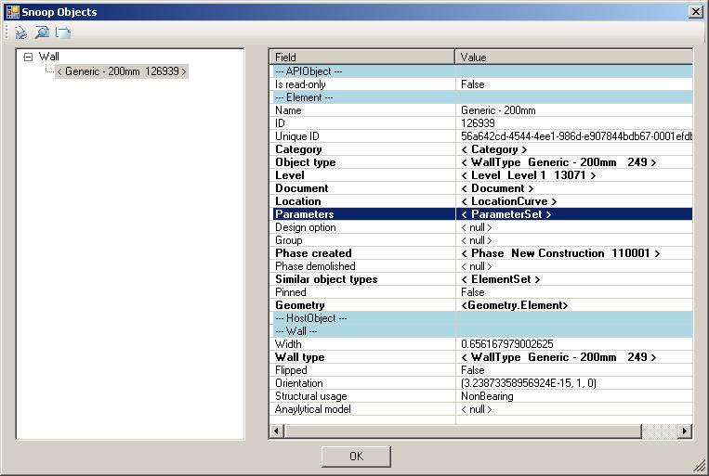
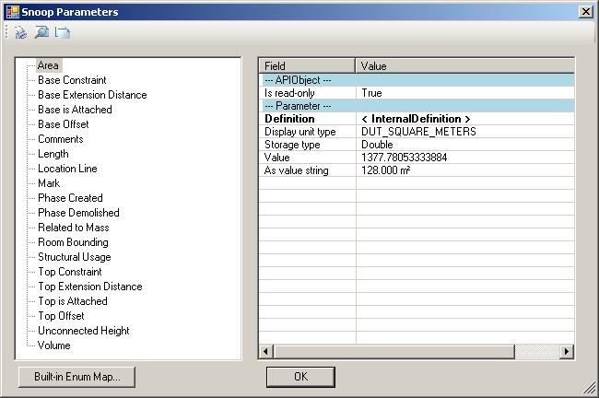
RvtMgdDbg Demo
Debugging Tool
Notes:
RvtMgdDbg is implemented as an external application, so it installs its own menu ‘RvtMgdDbg‘ and toolbar with the entry ‘Snoop’ for quick access to the ‘Snoop Db..’ menu entry.

Slide 102
Samples
Separate Presentation Later Today

Slide 103
Learning More
Online Help
SDK Samples
Discussion Groups
http://discussion.autodesk.com
Revit API
API Training Classes
www.autodesk.com/apitraining
Autodesk Developer Network
www.autodesk.com/joinadn
DevHelp Online for ADN members
adn.autodesk.com/

Slide 104
Thank you!
Thank you very much for your interest and attention!
I wish you much success with the Revit API and your application development!

Slide 105


