Slide 1

Enhancing Your Revit® Add-In
Jeremy Tammik
Consulting Analyst

Slide 2

About the Presenter
Jeremy Tammik
Developer Technical Services
EMEA
Autodesk SARL
Jeremy is a member of the AEC workgroup of the DevTech team, providing developer support, training, and conferences to the Autodesk Developer Network ADN. He originally joined Autodesk in 1988 as the technology evangelist responsible for European developer support. In this capacity, he wrote articles, consulted, lectured on AutoCAD application programming techniques, and supported AutoCAD application developers in Europe, the U.S., Australia, and Africa. He was a cofounder of ADGE, the AutoCAD Developer Group Europe, and a prolific author on AutoCAD application development. He left Autodesk in 1994 to work as an HVAC application developer, and then rejoined the company in 2005.
Jeremy graduated with a MA in mathematics and physics in Marburg, Germany, in 1984, and worked first as a teacher and translator of both computer and human languages, then as a C++ programmer on early GUI and multitasking projects. He is fluent in five European languages, vegetarian, has four kids, plays the flute, likes reading, travelling, theatre improvisation and carpentry, loves mountains, oceans, sports and especially climbing.
Jeremy writes a blog on the Revit API at http://thebuildingcoder.typepad.com and can be contacted at jeremy.tammik@eur.autodesk.com.
Notes:
It is my pleasure to work in the AEC workgroup of the DevTech team supporting the Autodesk Developer Network ADN.

Slide 3
Agenda
Tips
0. Element Filtering
Namespaces, Aliases, and Regions
Version and Flavour Checking
Command Results, Error Handling and Transactions
Language Independence
Data Caching
Journaling Mechanism & Unit Testing
Assembly Information
Suspend Updating
Comparison C#, VB and C++
10. Creating a new Type
Geometry
Geometry Class Hierarchy
Non-APIObject Classes
Classes derived from APIObject
Classes derived from GeometryObject
Coverage, Creation, and Retrieval
Geometry sample code
XYZ and Transform
Curve and Line
Circle
Face
References and Dimensioning
Notes:
We have two main topics today: a collection of Revit API coding tips, and some more in-depth information on the Revit geometry namespace, including comparisons with ObjectARX AcGe functionality.
The numbering of the tips originally started at 1, but with the advent of the important API filtering functionality provided in Revit 2009, we added a note on that and put it in right up front.
Ah yes, another important and basic development tip that comes to mind and is not listed above, but will be demonstrated during this session and is explained in detail in http://thebuildingcoder.typepad.com/blog/2008/09/debugging-a-rev.html, is how to drive Revit and run your application in the Visual Studio debugger.

Slide 4
0 – Revit 2008 Element Loop
In 2008, an application had to loop over all elements
public static Level GetFirstLevel_2008( Document doc )
{
Level level = null;
ElementIterator iter = doc.Elements;
while( iter.MoveNext() )
{
level = iter.Current as Level;
if( null != level )
{
break;
}
}
return level;
}
Notes:
In the Revit 2008 API, one bottleneck of implementing effective applications was the element access, such as retrieving specific building elements from the Revit database. This bottleneck could be worked around somewhat by ensuring the application made one single pass through all elements and selected absolutely everything it required in that single pass, which required some extra effort and planning.
Element access has been tremendously speeded up in the Revit 2009 API by the implementation of API filters.
To compare the two, we take a look at retrieving the first building level from a Revit document. Several of the later tips will create walls for test purposes. To do so, they need to determine a level to place it on. Demonstrate selecting the first level using 2008-style iteration over all document elements, and 2009-style element filtering and compare the time. Actually, the time used for the 2008 style iteration is much less in Revit 2009 than in 2008 due to related optimisations.

Slide 5
0 – Revit 2009 Element Filter
2009 element filtering brings a huge performance increase
public static Level GetFirstLevel( Application app, Document doc )
{
Level level = null;
Filter f1 = app.Create.Filter.NewCategoryFilter( BuiltInCategory.OST_Levels );
Filter f2 = app.Create.Filter.NewTypeFilter( typeof( Level ) );
Filter f3 = app.Create.Filter.NewLogicAndFilter( f1, f2 );
ElementIterator iter = doc.get_Elements( f3 );
while( iter.MoveNext() )
{
level = iter.Current as Level;
Debug.Assert( null != level, "expected filter to return non-null level" );
break;
}
return level;
}
Notes:
Element access has been tremendously speeded up in the Revit 2009 API by the implementation of API filters.

Slide 6
0 – Element Access Guidelines
Understand and use filters exclusively where possible
If possible, let user select elements in the active view
Never walk the tree using Document.Elements; avoid
ElementIterator it = doc.Elements;
while( it.MoveNext() )
{
Element element = it.Current as Element;
}
Never execute this code every time a command is run Persist the element id instead
ElementId categoryId = doc.Settings.Categories.get_Item(
BuiltInCategory.OST_Doors ).Id;
See Revit 2009 Peformance, Guy Robinson, and Jeremy's blog
http://forums.augi.com/showthread.php?t=82239
http://thebuildingcoder.typepad.com/blog/performance
Notes:
Guy has done a some performance analysis in real-world projects.
1. If possible, have the user select elements in the active view and process these instead of walking the entire project. This will be significantly faster than any other method.
2. Unless there is an element you cannot get via a combination of filters never walk the tree using Document.Elements. In other words avoid at all costs this C# code:
ElementIterator itor = commandData.Application.ActiveDocument.Elements;
while(itor.MoveNext())
{
Element element = itor.Current as Element;
}
Unfortunately, new users will look to the SDK which in most cases still use this approach.
3. Understand and use filters exclusively where possible. The performance gains particularly on subsequent running of the command during a session will yield a massive improvement in performance. Not all filter options will give the same increase in performance and some do not perform as expected. Test against real world projects not blank projects. To understand what you can do, start with the filter sample included in the SDK. Then move on to writing simple test commands to evaluate different filter combinations and the resulting performance gains.
4. If you are writing localised commands the approach has been to get a language neutral category and test an element against this. However filters make this redundant which is a good thing because. Never have the following line of code execute every time a command is run.
ElementId categoryId = commandData.Application.ActiveDocument.Settings.Categories.get_Item(Autodesk.Revit.BuiltInCategory.OST_Doors).Id;
This single line walks the whole element tree building a unique set of categories. So in one line you can at a minimum double the time a command would take to run. If you have to get a category do it once and persist the id somewhere either per session or across sessions.

Slide 7
1 – Namespaces
Some type names are duplicated in different namespaces
Autodesk.Revit.Application
Autodesk.Revit.Creation.Application
System.Windows.Forms.Application
Autodesk.Revit.Element
Autodesk.Revit.Geometry.Element
1. No global 'using'
Namespace prefix everything
No ambiguities
2. Global 'using'
Less clutter
Use aliases to disambiguate individual types
Notes:
Some type names are duplicated in different namespaces. For instance, Application is defined at least three times, and Element at least twice.
The ambiguities caused by the duplicate type names must be resolved somehow. There are several different resolution possibilities.
1. No global 'using': This is a rather radical approach, and makes the code somewhat lengthy, cluttered, and unreadable. It also defeats the purpose of the ‘using’ statement. You can however combine this approach with alias statements to introduce shorter versions of the full namespace prefixes.
2. Global 'using': This approach is somewhat more elegant and permits succinct code. One can add all required 'using' statements up front, and use individual aliases to disambiguate any conflicts.
The syntax of the ‘using’ statement different between C#, VB and managed C++. All three flavours are presented in the code provided for tip #9.

Slide 8
1 – Namespace Aliases
Create aliases for Revit API namespaces
using Rvt = Autodesk.Revit;
using RvtGeom = Autodesk.Revit.Geometry;
using RvtSymbs = Autodesk.Revit.Symbols;
using RvtElems = Autodesk.Revit.Elements;
Prefix every type with its namespace alias
This completely avoids every ambiguity
Makes it easy to copy and paste code
Rvt.Application app = commandData.Application;
Rvt.Creation.Application creApp = app.Create;
Rvt.Creation.Document creDoc = app.ActiveDocument.Create;
Rvt.Element buildingElement;
RvtGeom.Element geometryElement;
WinForms.MessageBox.Show( "Hello", "Revit Tips" );
return Rvt.IExternalCommand.Result.Succeeded;

Slide 9
1 – Global 'using' + Type Alias
Use Revit API namespaces globally
Create aliases for ambiguous Revit API types
using Autodesk.Revit;
using Autodesk.Revit.Geometry;
using RvtElement = Autodesk.Revit.Element;
using GeoElement = Autodesk.Revit.Geometry.Element;
using CmdResult = IExternalCommand.Result;
No namespace prefix required
Makes code more readable and avoids clutter
Application app = commandData.Application;
RvtElement buildingElement;
GeoElement geometryElement;
return CmdResult.Succeeded;

Slide 10
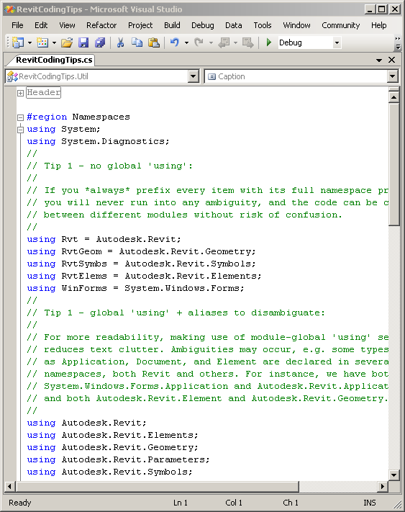
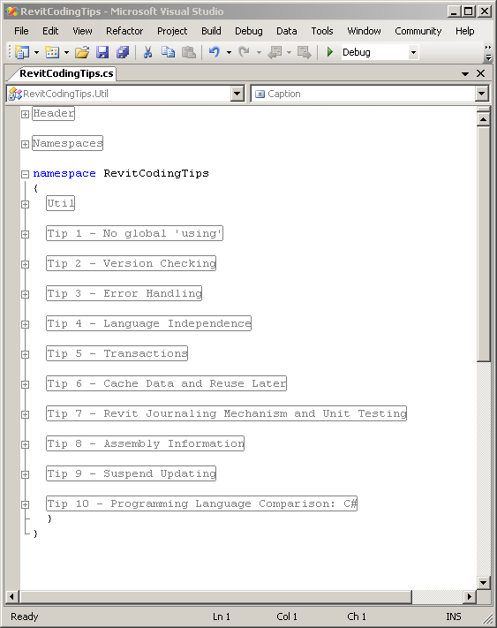
1 – Region
Enclose boilerplate code in #region
Avoid screen clutter
C#
#region Test
// This is a test.
#endregion // Test
VB
#Region "Test"
' This is a test.
#End Region
C++
#pragma region Test
// This is a test.
#pragma endregion

Slide 11
2 – Version Checking
Revit version information is available
Check application name and version and act accordingly
Three properties on the Revit Application object
VersionName
Revit Architecture
Revit Structure
Revit MEP
VersionNumber
9
2008
2009
VersionBuild
Notes:
In Revit API 2008, version information has been added. One can check the application name and version and act accordingly. The version information is available in three properties on the Revit Application object.

Slide 12
2 – Version Checking
Check version number
Enable or disable specific code or functionality
Application app = commandData.Application;
if( 2009 > int.Parse( app.VersionNumber ) )
{
message = string.Format( "You need a higher version of Revit,"
+ " at least 2009, not {0}.", app.VersionNumber );
return CmdResult.Cancelled;
}

Slide 13
2 – Revit Flavour Checking
Check Revit Flavour
enum Flavour { Architecture, Structure, MEP, Other };
Flavour flavour = Flavour.Other;
foreach( Flavour a in Enum.GetValues( typeof( Flavour ) ) )
{
if( app.VersionName.Contains( a.ToString() ) )
{
flavour = a;
}
}
switch( flavour )
{
case Flavour.Architecture:
newWall = creDoc.NewWall( line, level, false );
break;
case Flavour.Structure:
newWall = creDoc.NewWall( line, level, true );
break;
case default:
// no wall created in MEP or other flavour
break;
}
Notes:
To demonstrate this sample, you need to have Revit Architecture 2008, Revit Structure 2008, and Revit MEP 2008 installed on your computer.
Steps to live demo:
Add the command to the Revit.INI of Revit Architecture 2008.
Launch Revit Architecture.
Run the command.
A message box saying application name, version and build will appear. And an architectural wall will be created in Revit Architecture. Please check its properties to confirm this when in live demo.
1a. Add the command to the Revit.INI of Revit Structure 2008.
2a. Launch Revit Structure.
3a. Run the command.
4a. A message box saying application name, version and build will appear. And a structural wall will be created in Revit Structure. Please check its properties to confirm this when in live demo.
1b. Add the command to the Revit.INI of Revit MEP 2008.
2b. Launch Revit MEP.
3b. Run the command.
4b. A message box saying application name, version and build will appear. No wall will be created in Revit MEP. Please check its properties to confirm this when in live demo.

Slide 14
3 – Revit Command Results
Revit external command return value + args
Command result
Succeeded
Cancelled
Failed
using CmdResult = Autodesk.Revit.IExternalCommand.Result;
Error message
Element set
public CmdResult Execute(
ExternalCommandData commandData,
ref string message,
ElementSet elements )
Blog post on Document.IsModified property
If the document is not modified, you might not want to return Succeeded
Posted on Wednesday 2008-12-03 ... right now
Notes:
This command works only with WALL elements.
It takes the following scenarios into account:
1. If nothing is selected, return an error message and Cancelled result code;
2. If only walls are selected, pup up a good message and return a Succeeded result code;
3. If some elements other than walls are selected, put those elements into the returned ElementSet collection, put an error message into the returned string, and return an error code. In this way, Revit will highlight those elements and pop up a dialog to alert us the error.

Slide 15
3 – Exception versus Return Code
Exceptions replace and vastly simplify traditional error handling
Almost every line of code can cause a problem
Out of memory, disk space or other
Traditional error handling handles this at every line of code, and every level of the call stack
Every function call and every return value requires checking and handling
Vast code bloat, clutter, and complexity overhead
Exceptions can replace all this by one single top level exception handler

Slide 16
3 – Error Handling
Use exception handling
try
{
// normal execution stays here
return CmdResult.Succeeded;
}
catch( Exception ex )
{
// handle exceptions here
message = ex.Message;
return CmdResult.Failed;
}
finally
{
// do clean up here
}
An exception should be exceptional!
Do not misuse to handle expected situations, return values, invalid input etc.
Combine with Revit command return values
You can sometimes replace finally by using

Slide 17
3 – Transactions
Combine Revit transactions with .NET exception handling
Both can be nested
Document provides methods to begin, end and abort
BeginTransaction()
AbortTransaction()
EndTransaction()
Non-UI document requires manual transaction
Revit SDK sample TransactionControl
TransactionForm
Three buttons to begin, end or abort a transaction
Three buttons to create, move or delete a wall
Tree view to display all operations and transactions and their relationships

Slide 18
4 – Language Independence
Use language independent values
BuiltInCategory
BuiltInParameter
RvtElement e;
Categories categories = e.Document.Settings.Categories;
Category doorCategory = categories.get_Item( BuiltInCategory.OST_Doors );
bool invalidTest = e.Category.Equals( doorCategory ); // no
bool languageIndependentTest = e.Category.Id.Equals( doorCategory.Id ); // ok
bool languageDependentTest = ("Doors" == e.Category.Name); // no
Compare categories by id, not equality
Direct comparison was possible in 2008, but not in 2009
Notes:
To demonstrate this, you need to install English version of Revit and at least one of localized versions. Steps to demo:
Add the command to the Revit.INI of Revit Architecture 2008.
Launch Revit Architecture.
Choose a window.
Run the command.
A message box saying the element is a window will come out.
Repeat the same things from step 3 to 5 but choose a door instead.
Repeat the same things from step 3 to 5 but choose a wall instead.
Do the same things in a localized version of Revit. You will notice the same results come out.
To do a comparison to the language dependent coding, a command CommandLanguageDependent is also provided for this purpose.
Please repeat the same steps for this command, and you will notice the difference.

Slide 19
4 – Determine Language
Use .NET resource manager to manage localised resources
ResourceManager rm = Resources.ResourceManager;
Determine the currently running Revit language
Make use of known localised names of certain enums
BuiltInCategory
BuiltInParameter
Other alternative: use Revit.ini entry
[Language]
Select=ENU

Slide 20
5 – Caching Data for Reuse
Build data cache for later use
Improve application performance
Use static members to store cached data
class CommandBuildCachedata : Rvt.IExternalCommand
{
static public RvtSymbs.WallTypeSet wallTypeSet = new RvtSymbs.WallTypeSet();
static public Rvt.ElementSet levelSet = new Rvt.ElementSet();
// . . .
}
Populate cache
Problem: when to update
Waiting for element events
Element added, deleted, modified ...

Slide 21
5 – Reuse Cached Data
Reuse cached data in another command
string str = string.Empty;
int n = CommandBuildCachedata.WallTypes.Size;
if( 0 < n )
{
str += string.Format( "{0} wall type{1} cached:\n", n, PluralSuffix(n) );
foreach( WallType wt in CommandBuildCachedata.WallTypes )
{
str += "\n " + wt.Name;
}
}
n = CommandBuildCachedata.Levels.Size;
if( 0 < n )
{
str += string.Format( "\n\n{0} level{1} cached:\n", n, PluralSuffix(n) );
foreach( Level l in CommandBuildCachedata.Levels )
{
str += "\n " + l.Name;
}
}
Notes:
Steps:
Add the two commands to the Revit.INI of Revit Architecture 2008.
Launch Revit Architecture.
Run the BuildCache command first.
Run the UseCache command next to show cached data.

Slide 22
6 – Journaling Mechanism
All user actions in Revit are recorded in a journal file
<Revit 2008>\Journals
To rerun journal file
Drag it onto Revit icon
Pass it as command line parameter
Integrating an external application
Check whether app is driven by user or journal file
User: add information to journal file
Journal: retrieve information from journal file
StringStringMap m = Autodesk.Revit.ExternalCommandData.Data;
m.Insert( key, value );
m.get_Item( key );

Slide 23
6 – Journaling Mechanism
Example application adds a wall and saves its data
Journal file content
Jrn.Data "APIStringStringMapJournalData" _
, 4, "End Point", "(10,0,0)" _
, "Level Id", "30", "Start Point" _
, "(0,0,0)", "Wall Type Name", "Curtain Wall 1“
Sample application command
public Journaling( ExternalCommandData commandData )
public void Run()

Slide 24
7 – Assembly Information
Version information for an assembly
Major Version
Minor Version
Build Number
Revision
Visual Studio can autoincrement
Build and revision number
// You can specify all the values or you can default the
// Revision and Build Numbers by using the '*' as shown below:
[assembly: AssemblyVersion("2.3.*")]
[assembly: AssemblyFileVersion("2.3.0.0")]
Compiler-generated build is the number of days since 2000-01-01
Revision is number of seconds since the previous midnight MOD 2

Slide 25
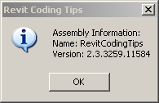
7 – Assembly Information
Retrieve the assembly name and version information
System.Reflection.Assembly asm = System.Reflection.Assembly.GetExecutingAssembly();
string str = "Assembly Information:";
str += "\nName: " + asm.GetName().Name;
str += "\nVersion: " + asm.GetName().Version;
Util.InfoMsg( str );
Use in application message or About... form

Slide 26
8 – Suspend Updating
Suspend certain updating and consistency operations
Possibly increases performance of large scale changes
RevitAPI.chm lists methods supported
No performance increase guaranteed
Stopwatch stopWatch = Stopwatch.StartNew();
if( useSuspendUpdating )
{
using( SuspendUpdating suspender = new SuspendUpdating( _doc ) )
{
rc = _doc.Mirror( walls, line );
}
}
else
{
rc = _doc.Mirror( walls, line );
}
stopWatch.Stop();
Look at SDK sample application FrameBuilder

Slide 27
9 – From Dot to Dot
Revit API coding in C# and VB.NET is similar
Easy to convert
Examples
C# VB.NET
using Rvt = Autodesk.Revit; Imports Rvt = Autodesk.Revit
doc.get_Element( id ); doc.Element(id)
param.AsDouble().ToString(); param.AsDouble
MyMethod( elem, ref name ); MyMethod(elem, name)
Notes:
I use dot (.) to refer to C# and VB.NET here since it's a delimiter in namespace and type names. In C++, it's a double colon (::).

Slide 28
9 – C# or VB.NET
C# and VB.NET are equivalent
The IL code generated is identical
Automatic translators are available
Google for "c# vb.net translator"
Reflector decompiles IL into C#, VB and also managed C++
Many SDK samples are in C#
Some SDK samples are in VB.NET
Except for language comparison, presentation labs are in C#
Notes:
Decompilation also brings up the topic of obfuscation. Decompilation, translation, and obfuscation are discussed on the blog.

Slide 29
9 – To Double Colon
Coding in managed C++ has more differences
Conversion from C# or VB.NET requires some effort
In C++
.NET assemblies can be referenced explicitly in the code
Not recommended due to lack of 'Copy Local' flag control
Use double colon rather than dot as in C# or VB.NET
Use #using rather than using as in C# to import namespaces
Use the namespace statement to specify an alias

Slide 30
9 – To Double Colon
C#
using System.Windows.Forms;
using Rvt = Autodesk.Revit;
using RvtGeom = Autodesk.Revit.Geometry;
using RvtSymbs = Autodesk.Revit.Symbols;
using RvtElems = Autodesk.Revit.Elements;
C++
#using <System.Windows.Forms.dll>
using namespace System::Windows::Forms;
#using <RevitAPI.dll>
namespace Rvt = Autodesk::Revit;
namespace RvtGeom = Autodesk::Revit::Geometry;
namespace RvtSymbs = Autodesk::Revit::Symbols;
namespace RvtElems = Autodesk::Revit::Elements;

Slide 31
9 – To Double Colon
C++ Execute() method signature
Handle to object (^)
Tracking reference (%)
C#
public IExternalCommand.Result Execute(
ExternalCommandData cmdData,
ref string message,
ElementSet elements )
{}
C++
virtual IExternalCommand::Result Execute(
ExternalCommandData ^ cmdData,
String ^% message,
ElementSet ^ elements )
{}

Slide 32
10 – Creating a new Type
Creating a new type for a given family
Not obvious from samples, frequently asked
Select existing type, then use the Duplicate() on it
Modify parameters or properties
List<Element> families = new List<Element>();
doc.get_Elements( f, families );
Family fam = families[0] as Family;
FamilySymbol famSym = null;
foreach( FamilySymbol fs in fam.Symbols ) { famSym = fs; break; }
string newFamilyName = "NewRoundColumn 3";
FamilySymbol newFamSym = famSym.Duplicate( newFamilyName ) as FamilySymbol;
Parameter par = newFamSym.get_Parameter( "b" );
par.Set( 3 );
Also discussed in the blog
http://thebuildingcoder.typepad.com/blog/2008/11/creating-a-new-family-symbol.html

Slide 33
Geometry
Notes:
In this section, we will take a look at the Revit API geometry library. The Geometry library in Revit API includes a set of classes representing commonly used geometry, such as points, lines, curves, and surfaces. It also includes classes representing solids, whose boundary information can be queried, such as edges and faces. It includes point, vector, and matrix calculations, special functions to find intersection of two geometric objects, and much more. Our discussion also includes some comparison with the ObjectARX AcGe geometry library.

Slide 34
Revit Geometry Library
Provide geometrical calculation functionality
Similar to ObjectARX AcGe library
Temporary objects in memory
Not database resident
Create objects using Application class methods
Namespace Autodesk.Revit.Application.Create
Everything is a reference type, no more value types
Main base classes
Object
APIObject
GeometryObject
Enumeration interfaces
XYZ, UV, BoundingBoxUV changed from 2008
Notes:
The Revit API includes a Geometry namespace encapsulating a geometry library providing geometrical calculation functionality. The library works with temporary objects in memory, i.e. non database resident objects. Some of the objects are created using methods on the Application class in the Autodesk.Revit.Creation namespace.

Slide 35
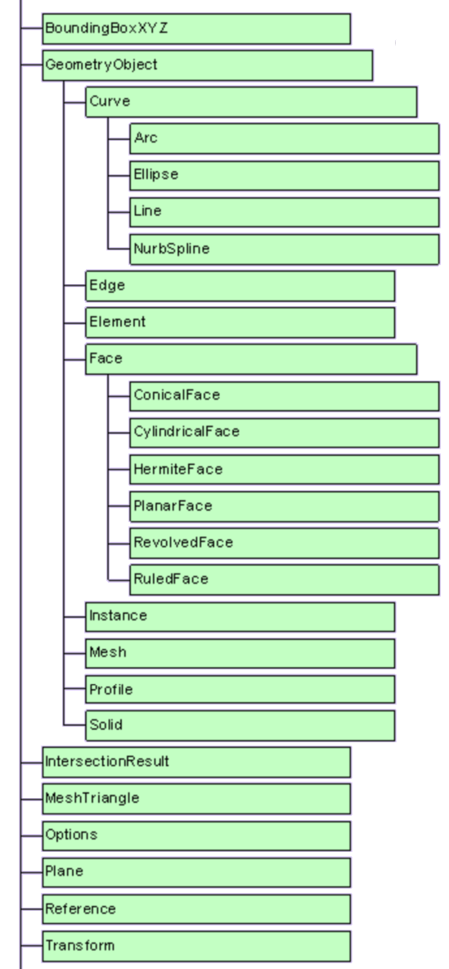
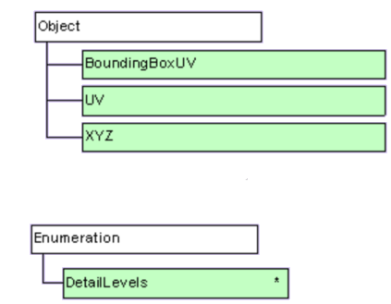
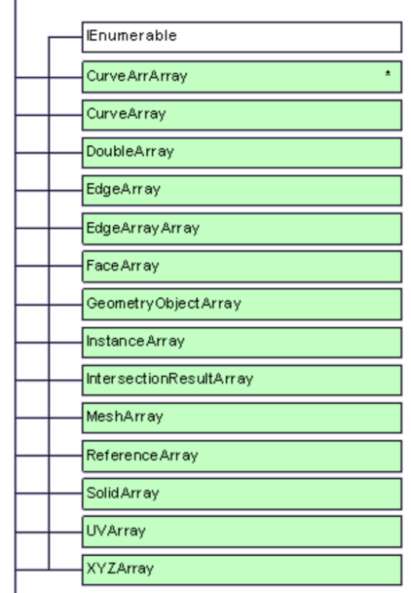
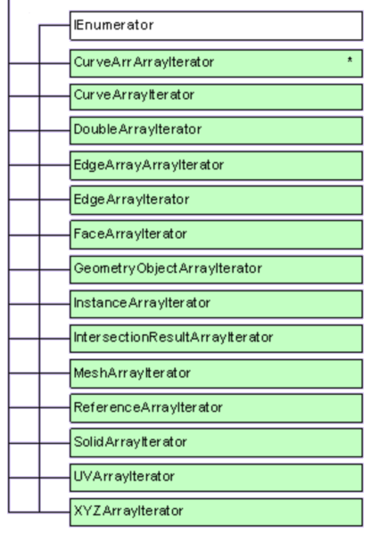
Geometry Class Hierarchy
Notes:
The main root classes of the Revit API geometry library class hierarchy are:
Object
APIObject
GeometryObject
Enumeration interfaces
All geometrical classes are now reference types derived from APIObject, object, or enumeration interfaces. The XYZ, UV, and BoundingBoxUV classes were value types in 2008 and earlier versions, but are so no longer. The figure provided in "Revit API Diagram.dwf" in the Revit SDK shows all the Revit API classes, including those defined in the Geometry namespace. The geometry library provides both simple and complex geometry classes. UV and XYZ represent a point and a vector in 2D and 3D, respectively. Transform offers basic matrix operations, such as translation, rotation and scaling. The Curve class provides a base class and common functionality for Line, Arc, Ellipse and the more complex subclass NurbSpline. The Revit API Geometry namespace also includes solid representations including Solid, Face, and Edge. These are used to retrieve geometry information for architectural elements in Revit. These different classes can be grouped together based on the class hierarchy like this:
Non APIObject – this includes UV and XYZ that represent points and vectors. They are derived directly from standard system classes, and you can create instance of them using the new keyword.
Autodesk.Revit.APIObject – this includes Transform, Plane, and other helper classes that are used in conjunction with GeometryObject derived classes.
Autodesk.Revit.Geometry.GeometryObject – this includes Line, Arc, Ellipse, and Solid, Faces, and Edges. Curve instances can be created by NewXXX() methods of the Autodesk.Revit.Creation.Application class, but Solid instances cannot.

Slide 36
Non-APIObject Classes
XYZ
3-dimensional point or vector co-ordinates
UV
2-dimensional point or vector co-ordinates
Usually parameters on a surface
Point and vector is not distinguished
Static properties define constants
Zero, BasisX, Y and Z
BoundingBoxUV
2-dimensional rectangle
Parallel to coordinate axes
These were value classes in 2008
Notes:
In Revit, UV and XYZ are used to represent points and vectors, 2D and 3D respectively. Unlike the more complex geometry classes, they are not derived from APIObject. Unlike ObjectARX's AcGe library, there is no strict distinction between point and vector. You can use them interchangeably depending on the context of the actual usage. UV could be a parameter on a surface. You will find many usages of these classes in the Revit SDK samples. Some classes provide static properties that define convenient predefined data. XYZ, for example, defines XYZ.BasisX as a typical vector representing the X axis, i.e., (1,0,0). Similarly, BasisY and BasisZ define the Y and Z axes, and XYZ.Zero defines the origin (0,0,0). You can find the corresponding 2D properties on UV as well.
Another non-APIObject class is BoundingBoxUV, which represents a 2-dimensional rectangle parallel to coordinate axes.

Slide 37
Classes derived from APIObject
BoundingBoxXYZ
IntersectionResult
MeshTriangle
Options
Plane
Reference
Transform
Translation, rotation, scaling, reflection
Static property Identity
Notes:
Some of the classes derived from APIObject are BoundingBoxXYZ, IntersectionResult, MeshTriangle, Options, Plane, Reference and Transform. Transformations are represented by the Transform class, which can be compared to a transformation matrix. You can set up a transformation for translation, rotation, and reflection, and perform such operations on points and vectors. Transform defines an Identity property.

Slide 38
Derived from GeometryObject
Element Container class, interface
Instance Instance class, reuse
Curve
Edge
Face
Mesh
Profile
Solid
Notes:
Some of the classes derived from GeometryObject are Element, which is a sort of geometry container class, Instance, which represents repeatable instances of symbol geometry, and the "real" geometry classes Curve, Edge, Face, Mesh, Profile, and Solid. The Autodesk.Revit.Geometry.Element class is not to be confused with the Autodesk.Revit.Element one. The latter represents a Revit database element, the former a geometrical one, and they are completely different.

Slide 39
Element
Container class for geometric primitives
Generated from database element
Database element uses parametric description
Main property: Objects
The geometric primitives contained in the element
Notes:
The geometry element class is a container for geometric primitives. It is generated from a database element when its geometry is queried. The database element uses a parametric description to define its geometry. The main property of the Element class is Objects, which provides access to the geometric primitives contained in the element. In other words, the geometry element is a container for the database element geometry, and provides the interface and temporary repository to query a building element for its geometry.

Slide 40
Instance
Instance of element (symbol) geometry
Positioned by this element
Symbol Symbol element that this object is referring to
SymbolGeometry Geometric representation of the symbol
Transform Affine transformation from the local coordinate space
Transformed Transforms this instance and returns the result
Notes:
The Instance class represents an instance of symbol geometry, which is positioned by this database element. Some of its important properties and methods are:
Symbol, returning the symbol element that this object is referring to
SymbolGeometry, the geometric representation of the symbol
Transform, an affine transformation from the local coordinate space
Transformed, which transforms this instance and returns the result

Slide 41
Curve
A parametric curve
Base class for arc, ellipse, line, and nurb spline
Properties
ApproximateLength Get the approximate length of the curve
IsBound Judge if the curve is restricted to a particular interval
IsCyclic Bounded geometric line
Length Get the exact length of the curve
Period Get the period of this curve
Methods
Clone, ComputeDerivatives, ComputeNormalizedParameter, ComputeRawParameter, Distance, Evaluate, Intersect, IsInside, MakeBound, MakeUnbound, Project, Tessellate
Transformed: apply transformation to this curve and return the result
Notes:
The Curve class represents a parametric curve and is the base class for arc, ellipse, line, and nurb spline. It has the typical properties and methods of a geometric curve class such as ApproximateLength, Length, ComputeDerivatives, Distance, Evaluate, Intersect, IsInside, etc. Its methods include Clone, ComputeDerivatives, ComputeNormalizedParameter, ComputeRawParameter, Distance, Evaluate, Intersect, IsInside, MakeBound, MakeUnbound, Project, Tessellate, Transformed, etc. Transformed applies a specified transformation to the curve and returns the result. Tessellate returns a set of line segments approximating the curve. It is used by the simple geometry viewers included in the Revit SDK, which reduce all geometry to line segments and display the result in a .NET form.

Slide 42
Edge
Properties
Approximate Length
EndPointReference
Face
Reference
Methods
ComputeDerivatives
Evaluate
EvaluateOnFace
Tessellate
TessellateOnFace
Notes:
The edge class represents a one-dimensional boundary segment of a face or a solid. Its properties include ApproximateLength, EndPointReference, Face, Reference, and it provides methods such as ComputeDerivatives, Evaluate, EvaluateOnFace, Tessellate,TessellateOnFace, etc.

Slide 43
Face
Properties
Area
EdgeLoops
IsCyclic
IsTwoSided
MaterialElement
Period
Reference
Methods
ComputeDerivatives
Evaluate
Intersect
IsInside
Project
Triangulate
No creation methods available, faces come from model
Notes:
The Face class represents a parametric face. It is a base class for more specialised derived classes such as ConicalFace, CylindricalFace, HermiteFace, PlanarFace, RevolvedFace and RuledFace. It provides a Triangulate method to simplify complex curved geometry into a collection of simple planar triangles approximating it. Its properties include Area, EdgeLoops, IsCyclic, IsTwoSided, MaterialElement, Period, Reference, etc., and its methods include ComputeDerivatives, Evaluate, Intersect, IsInside, Project, Triangulate, etc.
There is currently no way to create face from scratch in the Revit API. Generally, making a face is a lengthy process: you need to define the surface and all the edges and how it relates to all the other faces in the solid and the model at large. In fact, in Revit, faces are rarely created hand, but by geometry kernel routines. At the moment, there is no external API to these routines, and designing one is hard. So, for now you can only obtain a face from an existing model element. For instance, this satisfies the need for calculating the closest point to an existing object. The Revit API is not suited for generic geometry with no relation to the model; our expectation is that the client requiring this kind of computation has an own in-house math library anyway.

Slide 44
Mesh
A triangular mesh
Properties
NumTriangles
Transformed
Triangle
Vertices
Notes:
The Mesh class represents a mesh consisting of a number of triangles. It can be used to exactly represent a solid, if all its surfaces are planar, and it can be used to approximate a non-planar solid. An approximating mesh instance is returned by the Solid.Tesselate method. The mesh properties include NumTriangles, Transformed, Triangle, and Vertices.

Slide 45
Solid
Top level representation of database element solid geometry
Traverse boundary representation
Faces
Edge loops
Tesselate
Returns mesh
Planar approximation of complex curved surfaces
Notes:
The Solid is a top level representation of a database element solid geometry. From the solid, we can traverse the solid's boundary representation by querying it for its faces and edges. We can also simplify the solid by calling the Tesselate method to obtain simple triangles approximating the geometry, which may initially include complex non-planar surfaces.

Slide 46
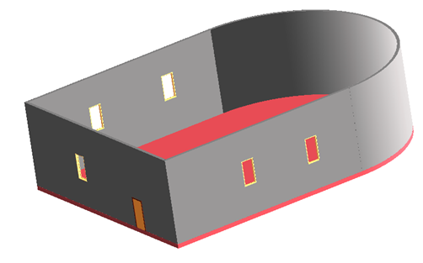
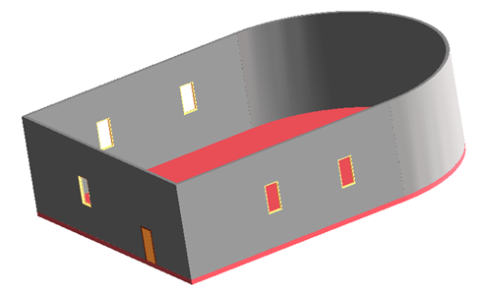
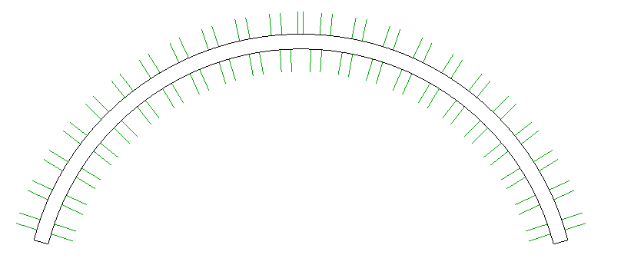
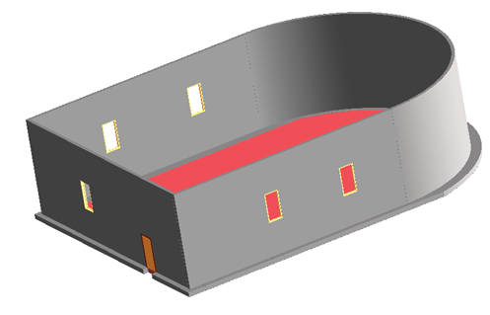
Geometry sample code
RevitGeometry sample code
ObjectARX AcGe comparison
1. XYZ and Transform
2. Curve and Line
3. Circle
4. Face
5. References and Dimensioning
Look at the blog for more samples

Slide 47
Learning More
Online Help and SDK Samples
DevTV Introduction to Revit 2008 Programming
http://adn.autodesk.com/adn/servlet/item?siteID=4814862&id=10194238&linkID=4901650
Recording of Revit 2009 Programming Introduction Webcast
http://adn.autodesk.com/adn/servlet/index?siteID=4814862&id=5475217&linkID=4901650
http://www.adskconsulting.com/adn/cs/api_course_sched.php
Discussion Groups
http://discussion.autodesk.com > Revit API
API Training Classes – Leave Business Card for Free Training
http://www.autodesk.com/apitraining
ADN, The Autodesk Developer Network
http://www.autodesk.com/joinadn
DevHelp Online for ADN members
http://adn.autodesk.com
The Building Coder, a Revit API Blog
http://thebuildingcoder.typepad.com
Notes:
Just a quick reminder that we’ll again be offering free attendance at an API training class to anyone who attends one of our classes at AU. Please announce this in your classes.
The offer will be one free training class per attendee to be taken at any time during calendar year 2009. To get this, they must leave their contact details with the presenter in the class (e.g. a business card). The free training is non-transferable, and is limited to one free training class per person (i.e. they can’t get more free training by handing in their cards at different classes). To use the free training, they just register for a training class on www.autodesk.com/apitraining and tell us they attended a class at AU and would like their free training when we confirm their registration, whereupon we’ll check their name against the collected business cards.
Please collect the business cards and hand them over to me.
Cheers,
Stephen

Slide 48
Meet The Experts
DE315-1 AEC API Talk
Thu. 12/4 3:15 pm - 4:45 pm

Slide 49
Thank you!
Thank you very much for your interest and attention!
Much success with the Revit API and your application development!
Please complete the session survey
Course id is DE205-3

Slide 50



& YOU

