Slide 1

Revit SDK Samples
Jeremy Tammik
Developer Technical Services

Slide 2

About the Presenter
Introduction
Jeremy Tammik
Developer Technical Services
EMEA
Autodesk SARL
Jeremy worked with Autodesk from 1988 until 1994 as a technology evangelist responsible for European Developer Support before the inception of the Autodesk Developer Network ADN. He was a co-founder of the AutoCAD Developer Group Europe and a prolific author around AutoCAD application development. He left Autodesk to work as an HVAC application developer, then rejoined in 2005 to work in the AEC group of the ADN DevTech team.
Jeremy studied mathematics and physics in Germany (Dipl. Math.), has four children, is a vegetarian, likes theatre improvisation and sports, especially climbing, plays the flute, and is fluent in five European languages.

Slide 3
Agenda
Introduction
Introduction
SDK history and contents
Managing samples
Main solution, spreadsheet, menu generator, non-SDK
Samples overview

Slide 4
Acronyms
Introduction
ADN Autodesk Developer Network
AEC Architecture, Engineering, Construction
API Application Programming Interface
BIM Building Information Model
MEP Mechanical, Electrical, Plumbing
RAC Revit Architecture
RME Revit MEP
RST Revit Structure
SDK Software Development Kit

Slide 5
Revit API History
Introduction
5, 6, 7 no API and no verticals
8.0 first public API for Building and Structure
8.1 "first and a half release"
9.0 many new objects and creation methods
9.1 journal, units, new creation methods
2008 major new features
2008.2 includes an SDK update and new samples
2009 first MEP API, growing complexity
API size has doubled in every release
Target is API and kernel-based application
Still evolving ...
Notes:
First, a little bit on the history of the Revit API.
The API has been and still is evolving, since Revit 8.0, has reached a certain maturity now, and is still evolvng very strongly.
We are in the process of restructuring Revit to make it more API driven, i.e. create a kernel providing the API on top of which the various Revit flavours can be implemented, instead of implementing the API as the outermost layer on top of the completed product.

Slide 6
SDK Documentation
Introduction
Read Me First.doc
Getting Started Revit API 2009 Beta 1.doc
Revit API Diagram.dwf
RevitAPI.chm
Revit Structure
Separate directory
API Changes
Added.xml and Removed.xml
xslt Transformation
Samples
Converting 2008 applications to Revit 2009 API.doc, Revit 2009 New Samples.doc, SamplesReadMe.htm, SDKSamples2009.sln
VSTA Samples

Slide 7
Managing Samples
Resources, Utilities and Tools

Slide 8
Managing Samples
Managing Samples
Main samples solution
SDKSamples2009.sln
Knowledge base
Global search
Revit SDK samples spreadsheet
Revit_SDK_Samples.xlsx
External sample manager applications
RvtSamples
Generic menu generator
Notes:
Open SDK Samples solution, look at cs versus cs.
Effort in testing them all: adjusting Revit.ini.
Search for CreateWall, note it appears many times, select whole word and match case, less hits, discover that the journaling sample actually calls the Revit API method NewWall, search for that, et voila all samples that create walls.
Open spreadsheet, look at classifications.
Open RvtSamples.txt, explain menu generation.
Open RvtSamples, look at how to create menu, debug through those steps.

Slide 9
Revit Samples Spreadsheet
Managing Samples
Excel spreadsheet listing all samples
Includes the required Revit.ini EC data
Includes classification by various categories
Flavour: all, rac, rme, rst
Version: 8.0, 8.1, 9.0, 9.1, 2008.0, 2008.2, 2009.0
Level: basic, intermediate, advanced
Type: cmd, app, exe
Language: cs or vb
Topic: creation, element, parameter, etc.
Files: number of source files
Bytes: total source file size

Slide 10
RvtSamples
Managing Samples
External application
Defines entire menu hierarchy
Generic menu generator
Lists all Revit samples
Multiple categorisations
Database driven
Avoid hitting max. number of menu entries
There is still another limit ... 500 reserved menu ids
Minimal edits in Revit.ini

Slide 11
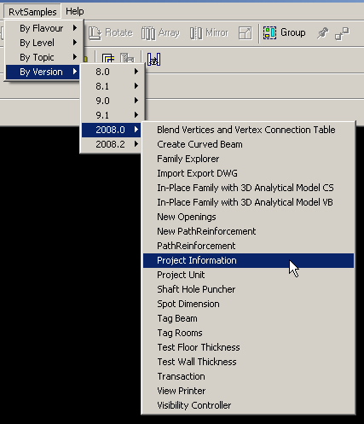
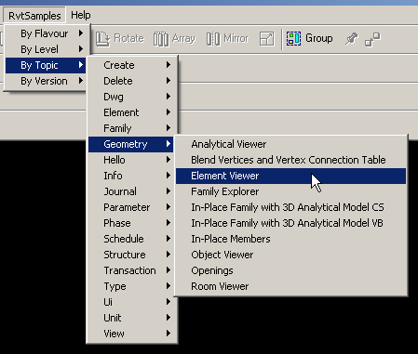
RvtSamples
Managing Samples

Slide 12
Non-SDK Samples
RST Labs and RS Link
2.3 Integrating Revit Structure with Analysis Programs
RvtMgdDbg
2.5 Whats in the Element List - Understand Revit project
Using the generic API for MEP
1.4 Revit MEP - what you can do with API today
MidasLink
Available from ADN
Handling elements, Export and import forms
Localisation, Units
Installer
Notes:
Is the Truss Wizard source available on ADN?
Batch printer source code?

Slide 13
Samples
Overview

Slide 14
Samples
Samples
Huge knowledge base … most of the Revit SDK information is contained in the samples
I will not go into each and every one of them ...
ProjectInfo
ProjectUnit
RDBLink
ReferencePlane
Reinforcement
RevitCommands
Rooms
RoomSchedule
RotateFramingObjects
ShaftHolePuncher
SharedCoordinateSystem
SlabProperties
SpanDirection
SpotDimension
StructSample
StructuralLayerFunction
TagBeam
TestFloorThickness
TestWallThickness
Toolbar
TransactionControl
TypeSelector
VersionChecking
Viewers/AnalyticalViewer
Viewers/ElementViewer
Viewers/RevitViewer
Viewers/RoomViewer
ViewPrinter
VisibilityControl
AllViews
AnalyticalSupportData_Info
APIAppStartup
ApplicationEvents
ArchSample
AreaReinCurve
AreaReinParameters
AutoTagRooms
BarDescriptions
BeamAndSlabNewParameter
BlendVertexConnectTable
BoundaryConditions
BrowseBindings
CreateBeamsColumnsBraces
CreateBeamSystem
CreateComplexAreaRein
CreateDimensions
CreateShared
CreateSimpleAreaRein
CreateViewSection
CreateWallinBeamProfile
CreateWallsUnderBeams
CurvedBeam
DeckProperties
DeleteDimensions
DeleteObject
DesignOptionReader
FamilyExplorer
FireRating
FoundationSlab
FrameBuilder
GenerateFloor
HelloRevit
HelloWorld
ImportExportDWG
InplaceFamilyAnalyticalModel3D
InPlaceMembers
InvisibleParam
Journaling
LevelsProperty
Loads
MaterialProperties
Materials
ModelLines
ModifyIniFile
MoveLinear
NewOpenings
NewPathReinforcement
ObjectViewer
Openings
ParameterUtils
PathReinforcement
PhaseSample
PhysicalProp
Notes:
Whenever faced with a new Revit API issue, one of the first places to search for information is in the extensive collection of samples.
Most tasks that can be accomplished through the API are illustrated by one of the samples.

Slide 15
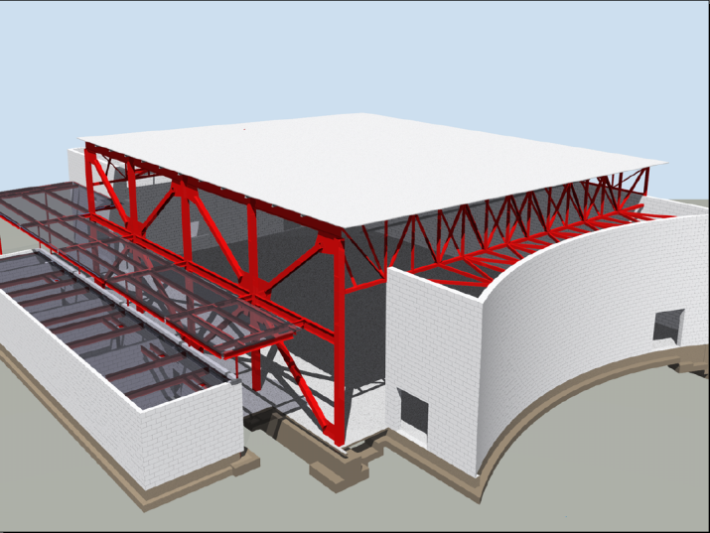
Basic Samples
Samples
ArchSample All
BrowseBindings All
CreateShared All
FireRating All
HelloRevit All
MoveLinear All
PhysicalProp All
RevitCommands All
StructSample All
TypeSelector All
ElementViewer All
RoomViewer All
AnalyticalViewer Rst
Notes:
These samples existed before 9.0. Many of them were originally written using COM. They are all migrated to .NET now. These are good samples to start with.

Slide 16
Revit 9.0 Samples
Samples
AllViews All
AnalyticalSupportData_Info Rst
AreaReinCurve Rst
AreaReinParameters Rst
BarDescriptions Rst
BeamAndSlabNewParameter Rst
CreateBeamsColumnsBraces All
CreateComplexAreaRein Rst
CreateDimensions All
CreateSimpleAreaRein Rst
CreateViewSection Rst
CreateWallinBeamProfile Rst*
CreateWallsUnderBeams Rst
DeleteDimensions All
DeleteObject All
DesignOptionReader All
GenerateFloor All
InPlaceMembers All (Rst?)
LevelsProperty All
Loads Rst
MaterialProperties All
ObjectViewer All
PhaseSample All
RotateFramingObjects All
SlabProperties Rst
StructuralLayerFunction Rst
VersionChecking All
Notes:
(*) The main functionality (to create walls) would work in both, but it relies on the analytical model of beams for the position, which fails in Architecture ...
[MH: modified “CreateViewSection” and “CreateWallsUnderBeams” as Structure Only.]

Slide 17
Revit 9.1 Samples
Samples
FrameBuilder All
Journaling All
ModelLines All
Openings All
ReferencePlane All
Rooms All
SharedCoordinateSystem All
BoundaryConditions Rst
CreateBeamSystem Rst
FoundationSlab Rst
Materials Rst
ObjectViewerII Rst
Reinforcement Rst
Notes:
An overview of the Revit 9.1 SDK samples, sorted by architecture/structure and alphabetically. ModelLines and Materials were originally provided in two versions suffixed with 1 and 2. In 2008.2 these separate variations were united into one each. ObjectViewerII was removed in the 2008.2 SDK update.

Slide 18
New 2008.0 SDK Samples
Samples
Described in
SDK/Samples/Revit 2008 New Samples.doc
APIAppStartup
ApplicationEvents
AutoTagRooms
BlendVertexConnectTable
CurvedBeam
FamilyExplorer
ImportExportDWG
InplaceFamilyAnalyticalModel3D
NewOpenings
NewPathReinforcement
PathReinforcement
ProjectInfo
ProjectUnit
ShaftHolePuncher
SpotDimension
TagBeam
TestFloorThickness
TestWallThickness
Toolbar
TransactionControl
ViewPrinter
VisibilityControl
Notes:
In the Revit 2008 SDK, the new samples are described in a special separate document.
In order to provide a quick overview and first impression, the following slides briefly introduce each one of the new samples and show a screen snapshot of the sample in action.

Slide 19
New 2008.2 SDK Samples
Samples
Described in
SDK/Samples/Revit 2008 New Samples.doc
RDBLink
RoomSchedule
Notes:
In the Revit 2008.2 SDK update, two more new samples are added and the new samples document describing them is updated as well.

Slide 20
New 2009 SDK Samples
Samples
Described in
SDK/Samples/Revit 2009 New Samples.doc
AddSpaceAndZone rme alpha 2
CurtainWallGrid rac beta 1
DoorSwing rac beta 1
ElementsBatchCreation rac alpha 2
ElementsFilter all alpha 2
GridCreation all alpha 2
NewRebar rst alpha 2
PlaceFamilyInstanceByFace all beta 1
PowerCircuit rme beta 1
Truss rst alpha 2
Notes:
In the Revit 2008.2 SDK update, two more new samples are added and the new samples document describing them is updated as well.

Slide 21
Rebar Detailing Samples
Samples
AnalyticalViewer Draw analytical model in a separate viewer window
AreaReinParameters Edit area reinforcement parameters and list rebar ones
CreateDimensions Create dimension
CreateViewSection Create section and drafting view
ImportAndExportDWG Import and export DWG
InPlaceMembers Display in-place member properties and analytical model
Reinforcement Create reinforcement
SpanDirection Display slab span direction and span direction symbols
TagBeam Tag beam and rebar and create text
Handled in a separate session by Mikako Harada
Notes:
In the Revit 2008.2 SDK update, two more new samples are added and the new samples document describing them is updated as well.

Slide 22
Basic Samples

Slide 23
Basic Samples
Basic Samples
Introductory
Pre-dating Revit 9.0
Good place to start looking at API
Comparable to Revit API Introduction labs
Labs are more systematic
Complete coverage
Element creation was a focus of the 9.0 and 9.1 APIs
Notes:
Select an element and then execute Tools > External Tools > RevitCommands - Selection or RvtSamples > By Version > 8.0 > RevitCommands.Selection.

Slide 24
Interactive Element Selection
Basic Samples
Current implicit selection set is passed to the command
Selection set be changed from the command
In 2008, explicit element selection functionality was added
If error returned, error set is highlighted
RevitCommands.Selection
ElementSet selSet = rvtApp.ActiveDocument.Selection.Elements;
Notes:
Select an element and then execute Tools > External Tools > RevitCommands - Selection or RvtSamples > By Version > 8.0 > RevitCommands.Selection.

Slide 25
Object Properties
Basic Samples
Generic properties provide access to
Type parameters
Instance parameters
Both include shared parameters (more later)
RevitCommands.ElementData
Dim instanceParams As Revit.ParameterSet = elem.Parameters
Dim typeParams As Revit.ParameterSet = elem.ObjectType.Parameters
Dim loc As Revit.Location = elem.Location
Dim geomElem As Revit.Geometry.Element = elem.Geometry

Slide 26
Import and Export Data
Basic Samples
Export to file or other applications such as Excel
Element and Type Properties
Location and Geometry
ArchSample Export to Excel command

Slide 27
Custom Data Addition
Basic Samples
Use shared parameter mechanism
Add custom data, i.e. new parameters
Add to new and existing elements and types
Data can be hidden
FireRating (vb) and Lab 4-3 (cs) commands
Apply Parameter
Export to Excel
Import from Excel
Revit.Parameters.Definition = ... ‘ e.g. Integer
Parameters.Binding = app.Create.NewInstanceBinding(categorySet) ‘ e.g. Doors
rvtApp.ActiveDocument.ParameterBindings.Insert(definition, binding)

Slide 28
Element Modification
Basic Samples
Move and rotate elements
Swap element types programmatically
Groups
Generic property access
Move Linear command
Type Selector command
FireRating et al show parameter editing

Slide 29
Load Families and Types
Basic Samples
Load whole family
Load specific family symbol aka type
Search for families and types loaded in doc
RevitCommands Load Family and Load Family Symbol commands
rvtApp.ActiveDocument.LoadFamily(fileName)
rvtApp.ActiveDocument.LoadFamilySymbol(fileName, symbolName)

Slide 30
Structure
Basic Samples
Exposes structural elements and their usage
Analytical model, including loads
Wall layer structure
Analytical Viewer
StructSample - Frame Wall with Timbers
// use level based NewFamilyInstance!
Level instLevel = rvtDoc.get_Element( ref baseLevelId ) as Level;
FamilyInstance column = doc.Create.NewFamilyInstance( ref p, columnType, instLevel );

Slide 31
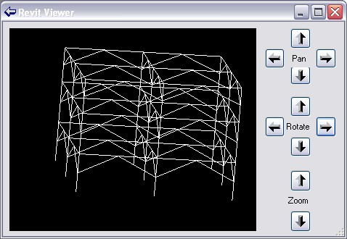
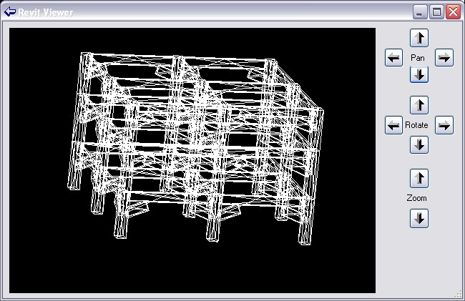
Viewers
Basic Samples
AnalyticalViewer Rst
ElementViewer All
Demonstrates viewing elements
Analytical model
Physical model

Slide 32
9.0 Samples

Slide 33

Revit 9 API Features
9.0 Samples
Significant API Features
Element Creation
Extended list of creatable elements: Wall, Floor, Level, Grid, all family based elements
Track Changes
Let user visually see the changes performed by the 3rd party application
Let user accept or reject the changes
Notes:
So in terms new API features displayed there on your screen, it looks like there’s not a lot to see really, but as we all know the newly added to Element creation list is a massive inclusion. We can now create Walls, Floors, Levels, Grids and all Family Based Elements which means that the Revit API is now becoming a very powerful API indeed.
We also have the new Track Changes feature, which at the moment is only available in Revit structure. What it does is to track certain changes to elements across a single API external command, allowing the user to revert the changes back to what they were before a user ran your command. The way you revert a change is by Right-clicking the element you want to revert, and you should see the reversion options displayed there.

Slide 34
9.0 Samples
Revit 9 New Objects
Elements
AreaReinforcement
AreaReinforcementCurve
Dimension
LoadCaseArray/Iterator
LoadUsage
LoadUsageArray/Iterator
View
View3D
ViewDrafting
ViewSection
ViewSet/Iterator
ViewSheet
Symbols
AreaReinforcementType
DimensionType
Objects
ExternalCommandData
Geometry
BoundingBoxXYZ
ConicalFace
CylindricalFace
DoubleArray/Iterator
HermiteFace
PlanarFace
Reference
ReferenceArray/Iterator
RevolvedFace
RuledFace
Structural
AnalyticalSupportData
AnalyticalSupportInfo
AnalyticalSupportInfoArray/Iterator
BarDescription

Slide 35
New Creation Methods
9.0 Samples
AreaReinforcement
Dimension
Structural family instances
Floor
Grid
Level
LoadCase
LoadCombination
LoadNature
LoadUsage
View3D
ViewDrafting
ViewSection
ViewSheet
Wall
Notes:
LoadNature is used to define the type of load as Dead, Live, Seismic, Wind etc.
LoadUsage is used for visibility of loads only.

Slide 36
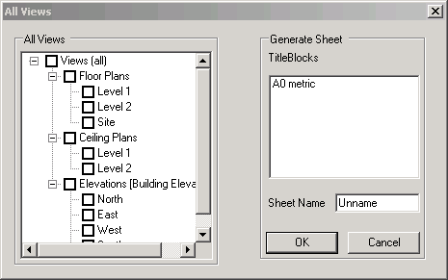
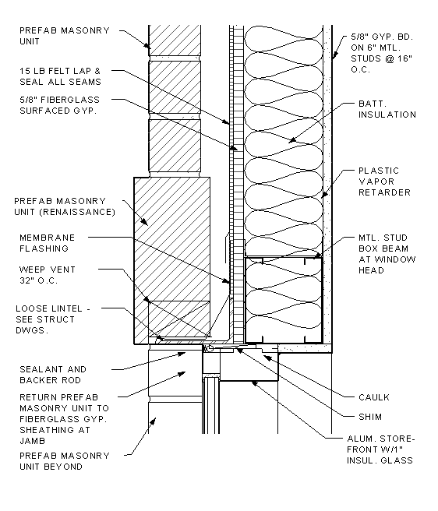
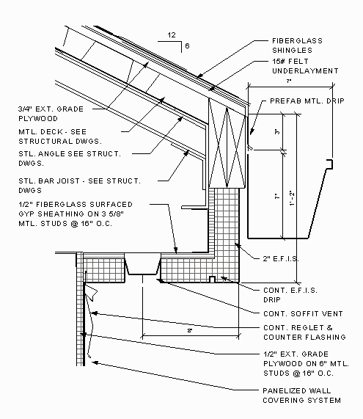
Sheets and Views
9.0 Samples - Element Creation
AllViews – works with all
Finds all views in project and displays in tree view
Creates a new sheet with selected views
Demonstrates creating a ViewSheet via NewViewSheet()
Notes:
This sample finds all the views in a project and displays the names in a tree view hosted by the modal dialog that is displayed. The user can select several of the views and when OK is clicked a new sheet is generated that has all the selected views placed in it correctly sized, scaled and aligned.
When the command is executed a dialog appears that contains the following:
a) A tree view represents all the views’ names.
b) A list of all title blocks.
c) An edit box for the sheet’s name.
Note: All views should represent by category, not including schedules, sheets.
Fenton’s notes:
Loading the drawing Training\Metric\m_RST_SAVE DETAIL.rvt allows me to produce new sheets of all the elevations.
Extra Usage Notes:
draw a simple model.
check the current status of views and sheet. If there is no sheet, fine.
run the command.
choose views. Click ok.
check under Sheets. You can see a sheet where the selected views are placed.

Slide 37
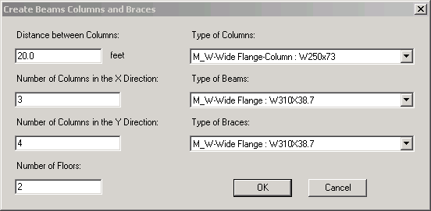
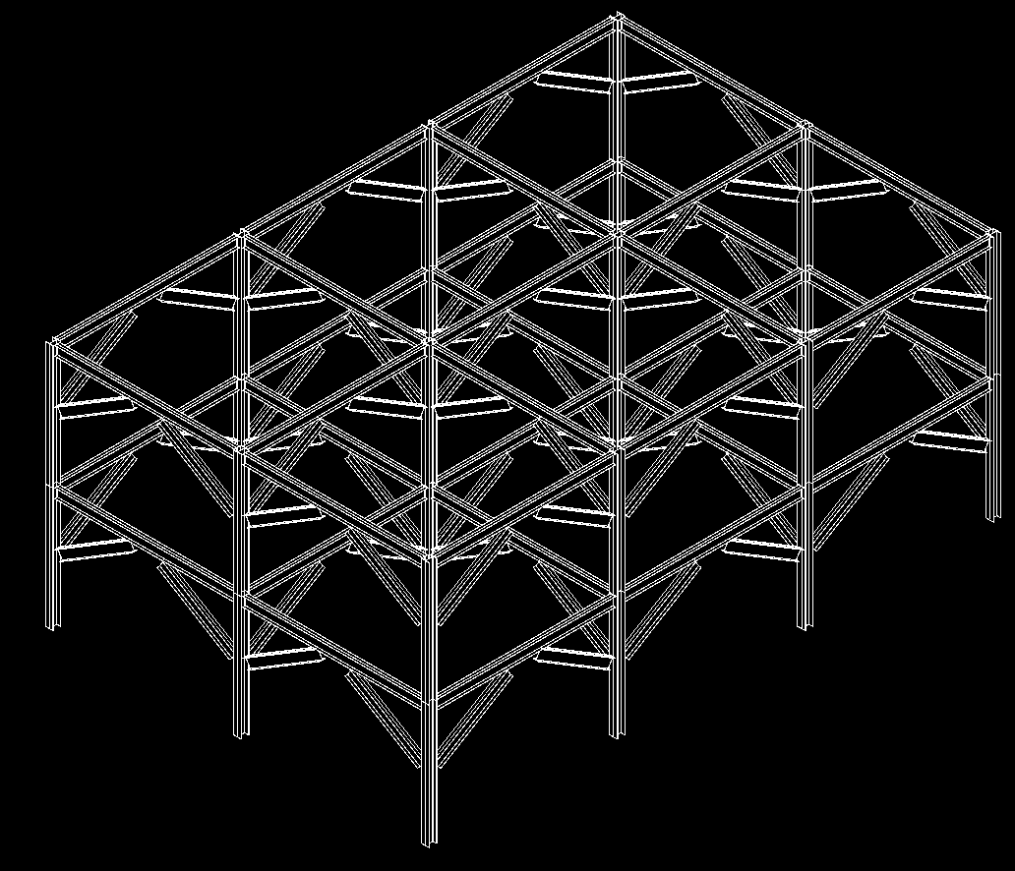
Beams, Columns and Braces
9.0 Samples - Element Creation
CreateBeamsColumnsBraces – All
Use NewFamilyInstance() to create structural elements
STRUCTURALTYPE stType = StructuralType.Beam;
// create the beam
FamilyInstance beam = doc.Create.NewFamilyInstance( ref pt, beamType, topLevel, stType );
// assign the location curve to the beam
LocationCurve beamCurve = beam.Location as LocationCurve;
if( null != beamCurve )
{
Line line = app.Create.NewLineBound( ref startPoint, ref endPoint );
beamCurve.Curve = line;
}
Notes:
This sample demonstrates the creation of new objects, in particular the NewFamilyInstance(). Notice that there’s some code below which shows how it’s done.
So lets take a look at the sample to see what it does exactly.
Fenton’s notes: Create a new project. Pick elevations to create 5 new levels, run the program.

Slide 38
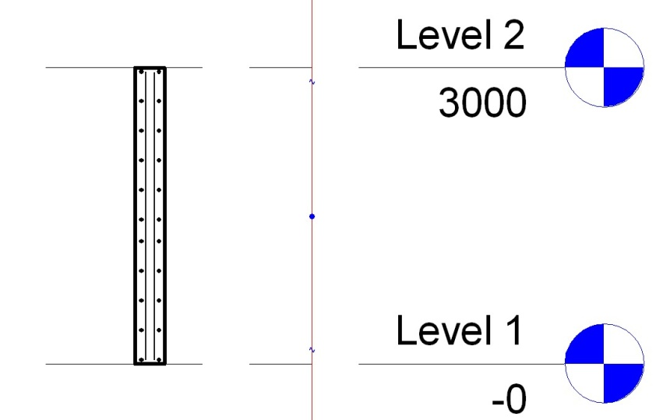
Area Reinforment
9.0 Samples - Element Creation
CreateSimpleAreaRein – Rst
Demonstrate creation of AreaReinforcement element
Uses NewAreaReinforcement()
Works on slab or wall
AreaReinforcementType symbol = dataOnWall.AreaReinType as AreaReinforcementType;
DocCreator creator = m_revit.Application.ActiveDocument.Create;
// create the AreaReinforcement
AreaReinforcement areaRein =
creator.NewAreaReinforcement(
symbol, wall, refer, curves );
Notes:
This sample creates an Area Reinforcement in a rectangular shape on a slab or wall. So lets take a look.
Fenton’s Notes:
Goto 3d view, then draw a wall/floor.
select it, and execute the command. Accept default and ok. It will add a rebars to the wall/floor. (But it may not be visible.)
try moving the cursor to the centre of the wall. You will see a "x" mark with "structural area reinforcement". This is what is added.
Goto Level1, then try creating a section. (View --> New --> Section). if you zoom in the section of a wall, you will see rebars placed inside of the wall.

Slide 39
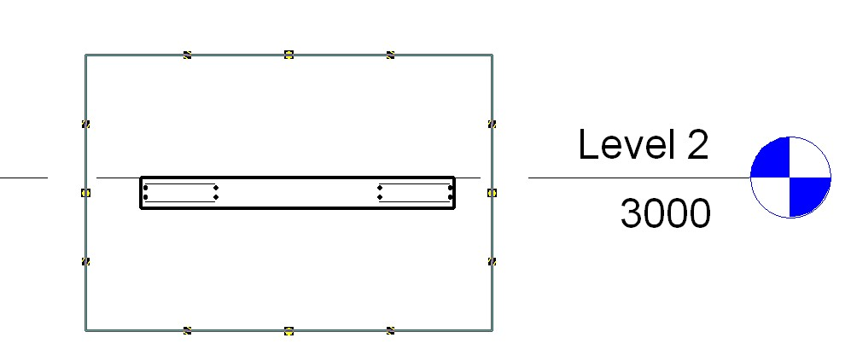
Area Reinforcement
9.0 Samples - Element Creation
CreateComplexAreaRein – Rst
Demonstrate creation of AreaReinforcement element
Uses NewAreaReinforcement()
Defines opening/cutout in slab
Only works on slab
Notes:
This sample is very similar CreateSimpleAreaRein, except that it generates a much more complex reinforcement detail and only works for a slab or floor.
The detail is created with all four layers of reinforcement defined and with two nested rectangular curve loops so that it defines a rectangular cutout opening, really cool stuff – so lets take a look.
On the interior 4 curves, set the override flag and flip the hooks on the top 2 layers to ‘up’, so the bars can hook into some walls around that opening.?

Slide 40
Dimensions
9.0 Samples - Element Creation
CreateDimensions – All
DeleteDimensions – All
Demonstrate creation and deletion of a dimension
Uses NewDimension()
// create dimension line geometry
Line newLine2 = new Line( ref point1, ref point2, true );
// create the actual dimension
Dimension newDimension = doc.Create.NewDimension(
doc.ActiveView, newLine2, referenceArray );
Notes:
This sample requires a basic wall to be drawn and selected in order to function.
NOTE: If you are going to use this same inside Structural be aware that, by default, Basic Walls are NOT displayed unless you turn them on. Goto View properties -> Discipline, here it will be set to either Structural or Analytical (this excludes anything not having that model type property) – simply change it to "Architectural" .

Slide 41
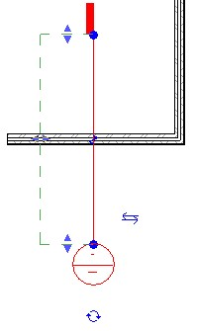
Section View
9.0 Samples - Element Creation
CreateViewSection – All
Demonstrate creation of a detail view
Uses NewViewSection()
Creates detail view across the midpoint of selected element
Works on linear element such as slab, wall or beam
// Create a section view:
ViewSection section = m_project.Create.NewViewSection( box );
Notes:
Next we have the CreateViewSection sample; this sample provides a tool for generating a section view across the mid point of a selected element.
Fenton’s notes: Draw a wall, beam or floor then select it to run the application.

Slide 42
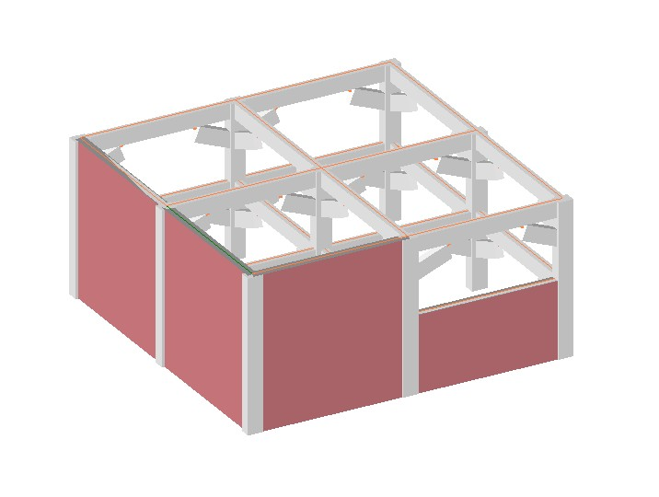
Walls
9.0 Samples - Element Creation
CreateWallsUnderBeams – All
Demonstrates creation of walls under selected beams
Uses NewWall()
Illustrates the AnalyticalModelFrame class
How to convert from physical model
Notes:
Fenton’s Notes: Create Beams Columns and Braces in Revit Structure. Select one or more of the beams and run the CreateWallsUnderBeams sample. This will create the walls, to show them, switch the shade mode to shaded.

Slide 43
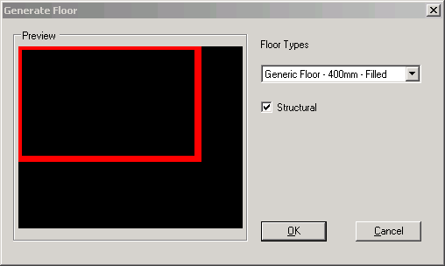
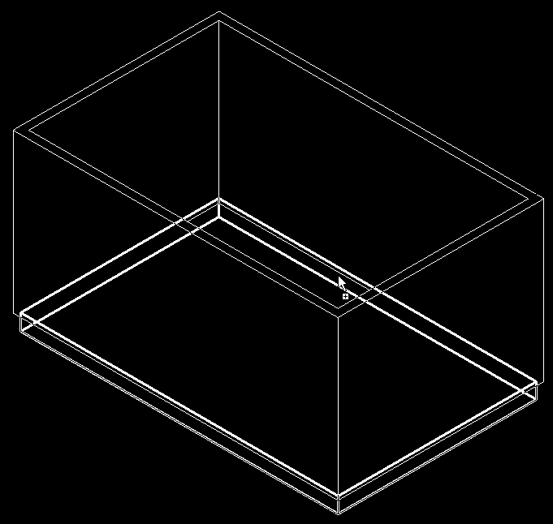
Floors
9.0 Samples - Element Creation
GenerateFloor – All
Demonstrates the creation of a floor or slab
Analyses wall geometry
Lists applicable floor types
Uses NewFloor()
// Create a new floor
Floor f = doc.Create.NewFloor( data.Profile,
data.FloorType, data.Level, data.Structural );
Notes:
This sample is very straight forward, you draw a closed room and run the command. You may get the Floor drawn on Level2 so set the properties of each of the walls so that the top constraint is level1 with a base offset of 0.0.
Fenton’s notes: Draw a wall, beam or floor then select it to run the application.

Slide 44
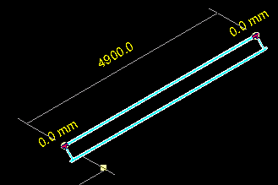
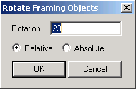
Rotation
9.0 Samples - Element Modification
RotateFramingObjects – All
Demonstrates how to rotate elements
Uses parameter access
// in case of a column
bool result = pointLocation.Rotate( rotateAxis, rotateDegree );
Notes:
This sample is a minimal sample which simply shows how to rotate objects selected from a Revit model via the API. It’s minimal, but answers a frequently asked question.
Fenton’s notes: Use Create Beams Columns and Braces to generate some test geometry, now you can run RotateFramingObjects nicely.

Slide 45
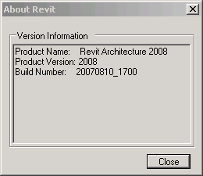
Product Version
9.0 Samples - Utilties
VersionChecking All
Demonstrates how to access the running product version
The most requested API feature!
Allows developers to channel functionality
Data is built into the Application class
VersionName
VersionNumber
VersionBuild

Slide 46
9.1 Samples

Slide 47
Revit 9.1 API Features
9.1 Samples
Access to journal file
Regression testing
Improved handling of units
Shelter the user from the internal Revit database units
Ability to suspend updating
Model can be changed or updated through the API with minimal impact on speed
Significant performance improvements to element transformations
New Elements
ModelLine, Material, Opening, ReferencePlane, SketchPlane
Notes:
The information in this presentation has been extracted from the SDK document “Getting Started.doc” and from analysis of the Revit 9.1 SDK samples themselves.
Here are the new features common to both architecture and structure.
There are additional features specific to either one of the two as well. More new elements have been added for structure, we will see those in a moment.
Journal file:
The journal file records all input parameters obrtained from the user during a session. These can be used to rerun a similar session later on without any user interaction. This feature is useful for regression testing, both for Revit itself and for external programs. Therefore, external programs now have read and write access to the data in the Revit journal file.
Units:
DisplayUnitSystem = Is Revit set up to show units in metric or Imperial
DisplayUnitType = Returns the display units for a value
AsValueString = Returns the value properly formatted in the same way that Revit would format the text

Slide 48
Rac 9.1 API Features
9.1 Samples
Access to rooms
Find
Tag
Notes:
Access to rooms have been added which will provide the user with the ability to find rooms that have been defined by the user and number of tag them.
Rooms:
Autodesk.Revit.Elements.Room.Number
Autodesk.Revit.Elements.RoomTag
Autodesk.Revit.Creation.Document.NewRoom
Autodesk.Revit.Creation.Document.NewRoomTag

Slide 49
Rst 9.1 API Features
9.1 Samples
Define and access boundary conditions
New elements
Boundary Conditions
Beam systems
Path Reinforcement
Ability to define reinforcement bar sets

Slide 50
Revit 9.1 API Fixes
9.1 Samples
NewArc() added to API
Improved Span Direction API
Track changes no longer highlights type changes to the same type
Delete methods now return the ids of the elements deleted
Grid lines are now available immediately after creation
Significant performance improvements to element transformations through the use of the SuspendUpdating functionality
Notes:
Here is a list of some of the improvements made to existing functionality. Nothing really important if you have not happened to run into a problem with this in an earlier release.

Slide 51
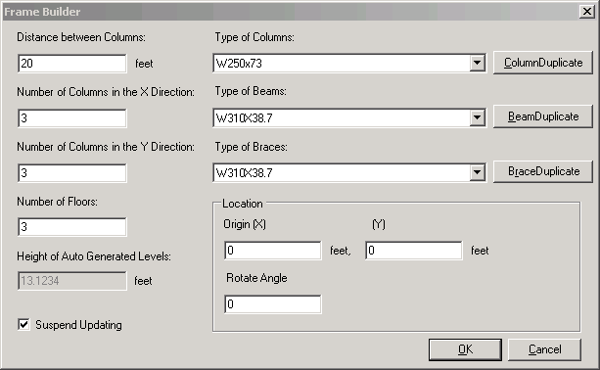
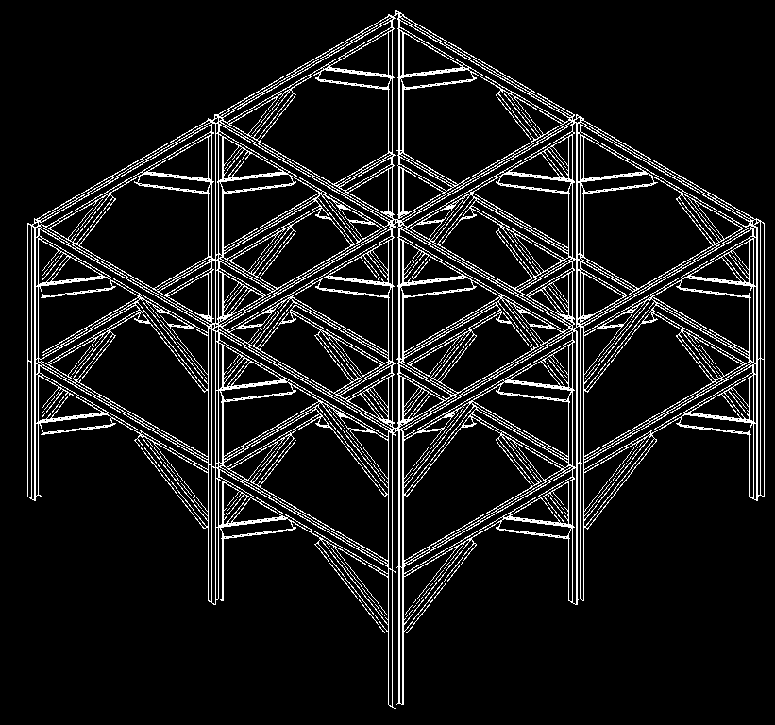
Creation of a Frame Control Display Update
9.1 Samples
FrameBuilder – All
Composed of floors, levels, columns, beams, braces
Demonstrates methods
NewLevel(), NewFamilyInstance()
Illustrates the SuspendUpdating mechanism
New SuspendUpdating( doc ), SuspendUpdating.Dispose()
Notes:
This sample is very similar to CreateBeamsColumnsBraces sample. It is enhanced with SuspendUpdating. Also, it creates its own levels if some are missing.
SuspendUpdating mechanism is used to avoid display updating within an operation so as to improve performance. It’s usually used when many entities are created in a single command. Simply run the command in an empty or non-empty drawing, either in architecture or structure.

Slide 52
Journaling Mechanism
9.1 Samples
Journaling – All
All user actions in Revit are recorded in the journal file
C:\Program Files\Autodesk Revit Structure 4\Journals
To rerun journal file
Drag it onto Revit icon
Drag it onto open session
Pass it as command line parameter
Integrating an external application
Add and retrieve information to and from journal file
StringStringMap Autodesk.Revit.ExternalCommandData.Data
StringStringMap.Insert()
StringStringMap.Item()
Example application adds a wall and saves its data
VBScript-like, work around missing API issues
Notes:
This sample demonstrates the journaling mechanism, integrating an external application into the Revit journaling environment and adding and retrieving information to and from the Revit journal file.
Demonstrates NewLine(), NewWall(), StringStringMap.Insert() used by ExternalCommandData.Data property, the data map that can be used to read and write data to the Autodesk Revit journal file.
1. Run this sample in Revit for the first time. It will ask the user for some data to create a wall, and then record the data into the revit journal file.
Select any wall type, level 2, (0,0,0), (10,0,0).
The journal data is written to
C:\Program Files\Autodesk Revit Building 9.1\Journals\
2. Start Revit from the command line with the path to the journal file as a parameter, or drag and drop the file onto Revit. This sample reads the data in the journal file and recreates a same wall in Revit.
"C:\Program Files\Autodesk Revit Building 9.1\Program\Revit.exe" "C:\Program Files\Autodesk Revit Building 9.1\Journals\journal.0031.txt"
Case ID 1211118 [How to use the journal file]
Revit SPR #122247 some of Journal files in Structure Test Models won't re-play
C:\Program Files\Autodesk Revit Building 9.1\Journals\ >..\Program\Revit.exe journal.0036.txt
Regression Testing
Unknown to many, Autodesk Revit records the operations that the user performs into a text file known as a Journal file. These files can then be used to playback the same operations if Revit is started with the journal filename as part of the command line. If the results of the operations in Revit differ from those that were previously recorded the application will stop and note the failure in the resulting journal file. This process of creating a journal file and then playing it back to ensure that operations remain the same is known as Regression Testing and is quick and simple way of ensuring that you application does not differ from previous known to work versions.
User interface interaction during the external command are not recorded in the journal file so a mechanism has been provided to store a limited mount of data within the journal file when the command finishes so that that data can be passed to the external command when executed via the journal file. The commandData object that is passed to the external command now has a Data property that contains a String to String map to hold such data. If your application sets values in this map they will become stored in the journal file. If this data member contains data when your command is executed then your application should read this data and assume it is being operated from a journal file without user interaction and hence should not pause for any user input at any time thus ensuring that the command can be played back completely programmatically.
Note: currently there is a limitation on the amount of data that can be placed in the Data map.
How to use the Journal File for Regression Testing
All the user actions in a Revit session are recorded to a journal file.
The Journal file is usually located in the Journal folder of the Revit Installation. (Example C:\Program Files\Autodesk Revit Structure 4\Journals)
To rerun the journal file simply drag the file on top of the Revit icon on your desktop or into an open session of Revit.

Slide 53
9.1 Samples
Model Lines
ModelLines – All
Report the number of instances of each model line type
Create new model lines
Arc, Ellipse, Line, NurbSpline
New and Modified Classes and Methods
Autodesk.Revit.Elements.ModelCurveArray
Autodesk.Revit.Elements.ModelCurveArrayIterator
Autodesk.Revit.Elements.ModelCurve
Autodesk.Revit.Elements.ModelArc
Autodesk.Revit.Elements.ModelEllipse
Autodesk.Revit.Elements.ModelLine
Autodesk.Revit.Elements.ModelHermiteSpline
Autodesk.Revit.Elements.ModelNurbSpline
Autodesk.Revit.Creation.Document.NewModelCurve
Autodesk.Revit.Creation.Document.NewModelCurveArray
Autodesk.Revit.Creation.Application.NewArc
Notes:
In Revit 9.1, we have the possibility to create model lines and curves through the API. In order to create a model line, we have to create the underlying geometry line or curve first. For some of the complex curve types, there is no method available to create the geometry curve from scratch, so those types of model curves have to obtain their underlying geometry corve from some existing object.
The model curve types supported are arc, ellipse, line and hermite and nurb splines.
The hermite spline is required in order to import certain geometry from AutoCAD, it is normally not used by Revit itself.
The two samples are very similar. In ModelLines1, a new sketch plane is created for the new model lines, whereas in ModelLines2, the user may select an existing sketch plane.
Model Lines:
Autodesk.Revit.Elements.ModelCurveArray
Autodesk.Revit.Elements.ModelCurveArrayIterator
Autodesk.Revit.Elements.ModelCurve
Autodesk.Revit.Elements.ModelArc
Autodesk.Revit.Elements.ModelEllipse
Autodesk.Revit.Elements.ModelLine
Autodesk.Revit.Elements.ModelHermiteSpline
Autodesk.Revit.Elements.ModelNurbSpline
Autodesk.Revit.Creation.Document.NewModelCurve
Autodesk.Revit.Creation.Document.NewModelCurveArray
Autodesk.Revit.Creation.Application.NewArc

Slide 54
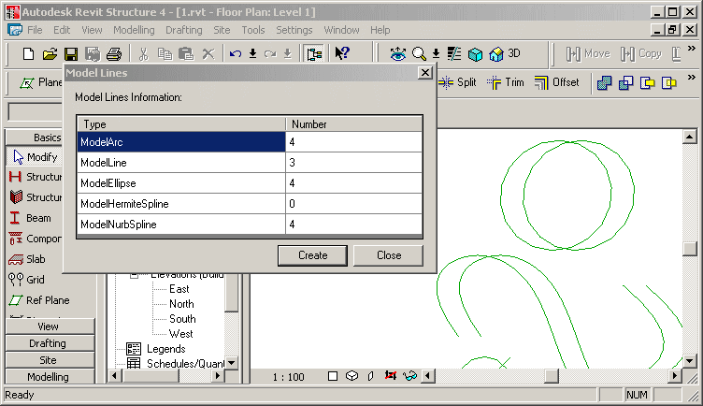
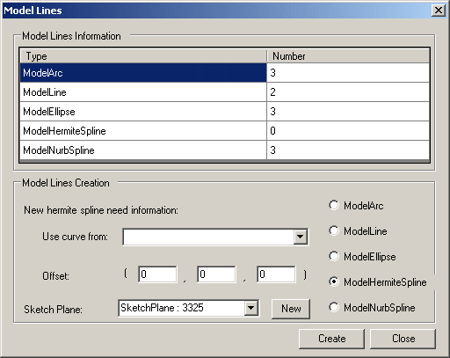
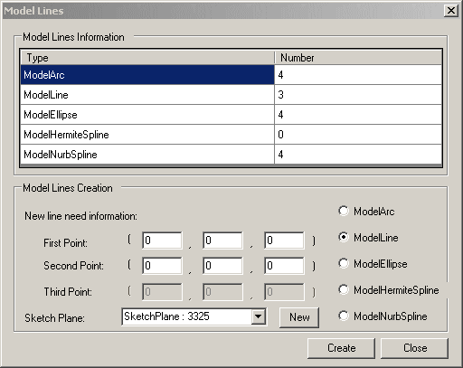
9.1 Samples
Model Lines
ModelLines – All
ModelLines1 - creates a new sketch plane for drawing the new model lines on
ModelLines2 - allows the user to select which existing sketch plane to draw the new lines on and data to use
You need to draw some ellipses and nurb splines before invoking the command. (these underlying geometry curves cannot be created with Revit API, yet.)
Notes:
Report the number of each model line type and allow the user to create one of each of the following in revit - Arc, Ellipse, Line, HermiteSpline and NurbSpline.
Makes use of Autodesk.Revit.Elements.ModelCurveArray.cs and an own helper class ModelCurveCounter.
Demonstrates the API calls NewSketchPlane(), NewArc(), NewLine(), NewModelCurve(), NewCurveArray(), NewModelCurveArray(),
Draw some ellipses, hermite and nurb splines before invoke the command, because the geometry curves of these cannot be created with Revit API.
Creates a new sketch plane for drawing the new model lines on.
ModelLines2 is similar to ModelLines1, but allows the user to select which existing sketch plane to draw the new lines on.

Slide 55
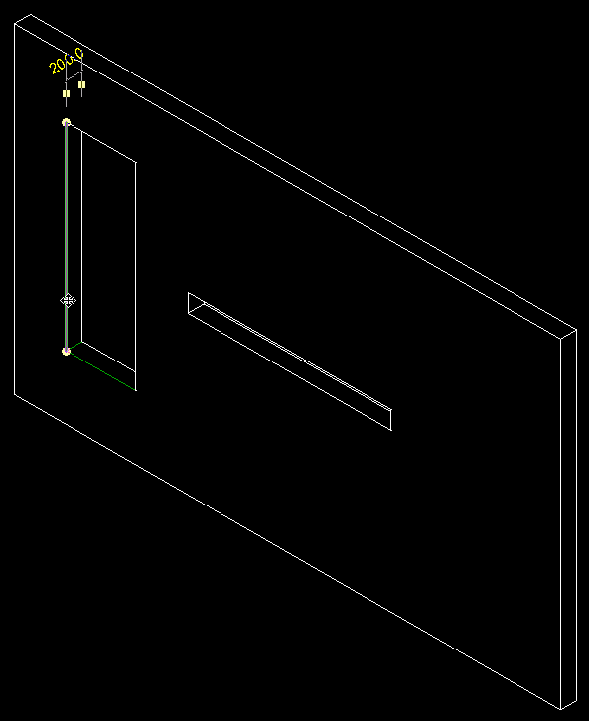
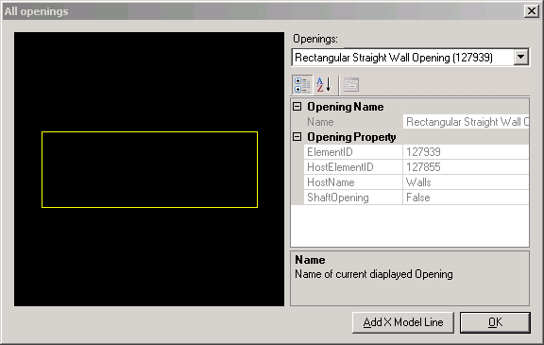
9.1 Samples
Openings
Openings – All
New API calls to access openings
Using family based elements or shafts
Sample displays openings and creates model lines on edges
Generic and Opening-specific helper classes
Vector, UCS, Line2D, Line3D, LineSketch, ObjectSketch
WireFrame to implement an own little mini graphics system
OpeningProperty, OpeningInfo
Notes:
Draw a wall, add one tall narrow and one low wide opening, run the command.
In the dialogue box, you can select any one of the openings in the model. It is displayed in a preview window. Clicking ‘Add X Model Line’ causes the application to draw model lines on the edges of the opening. For a rectangular opening in a planar wall, this will draw 12 model lines.
Bug: the model lines are in the wrong place if the wall is not axis aligned.
How to see the model lines created by this sample after running it? Use the tooltips on the 12 edges of the selected opening.
Description: Display openings in project and create X model lines on them.
Readme:
Autodesk Revit API application: Openings
This is a really minimal sample that shows how to get the property of an opening, show its profile in preview a window and create model lines on it. All the interesting code is in Openings project. Openings.cs contains the code to implement drawing. The WireFrame class retrieves the element profile.
To build the *.dll, edit project properties and make sure additional reference component include the Revit.dll in Revit Structure 4 installation directory. Then, paste the contents of Revit.ini into Revit.ini. Launch Revit, note the Tools -> External Tools -> Openings Commands menu.
This sample implements some generic helper classes Vector, UCS, Line2D, Line3D, LineSketch, ObjectSketch, WireFrame to implement an own little mini graphics system:
Vector: Point class use to store point coordinate value and get the value via (x, y ,z)property.
UCS: User coordinate system.
Line2D, Line3D: Line classes to represent a geometry segment line.
ObjectSketch: base class of sketch object to draw 2D geometry object, manages bounding box, pen and transformation.
LineSketch: sketch line and any tag on it.
WireFrame: class to generate the model lines and fit the picture box's size to display.
This sample implements some Opening-specific helper classes OpeningProperty, OpeningInfo
bug:
start revit
open 1.rvt
start openings
select one opening
select create x lines
close the dialogue
--> one opening is displayed on the revit screen with a black background
click View > Refresh
--> the whole screen turns black
it only happened once, when i was debugging a lot, and suspended the computer midway.

Slide 56
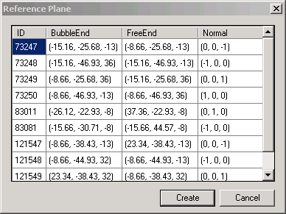
9.1 Samples
Reference Plane
Reference Plane – All
Report all reference planes in the current project
Show their ID, bubble end, free end, and normal
ReferencePlane class
Create a new reference plane at the left face of the selected wall or at the bottom of selected slab
NewReferencePlane() method
Notes:
I ran this in C:\a\j\adn\train\revit\mep\test\Urban House MEP.rvt.
Reference Planes and Sketch Planes
Autodesk.Revit.Creation.Application.NewPlane
Autodesk.Revit.Creation.Application.NewPlane
Autodesk.Revit.Creation.Document.NewReferencePlane
Autodesk.Revit.Creation.Document.NewReferencePlane2
Autodesk.Revit.Creation.Document.NewSketchPlane

Slide 57
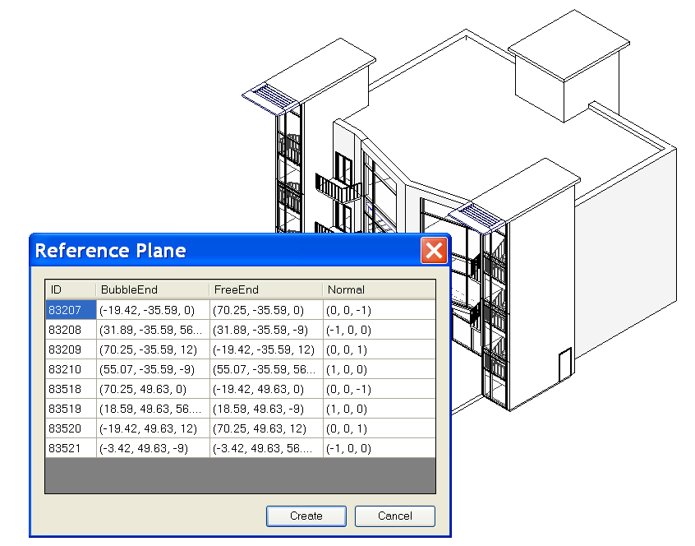
9.1 Samples
Reference Plane
Reference Plane – All
Notes:
Steps:
0. Open a .RVT file containing reference plane objects, e.g m_CoHouse.rvt in the training folder.
1. Run the external command.
2. A dialog will appear to report all reference planes in the current project, showing its ID, bubble end, free end, and normal.
3. If a wall or a slab is selected before the command is run, when Create button is clicked, a reference plan will be created at the left face of the wall or at the bottom of the slab.
4. After the new reference plan is created, we can list it out by running the command again.

Slide 58
9.1 Samples
Accessing Room Elements
Rooms – All
Report room information: ID, Name, Number, Level, Department, Area, Have tag
Room class
Create a tag for a room if it has none
NewRoomTag() method
Notes:
Rooms:
Autodesk.Revit.Elements.Room.Number
Autodesk.Revit.Elements.RoomTag
Autodesk.Revit.Creation.Document.NewRoom
Autodesk.Revit.Creation.Document.NewRoomTag

Slide 59
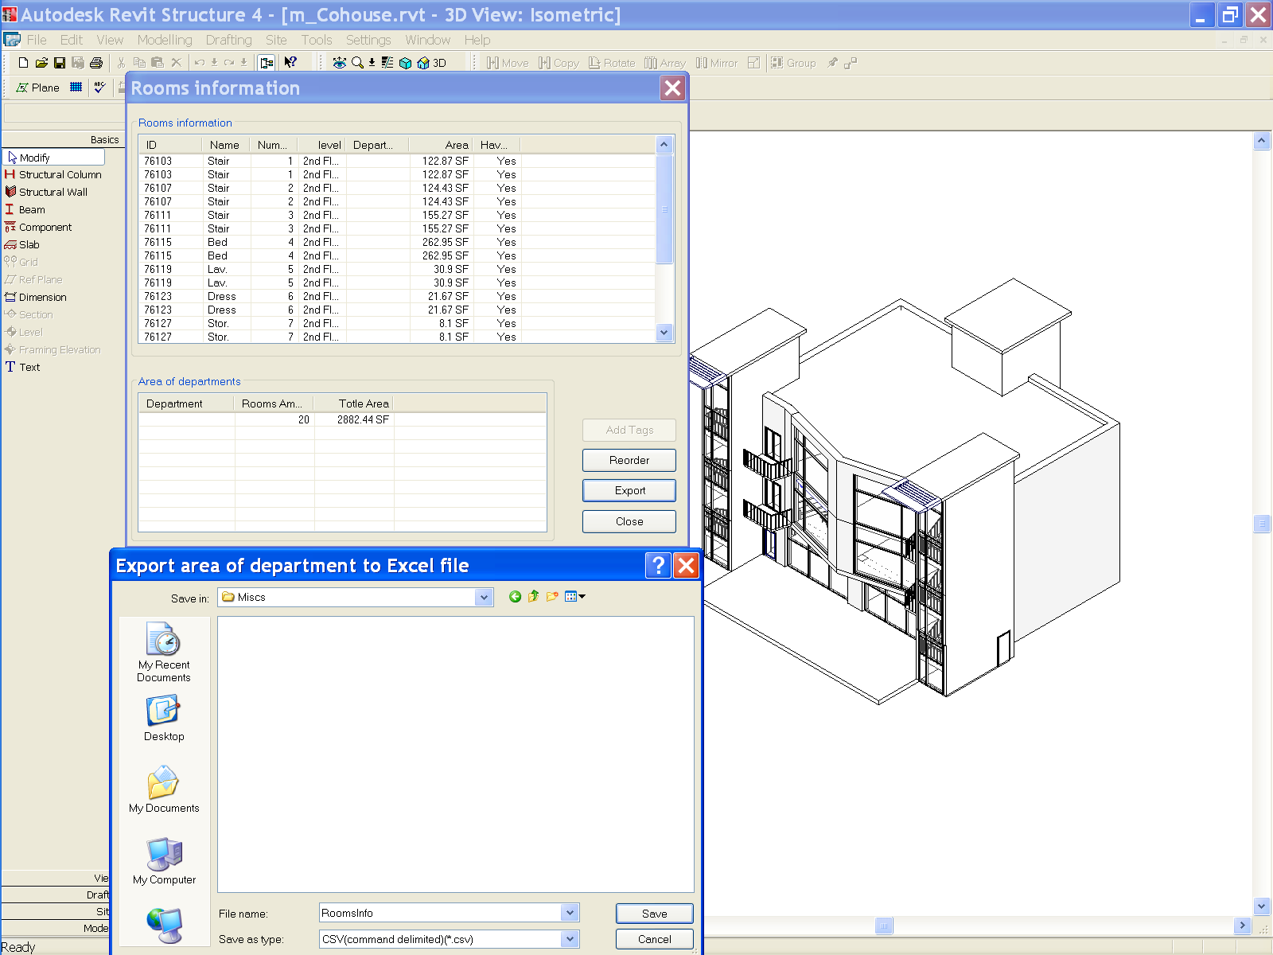
9.1 Samples
Accessing Room Elements
Rooms – All
Notes:
Steps: [MH: why do they have duplicates in the list above?]
0. Open a .RVT file containing room objects, e.g m_CoHouse.rvt in the training folder.
1. Run the command. A dialog will display the information of all rooms.
2. Create room tags and add them to the rooms which are lack of tags.
3. Reorder the number of all rooms by ascending order from ground floor to high floor, from left to right.
4. Calculate the rooms area for each department and export the result to an Excel document.

Slide 60
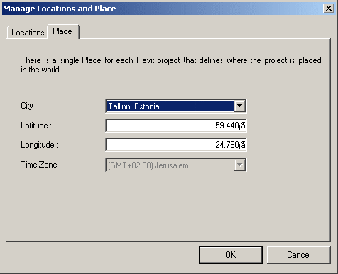
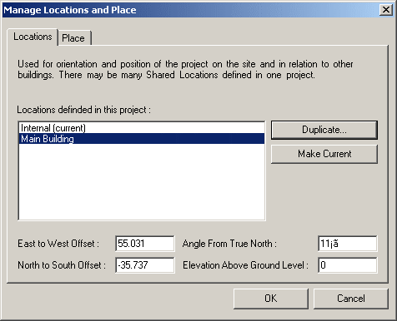
9.1 Samples
Location and Place
SharedCoordinateSystem – All
Display project location and site information
Similar to UI access, now API is available as well
[Settings] --> [Manage place and locations...]
Notes:
Display the locations and site information of the project.
1. Show the project location and site information for current project.
2. Users can set the values to change the location.
3. In the Project Browser, open a 2D plan view of the project. Click View menu and select View Properties, set the view orientation to True North.
4. On the Tools menu, click Shared Coordinates and select Acquire Coordinates.
To avoid the warning that timezone.txt could not be found, copy
R:\Samples\SharedCoordinateSystem\CS\timezone.txt
to
R:\Samples\SharedCoordinateSystem\CS\bin\Debug\timezone.txt
(1) where do you see this in UI.
This sample seems to be duplicating a two dialogs that you see in:
[Settings] menu --> [Sun and Shadows settings...] --> [Still] tab in [Name] --> click on the right-down arrow next to the [Place] under [By Date, Time and Place] toggle button,
You will see the very similar dialog there.
Actually, a better place to reach this info in UI is
[Setting] --> [Manage place and locations]
(2) what you see with External command?
If you duplicated the site location in the external command, you will see it there in the UI, too.
(3) implications
This is added for the Japanese developer who is developing Sun and Shadow Analysis. (Mikako logged this wish for GSA) In Japan, Sun and Shadow Analysis is the Must document. While revit has a long list of locations in ww, you couldn't have a more precise locations in earlier versions. (I think this is enhancement in UI, too. I don't remember exactly how it looked though...) So the developer can add more cities in Japan for exact locations.
The UI seems the same as 9.0, but there was no API to access this in the past.

Slide 61
9.1 Samples
Boundary Conditions
BoundaryConditions – Rst
Define and access boundary condition in the model
New and modified classes and methods
Autodesk.Revit.Elements.BoundaryConditions
Autodesk.Revit.Creation.Document.NewPointBoundaryConditions
Autodesk.Revit.Creation.Document.NewLineBoundaryConditions
Autodesk.Revit.Creation.Document.NewLineBoundaryConditions
Autodesk.Revit.Creation.Document.NewAreaBoundaryConditions
Autodesk.Revit.Creation.Document.NewAreaBoundaryConditions
Notes:
Now we come to the structure-only samples.

Slide 62
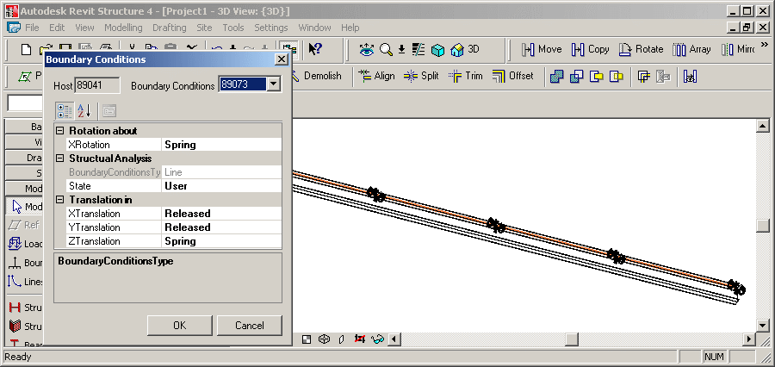
9.1 Samples
Boundary Conditions
BoundaryConditions – Rst
Display boundary conditions parameters
Create new boundary conditions
Notes:
Create a Structural Wall or Beam element.
Open a 3D view to see the analytical model, pointing out that no boundary conditions are set.
Select it.
Invoke the command.
Since it has no boundary conditions to start with, new ones are created and can be modified through the dialogue.
Set some boundary conditions.
Close the dialogue and point out that BCs have been added.
Autodesk Revit API application: BoundaryConditions
1. Firstly, user should select a structure element.
2. Invoke external command.
3. If the selected element has boundary conditions the parameters of the boundary conditions (BC) are presented. And users are also allowed to set these parameters with other valid values.
4. If the selected element does not have a BC then create one.
The sample set the conversion between the internal value and display value fit to Imperial unit.
Create a few walls in structural. Select one of them. Start the command.
The command checks whether exactly one element has been preselected and exits with an error message otherwise.
The method IsStructuralElement() determines whether the selected element is structural. To do so, it checks whether its class is one of FamilyInstance, Wall, Floor, or ContFooting, and whether it has a non-null AnalyticalModel property.
The boundary conditions for the selected element are collected from the database and saved in a dictionary in a BoundaryConditionsData instance, which also knows the host element, the dictionary key BC id.
If no boundary conditions have been set for the selected element, a suitable set of BCs are created when loading the form, in BoundaryConditionsForm_Load().
New boundary conditions are created by CreateBoundaryConditions(): point, line, and area.
Exercise the new API calls NewPointBoundaryConditions(), NewLineBoundaryConditions(), NewAreaBoundaryConditions().
The BoundaryConditionsData class has a member data object BCProperties which determines the data displayed by the ui PropertyGrid.
BCProperties knows about certain BC parameter values rules according to the Revit main program as well.
This sample also includes some sample boundary condition families: Boundary Conditions Fixed.rfa, Boundary Conditions Pinned.rfa, Boundary Conditions Roller.rfa, Boundary Conditions User.rfa
These families seems to be similar to the built-in boundary conditions?
This sample seems to be similar to the built-in boundary conditions command?

Slide 63
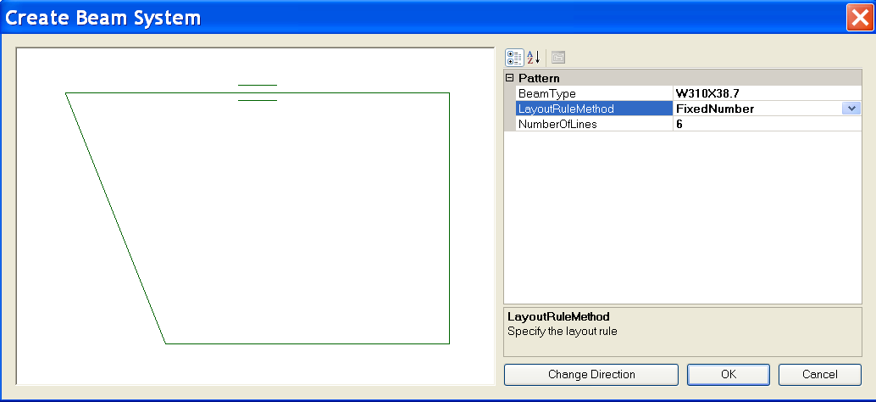
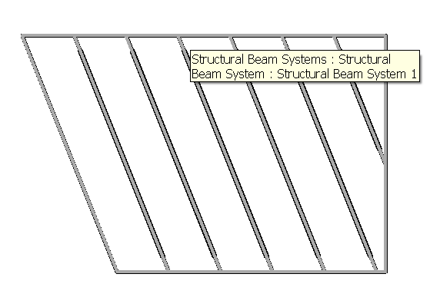
9.1 Samples
Create Beam System
CreateBeamSystem – Rst
Demonstrate creation of a beam system
From some beams connecting each other
Uses NewBeamSystem()
Illustrates the BeamSystem class
How to convert from physical model
Notes:
Steps:
0. Create a few beams connecting to each other to form a loop.
1. Select all these beams before running the command.
2. Invoke the external command.
Choose layout method and beam type in the dialog.
Change the direction of the beam system if necessary.
Click OK button to create the beam system.
Note: The spacing of the beam system may not be easy to specify especially when you create the beams on the fly. You can choose FixedNumber LayoutRuleMethod in the Create Beam System dialog to make things easier.
Beam Systems:
Autodesk.Revit.Elements.BeamSystem
Autodesk.Revit.Elements.LayoutRule
Autodesk.Revit.Elements.LayoutRuleFixedDistance
Autodesk.Revit.Elements.LayoutRuleFixedNumber
Autodesk.Revit.Elements.LayoutRuleMaximumSpacing
Autodesk.Revit.Elements.LayoutRuleClearSpacing
Autodesk.Revit.Creation.Document.NewBeamSystem

Slide 64
Create Foundation Slab
9.1 Samples
FoundationSlab – Rst
Create octagonal foundation slabs for selected floors at the base of the building
Demonstrate Autodesk.Revit.Creation.Document.NewFloor
Parameter BuiltInParameter.STRUCTURAL_FLOOR_ANALYZES_AS
4 suggests foundation slab
Notes:
This sample requires a floor at the lowest level of the building.
In a new drawing, draw three structural walls forming a closed triangle. Draw a slab by walls on level 1, pick the three walls. Run the command.
(1) New drawing.
(2) Basics > Structural Wall > Click, Click, Click, Click.
(3) Double click Structural Plans > Level 1.
(4) Basics > Slab > Pick Walls > Click, Click, Click, Finish Sketch.
(5) Tools > External Tools > Foundation Slab.
This sample iterates over the current building model and assembles the following data:
// A set of levels to find out the lowest level of the building.
SortedList<double, Level> m_levelList = new SortedList<double,Level>();
// A set of views to find out the regular slab's bounding box.
List<View> m_viewList = new List<View>();
// A set of floors to find out all the regular slabs at the base of the building.
List<Floor> m_floorList = new List<Floor>();
// A set of regular slabs at the base of the building.
// This set supplies all the regular slabs' datas for UI.
List<RegularSlab> m_allBaseSlabList = new List<RegularSlab>();
// A set of the types of foundation slab.
// This set supplies all the types of foundation slab for UI.
List<FloorType> m_slabTypeList = new List<FloorType>();
It defines a helper class Sketch for drawing slabs and floors profiles into a WinForms PictureBox instance.
It calculates the bounding box of each floor, calculates an octagonal slab shape enclsing its bounding box.
On clicking OK, the original floor is replaced by an octagonal foundation slab.
Demonstrates the API call NewFloor().
Deletes the original floor.

Slide 65
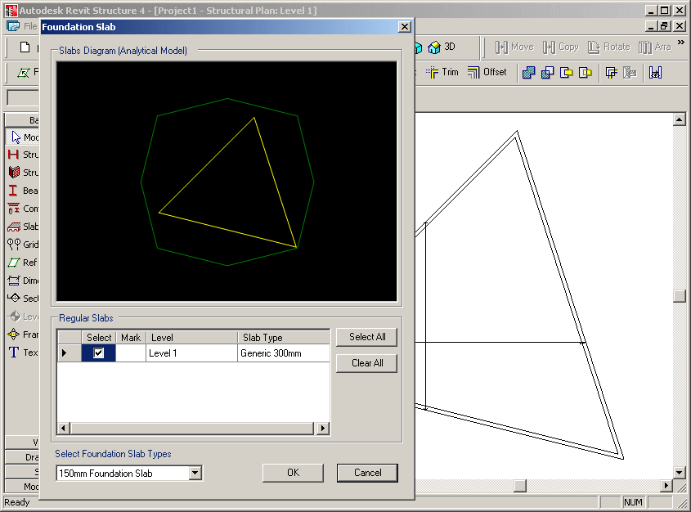
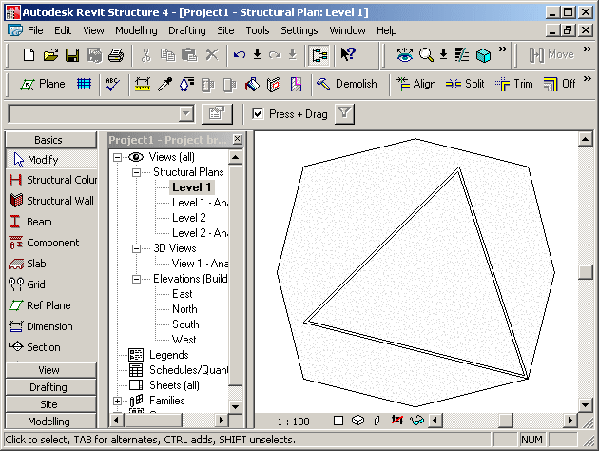
9.1 Samples
Foundation Slab
FoundationSlab – Rst
Extracts all floors and levels, determines lowest ones
Determines existing regular slab’s bounding box
Determines available foundation slab types
Implements a helper class Sketch for drawing slabs and floors profiles into a WinForms PictureBox instance
Calculates an enclosing octagonal slab shape

Slide 66
Structural Element Material
9.1 Samples
Materials – Rst
All available materials can be obtained by the property Materials of Setting object
All material parameters can be retreived using
Autodesk.Revit.Parameters.BuiltInParameter parameterId;
get_Parameter( parameterId );
One BuiltInParameter couples with one parameter
Structural Units are demonstrated as well
Materials2 is very similar to Materials1. No identity, misc. properties
Works with Structure – uses analytical model and “Beam Material”, “Column Material” properties
Currently, it won’t work with wall and floor: SPR #122487: Material API - doesn't reflect after changed
Notes:
Materials:
Autodesk.Revit.Color
Autodesk.Revit.FillPatternSet
Autodesk.Revit.FillPatternSetIterator
Autodesk.Revit.MaterialSet
Autodesk.Revit.MaterialSetIterator
Autodesk.Revit.Materials
Autodesk.Revit.Elements.FillPattern
Autodesk.Revit.Elements.Material
Autodesk.Revit.Elements.MaterialConcrete
Autodesk.Revit.Elements.MaterialGeneric
Autodesk.Revit.Elements.MaterialOther
Autodesk.Revit.Elements.MaterialSteel
Autodesk.Revit.Elements.MaterialWood
Autodesk.Revit.Settings.FillPatterns
Autodesk.Revit.Settings.Materials
Autodesk.Revit.Creation.Application.NewFillPatternSet
Autodesk.Revit.Creation.Application.NewColor
Autodesk.Revit.Creation.Document.NewMaterialSet

Slide 67
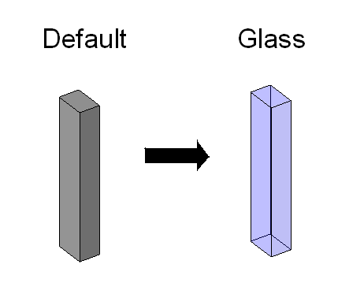
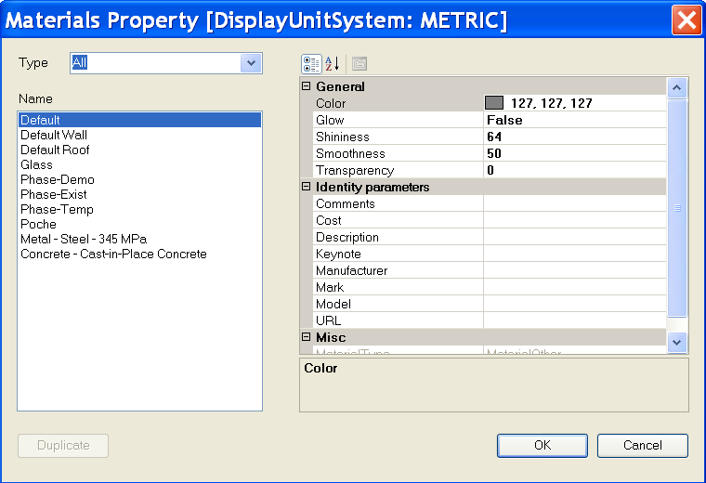
9.1 Samples
Structural Element Material
Materials1 – Rst
Notes:
Steps:
0. Create a structure element such as a column.
1. Select the structure element.
2. Run the external command.
3. All available materials in the current project will be listed out in a form.
4. Choose a material other than the previous one and press OK button.
5. The material of the structure element will be changed.
Note: Users can duplicate a concrete material which is not light weight.
Materials:
Autodesk.Revit.Color
Autodesk.Revit.FillPatternSet
Autodesk.Revit.FillPatternSetIterator
Autodesk.Revit.MaterialSet
Autodesk.Revit.MaterialSetIterator
Autodesk.Revit.Materials
Autodesk.Revit.Elements.FillPattern
Autodesk.Revit.Elements.Material
Autodesk.Revit.Elements.MaterialConcrete
Autodesk.Revit.Elements.MaterialGeneric
Autodesk.Revit.Elements.MaterialOther
Autodesk.Revit.Elements.MaterialSteel
Autodesk.Revit.Elements.MaterialWood
Autodesk.Revit.Settings.FillPatterns
Autodesk.Revit.Settings.Materials
Autodesk.Revit.Creation.Application.NewFillPatternSet
Autodesk.Revit.Creation.Application.NewColor
Autodesk.Revit.Creation.Document.NewMaterialSet

Slide 68
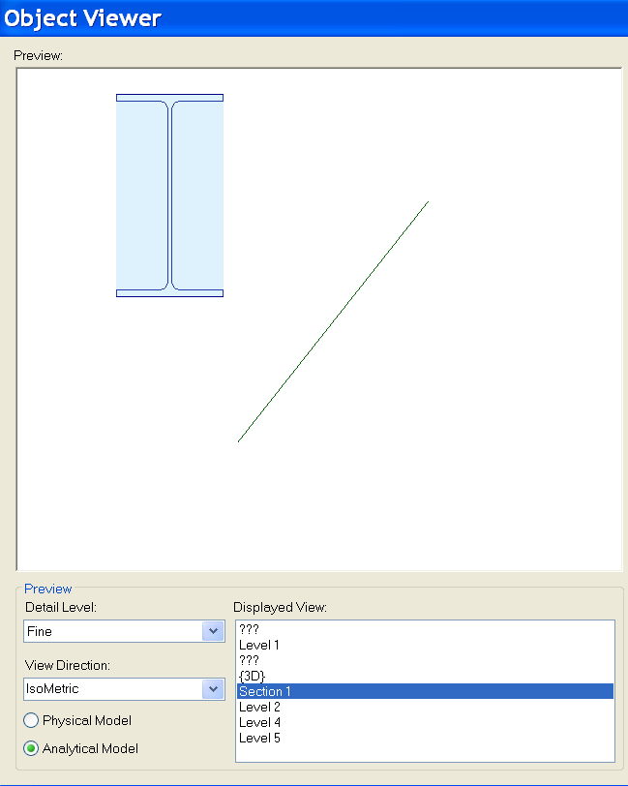
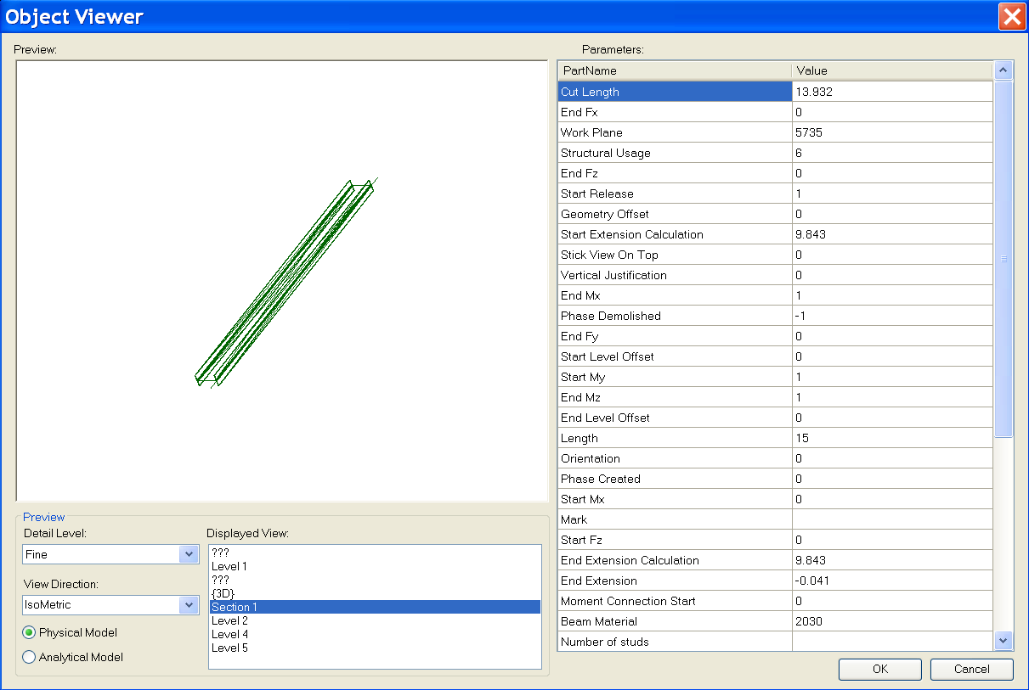
9.1 Samples
Viewer
ObjectViewerII – Rst
Display a selected single element in a preview window
Retrieve geometry from both physical and analytical model
Demonstrate unit handling
Notes:
Steps:
1. Select a structure element such as a beam.
2. Run the external command.
3. All Display Views are listed out. Detail Level can be chosen; Physical Model and Analytical Model can be switched.

Slide 69
9.1 Samples
Rebar in a Beam or Column
Reinforcement – Rst
Path reinforcement classes and methods
Autodesk.Revit.Elements.PathReinforcementCurve
Autodesk.Revit.Elements.PathReinforcement
Autodesk.Revit.Symbols.PathReinforcementType
Autodesk.Revit.Elements.SketchPlan
Autodesk.Revit.Elements.ReferencePlane
Autodesk.Revit.Elements.Opening
Autodesk.Revit.Geometry.Plane
Notes:
Path Reinforcement:
Autodesk.Revit.Elements.PathReinforcementCurve
Autodesk.Revit.Elements.PathReinforcement
Autodesk.Revit.Symbols.PathReinforcementType
Autodesk.Revit.Elements.SketchPlan
Autodesk.Revit.Elements.ReferencePlane
Autodesk.Revit.Elements.Opening
Autodesk.Revit.Geometry.Plane

Slide 70
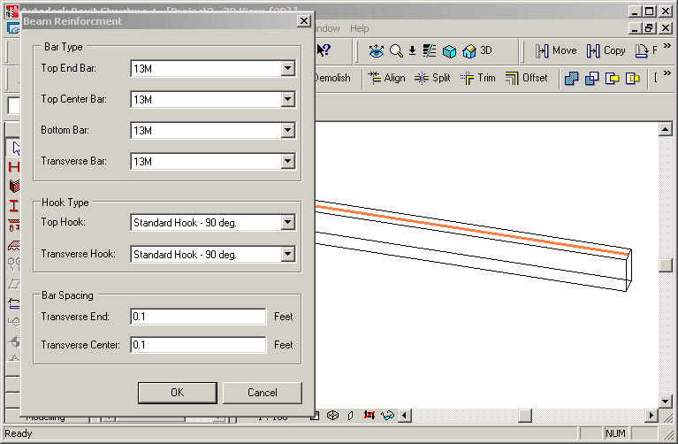
9.1 Samples
Rebar in a Beam or Column
Reinforcement – Rst
Create reinforcement rebars in selected non-reinforced concrete beam or column
Beam rebar: top, bottom or transverse
Column rebar: transverse or vertical
Notes:
Start Revit Structural, create a concrete beam, run the command.
Create reinforcement rebars on the selected concrete beam or column without reinforcement.
Create bar set in a selected concrete element (beam or column) that does not have any reinforcement.
1. Create bar set in a selected concrete element (beam or column) that does not have any reinforcement.
2. Beam rebar should be three kinds: top rebar, bottom rebar and transverse rebar.
3. Column rebar should be two kinds: transverse rebar and vertical rebar.
The class FrameReinMakerFactory does all the work, such as perform precondition testing
and create a corresponding FrameReinMaker and the reinforcement rebars.
Precondition checks include: is the selected object a beam or column, is it made of concrete, does it already contain any Rebar elements.
Two further classes do the work depending on host type: BeamFramReinMaker and ColumnFramReinMaker.
GeomUtil: basic geometric utility methods.
GeometrySupport: base class for BeamGeometrySupport and ColumnGeometrySupport, manages the solid of beam or column, the extend or sweep path of the beam or column, the director vector of beam or column, lists to store the edges and points, the transformation etc.
ParameterUtil: utility methods find or set certain parameter.

Slide 71
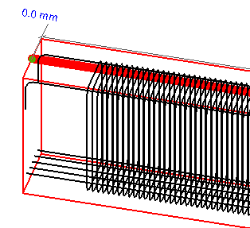
9.1 Samples
Rebar in a Beam or Column
Reinforcement – Rst
FrameReinMakerFactory class does all the work
Precondition checks
Is the selected object a beam or column?
Is it made of concrete?
Does it already contain any Rebar elements?
Create a corresponding FrameReinMaker and the reinforcement rebars
Host-dependant working classes
BeamFramReinMaker and ColumnFramReinMaker
GeomUtil
Basic geometric utility methods
GeometrySupport
Base class for BeamGeometrySupport and ColumnGeometrySupport, manages the solid of beam or column, the extend or sweep path of the beam or column, the director vector of beam or column, lists to store the edges and points, the transformation etc.
ParameterUtil
Utility methods find or set certain parameter
Notes:
Start Revit Structural, create a concrete beam, run the command.
Create reinforcement rebars on the selected concrete beam or column without reinforcement.
Create bar set in a selected concrete element (beam or column) that does not have any reinforcement.
1. Create bar set in a selected concrete element (beam or column) that does not have any reinforcement.
2. Beam rebar should be three kinds: top rebar, bottom rebar and transverse rebar.
3. Column rebar should be two kinds: transverse rebar and vertical rebar.
The class FrameReinMakerFactory does all the work, such as perform precondition testing
and create a corresponding FrameReinMaker and the reinforcement rebars.
Precondition checks include: is the selected object a beam or column, is it made of concrete, does it already contain any Rebar elements.
Two further classes do the work depending on host type: BeamFramReinMaker and ColumnFramReinMaker.
GeomUtil: basic geometric utility methods.
GeometrySupport: base class for BeamGeometrySupport and ColumnGeometrySupport, manages the solid of beam or column, the extend or sweep path of the beam or column, the director vector of beam or column, lists to store the edges and points, the transformation etc.
ParameterUtil: utility methods find or set certain parameter.

Slide 72
9.1 Samples
Units
New and updated methods
Autodesk.Revit.Document.DisplayUnitSystem
Autodesk.Revit.Parameter.DisplayUnitType
Autodesk.Revit.Parameter.AsValueString
Notes:
Improved handling of units
Shelter the user from the internal Revit database units
DisplayUnitSystem = Is Revit set up to show units in metric or Imperial
DisplayUnitType = Returns the display units for a value
AsValueString = Returns the value properly formatted in the same way that Revit would format the text
Units:
Autodesk.Revit.Document.DisplayUnitSystem
Autodesk.Revit.Parameter.DisplayUnitType
Autodesk.Revit.Parameter.AsValueString

Slide 73
2008 Samples
2008.0 and 2008.2

Slide 74
APIAppStartup
2008 Samples
Demonstrates start up and shut down events (C#)
Interface IExternalApplication
public class AppSample : IExternalApplication
IExternalApplication.OnStartup() event
IExternalApplication.Result
IExternalApplication.OnStartup(ControlledApplication application)
{
String version = application.VersionName;
//display splash window for 10 seconds
SplashWindow.StartSplash();
SplashWindow.ShowVersion(version);
System.Threading.Thread.Sleep(10000);
SplashWindow.StopSplash();
return IExternalApplication.Result.Succeeded;
}
IExternalApplication.OnShutdown() event
IExternalApplication.Result
IExternalApplication.OnShutdown(ControlledApplication application)
{
MessageBox.Show("Quit External Application");
return IExternalApplication.Result.Succeeded;
}
Notes:
Note:
Please do not forget to use the latest version of the APIAppStartup sample. Its beta version is INCOMPLETE!
It works with both Architecture and Structure.
In the callback of the IExternalApplication.OnStartup() event, displays a splash screen.
In the callback of the IExternalApplication.OnShutdown() event, displays a dialog box.

Slide 75
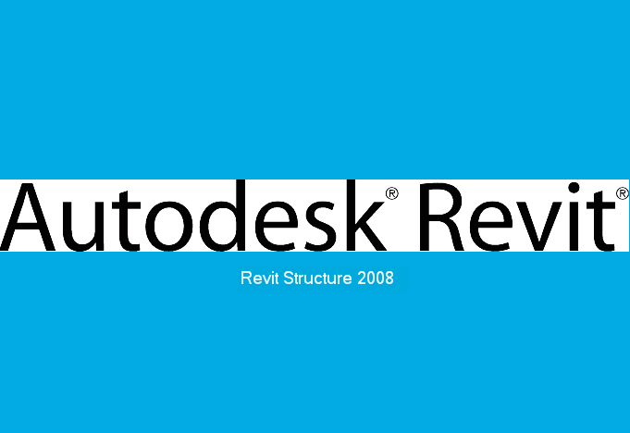
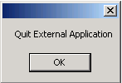
APIAppStartup Demo
2008 Samples
Notes:
Steps:
1. Make sure the sample is registered as an external application. For example:
[ExternalApplications]
EACount=1
EAClassName1=APIAppStartup.AppSample
EAAssembly1=C:\Revit\SDK\Samples\APIAppStartup\bin\Debug\APIAppStartup.dll
2. Launch Revit 2008. Notice the splash screen will show up.
3. Quit Revit. Notice the dialog will show up.
4. Click OK to exit.

Slide 76

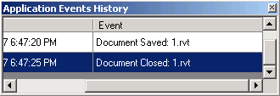
ApplicationEvents
2008 Samples
Subscribe to application events and create custom menus (C#)
Classes
Autodesk.Revit.Events.ApplicationEvents
Autodesk.Revit.MenuItem
Autodesk.Revit.Application
Autodesk.Revit.Document
Events
DocumentClosedEventHandler
DocumentOpenedEventHandler
DocumentSavedEventHandler
DocumentSavedAsEventHandler
Interface
public class RevitApplicationEvents : Autodesk.Revit.Events.ApplicationEvents
Event callbacks
public RevitApplicationEvents(Application app)
{
if (null != app)
{
app.OnDocumentClosed += new DocumentClosedEventHandler(OnDocumentClosed);
app.OnDocumentOpened += new DocumentOpenedEventHandler(OnDocumentOpened);
app.OnDocumentSaved += new DocumentSavedEventHandler(OnDocumentSaved);
app.OnDocumentSavedAs += new DocumentSavedAsEventHandler(OnDocumentSavedAs);
}
m_eventsLog = CreateEventsLogTable();
}
Notes:
The sample creates one custom top level menu and one sub-menu when Revit application starts up and uses this sub menu to show or hide a modeless window which displays the Revit application object events’ history log.
This sample will subscribe to Application’s document open, close, save and save as events.
This sample lists document’s opened, closed, saved or saved as information in a modeless window when the document is opened, closed, saved or saved as.
This sample creates a custom top level menu named "MyCustomTopMenu". And below this top menu a menu named "Track Revit Application Events" is created too to show and hide the modeless window.
Implementations:
The class which answers for adding custom menus must implement IExternalApplication interface. And the custom menus should be created in OnStartup method.
Application.CreateTopMenu method and MenuItem.Append method can be used to create custom menu.
OnDocumentOpened, OnDocumentClosed,OnDocumentSaved and OnDocumentSavedAs event handlers of Application class can be used to subscribe to relevant events.

Slide 77
Toolbar
2008 Samples
Demonstrates how to create a toolbar (C# and VB.NET)
Derive from the IExternalApplication interface
class CreateToolbar : IExternalApplication
Implement the OnStartup method
public IExternalApplication.Result OnStartup( _ ControlledApplication application )
Create a toolbar with
Application.NewToolbar()
Add a button with:
Toolbar.AddItem(MenuItem)
Toolbar commands are implemented with the interface
IExternalCommand
Notes:
This sample provides the following functionalities:
Add a custom toolbar with three buttons into Revit and Use Application.NewToolbar() to create the Toolbar via API.
Between the second button and the third button there is a separator.
Every button should have a corresponding command to execute. The command should implement the interface of IExternalCommand.
The first button will create a wall. Use Toolbar.AddItem(MenuItem) to add this button .
The second button will delete all walls in current project. Use Toolbar.AddItem(String, String) to add this button .
The third button will pop up a dialog box and show some information about Customer Toolbar.
There are two types of ToolbarItem, the third button has image only and the others two have both image and text.
Every button has a ToolTip when mouse on it.
Every button has a tip in Revit status bar to describe the button usage when it gets focus.
Implementation Notes
The command, which will be executed when the ToolbarItem button is clicked, should derive from IExternalCommand.
The Toolbar can be created via API: Application.NewToolbar().
The ToolbarItem button can be added via API: Toobar.AddItem(MenuItem) or Toobar.AddItem(String, String).
The separator is a ToolbarItem too, we can use AddItem(nullptr) to create this separator; or we can set the ToolbarItem’s ToolbarItemType property with ToolbarItemType::BtnSeparator.
The Image property of toolbar will affect the image of each ToolbarItem. Besides, the ImageIndex of toolbar will affect the image of ToolbarItem too.
ToolbarItem.ToolTip can set the tip when mouse move on the ToolbarItem button.
ToolbarItem.StatusbarTip can set the tip in Revit status bar when the ToolbarItem button gets focus

Slide 78
AutoTagRooms
2008 Samples
C# Sample
Get all rooms in a specified level
Get all room tags in the current document
Create new room tags with specified room tag type
Auto tag all rooms in a specified level
Classes
Autodesk.Revit.IExternalCommand
Autodesk.Revit.Elements.Room
Autodesk.Revit.Elements.RoomTag
Autodesk.Revit.Symbols.RoomTagType
Autodesk.Revit.Creation.Document
Code
RoomTag newTag = m_revit.ActiveDocument.Create.NewRoomTag( tmpRoom, ref point );
Notes:
This sample demonstrates three main features:
How to get all rooms in a specified level.
How to get all room tags in current document.
How to create new room tags with specified room tag type to auto tag all rooms in a specified level.

Slide 79
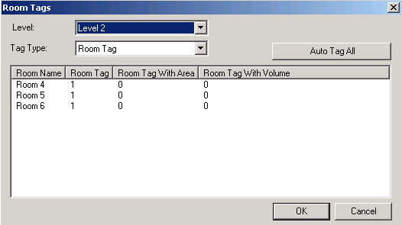
AutoTagRooms Demo
2008 Samples
Notes:
Add these lines to revit.ini file.
[ExternalCommands]
ECCount= 1
ECName1= Rooms Tag
ECClassName1= Revit.SDK.Samples.RoomsTag.CS.Command
ECAssembly1= RoomsTag.dll
ECDescription1= Auto tag all rooms in a specified level.
Steps:
Draw some rooms in different levels.
Run this command.
A dialog will be shown to display all the levels that have rooms, all the room tag types, all rooms in the selected level and the count of room tags of each type.
Select a level and a room tag type. Click the "Auto Tag All" to auto tag the rooms in the level.
Click "OK" button to accept the new created room tags or click "Cancel" button to abort them.

Slide 80
BlendVertexConnectTable
2008 Samples
Retrieve all vertices and vertex connection edges of blend family (C#)
Classes
Autodesk.Revit.IExternalCommand
Autodesk.Revit.Elements.GenericForm
Autodesk.Revit.Elements.Blend
Autodesk.Revit.Elements.View
Autodesk.Revit.Elements.FamilyInstance
Autodesk.Revit.Geometry.Transform
Autodesk.Revit.Geometry.Curve
Autodesk.Revit.Geometry.XYZ
Notes:
This sample uses Autodesk.Revit.Elements.GenericForm, Blend and View classes mostly to get the blend family from selected solid blend mass, to retrieve the vertex connect edges and sketches of blend, to display the vertex connect information in form.
The blend object can be retrieved from FamilyInstance.Symbol.Family.SolidForms.
Top sketch and bottom sketch can be retrieved from Blend.TopSketch and Blend.BottomSketch properties.
Blend.FirstEnd and Blend.SencondEnd can be used to get Z coordinate values of bottom sketch and top sketch.
The Geometry.Element can be retrieved from Blend.get_Geometry(Geometry.Options).
GeometryObjectArray can be retrieved from Gometry.Element.Objects.
Geometry.Solid can be retrieved from Geometry.GeometryObject.
Geometry.Edge objects can be retrieved from Geometry.Solid.Edges.
To get projection matrix of current view, use properties RightDirection, UpDirection, ViewDirection of View and method Inverse of Transform.

Slide 81
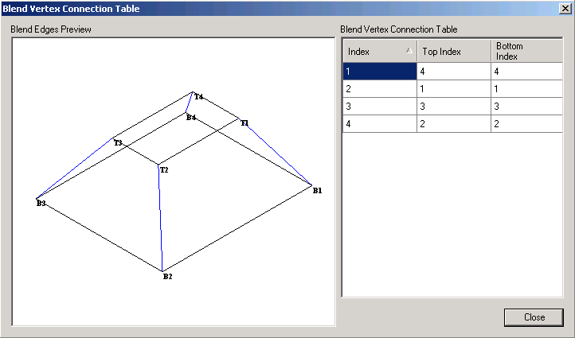
BlendVertexConnectTable Demo
2008 Samples
Notes:
Steps:
Register the command:
[ExternalCommands]
ECCount = 1
ECName1 = Blend Vertices and Vertex Connection Table
ECClassName1 = Revit.SDK.Samples.BlendVertexConnectTable.CS.Command
ECAssembly1 = C:\Revit\SDK\Samples\BlendVertexConnectTable\bin\Debug\BlendVertexConnectTable.dll
ECDescription1 = Get Blend Vertices and Vertex Connection Table.
Draw a solid blend form mass (Revit Structure 2008 User's Guide > Creating Your Own Components (Families) > Family Editor > Solid Geometry Tools > Creating Solid Blends).
Select the mass, and then run the command.
In the popped up form the PictureBox control paints the vertex connect edges of blend in blue color, paints all edges of sketch in black color, marks the top and bottom vertexes with "Tn" and "Bn" strings; the DataGridView control shows the vertex connect information.
User can reorder the DataGridView columns to see the connection information in different orders.

Slide 82
CurvedBeam
2008 Samples
Create curved beams (C#)
Classes
Autodesk.Revit.IExternalCommand
Autodesk.Revit.Elements
Autodesk.Revit.Creation.Document
Autodesk.Revit.Symbols.FamilySymbol
Autodesk.Revit.Elements.FamilyInstance
Autodesk.Revit.Elements.Level
Autodesk.Revit.LocationCurve
Autodesk.Revit.Geometry.Arc
Autodesk.Revit.Geometry.Ellipse
Autodesk.Revit.Geometry.NurbSpline
Autodesk.Revit.Geometry.XYZ
Code
m_revit.Create.NewArc( ref center, radius, startAngle, endAngle, ref xAxis, ref yAxis );
m_revit.Create.NewEllipse( ref center, radX, radY, ref xVec, ref yVec, param0, param1 );
NurbSpline detailNurbSpline = m_revit.Create.NewNurbSpline( ctrPoints, weights, knots, 3, false, true );
beam = m_revit.ActiveDocument.Create.NewFamilyInstance( ref center, fsBeam, level, StructuralType.Beam ); // Beam according to curve
Notes:
This sample uses FamilySymbol, FamilyInstance, LocationCurve, Arc, Ellipse and NurbSpline classes mostly to get all structural framing types and levels from Revit project, create new beam and change the curve of new beam.
To get all structural framing types and levels of Revit, use ActiveDocument.Elements property.
To get all symbols of one family, use Family.Symbols property.
To get category of family symbols, use FamiySybol.Category property.
To create arc, ellipse and nurbspline, use NewArc, NewEllipse and NewNurbSpline methods of Autodesk.Revit. Creation.Document class respectively.
To create new beam instance, use NewFamilyInstance method of Autodesk.Revit.Creation.Document class.
To get location and curve of beam, use Location property of FamilyInstance class.
To change the curve of beam, use Curve property of LocationCurve class.

Slide 83
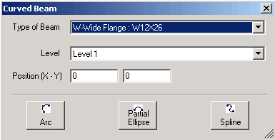
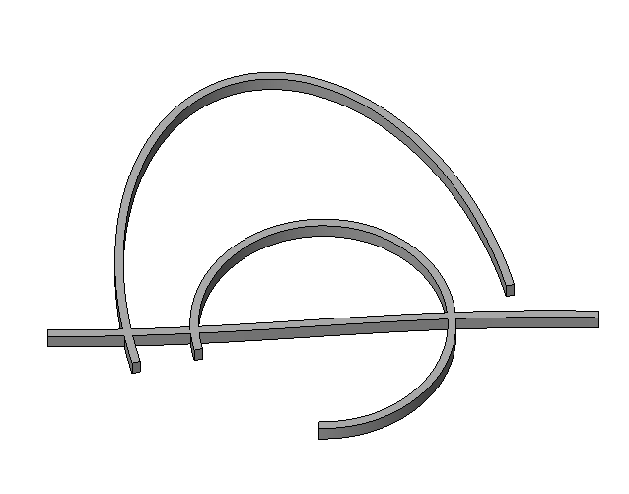
CurvedBeam Demo
2008 Samples
Live demo:
Notes:
Steps
[ExternalCommands]
ECCount = 1
ECName1 = CurvedBeam
ECDescription1 = Create Curved Beam...
ECClassName1 = Revit.SDK.Samples.CurvedBeam.CS.Command
ECAssembly1 = CurvedBeam.dll
1) Build the *.dll, edit project properties and make sure additional reference component include the RevitAPI.dll in Revit installation directory.
2) Paste the contents of Revit.ini into Revit.ini. Launch Revit, execute the "Curved Beam..." command.
3) Select the type of beam, the level. Edit the position where you want to put the curved beam. Then click button "Arc", "Partial Ellipse" or "Nurbspline" to create corresponding type of beam.

Slide 84
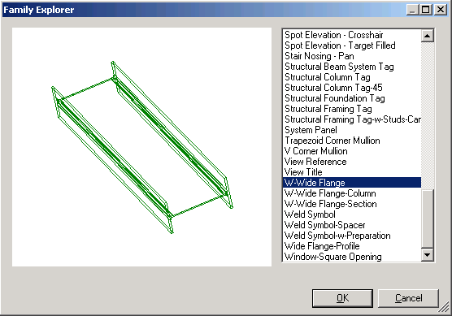
FamilyExplorer
2008 Samples
Display the profile (if applicable) of all families (C#)
Classes
Autodesk.Revit.Elements.Family
Autodesk.Revit.Elements.GenericForm
Autodesk.Revit.Geometry.Edge
Autodesk.Revit.Geometry.Transform
Notes:
Functionality:
List all families in the current document, including the in-place family.
Display the profile of the selected family with different colors, black for components, gray for others, green for solid forms, and yellow for void forms.
List all parameters of the selected family.
Implementation:
All families can be retrieved from method get_Elements(Type) of class Document, it provides access to all elements of specified type within the Document.
The family profile can be retrieved from the four properties of object Family:
Components, Others, SolidForms and VoidForms.
Components is an element set of all components that belong to a Family.
Others is an element set of all other components that belong to a Family.
SolidForms is a generic form set of all solid forms that belong to a Family.
VoidForms is s generic form set of all void forms that belong to a Family.
The geometry can be retrieved from the property Geometry of object Element or object GenericForm.
The components should be transformed according to UCS.
The viewer supports pan by click and drag and rotate by shift-click and drag.

Slide 85


Framing Builder
2008 Samples
Create a frame composed of columns, beams and braces (C#)
private void NewBeam( UV point2D1, UV point2D2, Level baseLevel, Level topLevel )
{
// calculate the start point and end point
// of Beam's location line in 3D
double height = topLevel.Elevation;
XYZ startPoint = new XYZ( point2D1.U, point2D1.V, height );
XYZ endPoint = new XYZ( point2D2.U, point2D2.V, height );
// create Beam and set its location
FamilyInstance beam = m_docCreator.NewFamilyInstance(
ref startPoint, m_data.BeamSymbol, topLevel,
StructuralType.Beam );
SetLocationLine( beam, startPoint, endPoint );
}
Notes:
This sample creates a frame.
It presents a dialog to the user asking for the following information:
Distance between columns
Number of Columns in the X direction
Number of Columns in the Y direction
The type of the columns
The type of the beams
The type of the braces
Number of Floors
The codes should verify that the number of floors is not more than the number of levels since columns will be inserted from the level below to the level above. For example if the number of floors requested is 3, then there must be 4 levels and the columns will go from Level 1 to 2, Level 2 to 3 and Level 3 to 4. If there are not enough levels tell the user the number of levels that must be added and exit the command with a failure.
Starting with the lowest level and progressing to higher levels, insert columns with the specified type into the project programmatically in an array format based on the number of columns specified in the X and Y directions with the correct specified distance between them. Do this for each floor specified.
Insert beams of the specified type between the tops of each adjacent column in the X and Y direction to form a square grid of beams. Beams are not needed between diagonal columns.
Insert braces of the specified type between the mid point of each column and the mid point of each adjoining beam.
User can create a new concrete element type through duplicating specified type. The work flow is as follows:
Press the Duplicate button in the dialog;
Change name of column’s type and press OK;
Change value for b and h of section in another dialog and press OK;
Similar steps can be followed for concrete/wood beams and braces.

Slide 86




ImportExportDWG
2008 Samples
Export the current project to DWG files
Import a DWG file into Revit (C#)
Methods
exported = doc.Export(folder, name, views, dwgExportOptions);
imported = doc.Import(m_importFileName, dwgImportOption, ref element);
Notes:
//parameter : DWGExportOptions dwgExportOptions
DWGExportOptions dwgExportOptions = new DWGExportOptions();
dwgExportOptions.ExportingAreas = m_exportOptionsData.ExportAreas;
dwgExportOptions.ExportOfSolids = m_exportOptionsData.ExportSolid;
dwgExportOptions.FileVersion = m_exportFileVersion;
dwgExportOptions.LayerMapping = m_exportOptionsData.ExportLayerMapping;
dwgExportOptions.LineScaling = m_exportOptionsData.ExportLineScaling;
dwgExportOptions.MergedViews = m_exportMergeFiles;
dwgExportOptions.PropOverrides = m_exportOptionsData.ExportLayersAndProperties;
dwgExportOptions.SharedCoords = m_exportOptionsData.ExportCoorSystem;
dwgExportOptions.TargetUnit = m_exportOptionsData.ExportUnit;
//parameter: DWGImportOptions
DWGImportOptions dwgImportOption = new DWGImportOptions();
dwgImportOption.ColorMode = m_importColorMode;
dwgImportOption.CustomScale = m_importCustomScale;
dwgImportOption.OrientToView = m_importOrientToView;
dwgImportOption.Placement = m_importPlacement;
dwgImportOption.ThisViewOnly = m_importThisViewOnly;
dwgImportOption.Unit = m_importUnit;
dwgImportOption.View = m_importView;
dwgImportOption.VisibleLayersOnly = m_importVisibleLayersOnly;
//parameter: Element
Element element = new Element();
In terms of the last parameter of the function Import, we don’t have to care much about it. And, we do not have to create a new element prior calling an Import method. We can simply pass a variable of Element type and it could be a nullptr. It is just a way if giving you back the element that was just imported. For example, say you import an image, since the import method does give you no scaling nor rotating option, if you happen to need such things you would have to do that manually after the image is imported.

Slide 87
InplaceFamilyAnalyticalModel3D
2008 Samples
Display in-place family instance information
Instance name
Family name and type
Analytical model 3D curve
Notes:
Description:
Iterate through the selection, picking out family instances that have a 3D analytical model.
Output family instance information.
Family name (use FamilyInstance.Symbol.Family.Name).
Family Symbol name (use FamilyInstance.Symbol.Name).
Family Instance name (use FamilyInstance.Name)
Use FamilyInstance.AnalyticalModel property to access the analytical model and judge if the type is AnalyticalModel3D. And output the curve of this AnalyticalModel3D.
Instructions:
Create an in-place structure column that has AnalyticalModel.
Select some elements in which the in-place structure column is included.
Run this sample.
Expected result: the selected column’s basic information and the AnalyticalModel3D curves information will be dumped to output window.

Slide 88
NewOpenings
2008 Samples
Demonstrates how to create openings (C#)
Classes
Autodesk.Revit.Creation.Application
Autodesk.Revit.Creation.Document
System.Drawing.Graphics
Autodesk.Revit.Elements.Wall
Autodesk.Revit.Elements.Floor
Code
// draw opening on wall with two points
Autodesk.Revit.Creation.Document doc;
doc.NewOpening( m_data, ref p1, ref p2 );
// create opening on floor according to curves
doc.NewOpening( m_data, curves, true );
Notes:
This sample uses Document.NewOpening method to create openings on the selected Wall or Floor. The profile can be created with NewCurveArray, NewArc and NewLine methods of Application.

Slide 89



NewOpenings Demo
2008 Samples
Notes:
Steps:
Register the command:
[ExternalCommands]
ECCount=1
ECName1=New Openings
ECClassName1=Revit.SDK.Samples.NewOpenings.CS.Command
ECAssembly1=NewOpenings.dll
ECDescription1=create openings on the selected floor or wall
Select a wall or a floor.
Run the command.
Draw the opening profile on the preview panel. Click the mouse middle button to switch tools, to draw a line, rectangle, arc or circle.
Click "Ok" button, openings will be created on the wall or floor.

Slide 90
NewPathReinforcement
2008 Samples
Create PathReinforcement (C#, for Structure only)
Classes
Autodesk.Revit.Elements.PathReinforcement
Autodesk.Revit.Symbols.PathReinforcementType
Autodesk.Revit.Geometry.Face
Autodesk.Revit.Geometry.Edge
Autodesk.Revit.Geometry.Solid
Autodesk.Revit.Geometry.Element
Code
Options = Autodesk.Revit.Creation.Application.NewGeometryOptions();
Geometry.Element geoElem = elem.get_Geometry(options);
GeometryObjectArray geobs = geoElem.Objects;
PathReinforcementType pathReinforcementType = m_docCreator.NewPathReinforcementType();
m_docCreator.NewPathReinforcement(
pathReinforcementType, host, CurveArray, bool );
Notes:
This sample demonstrates creating a PathReinforcement
1. Get geometrical data from FamilyInstance
Autodesk.Revit.Geometry.Element geoElem = Element.Geometry(Options);
GeometryObjectArray gObjects = Autodesk.Revit.Geometry.Element.Objects
2. How to create PathReinforcement.
NewPathReinforcement(PathReinforcementType, Element, CurveArray, bool) method:
Use Document.Create.NewPathReinforcementType() method to create one PathReinforcementType if there is no PathReinforcementType in current document.
Element here stands for the host of the PathReinforcement, a wall or a floor.
CurveArray stores the Path of the PathReinforcement.
bool value indicates the PathReinforcement lies to which side of Path.

Slide 91


NewPathReinforcement Demo
2008 Samples
Notes:
[ExternalCommands]
ECCount = 1
ECName1 = NewPathReinforcement
ECClassName1 = Revit.SDK.Samples.NewPathReinforcement.CS.Command
ECAssembly1 = NewPathReinforcement.dll
ECDescription1 = Create PathReinforcement on wall or slab.
Steps:
Draw a Structure Wall or Slab and select it.
Run this command.
Draw the path of PathReinforcement you want to create, user can click right mouse button to finish drawing.
Click the "Preview" will preview the path reinforcement will be created.
Select or unselect "Flip" check box to create PathReinforcement on the left or right side of the path which you drawn.
Click "Create" button will create PathReinforcement when you finish the path.
User can clean and redraw the sketch of path when click "Clean" button.

Slide 92

PathReinforcement
2008 Samples
Retrieve curves, profile and properties of path reinforcement object (C#)
Classes
Autodesk.Revit.IExternalCommand
Autodesk.Revit.Elements.PathReinforcement
Autodesk.Revit.Symbols.RebarBarType
Autodesk.Revit.Elements.ModelCurve
Notes:
This sample will get path reinforcement from active document and display its properties in a dialog. Curves of path reinforcement will be displayed in picture box and other data be displayed in property grid. The geometry data can be got by "Curves" property of path reinforcement and other properties can be got by "get_Parameter" and "Parameters" methods.

Slide 93

ProjectInfo
2008 Samples
Demonstrates how to get and set the current project information (C#)
Classes
Autodesk.Revit.Document
Autodesk.Revit.Elements.ProjectInfo
Autodesk.Revit.Elements.gbXMLParamElem
Autodesk.Revit.Parameters.BuildInParameter
Autodesk.Revit.Parameters.BuildingType
Properties
Document.ProjectInformation
ProjectInfo.gbXMLSettings
Notes:
This program displays a form with all information of the current project information, including gbXml Settings, and allows the user to modify them.
1. Display the current project information including gbXml Settings.
2. Allow the user to modify all the information.
3. User can change the buildingType by choosing one from a list of available types.

Slide 94

ProjectUnit
2008 Samples
C#
List project units and format information
Set decimal separator and slope type
Classes
Autodesk.Revit.IExternalCommand
Autodesk.Revit.Elements.ProjectUnit
Autodesk.Revit.FormatOptions
Notes:
Display the decimal symbol type of current project units and users can set it to comma or dot.
Display the slope type of current project units and users can set it to Rise or Angle.
List all the units in current project and display each unit’s format information.
List all the available Unit Discipline of current project in a list box
Classify the project units by the Unit Discipline
When users select one Unit Discipline in the list box to display the corresponding project units name (such as Length or Area) and its format information. The format information includes the display unit type (such as DUT_KIP_FEET_PER_DEGREE_PER_FOOT), the unit suffix type (such as UST_NONE), and the rounding (such as 0.2).

Slide 95
RDBLink
2008 Samples
C#
Export and import Revit data to/from ODBC database
Modify or create Revit elements
Extensive documentation in ReadMe_RDBLink.rtf
Notes:
The objective of the sample is to demonstrate how to export Revit model data into ODBC database and how to import data from database into Revit to modify or create Revit models. getting and setting Revit parameter values are often used. The sample takes advantage of DataSet, DataAdapter and CommandBuilder to implement database inserting, updating and deleting operations. There is only one external command. Import and export data function are triggered by clicking button in dialog.

Slide 96
RoomSchedule
2008 Samples
C#
Retrieve spread sheet data
Create rooms without placing them
Update spreadsheet data with room data
Uses OleDb.OleDbConnection and OleDb.OleDbCommand to synchronize spreadsheet based room schedule with Revit rooms
Implements two commands: import room schedule from spreadsheet and update room area fields in spreadsheet by using data from Revit
Classes
Room, Level, Phase, Category, BuiltInParameter, Definition, DefinitionGroup, InstanceBinding, DocumentSaveEventHandler, DocumentSaveAsEventHandler, DocumentCloseEventHandler
System.Data.OleDb.OleDbConnection, OleDbCommand, DataTable
Notes:
The main objective of the sample is to demonstrate how to retrieve spreadsheet data in excel, how to create rooms programmatically in Revit and how to update spreadsheet data with room properties. It also demonstrate how to create shared parameters, how to get all rooms in each PlanTopology and how to use document event handler.
The sample uses OleDb.OleDbConnection, OleDb.OleDbCommand, DataTable and relevant Revit classes to synchronize spreadsheet based room schedule with Revit rooms. It implements two commands: import room schedule from spreadsheet and update room area fields in spreadsheet.

Slide 97


ShaftHolePuncher
2008 Samples
Create shaft opening on a wall, floor or beam
NewOpening()

Slide 98
SpotDimension
2008 Samples
Retrieve all spot dimensions and properties in all views (C#)
Classes
Autodesk.Revit.IExternalCommand
Autodesk.Revit.Elements.SpotDimension
Autodesk.Revit.Parameter
while (elementIterator.MoveNext())
{
object obj = elementIterator.Current;
//find all the SpotDimensions and views
SpotDimension tmpSpotDimension = obj as SpotDimension;
if (null != tmpSpotDimension)
{
m_spotDimensions.Add(tmpSpotDimension);
if (m_views.Contains(tmpSpotDimension.View.ViewName) == false)
{
m_views.Add(tmpSpotDimension.View.ViewName);
}
}
}

Slide 99

SpotDimension Demo
2008 Samples
Notes:
Steps:
Register the command:
[ExternalCommands]
ECCount=1
ECName1=SpotDimension
ECClassName1 = Revit.SDK.Samples.SpotDimension.CS.Command
ECAssembly1 = C:\Revit\SDK\Samples\SpotDimension\CS\bin\Debug\SpotDimension.dll
ECDescription1 = Get all the spot dimensions in the all views and show each spot dimension's properties.
First draw an element (for example a wall), and then draw some spot dimensions with Revit Menu Command: Drafting->Spot Dimension tool in Revit UI.
Load and run the SpotDimension.dll.
Select a view to show all the spot dimensions in that selected view. And then select a spot dimension to show its properties in a DataGridView at the bottom of the dialog.
Select a spot dimension, and then close the dialog to return Revit, then the spot dimension will be highlighted afterwards.

Slide 100
TagBeam
2008 Samples
Create tags at the start and end of selected beams (C#)
Classes
Autodesk.Revit.IExternalCommand
Autodesk.Revit.Elements.FamilyInstance
Autodesk.Revit.LocationCurve
Autodesk.Revit.Elements.Family
Autodesk.Revit.Symbols.FamilySymbol
Autodesk.Revit.Creation.Document
Autodesk.Revit.Elements.IndependentTag
Methods
FamilyInstance.Location.Curve.EndPoint()
IndependentTag tag = docCreator.NewTag(
m_view, beam, leader, tagMode,
tagOrientation, curve.get_EndPoint(0) );
Notes:
This sample demonstrates how to create tags at the start and end of selected beams.
Tags’ Properties of leader 、TagMode、TagOrientation can be changed through the dialog.
The selected beam object is retrieved from Document.Selection.
The available Family belonging to the three tag mode--tag by Category, Multi-Category Tag and Material tag is retrieved from Document.Elements by judging familySymbol’s category.
The start point and the end point can be retrieved from FamilyInstance.Location.Curve.EndPoint[] property.
Use Autodesk.Revit.Creation.Document.NewTag(View, Element, Boolean, TagMode, TagOrientation, XYZ) method to create tag.

Slide 101



TagBeam Demo
2008 Samples
Notes:
[ExternalCommands]
ECCount = 1
ECName1 = TagBeam
ECClassName1 = Revit.SDK.Samples.TagBeam.CS.Command
ECAssembly1 = TagBeam.dll
ECDescription1 = "Tag beam's start and end."
Steps:
1. Draw some beams and select them.
2. Run this command.
3. Select tag mode--tag by Category, Multi-Category Tag or Material tag, and then select the tag family symbol of this mode. Select the tag orientation and chooses whether tags have leaders.
4. Click "OK" button to tag beam‘s start and end or click "Cancel" button to abort them.

Slide 102


TestFloorThickness
2008 Samples
Retrieve and change floor thickness (VB.NET)
Classes
Autodesk.Revit.Elements.Floor
Autodesk.Revit.Symbols.FloorType
Code
If TypeOf element Is Autodesk.Revit.Elements.Floor Then
Dim floor As Autodesk.Revit.Elements.Floor = element
Dim layer As Autodesk.Revit.Structural.CompoundStructureLayer
For Each layer In floor.FloorType.CompoundStructure.Layers
layer.Thickness = layer.Thickness * 10
Next
End If
Notes:
Logic:
Find the first selected floor.
Go through each layer of the compound structure of the floor, set its thickness as 10 times as itself.

Slide 103


TestWallThickness
2008 Samples
Demonstrates how to retrieve and change wall thickness (VB.NET)
Classes
Autodesk.Revit.Elements.Wall
Autodesk.Revit.Symbols.WallType
Code
If TypeOf element Is Autodesk.Revit.Elements.Wall Then
Dim wall As Autodesk.Revit.Elements.Wall = element
For Each layer In wall.WallType.CompoundStructure.Layers
layer.Thickness = layer.Thickness * 10
Next
End If
Notes:
Logic:
Go through each selected wall.
Go through each layer of the compound structure of the type of the wall, set thickness of the corresponding layer 10 times as original.
Note:
The sample changes the wall type thickness actually, so all walls with the same type will be thickened.

Slide 104


TransactionControl
2008 Samples
Begin, end and abort transactions (C#)
Methods
Application.ActiveDocument.BeginTransaction();
Application.ActiveDocument.EndTransaction();
Application.ActiveDocument.AbortTransaction();
Notes:
This sample demonstrates how to use transaction control.
Three buttons in a group box provide following operations: beginning a transaction, ending a transaction, aborting a transaction.
Three buttons in another group box provide following operations: creating a wall, moving a wall, deleting a wall.
Provide a tree view to display transactions, operations and the relationship between them.
Allow user to use nested transactions. User can do one or more of the operations listed above during a transaction.
When user clicks "Ok" and there are some transactions which are not over, show a message box to ask user whether to end all transactions.

Slide 105
ViewPrinter
2008 Samples
Demonstrates Revit printing API functionality (C#)
Print the printable views
Autodesk.Revit.Elements.View.Print
Access elements within document
while (itor.MoveNext())
{
RView view = itor.Current as RView;
if (null != view && view.CanBePrinted)
{
m_printableViews.Insert(view);
}
}
Open a project file on disk
m_commandData.Application.OpenDocumentFile(fileName);
Classes
Autodesk.Revit.Elements.View
Autodesk.Revit.Document

Slide 106



ViewPrinter Demo
2008 Samples
Notes:
Steps:
Register the command:
[ExternalCommands]
ECCount = 1
ECName1 = ViewPrinter
ECClassName1 = Revit.SDK.Samples.ViewPrinter.CS.Command
ECAssembly1 = C:\Revit\SDK\Samples\ViewPrinter\CS\bin\Debug\ViewPrinter.dll
ECDescription1 = Print the printable views
Make sure the printer is available.
Run Revit.
Run this command.
In the first page of the wizard, choose to print from the currently opened project or from a file on disk. In the latter case pick a Revit project with the file browser.
In the second page, choose the views you want to print from the tree view.
In the third page, make a confirmation of the views selected in the previous step. Click the "Settings…" button to set the printer and the "Print" button to print all the selected views.

Slide 107
VisibilityControl
2008 Samples
C# sample
Control visibility by category
Pick a single element or multiple elements
Classes
Autodesk.Revit.Elements.View
Autodesk.Revit.Document
Autodesk.Revit.Selection
Autodesk.Revit.Settings
Autodesk.Revit.Categories
Methods
m_document.ActiveView.setVisibility(cat, visible);
m_document.Selection.PickOne();
m_document.Selection.WindowSelect();
Notes:
This sample demonstrates how to control visibility by category, and how the API supports the options to pick a single element or pick multiple elements.
Control the visibility of elements in active view by category. A checked list box will allow user to choose the categories to be visible. After that, the active view will display elements belong to the checked categories, and elements belong to the unchecked categories will be invisible.
The user can select one element or multiple elements, and then the elements which belong to same category(s) of selected element(s) will be isolated in active view.

Slide 108

VisibilityControl Demo
2008 Samples
Notes:
Steps:
Register the command:
[ExternalCommands]
ECCount= 1
ECName1= Visibility Controller
ECClassName1= Revit.SDK.Samples.VisibilityController.CS.Command
ECAssembly1= VisibilityController.dll
ECDescription1= Control the visibility by category
Run Revit 2008.
Run this external command.
You can get and change the visibility of all categories in the active view.
You can choose PickOne or WindowSelect mode to isolate element(s).

Slide 109
2009 Samples
Currently Beta 1

Slide 110
New SDK Samples in 2009 Beta 1
2009 Samples
All
ElementsBatchCreation
ElementsFilter
GridCreation
PlaceFamilyInstanceByFace
RAC
CurtainWallGrid
DoorSwing
RME
AddSpaceAndZone
PowerCircuit
RST
NewRebar
Truss
More coming!

Slide 111

ElementsBatchCreation
2009 Samples
All, C#
Create new elements
Area NewAreas(List<AreaCreationData>)
FamilyInstance NewFamilyInstances(List<FamilyInstanceCreationData>)
Room NewRooms(List<RoomCreationData>)
TextNote NewTextNotes(List<TextNoteCreationData>)
Wall NewWalls(List< ProfiledWallCreationData>)
NewWalls(List<RectangularWallCreationData>)

Slide 112


ElementsFilter
2009 Samples
All, C#
Retrieve elements using atomic filters
category name, built-in category, family name, symbol name, type, structural classification, parameter value eq, gt, ge, lt, le, ne
Boolean combinations of atomic filters
and, or, not
Demonstrates how to use, populate and display
ResourceManager, DataTable and ProgressBar

Slide 113




GridCreation
2009 Samples
All, C#
Create grids and modify its properties
Generate based on selected lines and arcs
Orthogonal linear, radial and arc
Specify origin, spacing, span, number of lines, labels, bubble locations

Slide 114



PlaceFamilyInstanceByFace
2009 Samples
All, C#
Create a family instance on a face
Before running, load Line-based.rfa and Point-based.rfa
Select an element with faces, e.g. a wall
Line-based on wall face 1 worked for me

Slide 115



CurtainWallGrid
2009 Samples
RAC, C#
Create a curtain wall with specified level and wall type
Retrieve curtain grid, edit its properties, grid lines and segments: add new, lock, unlock, move; add, delete, add all
Mimics part of the UI operations on segments, but only supports simple cases
Retrieve and manipulate attached mullions: add and remove

Slide 116


DoorSwing
2009 Samples
RAC, C#
Create, maintain and schedule door opening parameters
Customize for country standards
Update schedule information from geometry and vice versa
Still under development

Slide 117


AddSpaceAndZone
2009 Samples
RME, C#
Get all spaces and zones using element filter
Create new spaces via NewSpaces() method
Add or remove spaces in a zone via AddSpaces() and Remove() member functions

Slide 118



PowerCircuit
2009 Samples
RME, C#
Operate power circuits
Create a power circuit with selected elements
Buttons to add and remove circuit element, select or disconnect a circuit panel

Slide 119



NewRebar
2009 Samples
RST, C#
Create a Rebar
Define a custom Rebar shape

Slide 120


Truss
2009 Samples
RST, C#
Create a truss of a selected truss type
Change beam types
Edit the profile of the truss

Slide 121
Learning More
Online Help
SDK Samples
Discussion Groups
http://discussion.autodesk.com
Revit API
API Training Classes
www.autodesk.com/apitraining
Autodesk Developer Network
www.autodesk.com/joinadn
DevHelp Online for ADN members
adn.autodesk.com/

Slide 122
Thank you!
Thank you very much for your interest and attention!
I wish you much success with the Revit API and your application development!

Slide 123


