Slide 1
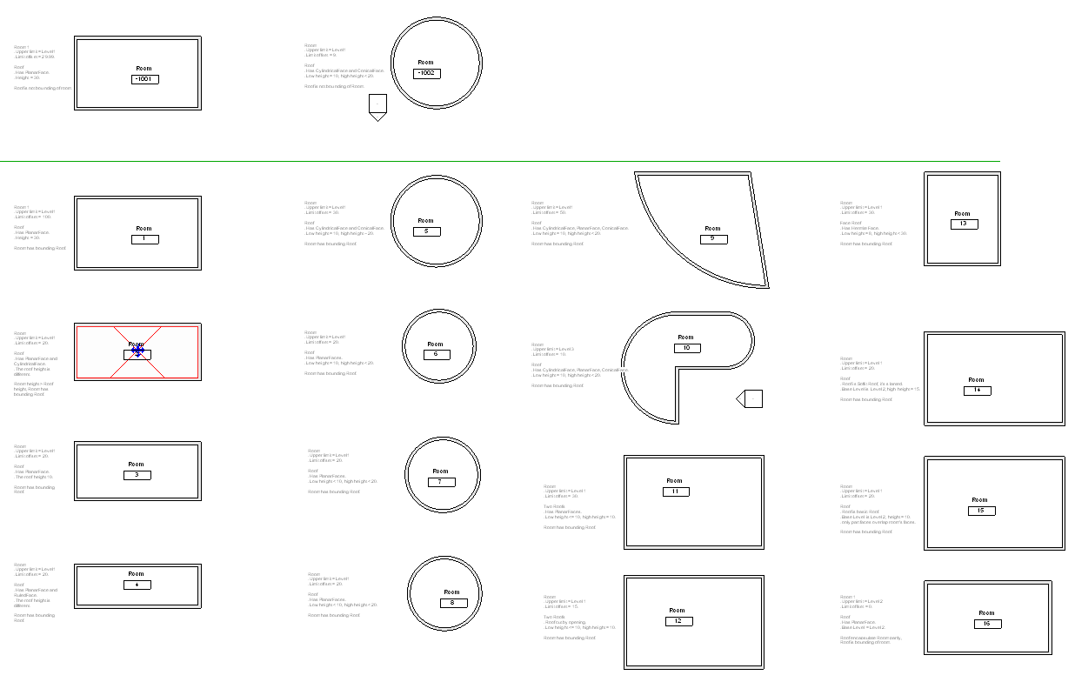
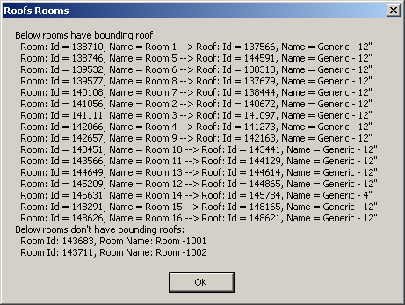
RoofsRooms
2009 Samples
RAC and RME, C#
Determine roof elements bounding a room or space from above
Separate sample files provided for RAC and RME
All rooms and spaces are found
Their roofs are determined and listed

