Slide 1

Autodesk Revit 2010 Family API
Jeremy Tammik
Developer Technical Services

Slide 2

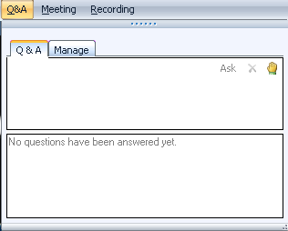
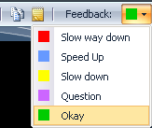
Before we start LiveMeeting and conference call – how to
Use Internet audio
Full screen mode
Provide feedback
Real-time Q&A
Mute phone *6
Expand to full screen mode
Press ESC to return

Slide 3

About the Presenter
Jeremy Tammik
Developer Technical Services
EMEA, Autodesk SARL
Jeremy is a member of the AEC workgroup of the DevTech team, providing developer support, training, and conferences to the Autodesk Developer Network ADN. He joined Autodesk in 1988 as the technology evangelist responsible for European developer support to lecture, provide consulting, and support AutoCAD application developers in Europe, the U.S., Australia, and Africa. He was a co-founder of ADGE, the AutoCAD Developer Group Europe, and a prolific author on AutoCAD application development. He left Autodesk in 1994 to work as an HVAC application developer, and then rejoined the company in 2005.
Jeremy graduated with a MA in mathematics and physics in Marburg, Germany, worked as a teacher and translator, then as a C++ programmer on early GUI and multitasking projects. He is fluent in five European languages, vegetarian, has four kids, plays the flute, likes reading, travelling, theatre improvisation, and carpentry, loves mountains, oceans, sports, and especially climbing.

Slide 4
The Revit Family API
Overview and creating a family through the user interface
Creating a family programmatically through the API
Family API SDK Samples
Family API Labs

Slide 5
Polls About You
1. What category best describes your main professional activity?
Architect, Engineer, Constructor, Programmer, Manager, Other
2. How would you rate your level of experience with the Revit products?
Very experienced, Quite experienced, Not experienced
3. How would you rate your level of experience with the Revit non-family API?
Very experienced, Quite experienced, Not experienced
4. How would you rate your level of experience with the Revit Family API?
Very experienced, Quite experienced, Not experienced
5. Which statement best describes you?
This topic directly affects my work today
I expect this topic to be useful to me in the future
I'm evaluating this technology
None of the above

Slide 6
Background
New in Revit 2010
History
Two large disjunct developer communities
Revit applications using the API
Revit content with no API access
Families is an enormous strength
Family API was the top wish list item
Huge potential for synergy uniting the two separate camps
Family API enables
Use of the Revit API in the family editor
Extract and modify existing or create new family content
Automatic library generation
Notes:
Families is an enormous strength of Revit, but until Revit 2010, no programming access was available in the family context. Therefore, two large and completely disjunct developer communities have evolved around the Revit products, creating either:
Revit applications using the API
Revit content with no API access
The Family API was the top wish list item and was made available for the first time in Revit 2010. It provides huge potential for synergy uniting the two separate camps. It enables:
Use of the Revit API in the family editor
Extract and modify existing or create new family content
Automatic library generation

Slide 7
Creating a Family through the User Interface
Notes:
A non-trivial family can have a complex internal structure and many decisions need to be taken. A large body of experience around building families and family libraries has been developed before the introduction of the API. It is useful to gather some experience creating families manually before implementing code to do so automatically. Just like the standard Revit API, almost all the features provided by the family API are available through the user interface as well.

Slide 8
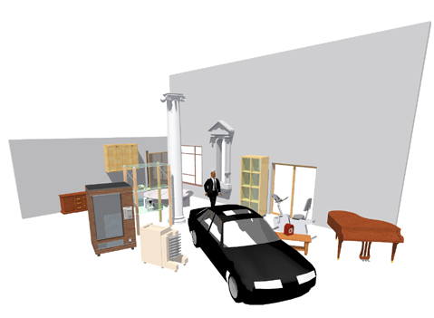
What is a Revit Family?
Graphic representation of building objects and symbols
Geometry in 2D or 3D
Data that supports definition and creation of object instances
Three classes of families
System Families – stored in the project template
Walls, Roofs, Floors, Ceilings, Rebar…
Standard Families – freestanding “.rfa” files
Windows, Doors, Furniture, Beams, Ductwork…
API in 2010
In-Place Families – “one of kind objects”
Notes:
Before discussing the family API, it is important to understand the basics of Revit families and their definition.
A Revit family is a graphic representation of building objects and symbols. It can include geometry in 2D or 3D as well as data that supports the definition and creation of object instances. A family defines one or more types or symbols. A type or symbol can be inserted into the project to create a family instance.
There are three different classes of families, system, standard and in-place:
System families are stored in the project template and used for objects such as Walls, Roofs, Floors, Ceilings, Rebar, etc.
Standard families are defined externally in freestanding ".rfa" files and used for objects such as Windows, Doors, Furniture, Beams, Ductwork, etc.
In-Place families are used for "one of kind objects".
The new family API provided in Revit 2010 addresses the standard families.

Slide 9
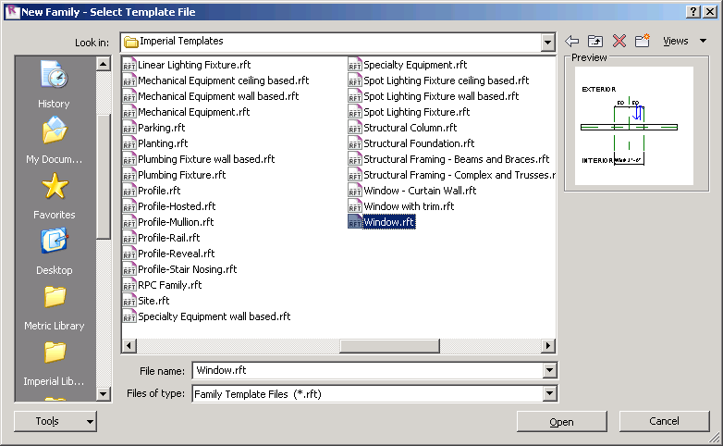
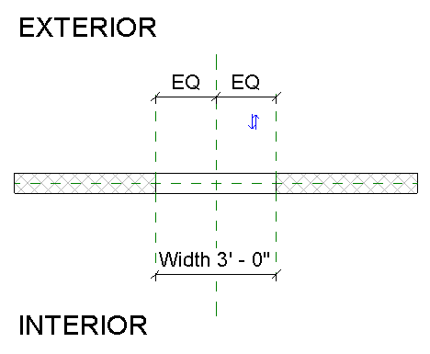
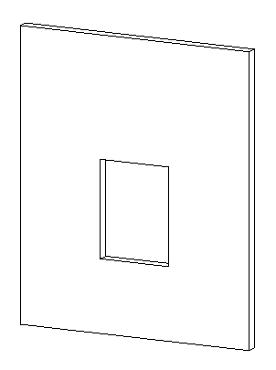
Revit Families – Where to Begin
Which is better?
Start from a family template
Modify an existing family
Which template to start with?
2D or 3D, model or detail component
Hosted or non-hosted: Wall, Ceiling,…
Category
Placement type: free or 2 point
Specialty: Lighting, RPC, …
Notes:
A new family is always based on a family template file, if created from scratch, or on an existing family, which is enhanced in some way. Regardless of whether you are using the UI or API, the first thing you will need to decide is which template or family file you want to begin with.
Create a completely new family starting from a family template.
Enhance an existing family.
You need to choose which approach to take, as well as which template or family file to start with. There are plenty of templates to choose from. Other decisions that need to be taken and which influence this choice include
Category?
Is the family 2D or 3D?
Model or detail component?
Hosted or non-hosted: Wall, Ceiling, etc.
Placement type: Free, two point, ...
Specialty: Lighting, RPC, ...

Slide 10
Revit Family Flavours
Revit Architecture
Basic building components with simplistic interactions in the model
Free placement objects - casework, furniture, etc.
“2 point” placement objects - detail components, hosted objects
Hosted objects: windows, doors, columns (“level to level”), ceiling or “wall based” lighting fixtures
Revit Structure
Additional components with complex interactions with other objects
Framing - beams (“beams to beam”, “beam to column”), columns
Trusses - layout for girder trusses; boundary conditions
Span direction symbols; reinforcement symbols - area reinforcement expands to find edges, path reinforcement
Revit MEP
Connectors allowing objects to resize based on connected neighbour elements
Notes:
Just like the Revit product, Revit families also come in three flavours for architecture, MEP (mechanical, engineering, and plumbing), and structure. Most of the functionality is common to all three. Here are some aspects of the flavours:
Revit Architecture:
Basic building components with simplistic interactions in the model
Free placement objects - casework, furniture, etc.
Two point placement objects - detail components, hosted objects
Hosted objects: windows, doors, columns ("level to level"), ceiling or "wall based" lighting fixtures
Revit Structure:
Additional components with complex interactions with other objects
Framing - beams ("beams to beam", "beam to column"), columns
Trusses - layout for girder trusses; boundary conditions
Span direction symbols; reinforcement symbols - area reinforcement expands to find edges, path reinforcement
Revit MEP:
Connectors allowing objects to resize based on connected neighbour elements

Slide 11
Revit Family Editor
Revit offers six basic family editors
3D model, annotation, detail, rebar, truss and new conceptual mass
Each family editor provides a specific feature set and is tied to the chosen family template
Geometry – extrusions, blends, sweeps, revolves
Lines – model, symbolic, detail
Basic tools – copy, mirror, paint, join/unjoin, cut geometry/don’t cut
References – reference planes, reference lines
Annotation tools – labels
Advanced tools – formulas, nesting, arrays, type catalogs
MEP tools – add connectors
Notes:
Of the six basic family editors, the conceptual mass creation one is new to 2010. Depending on the editor, you will see a different set of available tools and building blocks. For instance, you will see tools to create forms in the model editor, but not in the annotation one. If you are using the truss editor, you will have access to the top and bottom chord, which will be shown in the model editor.

Slide 12
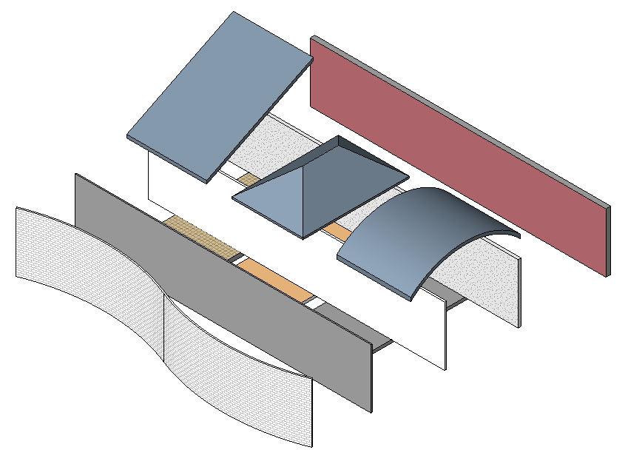
Revit Families Best Practice
The “process” for building families
Need to learn, most important aspect of family creation
Process order:
Plan (insertion point, parametric origin)
Lay out reference planes (the bones)
Add parameters
Add multiple host thickness types
Add two or more types
Flex types and host (testing procedure)
Add a single level of geometry
Repeat steps 6 and 7 until you are satisfied with the results
Test in project environment (create testing project)
Steven Campbell, Revit content management project manager
Notes:
Families are a powerful feature in Revit. Creating a family can be fun, and it can also be complex. When it becomes complex, it requires good planning. Here are some suggestions for a process for building families by the Autodesk Revit content manager Steve Campbell. It describes the manual definition of a family. The same applies to a programmatic approach as well. A key to understanding the family API is to understand the UI.

Slide 13
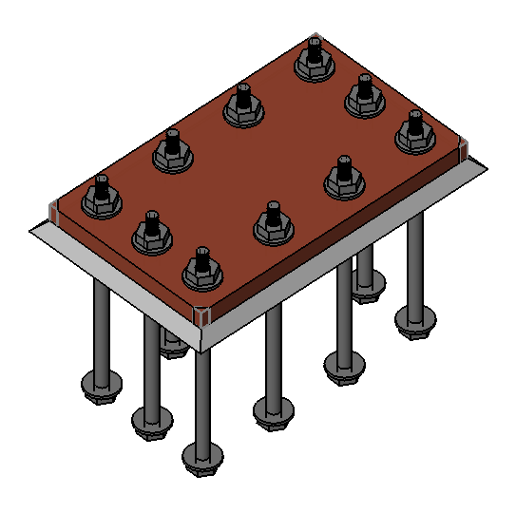
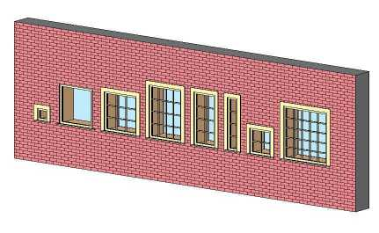
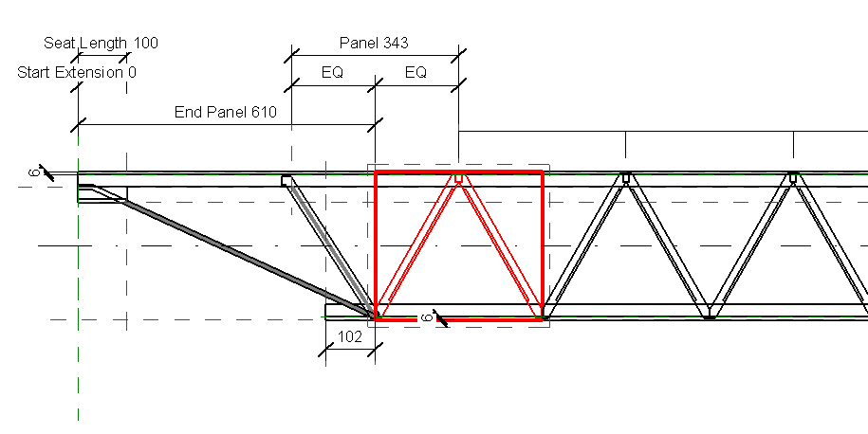
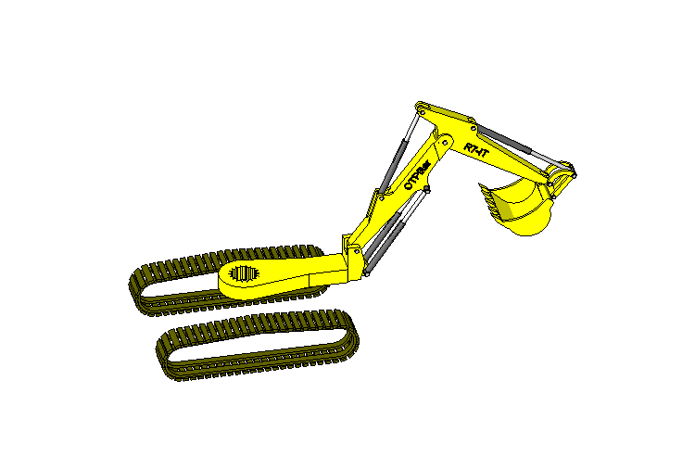
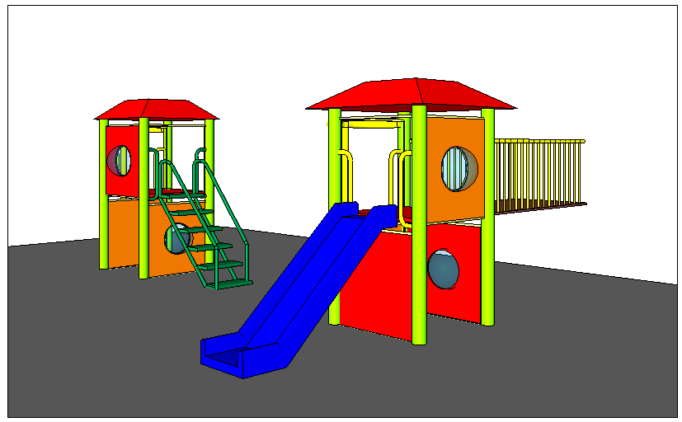
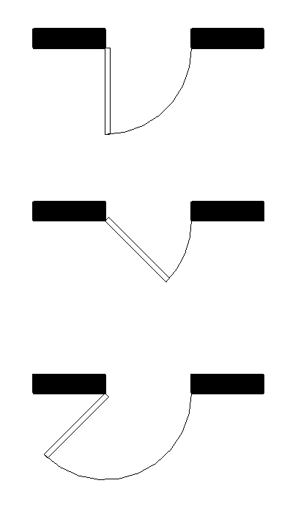
Revit Family Possibilities
Formulas can be used to control behaviour, visibility, arrays
Arrays and nesting support repeatable, resizable elements across an array
Advanced nesting may include subcomponents can be swapped
Reference lines also support angular movement
Notes:
You can create quite complex objects and behaviour using Revit families. Here are a few of the possibilities:
Formulas to control behaviour, visibility, arrays
Arrays and nesting for repeatable, resizable elements across an array
Advanced nesting with subcomponents that can be swapped
Reference lines and angular movement
Formulas can be used to control behaviour, visibility, arrays, e.g. to define arrays of bolts depending on the size of a plate.
Arraying nested components allows the user to create families with repeatable elements across an array that can resize based on user input or rules. For example, a bookshelf with arrayed shelves, mullion patterns based on rules, and open web joists that adjust based on length and height.
Advanced nesting can make use of nested families with family type parameters that can provide flexible components with swappable sub-components such as nested door panels, frames, hardware, playground equipment, swappable panels and components.
Reference lines allow geometry to move about in an angular fashion. They contain two endpoints and two built in work planes that can be parametrically controlled. Some simple examples include a door swing that can change the opening angle, or a light fixture head that moves and points. A more complex example is an excavator arm that can bend and rotate about three or more pivot points.

Slide 14
Creating a Family Programmatically The Family API
Notes:
Now that the basics of Revit families are clear, we can look at the new access to this functionality provided by the new family API.

Slide 15
Family API Usage
Enable use of the Revit API within the family editor context
Create and modify family content
Automatic library generation from database or other library specification
Extract family definitions from existing projects
Define references and constraints to drive model geometry parametrically, formulas to drive parameter values, and annotation and dimensioning
Control detailed visibility of family types and their elements
Control loading behaviour of a family
Notes:
Exposure of the family API is probably the most important enhancement to the Revit API in 2010. The concept of component family is a unique feature and strength of Revit. This was the most wanted feature in the Revit API community and we expect the effect and growth in possibilities with the availability of family API will be dramatic.
An obvious opportunity provided by the new family API is the automatic generation of content from databases or other library sources. It is also possible to extract a family definition out of a project and store it back into an external family file. The document ‘Revit Platform API Changes and Additions.doc’ in the Revit SDK folder provides an overview of the family API. Family API specific samples are located in the Revit SDK samples FamilyCreation subfolder.

Slide 16
Document and Family Manager Classes
Document: added methods and properties for managing families
EditFamily – edit a family loaded in a project document
FamilyCreate – return a FamilyItemCreate object to create new instances of elements within a family document, analogous to the Create object in a project
FamilyManager – return a FamilyManager object providing access to family types and parameters
IsFamilyDocument – identify whether the current document is a family document
OwnerFamily – return the owning family of this family document
Family manager class functionality
Add, remove and rename types
Add and remove parameters
Set values and formulas

Slide 17
Creating Family Content
Family item factory utility object
Create new instances of elements within the family document
Dedicated creation methods instead of the .NET new operator
Elements types include
Alignment
Connector (MEP only)
Dimensioning
Annotation
Curves
Levels
Solids forms
Notes:
The FamilyCreate property on the family document returns a FamilyItemFactory instance. This family item factory object is a utility object used to create new instances of elements within the family document. Just like other Revit elements, these are instantiated using dedicated methods instead of the .NET new operator. This ensures that the elements created are correctly added to and hooked up within the family document. A wide range of elements types can be created, including alignments, dimensioning, annotation, curves, levels, and solid forms for conceptual design.

Slide 18
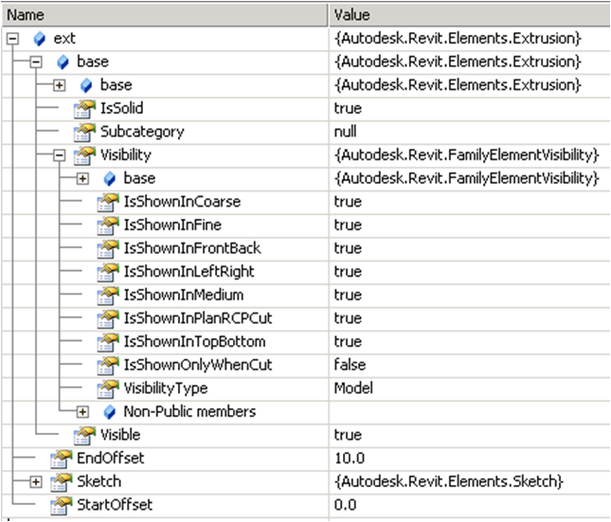
Visibility Settings and Loading Control
Every element in the family has own visibility settings
Define which levels of detail it has
Which types of views it appears in
FamilyElementVisibility class
LoadFamily provides different overloads
Takes either in-memory Document or filename argument
Optionally use the IFamilyLoadOptions interface
Call-backs for handling family load situations
OnFamilyFound
OnSharedFamilyFound
Notes:
A critical topic when building family content are the visibility settings. They are now accessible for each element in a family through the new FamilyElementVisibility class.
Each element in a family has its own visibility settings which define which levels of detail and which types of views it appears in. These options are critical to building good content. For example, intricate details of a family should only be visible in the fine detail views. 3D solid content could optionally be suppressed in plan views, where light weight 2D line work could be displayed instead. Such an approach can make a substantial performance difference, especially in large building models.
The Document.LoadFamily method has been enhanced and new overloads have been added, which can help to handle situations such as when a family already exists in the project. The following overloads are now provided:
LoadFamily(Document) - loads the contents of this family document into another document.
LoadFamily(String) - loads an entire family and all its types into the document.
LoadFamily(String, Family) - loads an entire family and all its types into the document and provides a reference to the loaded family.
LoadFamily(Document, IFamilyLoadOptions) - loads the contents of this family document into another document.
The IFamilyLoadOptions argument to the last overload defines an interface which specifies two call-backs for handling family load situations: OnFamilyFound and OnSharedFamilyFound. These are called when a family or a shared family is already present in the target document.

Slide 19
The Revit SDK Family API Samples

Slide 20
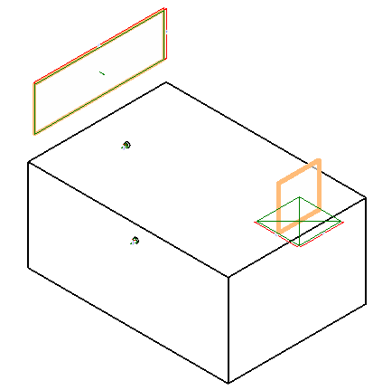
Family API SDK Samples
FamilyCreation folder in the SDK Samples directory
AutoJoin
Automatically join geometry of multiple generic forms for use in family modeling and massing
Uses the method Document::CombineElements to join geometry between overlapping generic forms
Provide a utility method check geometry object overlap, based on Face::Intersect(Curve) method
AutoParameter
Batch mode automatic addition of shared or non-shared parameters to one or more family documents
Process active family document or all families in a folder
Uses FamilyManager class AddParameter methods
Reads input data from parameter text files in Revit shared parameter format
CreateAirHandler – RME
Create an air handler with pipe and duct connectors
Check the template family category to verify valid starting point
Use FamilyItemFactory class methods NewExtrusion, NewPipeConnector, NewDuctConnector
Set proper connector parameters and use Document.CombineElements to join the extrusions
CreateTruss – RST
Create a mono truss in a truss family document
Create truss curves using NewModelCurve, set truss type through ModelCurve TrussCurveType property
Add constraints to the truss curves with NewAlignment

Slide 21
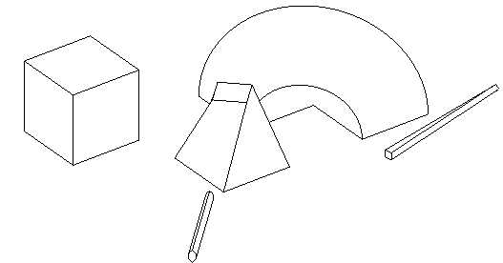
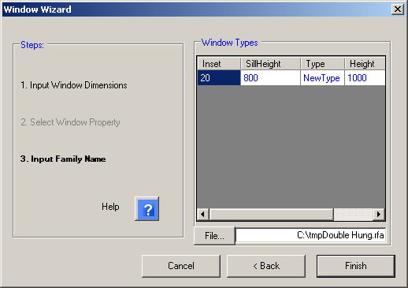
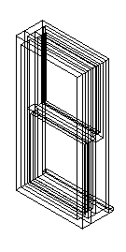
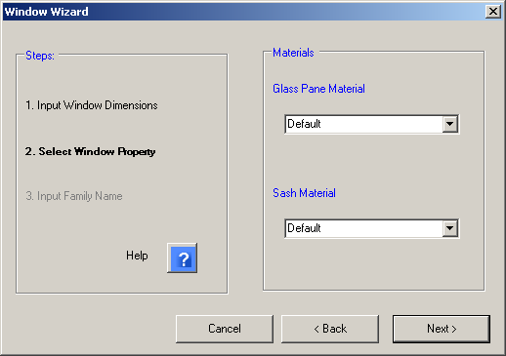
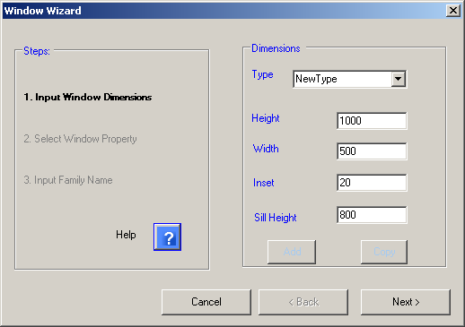
Family API SDK Samples 2
DWGFamilyCreation
Import DWG file into family document add type parameters to the imported instance
DWGFileName with the DWG file name and ImportTime when it was imported
GenericModelCreation
Create a generic model using extrusion, blend, revolution, sweep and swept blend elements
Checks that open document is a family one or creates a new family document
Exercises CreateSketchPlane, NewLineBound, and FamilyItemFactory methods to create profiles and shapes
TypeRegeneration
Use FamilyManager Types property to determine all types defined, and CurrentType to iterate through them
Report whether all types regenerated successfully, log errors to file
ValidateParameters
Check whether every type has valid values for certain parameters and log result to file
External application subscribing to DocumentSaving and DocumentSavingAs events runs check automatically
External command to launch manually
WindowWizard
Create a window family via wizard user interface
Start in window family template, e.g. Metric Window.rft
User defines input dimensions for window parameters and materials
Create extrusion, alignment, dimension, reference plane, and family type

Slide 22
Creating an Example Family Labs

Slide 23
Family API Labs
Full documentation and instructions included for C# and VB
Lab1 – define a column with rectangular profile
Lab2 – define a column with L-shape profile
Lab3 – add formula and materials
Lab4 – add visibility control

Slide 24
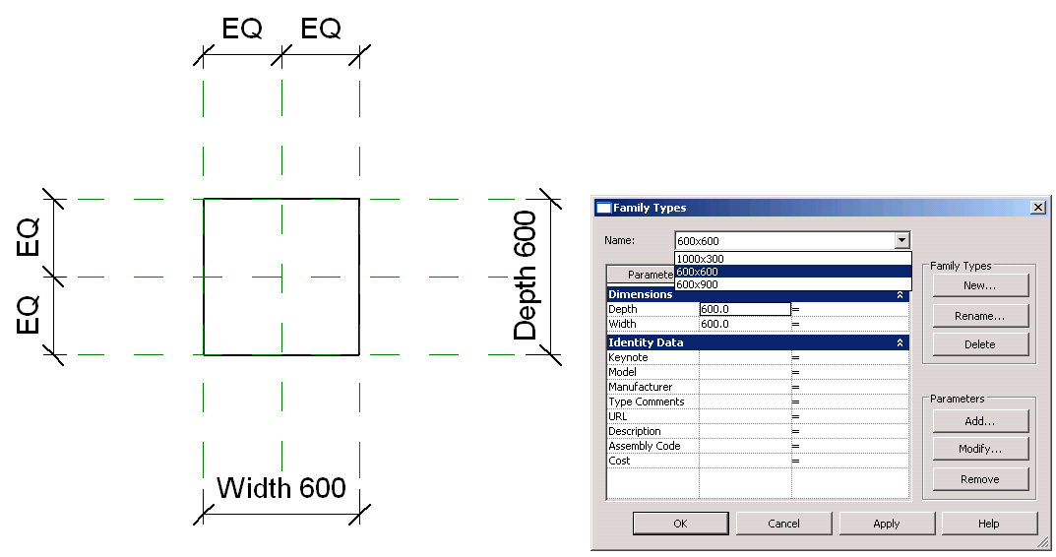
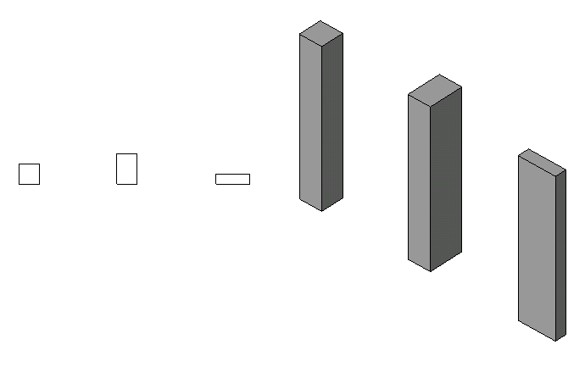
Lab 1 – Create Rectangular Column
Objective: Learn the basics of family API
Check the family context
Create a simple solid using extrusion
Set alignments
Add types
Classes and methods:
doc.IsFamilyDocument()
doc.OwnerFamily.FamilyCategory.Name
doc.FamilyCreate.NewExtrusion()
doc.FamilyCreate.NewAlignment()
familyMgr = doc.FamilyManager
familyMgr.NewType()
familyMgr.Parameter(); familyMgr.Set()

Slide 25
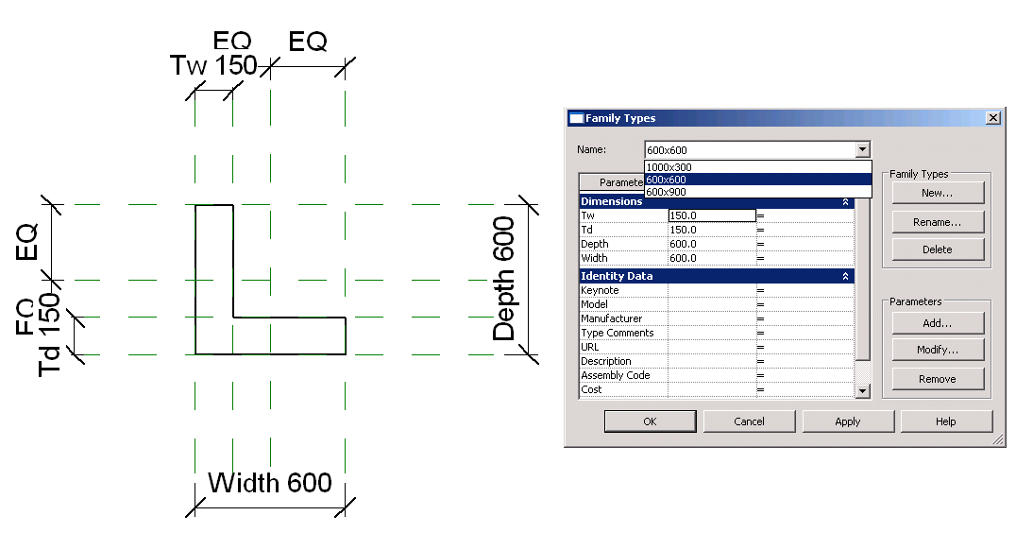
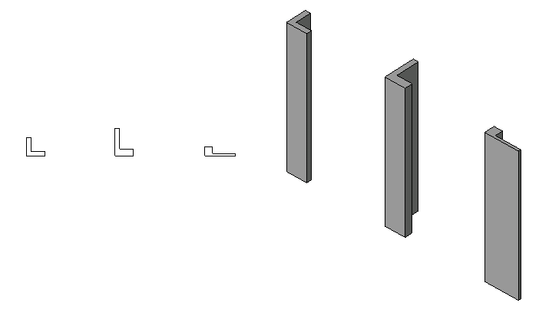
Lab 2 – Create L-Shaped Column
Objective: Learn the basics of family API
Add reference planes
Add parameters
Add dimensions
Classes and methods:
doc.FamilyCreate.NewReferencePlane()
familyMgr.AddParameter()
doc.FamilyCreate.NewDimension()

Slide 26
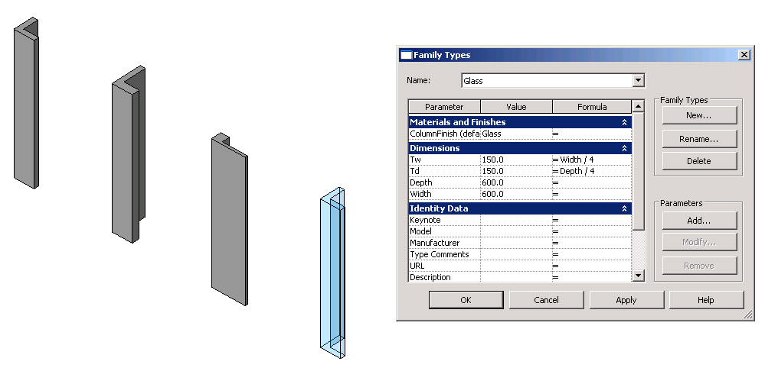
Lab 3 – Add Formulas and Materials
Objective: Learn the basics of family API
Add formulae
Add materials
Classes and methods:
familyMgr.SetFormula()
pSolid.Parameter(“Material”)
familyMgr.AddParameter(“MyColumnFinish”, BuiltInParameterGroup.PG_MATERIALS, ParameterType.Material, True)
familyMgr.AssociateElementParameterToFamilyParameter()

Slide 27
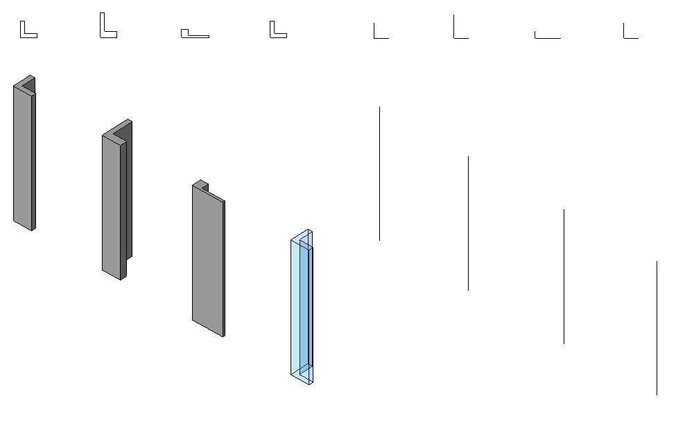
Lab 4 – Add Visibility Control
Objective:
Add line representation
Add visibility control
Classes and methods:
doc.FamilyCreate.NewSymbolicCurve()
doc.FamilyCreate.NewModelCurve()
FamilyElementVisibility(FamilyElementVisibilityType.ViewSpecific/Model)
FamilyElementVisibility.IsShownInFine, etc.
pLine.SetVisibility(pFamilyElementVisibility)

Slide 28
Learning More
Online Help, Developer's Guide and SDK Samples
Families Guide
http://usa.autodesk.com/adsk/servlet/item?siteID=123112&id=13376394
DevTV Introduction to Revit Programming
http://usa.autodesk.com/adsk/servlet/index?siteID=123112&id=2484975
Recording of Revit 2010 Programming Introduction Webcast
http://www.adskconsulting.com/adn/cs/api_course_sched.php > Revit API
Discussion Group
http://discussion.autodesk.com > Revit Architecture > Revit API
API Training Classes
http://www.autodesk.com/apitraining
The Building Coder, Jeremy Tammik's Revit API Blog
http://thebuildingcoder.typepad.com
Autodesk Developer Network
http://www.autodesk.com/joinadn
DevHelp Online for ADN members
http://adn.autodesk.com

Slide 29
Polls About the Presentation
6. How was the audio quality of the presentation?
Good, Acceptable, Poor
7. How was the visual quality of the presentation?
Good, Acceptable, Poor
8. How do you rate the presentation material?
Excellent, Good, Okay, Poor
9. How do you rate the presentation delivery?
Excellent, Good, Okay, Poor
10. Would you recommend this webcast to a friend or colleague?
Yes, No

Slide 30
