Slide 1
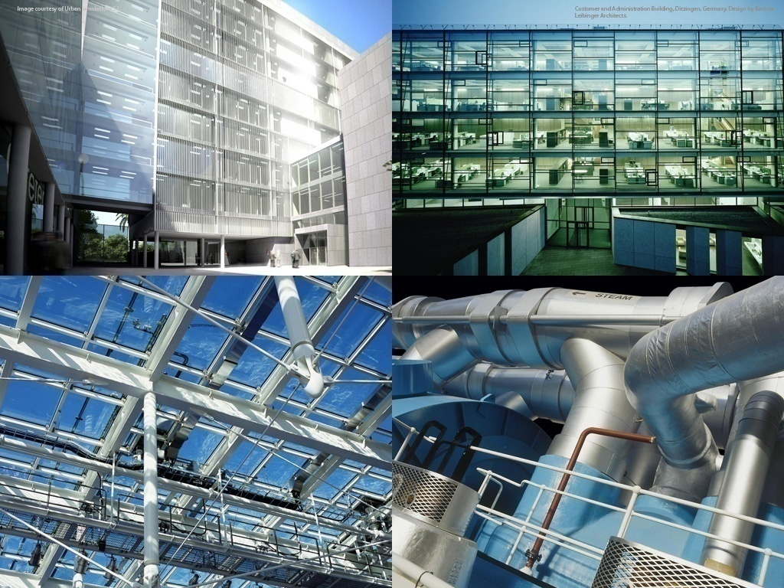
Autodesk Revit 2010 MEP API
Jeremy Tammik
Developer Technical Services

Slide 2

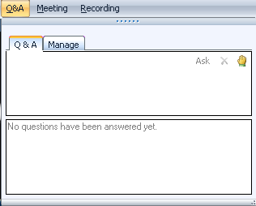
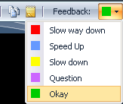
Before we start LiveMeeting and conference call – how to
Use Internet audio
Full screen mode
Provide feedback
Real-time Q&A
Mute phone *6
Expand to full screen mode
Press ESC to return

Slide 3

About the Presenter
Jeremy Tammik
Developer Technical Services
EMEA, Autodesk SARL
Jeremy is a member of the AEC workgroup of the DevTech team, providing developer support, training, and conferences to the Autodesk Developer Network ADN. He joined Autodesk in 1988 as the technology evangelist responsible for European developer support to lecture, provide consulting, and support AutoCAD application developers in Europe, the U.S., Australia, and Africa. He was a co-founder of ADGE, the AutoCAD Developer Group Europe, and a prolific author on AutoCAD application development. He left Autodesk in 1994 to work as an HVAC application developer, and then rejoined the company in 2005.
Jeremy graduated with a MA in mathematics and physics in Marburg, Germany, worked as a teacher and translator, then as a C++ programmer on early GUI and multitasking projects. He is fluent in five European languages, vegetarian, has four kids, plays the flute, likes reading, travelling, theatre improvisation, and carpentry, loves mountains, oceans, sports, and especially rock climbing.
Many thanks to Martin Schmid, Autodesk, for inspiration and support, and my fellow colleagues in DevTech and especially in the AEC workgroup for being such a great team.

Slide 4
The Revit MEP API
Introduction
Analysis
Hierarchical Systems and Connectors
Electrical
HVAC and Plumbing
Sample Applications
Learning More

Slide 5
Polls About You
1. What category best describes your main professional activity?
Architect, Engineer, Constructor, Programmer, Manager, Other
2. How would you rate your level of experience with the Revit products?
Very experienced, Quite experienced, Not experienced
3. How would you rate your level of experience with the Revit API?
Very experienced, Quite experienced, Not experienced
4. How would you rate your level of experience with the Revit MEP API?
Very experienced, Quite experienced, Not experienced
5. Which statement best describes your interest in this topic?
This topic directly affects my work today
I expect this topic to be useful to me in the future
I'm evaluating this technology
None of the above

Slide 6
Acronyms
ADN Autodesk Developer Network
AEC Architecture, Engineering, Construction
API Application Programming Interface
BIM Building Information Model
GUI Graphical User Interface
HVAC Heating, Ventilation, and Air Conditioning
MEP Mechanical, Electrical, and Plumbing
RAC Revit Architecture
RME Revit MEP
RST Revit Structure
SDK Software Development Kit
UI User Interface

Slide 7
MEP Application Requirements
Mechanical, electrical and plumbing domains
HVAC, i.e. heating, ventilation and air conditioning, is mechanical
Need for strong model analysis tools
Need to read and write access to the components and data
MEP project information
Green Building XML, gbXML
Spaces and zones
Electrical systems, components, properties and parameters
Duct and pipe systems, components, properties and parameters
Element creation and modification
System traversal and analysis

Slide 8
The Generic Revit API
Basic Revit API is generic
All flavours use the same .NET assembly RevitAPI.dll
Specific additional features exist for each flavour, e.g.
Room-related functionality in Revit Architecture
Access to the analytical model in Revit Structure
Access to the MEP model in Revit MEP

Slide 9
Revit MEP API Evolution
Revit 2008 provided no MEP-specific API
Generic element and parameter access can be used
Revit 2009 introduced MEP-specific API support
MEP model property, space and zone, electrical and mechanical equipment, lighting device and fixture, connector, electrical system
MEP-specific API was a focal point of the Revit 2010 API
Support for HVAC and piping systems
MEP namespace

Slide 10
Analysis

Slide 11
MEP Project Info and gbXML
MEP Project Info is accessed through ProjectInfo.gbXMLSettings
Data includes PostalCode, ProjectLocation, BuildingService, BuildingConstruction, GroundPlane, ShadingSurfaces, ProjectPhase
Green Building XML export
Document.Export(
string folder,
string name,
GBXMLExportOptions );

Slide 12
Spaces and Zones
Revit 2009 improved workflow between Architecture and MEP
Previously, MEP user had to Copy/Monitor rooms from architect
Architectural rooms are unsuitable for MEP analysis
Wrong height, often too large for analysed region
MEP uses space instead of room, and zone to manage spaces
Rooms can be subdivided into exterior and interior subspaces
AddSpaceAndZone SDK sample
Programmatic creation and management of spaces and zones
FamilyInstance class has Room and Space properties
FamilyInstance fi; // get a family instance
Space space = fi.Space; // query its space
Space space2 = fi.get_Space( phase ); // query space in given phase

Slide 13
Model Inspection Utilities
Volumes, rooms and spaces
Room.IsPointInRoom() determines if a point is in the volume of a room
Space.IsPointInSpace() determines if a point is in the volume of a space
GetRoomAtPoint() and GetSpaceAtPoint() returns room or space containing point
FamilyInstance.Space determines space containing Revit MEP family instance
Ray intersection
FindReferencesByDirection returns an array of elements, faces, and references found when moving through the model from a specified point in a specified direction
RayTraceBounce SDK sample
Enables component location and space adjacency analysis, etc.

Slide 14
Connectors and Hierarchical Systems

Slide 15
Hierarchical System Structure and MEP Model
MEP systems consist of hierarchically connected components
Many components are represented using families
Connectors represent links between components
System classes
ElectricalSystem
MechanicalSystem
PipingSystem
Family instance provides MEPModel property
MEPModel has ConnectorManager and ElectricalSystems properties
Derived classes include ElectricalEquipment, LightingDevice, LightingFixture, MechanicalEquipment, MechanicalFitting

Slide 16
Connectors
Connector class
Used to represent connections in the Revit BIM project context
Part of each MEP component, no independent element
Logical connectors
Used in electrical domain
Cables and wires are not modelled individually
Enables traversal of connected electrical system hierarchies
Physical connectors
Connect neighbouring components physically
Transmit sizing dimensions and flow information
Family editor connection elements
Independent elements for defining connectors
Used to model library parts in family context
Derived classes for duct, pipe and electrical connectors

Slide 17
Electrical

Slide 18
Electrical System Hierarchy
Three-tier recursive hierarchy, cf. electrical system browser
Panel > systems or circuits > circuit elements, may be panels
Cables and wires are not modelled
Logical connections between components
System can be traversed through connectors
Connectivity information also available in element parameters
MEP electrical sample application demonstrates traversal using both MEP connectors and generic parameters
Revit SDK PowerCircuit sample demos creation and editing

Slide 19
HVAC and Plumbing

Slide 20
HVAC and Piping Hierarchy
Systems manage the top level system properties
Ducts and pipes define the main flow elements
Fittings implement bends and branches in the system
Connectors hook up the ducts, pipes and fittings

Slide 21
Systems
Revit 2010 classes MechanicalSystem and PipingSystem
Access to equipment, connectors and system type
Access to system properties such as flow and static pressure
DuctNetwork and PipeNetwork properties access system contents
Ducts and fitting elements in no particular order
Does not include terminals or equipments
Query connector managers for traversal in flow direction
TraverseSystem SDK sample

Slide 22
Duct and Pipes
Represented by Duct, FlexDuct, Pipe and FlexPipe classes
Derived from MEPCurve
Provide read access to duct properties, types, and geometry
Change duct or pipe type
Move duct or pipe
Use Move method rather than Location
Layout duct or pipe
Driven by two points, point and connector, or two connectors

Slide 23
Fittings
Represented by standard RFA family instances
Created using dedicated creation doc New*Fitting methods
Elbow, Tee, Cross, Takeoff, Transition, and Union
Access fitting properties, shape and dimensions through the FamilyInstance.MEPModel property

Slide 24
Connectors
Read duct, pipe, and fitting connector properties
Flow, Coefficient, Demand
Access physical connector properties
Origin, Angle, Height, Width, Radius
Read and write assigned connector properties
The fitting connectors define the properties
Flow, Flow Configuration, Coefficients, Loss Method
Change connector size and location
Connect and disconnect

Slide 25
Element Creation
New methods on Autodesk.Revit.Creation.Document
Create New Systems
NewXyzSystem
Mechanical, Piping
Create New Elements
NewDuct, NewFlexDuct, NewPipe, NewFlexPipe
Create New Fittings
NewXyzFitting
Cross, Elbow, TakeOff, TeeFitting, Transition, Union
Connector elements are created in the family context
Creation methods on FamilyItemFactory
Accessed through the Document.FamilyCreate property
NewDuctConnector, NewPipeConnector, NewElectricalConnector

Slide 26
Sample Applications

Slide 27
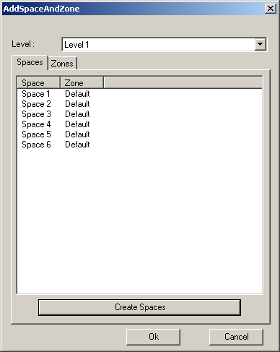
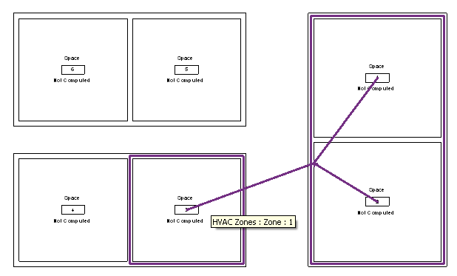
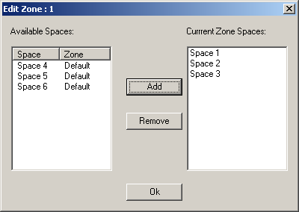
AddSpaceAndZone
Retrieve and list existing spaces and zones
Demonstrates use of an element filter
Create new spaces
For each closed wall loop or space separation
Demonstrates use of the NewSpaces() method
Create a new zone element
Specified level and phase
Add and remove spaces in a zone
Use the AddSpaces() and Remove() methods

Slide 28
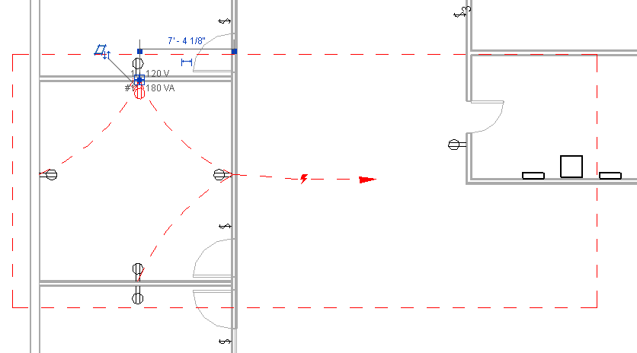


PowerCircuit
Operate power circuits, similar to RME Circuit Editor toolbar
Demonstrate handling interactive element selection
Implement toolbar user interface for external command
Use .NET ResourceManager class for image and string resources
Create a new power circuit with selected elements
Edit circuit and add and remove circuit elements
Select or disconnect a circuit panel
Explore Autodesk.Revit.MEP namespace, MEPModel and ElectricalSystem classes

Slide 29
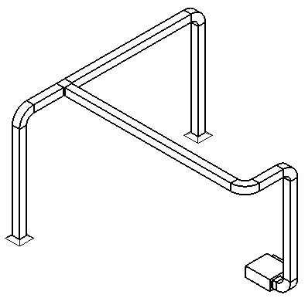
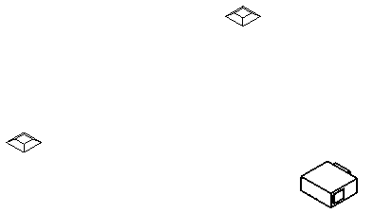
AutoRoute
Automatically create and route a set of ducts and fittings
Source is the air supply equipment
Sink is two air outlet terminals
Positions can be freely moved
Create a new mechanical system, ducts, fittings and connections
NewMechanicalSystem, NewDuct, NewElbowFitting, NewTeeFitting and Connector.ConnectTo
Determine the bounding box of all the three elements
Use the middle line or quarter lines on the X and Y axes
Uses.NET framework Trace class to create a log file

Slide 30
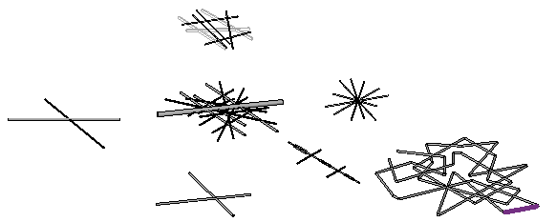
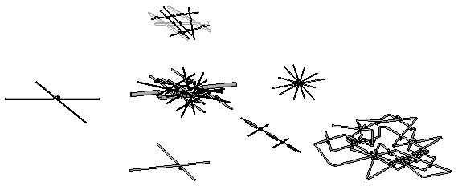
AvoidObstruction
Detect and resolve obstructions between ducts, pipes, and beams
FindReferencesByDirection ray casting intersection analysis
Split pipe into segments and insert elbows to reroute detour
Obstruction between pipes and beams
Pipes intersected together
Pipe loop intersection
Obstruction between pipes and ducts
Obstruction between a pipe and a duct

Slide 31
TraverseSystem
Traverse a mechanical or piping system in the direction of flow
Check MechanicalSystem IsWellConnected property
Dump the traversal results into an XML file
Determine system
Query base equipment as starting point
Query connector manager for connected neighbour elements
Similar approach works for electrical as well, cf. MEP sample

Slide 32
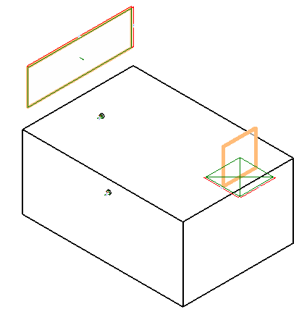
CreateAirHandler
Create an air handler with pipe and duct connectors
Check the template family category to verify valid starting point
Use FamilyItemFactory class methods NewExtrusion, NewPipeConnector, NewDuctConnector
Set proper connector parameters and use Document.CombineElements to join the extrusions
Geometric shape creation is generic
Addition of the connectors is MEP specific
Runs in all flavours of Revit

Slide 33
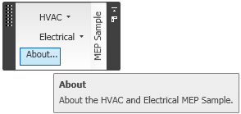
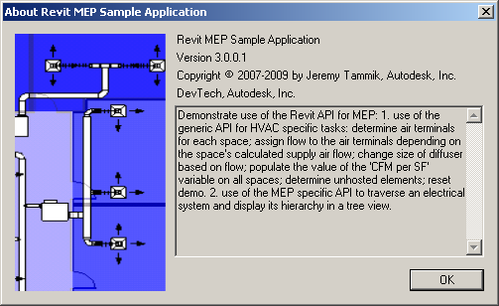

MEP Sample
Non-SDK sample, included in presentation material
HVAC air terminal analysis and sizing
Hierarchical display of an electrical system
Implements a ribbon panel, about box, and progress bar

Slide 34
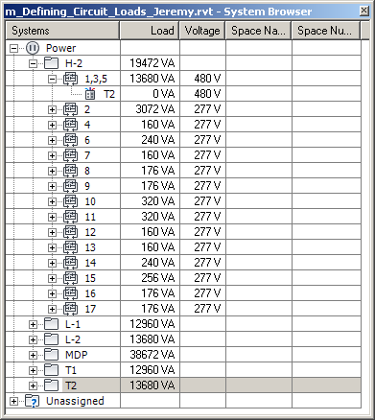
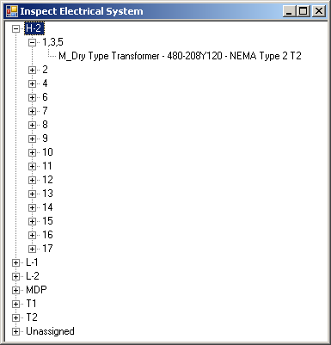
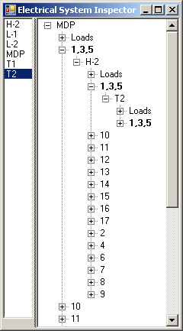
MEP Electrical Sample
Traverse the electrical system
Reproduce the system browser data structure in a tree view
Display the complete connection hierarchy in a tree view
Easy in Revit 2010 using connection manager
CmdElectricalConnectors is similar to TraverseSystem
Includes old commands using parameters instead of connectors

Slide 35
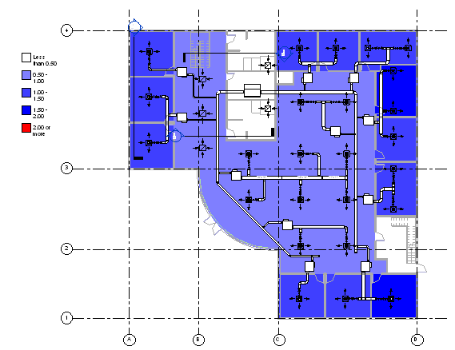
MEP HVAC Sample
HVAC Task
Place and size air ducts and terminals
Analysis and verification of results
Commands aligned with HVAC engineering workflow
Assign flow to terminals
Change air terminal size
Verify design by air flow per surface area
Reset demo
All modification uses generic parameter and type access
Changes are reflected by schedules and colour fill

Slide 36
Materials
Webcast recording and materials will be posted to ADN
Software & Support > Revit > Knowledgebase > Whitepapers and Training Videos
Also to the public ADN web site training schedule
http://www.adskconsulting.com/adn/cs/api_course_sched.php > Revit MEP API
Content
rme_api_doc.zip – Documentation
rme_api_ppt.zip – Presentation
rme_api_src.zip – Sample source code

Slide 37
Learning More
Online Help, Developer's Guide and SDK Samples
DevTV Introduction to Revit Programming
http://usa.autodesk.com/adsk/servlet/index?siteID=123112&id=2484975
Recording of Revit 2010 Programming Introduction Webcast
http://www.adskconsulting.com/adn/cs/api_course_sched.php > Revit API
Recording of Revit MEP API Webcast
http://www.adskconsulting.com/adn/cs/api_course_sched.php > Revit MEP API
http://thebuildingcoder.typepad.com/blog/2009/06/revit-mep-api.html
Discussion Group
http://discussion.autodesk.com > Revit Architecture > Revit API
API Training Classes
http://www.autodesk.com/apitraining
The Building Coder, Jeremy Tammik's Revit API Blog
http://thebuildingcoder.typepad.com
ADN, The Autodesk Developer Network
http://www.autodesk.com/joinadn
DevHelp Online for ADN members
http://adn.autodesk.com

Slide 38
Polls About the Presentation
6. How was the audio quality of the presentation?
Good, Acceptable, Poor
7. How was the visual quality of the presentation?
Good, Acceptable, Poor
8. How do you rate the presentation material?
Excellent, Good, Okay, Poor
9. How do you rate the presentation delivery?
Excellent, Good, Okay, Poor
10. Would you recommend this webcast to a friend or colleague?
Yes, No

Slide 39


