Slide 1
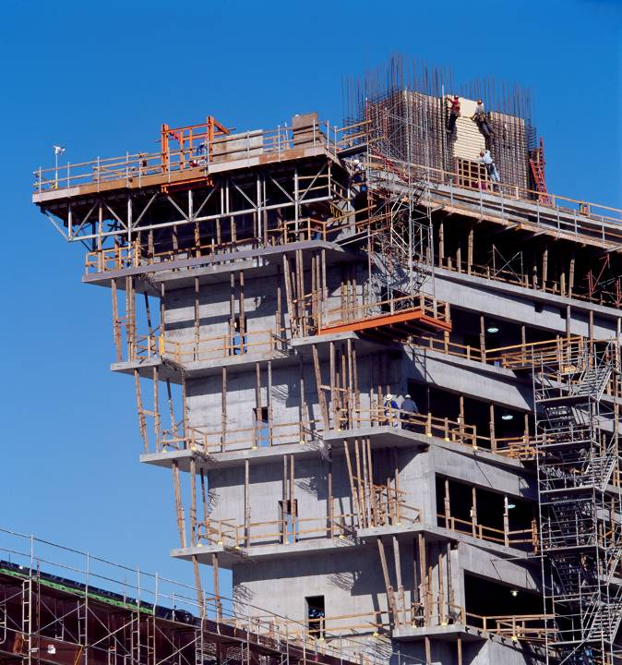




Revit API Tips and Tricks Jeremy Tammik AEC Workgroup DevTech Autodesk
Image Courtesy of RTKL Associates Inc

Slide 2

About the Presenter
Introduction
Jeremy Tammik
Developer Technical Services
EMEA, Autodesk SARL
Jeremy is a member of the AEC workgroup of the Autodesk Developer Network ADN team, providing developer support, training, conference presentations, and blogging on the Revit API.
He joined Autodesk in 1988 as the technology evangelist responsible for European developer support to lecture, consult, and support AutoCAD application developers in Europe, the U.S., Australia, and Africa. He was a co-founder of ADGE, the AutoCAD Developer Group Europe, and a prolific author on AutoCAD application development. He left Autodesk in 1994 to work as an HVAC application developer, and then rejoined the company in 2005.
Jeremy graduated in mathematics and physics in Germany, worked as a teacher and translator, then as a C++ programmer on early GUI and multitasking projects. He is fluent in five European languages, vegetarian, has four kids, plays the flute, likes reading, travelling, theatre improvisation, and carpentry, loves mountains, oceans, sports, and especially climbing.
Notes:
It is my pleasure to work in the AEC workgroup of the DevTech team supporting the Autodesk Developer Network ADN.

Slide 3
Intermediate Regeneration Required
If you use the automatic regeneration option, you will be slow
If you use the manual regeneration option, please watch out!
Changes to elements will not automatically update the model
You need to manually regenerate before querying the model
Notes:
Cf. 1258165 [Revit API functions delay].

Slide 4
Thank you!
Thank you very much for your interest and attention!
Much success with the Revit API and your application development!

Slide 5

End of Presentation

