Slide 1

Revit Family API
Jeremy Tammik
Developer Technical Services
Notes:
AEC Title

Slide 2
Family API
Overview
UI
API
Exercises:
Lab1 – define a column with rectangular profile
Lab2 – define a column with L-shape profile
Lab3 – add formula and materials
Lab4 – add visibility control
SDK Samples

Slide 3
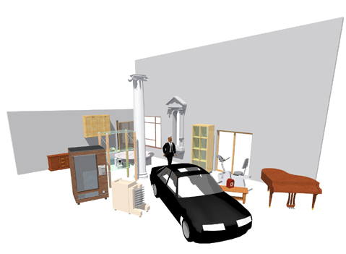
Revit Families – What is it?
Graphic representations of building objects and symbols
Geometry in 3D or 2D
Data that supports definition/creation of objects
Generically - 3 Types
System Families – stored in the project template
Walls, Roofs, Floors, Ceilings, Rebar…
Standard Families – freestanding “.rfa” files
Windows, Doors, Furniture, Beams, Ductwork…
API in 2010
In-Place Families – “one of kind objects”
Notes:
Before discussing the new Revit family API, it is important to understand the basics of Revit families and their definition.
Families in Revit are graphical representations of building objects and symbols. It could be 2D or 3D geometric objects. It could be a data objects.
There are three kinds of families:
(1) System family – which is stored in the project template. Objects like, walls, roofs, floors, ceilings are in this category.
(2) Standard family – uses .rfa file. Windows, doors, furniture, beams are in this category.
(3) In-place families – this third category is the one stored in project and creates one of a kind of objects.
The API in 2010 supports the second category, standard families.

Slide 4
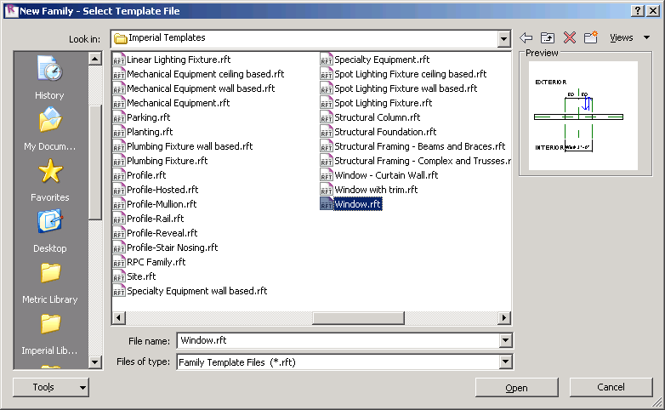
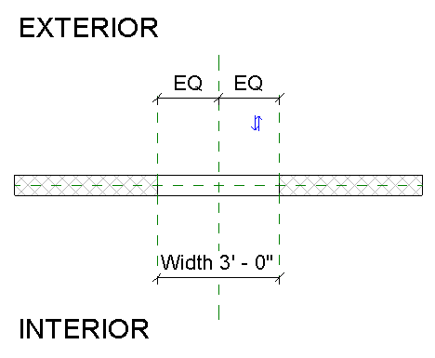
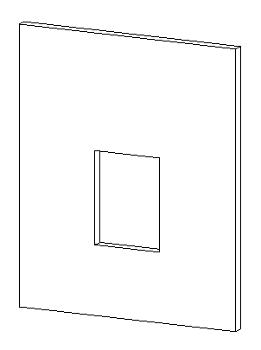
Revit Families – Where to begin
Which is better?
Start from a family template
Modify an existing family
Which Family template to start with?
2D or 3D, model or detail component
Hosted or non hosted: Wall, Ceiling,…
Category
Placement type: free or 2 point
Specialty: Lighting, RPC, …
Notes:
Regardless of whether you are using the UI or API, the first thing you will need to decide is which template or family file you want to begin with.
- You can create a family starting from a family template.
- You can also take an existing family and start from there.
There are plenty of templates to choose from. You will need to decide which template to start with. Typically, you will need to think about:
- Is your family 2D or 3D? Model or detail?
- Is it hosted or hosted, to a wall, ceiling?
- What about the category?
- How do you want to place it? Anywhere on a project? By two points?
- Do you need a specialty one, such as lighting, or RPC?

Slide 5
Revit Family Flavors
Revit Architecture
Basic building components with simplistic interactions in the model
Free placement objects - casework, furniture, etc.
“2 point” placement objects - detail components, hosted objects
Hosted objects: windows, doors, columns (“level to level”), ceiling or “wall based” lighting fixtures
Revit Structure
Additional components with complex interactions with other objects
Framing - beams (“beams to beam”, “beam to column”), columns
Trusses - layout for girder trusses; Boundary Conditions
Span Direction Symbols; Reinforcement Symbols - area reinforcement expands to find edges, path reinforcement
Revit MEP
Connectors allowing objects to resize based on what they are connected to
Notes:
Just like products, Family also has three flavours. Most of the functionalities are same as Revit Architecture.
Revit Architecture
- Family in Revit Architecture supports basic building components with simplistic interactions in the model.
(MH: you can skip to structure here. These are similar to what we said in previous slides.)
- Free placement objects - casework, furniture, etc.
- “2 point” placement objects - detail components, hosted objects
- Hosted objects – windows, doors, columns (“level to level”), ceiling or “wall based” lighting fixtures.)
Revit Structure
- Has Additional components with complex interactions with other objects. In particular ones that support analytical models:
- Framing - beams (“beams to beam”, “beam to column”), columns
- Trusses - layout for girder trusses; Boundary Conditions
- Span Direction Symbols; Reinforcement Symbols - area reinforcement expands to find edges, path reinforcement
In Revit MEP
- Connectors allowing objects to resize based on what they are connected to.

Slide 6
Revit Family Editor
Revit offers 6 basic family editors
3D model, annotation, detail, rebar, truss and new conceptual mass.
Each family editor provides a specific set and is tied to the chosen family template
Geometry – extrusions, blends, sweeps, revolves
Lines – model, symbolic, detail
Basic tools – copy, mirror, paint, join/unjoin, cut geometry/don’t cut
References – reference planes, reference lines
Annotation tools – labels
Advanced tools – formulas, nesting, arrays, type catalogs
MEP tools – add connectors
Notes:
Of the six basic family editors, the conceptual mass creation one is new to 2010. Depending on the editor, you will see a different set of available tools or tools to create building blocks. For instance, you will see tools to create forms in the model editor, but not in the annotation one. If you are using the truss editor, you will see top/bottom chord, which will be shown in the model editor.

Slide 7
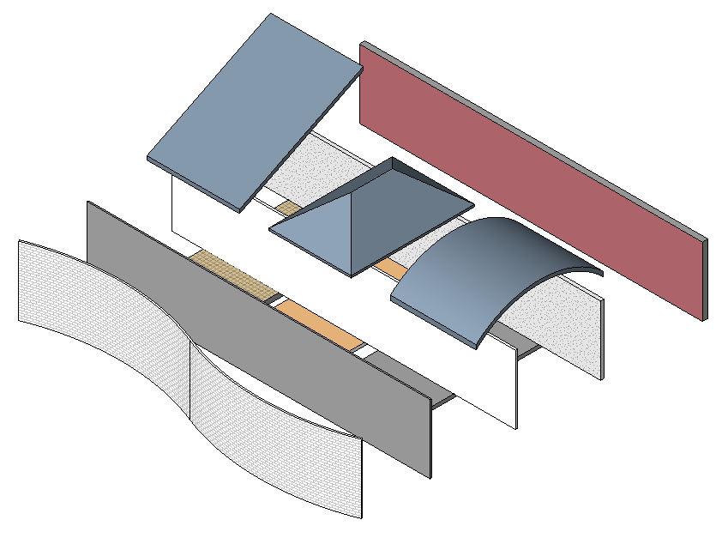
Revit Families Best Practice
The “process” for building families is the most important aspect of family creation that one needs to learn
Process order:
Plan (Insertion Point, Parametric Origin)
Layout Reference Planes (The Bones)
Add Parameters
Add multiple host thickness types
Add 2 or more types
Flex Types and Host (Testing Procedure)
Add a Single Level of Geometry
Repeat Steps 6 and 7 until you are satisfied with the results
Test in Project Environment (create testing project)
Steven Campbell, Revit content management project manager
Notes:
Family is a powerful feature in Revit, creating a Family could be fun, but it could be complex. When it becomes complex, it requires a good planning. Here are some suggestions when building families by the Autodesk Revit content manager Steve Campbell.
The same applies to API; a key to understand Family API is to understand UI.

Slide 8
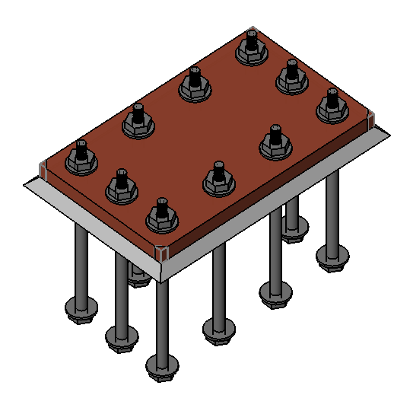
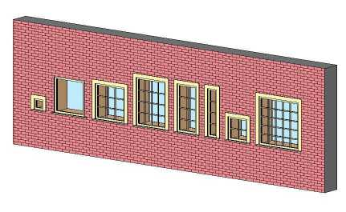
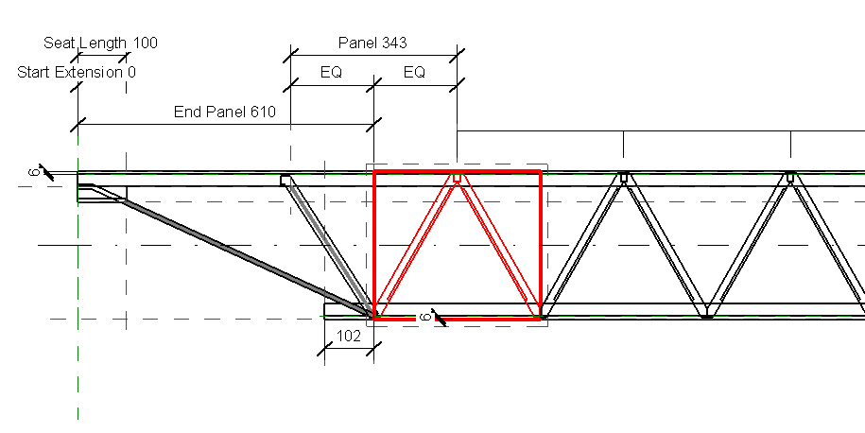
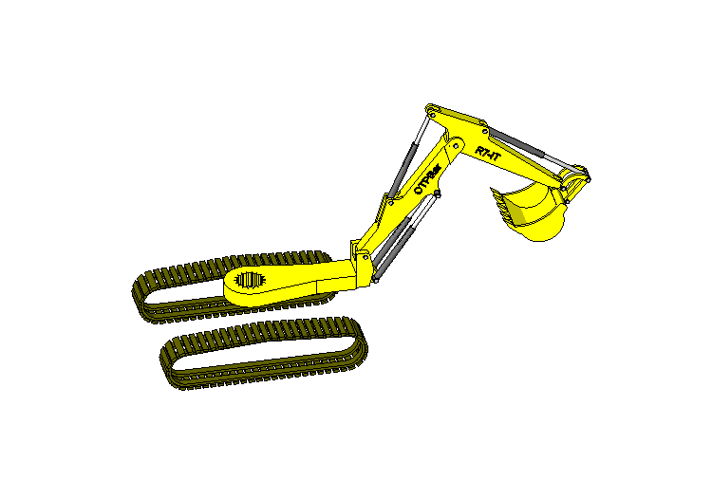
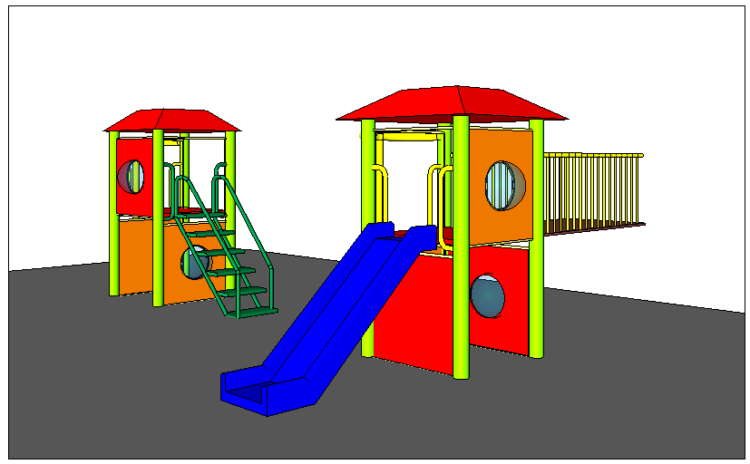
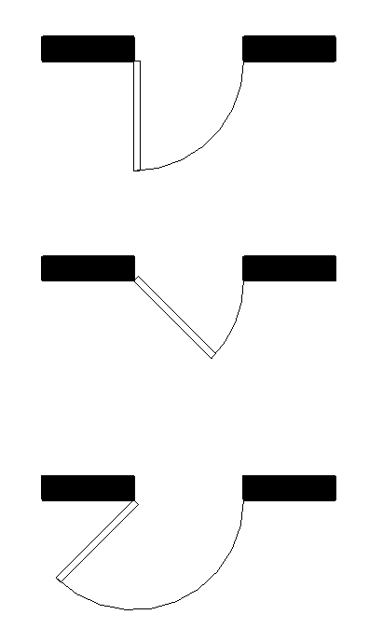
Revit Families – What is possible
Formulas – can be used to control behavior, visibility, arrays
Arrays and nesting – repeatable, resizable elements across an array
Advanced nesting – subcomponents can be swapped
Reference lines – angular movement
Notes:
You can create a quite complex object using family. For example,
- Formulas can be used to control behavior, visibility, arrays. For example, define arrays of bolts depending on the size of a plate.
- Arraying nested components allows the user to create families with repeatable elements across an array that can resize based on user input or rules. For example, a bookshelf with arrayed shelves. Mullion patterns based on rules. Open web joists that adjust based on length and height.
- Advanced nesting - Using nested families with the Family Type parameter can provide flexible components with swappable sub-components such as nested door panels, frames, hardware, playground equipment, shown on the right, swappable panels and components.
- Reference lines allow geometry to move about in an angular fashion. They contain two endpoints and two “built in” work planes that can be parametrically controlled. Simple examples: Door swing (lower middle) that can change the opening angle. Light fixture head that moves and points; Complex example: Excavator arm (lower left) that can bend and rotate about 3 or more pivot points.

Slide 9
Family API Overview
Use the Revit API within the family editor context
Create and modify family content
Automatic library generation from database or other library specification
Extract family definitions from existing projects
Define references and constraints to drive model geometry parametrically, formulas to drive parameter values, and annotation and dimensionsing
Control detailed visibility of family types end their elements
Control loading behaviour of a family
Notes:
Exposure of Family API is probably the most important enhancement to the Revit API in 2010. The concept of component family is a unique feature and strength of Revit. This is the most wanted feature in the Revit API community and we expect the effect and growth in possibilities with the availability of family API will be dramatic. An obvious opportunity provided by the new family API is the automatic generation of content from databases or other library sources. It is also possible to extract a family definition out of a project and store it back into an external family file. Revit Platform API Changes and Additions.doc found under Revit SDK folder provides overview of Revit Family API. Samples are located under <Revit SDK>\samples\FamilyCreation folder.

Slide 10
Document and Family Manager Classes
Document: dedicated methods and properties added for managing families
EditFamily – edit a family loaded in a project document
FamilyCreate – returns a FamilyItemCreate object to create new instances of elements within a family document, analogous to the Create object in a project
FamilyManager – returns a FamilyManager object to provide access to family types and parameters
IsFamilyDocument – identifies whether the current document is a family document
OwnerFamily – returns the owning family of this family document
FamilyManager class functionality
Add, remove and rename types
Add and remove parameters
Set values and formulas

Slide 11
Creating Family Content
Family item factory utility object
Create new instances of elements within the family document
Dedicated creation methods instead of the .NET new operator
Elements types include
Alignment
Connector (MEP only)
Dimensioning
Annotation
Curves
Levels
Solids forms
Notes:
FamilyCreate returns a FamilyItemFactory instance. The family item factory object is a utility object used to create new instances of elements within the family document. Just like other Revit elements, these are instantiated using dedicated methods instead of the .NET new operator. This ensures that the elements created are added correctly to the family document. A wide range of elements types can be created, including alignments, dimensioning, annotation, curves, levels, as well as solids forms, such as ones we have seen in the conceptual design section above. It is an important subset of the family API.

Slide 12
Visibility Settings and Loading Control
Every element in the family has own visibility settings
Define which levels of detail it has
Which types of views it appears in
FamilyElementVisibility class
LoadFamily has various overloads
Takes Document or filename argument
Optional argument interface IFamilyLoadOptions
Call-backs for handling family load situations
OnFamilyFound
OnSharedFamilyFound
Notes:
A critical topic when building family content is the visibility settings. It is now accessible for each element in a family through the new FamilyElementVisibility class.
Each element in a family has its own visibility settings which define which levels of detail it has and which types of views it appears in. These options are critical to building good content. For example, intricate details of a family should only be visible in the fine detail views. 3D solid content could optionally be suppressed in plan views, where light weight 2D line work could be displayed instead. Such an approach can make a substantial performance difference, especially in large building models.
The Document.LoadFamily method has been enhanced and new overloads are added, which can help to handle situations such as when a family already exists in the project. The following overloads are now provided:
LoadFamily(Document) - loads the contents of this family document into another document.
LoadFamily(String) - loads an entire family and all its types into the document.
LoadFamily(String, Family ) - loads an entire family and all its types into the document and provides a reference to the loaded family.
LoadFamily(Document, IFamilyLoadOptions) - loads the contents of this family document into another document.
IFamilyLoadOptions is an interface class which defines two call-backs for handling family load situations: OnFamilyFound, OnSharedFamilyFound. These are called when family or shared family was already present in the target document.

Slide 13
Family API Labs Exercises
Incremental exercises to create a column family:
Lab1 – create a column family with rectangular profile
Lab2 – create a column family with L-shaped profile
Lab3 – add formula and assign materials
Lab4 – add visibility control

Slide 14
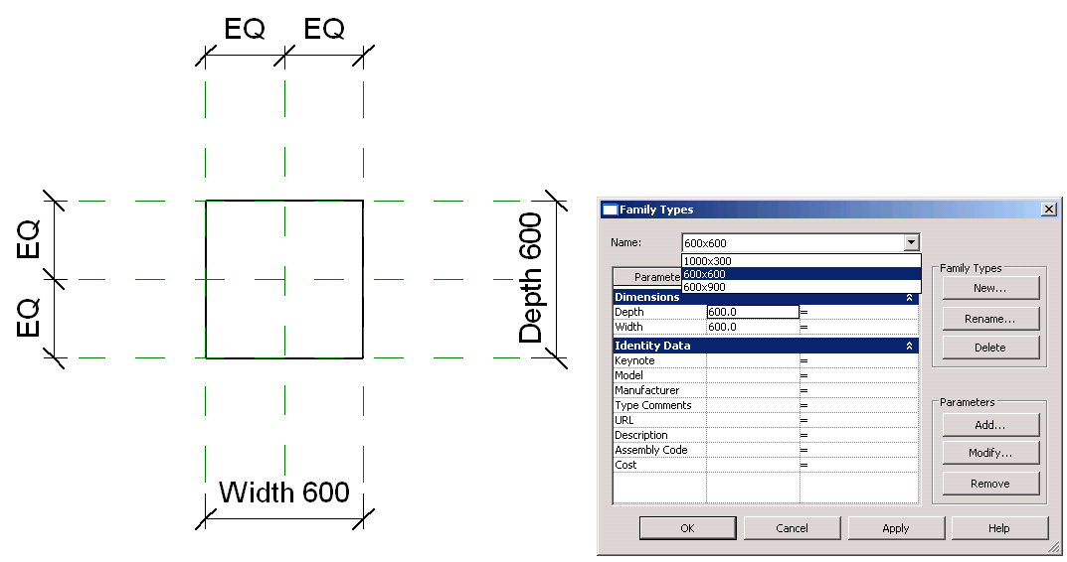
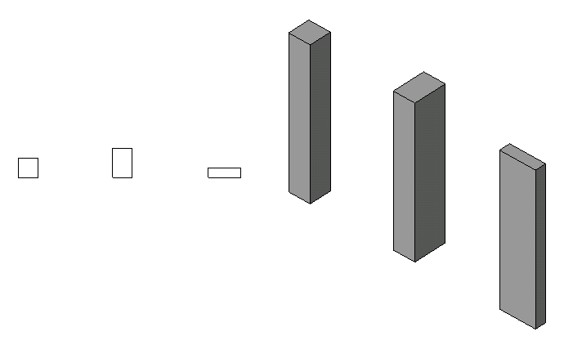
Lab1 – Create a Rectangular Column
Objective: learn THE basics of family API.
check the family context
create a simple solid using extrusion
set alignments
add types
Classes and methods:
rvtDoc.IsFamilyDocument()
rvtDoc.OwnerFamily.FamilyCategory.Name
rvtDoc.FamilyCreate.NewExtrusion()
rvtDoc.FamilyCreate.NewAlignment()
familyMgr = rvtDoc.FamilyManager
familyMgr.NewType()
familyMgr.Parameter(); familyMgr.Set()

Slide 15
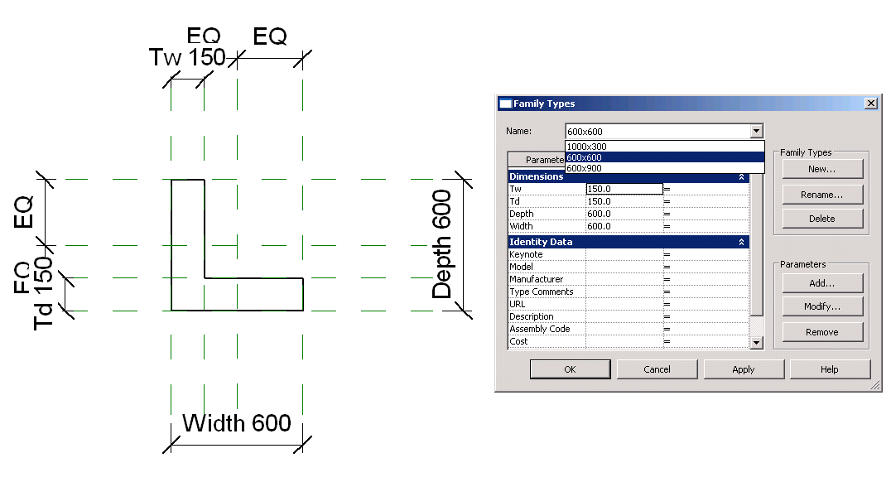
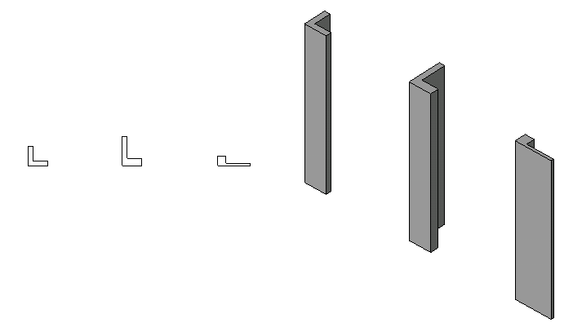
Lab2 – Create a L-Shape Column
Objective: learn the basics of family API.
add reference planes
add parameters
add dimentiones
Classes and methods:
rvtDoc.FamilyCreate.NewReferencePlane()
familyMgr.AddParameter()
rvtDoc.FamilyCreate.NewDimension()

Slide 16
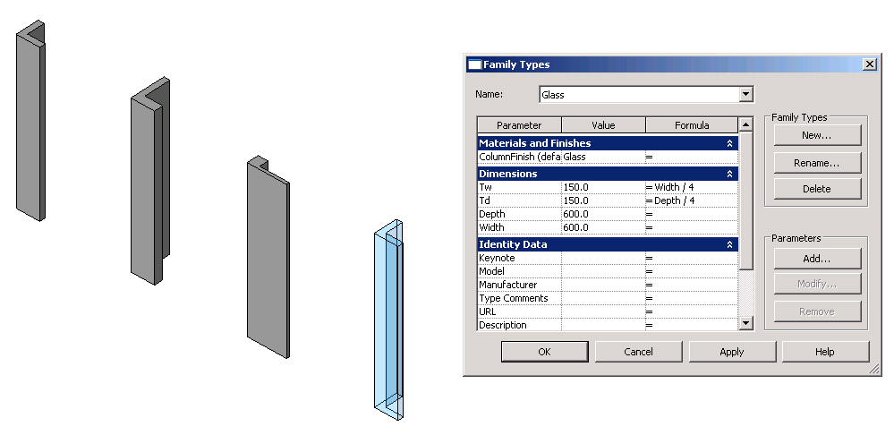
Lab3 – Add Formulas and Materials
Objective: learn the basics of family API.
add formulas
add materials
Classes and methods:
familyMgr.SetFormula()
pSolid.Parameter(“Material”)
familyMgr.AddParameter(“MyColumnFinish”, BuiltInParameterGroup.PG_MATERIALS, ParameterType.Material, True)
familyMgr.AssociateElementParameterToFamilyParameter()

Slide 17
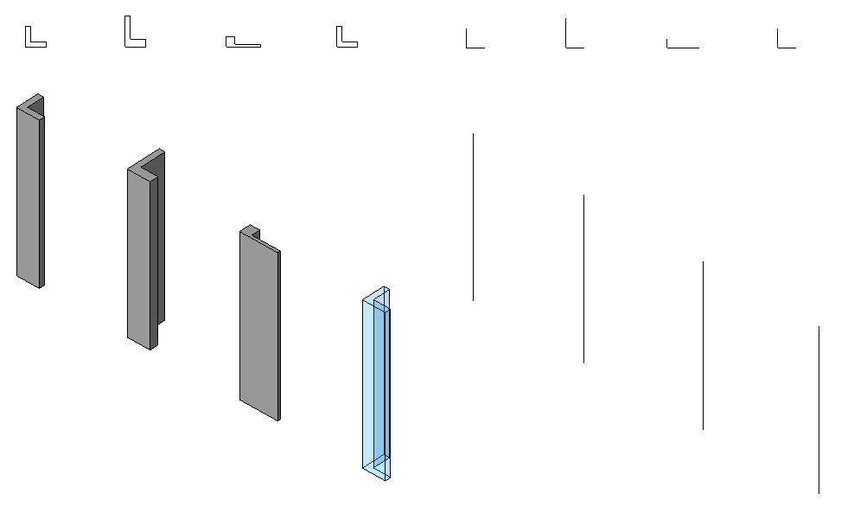
Lab4 – Add Visibility Control
Objective:
add line representation
add visibility control
Classes and methods:
rvtDoc.FamilyCreate.NewSymbolicCurve()
rvtDoc.FamilyCreate.NewModelCurve()
FamilyElementVisibility(FamilyElementVisibilityType.ViewSpecific/Model)
FamilyElementVisibility.IsShownInFine, etc.
pLine.SetVisibility(pFamilyElementVisibility)

Slide 18
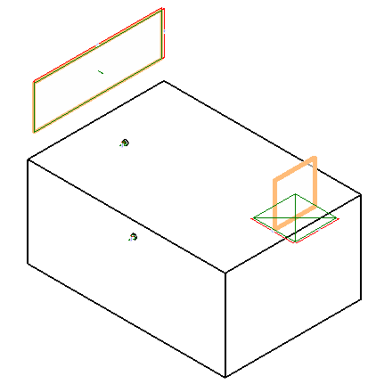
Family API Samples
FamilyCreation folder in the SDK Samples directory
AutoJoin
Automatically join geometry of multiple generic forms for use in family modeling and massing
Uses the method Document::CombineElements to join geometry between overlapping generic forms
Provide a utility method check geometry object overlap, based on Face::Intersect(Curve) method
AutoParameter
Batch mode automatic addition of shared or non-shared parameters to one or more family documents
Process active family documentor all families in a folder
Uses FamilyManager class AddParameter methods
Reads input data from parameter text files in Revit shared parameter format
CreateAirHandler – RME
Create an air handler with pipe and duct connectors
Check the template family category to verify valid starting point
Use FamilyItemFactory class NewExtrusion, NewPipeConnector, NewDuctConnector methods
Set proper connector parameters and use Document::CombineElements to join the extrusions
CreateTruss – RST
Create a mono truss in a truss family document
Create truss curves using NewModelCurve, set truss type through ModelCurve TrussCurveType property
Add constraints to the truss curves with NewAlignment

Slide 19
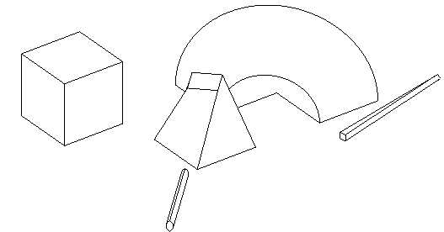
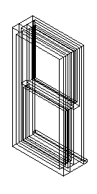
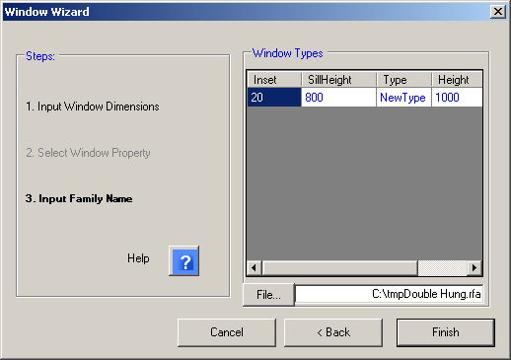
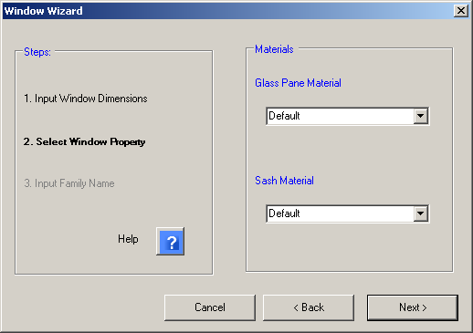
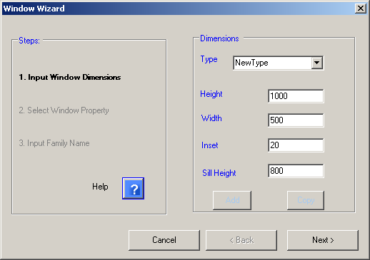
Family API Samples (cont.)
DWGFamilyCreation
Import DWG file into family document add type parameters to the imported instance
DWGFileName with the DWG file name and ImportTime when it was imported
GenericModelCreation
Create a generic model using extrusion, blend, revolution, sweep and swept blend elements
Checks that open document is a family one or creates a new family document
Exercises CreateSketchPlane, NewLineBound, and FamilyItemFactory methods to create profiles and shapes
TypeRegeneration
Use FamilyManager Types property to determine all types defined, and CurrentType to iterate through them
Report whether all types regenerated successfully, log errors to file
ValidateParameters
Check whether every type has valid values for certain parameters and log result to file
External application subscribing to DocumentSaving and DocumentSavingAs events runs check automatically
External command to launch manually
WindowWizard
Create a window family via wizard user interface
Start in window family template, e.g. Metric Window.rtf
User defines input dimensions for window parameters and materials
Create extrusion, alignment, dimension, reference plane, and family type

Slide 20
