Slide 1
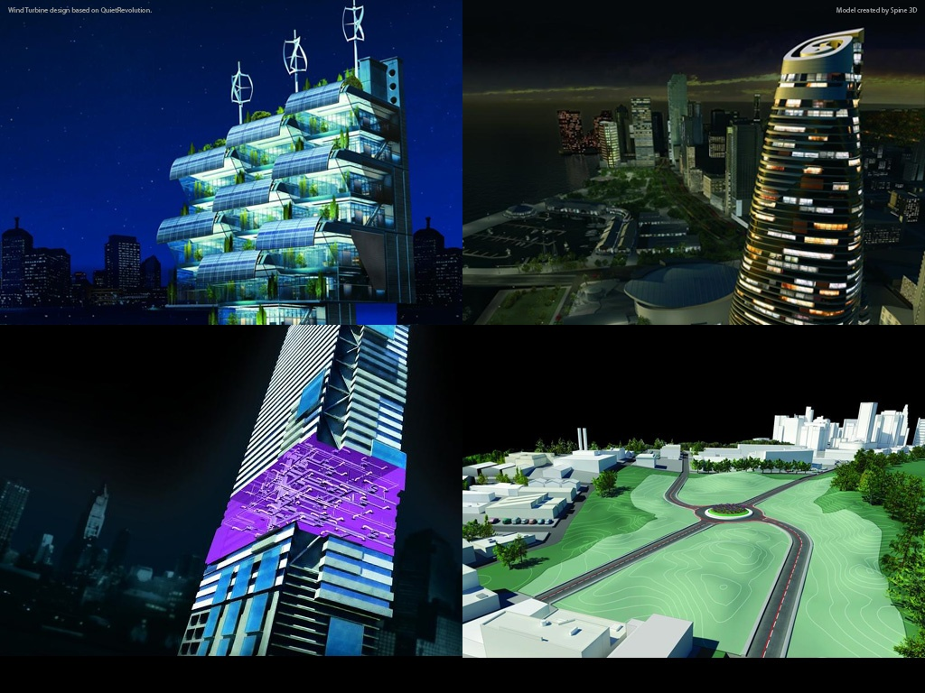
Developer Days Online
What’s New in Revit 2011
Adam Nagy, Jeremy Tammik, Saikat Bhattacharya
Developer Technical Services
What’s New in Revit 2011 API
Developer Technical Services
Autodesk Developer Network April 2010

Slide 2
Today’s presentation…
Based on ADN Developer Days Conference
ADN member only conference
November/December last year
More than 20 cities worldwide
This webcast is open to public

Slide 3
Today’s presentation…
Is being recorded and will be posted at:
ADN Extranet
http://adn.autodesk.com
> Revit > Knowledgebase
> Whitepapers and Training Videos
Developer Center
API Training & Consulting > Schedule
http://www.autodesk.com/joinadn
Notes:
[Please make sure you inform that we are recording.]

Slide 4
Polls
What category best describes your main professional activity?
Architect
Engineer
Constructor
Programmer
Manager
Other
How would you rate your level of experience with the Revit products?
Very experienced
Quite experienced
Not experienced
How would you rate your level of experience with the Revit API?
Very experienced
Quite experienced
Not experienced
Which statement best describes you?
This topic directly affects my work today
I expect this topic to be useful to me in the future
I'm evaluating this technology
None of the above

Slide 5
Agenda
Revit 2011 Features
APIs
The Rice (must do)
The Wine and MEP (value add)
New SDK Samples

Slide 6
Agenda
Revit 2011 Features
APIs
The Rice (must do)
The Wine and MEP (value add)
New SDK Samples

Slide 7
Themes of Revit 2011
Conceptual Design
User Interaction
Large Team Workflow
MEP acceleration
Sustainable Design and Analysis
API Expansion
Notes:
Continued work on Conceptual Design aspect both with the UI and API
Enhancements in the user interaction
Some resource investment in Large Team Workflows which are more to do with specific needs of large customers and their workflows. This has less to do with the API as such.
MEP being the youngest of the RAC and RST has not quite caught up with the other Revit verticals (RAC and RST). And so a significant focus has been given to getting the development of MEP in order to get it up to the same level as RAC and RST.
Keeping in mind the growing significance of Sustainable Design and Development, Revit will now offers tool to help users with that.
And of course enhancements to the API

Slide 8
Revit 2011 Key Features
Revit Architecture
Improved Form Generation
Adaptive Components
Revit Structure
Concrete Joins
Improved Analytical Model
Revit MEP
Conduit and Cable Trays
Panel Schedules
Platform
Improved User Interface
Performance Improvements
Reporting Parameters
API
Selection and Filtering
Dynamic Model Update
Analysis Visualization
Transactions
Much more!

Slide 9
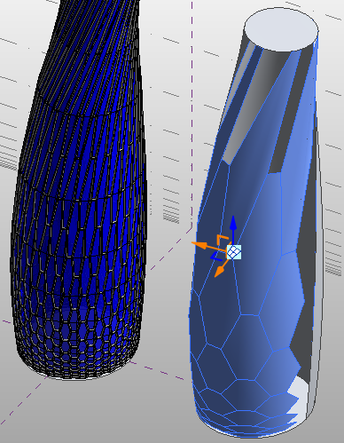
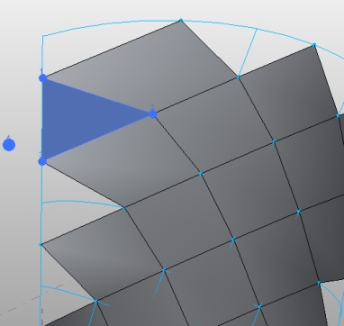
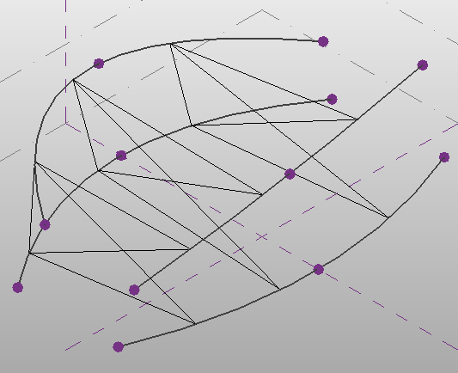
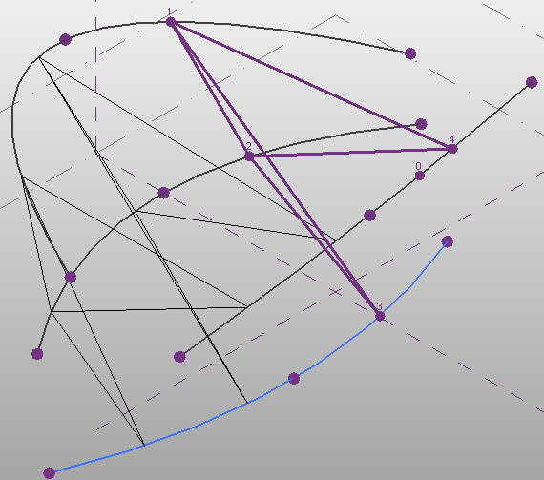
Revit 2011 Key Features - RAC
Improved Form Generation
Flexible Components

Slide 10
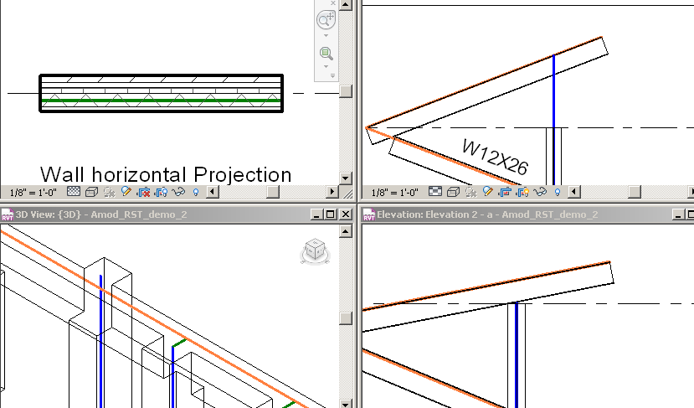
Revit 2011 Key Features - RST
Concrete Joins
Improved Analytical Model

Slide 11
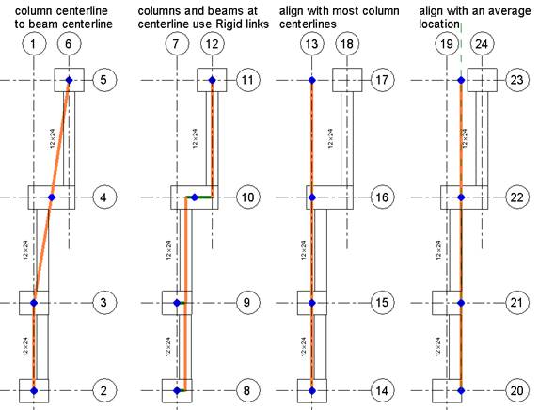
Analytical Model Adjustments
Reduce small noise in analytical model
Four of many ways to describe the same physical model
The last two use the new rigid links
Notes:
Most of the time an engineer will not be faced with a need (or desire) to locate the analytical model of a member at any significant distance from the geometric model. The analytical model is an approximation for the purposes of discretizing the model into a set of equations approximating the response of the structure to a set of applied loads (or displacements). Engineers will often make decisions in their approximations which are based on their professional judgment and/or practical experience. Here are 4 of many possible ways to describe the same physical structure with
an analytical model. Some engineers feel that the rigid link approximation is the only acceptable approximation though others would argue that it hasn’t accounted for inherent stabilization provided by framing members and that any of the other approximations are equally applicable.
The last two approximations utilize the new functionality. A more subtle example of this would be where the beams between gridlines 2 and 4 are different widths where the exterior edge is intended to align yet the centers of the beams would be mis-aligned. The new functionality could be used to reduce this small noise in the analytical model.
I hope this helps illustrate how one might use the new functionality in a somewhat more realistic scenario.

Slide 12
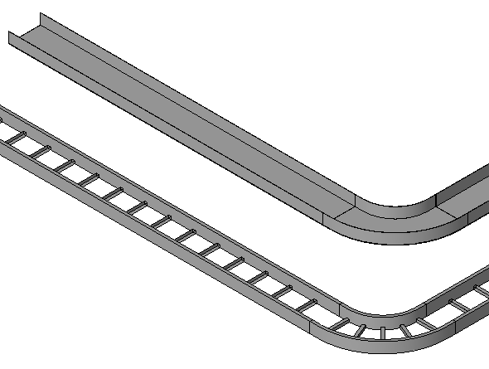
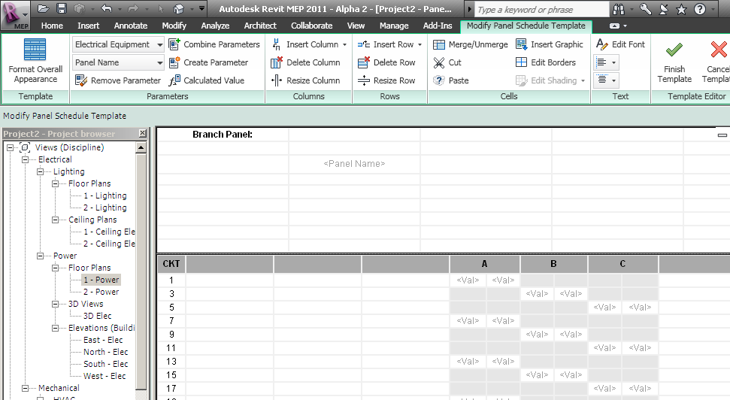
Revit 2011 Key Features - RME
Conduit and Cable Trays
Panel Schedules

Slide 13
Revit 2011 Key Features – Platform
Platform
Improved User Interface
Performance Improvements
Reporting Parameters
API
Selection and Filtering
Dynamic Model Update
Analysis Visualization Framework
Transactions
Much more!
Notes:
A lot of focus has been on performance improvements and there has been substantial gain in achieving that. And some enhancement around parameters, which is like a user designed feature to report out on family parameters.
The four API related points mentioned in this slide don’t even scratch the surface of the API enhancements. We will be talking at length about the new API functionality in the following slides.

Slide 14
Agenda
Revit 2011 Features
APIs
The Rice (must do)
The Wine and MEP (value add)
New SDK Samples

Slide 15
Revit 2011 APIs

Slide 16


API’s and Porting
The Rice
Making sure your application runs
Steps to support the next release
The Wine
Opportunities to add value
Using the new features and APIs to increase the value of your and our products

Slide 17
API’s and Porting
How difficult it is?
1 to 2 days to migrate an extension
Revit Extension team – 36 extensions, 42 person-days migrating, 4 pd testing
Robot Structural Analysis (RSA) team – 1 extension, 2 pd migration, 1 pd testing
RSA Concrete team – 3 extensions, 5 pd migration, 1 pd testing
Revit API introduction labs – 31 external commands in both C# and VB, a few days
The Building Coder samples – 60 external commands, 2-3 pd migration
Your mileage will vary, of course
Notes:
Before getting into the rice and wine, for which I will hand over to first Adam and then Saikat, here are a few words on our various teams' migration experiences.

Slide 18
The Rice
Changes to Revit API Namespaces
Set Regeneration Option
New Classes for XYZ, UV, and ElementId
Replacement for Symbol
New Transaction Interfaces
New Element Iteration Interfaces
Replacement for AnalyticalModel
Replacement for gbXMLParamElem
Revit Exceptions
Removed Deprecated Events
VSTA Proxy Removal
Some Function Signature Changes

Slide 19
The Rice – Changes to Revit API Namespaces
Revit 2011 divides the API three primary namespaces:
Autodesk.Revit.ApplicationServices
Classes accessing application settings and options
Autodesk.Revit.DB
Classes accessing file data
Autodesk.Revit.UI
Classes accessing or customizing the user interface
Notes:
The namespaces have undergone considerable re-structuring to enable
Quicker and structured access to API functionality that the API users need to work with. Getting access to the right functions was one of the reasons
There was no way to scale up the API without some fundamental reorganization of structure which would help it expand not just now but in releases to come
There was a need to separate the UI from the DB more cleanly. There were also some requirements to separate the Revit engine from the UI and more work on this was done which is now manifesting itself through the API.
In previous releases, the API was split along the functionality around the verticals which led to confusion about where the classes were if elements or symbols were specific to one vertical.
So now we have three main namespaces –
Application Services – Similar to AutoCAD’s ApplicationServices namespaces.
DB – classes accessing the file data
UI – classes accessing or customizing the UI

Slide 20
The Rice – Changes to Revit API Namespaces
DLL Split
RevitAPI.dll (DB, database)
RevitAPIUI.dll (UI, user interface)
Notes:
The namespace re-organization has also manifested itself in having two DLLs. Alpha 2 still has one DLL but from Beta onwards we can expect to have both the DLLs.

Slide 21
The Rice – Changes to Revit API Namespaces
Each Namespace has discipline subdivision
Autodesk.Revit.DB.Architecture
Autodesk.Revit.DB.Structure
Autodesk.Revit.DB.Mechanical
Autodesk.Revit.DB.Electrical
Autodesk.Revit.DB.Plumbing
…
Notes:
Each of the namespaces now will have discipline specific subdivisions. These will correspond to various verticals available. As you can notice MEP too has been broken down into its various disciplines under it – namely the Mechanical, Electrical and Plumbing.

Slide 22
The Rice – Changes to Revit API Namespaces
Classes moved and renamed to avoid naming conflicts
Autodesk.Revit.Geometry.Element -> Autodesk.Revit.DB.GeometryElement
Autodesk.Revit.Geometry.Instance -> Autodesk.Revit.DB.GeometryInstance
Autodesk.Revit.Structural.Enums.Material -> Autodesk.Revit.DB.MaterialType
Autodesk.Revit.Options.Application was removed; use Autodesk.Revit.ApplicationServices.Application

Slide 23
The Rice – Set Regeneration Option
Registered Commands and Applications must explicitly set a Regeneration Option
RegenerationOption.Automatic:
The API framework will regenerate after every model level change (equivalent behavior with Revit 2010 and earlier). This mode is provided for behavioral equivalence with Revit 2010 and earlier; it is obsolete and will be removed in a future release.
RegenerationOption.Manual:
The API framework will not regenerate after every model level change. SuspendUpdating blocks are unnecessary and should not be used. Regeneration may be triggered by your application.
Notes:
This particular enhancement is both a rice and wine. This is something that you have to do but also has a lot of benefits of doing the same. Some of the audience might be familiar with Suspend Updating feature which disables Revit from regenerating every time we initiate some action. That mode will be still in available in Revit 2011 but there is also a new feature now which manually sets the regeneration option so that you can decide on when you want Revit to regenerate. This will be part of an attribute of the new command registration mechanism we shall talk about soon. So this would help in deciding if you want Revit to regenerate every time on its own or you want to manually regenerate when you think is more appropriate. So moving forward, Suspend updating might be obsolete with focus now shifting to RegenerationOption.

Slide 24
The Rice – New classes for XYZ, UV, ElementId
Autodesk.Revit.DB.XYZ
Autodesk.Revit.DB.UV
Autodesk.Revit.DB.ElementId
Implemented in managed code
Suitable for properties.
API methods have been converted to accept and return these types
Methods now take .NET collections interfaces containing these types (instead of Revit collections):
Autodesk.Revit.ElementIdSet -> ICollection<Autodesk.Revit.DB.ElementId>
Autodesk.Revit.Geometry.XYZArray -> IList<Autodesk.Revit.DB.XYZ>
Autodesk.Revit.Geometry.UVArray -> IList<Autodesk.Revit.DB.UV>
ElementId is now a class instead of a struct and should not be passed by reference.
Notes:
These all new classes are directly implemented in Managed code and so the performance, firstly, should vastly improve.
They are also immutable and thus should be more suitable for use as properties.
With ElementId, methods now can accept and return them and methods have been modified to accept .NET collections. And ElementId is now a class instead of struct and this might need to be updated in your applications. And this also implies that we can no longer pass this as reference.

Slide 25
The Rice – Replacement for Symbol
Symbol class was renamed to ElementType
New methods to identify and find similar types that can replace the element
Notes:
This replacement of Symbol class to a more explanatory ElementType class also exposes some new methods to identify and find similar elements of that type. This helps reduce the detective work when we want to replace one element in the database with another.

Slide 26
The Rice – New Transaction Interfaces
Transaction – no nesting
Subtransaction – can be nested
TransactionGroup – treat several transactions as one
Transaction Control:
Start
Commit
RollBack
GetStatus
Uninitialized
Started
Committed
RolledBack
Pending
Notes:
Transactions have been redone to make it more logical and provide more comprehensive set of options for managing changes being made to the Revit document. The previous mechanism was mainly structured with API built on top of internal mechanism. In this release, some work was done internally to the transactions and that is making directly through to the API. This has also helped provide more functionality directly to the transactions through the API. So you will have to work on transactions explicitly if you have to work with them considering these changes. Besides opening and closing transactions, now we can logically group certain tasks. We now have sub transactions that we can optionally generate to do some changes. Sub-transactions help in logically splitting larger tasks into smaller ones. They have to created within open transaction and must be closed before closing of the outer (main) transaction. They don’t have any name and thus do not appear in the Undo stack. Grouping will help group transactions in the undo stack so that they can be undone in one shot. So we can start, commit, rollback and get status which includes the flag of Pending which indicates that some error has happened and with some interaction from the user, it will be either rolled back or committed once the user resolves the issue.
So overall this helps manage the undo stack more closely. And so users now have greater control on deciding on how to group tasks in one undo stack or have them undone in more granular fashion.

Slide 27
The Rice – New Element Iteration Interfaces
Iterate and filter elements from a document, or only elements from a list of element ids
High performance filters which do not expand the element in memory for evaluation
Chained shortcuts which apply common filters
Group more than two filters
Match derived types automatically with the type filter
Iterate elements from all design options or from specific design options
Use foreach on the collector element
LINQ query compatible
Notes:
This iteration interface provides greater performance. You can get a list of elements from the document or a list of element ids. We shall also identify some high performance filters.
Revit internally has some elements in memory that are not expanded. So typically Revit has to expand those to perform certain iterations and that consumes some of the cycles. The unexpanded bit of each element does contain some information and so this release is expected to provide some services in case you have to read some information off an element, it does not have to expand the element in memory and get the information out for you and thus providing a performance advantage. We can now chain up the filters if we want to provide some combination of filters in sequence.
…
…
…

Slide 28
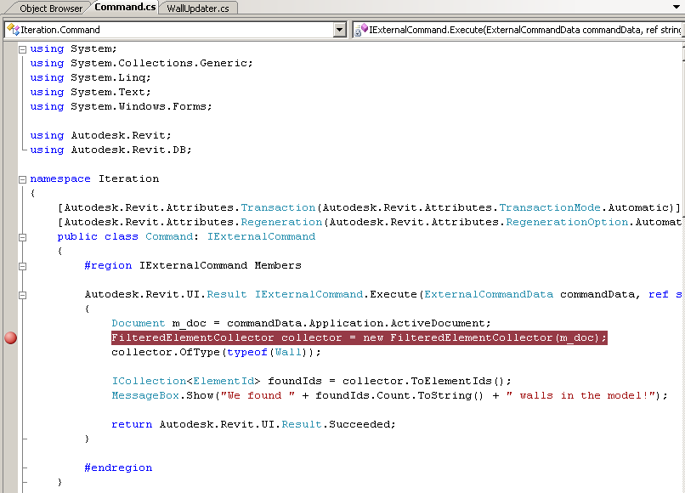
The Rice Demo…
Element Iteration

Slide 29
The Rice – Changes to the AnalyticalModel
Removed the following AnalyticalModel subclasses
AnalyticalModel3D
AnalyticalModelFloor
AnalyticalModelFrame
AnalyticalModelLocation
AnalyticalModelWall
The base class AnalyticalModel provides replacement functions
Notes:
The structure internally for Analytical model has changed. There used to a lot of sub classes around the analytical model. So all that has been consolidated to the parent class of analytical model. This offers a more streamlined interface and more capabilities to read data and modify analytical model settings.
And some extra functionality was also added around the analytical model too.

Slide 30
The Rice – Changes to the AnalyticalModel
AnalyticalModel offers:
Manual and automatic adjustments
Projection, hard points, approximation, and rigid links
Analytical offset
AnalyticalModelProfile has been replaced by AnalyticalModelSweptProfile
AnalyticalSupportData and AnalyticalSupportInfo are now collections of AnalyticalModelSupport objects.
Support priority
Curve, point, and face providing support
GetAnalyticalModel() on Element.
Notes:
The AnalyticalModel class offers new methods to access other Analytical Model properties, such as:
• Adjustment information, both manual and automatic
• Parameter information, including projection, hard points, approximation, and rigid links
• Analytical offset
The AnalyticalModelProfile class has been replaced by the AnalyticalModelSweptProfile class, which offers similar contents to the original class.
The AnalyticalSupportData and AnalyticalSupportInfo classes have been replaced by collections of AnalyticalModelSupport objects. This new class offers the same information offered by AnalyticalSupportInfo, plus:
• The support priority
• The curve, point, and face providing support
The new AnalyticalSupportChecking interface offers the ability to run the check for unsupported structural elements. The new AnalyticalConsistencyChecking interface offers the ability to run a consistency check for the Analytical Model. The results of both checks are added to the document as warnings.

Slide 31
The Rice – Replacement for gbXMLParamElem
gbXMLParamElem property | EnergyDataSettings property
BuildingService | ServiceType
BuildingType | BuildingType
ExportComplexity | ExportComplexity
GroundPlane | GroundPlane
ProjectLocation | ProjectGeographicLocationString
ProjectPhase | ProjectPhase
Notes:
If you have some energy applications, we have changed the name (as mentioned in the slides) to make the understanding of what these imply more appropriate. So you would have to do some translation in the property names if you have an existing application that uses these properties already.

Slide 32
The Rice – Revit Exceptions
API methods throw subclasses of Autodesk.Revit.Exceptions.ApplicationException.
Similar to .NET System Exceptions:
ArgumentException
InvalidOperationException
FileNotFoundExceptions
Some subclasses unique to Revit, e.g:
AutoJoinFailedException
RegenerationFailedException
ModificationOutsideTransactionException
InternalException:
Contains extra diagnostic information which can be passed back to Autodesk for diagnosis.
Notes:
The structure of the Exception structure has been changed to make it in conjunction with the .NET system exceptions. And we also have subclasses out of which some exceptions that are unique to Revit only. This was done so that API users (developers) would know more when any exception was thrown and in the previous setup it wasn’t quite clear. This subclassing helped us provide some additional information that will help you in your development and debugging process (instead of giving a generic say InvalidOperation exception). Besides these, there might still be exceptions that the Engg team did not anticipate and these will be under InternalException. You can share this with support team and we can help diagnose what actually went wrong and probably help us add a new subclass exception in future to handle such exceptions.

Slide 33
The Rice – Deprecated Event Removal
Application.OnDocumentSaved
Application.OnDocumentSavedAs
Application.OnDocumentOpened
Application.OnDocumentClosed
Application.OnDocumentNewed
Application.OnDialogBox
Document.OnSaveAs
Document.OnSave
Document.OnClose
Notes:
In Revit 2010, we had deprecated most of the old events and now in this release, we have deprecated the remaining old events. API users can work with the new Events available in Revit 2010 and they help deal with all sorts of event actions that might be needed to be tracked.

Slide 34
The Rice – VSTA Proxy Removal
No longer depends on Proxy DLL
Directly access both the new Revit API DLLs.
Notes:
The entry point class templates have been modified to accommodate this change.

Slide 35
Revit API Wishlist Survey Results
UI - Better integration into Revit UI ^{(*)}
- User selection of element ends, intersection and faces while external app is running inside of Revit
- Ability to post and handle custom errors
- Access to the Revit Project Browser
- Creation of docked windows in the Revit user interface.
- Open a Revit document in the user interface
- Access to Views
Elements - Encode more complex formulas into family parameters
- Change existing element behavior, such as the join behavior of a wall
- Event handlers for elements when added, deleted, changed, moved or selected
(*) Not complete, but incrementally improved (e.g., exposing a dialog).

Slide 36
The Wine – New APIs
Selection
Dynamic Update
OnIdle Event
Command Registration
Error Handling
Analysis Visualization
Conduit & Cable Tray
UI API Enhancements
Task Dialogs
…and more!
Notes:
This release will be even bigger release as compared to last years where in we had the new family creation API and form creation (Conceptual modeling) API. Besides quite an exhaustive list of Rice items this year, we also have a long list of wine items.

Slide 37
The Wine – Selection
Selection.PickPoint()
Select a point on the active workplane
Snap overrides
View.SketchPlane
Set the active workplane
Selection.PickObject
Selection.PickObjects
Users can make one or multiple selections
Users can make multiple selections via box select
Custom status prompt
Custom selection filter
Notes:
Selection.PickPoint has been on top of the wish list items for some releases now and in this release, we can now have the users pick a point on the screen and it will give a point on the active work-plane. We can also override the default user snap settings if that is appropriate and providing a custom status to prompt to direct users what to pick. The method returns an XYZ corresponding to the users pick.
We can also set the active work-plane so that we have control on the point that we having the user select. Hopefully this will give a lot of flexibility around user interaction.
Besides point, we can select objects, perform single or multiple selections, do a box select, add or subtract items from a selection set, have included custom status prompts and also have filter to avoid users from selecting certain objects (thus allowing us to funnel what users want to select).

Slide 38
The Wine – Dynamic Model Update
Element Events
Track by type, or particular elements
Added
Modified
Deleted
Model Edit on Event
Within the same regeneration cycle
Undo with triggering operation
Notes:
Dynamic model update offers the ability for a Revit API application to modify the Revit model as a reaction to changes happening in the model. Revit will now let you know when elements are added, modified or deleted. So Dynamic model update offers the ability to track and modify the model as a reaction to changes happening in the model. This facility is offered through implementation of updaters. The updater interface offers the ability to implement a method that is informed of the scope of changes that triggered the changes.
To subscribe to an updater, we need to assign some triggers which work in combination of both update scope and update type. Update scope refers to changes in explicit list of element ids in document or implicit list of elements communicated via elementfilter. Change Type refers to changes including element addition, deletion , modification of geometry, parameters, or any property of element.
Besides this, we shall also enable you to edit the model during the model regeneration cycle triggered by the element change. For example – if the user stretches a concrete beam and our application is based on rebars, we can modify the rebar within the beam right after the users are done with resizing the beam. And those changes to the model will be contained in that overall transaction, and so if the user does an undo, our rebar sizing and the beam resizing will all be done at once in one shot (instead of having a clunky two stage resizing). This has lot of implication since we are now able to react to events in model and we can update our analysis applications, or make changes in the model in reaction to users interaction to the model elements.

Slide 39
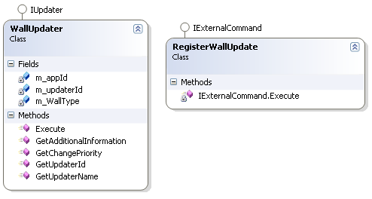
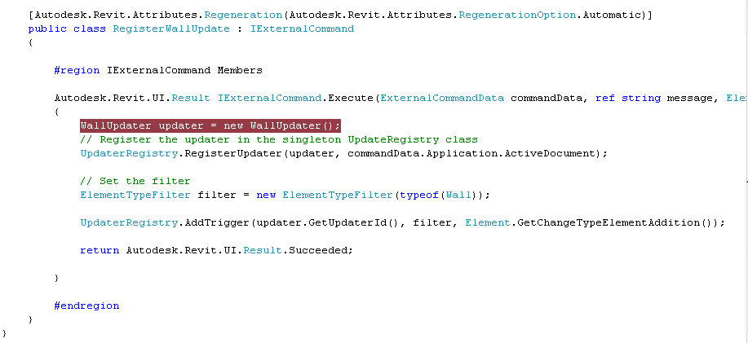
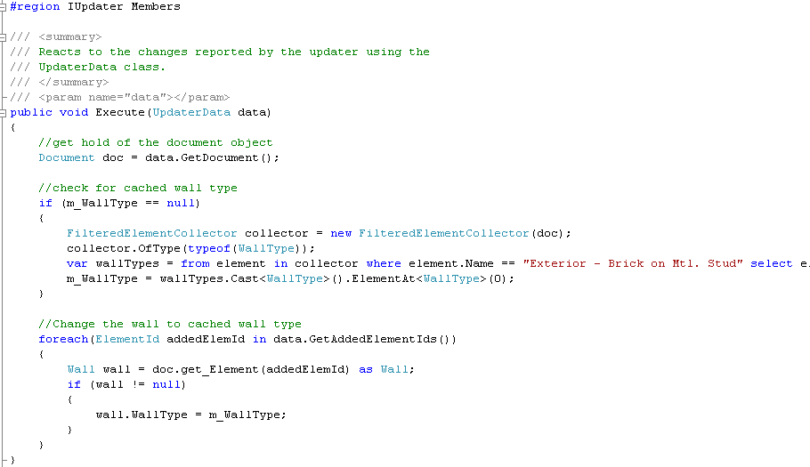
The Wine Demo…
Dynamic Model Update

Slide 40
The Wine – Idling Event
Application.Idling
Raised when the API application can safely access the active document between user interactions.
Allows changes to the document if a new transaction is opened.
User perception of Revit responsiveness will be improved by splitting tasks across multiple event calls
Notes:
The new event UIApplication.Idling is raised when it is safe for the API application to access the active document between user interactions. The event is raised only when the Revit UI is in a state where the user could successfully click on an API command button. We are adding an Application.OnIdle event so that when the application is not being used by the user, or when the user is not moving the mouse around or interacting with elements, etc, you can do something. So Revit will tell you that it is not busy at the moment and we can do certain operations. For example around the sustainable design and analysis context, when we get to know that Revit is idle, we can have some functionality added to update some database or analysis model based on changes that have occurred in the model and were tracked by the element events. Revit internally will make sure when it raises this event so that the model does not get corrupted by doing something when it is not available. The event allows changes to a document if a new transaction is opened.
There are also some safety considerations. Because this event is invoked between user actions in the Revit UI, if the handler for this event requires a significant amount of processing time, users will perceive a slowdown in the responsiveness of Revit. If the execution for updates can be safely split across multiple calls to this event, the user perception of Revit responsiveness will be improved.

Slide 41
The Wine – Command Registration
The Revit API now offers the ability to register API applications via a .addin manifest file
Multiple AddIn elements may be provided in a single manifest file
Among many others, the new mechanism offers the following XML tags:
Assembly
ClientId
Text
Description
The Revit.ini registration mechanism remains in place for the 2011 release but will be removed in the future
Notes:
The current INI mechanism will still remain in 2011. But we will be deprecating that in favor of a new command registration mechanism using the manifest file. This mechanism allows us to control a lot of the behavior of the external commands, application level behavior like regeneration that we talked about, etc. If you think this can still be improved, do let us know while you can continue using the INI file for your current projects in 2011.
Let us know if you have any suggestions around this too!

Slide 42
The Wine – Command Registration
Create entries in the Revit journal
JournalMode.UsingCommandData
Uses the “StringStringMap” supplied in the command data. Hides all Revit journal entries in between the external command invocation and the StringStringMap entry.
JournalMode.NoCommandData Does not write contents of the ExternalCommandData.Data map to the Revit journal. Allows Revit API calls to write to the journal as needed. This option should allow commands which invoke the Revit UI for selection or for responses to task dialogs to replay correctly.
Notes:
The custom attribute Autodesk.Revit.Attributes.JournalingAttribute can optionally be used to control the journaling behavior during the execution of your external command.
We can now add journal entries into the Revit journal – this could be handy for debugging purposes. The first option helps us record your commands and thus helps you do detective work if something goes wrong to find out if it was caused by your external command or because of Revit.
JournalMode.UsingCommandData
Uses the “StringStringMap” supplied in the command data. Hides all Revit journal entries in between the external command invocation and the StringStringMap entry. Commands which invoke the Revit UI for selection or for responses to task dialogs may not replay correctly.
JournalMode.NoCommandData
Does not write contents of the ExternalCommandData.Data map to the Revit journal. But does allow Revit API calls to write to the journal as needed. This option should allow commands which invoke the Revit UI for selection or for responses to task dialogs to replay correctly.

Slide 43
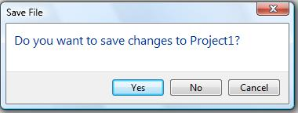
The Wine – Tasks Dialog
Instructions
Detailed Text
Icons
Buttons
Command Links
Notes:
The API now offers the ability to create and display Revit-style Task Dialogs. It is intended to provide capabilities similar to System.Windows.Forms.MessageBox with a Revit look-and-feel.
TaskDialog and the members of that class can be used to set the instructions, detailed text, icons, buttons and command links to be displayed in the task dialog. Then display the dialog using the Show() method. After the user responds to the dialog by clicking one of the buttons or links, the Show() method returns an identifier indicating the user's preferred choice. There are also shortcut static Show() methods on this class providing a quick way to show simple task dialogs.

Slide 44
The Wine – Failure Posting & Handling API
Define and Post Failures
Respond to Failures
Create Custom Failures
Customize Failure Resolution
Notes:
With regen control, dynamic model updating, journalling, error handling all in integration context, the Revit Engg team is trying to integrate your external commands and applications as closely as possible with Revit so that it feels like part of native Revit. With the new Failure API, API users will now be able to –
define and post failures from within API code when a user-visible problem has occurred.
respond to failures posted by Revit and by API code through code in your application.
Failure Posting: If you are using the failure posting mechanism to report your problem, all you need to do is:
If you are creating a new failure not already existing in Revit, define the new failure and register it in the FailureDefinitionRegistry during the OnStartup() call of your ExternalApplication (new failures must be registered at Revit startup)
Find the failure definition id, either from the BuiltInFailures classes or from your pre-registered custom failure using the class related to FailureDefinition
Post a failure to a document that has a problem - using the classes related to FailureMessage to set options and details related to the failure
Failure Handling: Normally posted failures are processed by Revit's standard failure resolution UI at the end of transaction. The user is presented information and options in the UI to deal with the failures.
However, if your operation (or set of operations) on the document requires some special treatment for certain errors (or even all possible errors), you can customize failure resolution. Custom failure resolution can be supplied:
For a given transaction using the interface IFailuresPreprocessor.
For all possible errors using the FailuresProcessing event.
Finally, the API offers the ability to completely replace the standard failure processing user interface using the interface IFailuresProcessor.

Slide 45
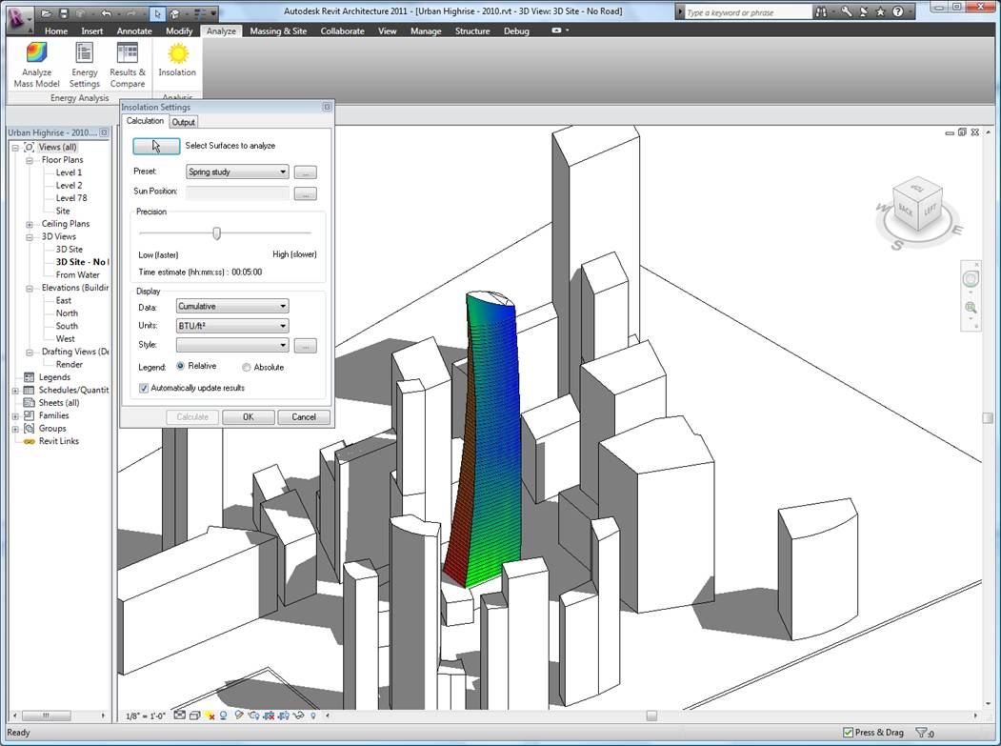
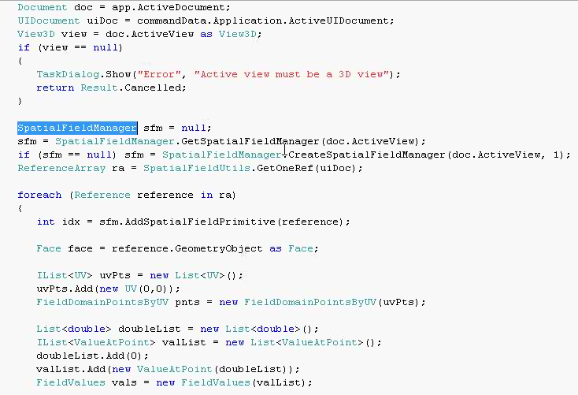
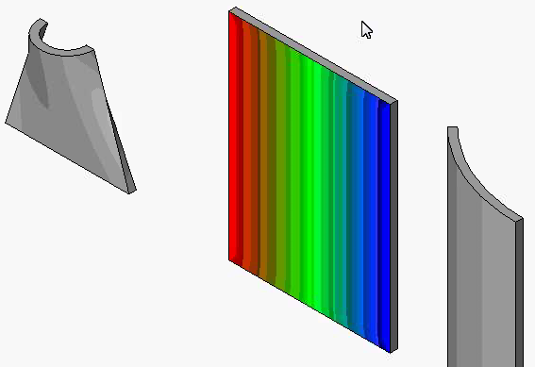
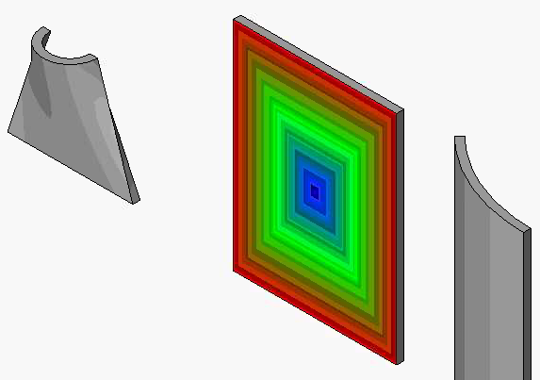
The Wine – Analysis Visualization
Notes:
This new functionality creates a mechanism for external analysis applications to easily display the results of their computation as 3D data in the Revit model. Note that the results data is transient; it is stored only in the model for the duration of the current Revit session. This feature is designed to allow third party applications to deeply integrate into Revit, do the calculations in their own third party applications, and then create this framework for displaying the results of the computations inside the Revit model. The analysis colors are based on certain values applied based on U and V points on the surface. And a new analysis display style will be used to decide on the display colors, marker types, legend style, text on surface, etc.

Slide 46
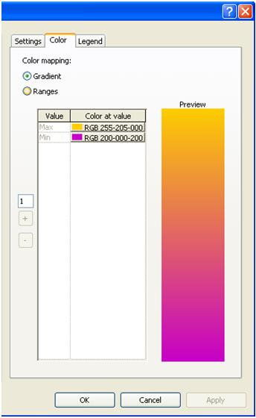
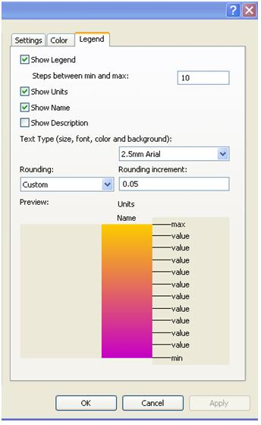
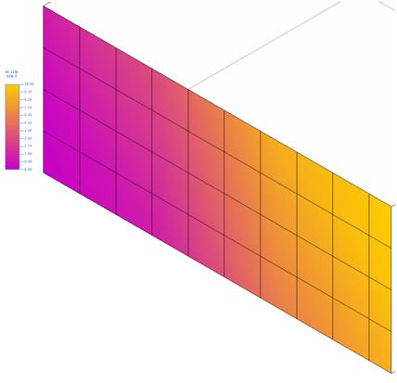
The Wine – Analysis Visualization Demo…
Notes:
The SpatialFieldManager class is used to create, delete, and modify the "containers" in which the analysis results are stored.
The FieldDomainPoints sub-classes indicate the points where analysis results are computed.
The FieldValues class contains the values for each domain point. Each domain point can have multiple values, each for a separate "measurement" at this point. For example, if a solar calculation is being done for every day of the year, each point would have 365 corresponding values

Slide 47
The Wine – UI API Enhancements
SplitButton - a pulldown button with a default pushbutton attached
RadioGroup - a set of ToggleButtons, where only one of the set can be active at a time
ComboBox - a pulldown containing a set of selectable items, which can be grouped optionally
TextBox - an input field for users to enter text
SlideOut panel - an extra panel can optionally slide down from a Ribbon panel; this panel can contain any of the standard Ribbon components
Notes:
With the integration context, we are providing some additional widgets to work with in the UI. The details of the widgets are included in the slide.
For ComboBox and TextBox, events are included; these events call your API code when the component is changed by the user.

Slide 48
The Wine – And More…
Obtain point placement references from a family
Import DWG as link
Identify if import instance is linked
Rehost a form
Rebar API changes
Associate array dimension to label in families
Refresh active view
Create sloped wall on mass face
Rename and replace a family parameter
Reporting parameters
Extract GUID from a Parameter
SuspendUpdating applies to Parameter.Set
Notes:
With the new API, it is now possible to obtain the point placement references in the loaded family symbol or placed family instance.
We can imports a DWG into the document as a link.
We can identify if import instance is linked to an external file.
Overloaded Rehost() method allows a form to a new edge, face, curve, or sketch plane.
The API refreshes the display of the active view during the execution of your command so users can see incremental updates to their model.
API contains method to create a new instance of a face wall on the sloped face of a mass.
Renaming and Replacing family params was a gap left over last year and now has been included. And this allows API users to rename a parameter and also allows to replace shared parameters with family parameters and vice versa.
Property which identifies if the parameter is a reporting parameter. If true, the parameter is associated to a dimension value and cannot be modified. If false, the parameter is a driving parameter and if associated to a dimension, can modify the dimension it labels. We also have methods to change reporting parameters to non-reporting.
Dedicated method to identify if a given parameter is shared parameter and if yes, extract the GUID out of it.
SuspendUpdating performance improvements now apply to Parameter.Set by default. By using the new constructor for SuspendUpdating which takes a boolean suspendForParameterSet, you can turn off this option.

Slide 49
The Wine – And More…
Export option for color mode
Export model to IFC
Floor slope and elevation
NewTruss() in Revit Architecture
Validation in ElectricalSystem properties
Converting between Model Curves and Detail/Symbolic Curves
WireMaterialType, InsulationType, TemperatureRatingType
DuctConnector, PipeConnector, ElectricalConnector
Truss - attach and detach chord
Drop truss and beam systems
Notes:
The new API allows the option of exporting colors matching the AutoCAD Color Index colors
For some of the partners in EU who have asked more on IFC, we now can export the model to IFC format.
The slope and elevation at a point on floor's surface can be found
We are porting some functionality from RST to RAC and the API will be ported accordingly. NewTruss which could be created in RST can now be created in RAC as well.
Length and VoltageDrop now throw an InvalidOperationException when the value cannot be computed (instead of returning 0).
We can also convert Model curves to Detail curves and back and forth. Some users have been working with the wrong curve and then realized it later and then have back up the file and redone the workflow. And this conversion is supported using the API too.
WireMaterialType, InsulationType, TemperatureRatingType methods now inherit from ElementType.
DuctConnector, PipeConnector, ElectricalConnector methods now inherit from a new common base class, ConnectorElement.
Some changes around the Attach and Detach chord method names
DropTruss() and DropBeamSystem() delete the parent collection elements after disassociating their constituent members.

Slide 50
Revit MEP 2011 Update

Slide 51
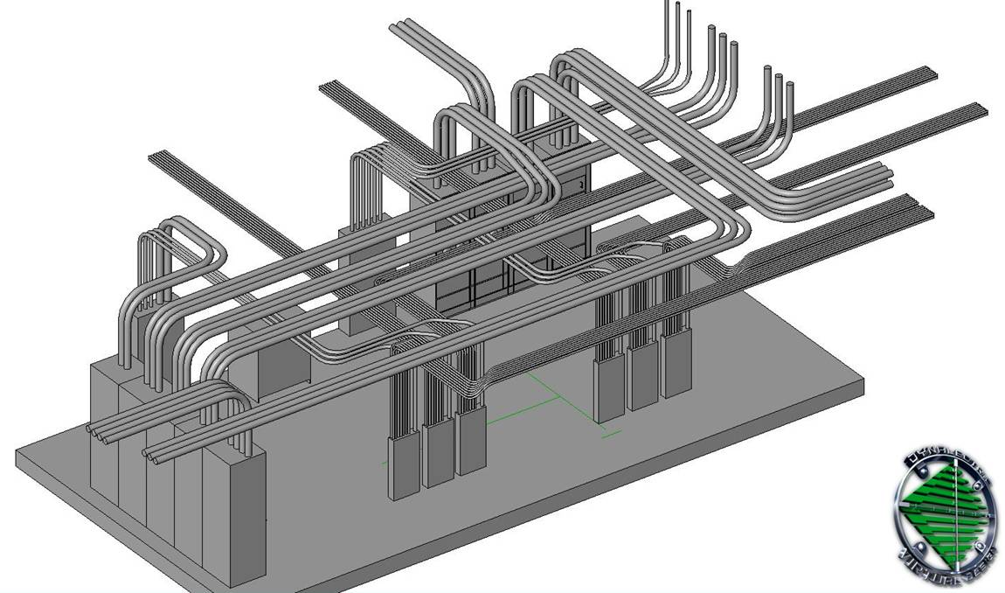
Conduit, Cable Tray, and Panel Schedules
Full API Support
Notes:
We are exposing an API to work with conduits, cable trays and panel schedules. So whatever users can do with the user interface with conduits and cable trays is now possible using the API. The entire functionality is accessible using the API.

Slide 52
Revit MEP API Evolution
Revit 2008 provided no MEP-specific API
Generic element and parameter access can be used
Revit 2009 introduced MEP-specific API support
MEP model property, space and zone, electrical and mechanical equipment, lighting device and fixture, connector, electrical system
MEP API is a focal point of the Revit 2010 and 2011 APIs
2010: MEP namespace, support for HVAC and piping systems
2011: conduit, cable tray, panel schedule and more

Slide 53
Revit MEP 2011 Product Enhancements
Cable Tray and Conduit
Panel Schedules
Other Enhancements
Placing Valves and Fittings in Section or Elevation Views
Tagging of MEP Elements during placement
Demand Factors and Load Categories
Piping Companion Flanges
New Electrical Content
Oval Duct

Slide 54
Revit MEP 2011 API Enhancements
Cable Tray and Conduit
CableTrayConduitBase, CableTrayConduitRunBase, CableTray, CableTrayType, CableTrayRun
Conduit, ConduitType,ConduitRun
ADN PipeToConduit Converter sample application
Panel Schedules
TableView, TableData, TableSectionData
PanelScheduleView, PanelScheduleData, PanelScheduleTemplate, PanelScheduleSheetSegment, PanelScheduleSheetInstance
Revit SDK PanelSchedule sample aplication
Other Enhancements
EnergyDataSettings
Validation in ElectricalSystem Properties
WireMaterialType, InsulationType, TemperatureRatingType
DuctConnector, PipeConnector, ElectricalConnector
Demand Factor and Load Classifications
Oval Duct

Slide 55
Revit 2011 New SDK Samples

Slide 56
New SDK samples
AnalysisVisualizationFramework
DistanceToSurfaces
SpatialFieldGradient
ConceputalDesign
DividedSurfaceByIntersects
ElementFilter
ViewFilters
FindReferencesByDirection
FindColumns
MeasureHeight
Massing
ParameterValuesFromImage
PointCurveCreation
DirectionCalculation
DocumentChanged/ ChangesMonitor
DynamicModelUpdate
ErrorHandling
ExternalCommand2011
MaterialQuantities
PanelSchedule
Selections
SolidSolidCut
Modified
HelloRevit
ImportExport
TransactionControl

Slide 57
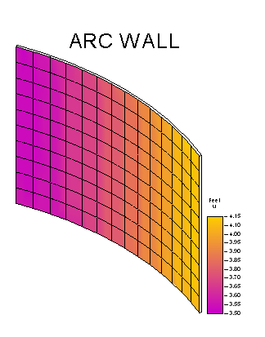
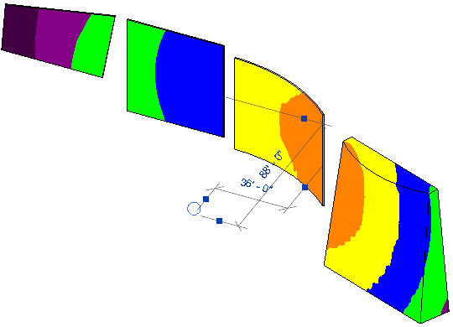
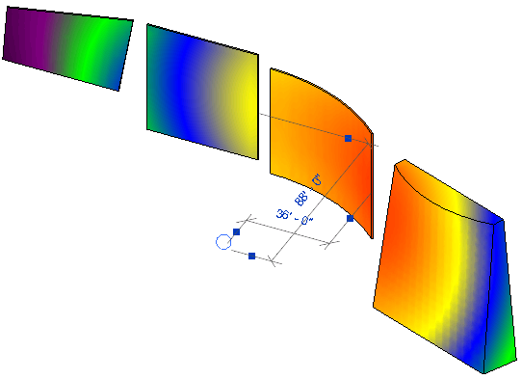
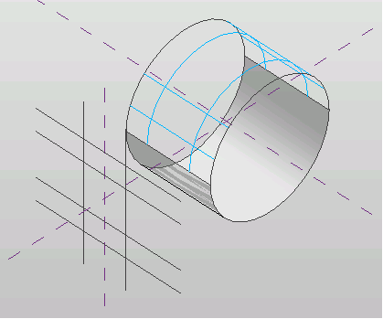
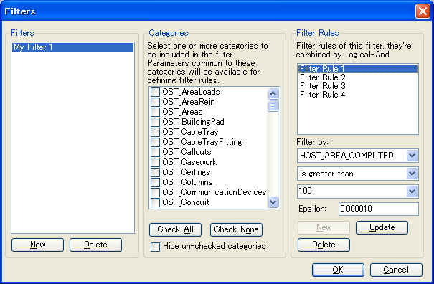
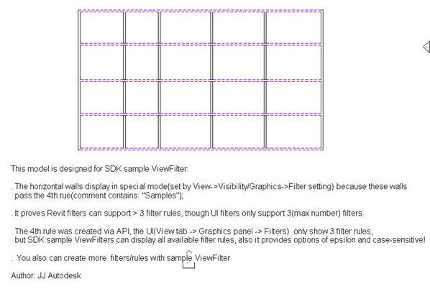
New SDK samples
Analysis Visualization Framework
SpatialFieldGradient
DistanceToSurfaces
Conceptual Design DividedSurfaceByIntersects
ElementFiltering ViewFilters
Notes:
DistanceToSurfaces: external application reacts to changes in walls and sphere object. calculates the distance from a family instance to several points on each face.
SpatialFieldGradient: display analysis results in a Revit model. On selection of a face, this sample displays numeric data on that face. includes legend and colour definition.
DividedSurfaceByIntersects: demonstrates how to add and remove intersection elements such as Level, ReferencePlane, ModelCurve on a DividedSurface.
ViewFilters: demonstrates how to create and modify view filters by 2011 new element iteration API, and show that the API can support more than the three filter maximum imposed by the user interface.

Slide 58
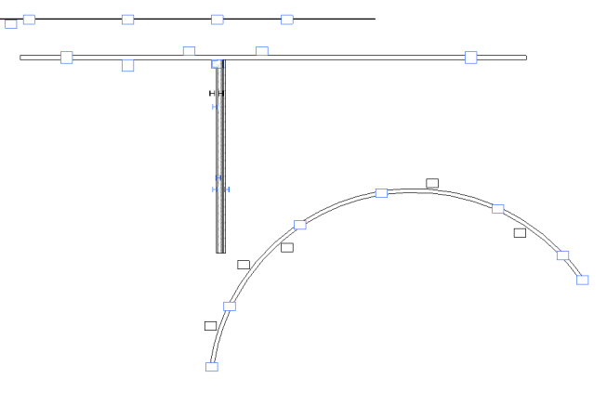
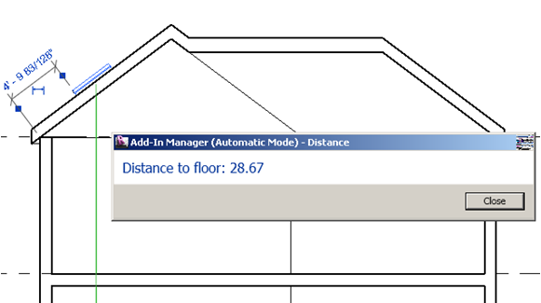
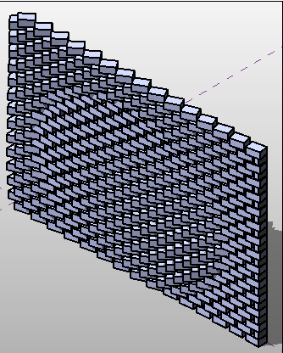

New SDK samples
FindReferencesByDirection
FindColumns
MeasureHeight
Massing
ParameterValuesFromImage
PointCurveCreation
Notes:
FindColumns: demonstrates how to find all walls that have embedded columns in them by shooting a ray along the wall center. Based on Scott's AU 2009 presentation on analysing building geometry.
MeasureHeight: demonstrates how to calculate the height of a selected skylight above the ground floor by shooting a ray with FindReferencesByDirection.
ParameterValuesFromImage: computes a grayscale value for each pixel in an image file. Use this value to set a parameter that will change the model geometry. From Harry's AU 2009 presentation on conceptual design and massing.
PointCurveCreation: seven different examples of using equations and external data files to create point, curve and loft form surface massing geometry.

Slide 59
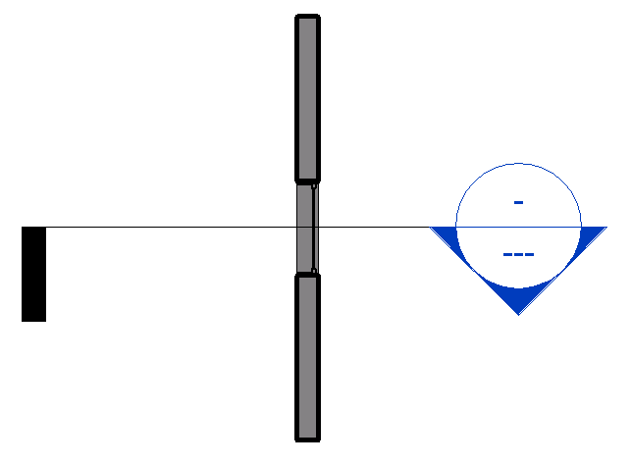
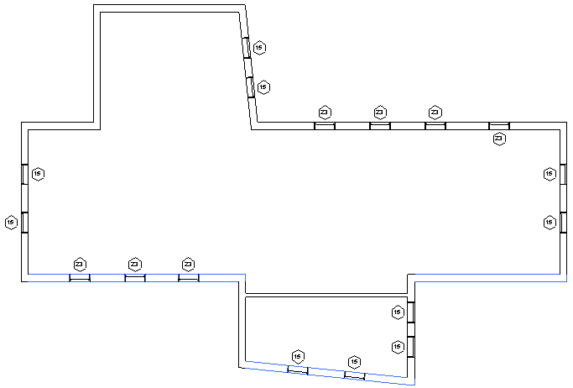
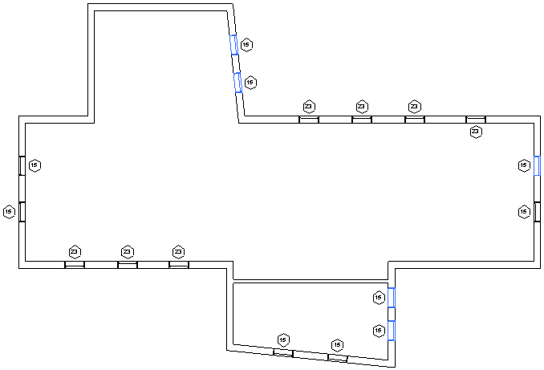
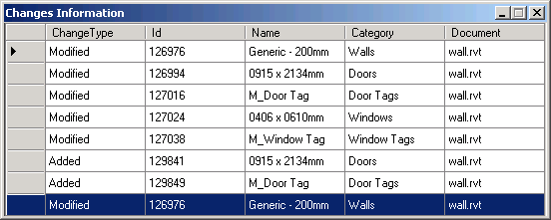
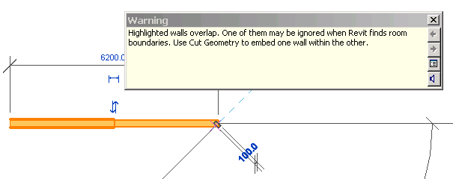
New SDK samples
DirectionCalculation
DynamicModelUpdate
ChangesMonitor
ErrorHandling
Notes:
DirectionCalculation: determine south facing walls and windows by geometrical analysis, with and without considering the project location. Part of Scott's AU 2009 presentation.
ChangesMonitor: demonstrates how to subscribe the DocumentChanged event in an external application and log all modified elements in a modeless dialogue.
DynamicModelUpdate: demonstrates how to maintain relative position between elements by moving a section marker to maintain relative position with a window.
ErrorHandling: implements both a command and an application in the same class to demonstrate how to create failure definition id, failure definition, failure message and how to resolve failures in the failure processing steps.

Slide 60
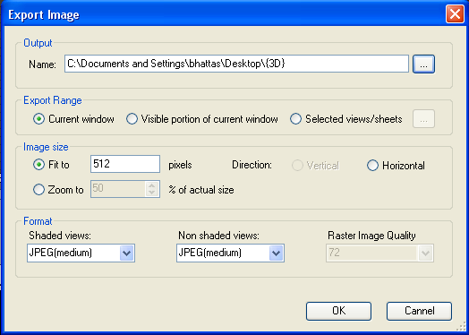
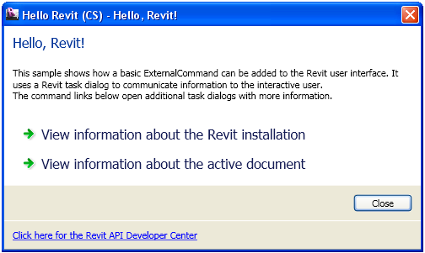
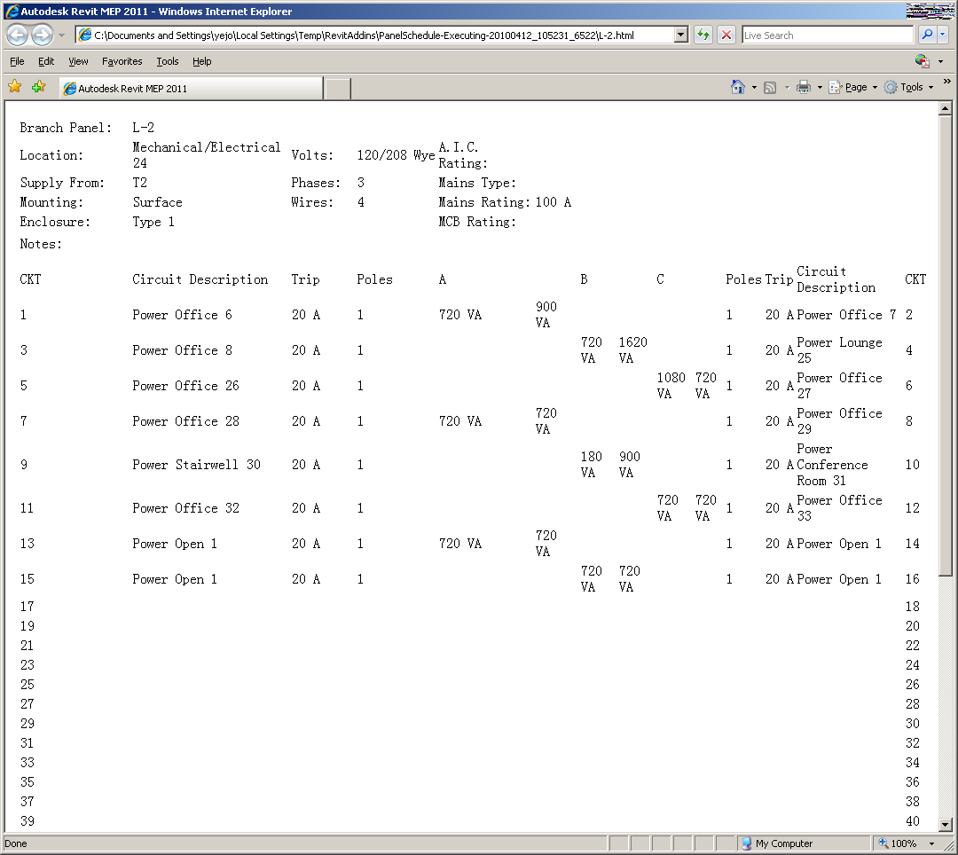
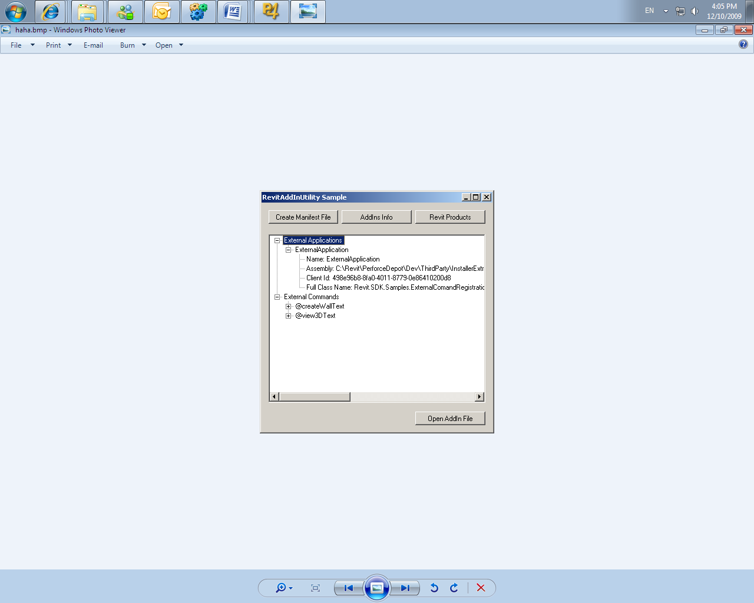
New SDK samples
ImportExport
HelloWorld
ExternalCommand2011
RevitAddInUtility executable
ExternalComandRegistration
MaterialQuantities
Notes:
ExternalCommand2011: a separate solution not included in SDKSamples2011.sln demonstrating how to use the new external command registration and the RevitAddInUtility functionality. it defines an add-in application with two external commands and an external application, as well as a stand-alone installation exe using the Revit add-in utility DLL to read and write a manifest file and analyse the revit installation.
HelloWorld: shows how a basic ExternalCommand can be added to the Revit user interface.
ImportExport: shows how to export current project to dwg, sat,dxf, dwf(x), gbxml, fbx, dgn, image or Civil3D files and how to import a dwg, image, GBXML or Inventor file into Revit.
MaterialQuantities: outputs an analysis of the net and gross material quantities of walls, floors, and roofs to a csv file and displays the output in Excel.

Slide 61
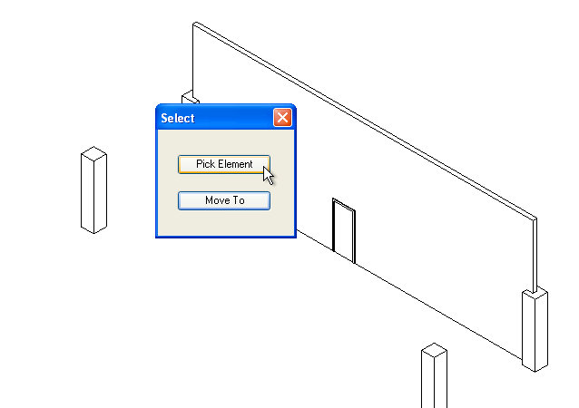
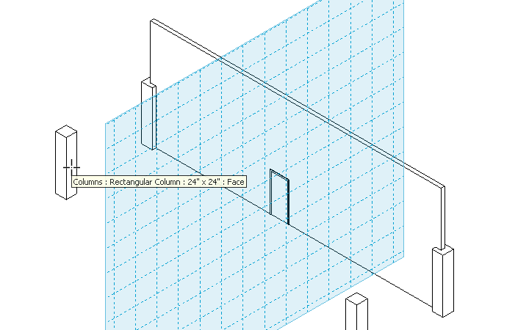
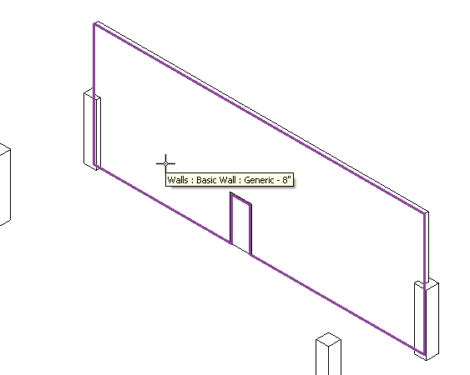
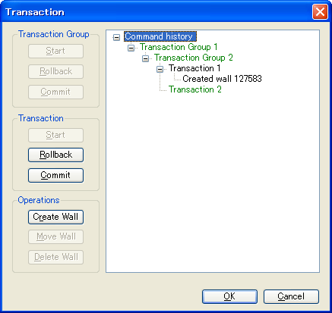
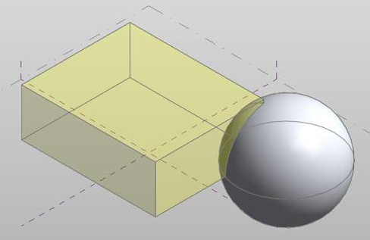
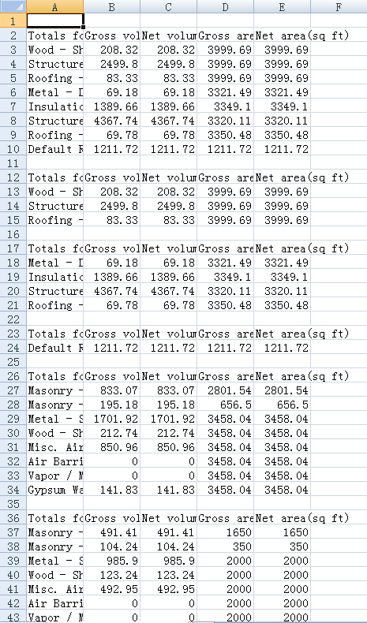
New SDK samples
Selections
SolidSolidCut
TransactionControl
PanelSchedule
Notes:
Selections: imlements four different commands demonstrating how to perform selection operations: element, point on wall face for window placement, face to set work plane and draw a circle, and element or point from dialogue.
SolidSolidCut: shows how to use the new SolidSolidCutUtils class in a conceptual mass family, cut and uncut a sphere from a cube.
TransactionControl: demonstrates how to use transaction group, transaction and sub transaction
PanelSchedule: shows how to use the Revit MEP Panel Schedule API:
1. PanelScheduleExport - gets the panel schedule view data via the API and generate a CSV file or a HTML page from it.
2. InstanceViewCreation - Create a panel schedule view instance for an electrical panel you selected.
3. SheetImport - Place the panel schedule view(s) on a sheet view.

Slide 62
Today’s presentation…
Is being recorded and will be posted at:
ADN Extranet
http://adn.autodesk.com
> Revit > Knowledgebase
> Whitepapers and Training Videos
Developer Center
API Training & Consulting > Schedule
http://www.autodesk.com/joinadn
Notes:
[Please make sure you inform that we are recording.]

Slide 63
AEC Developer Camp
June 7-9, 2010 Sheraton Boston, MA, USA
Customization focused 3 day training camp
Great opportunity to
Learn Autodesk’s latest technology
Talk directly with Autodesk management and engineering
Have one-on-one meetings
Share information with other customers and developers
More information and registration at
http://devcamps2010.autodeskevents.net

Slide 64
Polls
How was the audio quality of the presentation?
Good, Acceptable, Poor
How was the visual quality of the presentation?
Good, Acceptable, Poor
How do you rate the presentation material?
Excellent, Good, Okay, Poor
How do you rate the presentation delivery?
Excellent, Good, Okay, Poor
Would you recommend this webcast to a friend or colleague?
Yes, No
What topics would you be interested in for future webcasts?
New Element Iteration and Filtering
Conceptual Design/Form Creation API
Analysis Visualization Framework
Dynamic Model Update
Failure Handling
Geometry
(For other topics and multiple choices, please send suggestions through Q&A)

Slide 65
Thank you very much!

Slide 66
Questions & Answers

Slide 67
Developer Days Online
What’s New in Revit 2011
Adam Nagy, Jeremy Tammik, Saikat Bhattacharya
Developer Technical Services
What’s New in Revit 2011 API
Developer Technical Services
Autodesk Developer Network April 2010

