Slide 1
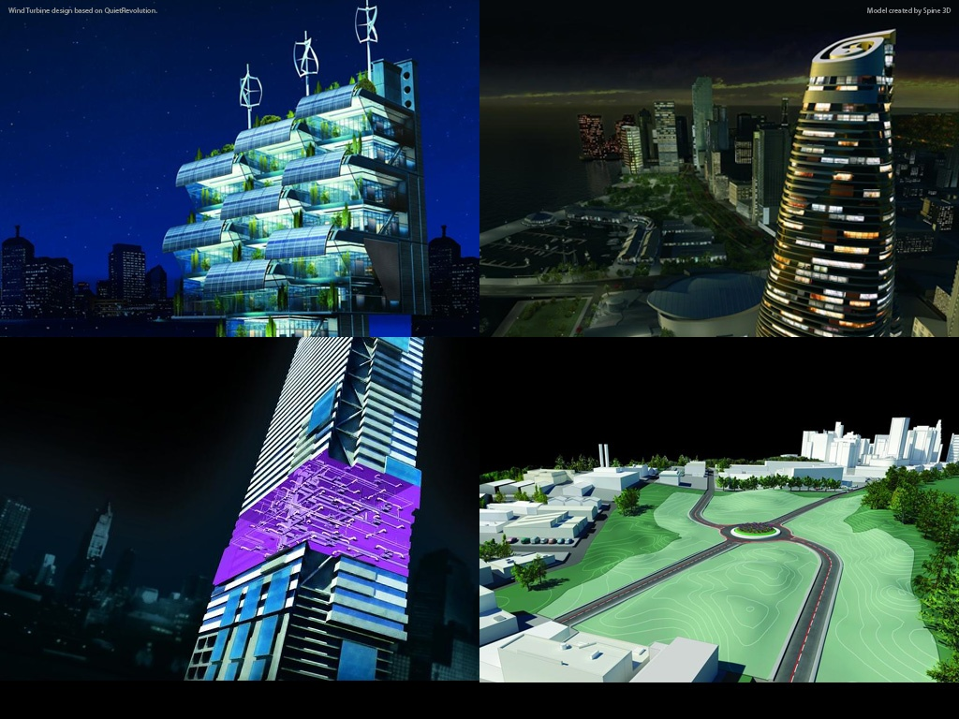
Introduction to Revit Programming Hands-on Training Class Melbourne, Australia, 2012-03-19
Jeremy Tammik
Principal Developer Consultant
Developer Technical Services

Slide 2
Before we start …
Background and Experience
Name, company
Background (IT, programming, architecture, HVAC, structural, mgmt)
Product experience, Revit Architecture/Structure/MEP
Revit API experience
C#, VB.NET, managed C++, ...
AutoCAD, AutoCAD Architecture, API’s, ...
ADN member
…

Slide 3
Agenda
Day 1: Overview and Revit database basics
External command, external application, RevitLookup and RvtSamples, understanding the Revit Element class and its data, filtered element collector, object creation and modification
Day 2
Revit UI basics: ribbon, dialog, selection, events
Family API
Advanced topics
Extended storage
Custom data in shared parameters: FireRating
DocumentChanged event: ChangesMonitor
Dynamic Model Update (DMU): DynamicModelUpdate and DistanceToSurfaces
Analysis Visualisation Framework (AVF): DistanceToSurfaces and SpatialFieldGradient
Notes:
We are running in low resolution today, so that we can switch back and forth between the presentation and live demos.
So, what are the initial steps in creating a Revit application?
The first thing is to understand is what is installed, the API architecture, the information provided and where to obtain more information.
Then we explore how to set up the development environment and create a first "Hello world" type application.
After that, we will look into the Revit database structure and its data and elements.
The samples provide a valuable knowledgebase on how to solve Revit programming tasks.
For the people who attended the recent webcast on the Revit Structure API on May 3rd, the current presentation covers the first half of that, all the generic material.

Slide 4
Revit API Intro Labs
Revit API fundamentals
Revit Add-ins: external command/application, attributes, add-in manifest and object model
Representation of Revit elements
Element iteration, filtering and queries
Element modification
Model creation
Exercises
Lab1 – “Hello World”
Lab2 – DB element
Lab3 – element filtering
Lab4 – element modification
Lab5 – model creation
Lab6 – extensible storage
Lab7 – shared parameters

Slide 5
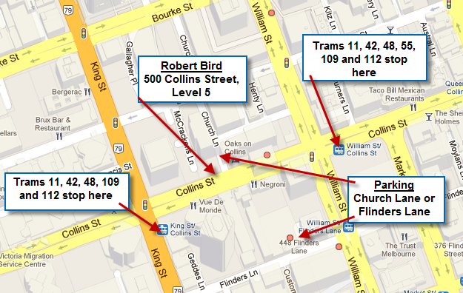
BIM Manager's Evening
Tuesday, March 20, 6-9 pm
Agenda 6:00 PM – 6:30 PM Virtual BIM Environments 6:30 PM – 7:30 PM IMAGINiT Clarity 7:30 PM – 9:00 PM NewForma™ Design Suite
Location Robert Bird Group Level 5, 500 Collins Street Melbourne

Slide 6
Questions & Answers

Slide 7
