Slide 1
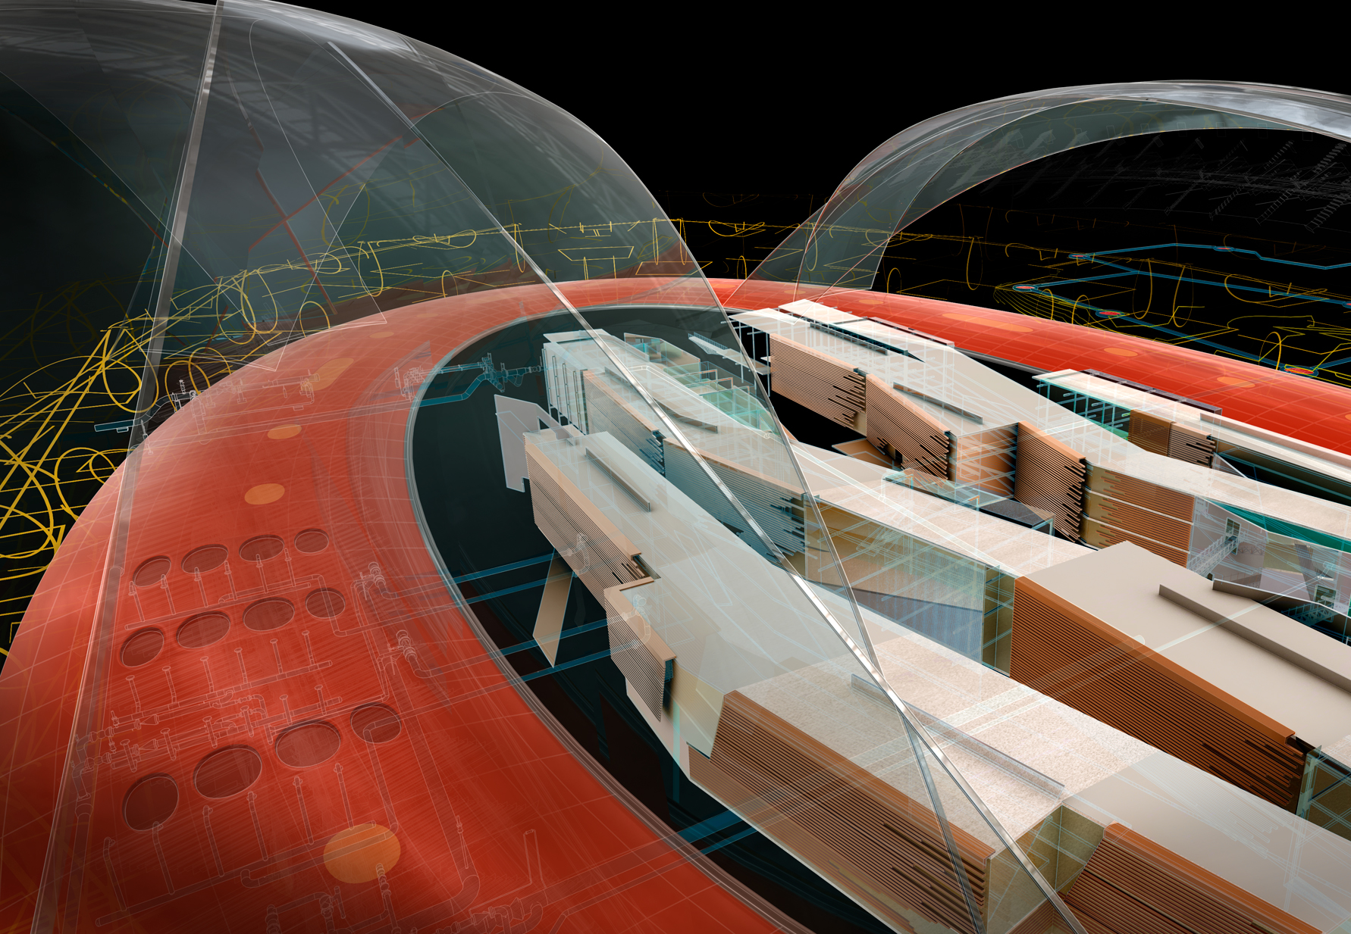
The Revit MEP API
Image courtesy of Hobart, Yañez, Ramos, Maguey, and Martínez
Jeremy Tammik
Principal Developer Consultant

Slide 2
Objectives of this RME API Unconference
Share and discuss best practices of Revit MEP programming
Your current areas of interest and hottest problems
Your ideas and visions
Your experience
Wish list items
You should be familiar with
Programming for MEP in a BIM
The functionality of the Revit MEP API
The Revit MEP API samples
We do not discuss and assume knowledge of
How to program in .NET
The basics of the generic Revit API
Revit product and Revit MEP usage
Notes:
This is a class for programmers who already have some familiarity with both the .NET Framework and the Revit .NET API.
We will be looking at using the Revit MEP API to work programmatically with an MEP BIM.

Slide 3

About the Presenter
Jeremy Tammik
Principal Developer Consultant
Developer Technical Services
EMEA, Autodesk SARL
Jeremy is a member of the AEC workgroup of the Autodesk Developer Network ADN team, providing developer support, training, conference presentations, and blogging on the Revit API.
He joined Autodesk in 1988 as the technology evangelist responsible for European developer support to lecture, consult, and support AutoCAD application developers in Europe, the U.S., Australia, and Africa. He was a co-founder of ADGE, the AutoCAD Developer Group Europe, and a prolific author on AutoCAD application development. He left Autodesk in 1994 to work as an HVAC application developer, and then rejoined the company in 2005.
Jeremy graduated in mathematics and physics in Germany, worked as a teacher and translator, then as a C++ programmer on early GUI and multitasking projects. He is fluent in six European languages, vegetarian, has four kids, plays the flute, likes reading, travelling, theatre improvisation, yoga and carpentry, loves mountains, oceans, sports, and especially climbing.
Notes:
Before we jump into the presentation proper, here’s a little bit about me. My name is Jeremy Tammik, and I work for the Autodesk Developer Network (ADN), in the AEC workgroup. I also write a blog on the Revit API. I have been working with AutoCAD APIs for over twenty years. A key part of my job is to support communication between external plug-in developers and our engineering to help the latter create the APIs that the former need to write really cool add-in applications.

Slide 4
Autodesk Developer Network
Access to almost all Autodesk software and SDK’s
Includes early access to beta software
Members-only website with thousands of technical articles
Unlimited technical support
Product direction through conferences
Marketing benefits
Exposure on autodesk.com
Promotional opportunities
One to three free API training classes
Based on user level
www.autodesk.com/joinadn
Notes:
Some of you may be unfamiliar with ADN. The Autodesk Developer Network is a program providing professional support to programmers writing add-in applications for Autodesk software. If you think the program benefits listed here would be useful to you, then visit this URL and read more about it. You don’t have to be a commercial software developer to join ADN.

Slide 5
The Revit MEP API
Introduction
Analysis
Hierarchical Systems and Connectors
Electrical
HVAC and Plumbing
Sample Applications
Learning More

Slide 6
Acronyms
ADN Autodesk Developer Network
AEC Architecture, Engineering, Construction
API Application Programming Interface
BIM Building Information Model
GUI Graphical User Interface
HVAC Heating, Ventilation, and Air Conditioning
MEP Mechanical, Electrical, and Plumbing
RAC Revit Architecture
RME Revit MEP
RST Revit Structure
SDK Software Development Kit
UI User Interface

Slide 7
MEP Application Requirements
Mechanical, electrical and plumbing domains
M is HVAC, i.e. heating, ventilation and air conditioning
Need for strong model analysis tools
Need to read and write access to the components and data
MEP project information
Green Building XML, gbXML
Spaces and zones
Electrical systems, components, properties and parameters
Duct and pipe systems, components, properties and parameters
Element creation and modification
System traversal and analysis

Slide 8
The Generic Revit API
Basic Revit API is generic
All flavours use the same .NET assembly RevitAPI.dll
Specific additional features exist for each flavour, e.g.
Room-related functionality in Revit Architecture
Access to the analytical model in Revit Structure
Access to the MEP model in Revit MEP

Slide 9
Revit MEP API Evolution
Generic element and parameter access can always be used
Revit 2008 provided no MEP-specific API
Revit 2009 introduced MEP-specific API support
MEP model property, space and zone, electrical and mechanical equipment, lighting device and fixture, connector, electrical system
MEP API was a focal point of the past few API releases
2010: MEP namespace, support for HVAC and piping systems
2011: conduit, cable tray, panel schedule and more
2012:
Pipe settings and sizes
Placeholder ducts and pipes
Duct and pipe insulation and lining
Small enancements: spare and space circuits, cable tray and conduit domain, connector, MEPSystem and space properties, disconnection warnings

Slide 10
Product Enhancements
Revit MEP 2011
Panel Schedules
Cable Tray and Conduit
Other Enhancements
Placing Valves and Fittings in Section or Elevation Views
Tagging of MEP Elements during placement
Demand Factors and Load Categories
Piping Companion Flanges
New Electrical Content
Oval Duct
Revit MEP 2012
Placeholder ducts and pipes
Notes:
Cable Tray and Conduit
Revit 2011 includes support for modelling conduit and cable tray as unique object types. The goal of this feature is to represent real world conduit and cable tray for coordination purposes and for accurate and legible construction drawings.
Cable trays and conduits and can be routed as individual runs with or without individual fittings placed between straight sections. Conduit runs without fittings would be used for conduit that is bent to change directions instead of having actual fittings. When using conduit or cable tray runs without fittings, you can now use a new schedule type to report the overall length of the run. These schedule types have categories of Conduit Runs and Cable Tray Runs respectively.
Cable trays can be drawn as channel or ladder type.
Conduits can be connected to cable tray segments. The conduit does not have to actually touch the cable tray to connect. For example, you can connect a conduit 6” below the cable tray and have the conduit end update if the cable tray segment is moved.
Conduit and cable tray each support graphics with varying levels of detail in fine, medium, and coarse display.
A new type of connector is now available for connecting conduit to equipment. This new surface connector enables an entire face of a piece of equipment to accept conduit connections without having to manually add individual conduit connectors to the equipment. This makes connecting to equipment such as switchgear, transformers and panels faster and easier.
Panel Schedules
You can create a schedule that lists the circuits connected to a panel, and displays information about each circuit such as location on the panel, circuit name, apparent loads, etc. Panel schedules display three main information sections: a header, circuit table, and a loads summary. A new Panel Schedule view for the selected panel is displayed in the drawing area, and panel schedules are added to the project browser under the Panel Schedules folder. A panel schedule shows the following data:
Panel Name
Distribution System supported by the panel
Number of phases available from the panel
Number of wires specified for the distribution system assigned to this panel
Rating of the mains feeding the panel
Type of mounting (Surface or Recessed)
Type of case enclosing the panel
Room where the panel is installed
Name assigned to a load circuit
Rated trip current for a circuit breaker
Number of poles on the circuit breaker
Circuit number
Phases
Apparent load (VA) for each of the phases
Total apparent load for all three phases
Manufacturer
Notation of any changes made to the panel
Root Means Square amperage
Additional circuit and panel information to display can be specified in the panel schedule templates.
Other Enhancements
Placing Valves and Fittings in Section or Elevation Views
It is now possible to place valves, fittings, and other types of duct or piping accessories while in an elevation or section view. For example, you can switch to an elevation view and place a valve in a vertical pipe.
Tagging of MEP Elements during placement
You can now tag MEP components as they are being placed instead of doing so in a separate step.
Piping Companion Flanges
There is a new pipe fitting type for flanges. If you define a flanged pipe type, you can edit the type and specify a companion flange that will be automatically inserted between the pipes and flanged fittings and on connections to equipment like pumps.
Oval Duct
Oval ducts are now available in addition to the rectangular and round duct shapes. New size separators are available for oval duct size annotations and oval ducts can be used in duct sizing.
Demand Factors and Load Categories
Demand factors have been updated to allow for more control over how demand loads are calculated and can be customized. Load categories are customizable and can be displayed in panel schedules.
New Electrical Content
Many new types of electrical content have been added. New content is provided for communications, fire safety, data, nurse call, etc. Control panels have been added in addition to the individual controls or devices, so several of these objects can be connected to their appropriate panels.

Slide 11
Revit MEP 2011 API Enhancements
Cable Tray and Conduit
CableTrayConduitBase – base class for cable trays and conduits
CableTrayConduitRunBase – base class for cable tray and conduit runs
CableTray – a cable tray instance
CableTrayType – a cable tray type
CableTrayRun – a cable tray run
Conduit – a conduit instance
ConduitType – a conduit type
ConduitRun – a conduit run
Panel Schedules
TableView – represents a view that shows a table
TableData – holds most of the data describing the table row, column, and cell
TableSectionData – holds row, column and cell data for a TableData instance
PanelScheduleView – represents a view that shows a panel schedule
PanelScheduleData – holds most of the layout, appearance, row, column, and cell style data
PanelScheduleTemplate – represents a branch panel, a switchboard or a data panel template
PanelScheduleSheetSegment – represents a segment of a panel schedule sheet instance
PanelScheduleSheetInstance – represents an instance of a panel schedule placed on sheet
Other Enhancements
EnergyDataSettings
Validation in ElectricalSystem Properties
WireMaterialType, InsulationType, TemperatureRatingType
DuctConnector, PipeConnector, ElectricalConnector
Demand Factor and Load Classifications
Notes:
The Revit MEP API
Many of the enhancements to the Revit 2011 MEP specific API are related to the electrical domain, since the HVAC and mechanical domains were a primary focus of the previous Revit 2010 release. Paralleling the product features, the cable tray, conduit and panel schedules are the main areas of enhancement. A number of other topics have been addressed as well.
Cable Tray and Conduit
The entire new cable tray and conduit feature is fully exposed through the API. Whatever can be done in the user interface should be possible using the API as well. A number of new classes and elements related to the cable tray and conduit ones have been added. The major ones are:
CableTrayConduitBase – the base class for cable trays and conduits.
CableTrayConduitRunBase – the base class for cable tray and conduit runs.
CableTray – a cable tray instance.
CableTrayType – a cable tray type.
CableTrayRun – a cable tray run.
Conduit – a conduit instance.
ConduitType – a conduit type.
ConduitRun – a conduit run.
As a result of the introduction of these new conduit elements, the previously existing classes ConduitType and ConduitTypeSet have been renamed to WireConduitType and WireConduitTypeSet.
Panel Schedules
A new comprehensive API has been introduced to support access to panel schedules and their contents. The major classes exposed by this API are:
TableView – represents a view that shows a table.
TableData – holds most of the data describing the table row, column, and cells.
TableSectionData – holds row, column and cell data for a TableData instance.
PanelScheduleView – represents a view that shows a panel schedule.
PanelScheduleData – holds most of the data that describe the layout, appearance, and style of the rows, columns, and cells of a panel schedule.
PanelScheduleTemplate – represents a branch panel, a switchboard or a data panel template.
PanelScheduleSheetSegment – represents a segment of a panel schedule sheet instance.
PanelScheduleSheetInstance – represents an instance of a panel schedule placed on sheet.
Other Enhancements
EnergyDataSettings
For greater clarity, the gbXMLParamElem class has been renamed to EnergyDataSettings, and some of its members were renamed as well.
Validation in ElectricalSystem Properties
The ElectricalSystem properties Length and VoltageDrop now throw an InvalidOperationException when the value cannot be computed, instead of returning zero.
WireMaterialType, InsulationType, TemperatureRatingType
These classes now inherit from ElementType.
DuctConnector, PipeConnector, ElectricalConnector
These classes now inherit from a new common ConnectorElement base class.
Demand Factor and Load Classifications
The ElectricalSystem LoadClassification property has been replaced with a new property LoadClassifications. It returns a semicolon-delimited string listing the load classifications assigned to the system. Load classifications are now elements and can be found through regular element iteration.
The class DemandFactor was replaced by ElectricalDemandFactorDefinition.
The ElectricalSetting method GetDemandFactor has been replaced by the DemandFactorId property on the ElectricalLoadClassification class, which returns the id of the ElectricalDemandFactorDefinition element assigned to the load classification.

Slide 12
Revit MEP 2012 API Enhancements
Major
Pipe settings and sizes
Placeholder ducts and pipes
Duct and pipe insulation and lining
Minor
Spare and space circuits
Cable tray and conduit domain
Connector, MEPSystem and Space properties
Disconnection warnings
Notes:
The Revit MEP API
Many of the enhancements to the Revit 2011 MEP specific API are related to the electrical domain, since the HVAC and mechanical domains were a primary focus of the previous Revit 2010 release. Paralleling the product features, the cable tray, conduit and panel schedules are the main areas of enhancement. A number of other topics have been addressed as well.
Cable Tray and Conduit
The entire new cable tray and conduit feature is fully exposed through the API. Whatever can be done in the user interface should be possible using the API as well. A number of new classes and elements related to the cable tray and conduit ones have been added. The major ones are:
CableTrayConduitBase – the base class for cable trays and conduits.
CableTrayConduitRunBase – the base class for cable tray and conduit runs.
CableTray – a cable tray instance.
CableTrayType – a cable tray type.
CableTrayRun – a cable tray run.
Conduit – a conduit instance.
ConduitType – a conduit type.
ConduitRun – a conduit run.
As a result of the introduction of these new conduit elements, the previously existing classes ConduitType and ConduitTypeSet have been renamed to WireConduitType and WireConduitTypeSet.
Panel Schedules
A new comprehensive API has been introduced to support access to panel schedules and their contents. The major classes exposed by this API are:
TableView – represents a view that shows a table.
TableData – holds most of the data describing the table row, column, and cells.
TableSectionData – holds row, column and cell data for a TableData instance.
PanelScheduleView – represents a view that shows a panel schedule.
PanelScheduleData – holds most of the data that describe the layout, appearance, and style of the rows, columns, and cells of a panel schedule.
PanelScheduleTemplate – represents a branch panel, a switchboard or a data panel template.
PanelScheduleSheetSegment – represents a segment of a panel schedule sheet instance.
PanelScheduleSheetInstance – represents an instance of a panel schedule placed on sheet.
Other Enhancements
EnergyDataSettings
For greater clarity, the gbXMLParamElem class has been renamed to EnergyDataSettings, and some of its members were renamed as well.
Validation in ElectricalSystem Properties
The ElectricalSystem properties Length and VoltageDrop now throw an InvalidOperationException when the value cannot be computed, instead of returning zero.
WireMaterialType, InsulationType, TemperatureRatingType
These classes now inherit from ElementType.
DuctConnector, PipeConnector, ElectricalConnector
These classes now inherit from a new common ConnectorElement base class.
Demand Factor and Load Classifications
The ElectricalSystem LoadClassification property has been replaced with a new property LoadClassifications. It returns a semicolon-delimited string listing the load classifications assigned to the system. Load classifications are now elements and can be found through regular element iteration.
The class DemandFactor was replaced by ElectricalDemandFactorDefinition.
The ElectricalSetting method GetDemandFactor has been replaced by the DemandFactorId property on the ElectricalLoadClassification class, which returns the id of the ElectricalDemandFactorDefinition element assigned to the load classification.

Slide 13
Analysis

Slide 14
MEP Project Info and EnergyDataSettings
EnergyDataSettings class manages MEP project info
Access via EnergyDataSettings.GetFromDocument method
For project location use Document.ActiveProjectLocation
Green Building XML export
Document.Export(
string folder,
string name,
GBXMLExportOptions );

Slide 15
Spaces and Zones
Revit 2009 improved workflow between Architecture and MEP
Previously, MEP user had to Copy/Monitor rooms from architect
Architectural rooms are unsuitable for MEP analysis
Wrong height, often too large for analysed region
MEP uses space instead of room, and zone to manage spaces
Rooms can be subdivided into exterior and interior subspaces
AddSpaceAndZone SDK sample
Programmatic creation and management of spaces and zones
FamilyInstance class has Room and Space properties
FamilyInstance fi; // get a family instance
Space space = fi.Space; // query its space
Space space2 = fi.get_Space( phase ); // query space in given phase

Slide 16
Model Inspection Utilities
Enable component location, space adjacency analysis, etc.
Volumes, rooms and spaces
FamilyInstance.Space determines space containing family instance
Room.IsPointInRoom determines if a point is in a room volume
Space.IsPointInSpace determines if a point is in a space volume
GetRoomAtPoint and GetSpaceAtPoint return room or space containing point
Ray intersection
FindReferencesByDirection shots a ray through the model
Given a starting point and direction vector
Returns an array of references of intersected elements and faces
AvoidObstruction, FindColumns, MeasureHeight, and RayTraceBounce SDK samples

Slide 17
Connectors and Hierarchical Systems

Slide 18
Hierarchical System Structure and MEP Model
MEP systems consist of hierarchically connected components
Many components are represented using family instances
Connectors can link neighbouring components and transfer info
System classes
ElectricalSystem
MechanicalSystem
PipingSystem
Family instance provides MEPModel property
MEPModel has ConnectorManager and ElectricalSystems properties
Derived classes include ElectricalEquipment, LightingDevice, LightingFixture, MechanicalEquipment, MechanicalFitting

Slide 19
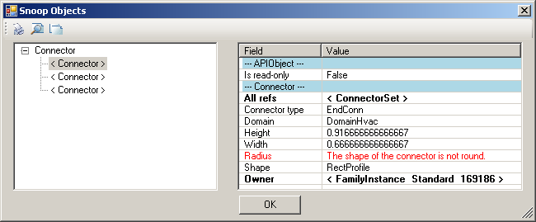

Connectors
Connector class
Used to represent connections in the Revit BIM project context
Part of MEP component, not independent Revit database element
Logical connectors
Used in electrical domain
Cables and wires are possibly not specified
Enables traversal of connected electrical system hierarchies
Physical connectors
Connect neighbouring components physically
Transmit sizing dimensions and flow information
Family editor connection elements
Independent elements for defining connectors
Used to model library parts in family context
Specialised derived classes for duct, pipe and electrical connectors

Slide 20
Electrical

Slide 21
Electrical System Hierarchy
Three-tier recursive hierarchy, cf. electrical system browser
Panel > systems or circuits > circuit elements, may be panels
Logical connections between components
Wires are annotation elements
System can be traversed through connectors
Connectivity information also available in element parameters
MEP electrical sample application demonstrates traversal using both MEP connectors and generic parameters (much harder)
Revit SDK PowerCircuit sample shows creation and editing

Slide 22
HVAC and Plumbing

Slide 23
HVAC and Piping Hierarchy
Systems manage the top level system properties
Ducts and pipes define the main flow elements
Fittings implement bends and branches in the system
Connectors hook up the ducts, pipes and fittings

Slide 24
Systems
MechanicalSystem and PipingSystem classes
Access to equipment, connectors and system type
Access to system properties such as flow and static pressure
DuctNetwork and PipeNetwork properties access system contents
Ducts and fitting elements in no particular order
Does not include terminals or equipments
Query connector managers for traversal in flow direction
TraverseSystem SDK sample

Slide 25
Duct and Pipes
Represented by Duct, FlexDuct, Pipe and FlexPipe classes
Derived from MEPCurve
Provide read access to duct properties, types, and geometry
Change duct or pipe type
Move duct or pipe
Use Move method rather than Location
Layout duct or pipe
Driven by two points, point and connector, or two connectors

Slide 26
Fittings
Represented by standard RFA family instances
Created using dedicated creation doc New*Fitting methods
Elbow, Tee, Cross, Takeoff, Transition, and Union
Access fitting properties, shape and dimensions through the FamilyInstance.MEPModel property

Slide 27
Connectors
Read duct, pipe, and fitting connector properties
Flow, Coefficient, Demand
Access physical connector properties
Origin, Angle, Height, Width, Radius
Read and write assigned connector properties
The fitting connectors define the properties
Flow, Flow Configuration, Coefficients, Loss Method
Change connector size and location
Connect and disconnect

Slide 28
Element Creation
Methods on Autodesk.Revit.Creation.Document
Create New Systems
NewXyzSystem
Mechanical, Piping
Create New Elements
NewDuct, NewFlexDuct, NewPipe, NewFlexPipe
Create New Fittings
NewXyzFitting
Cross, Elbow, TakeOff, TeeFitting, Transition, Union
Connector elements are created in the family context
Creation methods on FamilyItemFactory
Accessed through the Document.FamilyCreate property
NewDuctConnector, NewPipeConnector, NewElectricalConnector

Slide 29
Sample Applications

Slide 30
Sample Overview
Revit SDK Samples
AddSpaceAndZone
AutoRoute
AvoidObstruction
CreateAirHandler
PanelSchedule
PowerCircuit
TraverseSystem
Electrical System Hierarchy
HVAC Air Terminal Sizing
Pipe to Conduit Converter
Cable Tray Creation and Layout
Connector Check

Slide 31
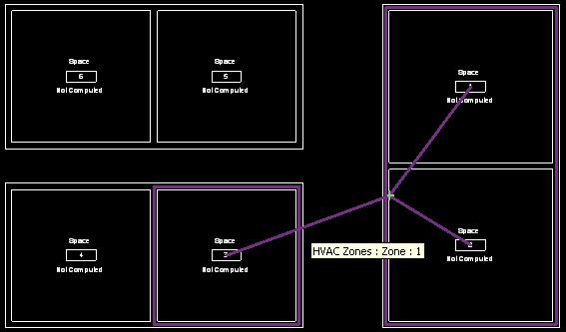
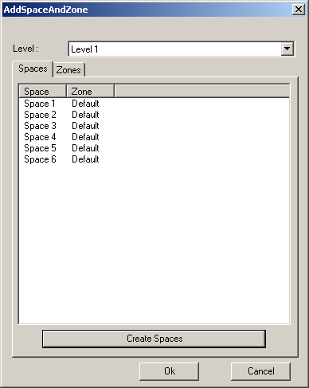
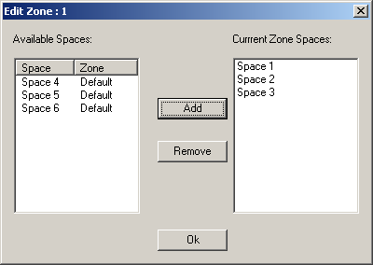
AddSpaceAndZone
Retrieve and list existing spaces and zones
Demonstrates use of an element filter
Create new spaces
For each closed wall loop or space separation
Demonstrates use of the NewSpaces method
Create a new zone element
Specified level and phase
Add and remove spaces in a zone
Use the AddSpaces and Remove methods

Slide 32
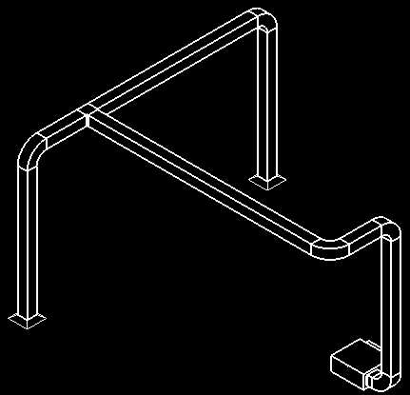
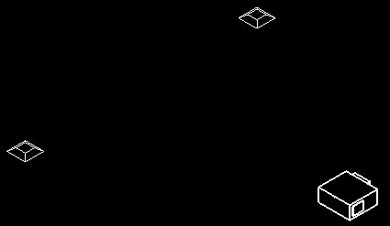
AutoRoute
Automatically create and route a set of ducts and fittings
Source is the air supply equipment
Sink is two air outlet terminals
Positions can be freely moved
Create a new mechanical system, ducts, fittings and connections
NewMechanicalSystem, NewDuct, NewElbowFitting, NewTeeFitting and Connector.ConnectTo
Determine the bounding box of all the three elements
Use the middle line or quarter lines on the X and Y axes
Uses.NET framework Trace class to create a log file

Slide 33
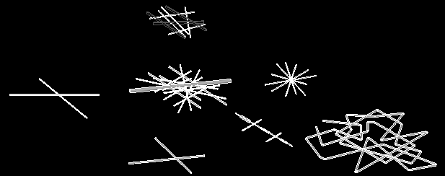

AvoidObstruction
Detect and resolve obstructions between ducts, pipes, and beams
FindReferencesByDirection ray casting intersection analysis
Split pipe into segments and insert elbows to reroute detour
Obstruction between pipes and beams
Pipes intersected together
Pipe loop intersection
Obstruction between pipes and ducts
Obstruction between a pipe and a duct

Slide 34
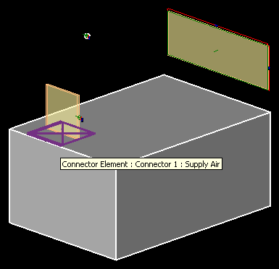
CreateAirHandler
Create an air handler with pipe and duct connectors
Check the template family category to verify valid starting point
Use FamilyItemFactory class methods
NewExtrusion, NewPipeConnector, NewDuctConnector
Set proper connector parameters
Use Document.CombineElements to join the extrusions
Geometric shape creation is generic
Addition of the connectors is MEP specific
Runs in all flavours of Revit

Slide 35
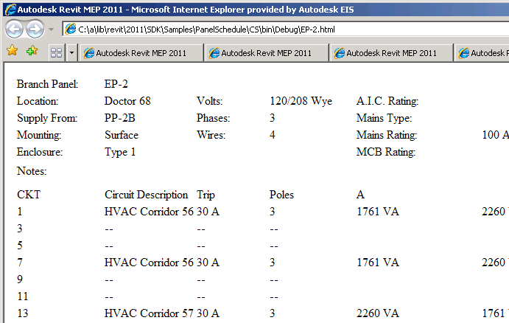
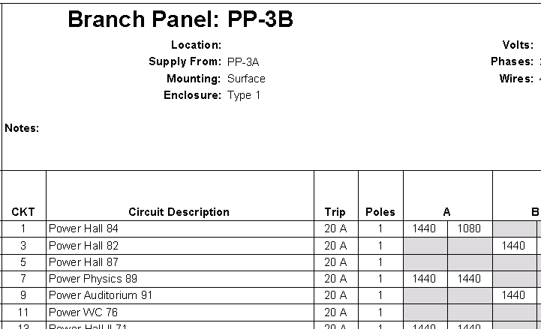
PanelSchedule
Data exchange sample showing use of the Panel Schedule API
PanelScheduleExport read + export panel schedule to CSV or HTML
InstanceViewCreation create panel schedule view instance for selected panel
SheetImport place all panel schedule views on a sheet
Notes:
PanelSchedule: shows how to use the Revit MEP Panel Schedule API:
1. PanelScheduleExport - gets the panel schedule view data via the API and generate a CSV file or a HTML page from it.
2. InstanceViewCreation - Create a panel schedule view instance for an electrical panel you selected.
3. SheetImport - Place the panel schedule view(s) on a sheet view.

Slide 36
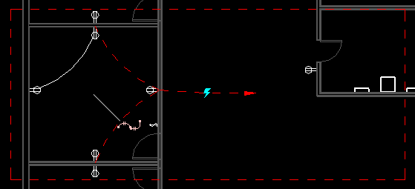


PowerCircuit
Operate power circuits, similar to legacy RME Circuit Editor toolbar
Demonstrate handling interactive element selection
Implement toolbar user interface for external command
Use .NET ResourceManager class for image and string resources
Create a new power circuit with selected elements
Edit circuit and add and remove circuit elements
Select or disconnect a circuit panel
Explore Autodesk.Revit.MEP namespace, MEPModel and ElectricalSystem classes

Slide 37
TraverseSystem
Traverse a mechanical or piping system in the direction of flow
Check MechanicalSystem IsWellConnected property
Dump the traversal results into an XML file
Determine system
Query base equipment as starting point
Query connector manager for connected neighbour elements
Similar approach works for electrical as well, cf. MEP sample

Slide 38
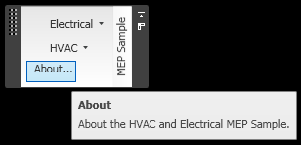
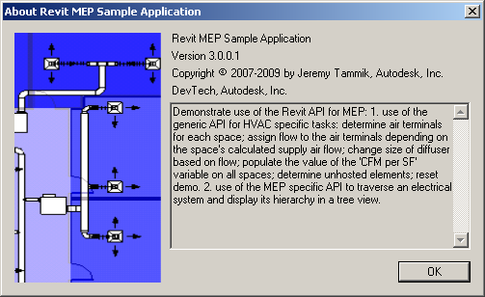

MEP Sample
Non-SDK sample, included in presentation material
HVAC air terminal analysis and sizing
Hierarchical display of an electrical system
Implements a ribbon panel, about box, and progress bar

Slide 39
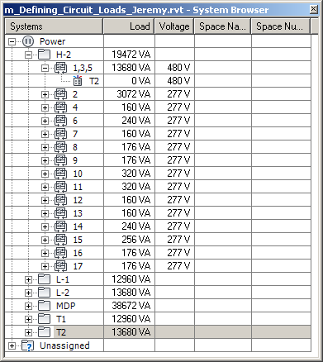
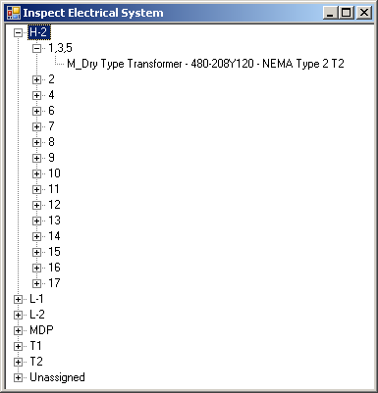
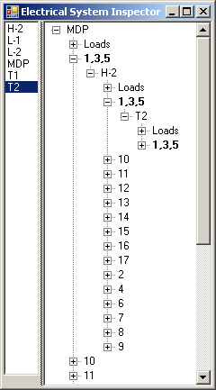
MEP Electrical Sample
Traverse the electrical system
Reproduce the system browser data structure in a tree view
Display the complete connection hierarchy in a tree view
Easy in Revit 2010 using connection manager
CmdElectricalConnectors is similar to TraverseSystem SDK sample ducts
Traversal is also possible using parameter data instead of connectors, but harder

Slide 40
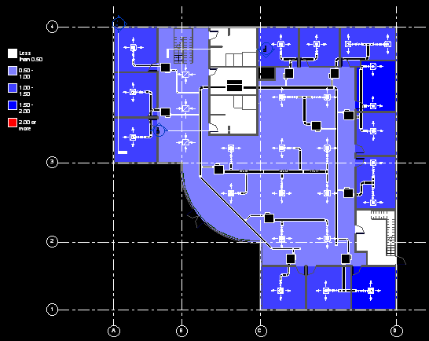
MEP HVAC Sample
HVAC Task
Place and size air ducts and terminals
Analysis and verification of results
Commands aligned with HVAC engineering workflow
Assign flow to terminals
Change air terminal size
Verify design by air flow per surface area
Reset demo
All modification uses generic parameter and type access
Changes are reflected by schedules and colour fill

Slide 41
Pipe to Conduit Converter My First Revit 2011 Add-in
Two hundred lines of code, illustrating most major API renovations
Revit API assembly split
Namespace reorganisation
Command registration manifest
External command Execute method and attributes
Transaction mode
Regeneration option
Task dialogues for user messages
Interactive filtered element selection
Redesigned element filtering
New element creation paradigm
Access to pipe and conduit sizes
p2c.sln
Complete solution and documentation included in class materials
Also available on the web

Slide 42
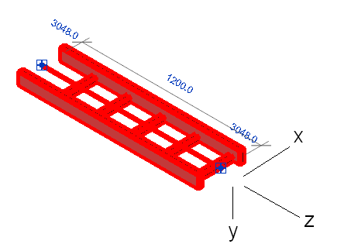
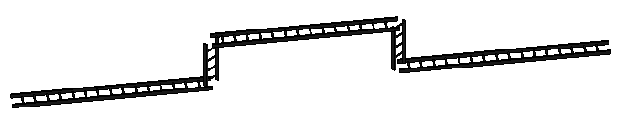
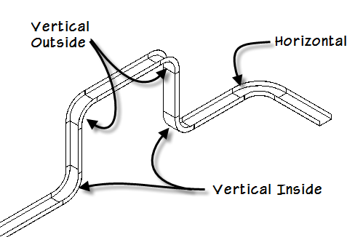
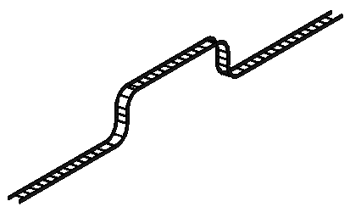
Cable Tray Fitting Creation and Layout
Inserting a cable tray is as easy as a conduit, cf. p2c
Inserting fittings requires exact alignment, i.e. proper orientation
CableTray.sln

Slide 43
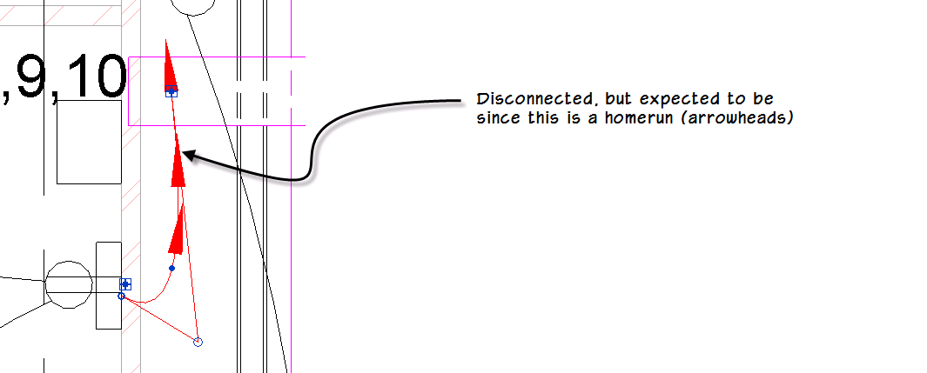
Modeless Loose Connector Navigation
Filter for all MEP connectors in project
Combine all relevant classes and family instance categories
Check IsConnected property on each connector
Unable to determine whether a wire is intended to be homerun
Log results to file and display it to user
Interactively navigate through results from a modeless dialogue
Ensure that modeless dialogue remains on top of Revit
Modeless navigation interacts with Idling event
LooseConnector.sln

Slide 44
Materials
RME_API.pptx – presentation
AU10_CP316-3U_RME_API.docx – AU handout document
rme_2011_api.rtf – RME 2011 API news
Beta 2 - Revit Galaxy API Changes and Additions.pdf – 2012
rme_api_src.zip – HVAC and electrical MEP sample code
p2c – pipe to conduit converter
CableTray.zip – cable tray fitting creation and layout
loose_connectors_6.zip – modeless loose connector navigator
Guidize – populate add-in manifest ClientId tag

Slide 45
Learning More
Online Help, Developer's Guide and SDK Samples
Revit Developer Center
http://www.autodesk.com/developrevit
DevTV Introduction to Revit Programming
Revit Programming Introduction and MEP API Webcasts and Trainings
http://www.adskconsulting.com/adn/cs/api_course_sched.php > Revit API
Discussion Group
http://discussion.autodesk.com > Revit Architecture > Revit API
API Training Classes
http://www.autodesk.com/apitraining
The Building Coder, Jeremy Tammik's Revit API Blog
http://thebuildingcoder.typepad.com
ADN, The Autodesk Developer Network
http://www.autodesk.com/joinadn
DevHelp Online for ADN members
http://adn.autodesk.com

Slide 46
Thank you!
Questions?

