Slide 1
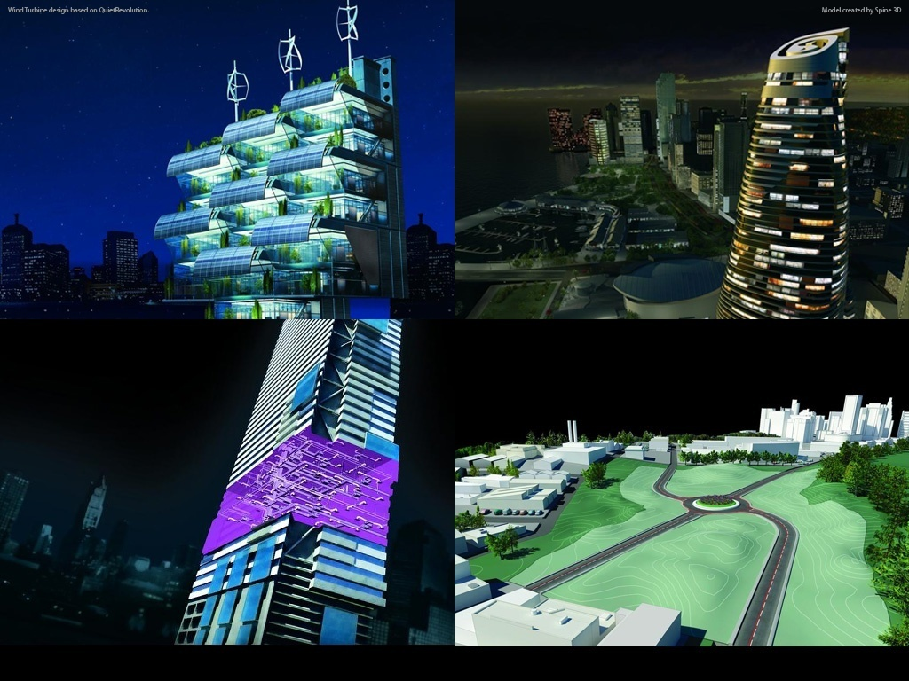
Introduction to Revit Programming Hands-on Training Class
Developer Technical Services
Notes:
AEC Title

Slide 2
About these materials …
Materials provided here are from our two day classroom trainings. You can also use this for self-learning.
This is to introduce you to the fundamentals of Revit API and to get you started.
(Not meant to provide a complete coverage of Revit API nor .NET Framework.)
Materials are in C# and VB.NET. Lab exercises are provided in two languages. Powerpoint presentation is mixed.
Disclaimer: We are aware that materials are not free of errors. We intend to correct them as we encounter. We hope this will still be useful for you to get started with Revit API programming.
Good luck!
AEC workgroup
Developer Technical Services
Autodesk Developer Network
March 2012

Slide 3
Agenda
Day 1: Overview and Revit database basics
External command, external application, more RevitLookup and RvtSamples, understanding the Revit Element class, filtered element collector, object creation and modification
Day 2
Revit UI basics: ribbon, dialog, selection, events
Family API
Advanced topics
Extended storage
Custom data in shared parameters: FireRating
DocumentChanged event: ChangesMonitor
Dynamic Model Update (DMU): DynamicModelUpdate and DistanceToSurfaces
Analysis Visualisation Framework (AVF): DistanceToSurfaces and SpatialFieldGradient
Notes:
We are running in low resolution today, so that we can switch back and forth between the presentation and live demos.
So, what are the initial steps in creating a Revit application?
The first thing is to understand is what is installed, the API architecture, the information provided and where to obtain more information.
Then we explore how to set up the development environment and create a first "Hello world" type application.
After that, we will look into the Revit database structure and its data and elements.
The samples provide a valuable knowledgebase on how to solve Revit programming tasks.
For the people who attended the recent webcast on the Revit Structure API on May 3rd, the current presentation covers the first half of that, all the generic material.

Slide 4
Revit API Intro Labs
Revit API fundamentals
Revit Add-ins: external command/application, attributes, add-in manifest and object model
Representation of Revit elements
Element filtering and queries
Element modification
Model creation
Application own data
Exercises
Lab1 – “Hello World”
Lab2 – DB element
Lab3 – element filtering
Lab4 – element modification
Lab5 – model creation
Lab6 – extensible storage
Lab7 – shared parameter

Slide 5
