Slide 1
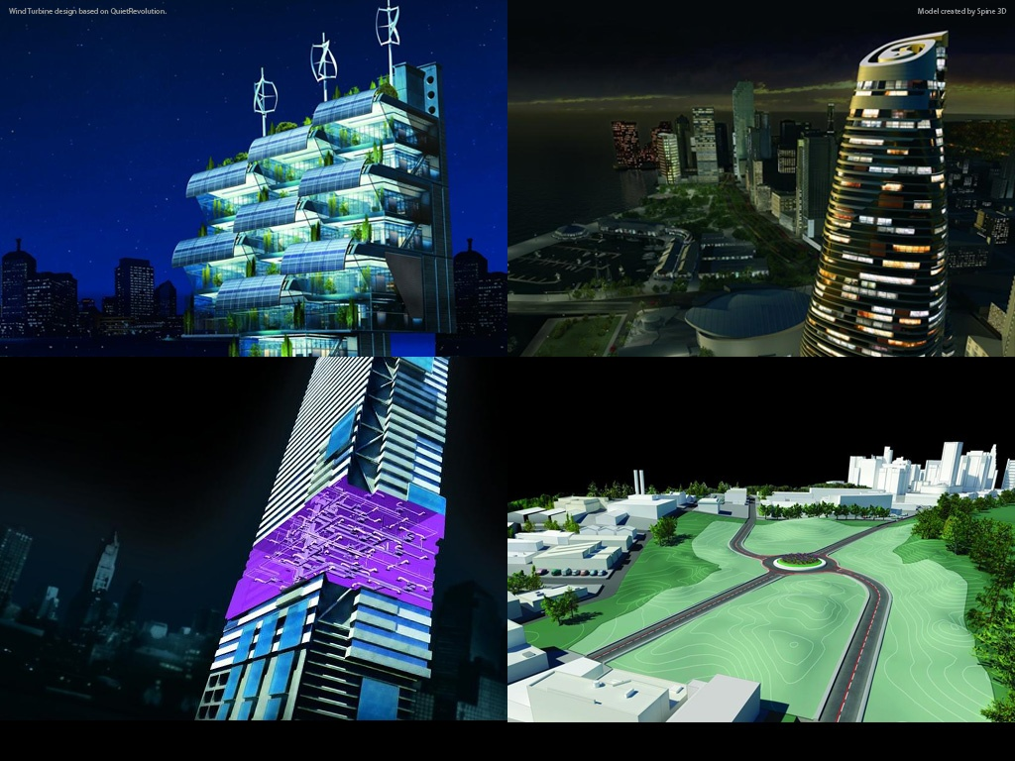
Revit Family API
Developer Technical Services

Slide 2
Revit Family API
Background
Family content creation itself is highly customizable feature even without API
Understanding how it works in UI is a key to successful creation in API
There used to be two Revit API expertise communities
those who know UI and content creation well
those who are fluent in programming, but are not familiar with UI
Goals of this talk
Learn the Family API along the best practice in UI
Establish steps to follow to write a program using Family API, which are stable, flexible and adaptable when you move beyond the basics

Slide 3
Agenda
Revit Family from UI
What is it?
Where to begin, flavors, editor, what is possible
Best practice
Family creation using API
Learning along best practice
Example: L-shape column
Learning resources

Slide 4
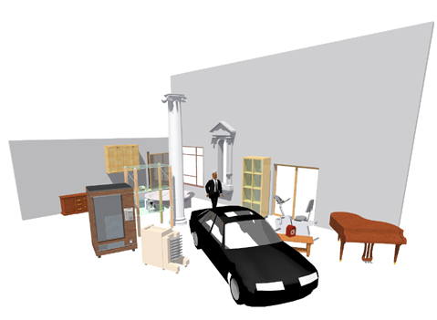
Revit Families – What is it?
Graphic representations of building objects and symbols
Geometry in 3D or 2D
Data that supports definition/creation of objects
Generically - 3 Types
System Families – stored in the project template
Walls, Roofs, Floors, Ceilings…
In-Place Families – “one of kind objects”
Standard Families – freestanding “.rfa” files
Windows, Doors, Furniture, Beams, Light Fixtures…
API in 2010
Notes:
Before discussing the new Revit family API, it is important to understand the basics of Revit families and their definition.
Families in Revit are graphical representations of building objects and symbols. It could be 2D or 3D geometric objects. It could be a data objects.
There are three kinds of families:
(1) System family – which is stored in the project template. Objects like, walls, roofs, floors, ceilings are in this category.
(2) Standard family – uses .rfa file. Windows, doors, furniture, beams are in this category.
(3) In-place families – this third category is the one stored in project and creates one of a kind of objects.
The API in 2010 supports the second category, standard families.

Slide 5
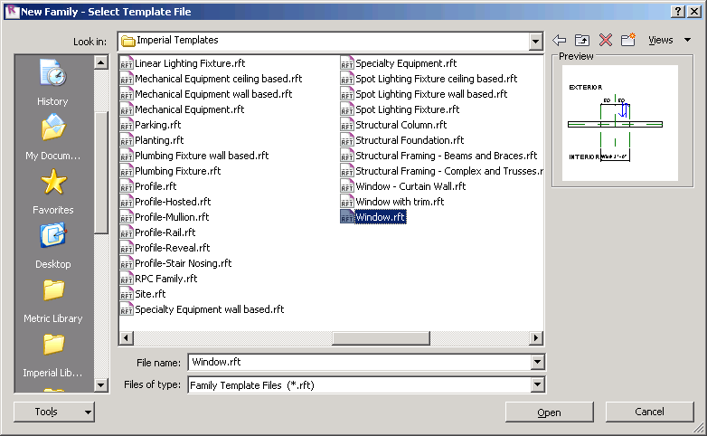
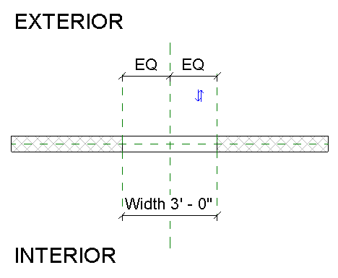
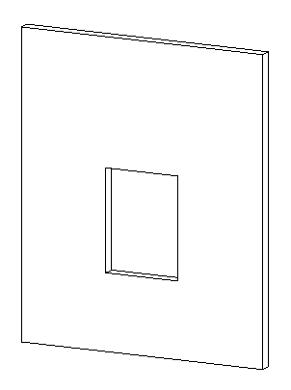
Revit Families – Where to begin
Which is better?
Start from a family template
Modify an existing family
Which Family template to start with?
2D or 3D, model or detail component
Hosted or non hosted: Wall, Ceiling, Face based…
Category
Placement type: free or 2 point
Specialty: Truss, Rebar…
Notes:
Regardless of whether you are using the UI or API, the first thing you will need to decide is which template or family file you want to begin with.
- You can create a family starting from a family template.
- You can also take an existing family and start from there.
There are plenty of templates to choose from. You will need to decide which template to start with. Typically, you will need to think about:
- Is your family 2D or 3D? Model or detail?
- Is it hosted or hosted, to a wall, ceiling, face based?
- What about the category?
- How do you want to place it? Anywhere on a project? By two points?
- Do you need a specialty one, such as Truss or Rebar

Slide 6
Revit Family Flavors
Revit Architecture
Basic building components with simplistic interactions in the model
Free placement objects - casework, furniture, etc.
“2 point” placement objects – beams, detail components, etc.
Hosted objects: windows, doors, columns (“level to level”), ceiling or “wall based” lighting fixtures
Revit Structure
Additional components with complex interactions with other objects
Framing - beams (“beams to beam”, “beam to column”), columns
Trusses - layout for girder trusses; Boundary Conditions
Span Direction Symbols; Reinforcement Symbols - area reinforcement expands to find edges, path reinforcement
Revit MEP
Connectors allowing objects to resize based on what they are connected to
Notes:
Just like products, Family also has three flavours. Most of the functionalities are same as Revit Architecture.
Revit Architecture
- Family in Revit Architecture supports basic building components with simplistic interactions in the model.
- Free placement objects - casework, furniture, etc.
- “2 point” placement objects – beams, detail components, etc.
- Hosted objects – windows, doors, columns (“level to level”), ceiling or “wall based” lighting fixtures.)
Revit Structure
- Has Additional components with complex interactions with other objects. In particular ones that support analytical models:
- Framing - beams (“beams to beam”, “beam to column”), columns
- Trusses - layout for girder trusses; Boundary Conditions
- Span Direction Symbols; Reinforcement Symbols - area reinforcement expands to find edges, path reinforcement
In Revit MEP
- Connectors allowing objects to resize based on what they are connected to.

Slide 7
Revit Family Editor
Revit offers 6 basic family editors
3D model, annotation, detail, rebar, truss and conceptual mass.
Each family editor provides a specific set and is tied to the chosen family template
Geometry – extrusions, blends, sweeps, revolves, swept blends
Lines – model, symbolic, detail
Basic tools – copy, mirror, paint, join/unjoin, cut geometry/don’t cut
References – reference planes, reference lines
Annotation tools – labels
Advanced tools – formulas, nesting, arrays, type catalogs
MEP tools – add connectors
Notes:
Depending on the editor, you will see a different set of available tools or tools to create building blocks. For instance, you will see tools to create forms in the model editor, but not in the annotation one. If you are using the truss editor, you will see top/bottom chord, which will be shown in the model editor.

Slide 8
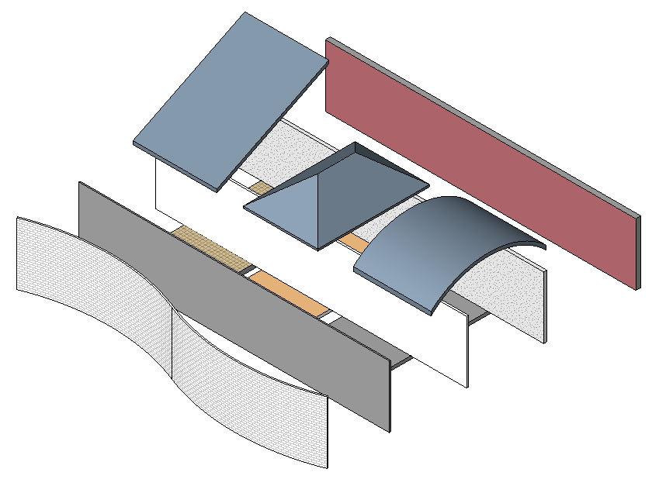
Revit Families Best Practice
The “process” for building families is the most important aspect of family creation that one needs to learn
Process order:
Plan (Insertion Point, Parametric Origin)
Layout Reference Planes (The Bones)
Add Parameters
Add multiple host thickness types (for testing hosted families)
Add 2 or more types
Flex Types and Host (Testing Procedure)
Add a Single Level of Geometry
Repeat Steps 6 and 7 until you are satisfied with the results
Test in Project Environment (create testing project)
Steven Campbell, Revit Content Project Manager
Notes:
Family is a powerful feature in Revit, creating a Family could be fun, but it could be complex. When it becomes complex, it requires a good planning. Here are some suggestions when building families by the Autodesk Revit content manager Steve Campbell.
The same applies to API; a key to understand Family API is to understand UI.

Slide 9
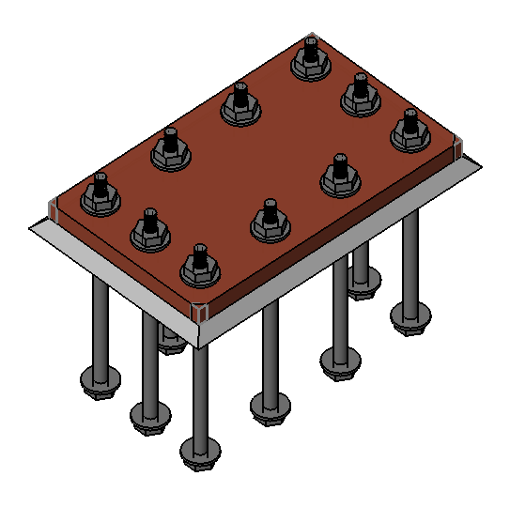
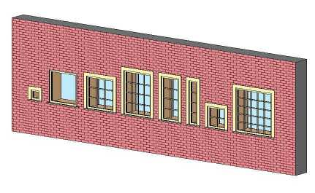
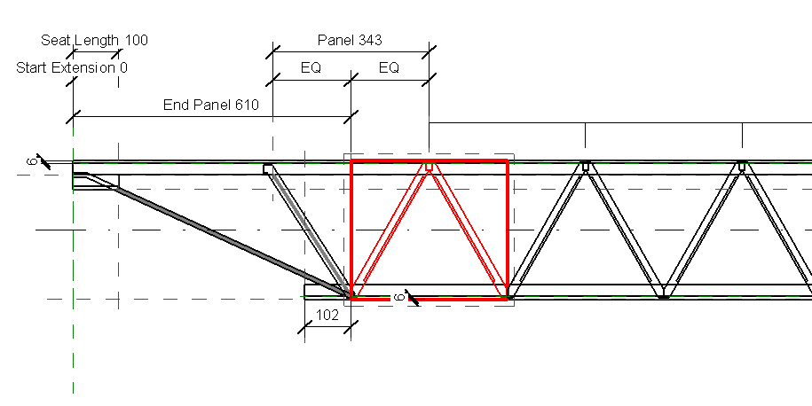
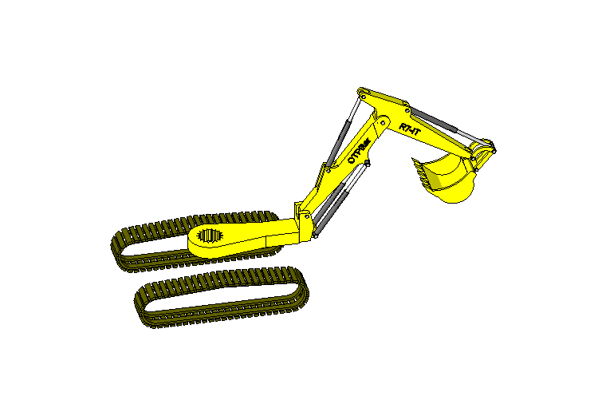
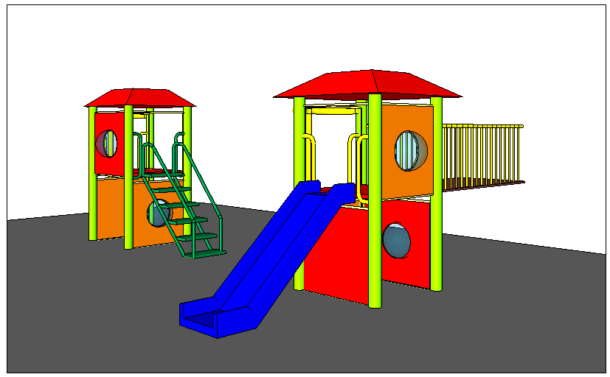
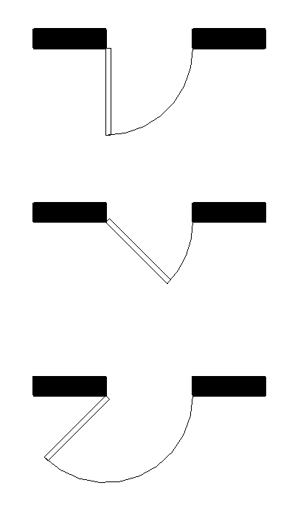
Revit Families – What is possible
Formulas – can be used to control behaviour, visibility, arrays
Arrays and nesting – repeatable, resizable elements across an array
Advanced nesting – subcomponents can be swapped
Reference lines – angular movement
Notes:
You can create a quite complex object using family. For example,
- Formulas can be used to control behaviour, visibility, arrays. For example, define arrays of bolts depending on the size of a plate.
- Arraying nested components allows the user to create families with repeatable elements across an array that can resize based on user input or rules. For example, a bookshelf with arrayed shelves. Mullion patterns based on rules. Open web joists that adjust based on length and height.
- Advanced nesting - Using nested families with the Family Type parameter can provide flexible components with swappable sub-components such as nested door panels, frames, hardware, playground equipment, shown on the right, swappable panels and components.
- Reference lines allow geometry to move about in an angular fashion. They contain two endpoints and two “built in” work planes that can be parametrically controlled. Simple examples: Door swing (lower middle) that can change the opening angle. Light fixture head that moves and points; Complex example: Excavator arm (lower left) that can bend and rotate about 3 or more pivot points.

Slide 10
Family Resources
Revit Families Guide
2009 & 2010 release
Newsgroups
discussion.autodesk.com
AUGI - http://forums.augi.com
Books & DVD’s
Mastering Autodesk Revit Building – Paul F. Aubin
Mastering Family Editor Series - 5 DVD’s – Paul F. Aubin
Learning Autodesk Revit MEP 2012 video training by Simon Whitbread, Don Bokmiller and Joel Londenberg http://cad-notes.com/2011/12/learning-autodesk-revit-mep-2012-training-video-is-available
Notes:
Revit Families Guide
2009 & 2010 release
Newsgroups
discussion.autodesk.com
AUGI - http://forums.augi.com
Books & DVD’s
Mastering Autodesk Revit Building – Paul F. Aubin
Mastering Family Editor Series - 5 DVD’s – Paul F. Aubin

Slide 11
Family API
Learn basics along the best practice

Slide 12
Family API Overview What is it?
Revit API within the family editor context
Automate library generation, generate a family library on the fly, possibly linking with other library specification
Extract information and modify
Analogous to UI
There are a few differences and limitations you may want to be aware

Slide 13
Family API Overview Family specific classes and methods
FamilyManager class:
add/remove/rename types, add/remove parameters, set values and formulas
Document methods specific to family context:
IsFamilyDocument – identifies whether the current document is a family document
OwnerFamily – returns the owning family of this family document
FamilyManager – returns a FamilyManager object to provide access to family types and parameters
FamilyCreate – returns a FamilyItemCreate object to create new instances of elements within a family document, analogous to the Create object in a project
EditFamily – edit a family loaded in a project document

Slide 14
Labs Exercises
Hands-on

Slide 15
Family API Labs Exercises Hands-on
Incremental exercises to create a column family:
Lab1 – create a column family with rectangular profile
Lab2 – create a column family with L-shaped profile
Lab3 – add formula and assign materials
Lab4 – add visibility control
Include step-by-step instruction
In VB.NET and C#

Slide 16
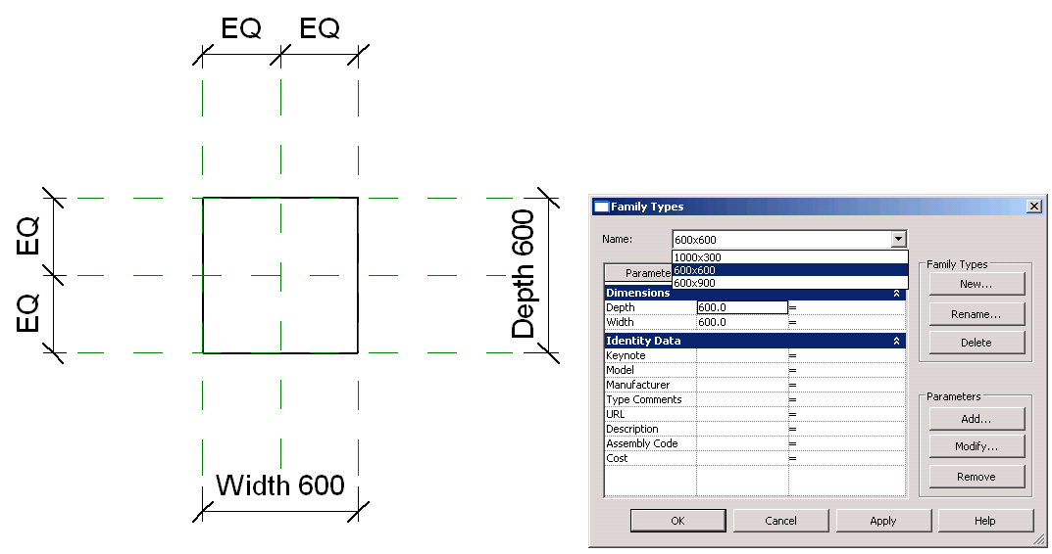
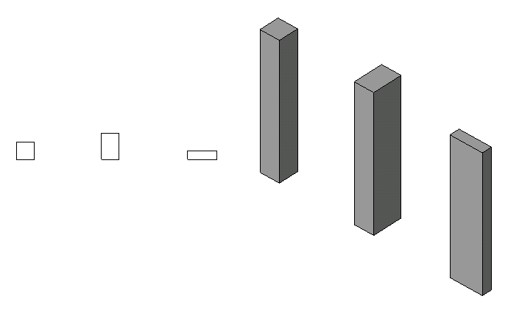
Lab1 – Create a Rectangular Column
Objective: learn THE basics of family API.
check the family context
create a simple solid using extrusion
set alignments
add types
Classes and methods:
rvtDoc.IsFamilyDocument()
rvtDoc.OwnerFamily.FamilyCategory.Name
rvtDoc.FamilyCreate.NewExtrusion()
rvtDoc.FamilyCreate.NewAlignment()
familyMgr = rvtDoc.FamilyManager
familyMgr.NewType()
familyMgr.Parameter(); familyMgr.Set()

Slide 17
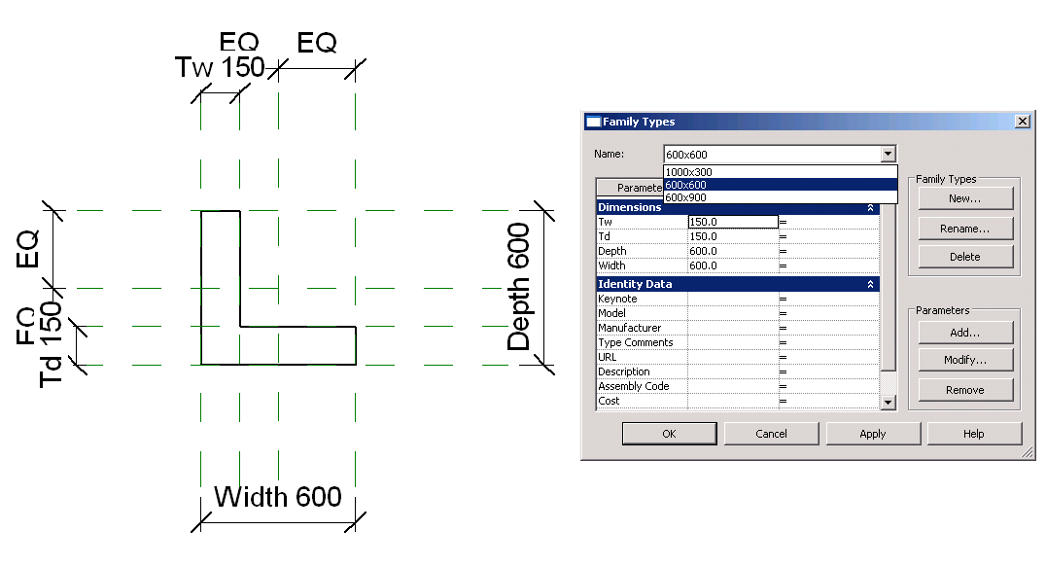
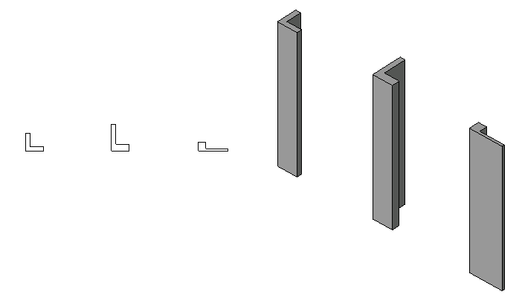
Lab2 – Create a L-Shape Column
Objective: learn the basics of family API.
add reference planes
add parameters
add dimensions
Classes and methods:
rvtDoc.FamilyCreate.NewReferencePlane()
familyMgr.AddParameter()
rvtDoc.FamilyCreate.NewDimension()

Slide 18
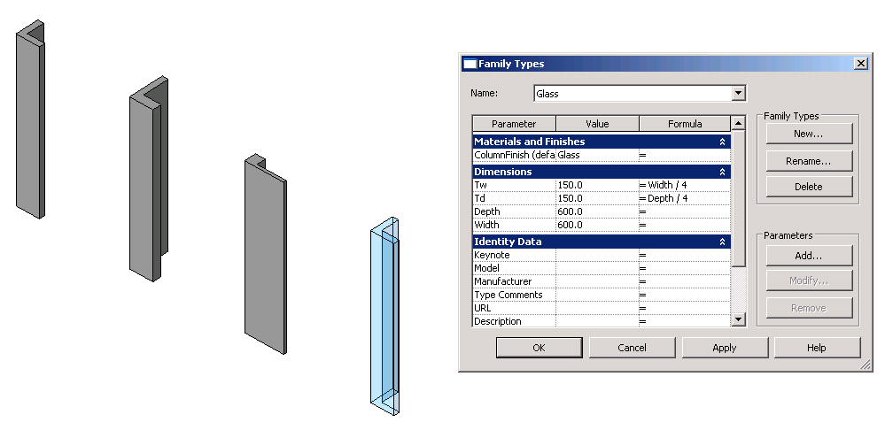
Lab3 – Add Formulas and Materials
Objective: learn the basics of family API.
add formulas
add materials
Classes and methods:
familyMgr.SetFormula()
pSolid.Parameter(“Material”)
familyMgr.AddParameter(“MyColumnFinish”, BuiltInParameterGroup.PG_MATERIALS, ParameterType.Material, True)
familyMgr.AssociateElementParameterToFamilyParameter()

Slide 19
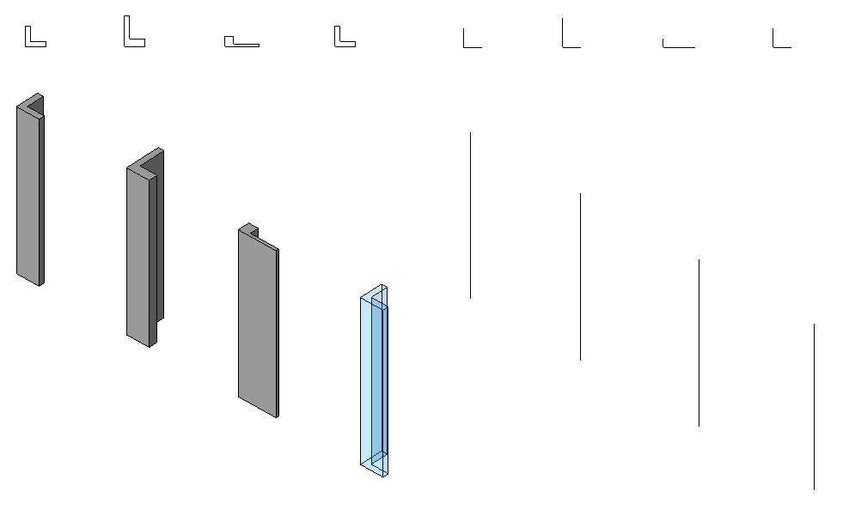
Lab4 – Add Visibility Control
Objective:
add line representation
add visibility control
Classes and methods:
rvtDoc.FamilyCreate.NewSymbolicCurve()
rvtDoc.FamilyCreate.NewModelCurve()
FamilyElementVisibility(FamilyElementVisibilityType.ViewSpecific/Model)
FamilyElementVisibility.IsShownInFine, etc.
pLine.SetVisibility(pFamilyElementVisibility)

Slide 20
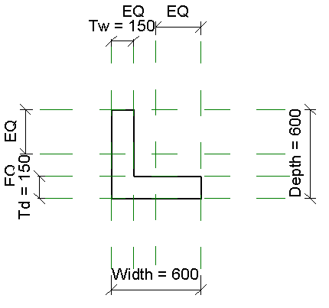
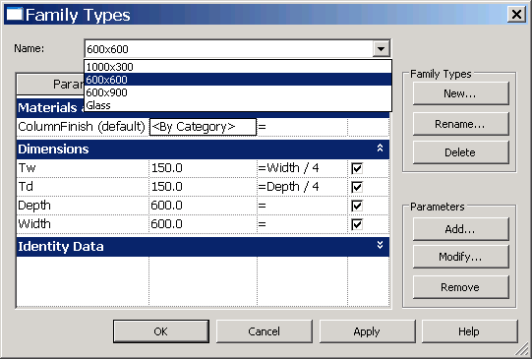
Family API along Best Practice Example: Simple L-shape column
Reference planes
Parameters
Dimensions
Types
Geometry
Alignments
Plan
Reference planes
Parameters
Types
Geometry

Slide 21
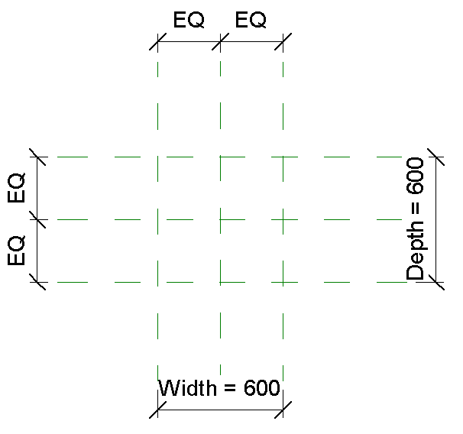
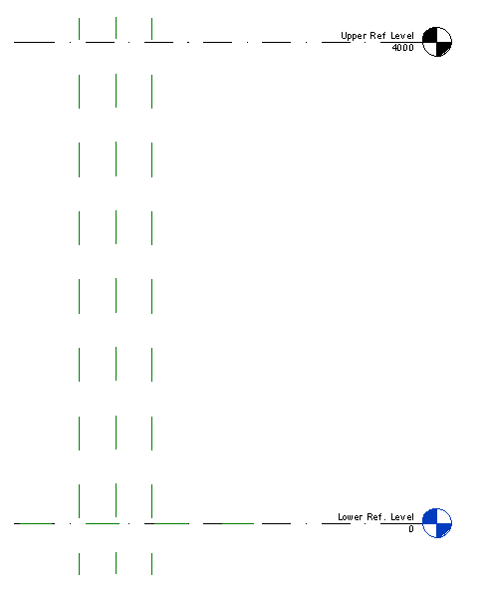
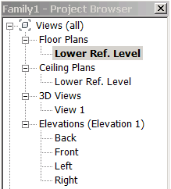
1. Plan
Right template (e.g., “Metric Column.rft”)
Understand your template
Upper Ref Level
Left
Center (Left/Right)
Right
Back
Center (Front/Back)
Front
Lower Ref. Level
Reference Plane
Notes:
Like with the UI, you will still need to plan. Choose a right template.

Slide 22
1. Plan Validate the document
Function ValidateDocument(ByVal rvtDoc As Document) As Boolean
'' our command works in the context of family editor only
If Not rvtDoc.IsFamilyDocument Then
TaskDialog.Show("Family API", "This works only in the family editor.")
Return False
End If
'' check if we have a right template
Dim ownerFamily As Family = rvtDoc.OwnerFamily
If ownerFamily Is Nothing Then
TaskDialog.Show("Family API", "This document does not have Owner Family.")
Return False
End If
'' check the family category of this document
Dim catColumn As Category = _ rvtDoc.Settings.Categories.Item(BuiltInCategory.OST_Columns)
If Not ownerFamily.FamilyCategory.Id.Equals(catColumn.Id) Then
TaskDialog.Show("Family API", "Please open Metric Column.rft")
End If
Return True
End Function
Check if the current document is a family document
Get the Family of this document
Check the family category of this document

Slide 23
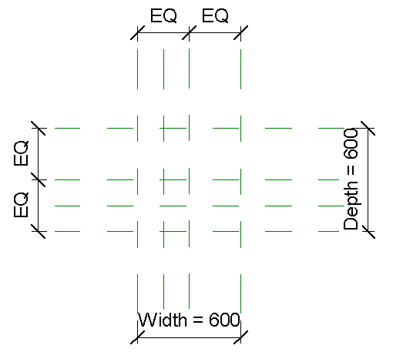
2. Layout Reference Planes Add reference planes
Reference Plane : OffsetV
Reference Plane : OffsetH

Slide 24
2. Layout Reference Planes Example: Vertical offset
Sub AddReferencePlane_VerticalOffset()
'' create a reference plan, using NewReferencePlane
Dim pt1 As New XYZ(-0.5, -2.0, 0.0) '' one end
Dim pt2 As New XYZ(-0.5, 2.0, 0.0) '' the other end
Dim vec As XYZ = XYZ.BasisZ '' perpendicular to the first line.
Dim view As View = _
Utils.FindElement(rvtDoc, GetType(ViewPlan), "Lower Ref. Level")
Dim refPlane As ReferencePlane = _ m_rvtDoc.FamilyCreate.NewReferencePlane(pt1, pt2, vec, view)
refPlane.Name = "OffsetV"
End Sub

Slide 25
2. Layout Reference Planes Example: Vertical offset
Sub AddReferencePlane_VerticalOffset()
'' create a reference plan, using NewReferencePlane
Dim pt1 As New XYZ(-0.5, -2.0, 0.0) '' one end
Dim pt2 As New XYZ(-0.5, 2.0, 0.0) '' the other end
Dim vec As XYZ = XYZ.BasisZ '' perpendicular to the first line.
Dim view As View = _
Utils.FindElement(rvtDoc, GetType(ViewPlan), "Lower Ref. Level")
Dim refPlane As ReferencePlane = _ m_rvtDoc.FamilyCreate.NewReferencePlane(pt1, pt2, vec, view)
refPlane.Name = "OffsetV"
End Sub
z
z (0,0,1)
y
pt1
pt2
x

Slide 26
2. Layout Reference Planes Example: NewReferencePlane2()
Sub AddReferencePlane_VerticalOffset2()
'' create a reference plan, using NewReferencePlane
Dim pt1 As New XYZ(-0.5, -2.0, 0.0) '' one end
Dim pt2 As New XYZ(-0.5, 2.0, 0.0) '' the other end
Dim pt3 As New XYZ(-0.5, -1.0, 1.0) '' the third point
Dim view As View = _
Utils.FindElement(rvtDoc, GetType(ViewPlan), "Lower Ref. Level")
Dim refPlane As ReferencePlane = _ m_rvtDoc.FamilyCreate.NewReferencePlane2(pt1, pt2, pt3, view)
refPlane.Name = "OffsetV"
End Sub
z
pt3
y
pt1
pt2
x

Slide 27
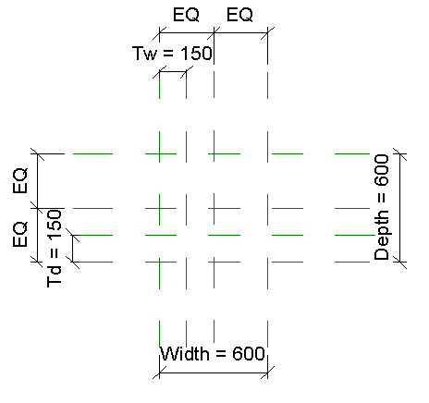
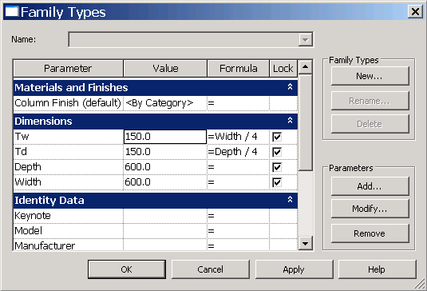
3. Add Parameters
Parameters
Dimensions

Slide 28
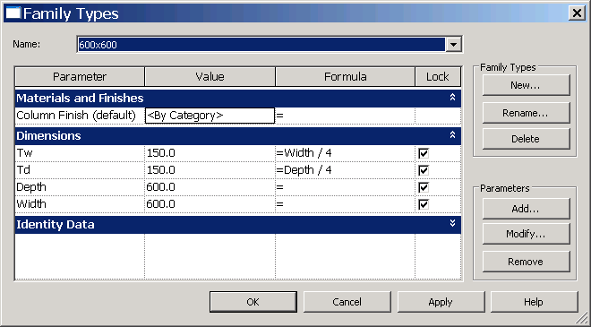
3a. Add Parameters Example: Tw
Dim m_familyMgr As FamilyManager = m_rvtDoc.FamilyManager
Sub AddParameter_Tw()
'' add a parameter "Tw" Dim isInstance As Boolean = False
Dim paramTw As FamilyParameter = _ m_familyMgr.AddParameter( _ "Tw", BuiltInParameterGroup.PG_GEOMETRY, ParameterType.Length, isInstance)
'' give initial values. Dim tw As Double = Utils.mmToFeet(150.0) '' in metric
'Dim tw As Double = 0.5 '' in feet
m_familyMgr.Set(paramTw, tw)
'' add a formula (optional)
m_familyMgr.SetFormula( _ paramTw, "Width / 4.0“)
End Sub
Notes:
for Materials, it will be PG_MATERIALS and ParameterType.Materials

Slide 29
3a. Add Parameters Example: Column Finish
Sub AddParameter_Material()
'' add a parameter "Tw" Dim param As FamilyParameter = m_familyMgr.AddParameter("Column Finish", _
BuiltInParameterGroup.PG_MATERIALS, ParameterType.Material, True)
'' we will come back to setting to a solid later
End Sub
Notes:
for Materials, it will be PG_MATERIALS and ParameterType.Materials

Slide 30
3b Add Dimensions Example: Tw
Sub AddDimention_Tw()
'' find the plan view that we want to place a dimension
Dim pViewPlan As View = _ Utils.FindElement(m_rvtDoc, GetType(ViewPlan), "Lower Ref. Level")
'' find two reference planes which we want to add a dimension between
Dim ref1 As ReferencePlane = _ Utils.FindElement(m_rvtDoc, GetType(ReferencePlane), "Left")
Dim ref2 As ReferencePlane = _ Utils.FindElement(m_rvtDoc, GetType(ReferencePlane), "OffsetV")
'' make an array of references
Dim pRefArray As New ReferenceArray
pRefArray.Append(ref1.Reference)
pRefArray.Append(ref2.Reference)
'' define a dimension line
Dim p0 As XYZ = ref1.FreeEnd
Dim p1 As XYZ = ref2.FreeEnd
Dim pLine As Line = m_rvtApp.Create.NewLineBound(p0, p1)
'' create a dimension
Dim pDimTw As Dimension = _ m_rvtDoc.FamilyCreate.NewDimension(pViewPlan, pLine, pRefArray)
'' add label to the dimension
pDimTw.Label = m_familyMgr.Parameter("Tw")
End Sub

Slide 31
4. Add Multiple Host Thickness Types
For testing purposes
No host in our example.

Slide 32
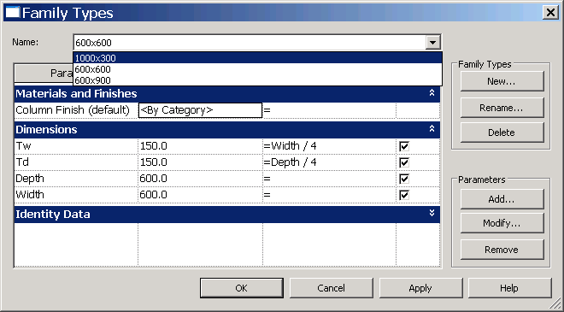
5. Add Two or More Types

Slide 33
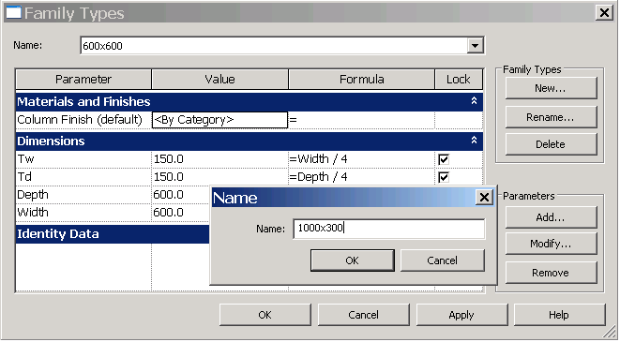
5. Add Two or More Types Example: Width x Depth
Sub AddType(ByVal name As String, ByVal w As Double, ByVal d As Double)
'' add new types with the given name.
Dim type1 As FamilyType = m_familyMgr.NewType(name)
'' look for 'Width' and 'Depth' parameters and set them with the given values
Dim paramW As FamilyParameter = m_familyMgr.Parameter("Width")
Dim valW As Double = Utils.mmToFeet(w)
If paramW IsNot Nothing Then
m_familyMgr.Set(paramW, valW)
End If
Dim paramD As FamilyParameter = m_familyMgr.Parameter("Depth")
Dim valD As Double = Utils.mmToFeet(d)
If paramD IsNot Nothing Then
m_familyMgr.Set(paramD, valD)
End If
End Sub
Sub AddTypes()
'' AddType(name,Width,Depth)
AddType("600x900", 600.0, 900.0)
AddType("1000x300", 1000.0, 300.0)
AddType("600x600", 600.0, 600.0)
End Sub

Slide 34
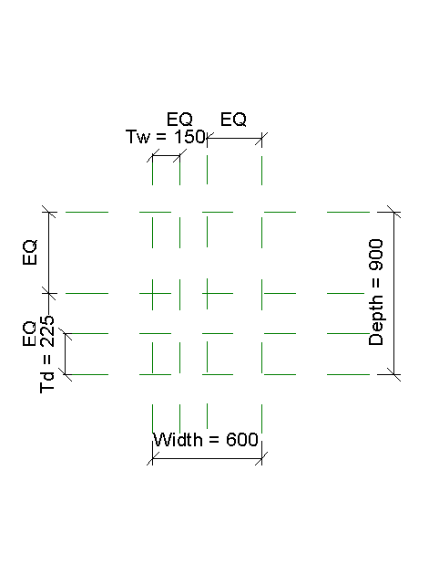
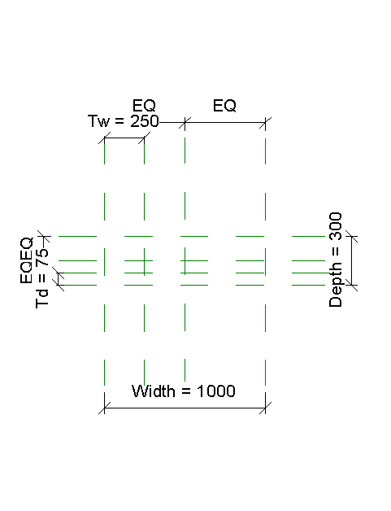
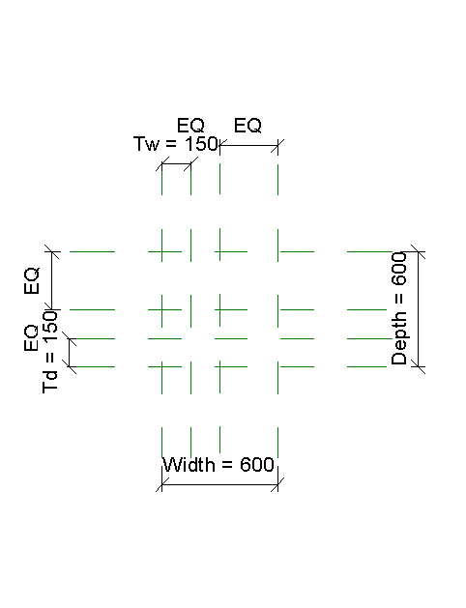
6. Flex Types and Host (Testing Procedure)
Testing Procedure

Slide 35
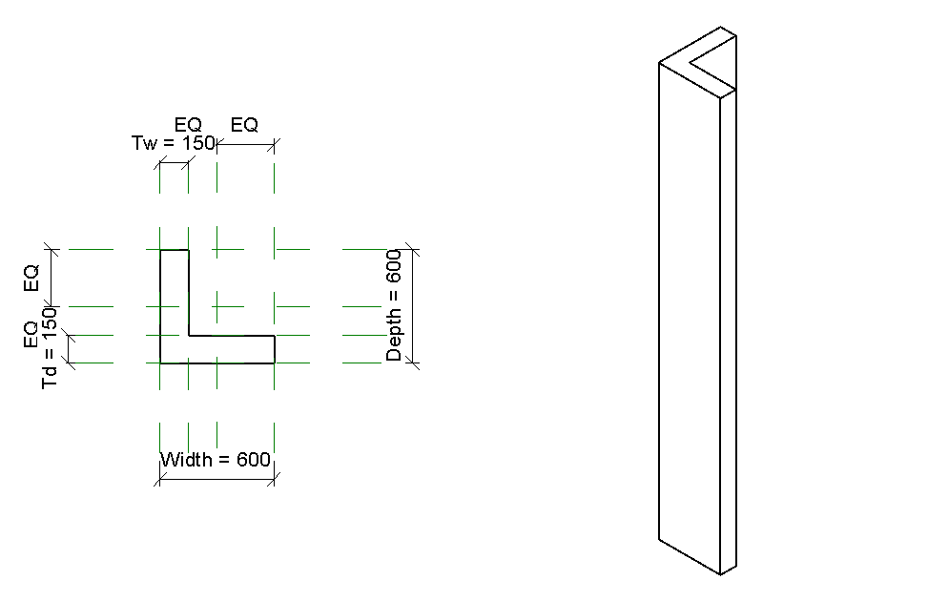
7. Add Single Level of Geometry
Add a solid
Add alignments

Slide 36
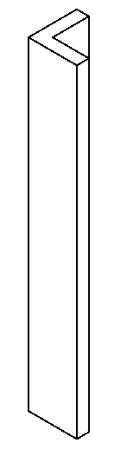
7a. Add Single Level of Geometry Example: Extrusion
Function CreateSolid() As Extrusion
'' (1) define a simple L-shape profile
Dim pProfile As CurveArrArray = CreateProfileLShape()
'' (2) create a sketch plane
Dim pRefPlane As ReferencePlane = _ Utils.FindElement(m_rvtDoc, GetType(ReferencePlane), "Reference Plane")
Dim pSketchPlane As SketchPlane = _ m_rvtDoc.FamilyCreate.NewSketchPlane(pRefPlane.Plane)
'' (3) height of the extrusion. distance between Lower and Upper Ref Level.
Dim dHeight As Double = Utils.mmToFeet(4000)
'' (4) create an extrusion here. at this point.
Dim bIsSolid As Boolean = True '' as oppose to void.
Dim pSolid As Extrusion = _
m_rvtDoc.FamilyCreate.NewExtrusion(bIsSolid, pProfile, pSketchPlane, dHeight)
Return pSolid
End Function

Slide 37
7a. Add Single Level of Geometry Example: L-shape profile
tw
5
4
Function CreateProfileLShape() As CurveArrArray
Dim w As Double = Utils.mmToFeet(600)
Dim d As Double = Utils.mmToFeet(600)
Dim tw As Double = Utils.mmToFeet(150)
Dim td As Double = Utils.mmToFeet(150)
'' define vertices (the last one is to make the loop simple)
Const nVerts As Integer = 6 '' the number of vertices
Dim pts() As XYZ = {New XYZ(-w / 2, -d / 2, 0), New XYZ(w / 2, -d / 2, 0), _ New XYZ(w / 2, -d / 2 + td, 0), New XYZ(-w / 2 + tw, -d / 2 + td, 0), _ New XYZ(-w / 2 + tw, d / 2, 0), New XYZ(-w / 2, d / 2, 0), _ New XYZ(-w / 2, -d / 2, 0)}
'' define a loop. define individual edges and put them in a curveArray
Dim pLoop As CurveArray = m_rvtApp.Create.NewCurveArray
Dim lines(nVerts - 1) As Line
For i As Integer = 0 To nVerts - 1
lines(i) = m_rvtApp.Create.NewLineBound(pts(i), pts(i + 1))
pLoop.Append(lines(i))
Next
'' then, put the loop in the curveArrArray as a profile
Dim pProfile As CurveArrArray = m_rvtApp.Create.NewCurveArrArray
pProfile.Append(pLoop)
Return pProfile
End Function
d
O
3
2
td
0
1
w

Slide 38
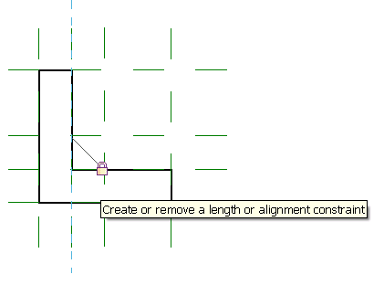
7b. Add Alignments Example: lock a face on the ref plane “OffsetV”
Sub AddAlignment_ReferencePlane(ByVal pSolid As Extrusion, _ ByVal normal As XYZ, ByVal nameRefPlane As String)
'' get the plan view
Dim pViewPlan As View = _
Utils.FindElement(m_rvtDoc, GetType(ViewPlan), "Lower Ref. Level")
'' find reference planes
Dim refPlane As ReferencePlane = _ Utils.FindElement(m_rvtDoc, GetType(ReferencePlane), nameRefPlane)
'' find the face of the solid
Dim pFace As PlanarFace = Utils.FindFace(pSolid, normal, refPlane)
'' create a locked alignment
m_rvtDoc.FamilyCreate.NewAlignment( _
pViewPlan, refPlane.Reference, pFace.Reference)
End Sub

Slide 39
7b. Add Alignments Example: Level alignment
Sub AddAlignment_Level( _
ByVal pSolid As Extrusion, ByVal normal As XYZ, ByVal nameLevel As String)
'' which direction are we looking at?
Dim pView As View = Utils.FindElement(m_rvtDoc, GetType(View), "Front")
'' find the upper ref level. FindElement() is a helper function.
Dim pLevel As Level = Utils.FindElement(m_rvtDoc, GetType(Level), nameLevel)
'' find the face of the box. FindFace() is a helper function.
Dim pFace As PlanarFace = Utils.FindFace(pSolid, normal)
'' create alignments
m_rvtDoc.FamilyCreate.NewAlignment(pView, pLevel.PlaneReference, pFace.Reference)
End Sub

Slide 40
7b. Add Alignments Example: L-shape solid alignments
Sub AddAlignments(ByVal pSolid As Extrusion)
AddAlignment_Level(pSolid, New XYZ(0.0, 0.0, 1.0), "Upper Ref Level")
AddAlignment_Level(pSolid, New XYZ(0.0, 0.0, -1.0), "Lower Ref. Level")
AddAlignment_ReferencePlane(pSolid, New XYZ(1.0, 0.0, 0.0), "Right")
AddAlignment_ReferencePlane(pSolid, New XYZ(-1.0, 0.0, 0.0), "Left")
AddAlignment_ReferencePlane(pSolid, New XYZ(0.0, -1.0, 0.0), "Front")
AddAlignment_ReferencePlane(pSolid, New XYZ(0.0, 1.0, 0.0), "Back")
AddAlignment_ReferencePlane(pSolid, New XYZ(1.0, 0.0, 0.0), "OffsetV")
AddAlignment_ReferencePlane(pSolid, New XYZ(0.0, 1.0, 0.0), "OffsetH")
End Sub

Slide 41
8. Repeat Steps 6 and 7 Till Satisfied
6. Flex Types and Host (Testing Procedure)
7. Add geometry

Slide 42
9. Test in Project Environment
Create Testing Project

Slide 43
Additional Classes and Methods Visibility
Sub SetVisibility(ByVal pSolid As Extrusion)
'' set the visibility of the model not to shown in coarse.
Dim pVis As FamilyElementVisibility = _ New FamilyElementVisibility(FamilyElementVisibilityType.Model)
pVis.IsShownInCoarse = False
pSolid.SetVisibility(pVis)
End Sub

Slide 44
Additional Classes and Methods Associate parameters
Sub addMaterials(ByVal pSolid As Extrusion)
'' get the material id that we are intersted in (e.g., "Glass")
Dim pMat As Material = Utils.FindElement(m_rvtDoc, GetType(Material), "Glass")
Dim idMat As ElementId = pMat.Id
'' add a parameter for material finish
Dim paramFamilyMaterial As FamilyParameter = _
m_familyMgr.Parameter("Column Finish")
'' associate material parameter to the family parameter we just added
Dim paramSolidMaterial As Parameter = pSolid.Parameter("Material")
m_familyMgr.AssociateElementParameterToFamilyParameter( _
paramSolidMaterial, paramFamilyMaterial)
'' let's add another type with Glass finish
AddType("Glass", 600.0, 600.0)
m_familyMgr.Set(paramFamilyMaterial, idMat)
End Sub

Slide 45
Family API SDK Samples
For further references

Slide 46
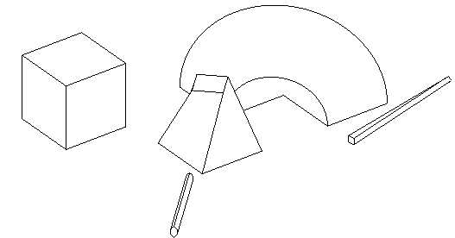
Family API SDK Samples Learning resources
In <SDK folder>\Samples\FamilyCreation
AutoJoin
Automatically join geometry of multiple generic forms for use in family modeling and massing
Uses the method Document::CombineElements to join geometry between overlapping generic forms
Provide a utility method check geometry object overlap, based on Face::Intersect(Curve) method
AutoParameter
Batch mode automatic addition of shared or non-shared parameters to one or more family documents
Process active family document or all families in a folder
Uses FamilyManager class AddParameter methods
Reads input data from parameter text files in Revit shared parameter format
DWGFamilyCreation
Import DWG file into family document add type parameters to the imported instance
DWGFileName with the DWG file name and ImportTime when it was imported
GenericModelCreation
Create a generic model using extrusion, blend, revolution, sweep and swept blend elements
Checks that open document is a family one or creates a new family document
Exercises CreateSketchPlane, NewLineBound, and FamilyItemFactory methods to create profiles and shapes

Slide 47
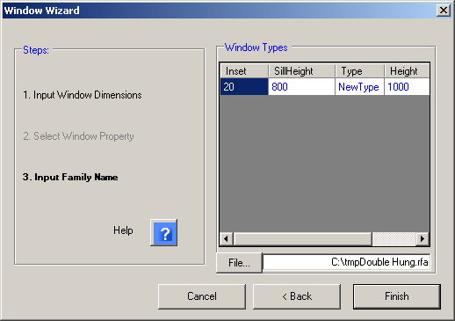
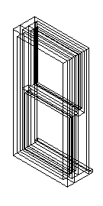
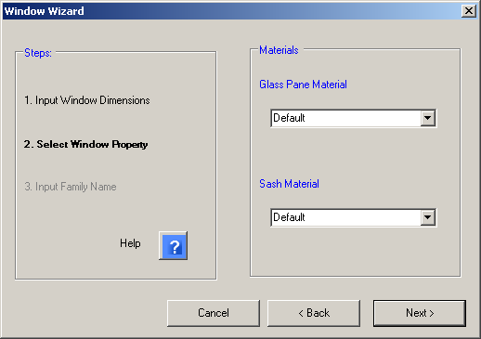
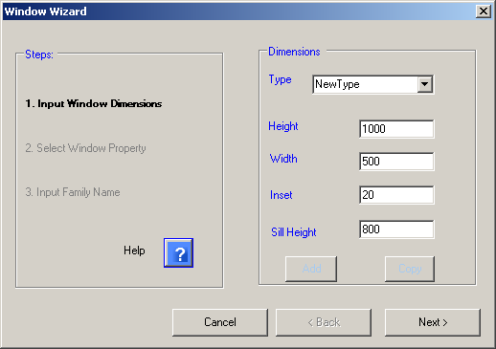
Family API SDK Samples (cont.) Learning resources
TypeRegeneration
Use FamilyManager Types property to determine all types defined, and CurrentType to iterate through them
Report whether all types regenerated successfully, log errors to file
ValidateParameters
Check whether every type has valid values for certain parameters and log result to file
External application subscribing to DocumentSaving and DocumentSavingAs events runs check automatically
External command to launch manually
WindowWizard
Create a window family via wizard user interface
Start in window family template, e.g. Metric Window.rtf
User defines input dimensions for window parameters and materials
Create extrusion, alignment, dimension, reference plane, and family type

Slide 48
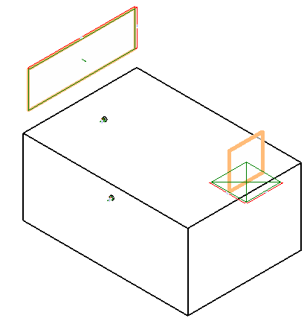
Family API SDK Samples (cont.) Learning resources
CreateAirHandler – RME
Create an air handler with pipe and duct connectors
Check the template family category to verify valid starting point
Use FamilyItemFactory class NewExtrusion, NewPipeConnector, NewDuctConnector methods
Set proper connector parameters and use Document::CombineElements to join the extrusions
CreateTruss – RST
Create a mono truss in a truss family document
Create truss curves using NewModelCurve, set truss type through ModelCurve TrussCurveType property
Add constraints to the truss curves with NewAlignment

Slide 49
and more … Learning resources
Revit Developer Guide
Section 13 Family Creation
RevitAPI.chm
Reference guide. Include code snippet
Recordings
Revit Family API Webcast (July 2009)
AU 2009 virtual class AU2009 CP9118-1 : “The New Autodesk® Revit® Family API: Everything is Relative” by Jeremy Tammik
In Revit 2010, but mostly still valid for Family API
Based on the exercise labs
Discussion Groups >> Revit Architecture >> Revit API
API Training Classes
The Building Coder, Jeremy Tammik's Revit API Blog
Autodesk Developer Network
DevHelp Online for ADN members

Slide 50
Summary
Revit Family from UI
What is it?
Where to begin, flavors, editor, what is possible
Best practice
Family creation using API
Learning along best practice
Example: L-shape column
Learning resources

Slide 51
Thank you very much!

Slide 52


