Slide 1

The Revit MEP API
Jeremy Tammik
Principal Developer Consultant

Slide 2

About the Presenter
Jeremy Tammik
Principal Developer Consultant
Developer Technical Services
EMEA, Autodesk SARL
Jeremy is a member of the AEC workgroup of the Autodesk Developer Network ADN team, providing developer support, training, conference presentations, and blogging on the Revit API.
He joined Autodesk in 1988 as the technology evangelist responsible for European developer support to lecture, consult, and support AutoCAD application developers in Europe, the U.S., Australia, and Africa. He was a co-founder of ADGE, the AutoCAD Developer Group Europe, and a prolific author on AutoCAD application development. He left Autodesk in 1994 to work as an HVAC application developer, and then rejoined the company in 2005.
Jeremy graduated in mathematics and physics in Germany, worked as a teacher and translator, then as a C++ programmer on early GUI and multitasking projects. He is fluent in six European languages, vegetarian, has four kids, plays the flute, likes reading, travelling, theatre improvisation, yoga, carpentry, loves mountains, oceans, sports, dancing, and especially climbing.
Notes:
Before we jump into the presentation proper, here’s a little bit about me. My name is Jeremy Tammik, and I work for the Autodesk Developer Network (ADN), in the AEC workgroup. I also write a blog on the Revit API. I have been working with AutoCAD APIs for over twenty years. A key part of my job is to support communication between external plug-in developers and our engineering to help the latter create the APIs that the former need to write really cool add-in applications.

Slide 3
Class Summary
Overview of the Revit MEP API
MEP API enhancements in Revit 2013
Working programmatically with Revit MEP models
Overview of available Revit MEP API samples
Prerequisites: we assume prior knowledge of
How to program in .NET
The basics of the generic Revit API
Revit MEP product usage

Slide 4
Learning Objectives
At the end of this class, you will be able to:
Understand and use the Revit MEP 2013 API enhancements
Analyze, create, manage and modify electrical, HVAC and plumbing models, systems, and components programmatically
Understand and reuse functionality provided by the standard Revit MEP SDK and custom ADN samples

Slide 5
Agenda
Introduction
Analysis
Hierarchical systems and connectors
Electrical
HVAC and plumbing
The Revit MEP 2013 API
Sample applications
Learning more

Slide 6
Introduction

Slide 7
Autodesk Developer Network
Access to almost all Autodesk software and SDK’s
Includes early access to beta software
Members-only website with thousands of technical articles
Product direction through conferences
Unlimited technical support
API training classes
One to three free for professional members
Marketing benefits
Exposure on autodesk.com
Promotional opportunities
www.autodesk.com/joinadn
Notes:
Some of you may be unfamiliar with ADN. The Autodesk Developer Network is a program providing professional support to programmers writing add-in applications for Autodesk software. If you think the program benefits listed here would be useful to you, then visit this URL and read more about it. You don’t have to be a commercial software developer to join ADN.

Slide 8
Acronyms
ADN Autodesk Developer Network
AEC Architecture, Engineering, Construction
API Application Programming Interface
BIM Building Information Model
GUI Graphical User Interface
HVAC Heating, Ventilation, and Air Conditioning
MEP Mechanical, Electrical, and Plumbing
RAC Revit Architecture
RME Revit MEP
RST Revit Structure
SDK Software Development Kit
UI User Interface

Slide 9
MEP Application Requirements
Mechanical, electrical and plumbing domains
M is for HVAC, i.e. heating, ventilation and air conditioning
Model analysis tools
Physical, thermal, environmental etc.
Building codes and regulations
Geometrical relationships
MEP project information
Green Building XML, gbXML
Spaces and zones
BIM component and data access
Systems, components, properties and parameters
Creation and modification
Traversal and analysis

Slide 10
The Generic Revit API
Basic Revit API is generic
All flavours use the same Revit API .NET assemblies
Specific additional features exist for each flavour, e.g.
Room-related functionality in Revit Architecture
Access to the analytical model in Revit Structure
Access to the MEP model in Revit MEP
Onebox supports all in one box
Runtime discipline switching
ProductType Architecture, Structure, MEP, Revit

Slide 11
Revit MEP API Evolution
Generic element and parameter access can always be used
Revit 2008 provided no MEP-specific API
Revit 2009 introduced MEP-specific API support
MEP model property, space and zone, electrical and mechanical equipment, lighting device and fixture, connector, electrical system
Revit MEP 2010 – mechanical
MEP namespace, support for HVAC and piping systems
Revit MEP 2011 – electrical
Conduit, cable tray, panel schedule
Revit MEP 2012 – mechanical
Pipe settings and sizes, placeholder elements, insulation and lining
Revit MEP 2013 – mechanical and analysis
Routing preferences, analysis and calculation enhancements, new and updated APIs

Slide 12
Analysis

Slide 13
MEP Project Info and EnergyDataSettings
EnergyDataSettings object represents gbXML project info
Manage > Project Settings > Project Information > Energy Data
Access via EnergyDataSettings.GetFromDocument method
Define settings for gbXML export, heating and cooling load calculations, conceptual energy analysis
For project location use Document.ActiveProjectLocation
Green Building XML export
Document.Export(
string folder,
string name,
GBXMLExportOptions );

Slide 14
Spaces and Zones
Architectural rooms are unsuitable for MEP analysis
Wrong height, often too large for analysed region
MEP uses space instead of room, and zone to manage spaces
Rooms can be subdivided into exterior and interior subspaces
AddSpaceAndZone SDK sample
Programmatic creation and management of spaces and zones
FamilyInstance class has Room and Space properties
FamilyInstance fi; // get a family instance
Space space = fi.Space; // query space containing it
Space space2 = fi.get_Space( phase ); // space in a specific phase

Slide 15
Model Inspection Utilities
Determine component location, space adjacency analysis, etc.
Volumes, rooms and spaces
FamilyInstance.Space determines space containing family instance
Room.IsPointInRoom determines if a point is in a room volume
Space.IsPointInSpace determines if a point is in a space volume
GetRoomAtPoint and GetSpaceAtPoint return room or space containing point
Element filters by intersection, Boolean operations, etc.
BoundingBoxIntersectsFilter, BoundingBoxIsInsideFilter, BoundingBoxContainsPointFilter, ElementIntersectsElementFilter, ElementIntersectsSolidFilter
Ray intersection
ReferenceIntersector class, ex FindReferencesWithContextByDirection method
Shoot a ray through the model, given a starting point and direction vector
Return an array of references of intersected elements and faces
AvoidObstruction, FindColumns, MeasureHeight, RayTraceBounce SDK samples

Slide 16
Revit 2013 ReferenceIntersector Class
Constructor specifies target elements, target type and 3D view
Elements specified by ElementId, ElementIdSet , ElementFilter
Target type can be elements, meshes, edges, curves, faces
ReferenceIntersector( <elements>, FindReferenceTarget, View3d )
Call Find or FindNearest to cast a ray given origin and direction
Returns references intersecting ray, or closest to origin
Find( XYZ origin, XYZ direction )
FindNearest( XYZ origin, XYZ direction )

Slide 17
Conceptual Energy Analysis API
Energy analysis on conceptual design models
New overload of Document.Export method taking MassGBXMLExportOptions argument
Create a gbXML file containing energy analysis elements generated from conceptual mass family instances
Notes:
New classes in the Autodesk.Revit.DB.Analysis namespace provide access to the elements and objects created by Revit to perform energy analysis on conceptual design models. The method Document Export method overload taking a MassGBXMLExportOptions argument exports a gbXML file containing conceptual energy analysis elements (mass elements) only.

Slide 18
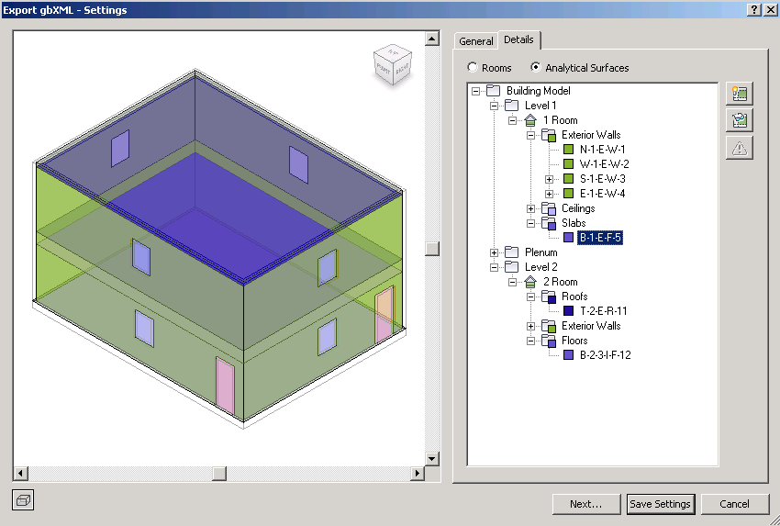
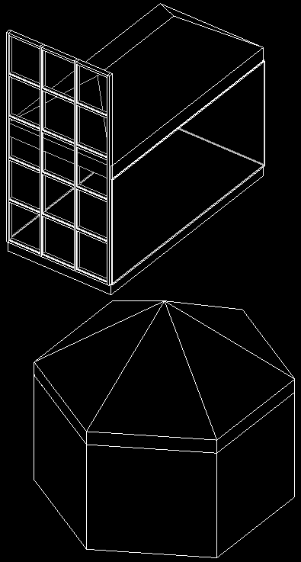
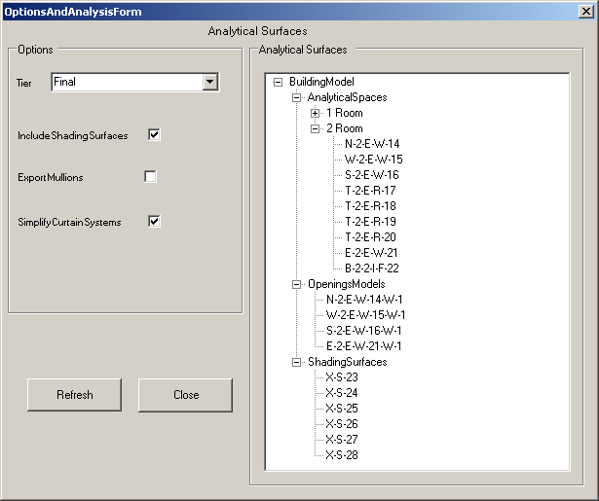
Detailed Energy Analysis Model API
Produce analytical thermal model from physical building model
Retrieve energy analysis detail model and present as tree view
Access Export to gbXML, Heating and Cooling Loads data
Analytical thermal model
Composed of volumetric elements: spaces, zones, planar surfaces
Created and initialised by calling EnergyAnalysisDetailModel.Create()
Methods GetAnalyticalSpaces, Surfaces, Openings, ShadingSurfaces
SDK sample Analysis > EnergyAnalysisModel
Notes:
Open
C:\a\lib\revit\2012\SDK\Samples\GeometryAPI\EnergyAnalysisModel\EnergyAnalysisModel.rvt
C:\a\doc\revit\au\2011\sample\Urban House MEP - 2012.rvt
Run RvtSamples > Analysis > EnergyAnalysisModel.
EnergyAnalysisDetailModelTier specifies level of computation detail for energy analysis model.
This new API provides access to the contents of a project's detailed energy analysis model, as seen in the Export to gbXML and the Heating and Cooling Loads features.
This analysis produces an analytical thermal model from the physical model of a building. The analytical thermal model is composed of spaces, zones and planar surfaces that represent the actual volumetric elements of the building.
New classes in Autodesk.Revit.DB.Analysis namespace for the energy analysis detail model itself, creation options, openings, spaces, surfaces and loops can be used to generate and analyze the contents of the detailed energy analysis model. The EnergyAnalysisDetailModel Create method creates and populates the model with appropriate options selected. The methods GetAnalyticalSpace, GetAnalyticalSurfaces, GetAnalyticalOpenings and GetAnalyticalShadingSurfaces extract entities from the analysis model. The method Destroy cleans up the Revit database after finishing with the analysis results.

Slide 19
Hierarchical Systems and Connectors

Slide 20
Hierarchical System Structure and MEP Model
MEP systems consist of hierarchically connected components
Many components are represented using family instances
Connectors can link neighbouring components and transfer info
Top level node is MEP system
Represented by MEPSystem class, with derived classes ElectricalSystem, MechanicalSystem, PipingSystem
Family instance provides MEPModel property
MEPModel has ConnectorManager and ElectricalSystems properties
Derived classes include ElectricalEquipment, LightingDevice, LightingFixture, MechanicalEquipment, MechanicalFitting

Slide 21
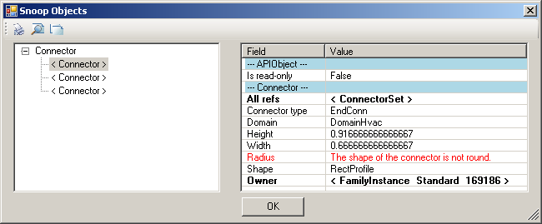

Connectors
Connector class
Used to represent connections in the Revit BIM project context
Part of MEP component, not independent Revit database element
Logical connectors
Used in electrical domain
Cables and wires are possibly not specified
Enables traversal of connected electrical system hierarchies
Physical connectors
Connect neighbouring components physically
Transmit sizing dimensions and flow information
Family editor connection elements
Independent elements for defining connectors
Used to model library parts in family context
Specialised derived classes for duct, pipe and electrical connectors

Slide 22
Electrical

Slide 23
Electrical System Hierarchy
Three-tier recursive hierarchy, cf. electrical system browser
Panel > systems or circuits > circuit elements, may be panels
Logical connections between components
Wires are annotation elements
System can be traversed through connectors
Connectivity information also available in element parameters
Electrical samples
PowerCircuit SDK sample shows creation and editing power circuits
PanelSchedule SDK demonstrates use of the electrical panel schedule API
AdnRme electrical sample demonstrates traversal using both MEP connectors and generic parameters (much harder)

Slide 24
HVAC and Plumbing

Slide 25
HVAC and Piping Hierarchy
Systems manage the top level system properties
Ducts and pipes define the main flow elements
Fittings implement bends and branches in the system
Connectors hook up the ducts, pipes and fittings

Slide 26
Systems
MechanicalSystem and PipingSystem classes
Access to equipment, connectors and system type
Access to system properties such as flow and static pressure
DuctNetwork and PipeNetwork properties access system contents
Ducts and fitting elements in no particular order
Does not include terminals or equipments
Query connector managers for traversal in flow direction
TraverseSystem SDK sample

Slide 27
Duct and Pipes
Represented by Duct, FlexDuct, Pipe and FlexPipe classes
Derived from MEPCurve
Provide read access to duct properties, types, and geometry
Change duct or pipe type
Move duct or pipe
Use Move method rather than Location
Layout duct or pipe
Driven by two points, point and connector, or two connectors

Slide 28
Fittings
Represented by standard RFA family instances
Created using dedicated creation doc New*Fitting methods
Elbow, Tee, Cross, Takeoff, Transition, and Union
Access fitting properties, shape and dimensions through the FamilyInstance.MEPModel property

Slide 29
Connectors
Read duct, pipe, and fitting connector properties
Flow, Coefficient, Demand
Access physical connector properties
Origin, Angle, Height, Width, Radius
Read and write assigned connector properties
The fitting connectors define the properties
Flow, Flow Configuration, Coefficients, Loss Method
Change connector size and location
Connect and disconnect

Slide 30
Element Creation
Methods on Autodesk.Revit.Creation.Document
Create New Systems
NewMechanicalSystem, NewPipingSystem
Create New Elements
NewDuct, NewFlexDuct, NewPipe, NewFlexPipe
Create New Fittings
New...Fitting for Cross, Elbow, TakeOff, TeeFitting, Transition, Union
New classes Conduit, CableTray provide static Create methods
Connector elements
Created in the family context using methods on FamilyItemFactory
Accessed through the Document.FamilyCreate property
NewDuctConnector, NewPipeConnector, NewElectricalConnector

Slide 31
The Revit MEP 2013 API and the past few releases as well...

Slide 32
Revit MEP 2011 Product Enhancements
Panel Schedules
Cable Tray and Conduit
Other Enhancements
Placing Valves and Fittings in Section or Elevation Views
Tagging of MEP Elements during placement
Demand Factors and Load Categories
Piping Companion Flanges
New Electrical Content
Oval Duct
Notes:
Cable Tray and Conduit
Revit 2011 includes support for modelling conduit and cable tray as unique object types. The goal of this feature is to represent real world conduit and cable tray for coordination purposes and for accurate and legible construction drawings.
Cable trays and conduits and can be routed as individual runs with or without individual fittings placed between straight sections. Conduit runs without fittings would be used for conduit that is bent to change directions instead of having actual fittings. When using conduit or cable tray runs without fittings, you can now use a new schedule type to report the overall length of the run. These schedule types have categories of Conduit Runs and Cable Tray Runs respectively.
Cable trays can be drawn as channel or ladder type.
Conduits can be connected to cable tray segments. The conduit does not have to actually touch the cable tray to connect. For example, you can connect a conduit 6” below the cable tray and have the conduit end update if the cable tray segment is moved.
Conduit and cable tray each support graphics with varying levels of detail in fine, medium, and coarse display.
A new type of connector is now available for connecting conduit to equipment. This new surface connector enables an entire face of a piece of equipment to accept conduit connections without having to manually add individual conduit connectors to the equipment. This makes connecting to equipment such as switchgear, transformers and panels faster and easier.
Panel Schedules
You can create a schedule that lists the circuits connected to a panel, and displays information about each circuit such as location on the panel, circuit name, apparent loads, etc. Panel schedules display three main information sections: a header, circuit table, and a loads summary. A new Panel Schedule view for the selected panel is displayed in the drawing area, and panel schedules are added to the project browser under the Panel Schedules folder. A panel schedule shows the following data:
Panel Name
Distribution System supported by the panel
Number of phases available from the panel
Number of wires specified for the distribution system assigned to this panel
Rating of the mains feeding the panel
Type of mounting (Surface or Recessed)
Type of case enclosing the panel
Room where the panel is installed
Name assigned to a load circuit
Rated trip current for a circuit breaker
Number of poles on the circuit breaker
Circuit number
Phases
Apparent load (VA) for each of the phases
Total apparent load for all three phases
Manufacturer
Notation of any changes made to the panel
Root Means Square amperage
Additional circuit and panel information to display can be specified in the panel schedule templates.
Other Enhancements
Placing Valves and Fittings in Section or Elevation Views
It is now possible to place valves, fittings, and other types of duct or piping accessories while in an elevation or section view. For example, you can switch to an elevation view and place a valve in a vertical pipe.
Tagging of MEP Elements during placement
You can now tag MEP components as they are being placed instead of doing so in a separate step.
Piping Companion Flanges
There is a new pipe fitting type for flanges. If you define a flanged pipe type, you can edit the type and specify a companion flange that will be automatically inserted between the pipes and flanged fittings and on connections to equipment like pumps.
Oval Duct
Oval ducts are now available in addition to the rectangular and round duct shapes. New size separators are available for oval duct size annotations and oval ducts can be used in duct sizing.
Demand Factors and Load Categories
Demand factors have been updated to allow for more control over how demand loads are calculated and can be customized. Load categories are customizable and can be displayed in panel schedules.
New Electrical Content
Many new types of electrical content have been added. New content is provided for communications, fire safety, data, nurse call, etc. Control panels have been added in addition to the individual controls or devices, so several of these objects can be connected to their appropriate panels.

Slide 33
Revit MEP 2011 API Enhancements
New classes for cable tray and conduit
Pipe to conduit converter sample
Panel schedules
API access and PanelSchedule SDK sample
Other Enhancements
EnergyDataSettings
Validation in ElectricalSystem Properties
WireMaterialType, InsulationType, TemperatureRatingType
DuctConnector, PipeConnector, ElectricalConnector
Demand Factor and Load Classifications
Notes:
The Revit MEP API
Many of the enhancements to the Revit 2011 MEP specific API are related to the electrical domain, since the HVAC and mechanical domains were a primary focus of the previous Revit 2010 release. Paralleling the product features, the cable tray, conduit and panel schedules are the main areas of enhancement. A number of other topics have been addressed as well.
Cable Tray and Conduit
The entire new cable tray and conduit feature is fully exposed through the API. Whatever can be done in the user interface should be possible using the API as well. A number of new classes and elements related to the cable tray and conduit ones have been added. The major ones are:
CableTrayConduitBase – the base class for cable trays and conduits.
CableTrayConduitRunBase – the base class for cable tray and conduit runs.
CableTray – a cable tray instance.
CableTrayType – a cable tray type.
CableTrayRun – a cable tray run.
Conduit – a conduit instance.
ConduitType – a conduit type.
ConduitRun – a conduit run.
As a result of the introduction of these new conduit elements, the previously existing classes ConduitType and ConduitTypeSet have been renamed to WireConduitType and WireConduitTypeSet.
Panel Schedules
A new comprehensive API has been introduced to support access to panel schedules and their contents. The major classes exposed by this API are:
TableView – represents a view that shows a table.
TableData – holds most of the data describing the table row, column, and cells.
TableSectionData – holds row, column and cell data for a TableData instance.
PanelScheduleView – represents a view that shows a panel schedule.
PanelScheduleData – holds most of the data that describe the layout, appearance, and style of the rows, columns, and cells of a panel schedule.
PanelScheduleTemplate – represents a branch panel, a switchboard or a data panel template.
PanelScheduleSheetSegment – represents a segment of a panel schedule sheet instance.
PanelScheduleSheetInstance – represents an instance of a panel schedule placed on sheet.
Other Enhancements
EnergyDataSettings
For greater clarity, the gbXMLParamElem class has been renamed to EnergyDataSettings, and some of its members were renamed as well.
Validation in ElectricalSystem Properties
The ElectricalSystem properties Length and VoltageDrop now throw an InvalidOperationException when the value cannot be computed, instead of returning zero.
WireMaterialType, InsulationType, TemperatureRatingType
These classes now inherit from ElementType.
DuctConnector, PipeConnector, ElectricalConnector
These classes now inherit from a new common ConnectorElement base class.
Demand Factor and Load Classifications
The ElectricalSystem LoadClassification property has been replaced with a new property LoadClassifications. It returns a semicolon-delimited string listing the load classifications assigned to the system. Load classifications are now elements and can be found through regular element iteration.
The class DemandFactor was replaced by ElectricalDemandFactorDefinition.
The ElectricalSetting method GetDemandFactor has been replaced by the DemandFactorId property on the ElectricalLoadClassification class, which returns the id of the ElectricalDemandFactorDefinition element assigned to the load classification.

Slide 34
Revit MEP 2012 Product Features
Placeholder elements
Insulation and lining
Parallel pipe and conduit runs
Sloped piping enhancements: settings, tooltips, connection
System browser filtering, hovering and selection
System: graphic overrides and warnings, disconnect markers, materials, calculation control, connector labels

Slide 35
Revit MEP 2012 API Enhancements
Pipe settings and sizes
Placeholder ducts and pipes
Duct and pipe insulation and lining
Small Enhancements and Changes
MEP related APIs
Detailed Energy Analysis
Conceptual Energy Analysis
Notes:
A group of new classes provide read and write access to the MEP pipe settings.
The Duct and Pipe classes provide new methods to create placeholder elements and predicate properties to identify such elements.
New utility methods MechanicalUtils.ConvertDuctPlaceholders and PlumbingUtils.ConvertPipePlaceholdersMechanicalUtils convert a set of placeholder ducts and pipes to real 3D elements.
The new classes DuctInsulation, PipeInsulation, DuctLining and related types support read/write and create access to duct & pipe insulation and lining. In Revit 2012, these objects are now accessible as standalone elements related to their parent duct, pipe, or fitting.

Slide 36
Placeholder Ducts and Pipes
Placeholder elements indicate a planned layout
System layout can be defined with minimal info and maximum flexibility
Convert into true duct and pipe elements later on
Size, slope and other properties can be assigned
MepPlaceholder sample
Two commands: CreatePlaceholders and ConvertPlaceholders

Slide 37
Insulation and Lining
Before, family defined insulation and lining, triplicating geometry
Now insulation and lining can be added programmatically
New classes DuctInsulation, PipeInsulation, DuctLining
Applicable to duct, pipe, and fitting
Support read, write and create access
Accessible as standalone element related to parent
Sample command: InsulateDuctwork
Notes:
The new classes DuctInsulation, PipeInsulation, DuctLining and related types support read/write and create access to duct and pipe insulation and lining. In Revit 2012, these objects are accessible as standalone elements related to their parent duct, pipe, or fitting.

Slide 38
Pipe Settings and Sizes
MEP pipe settings and pipe size settings are now accessible programmatically
Read and write access
Static methods PipeSettings.GetPipeSettings and PipeSizeSettings.GetPipeSizeSettings return singleton objects
Sample command: GetPipeSettings

Slide 39
Small Enhancements and Changes
Spare and space circuits
ElectricalSystem.CircuitType property identifies type: circuit, spare or space
ElectricalSystem.AddToCircuit throws exception on spare or space systems
Cable tray and conduit domain
Autodesk.Revit.DB.Domain enumeration cable tray and conduit values
Connector
New read-only properties added for JointType, GenderType and EngagementLength
MEPSystem
New property MEPSystem.IsEmpty
Graphical warnings for disconnects
New ‘show graphical warning’ properties and setters on the Application class
Space properties
BaseHeatLoadOn indicates if heat gain per person properties have default or user defined value
Fitting methods
New fitting methods no longer remove unused or dangling curve connectors

Slide 40
Revit MEP 2013 Product Features
Routing preferences
MEP centrelines
MEP properties
Calculation functionality
Enhanced analysis and simulation functionality
Notes:
In Revit MEP 2012, you can only define one single default elbow, tee, etc., which is rather limiting. In Revit 2013, however, numerous different setting for different materials and sizes are supported. One of the major MEP API additions provides access to the routing preferences, as demonstrated by the new Routing Preference Analysis SDK sample. Enhancements include programmatic selection of pipe sizes, materials, fitting types, calculation of pipe and duct friction factors, better handling of duct and pipe sections with the new MEPSection base class, handling of viscosity and density at specified temperatures, read and write access to spare circuit values, and retrieval of the localised user-visible display strings for enumeration values.
New physical properties include a new class ThermalProperties, an additional structural material element, structural and thermal material assets that can be shared, and the ability to indicate if thermal information is included in the gbXML export.

Slide 41
Revit MEP 2013 API Enhancements
Routing preferences
RoutingPreferenceTools SDK sample
Analysis enhancements
MEPSection class
Viscosity and density
Spare circuit values
Display strings
Thermal properties, material assets, and gbXML export
External Services framework
Wrap external service functionality, enable encapsulation, replacement
Basis for future MEP calculations and structural code checking
In place and fully functional, but not yet used, so no examples
Notes:
In Revit MEP 2012, you can only define one single default elbow, tee, etc., which is rather limiting. In Revit 2013, numerous different setting for different materials and sizes are supported. One of the major MEP API additions provides access to the routing preferences, as demonstrated by the new Routing Preference Analysis SDK sample. Enhancements include programmatic selection of pipe sizes, materials, fitting types, calculation of pipe and duct friction factors, better handling of duct and pipe sections with the new MEPSection base class, handling of viscosity and density at specified temperatures, read and write access to spare circuit values, and retrieval of the localised user-visible display strings for enumeration values.
New physical properties include a new class ThermalProperties, an additional structural material element, structural and thermal material assets that can be shared, and the ability to indicate if thermal information is included in the gbXML export.

Slide 42
Analysis, Simulation and Revit MEP API News
Routing preferences: pipe sizes, materials, fitting types
RoutingPreferenceTools SDK sample
Pipe and duct friction factors
MEPSection base class for duct and pipe sections
Viscosity and density, FluidType and FluidTemperature classes
Access to panel schedule spare circuit values
More LabelUtils access to localized user-visible display strings
ConnectorProfileType and PartType enumeration changes
ConnectorElement changes and new static creation methods
ThermalProperties, thermal material assets, gbXML thermal information
AVF support for deformed shapes
New external services framework
New Light and Light Group API
ReferenceIntersector class
Notes:
Let's look at some of the topics going beyond the recorded DevDays Online presentation, starting with some of the new analysis and simulation features.
In Revit MEP 2012, you can only define one single default elbow, tee, etc., which is rather limiting. In Autodesk Revit 2013 software, numerous different setting for different materials and sizes are supported. One of the major MEP API additions provides access to the routing preferences, as demonstrated by the new Routing Preference Analysis SDK sample. Other enhancements enable programmatic selection of pipe sizes, materials, fitting types, calculation of pipe and duct friction factors, better handling of duct and pipe sections with the new MEPSection base class, handling of viscosity and density at specified temperatures, read and write access to spare circuit values, and retrieval of the localized user-visible display strings for enumeration values.
New physical properties include a new class ThermalProperties, an additional structural material element, structural and thermal material assets that can be shared, and the ability to indicate if thermal information is included in the gbXML export.
The structural analytical model includes a new AnalyticalLink element type that can be user defined or automatically generated between two analytical elements and access to link properties like "fixity state".
The Analysis Visualization Framework AVF now better supports the structural analysis workflow, e.g. by including support for deformed shapes.
A Light and Light Group API provides new classes to get and set photometric data, including initial color and intensity, loss factor, color filter and dimming color.
The new ReferenceIntersector class mentioned above provides simplified and more performant ray-cast selection of elements using a given point and direction, similar to the existing FindReferencesWithContextByDirection method, with additional support for filtering the output, e.g. to collect elements, meshes, edges, curves, and faces.

Slide 43
Sample Applications

Slide 44
Sample Overview
Revit SDK Samples
AddSpaceAndZone
AutoRoute
AvoidObstruction
CreateAirHandler
EnergyAnalysisModel
PanelSchedule
PowerCircuit
RoutingPreferenceTools
TraverseSystem
AdnRme
Electrical System Hierarchy
HVAC Air Terminal Sizing
Blog
Pipe to Conduit Converter
Cable Tray Creation and Layout
Loose Connector Navigator
MEP Placeholders

Slide 45
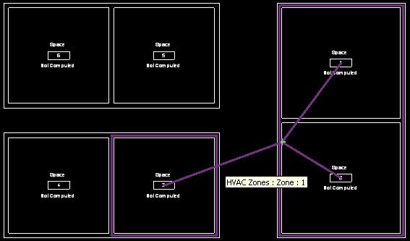
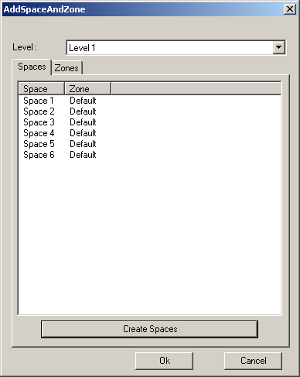
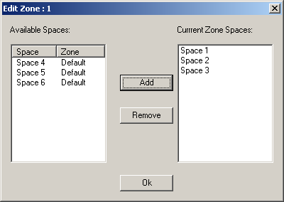
AddSpaceAndZone
Retrieve and list existing spaces and zones
Demonstrates use of an element filter
Create new spaces
For each closed wall loop or space separation
Demonstrates use of the NewSpaces method
Create a new zone element
Specified level and phase
Add and remove spaces in a zone
Use the AddSpaces and Remove methods

Slide 46
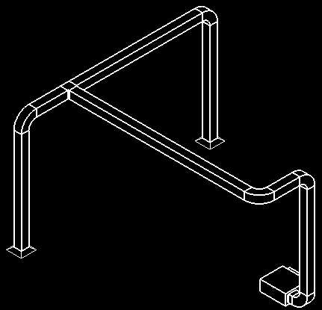
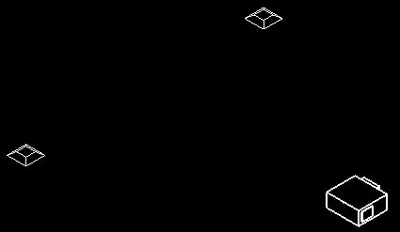
AutoRoute
Automatically create and route a set of ducts and fittings
Source is the air supply equipment
Sink is two air outlet terminals
Positions can be freely moved
Create a new mechanical system, ducts, fittings and connections
NewMechanicalSystem, NewDuct, NewElbowFitting, NewTeeFitting and Connector.ConnectTo
Determine the bounding box of all the three elements
Use the middle line or quarter lines on the X and Y axes
Uses.NET framework Trace class to create a log file

Slide 47
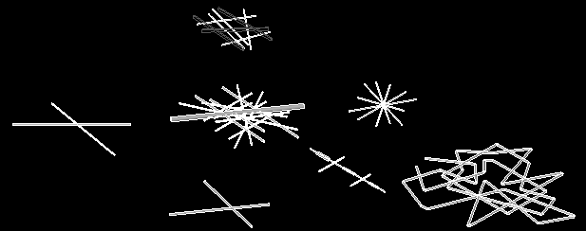

AvoidObstruction
Detect and resolve obstructions between ducts, pipes, and beams
FindReferencesWithContextByDirection ray casting intersection analysis
Split pipe into segments and insert elbows to reroute detour
Resolve collisions between pipes and beams, ducts, and other pipes

Slide 48
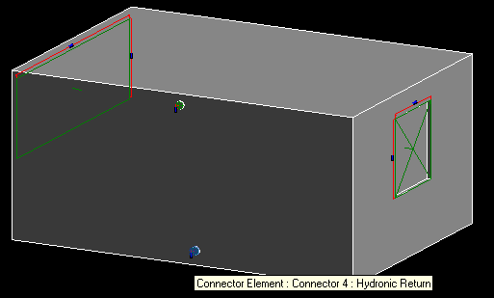
CreateAirHandler
Create an air handler with pipe and duct connectors
Check family category to verify valid mechanical equipment starting point
Use FamilyItemFactory class methods
NewExtrusion, NewPipeConnector, NewDuctConnector
Set proper connector parameters
Use Document.CombineElements to join the extrusions
Geometric shape creation is generic
Addition of the connectors is MEP specific
Runs in all flavours of Revit

Slide 49
EnergyAnalysisModel
Retrieve energy analysis detail model and present as tree view
Analytical thermal model generated from physical building model
Similar to Export to gbXML and Heating and Cooling Loads
Analytical thermal model is composed of spaces, zones, planar surfaces
Volumetric elements
Created and initialised by calling EnergyAnalysisDetailModel.Create()
Methods GetAnalyticalSpaces, Surfaces, Openings, ShadingSurfaces

Slide 50
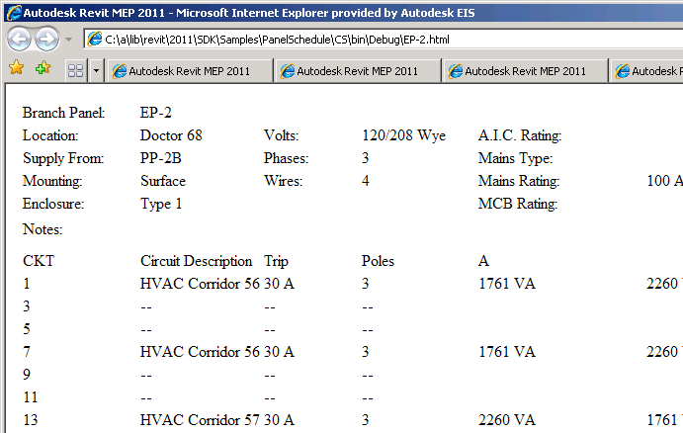
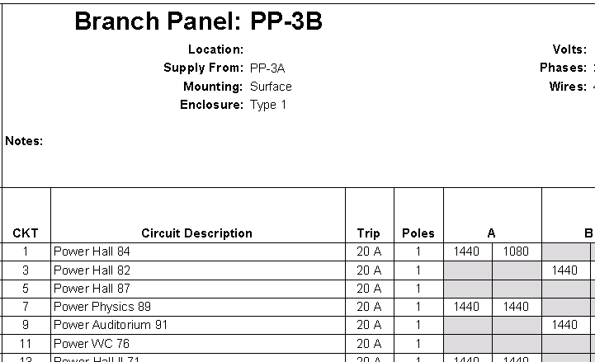
PanelSchedule
Data exchange sample showing use of the Panel Schedule API
PanelScheduleExport read + export panel schedule CSV or HTML
InstanceViewCreation create panel schedule view instance
SheetImport place all panel schedule views on a sheet
Notes:
PanelSchedule: shows how to use the Revit MEP Panel Schedule API:
1. PanelScheduleExport - gets the panel schedule view data via the API and generate a CSV file or a HTML page from it.
2. InstanceViewCreation - Create a panel schedule view instance for an electrical panel you selected.
3. SheetImport - Place the panel schedule view(s) on a sheet view.

Slide 51
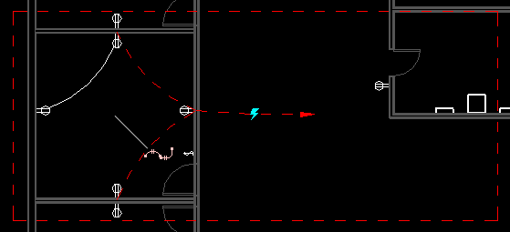


PowerCircuit
Operate power circuits, similar to legacy RME Circuit Editor toolbar
Show use of MEPModel and ElectricalSystem classes
Demonstrate handling interactive element selection
Implement toolbar user interface for external command
Use .NET ResourceManager class for image and string resources
Create a new power circuit with selected elements
Edit circuit and add and remove circuit elements
Select or disconnect a circuit panel

Slide 52
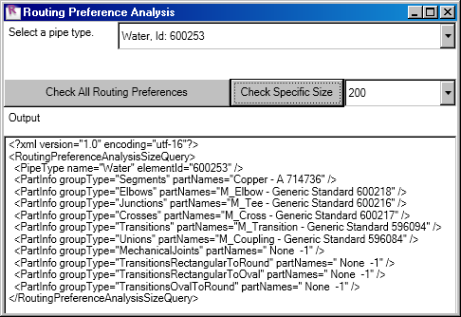
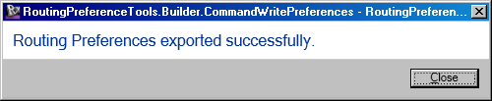
RoutingPreferenceTools
Routing preference analysis and reporting
Analyse routing preferences of a given pipe type
Check for common problems
Look at all rules and criteria for a given pipe type
Routing preference builder XML import and export
CommandReadPreferences and CommandWritePreferences
Set pipe type, fitting, and routing preferences in a project
Export for archival, documentation, and collaboration purposes
Enable users to work with RP data in a shareable XML format
Suitable for reuse in a wide variety of BIM management environments

Slide 53
TraverseSystem
Traverse a mechanical or piping system in the direction of flow
Check MechanicalSystem IsWellConnected property
Dump the traversal results into an XML file
Determine system
Query base equipment as starting point
Query connector manager for connected neighbour elements
Similar approach works for electrical as well, cf. AdnRme sample

Slide 54
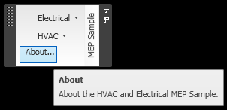
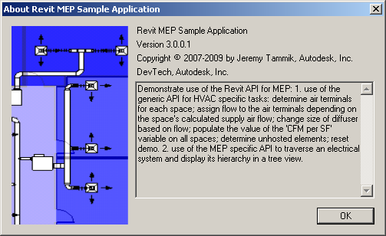

AdnRme Sample
Non-SDK sample, included in presentation material
HVAC air terminal analysis and sizing
Hierarchical display of an electrical system
Implements a ribbon panel, about box, and progress bar

Slide 55
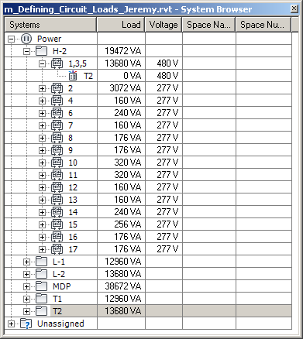
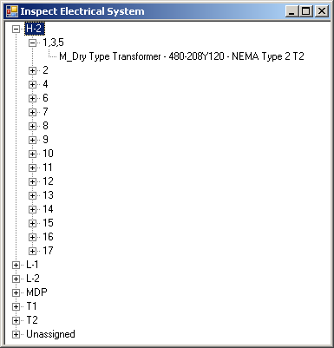
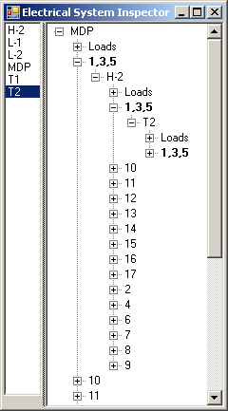
AdnRme Electrical Sample
Traverse the electrical system
Reproduce the system browser data structure in a tree view
Display the complete connection hierarchy in a tree view
CmdElectricalConnectors is similar to TraverseSystem SDK sample for ducts
Traversal is also possible using parameter data instead of connector manager, but harder

Slide 56
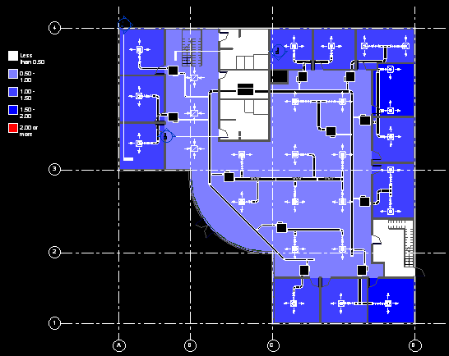
AdnRme HVAC Sample
HVAC Task
Place and size air ducts and terminals
Analysis and verification of results
Commands aligned with HVAC engineering workflow
Assign flow to terminals
Change air terminal size
Verify design by air flow per surface area
Reset demo
All modification uses generic parameter and type access
Changes are reflected by schedules and colour fill

Slide 57
Pipe to Conduit Converter
Two hundred lines of code
My First Revit 2011 Add-in
Illustrates all major Revit 2011 API renovations
Revit API assembly split
Namespace reorganisation
Command registration manifest
External command Execute method and attributes
Transaction mode
Regeneration option
Task dialogues for user messages
Interactive filtered element selection
Redesigned element filtering
New element creation paradigm
Access to pipe and conduit sizes

Slide 58
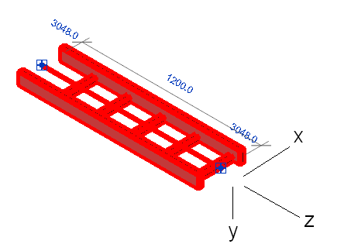
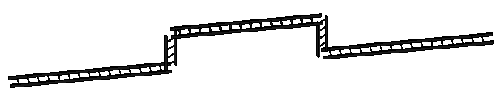
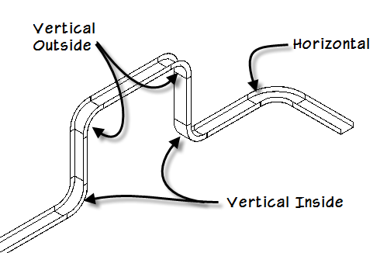
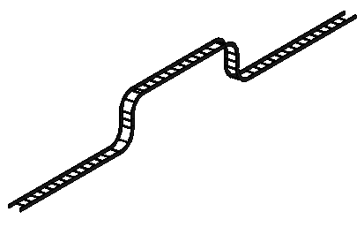
Cable Tray Fitting Creation and Layout
Inserting a cable tray is as easy as a conduit, cf. p2c
Inserting fittings requires exact alignment, i.e. proper orientation

Slide 59
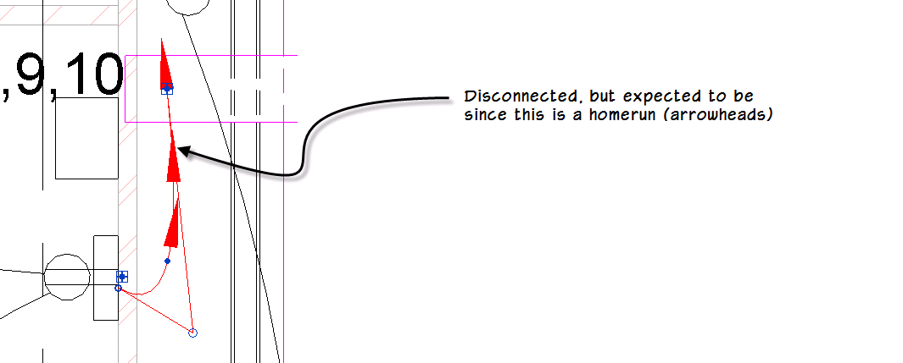
Modeless Loose Connector Navigator
Filter for all MEP connectors in project
Combine all relevant classes and family instance categories
Check IsConnected property on each connector
Unable to determine whether a wire is intended to be homerun
Log results to file and display it to user
Interactively navigate through results from a modeless dialogue
Ensure that modeless dialogue remains on top of Revit
Modeless navigation interacts with Idling event

Slide 60
MEP Placeholder Sample
Placeholder ducts and pipes
CreatePlaceholders and ConvertPlaceholders commands
Duct and pipe insulation and lining
InsulateDuctwork command
Read and write access to MEP pipe settings and sizes
GetPipeSettings command

Slide 61
Summary and Further Reading

Slide 62
Class Summary
Overview of the Revit MEP API
MEP API enhancements in Revit 2013
Working programmatically with Revit MEP models
Overview of available Revit MEP API samples

Slide 63
Materials
Blog posts
http://thebuildingcoder.typepad.com/mep
Autodesk University 2011 hand-out and sample code
CP4453_tammik_rme_api.pdf
CP4453_tammik_rme_api.zip
MEP placeholder sample – MepPlaceholders.zip
HVAC and electrical MEP sample code – AdnRme.zip
Modeless loose connector navigator – loose_connectors_11.zip
Cable tray sample – CableTray.zip

Slide 64
Learning More
Revit Developer Center: DevTV introduction, SDK, Samples, API Help
http://www.autodesk.com/developrevit
Developer Guide and Online Help
http://www.autodesk.com/revitapi-wikihelp
Public ADN Revit and Revit MEP API Webcasts, Trainings and Archives
http://www.adskconsulting.com/adn/cs/api_course_sched.php > Revit API
http://www.adskconsulting.com/adn/cs/api_course_webcast_archive.php > Revit API
Discussion Group
http://discussion.autodesk.com > Revit Architecture > Revit API
API Training Classes
http://www.autodesk.com/apitraining
ADN AEC DevBlog and The Building Coder Revit API Blog
http://adndevblog.typepad.com/AEC
http://thebuildingcoder.typepad.com
ADN, The Autodesk Developer Network
http://www.autodesk.com/joinadn
DevHelp Online for ADN members
http://adn.autodesk.com
Learning Autodesk Revit MEP 2012 video training
http://cad-notes.com/2011/12/learning-autodesk-revit-mep-2012-training-video-is-available

Slide 65

Autodesk, AutoCAD, Civil 3D, DWG, Green Building Studio, Navisworks, and Revit are registered trademarks or trademarks of Autodesk, Inc., and/or its subsidiaries and/or affiliates in the USA and/or other countries. All other brand names, product names, or trademarks belong to their respective holders. Autodesk reserves the right to alter product and services offerings, and specifications and pricing at any time without notice, and is not responsible for typographical or graphical errors that may appear in this document.
© 2012 Autodesk, Inc. All rights reserved.

