Slide 1

Revit 2013 API
Balaji Ramamoorthy
Jeremy Tammik
Notes:
Hello everybody. Welcome to the Revit 2013 API webcast.
This Revit API presentation addresses two main areas: an introduction to Revit programming for beginners, including a quick walkthrough of basic concepts, and an overview of the new functionality provided by the Revit 2013 API, which will be of interest to both beginners and experienced developers.

Slide 2
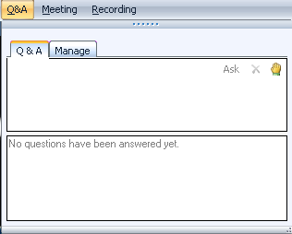

Before we start LiveMeeting and conference call – how to
Full Screen Mode
Real-time Q&A
Use Internet Audio
Mute phone *6
Expand to full screen mode
Press ESC to return
Notes:
This conference is muted, so you cannot hear anybody else than me talking, and cannot provide feedback through the phone conference. We will unmute it and open it up for general discussion and questions and answers at the end. Meanwhile, written questions can be entered in the live meeting console and will be answered in real-time during the presentation by my colleagues. Thank you very much for that support! Since I will be switching back and forth between these slides and live demonstrations in Revit and Visual Studio, I will set my computer to low resolution and full screen mode to reduce bandwidth and speed up the display. This means I will not see the live meeting console and the feedback panel. My colleagues will be monitoring the livemeeting console and also answering questions online. We will post the materials from this presentation together with the audio recording. We encourage you to use the live meeting internet audio facility, rather than the telephone conference call.

Slide 3

About the Presenter
Balaji Ramamoorthy
Developer Technical Services
APAC, Autodesk
Balaji is a member of the AEC and PTD workgroups within the Developer Technical Services (DevTech) team in Autodesk where he provides programming support and training to developers on the Revit and AutoCAD API.
Balaji holds a Masters degree in Machine Design from Indian Institute of Technology, Kharagpur, India.

Slide 4

About the Presenter
Introduction
Jeremy Tammik
Developer Technical Services
EMEA, Autodesk
Jeremy is a member of the AEC workgroup of the DevTech team, providing developer support, training, and conferences to the Autodesk Developer Network ADN. He originally joined Autodesk in 1988 as the technology evangelist responsible for European developer support. In this capacity, he wrote articles, consulted, lectured on AutoCAD application programming techniques, and supported AutoCAD application developers in Europe, the U.S., Australia, and Africa. He was a cofounder of ADGE, the AutoCAD Developer Group Europe, and a prolific author on AutoCAD application development. He left Autodesk in 1994 to work as an HVAC application developer, and then rejoined the company in 2005.
Jeremy graduated with a MA in mathematics and physics in Marburg, Germany, in 1984, and worked first as a teacher and translator of both computer and human languages, then as a C++ programmer on early GUI and multitasking projects. He is fluent in five European languages, vegetarian, has four kids, plays the flute, likes reading, travelling, theatre improvisation and carpentry, loves mountains, oceans, sports and especially climbing.

Slide 5
Agenda
Introduction
Getting Started and Hello World
Basics
Break
Revit 2013 News
AEC DevCamp and AEC DevBlog
Notes:
The first part covers the Revit SDK, documentation and samples, getting started, the basic structure and access to the Revit database, its elements, and their parameters.
The second part presents a summary of the DevDays Online recording and examines some new Revit 2013 API features in depth, including add-in integration features, the Idling and external events, Revit MEP and Structure API news and the new SDK samples.

Slide 6
Polls About You
1. What category best describes your main professional activity?
Architect, Engineer, Constructor, Programmer, Manager, Other
2. How would you rate your level of experience with the Revit products?
Very experienced, Quite experienced, Not experienced
3. How would you rate your level of experience with the Revit API?
Very experienced, Quite experienced, Not experienced
4. Which statement best describes you?
This topic directly affects my work today
I expect this topic to be useful to me in the future
I'm evaluating this technology
None of the above
Notes:
Thanks for participating in the poll.
The first half of this webcast will be an introduction to the Revit API and provide information on where to find resources to learn more about the Revit API.

Slide 7
Revit Products
Introduction
Four flavours of Revit
Revit Architecture
Revit MEP: Mechanical, Electrical, Plumbing
Revit Structure
Revit – OneBox version
(Part of the Autodesk Building Design Suite - Premium and Ultimate)
Product build and distribution
DVD version posted to ADN member web site
Software & Support > Autodesk Revit or Autodesk Building Design Suite > Downloads
Posted once only
Web version and Web Update version on Autodesk home page
Autodesk home page > Support > Service Packs & Downloads or
Autodesk home page > Revit Products >> Product Trial
Latest download version from the public product site
Notes:
Revit 2013 has now combined Revit Architecture, MEP and Structure which we term as “Revit Onebox”.
Revit Onebox is part of the Autodesk Building Design Suite (Premium and Ultimate) and not in the Standard edition.
ADN partners can download it from the ADN member website under “Software & Support > Autodesk Building Design Suite > Downloads”
The posting is only done once at the time of FCS.
The latest version can be downloaded from the public link from the Autodesk home page under “Products > Building Design > Product Download
“

Slide 8
Revit 2013 SDK
Introduction
RevitAPI.dll and RevitAPIUI.dll are present in every Revit installation
The SDK is provided with the product
From Installer under 'Install Tools and Utilities'
From the extraction of RTM download version <extraction folder>\Utilities\SDK\Revit2013SDK.exe
Ex:
C:\Autodesk\Autodesk_Revit_2013_English_Win_32-64bit\Utilities\SDK\RevitSDK.exe
Please download latest update from Developer Center
http://www.autodesk.com/developrevit
Notes:
The Revit SDK is basically purely for support and documentation purposes. All you actually need to develop a Revit add-in is the development environment and the RevitAPI dlls, nothing else. The SDK install is located under the 'Install Tools and Utilities' menu on the main page of the Revit installer. Alternatively, you can also find the SDK in the extraction folder, under:
<extraction folder>\Utilities\SDK\RevitSDK.exe

Slide 9
Revit 2013 SDK Documentation
Introduction
Read Me First.doc
Getting Started with the Revit API.doc
Revit Platform API Changes and Additions.doc
RevitAPI.chm
Add-In Manager
Samples
SamplesReadMe.htm
SDKSamples2013.sln
Revit API Developer Guide moved to the Autodesk Wiki Help
http://wikihelp.autodesk.com/Revit/enu/2013
Notes:
Here are the top level contents of the SDK. The RevitAPI.chm help file includes a What's New section. This information is duplicated in the Changes and Additions document. The Developer Guide is very comprehensive. The Revit SDK samples provide a huge knowledgebase on how to address specific programming tasks using the Revit API. The API documentation in the help file lists all the classes and their methods and properties, and the developer guide and samples explain and demonstrate how they work together to solve specific tasks.

Slide 10
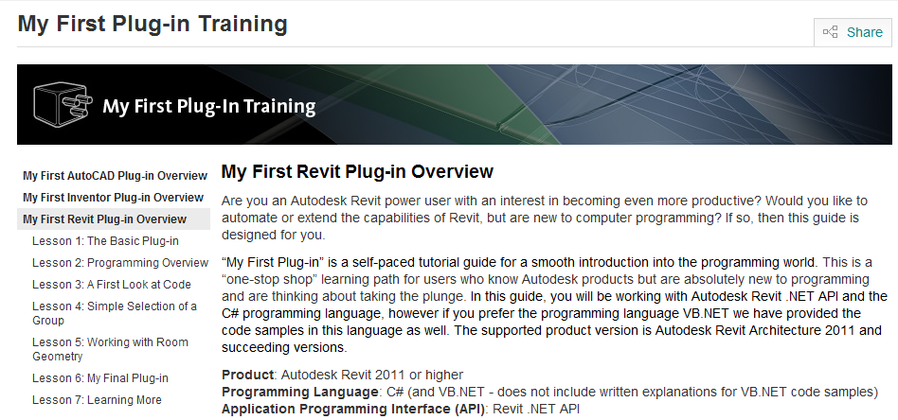
My First Plugin
Introduction
http://www.autodesk.com/myfirstrevitplugin
A self-paced tutorial and assumes no programming knowledge.
7 lessons to get you started with Revit programming
Video and lessons can be downloaded
Notes:
My First Plug-in” is a self-paced tutorial available for download at the Revit Developer Center.
This is useful for users who are new to programming and will help them to get started with Revit programming. It assumes no previous programming knowledge.
It consists of 7 lessons and you can choose either VB .Net or C#.

Slide 11
More resources
Introduction
Revit 2013 API Labs
Revit training material for self-paced learning
http://www.autodesk.com/developrevit
DevTV and Webcast recordings
Revit API Webcast archive
Revit SDK Samples folder
Large number of sample projects on different topics
Look at “[SDK Folder]\Samples\SamplesContent.htm”
Jeremy Tammik’s blog on Revit API
http://thebuildingcoder.typepad.com
Notes:
We have a series of labs that are designed to cover topics starting from Introduction to an intermediate level in Revit programming. This is available for download at the Revit Developer Center.
To download a recorded DevTV or a webcast, visit our Revit API webcast archive. The DevTV and webcasts cover specific topics related to the Revit programming.
The Revit SDK comes with a lot of samples that are updated in every release of the SDK. Using the “SamplesContent.htm” you can find the samples grouped under categories such as “Beginner”, “Intermediate” and “Advanced”
Thebuildingcoder blog – This is Jeremy Tammik’s blog on RevitAPI that is a collection of posts that provide in-depth explanation of topics related to the Revit API.

Slide 12
Getting Started
First Steps up to Hello World
Notes:
That concludes the introduction. Now let us start looking at real development issues and take our first steps up to a simple “Hello World” example. The accompanying labs demonstrate the concepts discussed. They can also be used for self-learning, and as a reference to answer the most common Revit API beginner’s questions. The code that I am using during this demonstration is a subset of the labs that are available for download from the Revit Developer Center.

Slide 13
Extending Revit
Getting Started
1. External command
Implement IExternalCommand
Commands are added to the External Tools pulldown in the ribbon Add-Ins tab
Add-Ins > External Tools
Listed in a add-in manifest file
2. External application
Implement IExternalApplication
Applications can create new panels in the ribbon Add-Ins tab
External applications make use of external commands, so 1. is a subset of 2.
Listed in a add-in manifest file
3. Macro
[SDK Folder]\SDK\Macro Samples
Macro environment changed from VSTA Macros to SharpDevelop
WikiHelp > Revit Help > Customize Revit > Automating Tasks with Macros > “Upgrading Revit Macros”
http://thebuildingcode.typepad.com/blog/2012/04/migrating-vsta-macros-to-sharpdevelop.html
Notes:
We have two flavours of Revit add-in, the external command and the external application. An external application can define a user interface by creating its own panel in the ribbon add-ins tab. Within the panel, widgets are defined which are hooked up with external commands implementing the application functionality. An external command listed in add-in manifest file is always added to the add-ins tab under the External Tools pulldown. You can also extend Revit by implementing macros using SharpDevelop. This is a replacement for the VSTA macros that we had until the last release. For samples on SharpDevelop, please refer to the examples under the “Macro Samples” folder in the SDK. If you have existing VSTA macros then the link provided here will help you in migrating them to SharpDevelop.

Slide 14
Revit API DLLs
Getting Started
.NET API
Microsoft Visual Studio 2010
Microsoft .NET Framework 4.0
Reference "[Revit Install folder]\Program\RevitAPI.dll“
Reference "[Revit Install folder]\Program\RevitAPIUI.dll“
Remember to set 'Copy Local' to False
C# or VB.NET, managed C++, any .NET compliant language
Revit, Revit Architecture, Structure and MEP flavours
Same API DLL
Certain functionality only works in Architecture, MEP or Structure
Notes:
The Autodesk Revit 2013 API requires the Microsoft .NET Framework v4.0. For examples of flavour specific API functionality, room-related functionality is available in RAC only, the analytical model only in RST, systems only in RME.

Slide 15
External Command
Getting Started
Implement Autodesk.Revit.IExternalCommand interface
Implement IExternalCommand.Execute method
[Transaction(TransactionMode.Manual)]
[Regeneration(RegenerationOption.Manual)]
public class Command : IExternalCommand
{
public Result Execute(
ExternalCommandData commandData,
ref string message,
ElementSet elements
)
{
try
{
// Use transaction to perform DB changes...
return IExternalCommand.Result.Succeeded;
//return IExternalCommand.Result.Canceled;
}
catch( System.Exception ex )
{
message = ex.ToString();
return IExternalCommand.Result.Failed;
}
}
}
Notes:
Each command is implemented in an own class. The class implements the IExternalCommand. It implements the method Execute(). This method is called when the command is invoked. It takes one input and two output parameters and returns a result that signals success, cancel or failure.
The input argument is an ExternalCommandData instance, which gives the application its access to the Revit application and documents and so on, as we will see further on.
The two return arguments are only used in case the method returns a failure code (either Failed or Canceled), in which case the string message is displayed to the user in a standard Revit error message dialog, and the ElementSet elements are highlighted, to enable the application to show the user which objects may be causing a problem.

Slide 16
Add-in Manifest for External Command
Getting Started
<?xml version="1.0" encoding="utf-8"?>
<RevitAddIns>
<AddIn Type="Command">
<Text>Hello World</Text> <FullClassName>IntroCs.HelloWorld</FullClassName>
<Assembly>IntroCs.dll</Assembly>
<AddInId>
8d4aebdc-43f2-4b6e-98df-3afd3f2001c7
</AddInId>
<VendorId>ADNP</VendorId>
<VendorDescription>
Autodesk, Inc. www.autodesk.com
</VendorDescription>
</AddIn>
</RevitAddIns>
Create add-in manifest file and place it in
%appdata%\Autodesk\Revit\Addins\2013 or
%programdata%\Autodesk\Revit\Addins\2013
Notes:
Once we have created the application and/or command assemblies, we need to make them known to Revit. This is achieved by creating a add-in manifest file and placing it in “%appdata%\Autodesk\Revit\Addins\2013” folder. An external command appears in the add-ins tab -> External Tools pulldown if listed. It can also be accessed through an external application, with no such entry, or both.
The add-in assembly path can be omitted in the manifest if the dll is placed in the add-ins folder together with the manifest.
For simple add-ins, this the recommended location. For more complex add-ins, a location in a subdirectory of the revit.exe is recommended.

Slide 17
External Application
Getting Started
Implement Autodesk.Revit.UI.IExternalApplication interface
Implement OnStartup() and OnShutdown() methods
public class HelloWorldApp : IExternalApplication
{
// OnStartup() - called when Revit starts.
public Result OnStartup (UIControlledApplication app)
{
// Create panel in add-in tab
return Result.Succeeded;
}
// OnShutdown() - called when Revit ends.
public Result OnShutdown (UIControlledApplication app)
{
return Result.Succeeded;
}
}
Example: SDK Ribbon sample
Notes:
An external application also appear in the add-ins tab. It can create its own panels in the add-in tab. The objects are hooked up with external command implementations which are invoked and receive the same input and output parameters as normal external commands added to the external tools pulldown.

Slide 18
Add-in Manifest for External Application
Getting Started
<?xml version="1.0" encoding="utf-8"?>
<RevitAddIns>
<AddIn Type=“Application">
<Name>Hello World App</Name>
<FullClassName>IntroCs.HelloWorld</FullClassName>
<Assembly>IntroCs.dll</Assembly>
<AddInId>
4d4aebdc-43f2-4b6e-98df-3afd3f2001c7
</AddInId>
<VendorId>ADNP</VendorId>
<VendorDescription>
Autodesk, Inc. www.autodesk.com
</VendorDescription>
</AddIn>
</RevitAddIns>
Create add-in manifest file and place it in
%appdata%\Autodesk\Revit\Addins\2013 or
%programdata%\Autodesk\Revit\Addins\2013
Notes:
Once we have created the application, we need to make it known to Revit. This is achieved by creating a add-in manifest file and placing it in “%appdata%\Autodesk\Revit\Addins\2013” folder. For an external application, the “Addin Type” is now “Application”.

Slide 19
Getting Started
Getting Started
External command: HelloWorld
External applications: HelloWorldApp
"Hello World" basic sample
What arguments are passed to the command?
What can the command return?
Demo
Notes:
Now we are ready for our “Hello World” demonstration. Here are some labs for getting started. Lab 1-1 demonstrates a minimal “Hello World” command. Lab 1-2 explores the command argument issues.

Slide 20
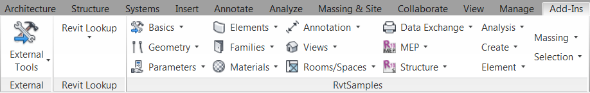
RvtSamples
Getting Started
So every sample command requires an explicit add-in manifest?
Use the RvtSamples SDK sample application
Includes RvtSamples.txt listing for all SDK samples
Adds them all to an own menu entry
Install “RvtSamples.addin” and never touch it again
You can add your own entries to RvtSamples.txt
Also define own pull-down buttons for additional sections
Notes:
The RvtSamples application and RvtSamples.txt is included in the Revit SDK ... show contents on screen in explorer ... so, SDKSamples2013.sln provides accesss to search and debug all sample source code, and RvtSamples enables running every single sample.
This can also be used for any external command that you develop. Without having to create a separate add-in manifest, all you will need is a change to the RvtSamples.txt. You external command can then be made to appear in a pulldown in the RvtSamples ribbon panel

Slide 21
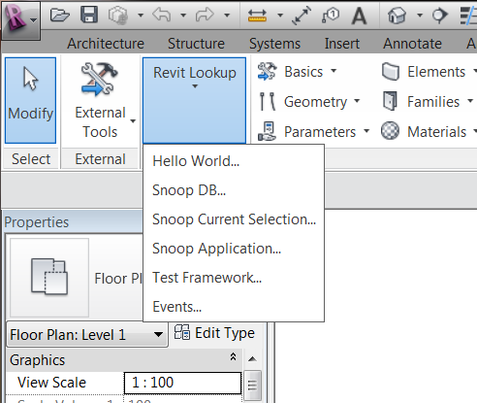
RevitLookup
Getting Started
Included in the Revit SDK
Interactively access and explore entire database structure
Elements, parameters, relationships
Comprehensive Revit API test
Sample code and utility classes
Scaffolding for quick tests
Refer RevitLookup.doc
Explore
Document
Current selection
Application
Tests
Events
Notes:
RevitLookup is a utility similar to the well-known ArxDbg and MgdDbg utilities provided for AutoCAD. It is a Revit extension application which defines its own ribbon panel. It is included in the Revit SDK.
The Revit Lookup is very useful for exploring the Revit database contents and events.

Slide 22
Database and Elements
Analyse the contents of the Revit database
Iterate and filter for specific elements
Notes:
Now that we understand how to create the bare bones of our add-in and how it sets up its initial communication with the Revit application, let us understand some basics of the Revit database and then explore the contents of the Revit database using Revit Lookup tool.

Slide 23
Subsubset of Object Model
Database and Elements
Element
Family Base
Instance
ElementType
HostObject
Family
Family Instance
Insertable Object
HostObj Attributes
Group Type
Wall
CeilingAndFloor
Family Symbol
Floor
ContFooting
Wall Type
Floor Type
Cont. Footing Type
RoofBase
Families and types, aka symbols
Host and component objects, standard and system
Notes:
Here is a smaller subset of the most important database classes, i.e. non-geometrical classes, that appear in a typical Revit model programming task. The red classes are the most commonly used. In the model, we see the host and component objects, such as wall and floor. These are actually instances of types. The family base and family are used to manage collections of related types. ElementType is a base class for all types, also known as symbols. Family symbol is the generic class for these, whereas wall and floor type are more specialised classes. Family instance represents an occurrence or usage instance of a generic family symbol, whereas wall and floor represent the same for a wall or floor type.

Slide 24
Accessing Current Revit Element Selection
Database and Elements
Use input argument ExternalCommandData
Current selection is member of UIDocument class
ExternalCommandData.Application.ActiveUIDocument.Selection.Elements
UIDocument.Selection.Elements returns SelElementSet collection
Use foreach, Size, Contains
Selection sel = uiDoc.Selection;
string s = "There are " + sel.Elements.Size + " elements";
foreach( Element e in sel.Elements )
{
string cat = (null == e.Category) ? e.GetType().Name : e.Category.Name;
string desc = cat + " Id=" + e.Id.IntegerValue.ToString();
}
Application
ActiveUIDocument
Selection
Elements
Notes:
Here we look at accessing the selected elements.
So, how do we access the selected objects? We start off with the external command data argument passed in to the external command.
The selection set of elements is a member of the UIDocument which can be iterated to access the selected elements.

Slide 25
Identifying Revit Elements
Database and Elements
Normal OO approach uses object type or class
In Revit API, an object can be identified by
Object type or class, i.e. .NET System.Type
Category
Specific parameter values
We use a combination of different criteria
Sometimes additional checks are needed
Many combinations can be encoded into the filtering mechanism which executes efficiently
Notes:
The identification of elements and determining what type they have, or iterating the entire building model and extracting the specific instances that we are interested in, depends on the objects type. In some cases, we use standard object oriented techniques, simply querying their type or class. In others, we use the object category, which is a Revit API element property. Sometimes, a combination of the two is used, or additional parameters are queried.

Slide 26
Accessing Revit Database Elements
Database and Elements
Access to all or filtered elements using FilteredElementCollector
Filtered
FilteredElementCollector.WherePasses(ElementFilter)
Specified type
FilteredElementCollector.OfClass(Type)
All
Rarely required
FilteredElementCollector collector1 = new FilteredElementCollector(doc);
collector1.WhereElementIsElementType();
FilteredElementCollector collector2 = new FilteredElementCollector(doc);
collector2.WhereElementIsNotElementType();
collector1.UnionWith(collector2);
foreach (Element e in collector1)
{
}
IList<Element> elements = collector1.ToElements();
Notes:
The FilteredElementCollector is used to access the elements. In most cases, you would need to access elements based on a certain criteria. For example, elements with a certain parameter value. In such cases, an element filter (ElementParameterFilter) can be created and used with the “WherePasses” method.
The “OfClass” method can help while filtering elements based on the type of the element. For example, to access all elements of the wall type, we could simply create a filtered element collector and use the OfClass method and pass-in the typeof wall.
Accessing all the elements in the Revit model is seldom required. But here is how to get it if you need it.
The trick here is to use the filtered element collector and populate it based on a certain criteria and union the results with another filtered element collector that is populated based on NOT fulfilling the same criteria.
For example, here we have created a FilteredElementCollector that gets all the elements that are of “ElementType” and union it with all elements that are NOT of “ElementType”.

Slide 27
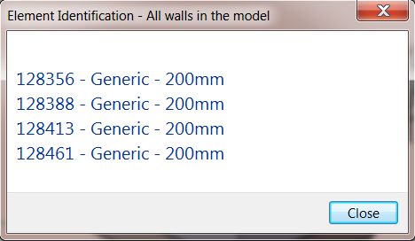
Get all Walls
Database and Elements
public static IList<Element> GetAllWalls(Document doc)
{
FilteredElementCollector wallTypeCollector = new FilteredElementCollector(doc);
wallTypeCollector = wallTypeCollector.OfClass(typeof(Wall));
// We now have the list of walls
IList<Element> walls = wallTypeCollector.ToElements();
return walls;
}

Slide 28
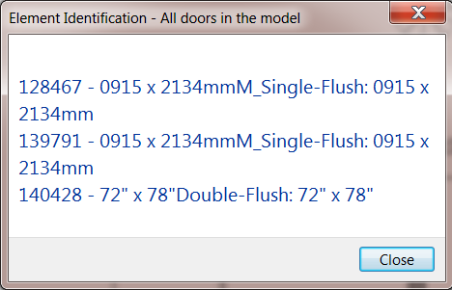
Get all Doors
Database and Elements
public static IList<Element> GetAllDoors(Document doc)
{
FilteredElementCollector collector = new FilteredElementCollector(doc);
collector = collector.OfClass(typeof(FamilyInstance));
collector = collector.OfCategory(BuiltInCategory.OST_Doors);
// We now have the list of doors
IList<Element> doors = collector.ToElements();
return doors;
}
Demo

Slide 29
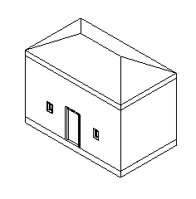
Creating Elements
Database and Elements
Adding
Methods defined by Autodesk.Revit.Creation.Document
Ex : Creation of a floor
NewSlab( CurveArray profile, Level, Line slopedArrow, double slope, bool isStructural );
For Wall creation, use its static methods
Wall.Create( CurveArray profile, bool structural ); // + 4 overloads
Deleting
Revit SDK Samples - DeleteDimensions, DeleteObject
Demo

Slide 30
Element manipulation
Database and Elements
e.g., Rotate a wall
Wall aWall = e as Wall;
LocationCurve wallLocation = (LocationCurve)aWall.Location;
XYZ pt1 = wallLocation.Curve.get_EndPoint(0);
XYZ pt2 = wallLocation.Curve.get_EndPoint(1);
XYZ axisPt1 = pt1;
XYZ axisPt2 = new XYZ(pt1.X, pt1.Y, pt1.Z + 10.0);
// Create a new line bound for rotational axis.
Line axis = app.Create.NewLineBound(axisPt1, axisPt2);
// Finally change the curve.
wallLocation.Rotate(axis, Math.PI / 2.0);
doc.Regenerate();
Wall aWall = e as Wall;
Line axis = app.Create.NewLine(axisPnt1, axisPnt2, true);
ElementTransformUtils.RotateElement(doc, e.Id, axis, Math.PI / 2.0);
doc.Regenerate();
Demo

Slide 31
Parameters
Built-In and Shared parameters,
Built-In Parameter Snoop
Notes:
The main data container on every Revit building element is its collection of parameters. This section explores the Revit database parameters and how they are associated with Revit database elements.

Slide 32
Built-in Vs Shared Parameters
Parameters
Built-in parameters can be accessed and edited for each element
Each parameter has its own name, storage type and value
Shared parameters are external text files containing parameter specification
useful for storing additional information on elements
Fire Rating SDK sample deals with shared parameters.
[SDK Folder]\SDK\Samples\FireRating

Slide 33
Accessing Parameters
Parameters
How do we access element parameters?
Loop through Element.Parameters
If name, built-in parameter enum, definition or GUID is known, get it directly
Parameter(BuiltInParameter) – Retrieve parameter given a parameter id
Parameter param = e.get_Parameter(BuiltInParameter.ALL_MODEL_INSTANCE_COMMENTS);
Parameter(String) – Retrieve parameter from parameter name
param = e.get_Parameter("Mark");
Less commonly used methods :
Parameter(Definition) – Retrieve parameter based on its definition
Parameter(Guid) – Retrieve parameter given a shared parameter GUID
Notes:
Built-In parameters can be accessed and edited for each element. Individual parameters can be accessed in different ways: by localised name, by built-in parameter id, by definition or by GUID. You can also loop over the entire Parameters collection of an element.

Slide 34
Element Parameters Collection is Incomplete
Parameters
Most elements have more parameters than those listed in the Parameters collection
One way to find more is to attempt to retrieve a parameter for each one of the built-in parameters enum values
This is implemented by the BuiltInParamsChecker and also by Revit Lookup 'Built-in Enums Snoop...‘
For instance, every family instance has a Room property represented by the ELEM_ROOM_ID built-in parameter, which is not listed in the Parameters collection on a door element

Slide 35
Shared Parameters
Parameters
Use shared parameters to add per-element data to Revit elements
Export and import these parameters to and from third party applications
The SDK Sample “FireRating” demonstrates Shared Parameters
Creation of shared parameter
Export shared parameter data to Microsoft Excel
Import shared parameter data from Microsoft Excel

Slide 36
Create Shared Parameter
Parameters
Get shared parameters definition file
Class Parameters.DefinitionFile
Application.Options.SharedParametersFilename
Application.OpenSharedParameterFile
Get shared parameters group
Class Autodesk.Revit.Parameters.DefinitionGroup
DefinitionFile.Groups
DefinitionFile.Groups.Create
Get shared parameters definition
Class Parameters.Definition
DefinitionGroup.Definitions
DefinitionGroup.Definitions.Create
Create category set for binding to 'Doors‘
CategorySet = revitApp.Create.NewCategorySet()
catSet.Insert( doc.Settings.Categories.Item( BuiltInCategory.OST_Doors ) )
Bind the parameter
Dim binding As Parameters.Binding = revitApp.Create.NewInstanceBinding( catSet )
doc.ParameterBindings.Insert( fireRatingParamDef, binding )
Demo

Slide 37
Advanced Data Storage: Extensible Storage
Parameters
Need for more complex data storage capabilities?
Extensible Storage available since Revit 2012
Examples
ExtensibleStorageManager SDK sample
Jeremy Tammik’s AU 2011 class Extensible Storage in the Autodesk Revit 2012 API
Notes:
Extensible Storage is an advanced topic. I’m not going into detail here. But I mention as a topic related to the shared parameter.

Slide 38

We will continue after a 5 minute break

Slide 39
Revit 2013 New API Features
New feature overview and DevDays Online recording
Add-in integration features in depth, Idling and external events
Analysis, simulation, MEP and Structure
New SDK samples
More News

Slide 40
Product Focus
Construction, fabrication and engineering process
Parts and assemblies, precast elements, reinforcement detailing, point clouds, MEP piping system routing
Platform scalability
Revit Server
Countrification
Stair and railing elements, MEP centerlines, IFC API
Interoperability
Revit One Box, runtime discipline switch, translation fidelity, Inventor interoperabilit, add-in integration, view and visualization APIs
Analysis and simulation
New physical properties, structural analysis and code checking, analysis visualization, analytical volumes, MEP properties and calculation functionality
Notes:
The first two items are continuations of projects started in previous releases. The countrification, modelling, analysis and simulation enhancements are infinite on-going projects. Interoperability is an important focus across the entire Autodesk product line. The enhanced add-in integration adresses a large number of long standing wish list items.

Slide 41
New API Feature Overview
Integration
Discipline control, contextual help, keyboard shortcuts, quick access toolbar, replace commands, embed view, drag and drop, custom Options dialogue extensions, progress bar events, view creation and access, access to rendering settings schedule API, DataStorage element, external event framework
Modelling
Stairs and railings, new construction modeling and assembly functionality, ceiling element, filled regions
Interoperability
More generic IFC toolkit, IFC exporter open source, ability to create Revit links, document and worksharing changes, detaching from central, BasicFileInfo class, dimension pre- and suffixes
Analysis and simulation
MEP and Structure
Notes:
Here are some of the ways the numerous goals listed in the previous slide express themselves in API enhancements. Many aspects are directly demonstrated by new SDK samples.

Slide 42
DevDays Online Recording
World-wide conference tour
What's New in the Revit 2013 API recording
http://www.adskconsulting.com/adn/cs/api_course_webcast_archive.php
http://download.autodesk.com/media/adn/DevDaysOnline-Revit2013API.zip
http://adn.autodesk.com/adn/servlet/item?siteID=4814862&id=19231929&linkID=4901650
Notes:
All the enhancements listed above are discussed and demonstrated in much greater detail in the DevDays Online recording of the world-wide DevDays conference presentations on the Revit 2013 API. The recording includes demos of several of the new SDK samples, showing their usage from the UI, without looking into the details fo the source code.
The following samples are presented: Stairs and railings, Schedule API sample, MEP routing preferences, UIAPI SDK sample with contextual F1 help, WPF preview control, drag and drop, customisation of the Options dialogue, IFC command override, switching button availability based on discipline.

Slide 43
Analysis, Simulation and Revit MEP API News
Routing preferences: pipe sizes, materials, fitting types
RoutingPreferenceTools SDK sample
Pipe and duct friction factors
MEPSection base class for duct and pipe sections
Viscosity and density, FluidType and FluidTemperature classes
Access to panel schedule spare circuit values
More LabelUtils access to localized user-visible display strings
ConnectorProfileType and PartType enumeration changes
ConnectorElement changes and new static creation methods
ThermalProperties, thermal material assets, gbXML thermal information
AVF support for deformed shapes
New external services framework
New Light and Light Group API
ReferenceIntersector class
Notes:
Let's look at some of the topics going beyond the recorded DevDays Online presentation, starting with some of the new analysis and simulation features.
In Revit MEP 2012, you can only define one single default elbow, tee, etc., which is rather limiting. In Autodesk Revit 2013 software, numerous different setting for different materials and sizes are supported. One of the major MEP API additions provides access to the routing preferences, as demonstrated by the new Routing Preference Analysis SDK sample. Other enhancements enable programmatic selection of pipe sizes, materials, fitting types, calculation of pipe and duct friction factors, better handling of duct and pipe sections with the new MEPSection base class, handling of viscosity and density at specified temperatures, read and write access to spare circuit values, and retrieval of the localized user-visible display strings for enumeration values.
New physical properties include a new class ThermalProperties, an additional structural material element, structural and thermal material assets that can be shared, and the ability to indicate if thermal information is included in the gbXML export.
The structural analytical model includes a new AnalyticalLink element type that can be user defined or automatically generated between two analytical elements and access to link properties like "fixity state".
The Analysis Visualization Framework AVF now better supports the structural analysis workflow, e.g. by including support for deformed shapes.
A Light and Light Group API provides new classes to get and set photometric data, including initial color and intensity, loss factor, color filter and dimming color.
The new ReferenceIntersector class mentioned above provides simplified and more performant ray-cast selection of elements using a given point and direction, similar to the existing FindReferencesWithContextByDirection method, with additional support for filtering the output, e.g. to collect elements, meshes, edges, curves, and faces.

Slide 44
Revit Structure API News
New Rebar members
New class ReinforcementSettings
AreaReinforcement and PathReinforcement now have types
New element type AnalyticalLink
Created between two analytical elements, e.g. a beam and a column
Two kinds of links, user defined and automatically generated
Properties like "fixity state" can be accessed via the API
Rebar.GetCenterlineCurves changes improve control
Adjustment for self-intersection, hooks, bend radius curves (fillets)
Rebar member changes
New RebarInSystem element replaces obsolete BarDescription
Access to individual rebars in a system
Welded wire mesh and fabric sheet elements
Notes:
The structural analytical model includes a new AnalyticalLink element type that can be user defined or automatically generated between two analytical elements and access to link properties like "fixity state".
Reinforcement systems have been enhanced to support adding and removing individual subcomponents. A new class RebarInSystem represents an individual bar in a system. System members and curve boundaries are accessible, and system bars can be converted back and forth between the system and standard rebar. Welded wire mesh and fabric sheet elements have been added.

Slide 45
Enhanced Add-In Integration
Discipline controls: control active discipline and command availability
Task dialogue, status bar, quick access toolbar, ribbon tabs and panels
Contextual help menu
Keyboard shortcuts
Replacing Revit commands with custom commands
WPF components
Options dialogue custom extensions
Subscribe to Revit progress bar notifications
Embedding and controlling a Revit view in a form
Drag and drop API
Notes:
The new add-in integration features are important and address a number of long-standing developer wishes. Let's take a more detailed look at some of them.

Slide 46
Idling Frequency
Interaction with modeless dialogue or asynchronous process
Control of Idling event repetition
Default mode: raise one event per idle session
Non-default mode: keeps idling session open and make repeated calls
Previously only option, now you must call SetRaiseWithoutDelay
Idling event with no active document
ModelessForm_IdlingEvent SDK sample
Notes:
Integration with external asynchronous processes and modeless dialogues was enabled by the Idling event and caused a lot of confusion about its correct usage. The Idling event has been anhanced to address some iddues, and a new simpler external event framework introduced to significantly simplify things.

Slide 47
External Events
Wrapper around the the Idling event, simplified interface
Implement event handler derived from IExternalEventHandler
Implement Execute and GetName methods
Instantiate event itself via ExternalEvent.Create
Asynchronous process calls event.Raise
RequestHandler handler = new RequestHandler();
ExternalEvent event = ExternalEvent.Create( handler );
form = new ModelessForm( event, handler );
form.Show();
. . .
event.Raise();
ModelessForm_ExternalEvent SDK sample

Slide 48
Revit 2013 SDK Samples
DisableCommand
ModelessForm_IdlingEvent ModelessForm_ExternalEvent
ModelessDialog
ProgressNotifier
Events
RoutingPreferenceTools
ScheduleCreation
StairsAutomation
UIAPI
WorkThread
MultiThreading

Slide 49
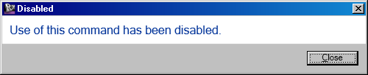
DisableCommand
External application, not a command
Disables a built-in Revit command: Design Options
Replaces implementation with a popup message
RevitCommandId is found to match the journal name of the command
AddInCommandBinding is created for this command id
Alternate implementation is provided for the command binding

Slide 50
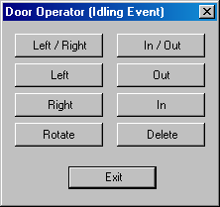
ModelessForm_ExternalEvent and IdlingEvent
Show how to interact with a modeless form
External application to handle events
External command to display modeless form
Uses System.Threading.Interlocked
Atomic operations for variables shared by multiple threads
In Revit 2012: use the Idling event
Arnošt Löbel's Autodesk University 2011 class CP5381 on asynchronous interactions and managing modeless UI
In Revit 2013: new external event interface
Run either in a simple model with a couple of walls and doors

Slide 51
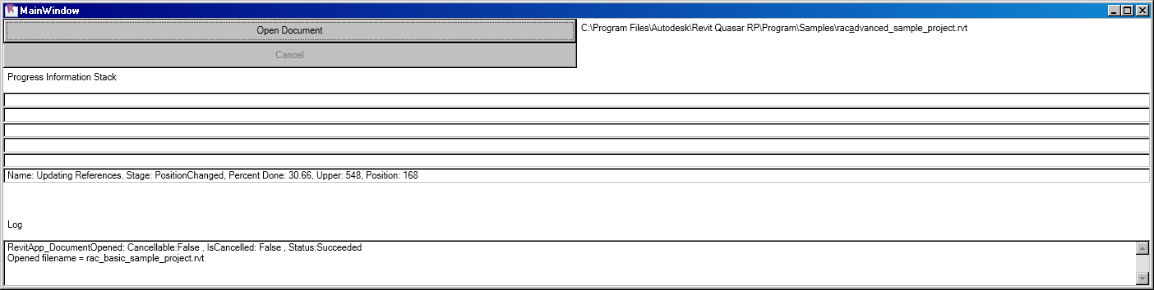
ProgressNotifier
Display progress information in a stack data structure
Subscribe to the ProgressNotify related events
Access properties in the event handler arguments
Organize the subtransaction progress information into a stack

Slide 52
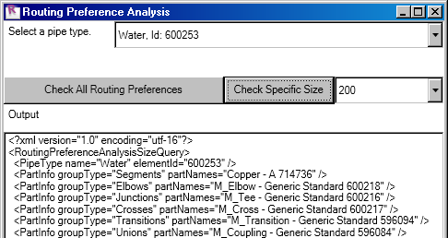
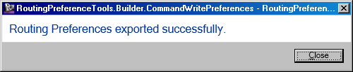
RoutingPreferenceTools
Routing preference analysis and reporting
Analyse routing preferences of a given pipe type
Check for common problems
Look at all rules and criteria for a given pipe type
Routing preference builder XML import and export
CommandReadPreferences and CommandWritePreferences
Set pipe type, fitting, and routing preferences in a project
Export for archival, documentation, and collaboration purposes
Enable users to work with RP data in a shareable XML format
Suitable for reuse in a wide variety of BIM management environments

Slide 53
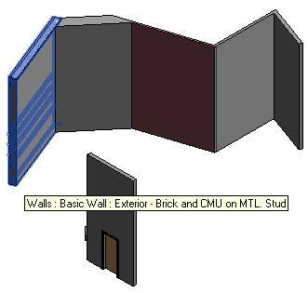
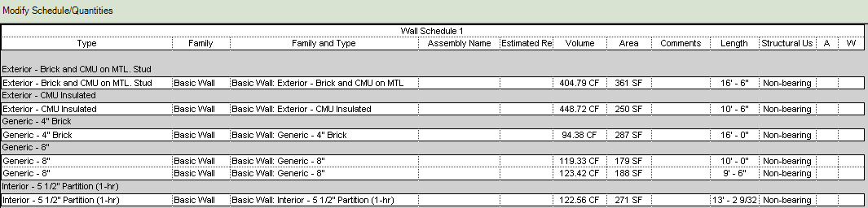
ScheduleCreation
Create a wall category view schedule and display on sheet
Create an empty wall schedule
Add some schedule fields by schedulable field
Create new schedule filter
Create schedule sorting/grouping field
Display a sheet containing the wall schedule

Slide 54
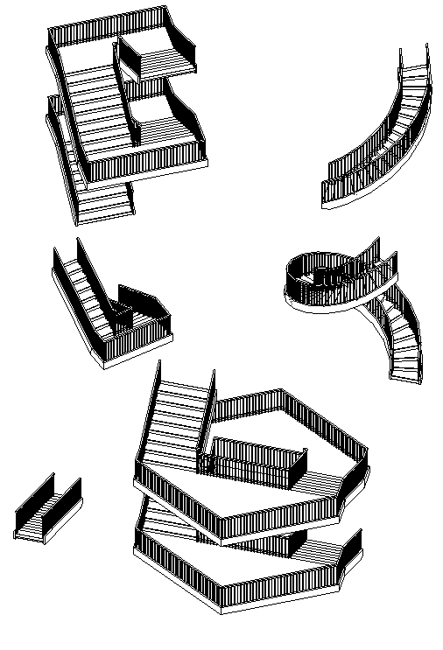
StairsAutomation
Create a series of stair, run and landing configurations
Based upon predefined hard-wired rules and parameters
Use of StairsEditMode
Creation of standard stairs runs
Creation of sketched stairs runs
Creation of sketched landings
Configurations
Single straight stair run
Stairs/landing combination up to level 2
Multi-span stairs/landing combination up to level 3
Single curved stairs run
Curve stairs run > 360 degrees

Slide 55

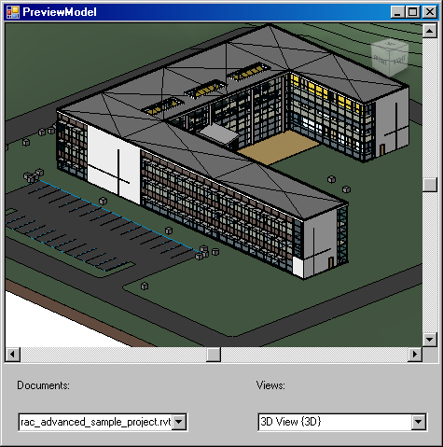
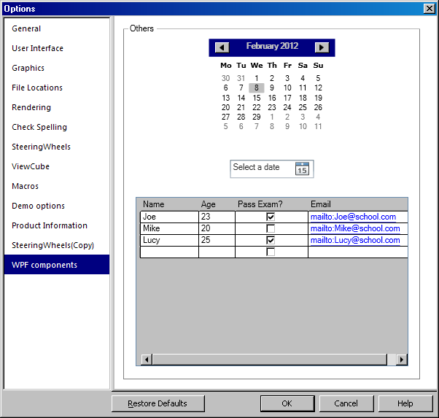
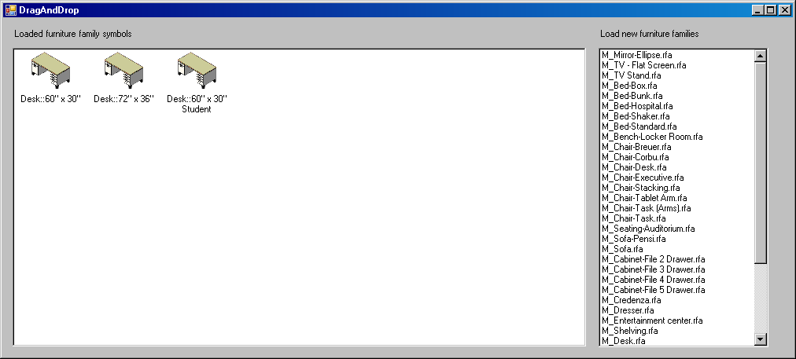
UIAPI
New add-in integration API features
Substitution of a built-in Revit command
Setting contextual help for a ribbon button
Internet URL, wiki, or local CHM file
Options dialogue custom extension support
Embedding a Revit view as a WPF control
Drag and drop API

Slide 56
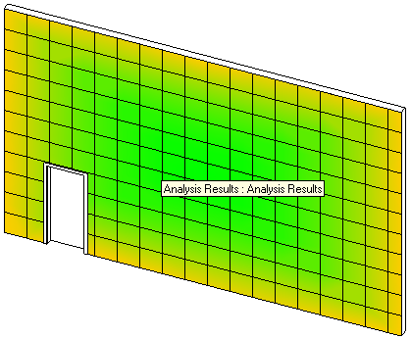
WorkThread
Utilise Idling event in a multi-threaded application
Communicate with the Revit API from an external work thread
Similar to modeless interaction from same thread
External application to handle events
External command to select BIM element face and start analysis simulation
Display simulated result using Analysis Visualisation Framework
Continue working in model
Every modification triggers recalculation and redisplay
RvtSamples

Slide 57
Manual Mode and Using Transactions
All Revit API calls need a valid context, including
DoDragDrop
IsQuiescent
Automatic transaction mode is inofficially deprecated
Dispose of transactions
Easiest way is 'using' statement
using( Transaction tx = new Transaction( doc ) )
{
tx.Start( "Transaction Name" );
// . . .
tx.Commit();
}
http://thebuildingcoder.typepad.com/blog/2012/04/drag-and-drop-api.html
http://thebuildingcoder.typepad.com/blog/2012/04/scope-and-dispose-transactions.html
http://thebuildingcoder.typepad.com/blog/2012/04/using-using-automagically-disposes-and-rolls-back.html
Notes:
Here is a summary of the results of some of the most important recent high level discussion topics on the blog.

Slide 58
AEC Developer Camp
June 6-7, 2012 Westin Waltham-Boston, MA
Customization focused 2 day training camp
Anybody who is interested in customizing can attend
Optional DevLab June 8
Great opportunity to
Learn Autodesk’s latest technology
Talk with Autodesk management and engineering
Have one-on-one meetings
Share information with other customers and developers
More information and registration at
http://www.cvent.com/d/ycq03r
Notes:
An important upcoming event.

Slide 59

AEC DevBlog New!
http://adndevblog.typepad.com/AEC
Group blog by Autodesk Developer Technical Services members
Resource for software developers working with Revit, Navisworks and other Autodesk AEC and BIM technologies
Notes:
Democratisation of Autodesk support.

Slide 60
Revit API Wishlist Survey, Spring 2012
API wishlist survey coming soon
Please keep eyes on our blogs for announcement
The Building Coder blog: http://thebuildingcoder.typepad.com
ADN DevBlog: http://adndevblog.typepad.com/AEC
This is your chance to raise your voice and influence the future API enhancement planning
We appreciate your feedback!
Notes:
Your chance to drive Revit API development directions. Even stronger, of course, by attending AEC DevCamp and explaining your issues directly to the development team and product managers.

Slide 61
Learning More
Revit Developer Center: Revit SDK, Samples, API Help File, DevTV Introduction to Revit Programming, My First Revit Plugin
http://www.autodesk.com/developrevit
, Developer's Guide
http://wikihelp.autodesk.com/Revit > API Developer's Guide
Revit API Webcasts and Trainings
http://www.adskconsulting.com/adn/cs/api_course_sched.php > Revit API
Discussion Group
http://discussion.autodesk.com > Revit Architecture > Revit API
API Training Classes
http://www.autodesk.com/apitraining
The Building Coder, Jeremy Tammik's Revit API Blog
http://thebuildingcoder.typepad.com
ADN, The Autodesk Developer Network
http://www.autodesk.com/joinadn
DevHelp Online for ADN members
http://adn.autodesk.com
Notes:
A number of resources, some already mentioned previously, summarised for your convenience.

Slide 62
Polls About the Presentation
5. How was the audio quality of the presentation?
Good, Acceptable, Poor
6. How was the visual quality of the presentation?
Good, Acceptable, Poor
7. How do you rate the presentation material?
Excellent, Good, Okay, Poor
8. How do you rate the presentation delivery?
Excellent, Good, Okay, Poor
9. Would you recommend this webcast to a friend or colleague?
Yes, No
10. What API topics would you be interested in for future webcasts?
Advanced UI API, IFC Open Source, Materials and Physical Properties, Revit Server API, Revit Links API, Schedule API
(For other topics and multiple choices, please send suggestions through Q&A)

Slide 63
Questions and Answers

Slide 64
Thank you and Goodbye

Slide 65


