Slide 1
Building an auth microservice
with ASP.NET Core Identity and Duende IdentityServer
Miroslav Popović Technical Lead @Seavus @miroslavpopovic

Slide 3

Introduction

Slide 4
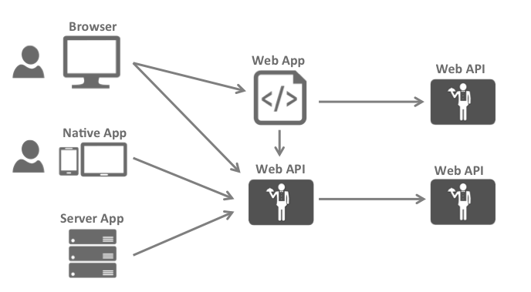
What modern apps look like?
Image taken from Duende IdentityServer documentation
Notes:
https://docs.duendesoftware.com/identityserver/v5/overview/big_picture/

Slide 5
Why an auth service?
Problems to solve:
Authentication
Authorization
Resource protection
Centralized solution
Auth service = Security Token Service

Slide 6


Standards: OAuth 2.0 & OpenID Connect
OAuth 2.0
Authorization
Granting access to data and features from one application to another
OpenID Connect
Authentication
Login and profile information
Notes:
Things to go through:
OAuth history
OpenID history
DotNetOpenAuth
OpenID Connect, built upon OAuth 2.0

Slide 7
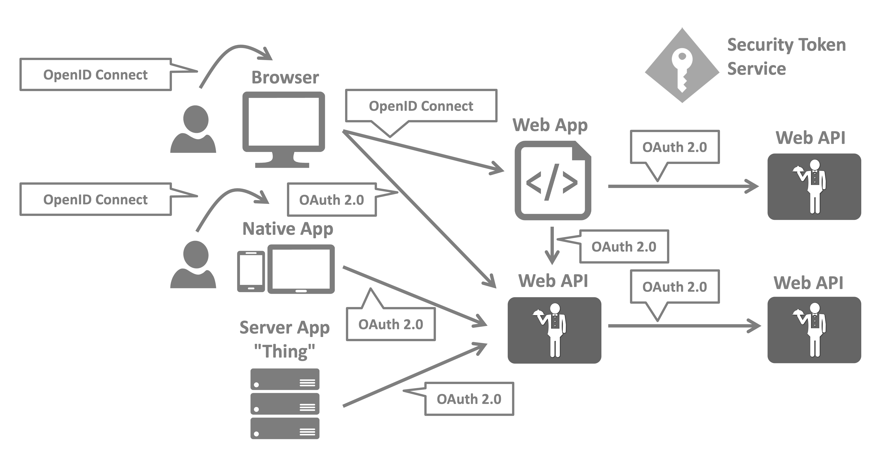
The big picture
Image taken from Duende IdentityServer documentation

Slide 8
Potential implementations
Cloud based
Auth0 / Okta
FusionAuth
Azure AD B2C
Self-hosted
https://www.keycloak.org/
https://www.ory.sh/
https://gluu.org/
Middleware
Duende IdentityServer
OpenIddict
Custom / built from scratch
?

Slide 9

ASP.NET Core Identity
Managing users, passwords, profile data, roles, …
DB persistence with EF Core
Predefined UI for login, register, forgot password, 2FA, …
UI Scaffolding
Support for external logins

Slide 10

Duende IdentityServer
Protect your resources
Authenticate users using a local account store or via an external identity provider
Provide session management and single sign-on
Manage and authenticate clients
Issue identity and access tokens to clients
Validate tokens

Slide 11
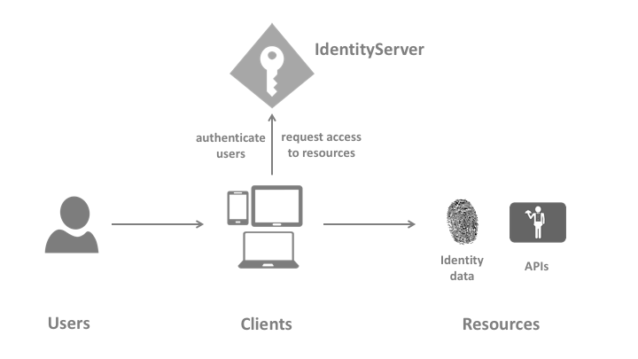
Terminology
ASP.NET Core Identity
+

Slide 12
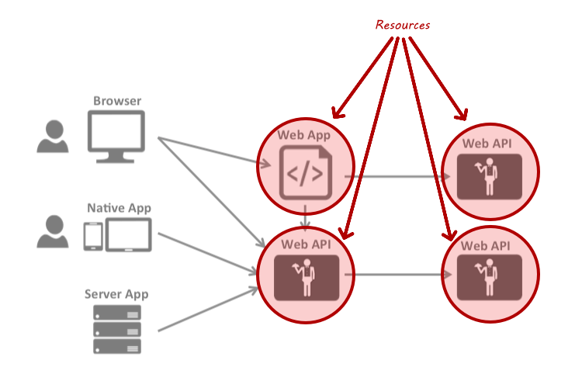
Resources
Identity resources
API resources
Notes:
Identity resources
Claims about the user – user ID, name, email…
Named group of claims that can be requested with scope parameter
API resources
A functionality client wants to access
Group of scopes – logical API

Slide 13
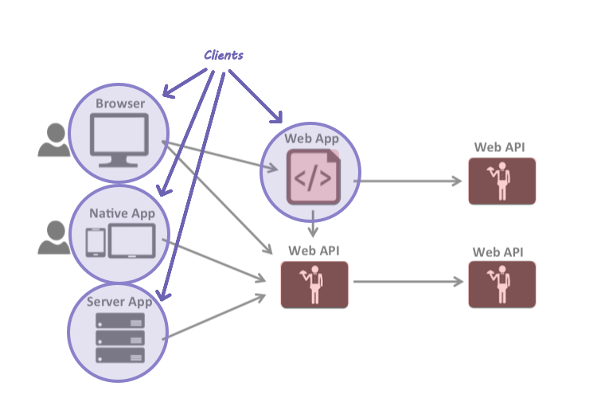
Clients
Accesses to resources
Need to be authorized

Slide 14
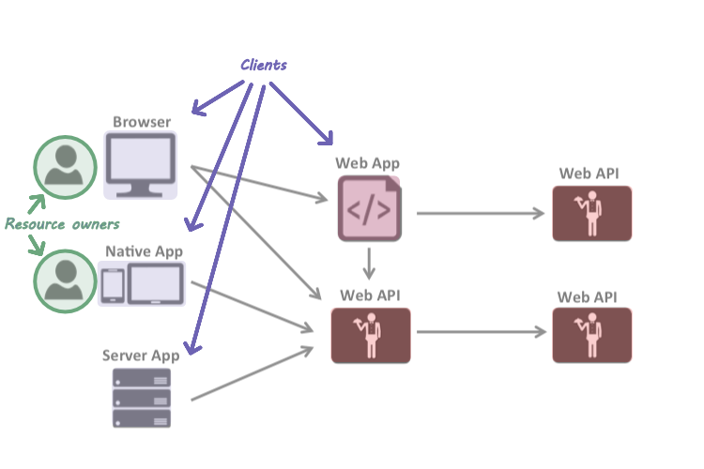
Resource owners
In most cases, users

Slide 15
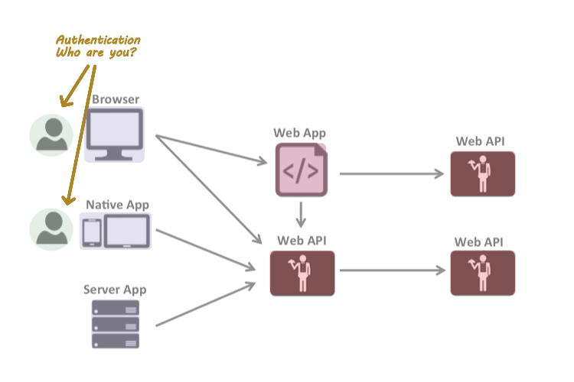
Authentication
Confirming user identity

Slide 16
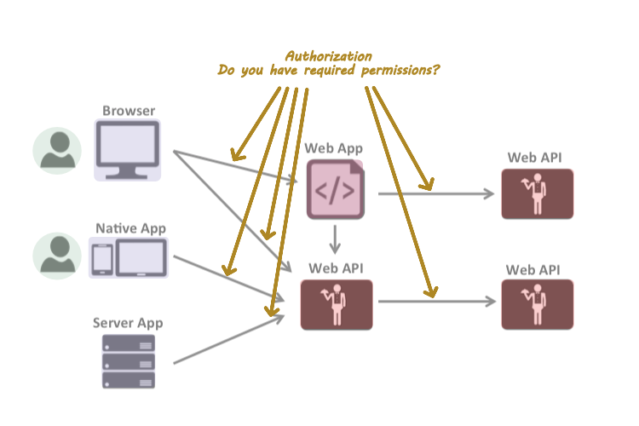
Authorization
Allowing the access to a specific functionality or resource

Slide 17
Other terms
Claim
One piece of information
Scopes
Something you want to protect and client wants to access
Grant types / flows
Non-interactive – client credentials flow
Interactive – authorization code flow with PKCE
Older flows are considered obsolete
Tokens
Access token – JWT
Refresh token
Identity token – JWT
Reference tokens (instead of JWT)

Slide 18
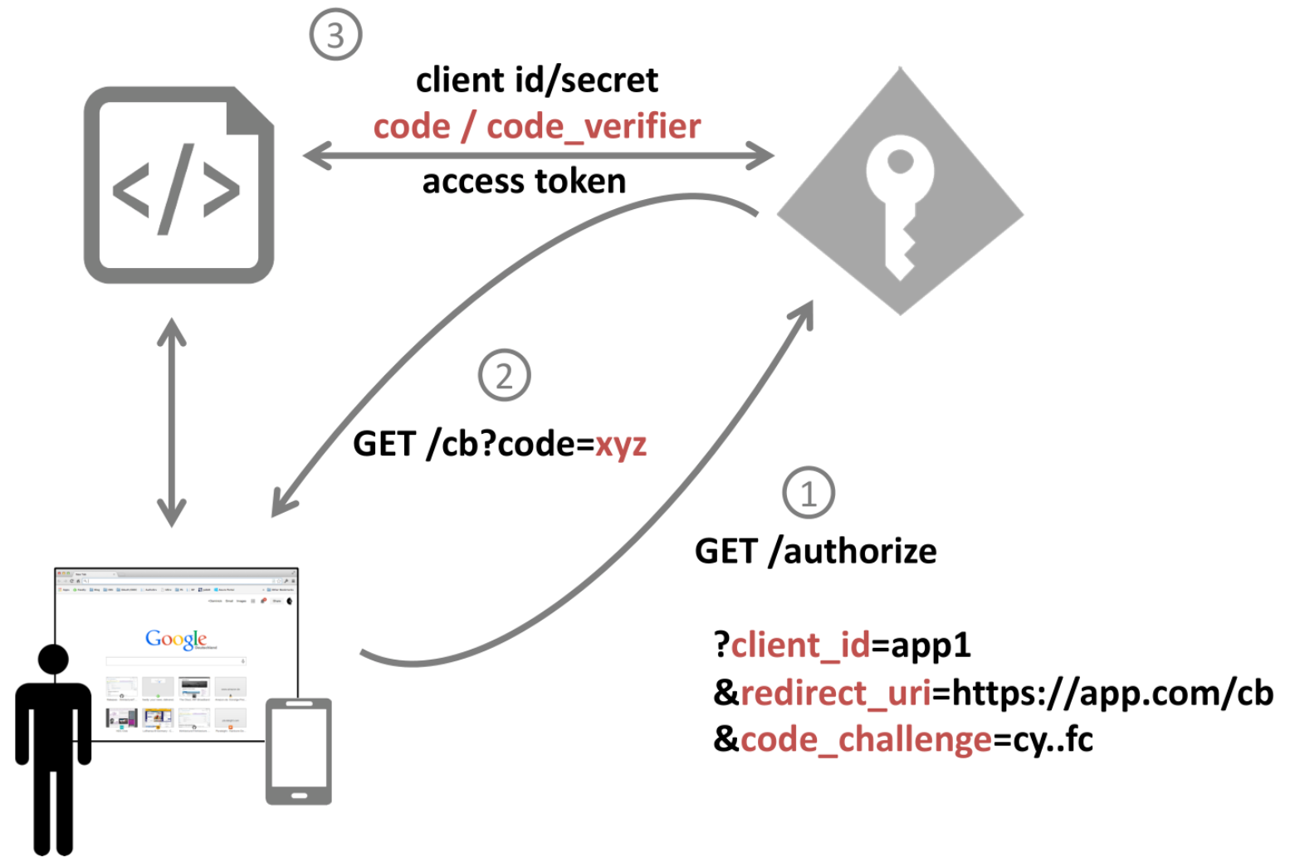
Authorization code flow with PKCE
code_verifier = random
code_challenge = hash
Image taken from IdentityServer4 workshop by Dominic Baier
Notes:
https://identityserver.io/training/
PKCE = Proof Key for Code Exchange

Slide 19

Demo

Slide 20
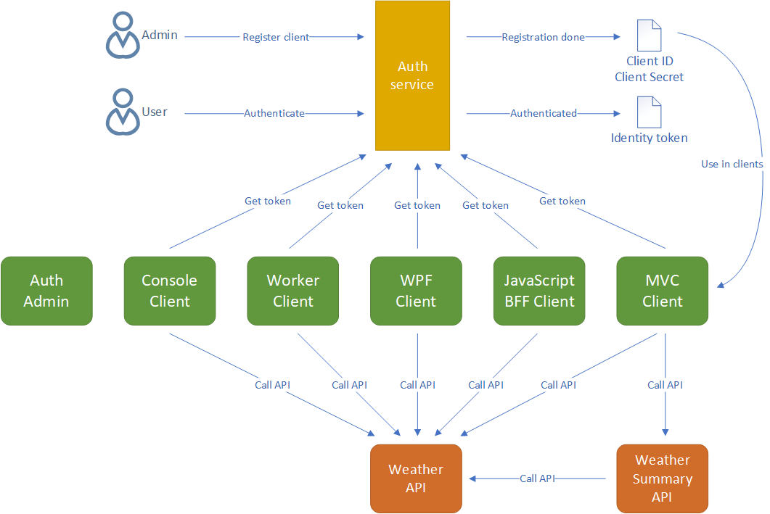

Slide 21
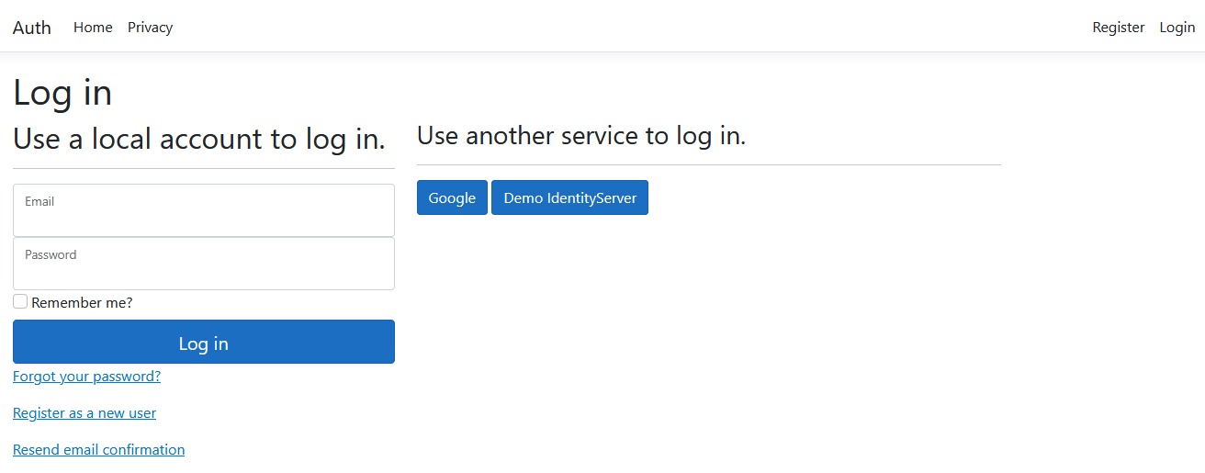
New ASP.NET Core project with Identity
Implement 2FA auth
Implement email service with MailKit
Extend IdentityUser
Notes:
- Don’t trust external authentication providers to always return claims that you need – ask the user to fill in the data on first login – i.e. email, display name, etc.

Slide 22
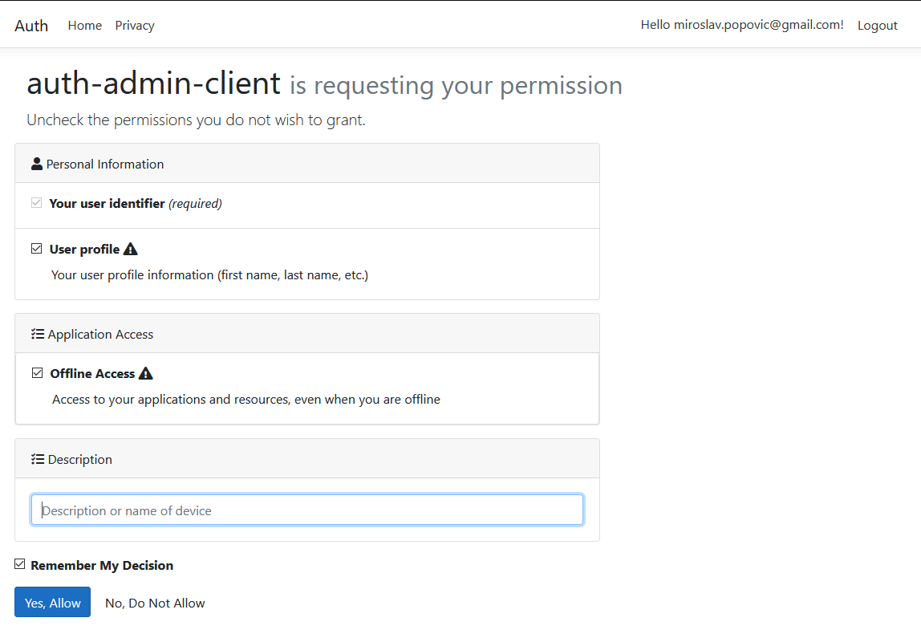
Including Duende.IdentityServer.AspNetIdentity
/.well-known/openid-configuration
Configuring middleware
Defining resources
Defining clients
Configuring Consent page
Configuring Device Authorization page

Slide 23
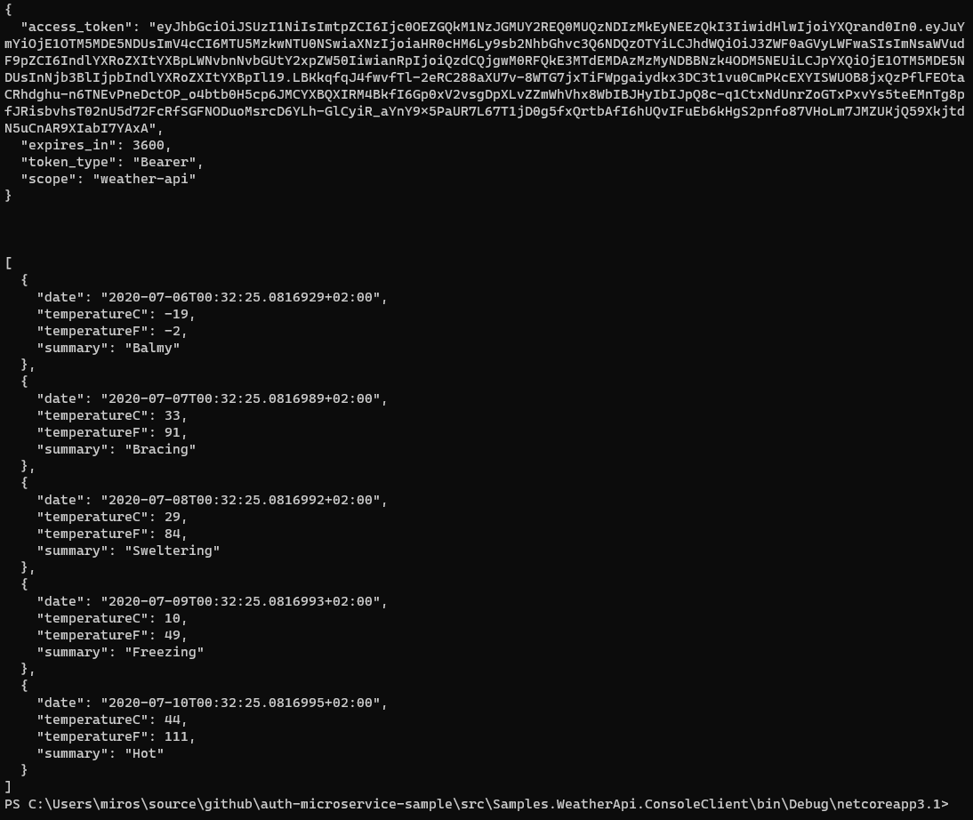
Console / Worker Client
IdentityModel library

Slide 24
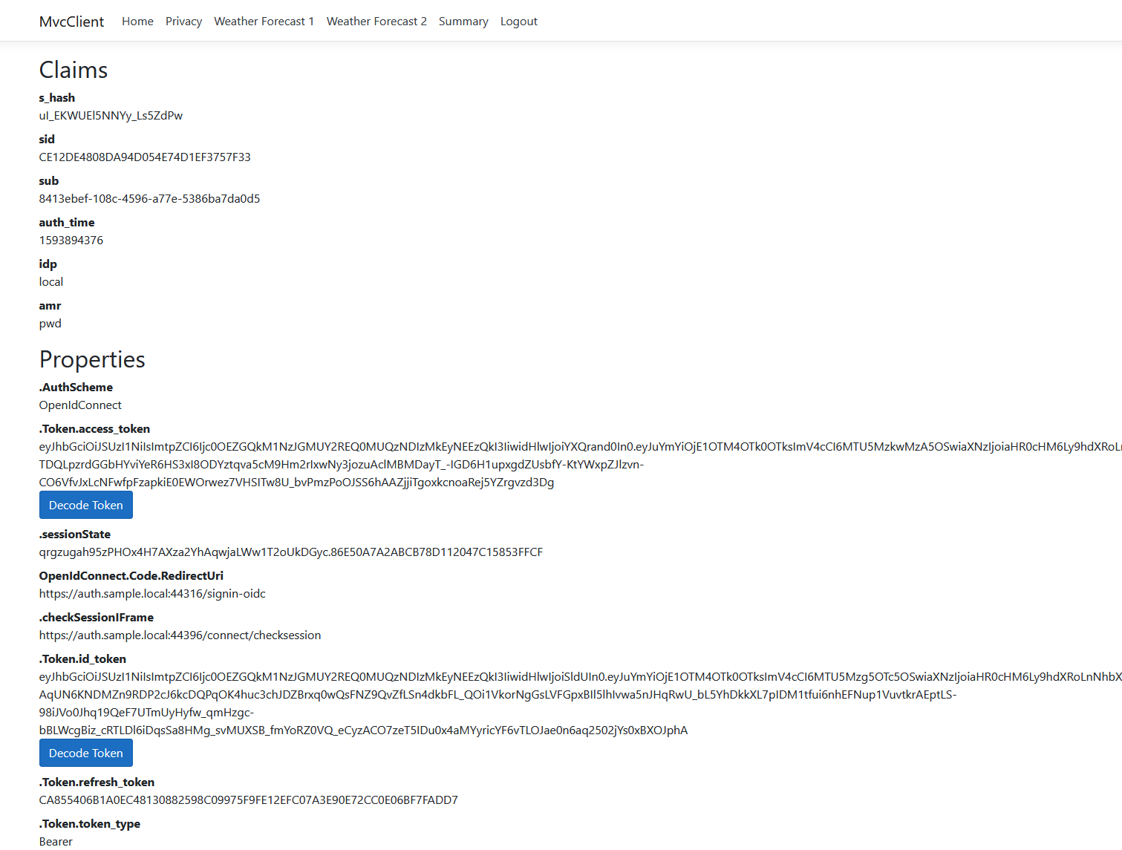
MVC client
Scenarios:
Same token for MVC app and API
Getting new token for the API
Calling API through another API

Slide 25
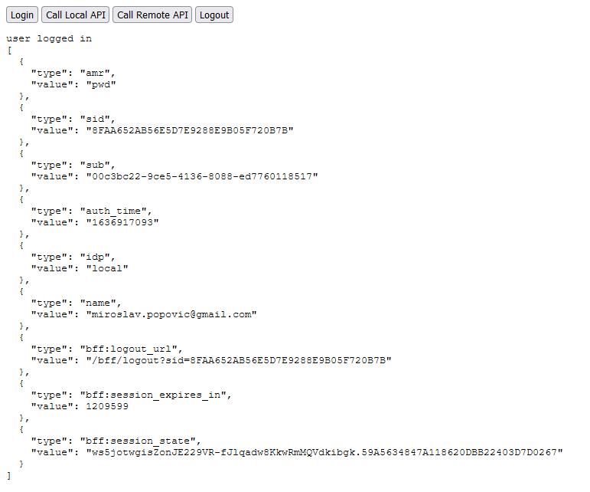
JavaScript BFF client
Duende.BFF
part of Business Edition or higher

Slide 26
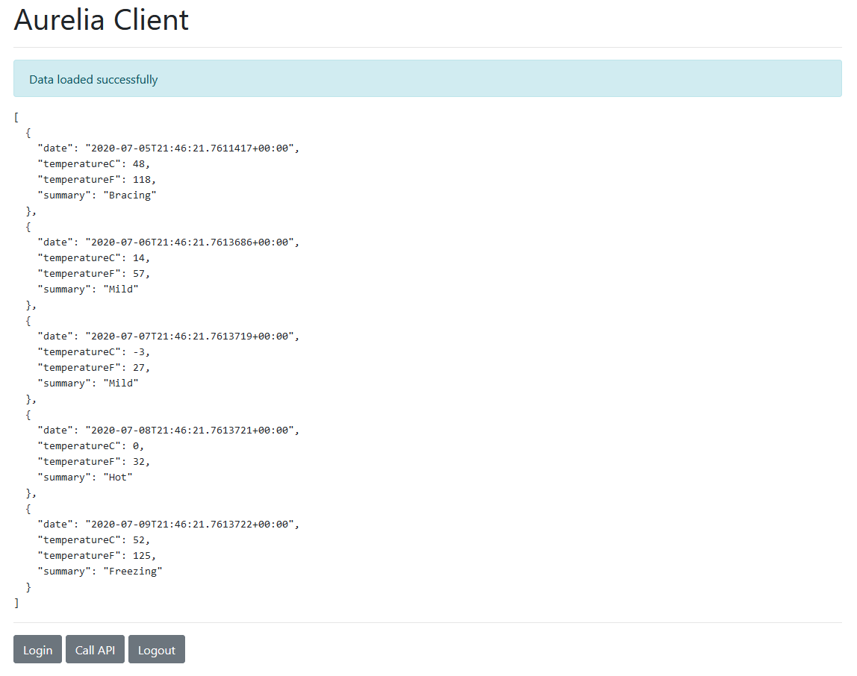
SPA client
Uses oidc-client library
Not recommended when working with sensitive data

Slide 27
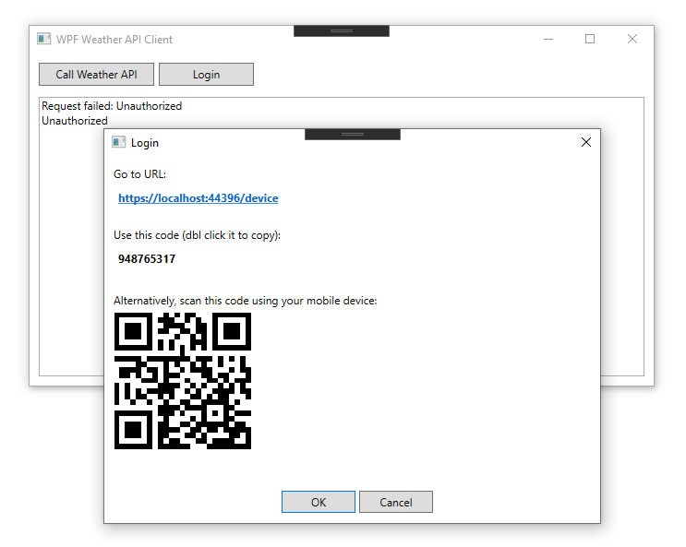
Device Client
Intended for devices without easy input
i.e. smart TVs, gaming consoles…
Simulated with WPF
RFC 8628

Slide 28
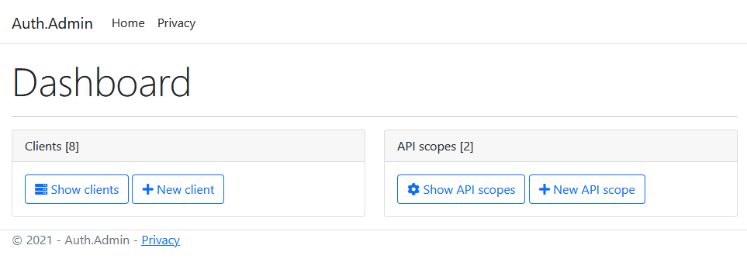
Switching to DB resources / clients
Adding Admin interface

Slide 29

Containerization
Docker
Docker Compose
Project Tye

Slide 30
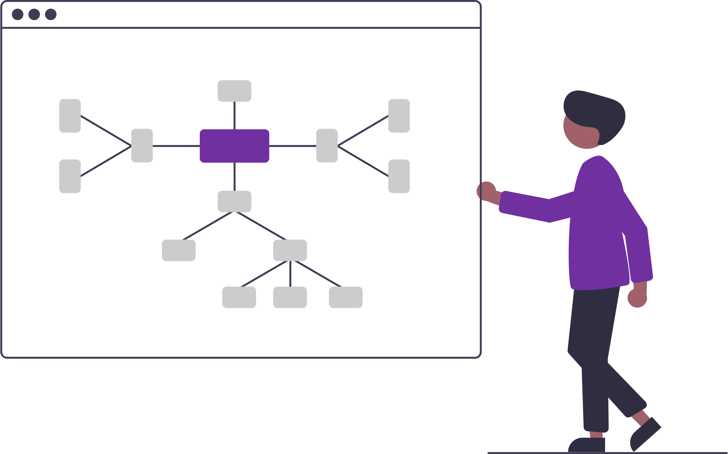
Tips & Tricks

Slide 31
Tips & tricks 1
Don’t add many claims to access tokens
Don’t include sensitive data to JWT tokens
Don’t store tokens to localStorage in browser-based apps if you are working with sensitive data
Use BFF architecture for browser-based apps
Use authorization code flow with PKCE for native apps too
Use rotation for refresh tokens (default behavior) and prevent reply attacks

Slide 32
Tips & tricks 2
Handle new users in external auth callback
i.e. ask them to fill in the data, don’t trust that provider will return it
Use IdentityModel library for .NET clients
Use IdentityServer as Federation Gateway
Create the strategy for encryption key rotation – implemented by default in Duende IdentityServer
Look into IdentityServer log output when resolving issues

Slide 33
Advanced concepts

Slide 34
Advanced
Single-sign on
Single-sign out
Complicated – front-channel, back-channel
Not all external providers support it
New server-side Session Management
Added in IS 6.1
Can be used instead of cookies
Key material
AddSigningCredentials, AddDeveloperSigningCredential, AddValidationKey
Proof of possession tokens
Bound to client that requested the token
Notes:
https://blog.duendesoftware.com/posts/20220406_session_management/

Slide 35

Closing words

Slide 36
What comes in future
OAuth 2.1
.NET 7
Duende
Duende.AccessTokenManagement (in preview) instead of IdentityModel.AspNetCore
Duende IdentityServer 7?

Slide 37
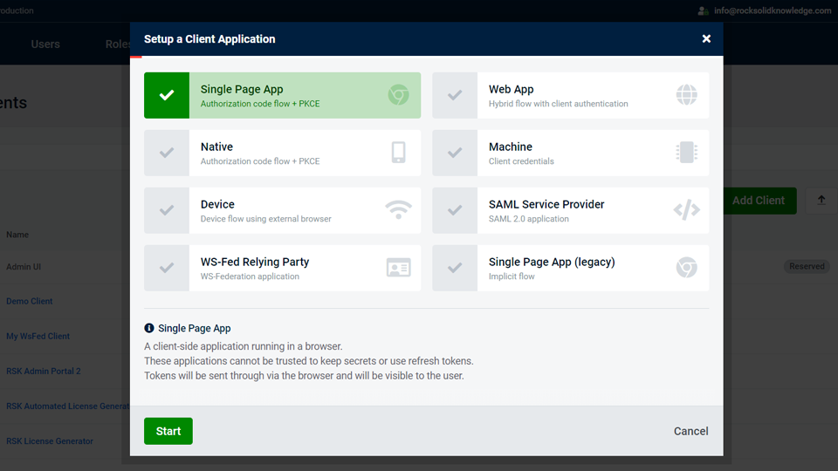
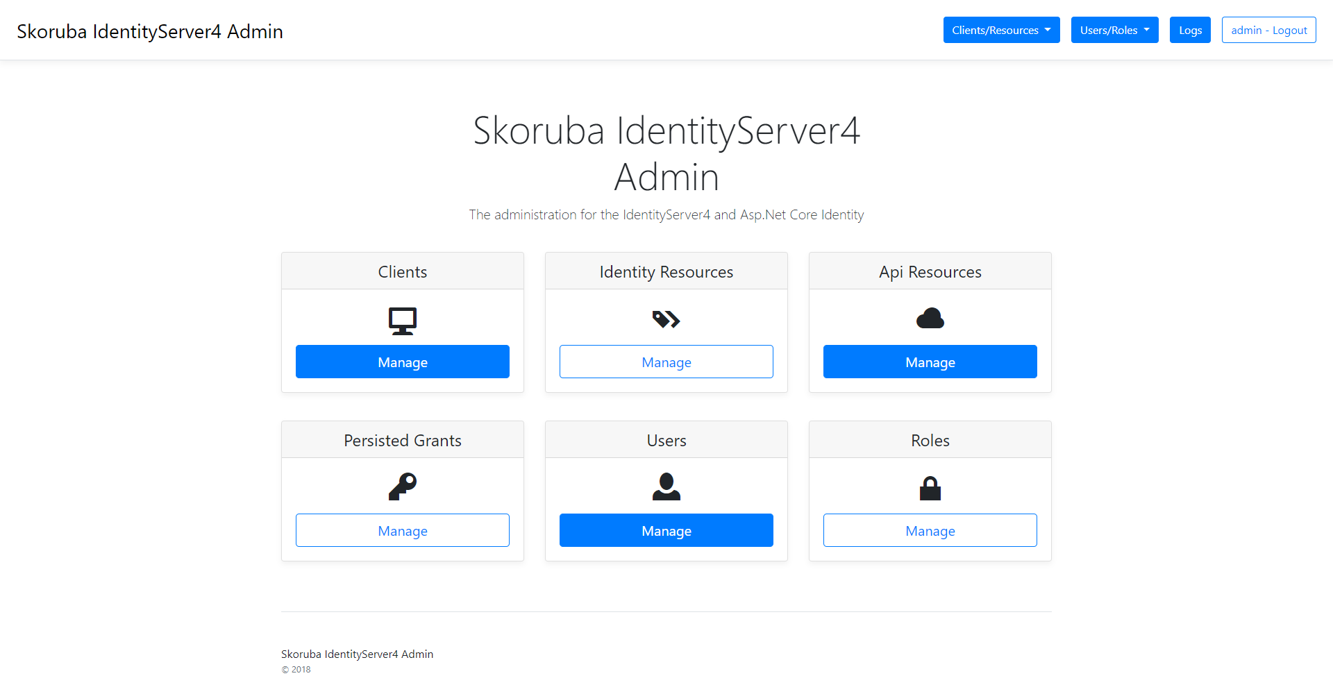
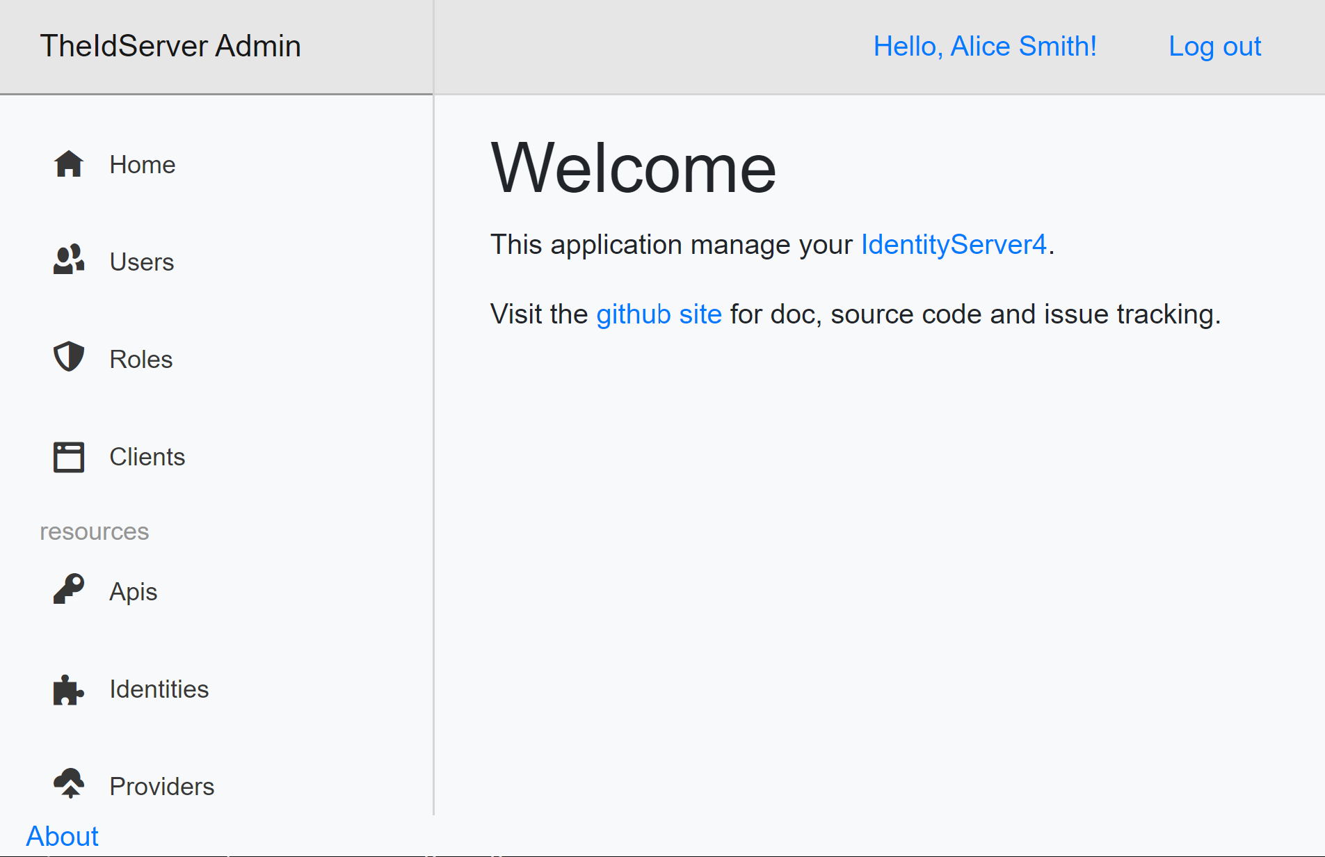

More things to look at
Admin interfaces
https://www.identityserver.com/products/adminui
https://github.com/skoruba/Duende.IdentityServer.Admin
https://github.com/Aguafrommars/TheIdServer
Policy / permission servers
https://policyserver.io/
https://github.com/Xabaril/Balea
Alternatives
https://www.keycloak.org/
https://www.ory.sh/
https://gluu.org/
https://github.com/openiddict/openiddict-core

Slide 38
Summary
Auth as a service
ASP.NET Core & Duende IdentityServer integration
Auth flows with IdentityServer
Simplification
Various client types
Tips & tricks
Future

Slide 39
References
IEFT: OAuth 2.0 Security Best Current Practice Draft
ASP.NET Core Identity documentation
Duende IdentityServer documentation
Duende Software Blog - https://blog.duendesoftware.com/
Dominick Baier’s blog - https://leastprivilege.com/
Brock Allen’s blog - https://brockallen.com/
IdentityServer workshops - https://duendesoftware.com/training/identityaccesscontrol
NDC Conferences YouTube channel
Search for “IdentityServer”, or “Dominick Baier”, or “Brock Allen”
Pluralsight: Securing ASP.NET Core 6 with OAuth2 and OpenID Connect

Slide 41
Thank you!
https://github.com/miroslavpopovic/auth-microservice-sample-dotnet6
https://github.com/miroslavpopovic/auth-sample-openiddict
Questions?
Miroslav Popović Technical Lead @Seavus @miroslavpopovic

