Slide 1


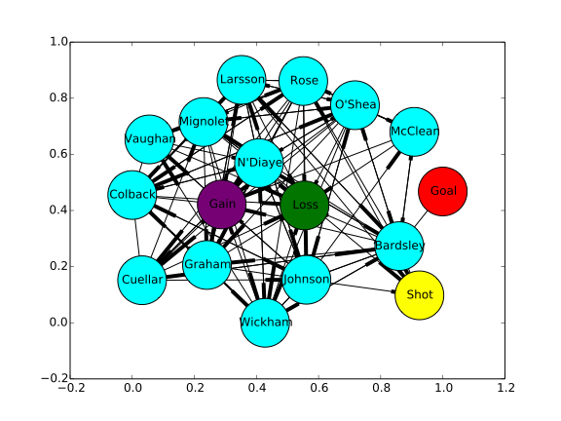
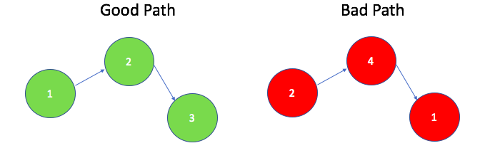
Graph-Based Learning on Professional Soccer Networks Evan Huang, Ahmad Ghalayini Email: {evhuang, ahmad2}@stanford.edu
CS 221: Artificial Intelligence
INTRODUCTION
MODEL
Results
Motivation: How can we utilize the network structure of soccer games to better analyze them and predict their outcomes?
Current Approaches:
soccer analytics has focused on individual player statistics
predictive modeling has been limited to simple logistic regression, decision trees, and LSTMs
Our Idea:
Given the natural existence of networks in soccer games, we hope to use network analysis to better understand game dynamics
Our Aim:
A better predictive model of game outcomes that can benefit both the sports betting industry and the soccer team's management
The betting on sports was $4.9 billion in 2017 in Nevada alone [1]
INPUT
A feature embedding of the graph. Three approaches:
Simple features: sets the average pass rate, max pass rate, min pass rate (nonzero), shot rate, gain rate, and loss rate in a vector for each node. This is averaged across all nodes to get a graph feature vector
node2vec on the graph: use the default parameters (128 dimensions, 80 length walk, 10 walks per source, weighted directed graph) to retrieve a feature vector per node. This is averaged across all nodes to get a graph feature vector.
Random walk simulation: similar to node2vec, we simulate random walks, but this time only starting at the gain state. We simulate with 100 hops and 100 samples, akin to Gibbs sampling. Ever visited node has its shot, loss, gain, and pass average rates incorporated into a separate channel within a 100x100x4 matrix.
OUTPUT
The game outcome with respect to the home team (Win, Loss, or Tie)
BASELINE MODEL
SVM on simple features and node2vec embeddings
Logistic Regression on simple features and node2vec embeddings
GCN MODEL
We implement a GCN (Graph Convolutional Network) similar to a CNN. We use an initial “sliding window” of size (1,n) that works on paths of length n within the random walk simulations. We then incorporate RELU non-linearity and average/max pooling for aggregation of samples. After a number of convolutional layers, we turn to fully connected layers. The purpose of this model is to learn how the distribution of paths length n contribute to the probability of win/loss/tie. The neural network architecture allows us to capture the non-linearity of the problem. The use of a sampling approach relating random walks gives us generalization of the model. When we run the network, it learns how paths within 100 simulations contribute.
A number of good paths between n players might be present in one team, while a number of bad paths are present in another team. The model will then predict win at a higher rate on the first team.
BASELINE RESULTS
Logistic regression on simple features
Test Accuracy: 43%
With low accuracy we turn to both more complex models and features
SVM on aggregated node2vec features
Test Accuracy: 47%
Slightly better accuracy due to increased complexity of the model
Potential problem in aggregation of node vectors through mean to get features of a graph – loss of information such as path distribution
GCN on random walk simulations
Test Accuracy: 62%
Significant increase in accuracy stems from use of path distributions without aggregation
Non-linearity of multiple convolutional layers better captured the relationship between network and game results
DATA
6 seasons of play-by-play soccer games from major leagues
2,280 games from players across 60 diverse teams, leading to 3,893,304 play-by-play events (rows of data)
Sample Play-by-Play Data:
Player ID and name, their x and y coordinates in the field, a timestamp, and the major action taken by that player, (such as a pass, goal, etc.)
Graph Construction from Data:
Nodes: 14 to 17 nodes consisting of the players and events: “Gain”, “Loss”, “Shot”, and “Goal”
Edges: Actions between states. Passing rates connect the player nodes. Shot, gain, and loss rates connect player nodes to event nodes
Conclusion and Future Work
Our results indicate we need to (1) have richer features (2) learn higher order interactions between players
Next steps:
Continue training the neural network on different hyper parameters for better results (use different optimizers)
Alter the sliding window for different aggregations of random walks (right now treating every walk separately)
Expand the network to include the opposing team, creating the ability to predict specific winners of matchups
Expand analysis to include seasonal data for before game predictions
References
[1] A look inside the numbers of sports betting in the U.S. and overseas (April 16, 2018)https://www.sportsbusinessdaily.com/Journal/Issues/2018/04/16/World-Congress-of-Sports/Research.aspx

