Slide 1

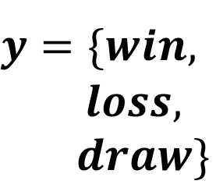

1. Raw Play-By-Play Data
3. Feature Learning
4. t-SNE Clustering
Player | Team | Play Attempt | Result …
A | Man. U | Pass | Fail
B | Liverpool | Goal | Success
Hand-Crafted
$${\vec{x}}_{}^{}$$
node2vec
2. Graph Extraction
Graph Conv. Network (GCN)
5. Game Outcome Prediction
$${\vec{x}}_{}^{}$$
$${\begin{aligned}y=\{win, \\ loss, \\ draw\}\end{aligned}}_{}^{}$$
Logistic
SVM

