Slide 1
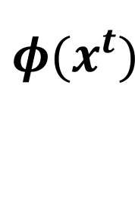
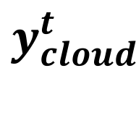
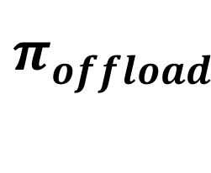



Edge Device
Network Link
Cloud
Edge Model
Cloud Model
$$y_{edge}^{t}$$
$$x_{}^{t}$$
Predict
$$π_{offload}^{}$$
$$y_{cloud}^{t}$$
$${\begin{aligned}φ(x^{t}) \\ \end{aligned}}_{}^{}$$
Edge Model Copies
$$a_{}^{t}$$
Offload
Features
Retraining
Dataset
Sample Buffer
Reward

Slide 2

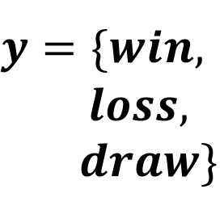

1. Raw Play-By-Play Data
3. Feature Learning
4. t-SNE Clustering
Player | Team | Play Attempt | Result …
A | Man. U | Pass | Fail
B | Liverpool | Goal | Success
Hand-Crafted
$${\vec{x}}_{}^{}$$
node2vec
2. Graph Extraction
Graph Conv. Network (GCN)
5. Game Outcome Prediction
$${\vec{x}}_{}^{}$$
$${\begin{aligned}y=\{win, \\ loss, \\ draw\}\end{aligned}}_{}^{}$$
Logistic
SVM

