Slide 1




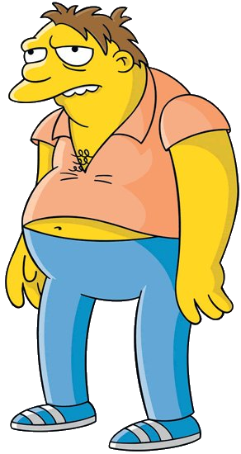
Treated
Untreated

Slide 2
Treated
Untreated
$$\operatorname{Pr}\left[A=1 | X=\text{adult}\text{, }\text{male}\right]=1/5$$
$$\operatorname{Pr}\left[A=0 | X=\text{adult}\text{, }\text{male}\right]=4/5$$

Slide 3
Treated
Untreated
$$\operatorname{Pr}\left[A=1 | X=\text{adult}\text{, }\text{male}\right]=1/5$$
$$\operatorname{Pr}\left[A=0 | X=\text{adult}\text{, }\text{male}\right]=4/5$$
$$w_{i}=5$$
$$w_{i}=5/4$$

Slide 4
Treated
Untreated
$$\operatorname{Pr}\left[A=1 | X=\text{adult}\text{, }\text{male}\right]=1/5$$
$$\operatorname{Pr}\left[A=0 | X=\text{adult}\text{, }\text{male}\right]=4/5$$
$$w_{i}=5$$
$$w_{i}=5/4$$

Slide 5
Treated
Untreated
$$\operatorname{Pr}\left[A=1 | X=\text{adult}\text{, }\text{male}\right]=1/5$$
$$\operatorname{Pr}\left[A=0 | X=\text{adult}\text{, }\text{male}\right]=4/5$$
$$w_{i}=5$$
$$w_{i}=5/4$$
Agent Smithson
Hybrid – a quarter of each

