Slide 1
Causal Inference Deep Learning
An incomplete review of deep learning methods for counterfactual prediction

Slide 2


Representation instead of weighting
Goal: balance between treatment group
weighting
representation learning

Slide 3





Representation instead of weighting
Goal: balance between treatment group
$$Y^{0},Y^{1}⊥A|π\left(X\right)$$
weighting
$$Y^{0},Y^{1}⊥A|X$$
$$Y^{0},Y^{1}⊥A|φ\left(X\right)$$
representation learning

Slide 4
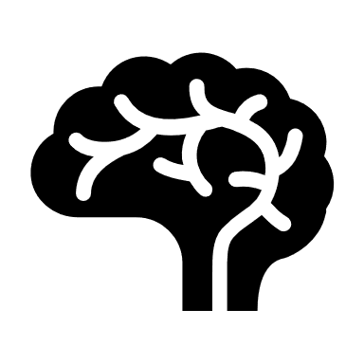



Meaningful representation of multiple proxies
High-dimensional data usually contains proxy information
Lung disease history might not be relevant for diabetes, but lung, kidney, liver, neurological status may hint at an internal (latent) health status of the patient that may contribute to progression or exposure.
Health
Tx
Onset

Slide 5
Use deep learning to learn useful representations
Some transformations on the input to a lower-dimension compact manifold
Notes:
Papers are listed chronologically.
For representation focus- can skip propensity-dropout and ganite.

Slide 6
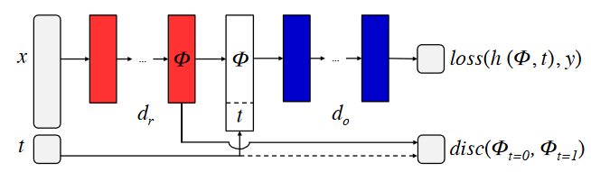
Use covariates for latent representation
Concatenate treatment to latent representation
Task 1: predict outcome
Task 2: minimize distance between representation of two groups
Distance is domain-adaptation norm of mean-differences: Arxiv:0902.3430
Learning Representations for Counterfactual Inference, Johansson et al. 2016

Slide 7
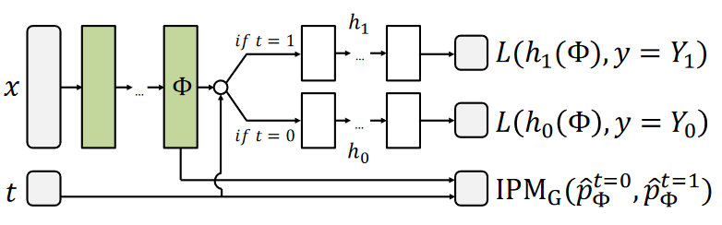
Use different task heads after representation layer
One head per treatment group
Use a richer distribution distance between group representation
Wasserstein distance or maximum mean discrepancy
Estimating individual treatment effect: generalization bounds and algorithms, Shalit et al. 2017
Notes:
MMD: https://stats.stackexchange.com/questions/276497/maximum-mean-discrepancy-distance-distribution
Code: https://github.com/clinicalml/cfrnet

Slide 8


Tradeoffs between maximizing balance and maximizing predictive accuracy
Encoding treatment as task, not feature
Better group-expressivity
Better distance between representation

Slide 9
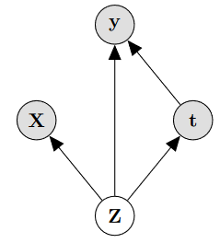
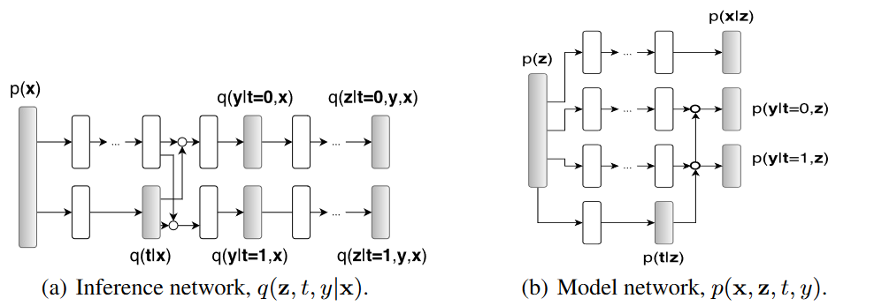


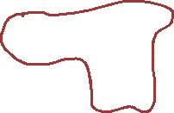


Variational autoencoders
Explicit assumption of proxy variables
encoder
decoder
losses
Multi-head outcome prediction
Reconstruct input
Multi-head outcome prediction
Treatment prediction
Treatment prediction
Latent space
Causal Effect Inference with Deep Latent-Variable Models, Louizos et al. 2017
Notes:
Code: https://github.com/AMLab-Amsterdam/CEVAE

Slide 10





Variational autoencoders
Explicit assumption of proxy variables
encoder
decoder
losses
Multi-head outcome prediction
Reconstruct input
Multi-head outcome prediction
Treatment prediction
Treatment prediction
Latent space
Causal Effect Inference with Deep Latent-Variable Models, Louizos et al. 2017
Notes:
Code: https://github.com/AMLab-Amsterdam/CEVAE

Slide 11
Variational autoencoders
Explicit assumption of proxy variables
encoder
decoder
losses
Multi-head outcome prediction
Reconstruct input
Multi-head outcome prediction
Treatment prediction
Treatment prediction
Latent space
Causal Effect Inference with Deep Latent-Variable Models, Louizos et al. 2017
Notes:
Code: https://github.com/AMLab-Amsterdam/CEVAE

Slide 12


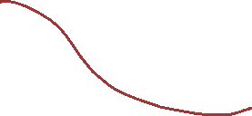
Variational autoencoders
Explicit assumption of proxy variables
Multi-task prediction
Both outcome and latent spaces
Though you select a single prediction based on the value ($ty^{1}+\left(1−t\right)y^{0}$)
Treatment prediction
Instead of observed
encoder
decoder
losses
Multi-head outcome prediction
Reconstruct input
Multi-head outcome prediction
Treatment prediction
Treatment prediction
Latent space
Causal Effect Inference with Deep Latent-Variable Models, Louizos et al. 2017
Notes:
Code: https://github.com/AMLab-Amsterdam/CEVAE

Slide 13
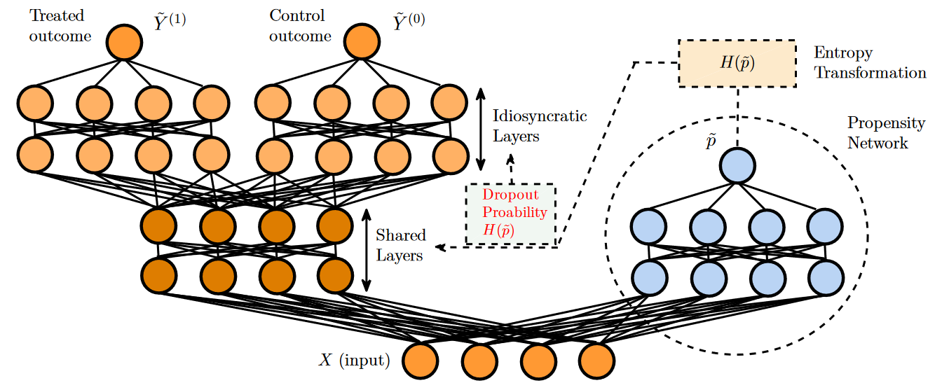
Combines a propensity network and an outcome network end-to-end
Multi-head outcome prediction
Treatment prediction
Deep Counterfactual Networks with Propensity-Dropout, Alaa et al. 2017
Notes:
Really multi-task ☺

Slide 14
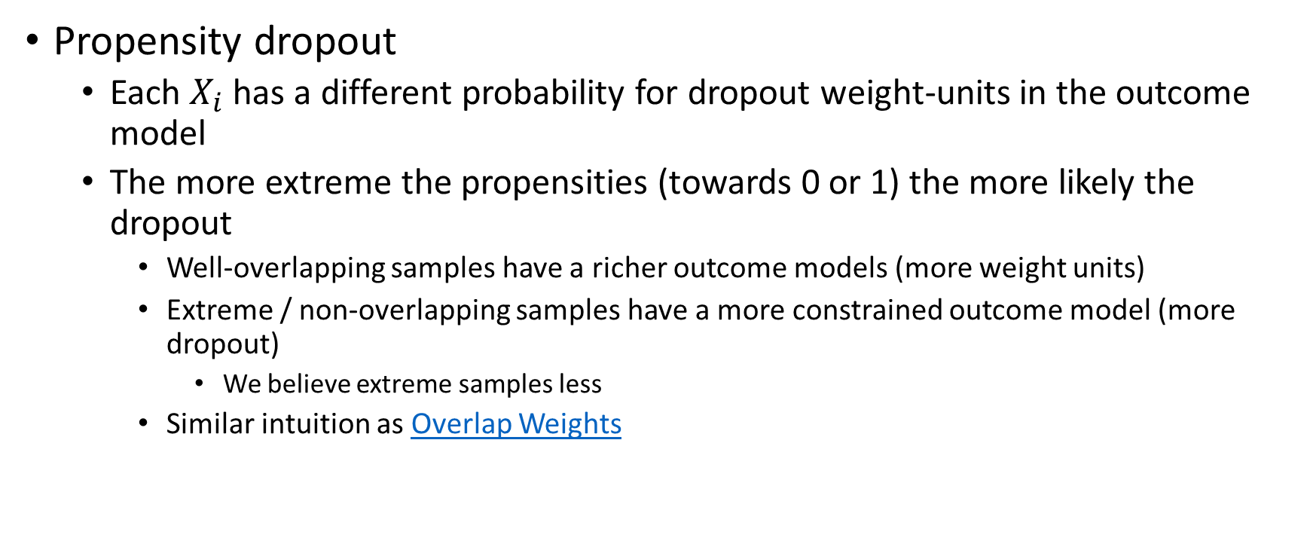
Propensity dropout
Each $X_{i}$ has a different probability for dropout weight-units in the outcome model
The more extreme the propensities (towards 0 or 1) the more likely the dropout
Well-overlapping samples have a richer outcome models (more weight units)
Extreme / non-overlapping samples have a more constrained outcome model (more dropout)
We believe extreme samples less
Similar intuition as Overlap Weights
Deep Counterfactual Networks with Propensity-Dropout, Alaa et al. 2017

Slide 15
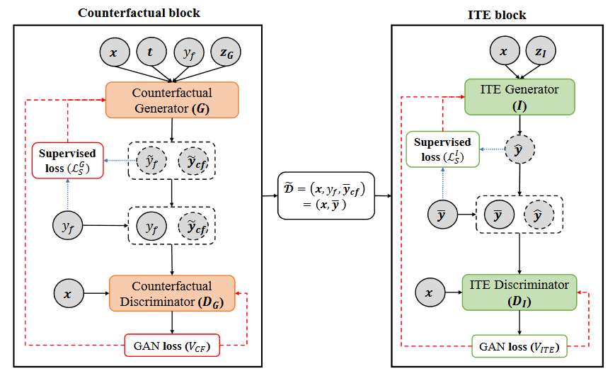
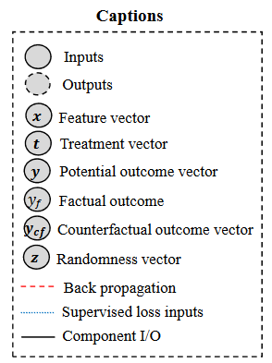
GAN-based framework
Step 1: Generate counterfactual outcomes that are indistinguishable from observed outcomes
Step 2: use the generated CF with the observed outcome to train on a “complete dataset” (all CFs). Outcome prediction is indistinguishable from factual outcome
GANITE: Estimation of Individualized Treatment Effects using Generative Adversarial Nets, Yoon et al. 2018
Notes:
Counterfactual generator: predict counterfactual outcomes
Counterfactual discriminator: give a probability for each counterfactual prediction that it is the factual outcome. Not a standard conditional GAN since only one true outcome for multiple predictions.
ITE generator:

Slide 16
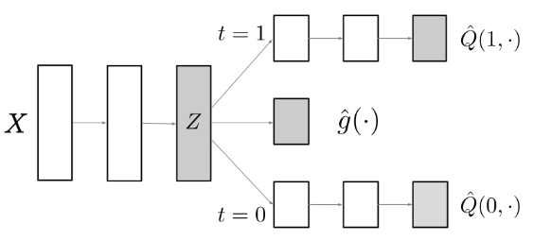
Predicting both outcome and treatment with different heads
Simple treatment prediction on purpose – force similarity between representation and propensity
Targeted (as in TMLE) regularization
Explicitly doubly-robust
Simpler, but more theoretically grounded
Multi-head outcome prediction
Treatment prediction
Adapting Neural Networks for the Estimation of Treatment Effects, Shi et al. 2019

Slide 17



Targeted (as in TMLE) regularization
End-to-end view as regularization:
AIPW equation:
TMLE-correction
Final prediction is $ε$-corrected prediction
Regularization
Effect as calculated with standardization
IP-weighted difference between factual prediction and factual outcome
Causal parameter
Adapting Neural Networks for the Estimation of Treatment Effects, Shi et al. 2019

Slide 18
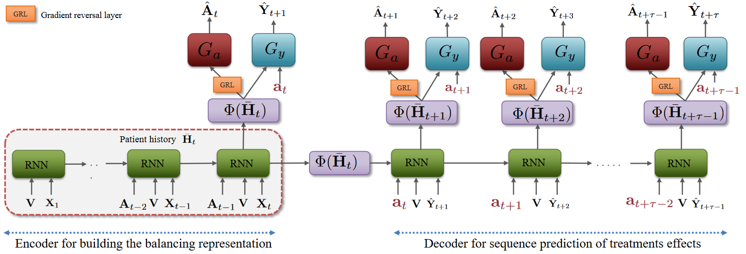
Sequential (RNN) model
Minimize loss on outcome prediction
Maximize loss on treatment prediction
Make a representation that cannot predict the treatment – treatment is ignoreable
Estimating Counterfactual Treatment Outcomes over Time Through Adversarially Balanced Representations, Bica et al. 2020

Slide 19


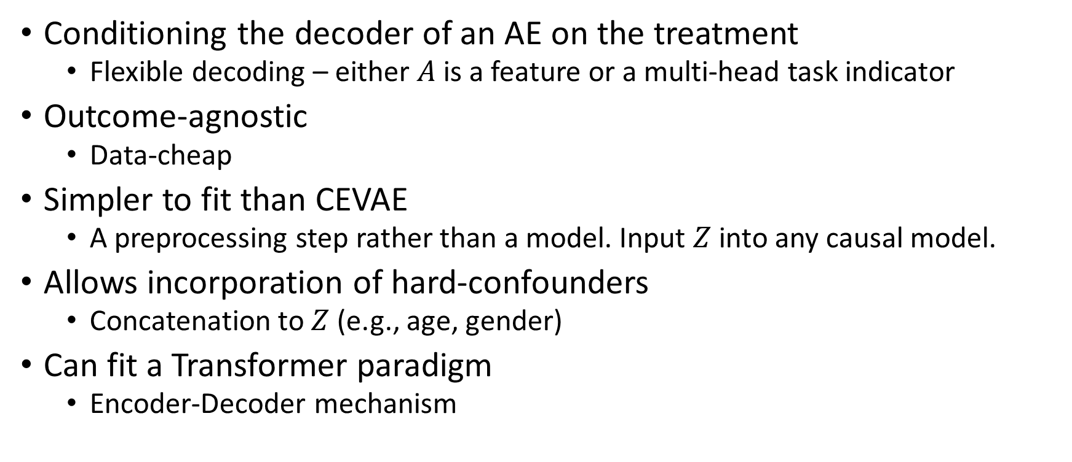



Conditioning the decoder of an AE on the treatment
Flexible decoding – either $A$ is a feature or a multi-head task indicator
Outcome-agnostic
Data-cheap
Simpler to fit than CEVAE
A preprocessing step rather than a model. Input $Z$ into any causal model.
Allows incorporation of hard-confounders
Concatenation to $Z$ (e.g., age, gender)
Can fit a Transformer paradigm
Encoder-Decoder mechanism
$$X_{0}$$
$$X_{1}$$
Encoder
Decoder
$$X^{′}$$
$$Z$$
$$A$$
Treatment Deconfounding Conditional Autoencoder, Karavani et al. 20??

Slide 20
Inspired by batch-correction from biostatistics
Each “batch” is like a domain under domain shift/adaptation
Treatment are regarded as batches
Intuition:
If you condition the decoder on the treatment, theoretically there’s no need for the encoder to encode treatment-related information.
The variance explained by the treatment
Residual gradients due to treatment information won’t flow back to the encoder
The encoder learns a treatment-canceling representation
$$X_{0}$$
$$X_{1}$$
Encoder
Decoder
$$X^{′}$$
$$Z$$
$$A$$
Treatment Deconfounding Conditional Autoencoder, Karavani et al. 20??

Slide 21







Alternative:
Shift the parts of treatment and confounders?
$$X$$
$$X$$
$$A$$
$$Y$$
Encoder
Decoder
$$A^{′}$$
$$A$$
$$Z$$
Treatment Deconfounding Conditional Autoencoder, Karavani et al. 20??

Slide 22
Common tricks
Multi-headed model
Outcome for each treatment value
Outcome and treatment prediction
Ignorable treatment assignment
Minimize distribution distance between group representations
Auxiliary loss
Make representation that cannot predict treatment
Conditional decoding (new?)

Slide 23
Common tricks
Multi-headed model
Outcome for each treatment value
Outcome and treatment prediction
Ignorable treatment assignment
Minimize distribution distance between group representations
Auxiliary loss
Make representation that cannot predict treatment
Conditional decoding (new?)
TMLE-like regularization component
Loss-based learning (IRM)
causality for DL, rather than DL for causality

Slide 24
Counterfactual Transformer
Different decoder stack for each treatment assignment
Predict a patient timeline given he was treated with A/B
How to regularize group representations?
How to make latent distributions similar

Slide 25
No free lunch
With enough dimensions and complexity, you could learn any mapping.
Doesn’t mean you can kitchen sink
Still depends on ignorability and overlap assumptions
Still requires well-defined causal question and data management for consistency
Can get inspiration from robust-ML or domain-adaptation works
Lots of similarities (if not straightforward causal justifications)

Slide 26
Other related work
Generalization Bounds and Representation Learning for Estimation of Potential Outcomes and Causal Effects
https://arxiv.org/pdf/2001.07426.pdf
Invariant Representation Learning for Treatment Effect Estimation
https://arxiv.org/pdf/2011.12379.pdf
IRM-derived loss for robust causal inference

