Slide 1
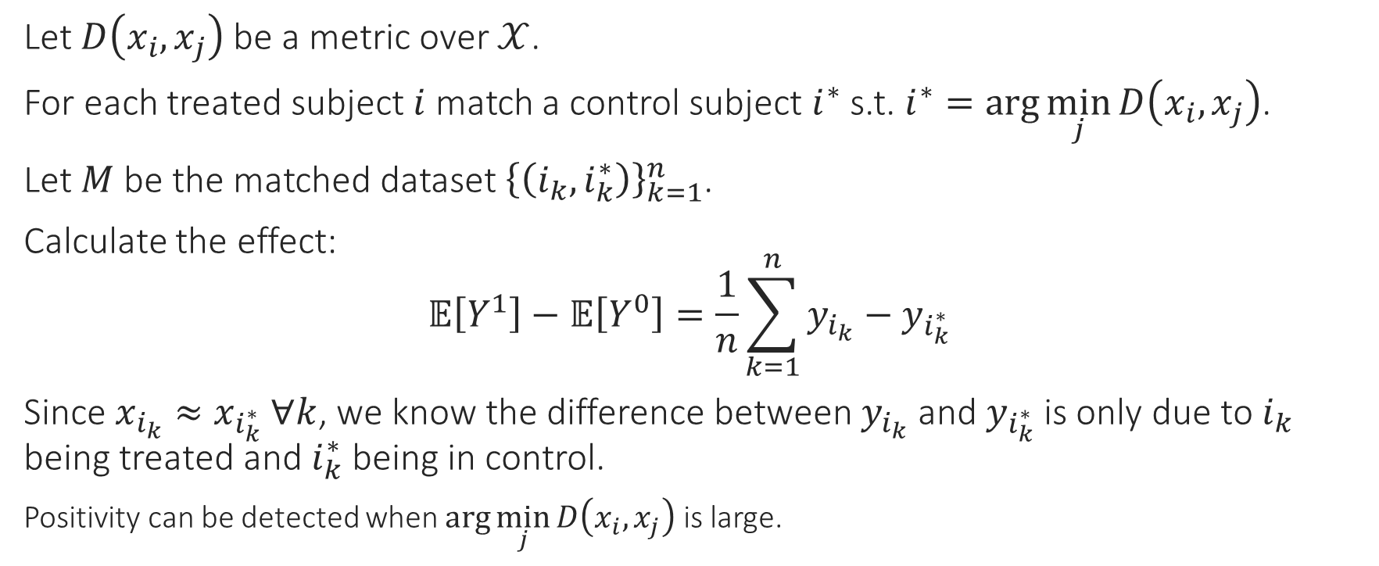
Matching
Let $D\left(x_{i},x_{j}\right)$ be a metric over $𝒳$.
For each treated subject $i$ match a control subject $i^{∗}$ s.t. $i^{∗}=\arg{\min_{j}{D\left(x_{i},x_{j}\right)}}$.
Let $M$ be the matched dataset ${\left\{\left(i_{k},i_{k}^{∗}\right)\right\}}_{k=1}^{n}$.
Calculate the effect:
$$𝔼\left[Y^{1}\right]−𝔼\left[Y^{0}\right]=\frac{1}{n}\sum_{k=1}^{n}{y_{i_{k}}−y_{i_{k}^{∗}}}$$
Since $x_{i_{k}}≈x_{i_{k}^{∗}} ∀k$, we know the difference between $y_{i_{k}}$ and $y_{i_{k}^{∗}}$ is only due to $i_{k}$ being treated and $i_{k}^{∗}$ being in control.
Positivity can be detected when $\arg{\min_{j}{D\left(x_{i},x_{j}\right)}}$ is large.
Notes:
Matching types: 1-to-1, many-to-1, all-below-threshold…
Can discard samples with no matching (caliper) – lack of positivity.

Slide 2
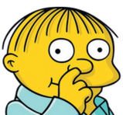


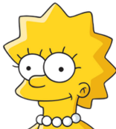


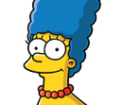


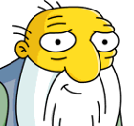
Matching (An Example)
Treated
Control
Notes:
We have a population with different ages and sexes.
Positivity (fish)
Control group being usually larger (many Lisas)

Slide 3
Matching (An Example)
Treated
Control
Notes:
We have a population with different ages (young old elder) and sexes (male female).
Real data will be of much higher dimensionality.

Slide 4



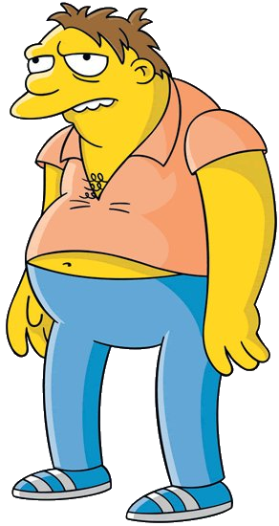
Inverse Probability Weighting
Consider the case where we have multiple control matches to a single treated.
Picking one in random
make a noise the estimate (what if we pick an outlier?)
Noise which can be mitigated over multiple matching, i.e., multiple analyses, which can be computationally demanding.
Discards much of the data.
Notes:
All these matches to Homer in age and sex. But what if one is an outlier? How can we mitigate its effect on the analysis?

Slide 5

Inverse Probability Weighting

Slide 6






Inverse Probability Weighting
$$w_{i}=\frac{1}{\text{Pr}\left[A=A_{i} | X=X_{i}\right]} ∀i$$
In our case, we have total of 5 adult male participants. One is treated.
$\text{Pr}\left[A=1 | X=\left\{\text{adult}, \text{male}\right\}\right]=1/5$, $\text{Pr}\left[A=0 | X=\left\{\text{adult}, \text{male}\right\}\right]=4/5$
$$\frac{5}{1}=5$$
$$\frac{5}{4}=1.25$$
$$\frac{5}{4}=1.25$$
$$\frac{5}{4}=1.25$$
$$\frac{5}{4}=1.25$$
Notes:
Positivity to avoid denominator being zero.

Slide 7
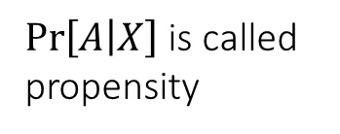
Inverse Probability Weighting
$\text{Pr}\left[A | X\right]$ is called propensity
$$w_{i}=\frac{1}{\text{Pr}\left[A=A_{i} | X=X_{i}\right]} ∀i$$
In our case, we have total of 5 adult male participants. One is treated.
$\text{Pr}\left[A=1 | X=\left\{\text{adult}, \text{male}\right\}\right]=1/5$, $\text{Pr}\left[A=0 | X=\left\{\text{adult}, \text{male}\right\}\right]=4/5$
$$\frac{5}{1}=5$$
$$\frac{5}{4}=1.25$$
$$\frac{5}{4}=1.25$$
$$\frac{5}{4}=1.25$$
$$\frac{5}{4}=1.25$$
Notes:
Propensity – how much an individual is inclined to be treated.
Should be aware of model’s probability calibration since we are modeling actual probabilities.

Slide 8

Inverse Probability Weighting
Creates a pseudo population:
Of size of $2n$: where $n$ are treated and $n$ are controlled.
$$\frac{5}{1}=5$$
$$\frac{5}{4}=1.25$$
$$\frac{5}{4}=1.25$$
$$\frac{5}{4}=1.25$$
$$\frac{5}{4}=1.25$$
Notes:
This pseudo population resides in the magic realm of unrealistic counterfactuals.

Slide 9

Inverse Probability Weighting
Creates a pseudo population:
Of size of $2n$: where $n$ are treated and $n$ are controlled.
Unconfounded (everyone are equally likely to be treated).
Balance between groups.
Agent Smithson
Hybrid – a quarter of each
Notes:
This pseudo population resides in the magic realm of unrealistic counterfactuals.
In original pop some where more/less likely to be treated based on their covariates, now they are equally likely: Pr[A|X]=0.5

Slide 10
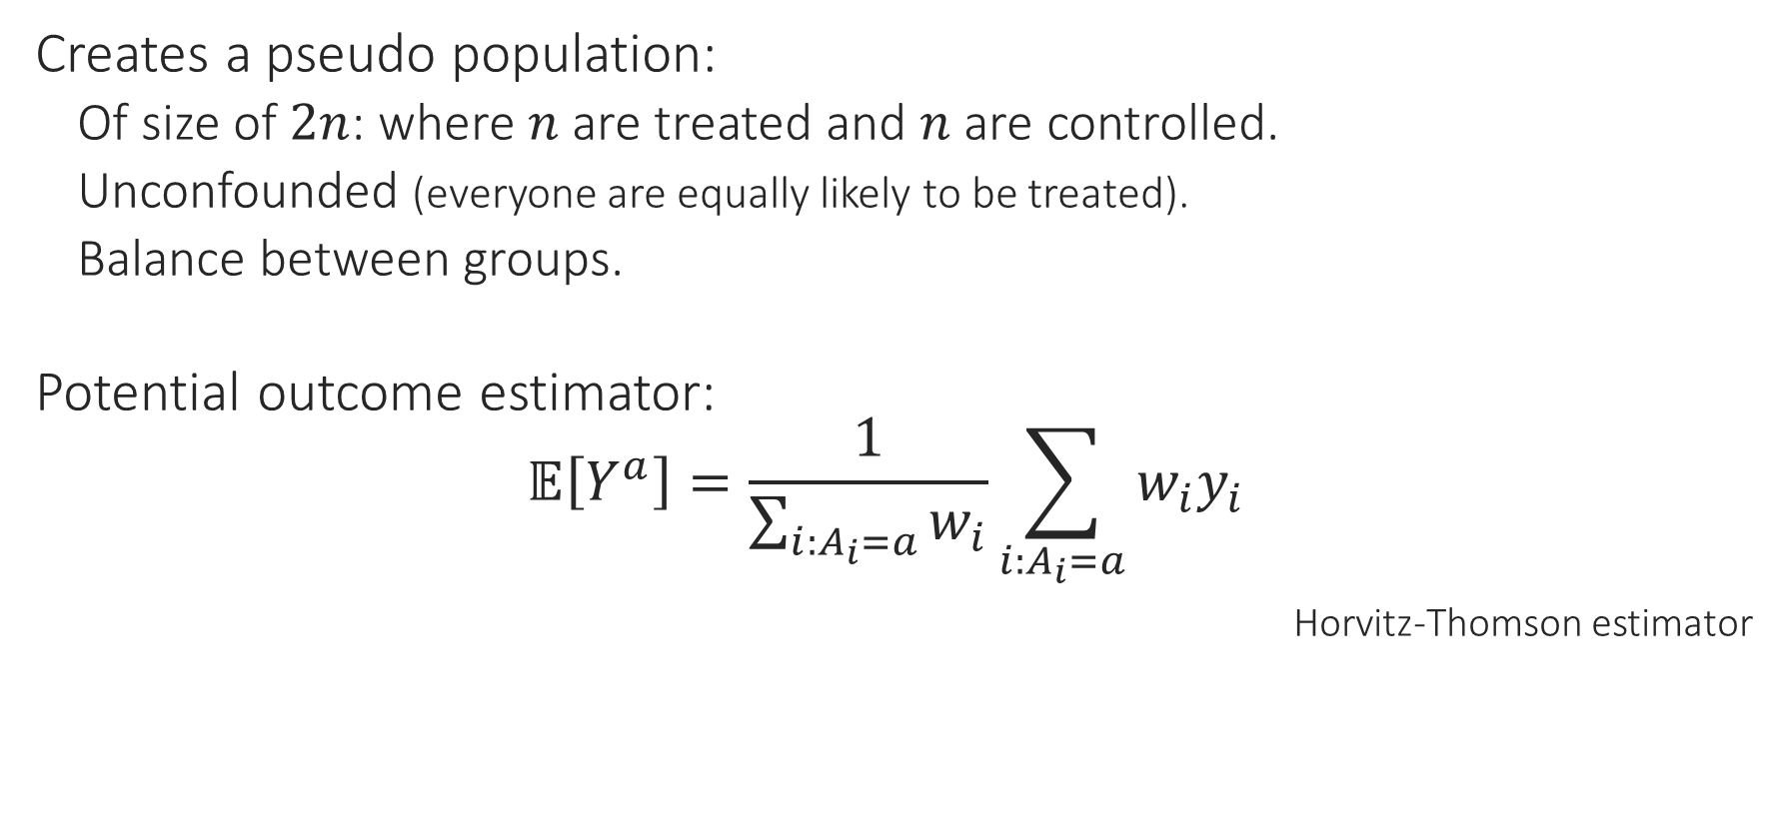
Inverse Probability Weighting
Creates a pseudo population:
Of size of $2n$: where $n$ are treated and $n$ are controlled.
Unconfounded (everyone are equally likely to be treated).
Balance between groups.
Potential outcome estimator:
$$𝔼\left[Y^{a}\right]=\frac{1}{\sum_{i:A_{i}=a}{w_{i}}}\sum_{i:A_{i}=a}{w_{i}y_{i}}$$
Horvitz-Thomson estimator
Notes:
Estimating unbiased potential outcome using weighted average.

