Slide 1
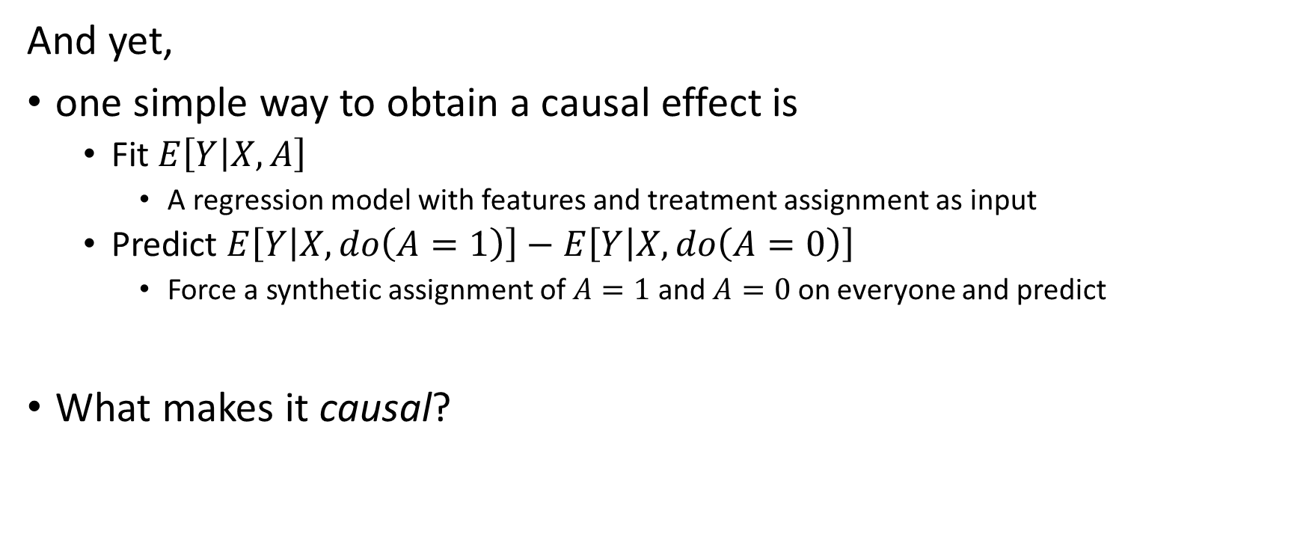
Causal Inference is supervised learning + thought
And yet,
one simple way to obtain a causal effect is
Fit $E\left[Y | X,A\right]$
A regression model with features and treatment assignment as input
Predict $E\left[Y | X,do\left(A=1\right)\right]−E\left[Y | X,do\left(A=0\right)\right]$
Force a synthetic assignment of $A=1$ and $A=0$ on everyone and predict
What makes it causal?
Notes:
Many models, but no magic.

Slide 2
Causal Inference assumptions
To make the leap between hypothetical to measurable quantities
Positivity Everyone have some chance to be in both treatment groups
Exchangeability No unmeasured confounding (causal sufficiency)
Consistency well defined interventions
To be able to translate from the hypothetical world to the real world
Notes:
In order to trust the counterfactual prediction from observed data.
ML assumptions: has iid assumption, uniform convergence for empirical risk minimization. Additional causal assumptions.

Slide 3


Causal Inference assumptions
Take the leap between hypothetical to measurable quantities
Positivity Everyone have some chance to be in both treatment groups
Do birth control pills
reduce headaches?
Treated
Untreated
The effect on “people” cannot be estimated from the data, because we can’t use the data to estimate what will happen to treated males and untreated females
Notes:
Covariate overlap

Slide 4
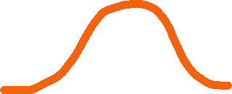

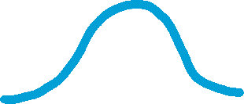


Causal Inference assumptions
Exchangeability No unmeasured confounding (causal sufficiency)
Treated
Untreated
Risk
Average “effect”
Age
Age
Notes:
HCQ + Covid-19

Slide 5
Causal Inference assumptions
Confounders are variables that affect both the assignment and the outcome
HCQ
COVID
We thought we saw Hydroxychloroquine reduce the risk of Covid-19

Slide 6
Causal Inference assumptions
Confounders are variables that affect both the assignment and the outcome
Age
Younger people tend to be prescribed to chloroquine
Younger people tend to have lower risk of covid
HCQ
COVID
Appears to reduce Covid-19 when not accounting for age

Slide 7




Causal Inference assumptions
In an experimental setting the drug is allocated randomly
Not constrained to the observed distribution
Promises similar distribution of features between treated and control
When comparing, these effects cancel themselves
Treated
Untreated
Risk
Average effect
Age
Age
Notes:
Create a new data-distribution (experimental [not observational] distribution) in which effect is identifiable.

Slide 8
Causal Inference assumptions
Effect decomposition
Randomized control trial
Observational data
Treated
Untreated
Treated
Untreated
Age
Age
Risk
Average effect
Risk
Average “effect”
Age
Age
Notes:
“Randomization is the closest thing we have to magic”

Slide 9

Causal Inference assumptions
Consistency well defined interventions
To be able to translate from the hypothetical world to the real world
Weight $↓$
Health

Slide 10



Causal Inference assumptions
Consistency well defined interventions
To be able to translate from the hypothetical world to the real world
Weight $↓$
Health
Notes:
Also: who’s the control group?

Slide 11
Causal Inference assumptions
To make the leap between hypothetical to measurable quantities
Consistency well defined interventions
To be able to translate from the hypothetical world to the real world
Exchangeability No unmeasured confounding (causal sufficiency)
Disentangle spurious correlations from causal contributions
Positivity Everyone have some chance to be in both treatment groups
“half the potential outcomes table is already full”
“Specific choice of $X$”
“IPW breaks if there are zero data points”
Notes:
In order to trust the counterfactual prediction from observed data.
ML assumptions: has iid assumption, uniform convergence for empirical risk minimization. Additional causal assumptions.

Slide 12
Causation = Correlation + Logic
Notes:
Getting correlations is easy. Hypothesizing whether these correlations are causal is hard.
willing to assume these assumptions holds
thought thoroughly about the problem and modelling (and your definition of intervention and carefully designed your control group), you may claim that the correlations you see are actually causal quantities.

