Slide 1
How causation causes correlation

Slide 2









How causation causes associations
4 reasons to see associations between $X$ and $Y$:
$X$ causes $Y$
$Y$ causes $X$
$X$ and $Y$ are confounded by $U$
$X$ and $Y$ are selected by $S$
$$X$$
$$Y$$
$$X$$
$$Y$$
$$U$$
$$X$$
$$Y$$
$$S$$

Slide 3
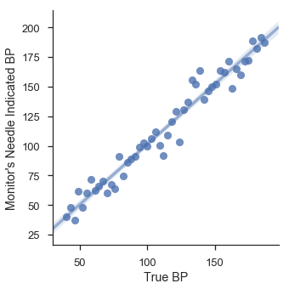
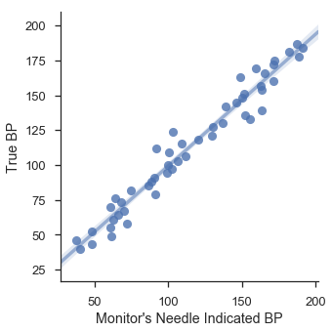
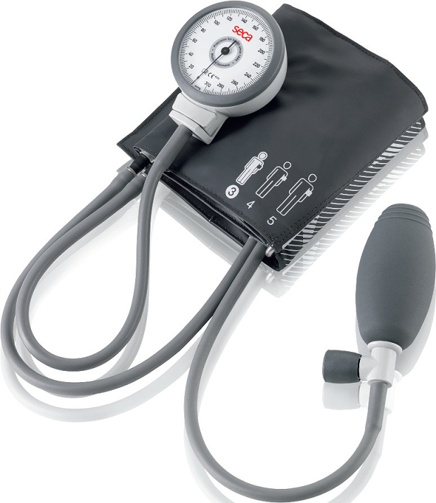
Direct causes
Data can only show patterns of association.
Notes:
To prove data is dumb I have the dumbest example.
BP monitor. With some noisy measurement.
Knowing true BP is my superpower.
BP raising so does the needle indication.
The relation is invariant to direction. That’s why we can transpose (Galton)
Holding the needle in the BP monitor will not keep BP constant.

Slide 4


Direct causes
But we can impose additional knowledge structure (meta-data) to talk about causes and effects
Association between phenomena and measurement

Slide 5
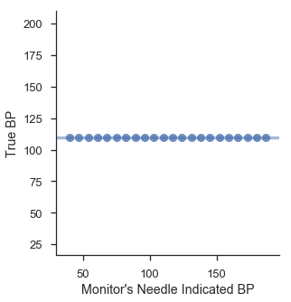
Direct causes
increase
increase
Notes:
Blood pressure as function of needle is constant

Slide 6
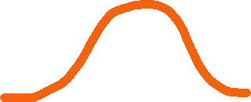




Confounding
Exchangeability / Ignorability No unmeasured confounding (causal sufficiency)
Treated
Untreated
Risk
Average “effect”
Age
Age

Slide 7
Confounding
Confounders are variables that affect both the assignment and the outcome
HCQ
COVID
We thought we saw Hydroxychloroquine reduce the risk of Covid-19

Slide 8
Confounding
Confounders are variables that affect both the assignment and the outcome
Age
Younger people tend to be prescribed to chloroquine
Younger people tend to have lower risk of covid
HCQ
COVID
Appears to reduce Covid-19 when not accounting for age

Slide 9
Selection bias
Hotness
Niceness

Slide 10

Selection bias
$$r^{2}\sim 0$$
Hotness
Niceness

Slide 11
Selection bias
Hotness
Niceness

Slide 12
Selection bias
Hotness
Less
desirable
Niceness

Slide 13
Selection bias
Hotness
Less
desirable
Niceness

Slide 14
Selection bias
Out of your league
Hotness
Less
desirable
Niceness

Slide 15
Selection bias
Hotness
Niceness

Slide 16

Selection bias
Hotness
$$r^{2}≪0$$
Niceness

Slide 17
Selection bias
Out of your league
Hotness
Less
desirable
$$r^{2}≪0$$
Niceness

Slide 18
Selection bias
Nice
Hot
$$r^{2}\sim 0$$
Hotness
Niceness

Slide 19
Selection bias
Nice
Hot
Hotness
Preference
$$r^{2}≪0$$
Niceness

Slide 20
Selection bias
Nice
Hot
Preference

Slide 21
Selection bias
Hotness
Niceness

Slide 22
How causation causes associations
4 reasons to see associations between $X$ and $Y$:
$X$ causes $Y$
$Y$ causes $X$
$X$ and $Y$ are confounded by $U$
$X$ and $Y$ are selected by $S$
$$X$$
$$Y$$
$$X$$
$$Y$$
$$U$$
$$X$$
$$Y$$
$$S$$

