Slide 1
Causality – A Road Map
Causality
Causal Discovery
What caused the outcome? Why?
Causal Inference
Quantify impact of a prespecified cause of interest
?
?
?
?
?
Notes:
What we mean when we say “causal inference”.
Left: inferring the graph.
Right: given the graph, put weights on its edges.

Slide 2
Causality – A Road Map
Causality
Causal Discovery
What caused the outcome? Why?
Causal Inference
Quantify impact of a prespecified cause of interest
?
Notes:
Forward causality – first choose a cause and then estimates its effect

Slide 3
Causal Inference – The Task
Quantifying the causal effect of a specified intervention on a specified outcome.
“Will the user buy a subscription if I would send them a coupon?”
“what’s the risk for stroke if you would take statins?”
Disentangle spurious correlations from causal contributions
Notes:
Known treatment of interest and known measure of outcome.
quantify the impact of the intervention on the outcome.

Slide 4
Causal Inference – The Task
Quantifying the causal effect of a specified intervention on a specified outcome.
“Will the user buy a subscription if I would send them a coupon?”
“what’s the risk for stroke if they wouldn’t take statins?”
Disentangle spurious correlations from causal contributions
Notes:
Known treatment of interest and known measure of outcome.
quantify the impact of the intervention on the outcome.

Slide 5
Causal Inference – The Task
Quantifying the causal effect of a specified intervention on a specified outcome.
“Will the user buy a subscription if I would send them a coupon?”
“what’s the risk for stroke if they wouldn’t take statins?”
Disentangle spurious correlations from causal contributions
Notes:
Known treatment of interest and known measure of outcome.
quantify the impact of the intervention on the outcome.

Slide 6
Causal Inference by counterfactual prediction
Conceptually, to quantify the causal effect:
Compare
what would have happened if we did something
to
what would have happened if we did nothing

Slide 7
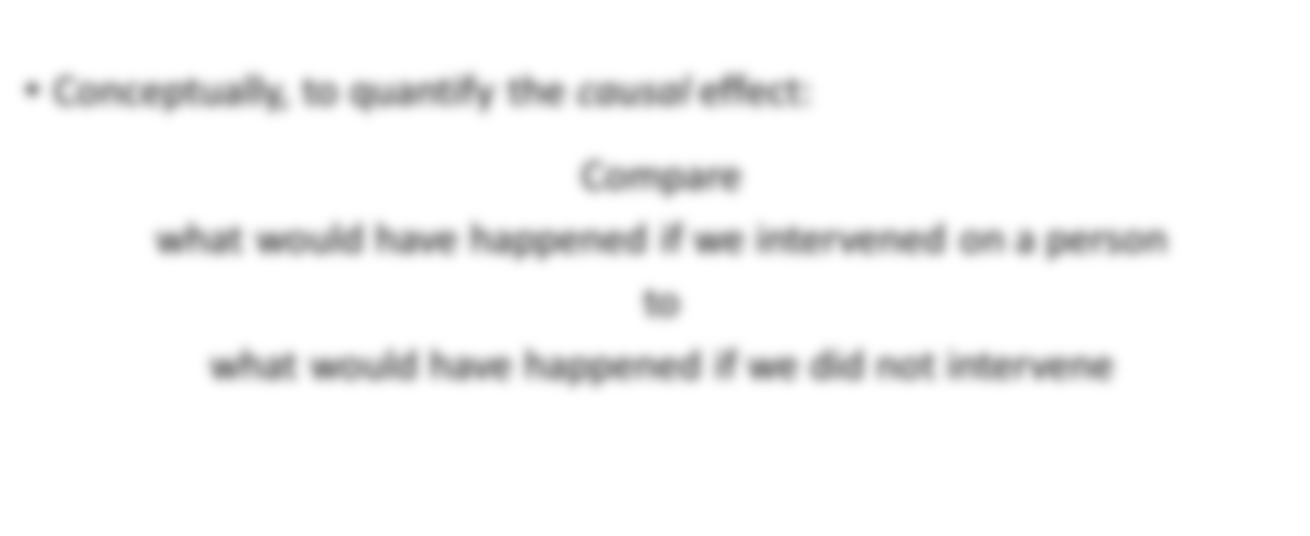

Causal Inference – How
Notes:
Or say your outcome is marital status and the treatment is missing vs catching the train [Your marital status if you catch the train or you miss it]
(It might be funny but it conveys the notion of the multi-verse)

Slide 8

Causal Inference by counterfactual prediction
Ideally,
The Multiverse!
Universe splits just before intervention is administrated

Slide 9


Causal Inference by counterfactual prediction
Ideally,
The Multiverse!
Universe splits just before intervention is administrated
The rest is identical
Notes:
in one you intervene on and on the other you do not. and the rest is identical. So every difference you observe between the universes must be due to the intervention you administered.

Slide 10
Causal Inference by counterfactual prediction
Ideally,
The Multiverse!
Universe splits just before intervention is administrated
The rest is identical
“Effect” is then the contrast between two worlds:
-
/
Notes:
in one you intervene on and on the other you do not. and the rest is identical. So every difference you observe between the universes must be due to the intervention you administered.

Slide 11
Causal Inference by counterfactual prediction
Counterfactual = counter to the fact
Contrary to the thing that happened in reality
In machine-learning/statistics we predict/describe the world
In causal inference we predict what would have happened in a slightly different world

Slide 12
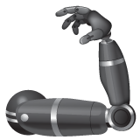
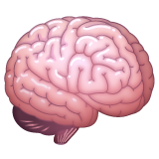
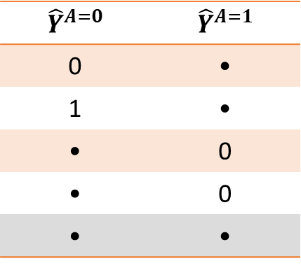

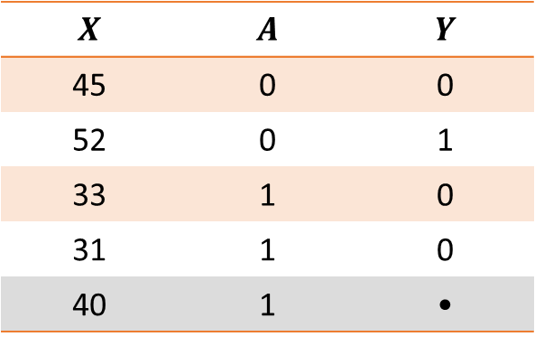

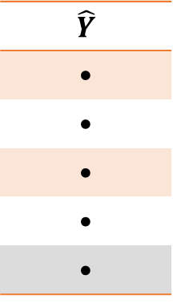
Causal Inference is not supervised learning
Supervised learning prediction
Counterfactual prediction
$X$: features
$Y$: target
$X$: features
$Y$: target
$A$: intervention/action
$$X$$ | $$A$$ | $$Y$$
45 | 0 | 0
52 | 0 | 1
33 | 1 | 0
31 | 1 | 0
40 | 1 | •
$$\hat{Y}$$
•
•
•
•
•
$${\hat{Y}}^{A=0}$$ | $${\hat{Y}}^{A=1}$$
0 | •
1 | •
• | 0
• | 0
• | •
■ Test-set
Observed Data
Outcome
Potential Outcome
Notes:
ML: training: model stroke from data (data can also include statins intake). Test: given a new patient, will they suffer stroke or not?
CI: Treatments are 1st–class citizens. training: model the contribution of A to stroke. Test: what would’ve happened if we had switched treatments?
Can set features synthetically, but if your model never saw young-people being treated you can’t trust it to provide a good prediction. CI “guarantees” that this extrapolation makes sense.

Slide 13
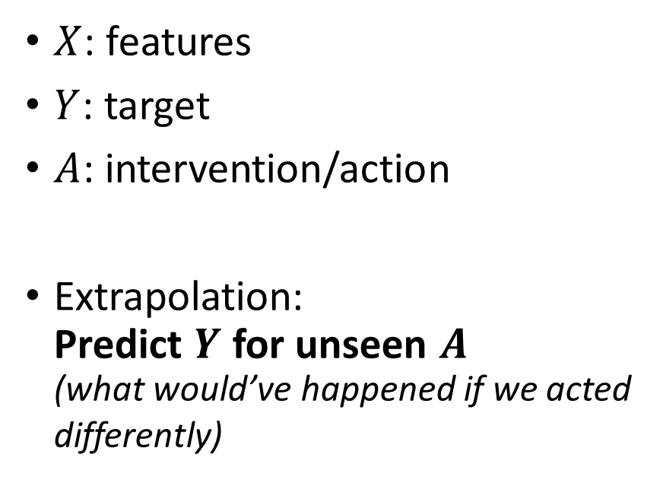
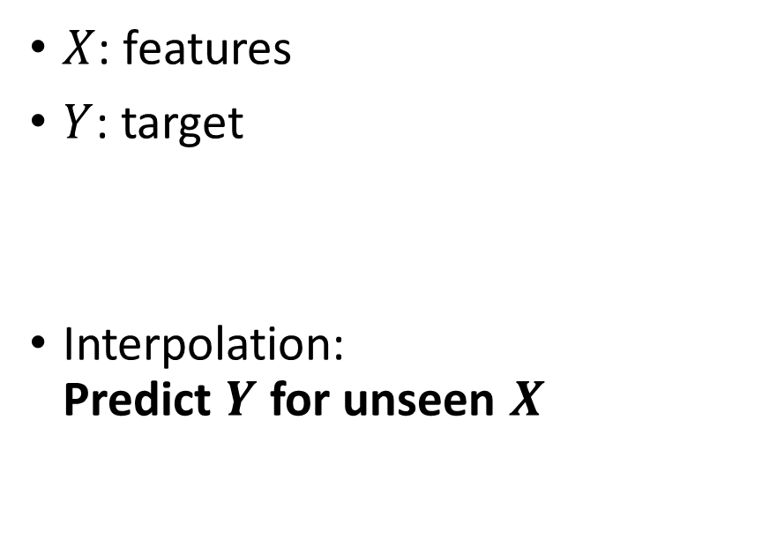
Causal Inference is not supervised learning
Supervised learning prediction
Counterfactual prediction
$X$: features
$Y$: target
Interpolation: Predict $Y$ for unseen $X$
$X$: features
$Y$: target
$A$: intervention/action
Extrapolation: Predict $Y$ for unseen $A$ (what would’ve happened if we acted differently)
Notes:
So in regular supervised learning we have features and a target and we use them to predict the target for new unseen samples.
I causal inference we also have actions, and we predict target for unseen actions.

Slide 14
Causal Inference is not supervised learning
A prediction task
An intervention task
Captures the current way a treatment is administered
Might capture differences in population, rather than treatment
What would have happened if we gave patients a drug that they didn’t actually get.
Can be outside the distribution of the observed past patterns

Slide 16
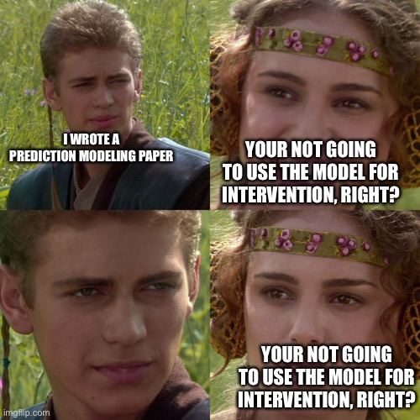
Causal Inference is not supervised learning
@AlexJohnLondon

Slide 17

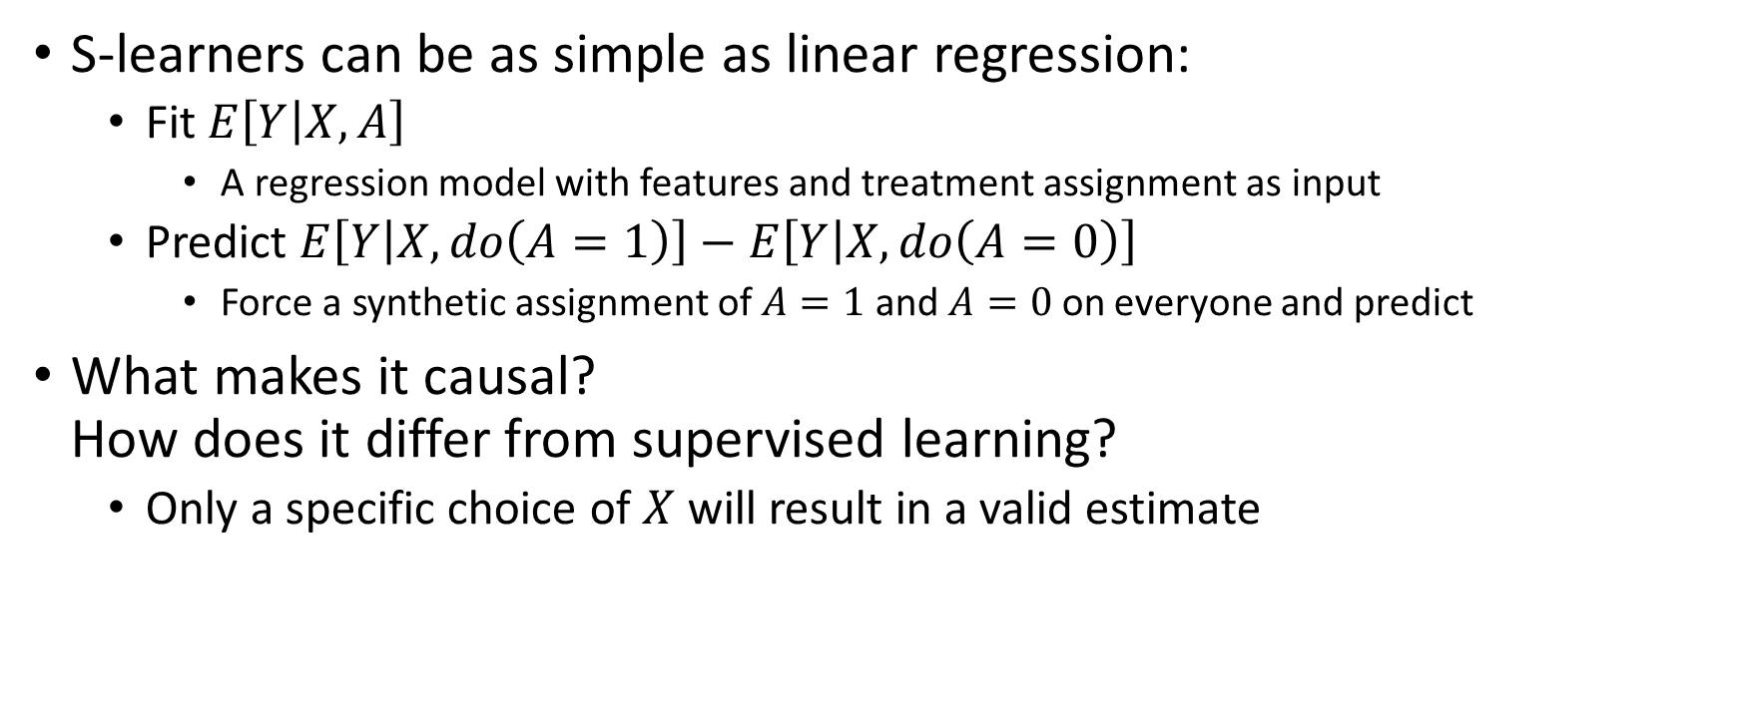
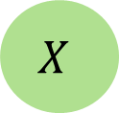
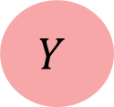
Outcome Models – meta-learners
S-learners can be as simple as linear regression:
Fit $E\left[Y | X,A\right]$
A regression model with features and treatment assignment as input
Predict $E\left[Y | X,do\left(A=1\right)\right]−E\left[Y | X,do\left(A=0\right)\right]$
Force a synthetic assignment of $A=1$ and $A=0$ on everyone and predict
What makes it causal? How does it differ from supervised learning?
Only a specific choice of $X$ will result in a valid estimate
$$X$$
$$A$$
$$Y$$

Slide 18
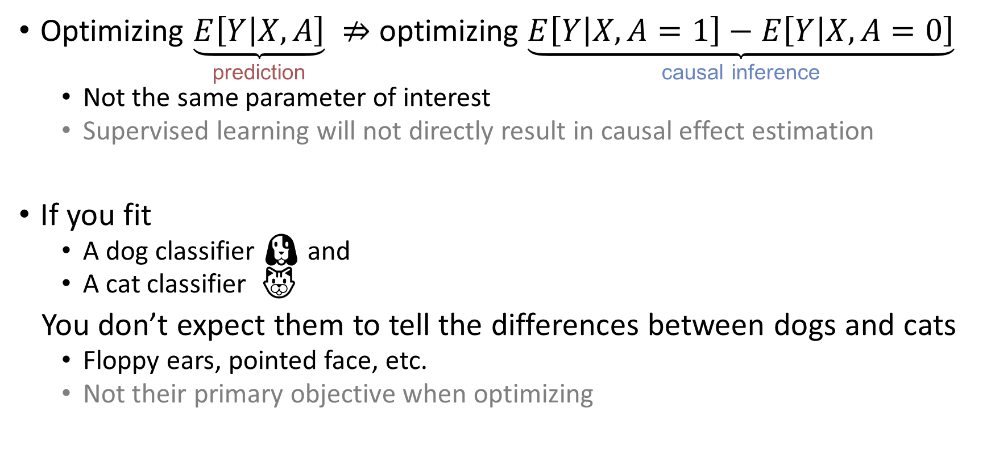
Supervised learning vs. counterfactual prediction
Optimizing $\underset{\text{prediction}}{\underbrace{E\left[Y | X,A\right]}} ⇏$ optimizing $\underset{\text{causal} \text{inference}}{\underbrace{E\left[Y | X,A=1\right]−E\left[Y | X,A=0\right]}}$
Not the same parameter of interest
Supervised learning will not directly result in causal effect estimation
If you fit
A dog classifier 🐶 and
A cat classifier 🐱
You don’t expect them to tell the differences between dogs and cats
Floppy ears, pointed face, etc.
Not their primary objective when optimizing

