Slide 1
Interrupted time series modelling

Slide 2
Interrupted time series modelling
Epidemiologists emulate a clinical trial with data
Cross-sectional data
Data is collected at a single point in time (up to a follow-up)
One group received intervention and another group did not at recruit time
Control confounders to emulate randomization
Eliminate the effect of the covariates to isolate the effect of the treatment
Econometrics deals with repeated observations over time
Panel (longitudinal) data
Repeated observations over time
A policy is introduced at a known point in time
Different problems ⇒ Different approaches ⇒ Different methods

Slide 3

Pre- Post- design
Time
$$T_{0}$$

Slide 4
Pre- Post- design
Pre-intervention
Post-intervention
Time
$$T_{0}$$

Slide 5
Pre- Post- design
Outcome
Time
$$T_{0}$$

Slide 6
Pre- Post- design
Outcome
Treated
Time
$$T_{0}$$
Notes:
See a difference but is it because the intervention or is it time-confounded? (continuing trend)

Slide 7
Pre- Post- design
Outcome
Treated
Control
Time
$$T_{0}$$
Notes:
Add a control to compare.
See the slope

Slide 8
Pre- Post- design
Difference in differences
Outcome
Treated
Difference
Difference
Control
Time
$$T_{0}$$
Notes:
Difference in pre-treatment, difference in post-treatment
Difference between those

Slide 9
Pre- Post- design
Outcome
Treated
Control
Time
$$T_{0}$$
Notes:
But that’s only one control

Slide 10
Pre- Post- design
Control
Outcome
Treated
Control
Control
Control
Control
Time
$$T_{0}$$

Slide 11
Pre- Post- design
Control
Outcome
Treated
Matched Control
Control
Control
Control
Time
$$T_{0}$$
Notes:
Most similar control
(throws away lots of info)

Slide 12
Pre- Post- design
Control
Outcome
Treated
Control
Average Control
Control
Control
Control
Time
$$T_{0}$$
Notes:
Simple average

Slide 13
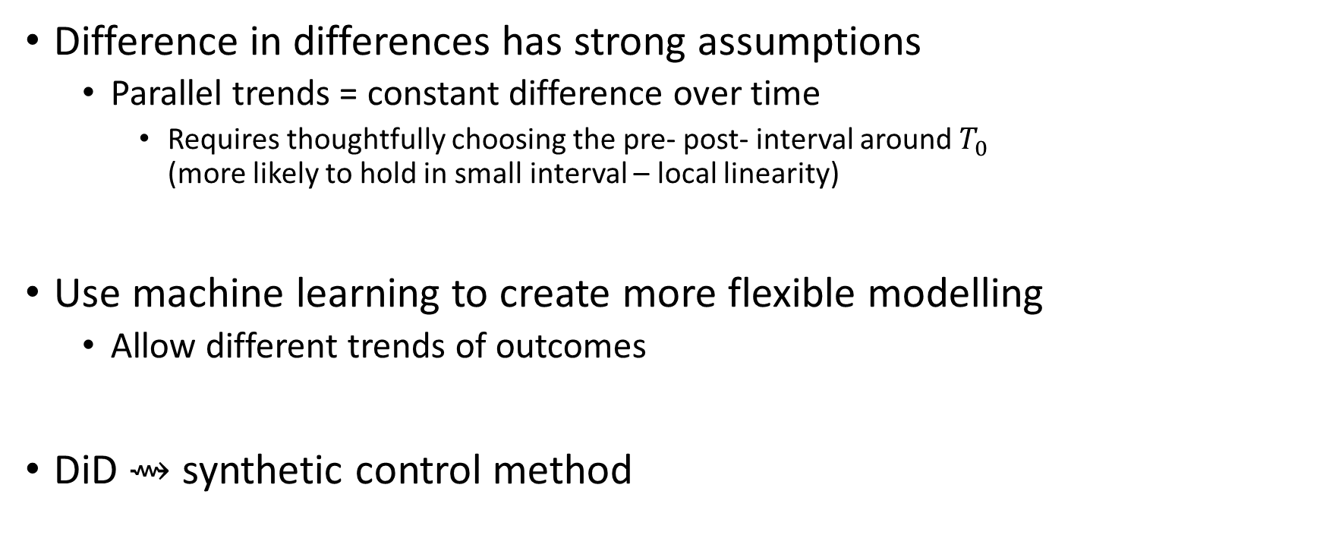
Pre- Post- design
Difference in differences has strong assumptions
Parallel trends = constant difference over time
Requires thoughtfully choosing the pre- post- interval around $T_{0}$ (more likely to hold in small interval – local linearity)
Use machine learning to create more flexible modelling
Allow different trends of outcomes
DiD ⇝ synthetic control method
Notes:
Constant difference = modelled with a regression coefficient of the interaction term, so the change must be constant

Slide 14
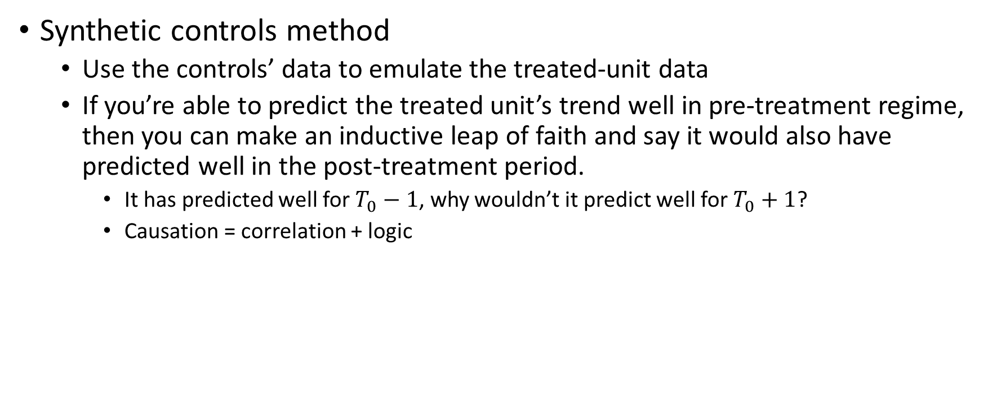
Pre- Post- design
Synthetic controls method
Use the controls’ data to emulate the treated-unit data
If you’re able to predict the treated unit’s trend well in pre-treatment regime, then you can make an inductive leap of faith and say it would also have predicted well in the post-treatment period.
It has predicted well for $T_{0}−1$, why wouldn’t it predict well for $T_{0}+1$?
Causation = correlation + logic

Slide 15

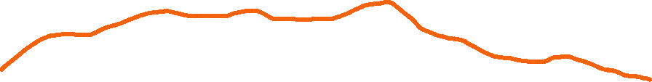
Pre- Post- design
Outcome
Time
$$T_{0}$$
Notes:
Some reduction after $T_{0}$ but is it because of the intervention?

Slide 16

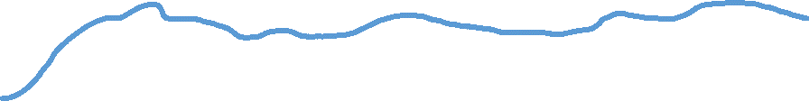
Pre- Post- design
Outcome
Time
Outcome
Time
Outcome
Time
$$T_{0}$$

Slide 17



Pre- Post- design
Outcome
$${\hat{y}}_{0,t}={f(y}_{1,t},y_{2,t})$$
Time
Outcome
$$y_{1,t}$$
Time
Outcome
$$y_{2,t}$$
Time
$$T_{0}$$

Slide 18


Pre- Post- design
$$\hat{y}=f\left(y_{1},y_{2}\right)$$
Outcome
Time
Outcome
Time
Outcome
Time
$$T_{0}$$

Slide 19
Pre- Post- design
$$\hat{y}=f\left(y_{1},y_{2}\right)$$
Causation = correlation + logic
Outcome
Time
Outcome
Time
Outcome
Time
$$T_{0}$$
Notes:
If you’re able to predict the treated unit’s trend well in pre-treatment regime, then you can make an inductive leap of faith and say it would also have predicted well in the post-treatment period.
$f$ has predicted well for 𝑇_0−1, why wouldn’t it predict well for 𝑇_0+1?

Slide 20


Pre- Post- design
$$\hat{y}=f\left(y_{1},y_{2}\right)$$
$${\hat{Y}}^{0}=f\left(y_{1},y_{2}\right)$$
Outcome
$$Y^{1}=y$$
Time
Outcome
Time
Outcome
Time
$$T_{0}$$
Notes:
Thoughtful prediction, maybe more recent time periods are more important, etc.

Slide 21
Pre- Post- design
Synthetic control method
Better prediction accuracy ⇒ more confidence in inductive leap
Measurable
Make sure residuals are not bias
Classic methods focus on inference, but you can focus on prediction instead

Slide 22
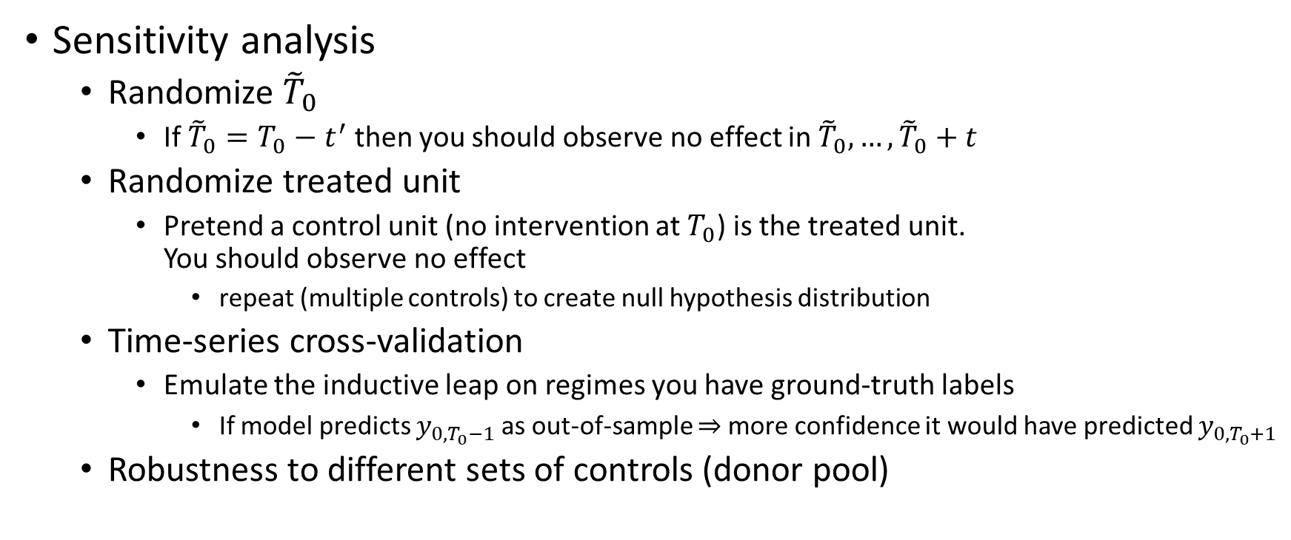
Pre- Post- design
Sensitivity analysis
Randomize ${\tilde{T}}_{0}$
If ${\tilde{T}}_{0}=T_{0}−t^{′}$ then you should observe no effect in ${\tilde{T}}_{0},…,{\tilde{T}}_{0}+t$
Randomize treated unit
Pretend a control unit (no intervention at $T_{0}$) is the treated unit. You should observe no effect
repeat (multiple controls) to create null hypothesis distribution
Time-series cross-validation
Emulate the inductive leap on regimes you have ground-truth labels
If model predicts $y_{0,T_{0}−1}$ as out-of-sample ⇒ more confidence it would have predicted $y_{0,T_{0}+1}$
Robustness to different sets of controls (donor pool)

