Slide 2
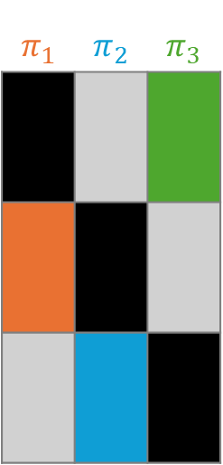




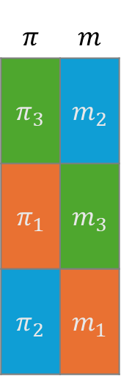

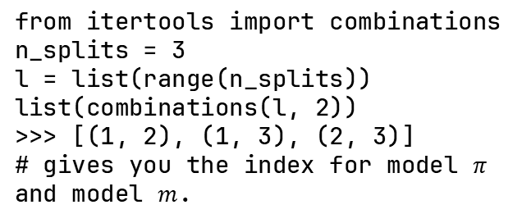

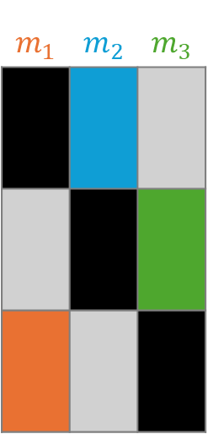
Stack each model’s predictions on the whole data
Look-up predictions based on model-index and split-index to get a single vector
$$π_{1}$$ | $$π_{2}$$ | $$π_{3}$$
$$m_{1}$$ | $$m_{2}$$ | $$m_{3}$$
$$π$$ | $$m$$
$$π_{3}$$ | $$m_{2}$$
$$π_{1}$$ | $$m_{3}$$
$$π_{2}$$ | $$m_{1}$$
$$X_{1}$$
$$π_{1}$$
$$m_{1}$$
$$X_{2}$$
$$π_{2}$$
$$m_{2}$$
$$X_{3}$$
$$π_{3}$$
$$m_{3}$$
Not selected
selected
In-sample prediction
from itertools import combinations
n_splits = 3
l = list(range(n_splits))
list(combinations(l, 2))
>>> [(1, 2), (1, 3), (2, 3)]
# gives you the index for model $π$ and model $m$.

Slide 4
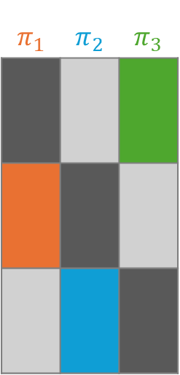

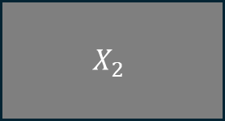







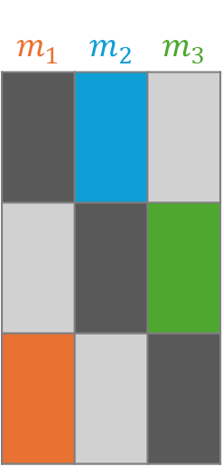

Stack each model’s predictions on the whole data
Look-up predictions based on model-index and split-index to get a single vector
$$π_{1}$$ | $$π_{2}$$ | $$π_{3}$$
$$m_{1}$$ | $$m_{2}$$ | $$m_{3}$$
$$π$$ | $$m$$
$$π_{3}$$ | $$m_{2}$$
$$π_{1}$$ | $$m_{3}$$
$$π_{2}$$ | $$m_{1}$$
$$X_{1}$$
$$A_{1}$$
$$Y_{1}$$
$$π_{1}$$
$$m_{1}$$
$$X_{2}$$
$$A_{2}$$
$$Y_{2}$$
$$π_{2}$$
$$m_{2}$$
$$X_{3}$$
$$A_{3}$$
$$Y_{3}$$
$$π_{3}$$
$$m_{3}$$
Not selected
selected
In-sample prediction

Slide 5
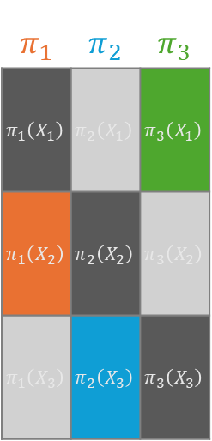




Double cross-fitting
$$π_{1}$$ | $$π_{2}$$ | $$π_{3}$$
$$π_{1}\left(X_{1}\right)$$ | $$π_{2}\left(X_{1}\right)$$ | $$π_{3}\left(X_{1}\right)$$
$$π_{1}\left(X_{2}\right)$$ | $$π_{2}\left(X_{2}\right)$$ | $$π_{3}\left(X_{2}\right)$$
$$π_{1}\left(X_{3}\right)$$ | $$π_{2}\left(X_{3}\right)$$ | $$π_{3}\left(X_{3}\right)$$
$$m_{1}$$ | $$m_{2}$$ | $$m_{3}$$
$$m_{1}\left(X_{1}\right)$$ | $$m_{2}\left(X_{1}\right)$$ | $$m_{3}\left(X_{1}\right)$$
$$m_{1}\left(X_{2}\right)$$ | $$m_{2}\left(X_{2}\right)$$ | $$m_{3}\left(X_{2}\right)$$
$$m_{1}\left(X_{3}\right)$$ | $$m_{2}\left(X_{3}\right)$$ | $$m_{3}\left(X_{3}\right)$$
$$π$$ | $$m$$
$$π_{3}$$ | $$m_{2}$$
$$π_{1}$$ | $$m_{3}$$
$$π_{2}$$ | $$m_{1}$$
$$X_{1}$$
$$A_{1}$$
$$Y_{1}$$
$$π_{1}$$
$$m_{1}$$
$$X_{2}$$
$$A_{2}$$
$$Y_{2}$$
$$π_{2}$$
$$m_{2}$$
$$X_{3}$$
$$A_{3}$$
$$Y_{3}$$
$$π_{3}$$
$$m_{3}$$
Not selected
selected
In-sample prediction

Slide 6
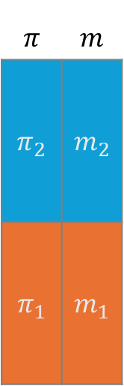
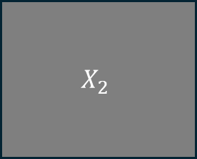
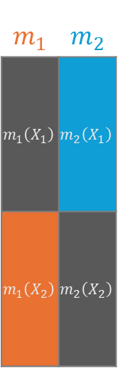


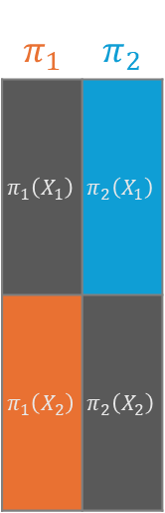





Cross-fitting
$$π_{1}$$ | $$π_{2}$$
$$π_{1}\left(X_{1}\right)$$ | $$π_{2}\left(X_{1}\right)$$
$$π_{1}\left(X_{2}\right)$$ | $$π_{2}\left(X_{2}\right)$$
$$m_{1}$$ | $$m_{2}$$
$$m_{1}\left(X_{1}\right)$$ | $$m_{2}\left(X_{1}\right)$$
$$m_{1}\left(X_{2}\right)$$ | $$m_{2}\left(X_{2}\right)$$
$$π$$ | $$m$$
$$π_{2}$$ | $$m_{2}$$
$$π_{1}$$ | $$m_{1}$$
$$X_{1}$$
$$A_{1}$$
$$Y_{1}$$
$$π_{1}$$
$$m_{1}$$
$$X_{2}$$
$$A_{2}$$
$$Y_{2}$$
$$π_{2}$$
$$m_{2}$$
selected
In-sample prediction

Slide 7
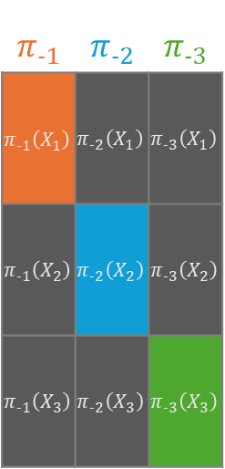



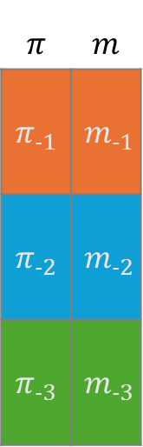
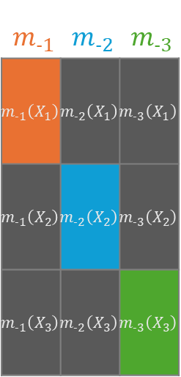
Cross-validation
$$π_{‐1}$$ | $$π_{‐2}$$ | $$π_{‐3}$$
$$π_{‐1}\left(X_{1}\right)$$ | $$π_{‐2}\left(X_{1}\right)$$ | $$π_{‐3}\left(X_{1}\right)$$
$$π_{‐1}\left(X_{2}\right)$$ | $$π_{‐2}\left(X_{2}\right)$$ | $$π_{‐3}\left(X_{2}\right)$$
$$π_{‐1}\left(X_{3}\right)$$ | $$π_{‐2}\left(X_{3}\right)$$ | $$π_{‐3}\left(X_{3}\right)$$
$$m_{‐1}$$ | $$m_{‐2}$$ | $$m_{‐3}$$
$$m_{‐1}\left(X_{1}\right)$$ | $$m_{‐2}\left(X_{1}\right)$$ | $$m_{‐3}\left(X_{1}\right)$$
$$m_{‐1}\left(X_{2}\right)$$ | $$m_{‐2}\left(X_{2}\right)$$ | $$m_{‐3}\left(X_{2}\right)$$
$$m_{‐1}\left(X_{3}\right)$$ | $$m_{‐2}\left(X_{3}\right)$$ | $$m_{‐3}\left(X_{3}\right)$$
$$π$$ | $$m$$
$$π_{‐1}$$ | $$m_{‐1}$$
$$π_{‐2}$$ | $$m_{‐2}$$
$$π_{‐3}$$ | $$m_{‐3}$$
$$X_{1}$$
$$A_{1}$$
$$Y_{1}$$
$$π_{‐1}$$
$$m_{‐1}$$
$$X_{2}$$
$$A_{2}$$
$$Y_{2}$$
$$π_{‐2}$$
$$m_{‐2}$$
$$X_{3}$$
$$A_{3}$$
$$Y_{3}$$
$$π_{‐3}$$
$$m_{‐3}$$
In-sample prediction
selected

Slide 8
Cross-fitting/Cross-validation
$$π_{‐1}$$ | $$π_{‐2}$$ | $$π_{‐3}$$
$$π_{‐1}\left(X_{1}\right)$$ | $$π_{‐2}\left(X_{1}\right)$$ | $$π_{‐3}\left(X_{1}\right)$$
$$π_{‐1}\left(X_{2}\right)$$ | $$π_{‐2}\left(X_{2}\right)$$ | $$π_{‐3}\left(X_{2}\right)$$
$$π_{‐1}\left(X_{3}\right)$$ | $$π_{‐2}\left(X_{3}\right)$$ | $$π_{‐3}\left(X_{3}\right)$$
$$m_{‐1}$$ | $$m_{‐2}$$ | $$m_{‐3}$$
$$m_{‐1}\left(X_{1}\right)$$ | $$m_{‐2}\left(X_{1}\right)$$ | $$m_{‐3}\left(X_{1}\right)$$
$$m_{‐1}\left(X_{2}\right)$$ | $$m_{‐2}\left(X_{2}\right)$$ | $$m_{‐3}\left(X_{2}\right)$$
$$m_{‐1}\left(X_{3}\right)$$ | $$m_{‐2}\left(X_{3}\right)$$ | $$m_{‐3}\left(X_{3}\right)$$
$$π$$ | $$m$$
$$π_{‐1}$$ | $$m_{‐1}$$
$$π_{‐2}$$ | $$m_{‐2}$$
$$π_{‐3}$$ | $$m_{‐3}$$
$$X_{1}$$
$$A_{1}$$
$$Y_{1}$$
$$π_{‐1}$$
$$m_{‐1}$$
$$X_{2}$$
$$A_{2}$$
$$Y_{2}$$
$$π_{‐2}$$
$$m_{‐2}$$
$$X_{3}$$
$$A_{3}$$
$$Y_{3}$$
$$π_{‐3}$$
$$m_{‐3}$$
In-sample prediction
selected

Slide 9
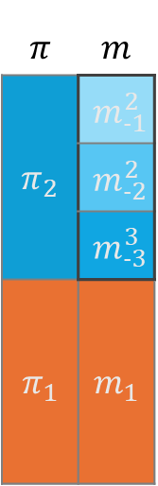
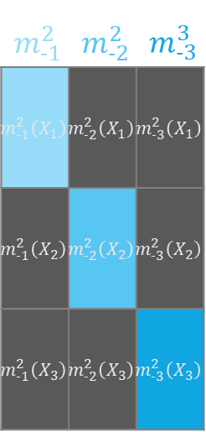
Cross-fitting with cross-validation
$$π_{1}$$ | $$π_{2}$$
$$π_{1}\left(X_{1}\right)$$ | $$π_{2}\left(X_{1}\right)$$
$$π_{1}\left(X_{2}\right)$$ | $$π_{2}\left(X_{2}\right)$$
$$m_{1}$$ | $$m_{2}$$
$$m_{1}\left(X_{1}\right)$$ | $$m_{2}\left(X_{1}\right)$$
$$m_{1}\left(X_{2}\right)$$ | $$m_{2}\left(X_{2}\right)$$
$$π$$ | $$m$$
$$π_{2}$$ | $$m_{‐1}^{2}$$
 | $$m_{‐2}^{2}$$
 | $$m_{‐3}^{3}$$
$$π_{1}$$ | $$m_{1}$$
$$X_{1}$$
$$A_{1}$$
$$Y_{1}$$
$$π_{1}$$
$$m_{1}$$
$$X_{2}$$
$$A_{2}$$
$$Y_{2}$$
$$m_{‐1}^{2}$$ | $$m_{‐2}^{2}$$ | $$m_{‐3}^{3}$$
$$m_{‐1}^{2}\left(X_{1}\right)$$ | $$m_{‐2}^{2}\left(X_{1}\right)$$ | $$m_{‐3}^{2}\left(X_{1}\right)$$
$$m_{‐1}^{2}\left(X_{2}\right)$$ | $$m_{‐2}^{2}\left(X_{2}\right)$$ | $$m_{‐3}^{2}\left(X_{2}\right)$$
$$m_{‐1}^{2}\left(X_{3}\right)$$ | $$m_{‐2}^{2}\left(X_{3}\right)$$ | $$m_{‐3}^{2}\left(X_{3}\right)$$
$$π_{2}$$
$$m_{2}$$
selected
In-sample prediction

Slide 10
Cross-fitting/Cross-validation
$$π_{‐1}$$ | $$π_{‐2}$$ | $$π_{‐3}$$
$$π_{‐1}\left(X_{1}\right)$$ | $$π_{‐2}\left(X_{1}\right)$$ | $$π_{‐3}\left(X_{1}\right)$$
$$π_{‐1}\left(X_{2}\right)$$ | $$π_{‐2}\left(X_{2}\right)$$ | $$π_{‐3}\left(X_{2}\right)$$
$$π_{‐1}\left(X_{3}\right)$$ | $$π_{‐2}\left(X_{3}\right)$$ | $$π_{‐3}\left(X_{3}\right)$$
$$m_{‐1}$$ | $$m_{‐2}$$ | $$m_{‐3}$$
$$m_{‐1}\left(X_{1}\right)$$ | $$m_{‐2}\left(X_{1}\right)$$ | $$m_{‐3}\left(X_{1}\right)$$
$$m_{‐1}\left(X_{2}\right)$$ | $$m_{‐2}\left(X_{2}\right)$$ | $$m_{‐3}\left(X_{2}\right)$$
$$m_{‐1}\left(X_{3}\right)$$ | $$m_{‐2}\left(X_{3}\right)$$ | $$m_{‐3}\left(X_{3}\right)$$
$$π$$ | $$m$$
$$π_{‐1}$$ | $$m_{‐1}$$
$$π_{‐2}$$ | $$m_{‐2}$$
$$π_{‐3}$$ | $$m_{‐3}$$
$$X_{1}$$
$$A_{1}$$
$$Y_{1}$$
$$π_{‐1}$$
$$m_{‐1}$$
$$X_{2}$$
$$A_{2}$$
$$Y_{2}$$
$$π_{‐2}$$
$$m_{‐2}$$
$$X_{3}$$
$$A_{3}$$
$$Y_{3}$$
$$π_{‐3}$$
$$m_{‐3}$$
In-sample prediction
selected

Slide 11
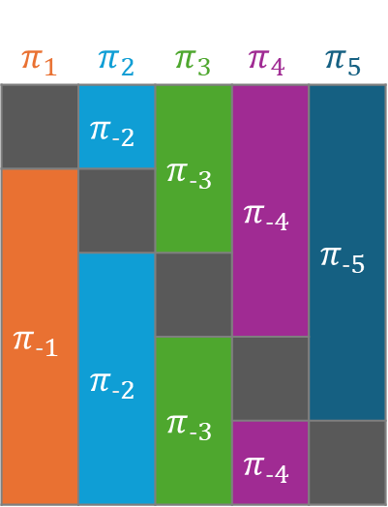
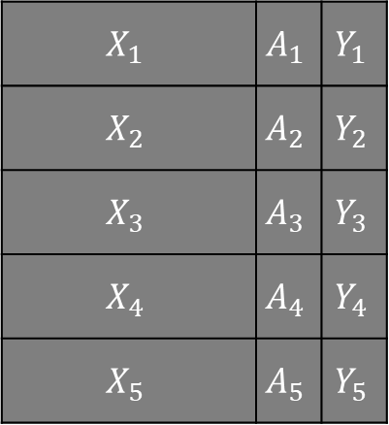
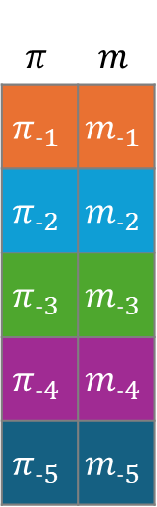
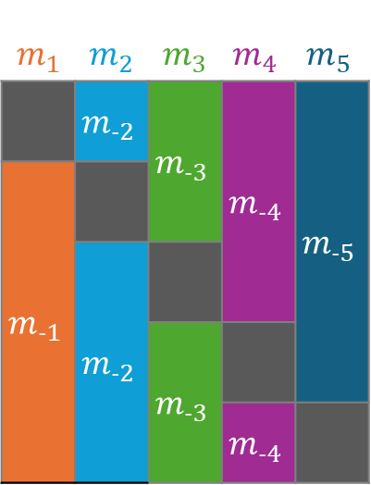
Cross-fitting/Cross-validation
$$π_{1}$$ | $$π_{2}$$ | $$π_{3}$$ | $$π_{4}$$ | $$π_{5}$$
 | $$π_{‐2}$$ | $$π_{‐3}$$ | $$π_{‐4}$$ | $$π_{‐5}$$
$$π_{‐1}$$
 | $$π_{‐2}$$
 |  | $$π_{‐3}$$
 |  |  | $$π_{‐4}$$
$$m_{1}$$ | $$m_{2}$$ | $$m_{3}$$ | $$m_{4}$$ | $$m_{5}$$
 | $$m_{‐2}$$ | $$m_{‐3}$$ | $$m_{‐4}$$ | $$m_{‐5}$$
$$m_{‐1}$$
 | $$m_{‐2}$$
 |  | $$m_{‐3}$$
 |  |  | $$m_{‐4}$$
$$π$$ | $$m$$
$$π_{‐1}$$ | $$m_{‐1}$$
$$π_{‐2}$$ | $$m_{‐2}$$
$$π_{‐3}$$ | $$m_{‐3}$$
$$π_{‐4}$$ | $$m_{‐4}$$
$$π_{‐5}$$ | $$m_{‐5}$$
$$X_{1}$$ | $$A_{1}$$ | $$Y_{1}$$
$$X_{2}$$ | $$A_{2}$$ | $$Y_{2}$$
$$X_{3}$$ | $$A_{3}$$ | $$Y_{3}$$
$$X_{4}$$ | $$A_{4}$$ | $$Y_{4}$$
$$X_{5}$$ | $$A_{5}$$ | $$Y_{5}$$
Fit folds
Out-of-sample prediction

Slide 12
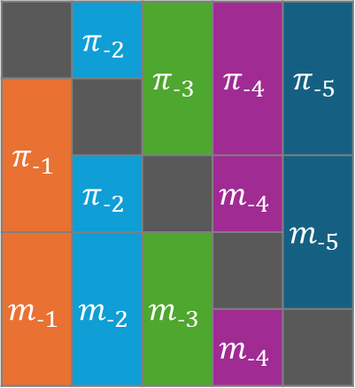
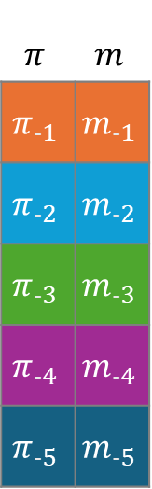
Generalized double cross-fitting
$$π$$ | $$m$$
$$π_{‐1}$$ | $$m_{‐1}$$
$$π_{‐2}$$ | $$m_{‐2}$$
$$π_{‐3}$$ | $$m_{‐3}$$
$$π_{‐4}$$ | $$m_{‐4}$$
$$π_{‐5}$$ | $$m_{‐5}$$
$$X_{1}$$ | $$A_{1}$$ | $$Y_{1}$$
$$X_{2}$$ | $$A_{2}$$ | $$Y_{2}$$
$$X_{3}$$ | $$A_{3}$$ | $$Y_{3}$$
$$X_{4}$$ | $$A_{4}$$ | $$Y_{4}$$
$$X_{5}$$ | $$A_{5}$$ | $$Y_{5}$$
 | $$π_{‐2}$$ | $$π_{‐3}$$ | $$π_{‐4}$$ | $$π_{‐5}$$
$$π_{‐1}$$
 | $$π_{‐2}$$ |  | $$m_{‐4}$$ | $$m_{‐5}$$
$$m_{‐1}$$ | $$m_{‐2}$$ | $$m_{‐3}$$
 |  |  | $$m_{‐4}$$
Outcome model folds
Fit fold
Out-of-sample prediction
Treatment model folds

Slide 13
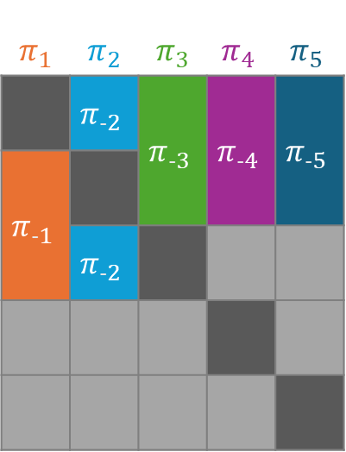
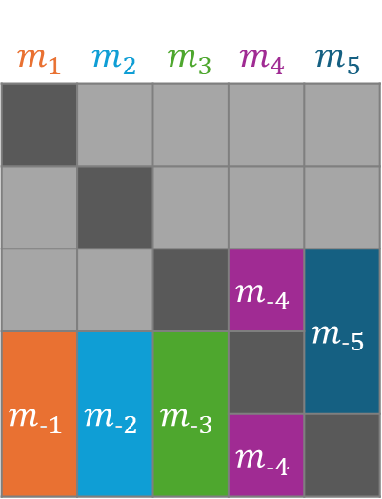
Generalized double cross-fitting
$$π_{1}$$ | $$π_{2}$$ | $$π_{3}$$ | $$π_{4}$$ | $$π_{5}$$
 | $$π_{‐2}$$ | $$π_{‐3}$$ | $$π_{‐4}$$ | $$π_{‐5}$$
$$π_{‐1}$$
 | $$π_{‐2}$$
$$m_{1}$$ | $$m_{2}$$ | $$m_{3}$$ | $$m_{4}$$ | $$m_{5}$$
 |  |  | $$m_{‐4}$$ | $$m_{‐5}$$
$$m_{‐1}$$ | $$m_{‐2}$$ | $$m_{‐3}$$
 |  |  | $$m_{‐4}$$
$$π$$ | $$m$$
$$π_{‐1}$$ | $$m_{‐1}$$
$$π_{‐2}$$ | $$m_{‐2}$$
$$π_{‐3}$$ | $$m_{‐3}$$
$$π_{‐4}$$ | $$m_{‐4}$$
$$π_{‐5}$$ | $$m_{‐5}$$
$$X_{1}$$ | $$A_{1}$$ | $$Y_{1}$$
$$X_{2}$$ | $$A_{2}$$ | $$Y_{2}$$
$$X_{3}$$ | $$A_{3}$$ | $$Y_{3}$$
$$X_{4}$$ | $$A_{4}$$ | $$Y_{4}$$
$$X_{5}$$ | $$A_{5}$$ | $$Y_{5}$$
Other model’s fit folds
Fit folds
Out-of-sample prediction

Slide 14
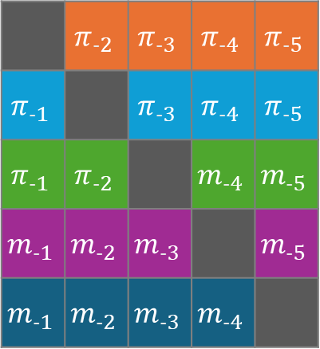
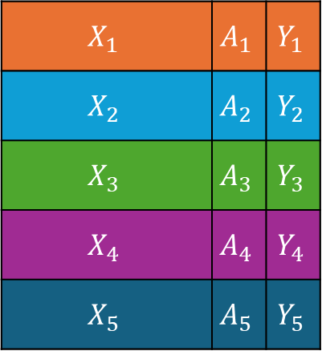
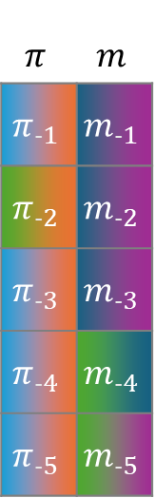
Generalized double cross-fitting
$$π$$ | $$m$$
$$π_{‐1}$$ | $$m_{‐1}$$
$$π_{‐2}$$ | $$m_{‐2}$$
$$π_{‐3}$$ | $$m_{‐3}$$
$$π_{‐4}$$ | $$m_{‐4}$$
$$π_{‐5}$$ | $$m_{‐5}$$
$$X_{1}$$ | $$A_{1}$$ | $$Y_{1}$$
$$X_{2}$$ | $$A_{2}$$ | $$Y_{2}$$
$$X_{3}$$ | $$A_{3}$$ | $$Y_{3}$$
$$X_{4}$$ | $$A_{4}$$ | $$Y_{4}$$
$$X_{5}$$ | $$A_{5}$$ | $$Y_{5}$$
 | $$π_{‐2}$$ | $$π_{‐3}$$ | $$π_{‐4}$$ | $$π_{‐5}$$
$$π_{‐1}$$ |  | $$π_{‐3}$$ | $$π_{‐4}$$ | $$π_{‐5}$$
$$π_{‐1}$$ | $$π_{‐2}$$ |  | $$m_{‐4}$$ | $$m_{‐5}$$
$$m_{‐1}$$ | $$m_{‐2}$$ | $$m_{‐3}$$ |  | $$m_{‐5}$$
$$m_{‐1}$$ | $$m_{‐2}$$ | $$m_{‐3}$$ | $$m_{‐4}$$
Outcome model folds
Fit fold
Out-of-sample prediction
Treatment model folds

Slide 15
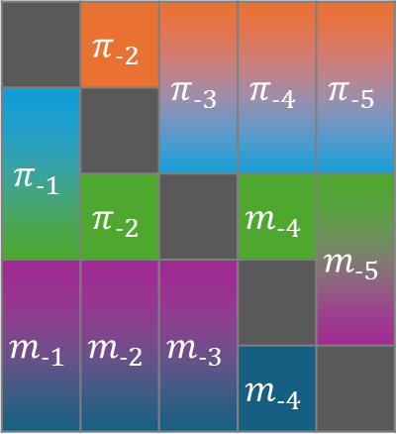
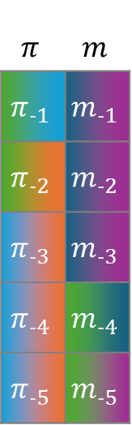
Generalized double cross-fitting
$$π$$ | $$m$$
$$π_{‐1}$$ | $$m_{‐1}$$
$$π_{‐2}$$ | $$m_{‐2}$$
$$π_{‐3}$$ | $$m_{‐3}$$
$$π_{‐4}$$ | $$m_{‐4}$$
$$π_{‐5}$$ | $$m_{‐5}$$
$$X_{1}$$ | $$A_{1}$$ | $$Y_{1}$$
$$X_{2}$$ | $$A_{2}$$ | $$Y_{2}$$
$$X_{3}$$ | $$A_{3}$$ | $$Y_{3}$$
$$X_{4}$$ | $$A_{4}$$ | $$Y_{4}$$
$$X_{5}$$ | $$A_{5}$$ | $$Y_{5}$$
 | $$π_{‐2}$$ | $$π_{‐3}$$ | $$π_{‐4}$$ | $$π_{‐5}$$
$$π_{‐1}$$
 | $$π_{‐2}$$ |  | $$m_{‐4}$$ | $$m_{‐5}$$
$$m_{‐1}$$ | $$m_{‐2}$$ | $$m_{‐3}$$
 |  |  | $$m_{‐4}$$
Outcome model folds
Out-of-sample prediction
Treatment model folds

Slide 16
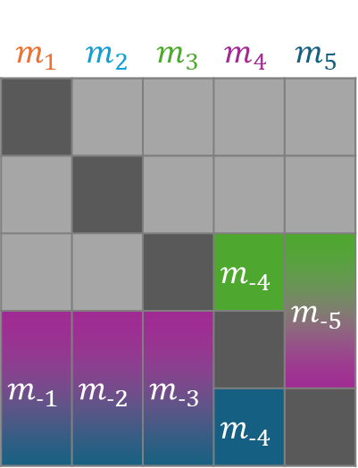
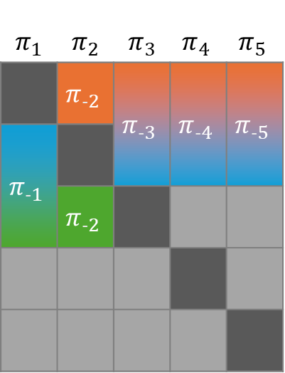
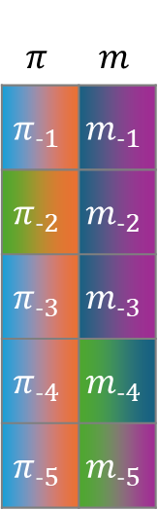
Generalized double cross-fitting
$$π_{1}$$ | $$π_{2}$$ | $$π_{3}$$ | $$π_{4}$$ | $$π_{5}$$
 | $$π_{‐2}$$ | $$π_{‐3}$$ | $$π_{‐4}$$ | $$π_{‐5}$$
$$π_{‐1}$$
 | $$π_{‐2}$$
$$m_{1}$$ | $$m_{2}$$ | $$m_{3}$$ | $$m_{4}$$ | $$m_{5}$$
 |  |  | $$m_{‐4}$$ | $$m_{‐5}$$
$$m_{‐1}$$ | $$m_{‐2}$$ | $$m_{‐3}$$
 |  |  | $$m_{‐4}$$
$$π$$ | $$m$$
$$π_{‐1}$$ | $$m_{‐1}$$
$$π_{‐2}$$ | $$m_{‐2}$$
$$π_{‐3}$$ | $$m_{‐3}$$
$$π_{‐4}$$ | $$m_{‐4}$$
$$π_{‐5}$$ | $$m_{‐5}$$
$$X_{1}$$ | $$A_{1}$$ | $$Y_{1}$$
$$X_{2}$$ | $$A_{2}$$ | $$Y_{2}$$
$$X_{3}$$ | $$A_{3}$$ | $$Y_{3}$$
$$X_{4}$$ | $$A_{4}$$ | $$Y_{4}$$
$$X_{5}$$ | $$A_{5}$$ | $$Y_{5}$$
Other model’s fit folds
Fit folds
Out-of-sample prediction

Slide 17
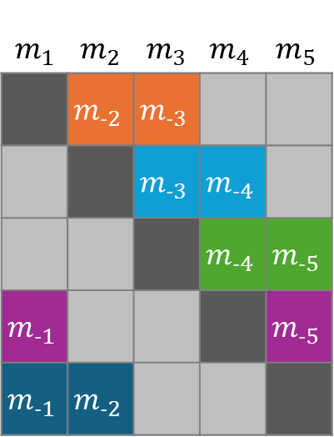
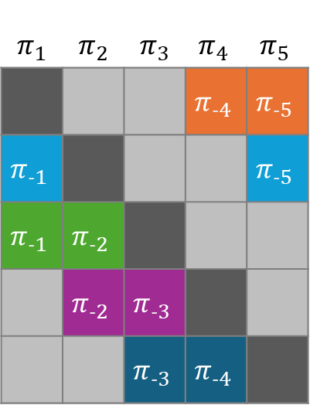
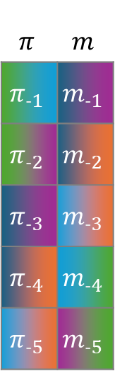
Generalized double cross-fitting
$$π_{1}$$ | $$π_{2}$$ | $$π_{3}$$ | $$π_{4}$$ | $$π_{5}$$
 |  |  | $$π_{‐4}$$ | $$π_{‐5}$$
$$π_{‐1}$$ |  |  |  | $$π_{‐5}$$
$$π_{‐1}$$ | $$π_{‐2}$$
 | $$π_{‐2}$$ | $$π_{‐3}$$
 |  | $$π_{‐3}$$ | $$π_{‐4}$$
$$m_{1}$$ | $$m_{2}$$ | $$m_{3}$$ | $$m_{4}$$ | $$m_{5}$$
 | $$m_{‐2}$$ | $$m_{‐3}$$
 |  | $$m_{‐3}$$ | $$m_{‐4}$$
 |  |  | $$m_{‐4}$$ | $$m_{‐5}$$
$$m_{‐1}$$ |  |  |  | $$m_{‐5}$$
$$m_{‐1}$$ | $$m_{‐2}$$
$$π$$ | $$m$$
$$π_{‐1}$$ | $$m_{‐1}$$
$$π_{‐2}$$ | $$m_{‐2}$$
$$π_{‐3}$$ | $$m_{‐3}$$
$$π_{‐4}$$ | $$m_{‐4}$$
$$π_{‐5}$$ | $$m_{‐5}$$
$$X_{1}$$ | $$A_{1}$$ | $$Y_{1}$$
$$X_{2}$$ | $$A_{2}$$ | $$Y_{2}$$
$$X_{3}$$ | $$A_{3}$$ | $$Y_{3}$$
$$X_{4}$$ | $$A_{4}$$ | $$Y_{4}$$
$$X_{5}$$ | $$A_{5}$$ | $$Y_{5}$$
Other model’s fit folds
Fit folds
Out-of-sample prediction

Slide 18
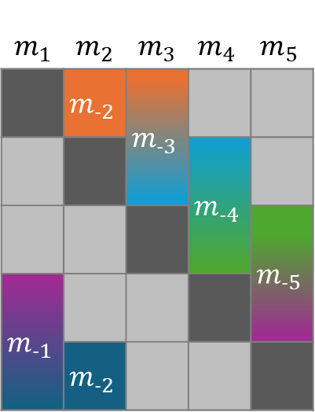
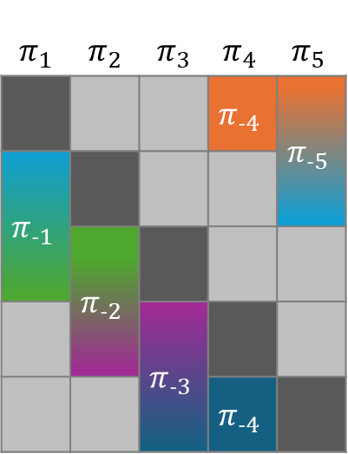
Generalized double cross-fitting
$$π_{1}$$ | $$π_{2}$$ | $$π_{3}$$ | $$π_{4}$$ | $$π_{5}$$
 |  |  | $$π_{‐4}$$ | $$π_{‐5}$$
$$π_{‐1}$$
 | $$π_{‐2}$$
 |  | $$π_{‐3}$$
 |  |  | $$π_{‐4}$$
$$m_{1}$$ | $$m_{2}$$ | $$m_{3}$$ | $$m_{4}$$ | $$m_{5}$$
 | $$m_{‐2}$$ | $$m_{‐3}$$
 |  |  | $$m_{‐4}$$
 |  |  |  | $$m_{‐5}$$
$$m_{‐1}$$
 | $$m_{‐2}$$
$$π$$ | $$m$$
$$π_{‐1}$$ | $$m_{‐1}$$
$$π_{‐2}$$ | $$m_{‐2}$$
$$π_{‐3}$$ | $$m_{‐3}$$
$$π_{‐4}$$ | $$m_{‐4}$$
$$π_{‐5}$$ | $$m_{‐5}$$
$$X_{1}$$ | $$A_{1}$$ | $$Y_{1}$$
$$X_{2}$$ | $$A_{2}$$ | $$Y_{2}$$
$$X_{3}$$ | $$A_{3}$$ | $$Y_{3}$$
$$X_{4}$$ | $$A_{4}$$ | $$Y_{4}$$
$$X_{5}$$ | $$A_{5}$$ | $$Y_{5}$$
Other model’s fit folds
Fit folds
Out-of-sample prediction

Slide 19

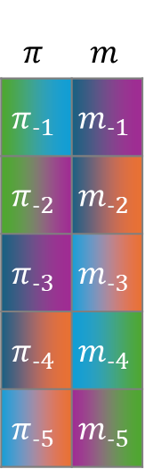
Generalized double cross-fitting
$$π$$ | $$m$$
$$π_{‐1}$$ | $$m_{‐1}$$
$$π_{‐2}$$ | $$m_{‐2}$$
$$π_{‐3}$$ | $$m_{‐3}$$
$$π_{‐4}$$ | $$m_{‐4}$$
$$π_{‐5}$$ | $$m_{‐5}$$
$$X_{1}$$ | $$A_{1}$$ | $$Y_{1}$$
$$X_{2}$$ | $$A_{2}$$ | $$Y_{2}$$
$$X_{3}$$ | $$A_{3}$$ | $$Y_{3}$$
$$X_{4}$$ | $$A_{4}$$ | $$Y_{4}$$
$$X_{5}$$ | $$A_{5}$$ | $$Y_{5}$$
 | $$m_{‐2}$$ | $$m_{‐3}$$ | $$π_{‐4}$$ | $$π_{‐5}$$
$$π_{‐1}$$ |  | $$m_{‐3}$$ | $$m_{‐4}$$ | $$π_{‐5}$$
$$π_{‐1}$$ | $$π_{‐2}$$ |  | $$m_{‐4}$$ | $$m_{‐5}$$
$$m_{‐1}$$ | $$π_{‐2}$$ | $$π_{‐3}$$ |  | $$m_{‐5}$$
$$m_{‐1}$$ | $$m_{‐2}$$ | $$π_{‐3}$$ | $$π_{‐4}$$
Outcome model folds
Out-of-sample prediction
Treatment model folds

Slide 20
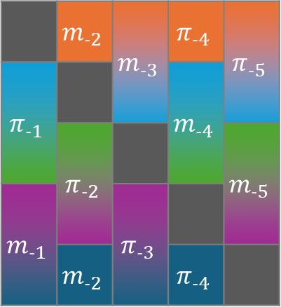
Generalized double cross-fitting
$$π$$ | $$m$$
$$π_{‐1}$$ | $$m_{‐1}$$
$$π_{‐2}$$ | $$m_{‐2}$$
$$π_{‐3}$$ | $$m_{‐3}$$
$$π_{‐4}$$ | $$m_{‐4}$$
$$π_{‐5}$$ | $$m_{‐5}$$
$$X_{1}$$ | $$A_{1}$$ | $$Y_{1}$$
$$X_{2}$$ | $$A_{2}$$ | $$Y_{2}$$
$$X_{3}$$ | $$A_{3}$$ | $$Y_{3}$$
$$X_{4}$$ | $$A_{4}$$ | $$Y_{4}$$
$$X_{5}$$ | $$A_{5}$$ | $$Y_{5}$$
 | $$m_{‐2}$$ | $$m_{‐3}$$ | $$π_{‐4}$$ | $$π_{‐5}$$
$$π_{‐1}$$ |  |  | $$m_{‐4}$$
 | $$π_{‐2}$$ |  |  | $$m_{‐5}$$
$$m_{‐1}$$ |  | $$π_{‐3}$$
 | $$m_{‐2}$$ |  | $$π_{‐4}$$
Outcome model folds
Out-of-sample prediction
Treatment model folds

Slide 21
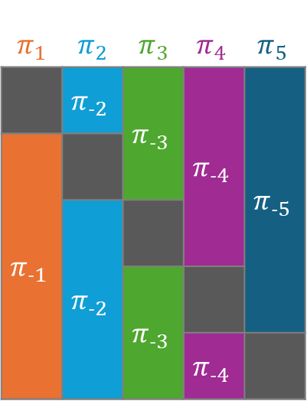
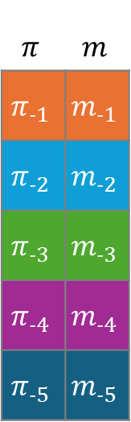
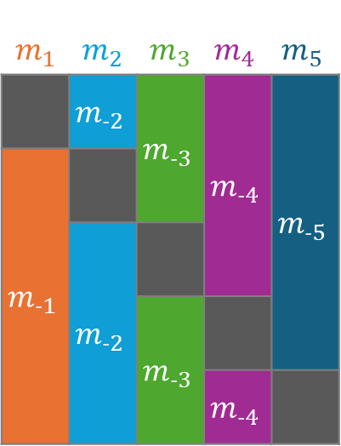
Cross-fitting/Cross-validation
$$π_{1}$$ | $$π_{2}$$ | $$π_{3}$$ | $$π_{4}$$ | $$π_{5}$$
 | $$π_{‐2}$$ | $$π_{‐3}$$ | $$π_{‐4}$$ | $$π_{‐5}$$
$$π_{‐1}$$
 | $$π_{‐2}$$
 |  | $$π_{‐3}$$
 |  |  | $$π_{‐4}$$
$$m_{1}$$ | $$m_{2}$$ | $$m_{3}$$ | $$m_{4}$$ | $$m_{5}$$
 | $$m_{‐2}$$ | $$m_{‐3}$$ | $$m_{‐4}$$ | $$m_{‐5}$$
$$m_{‐1}$$
 | $$m_{‐2}$$
 |  | $$m_{‐3}$$
 |  |  | $$m_{‐4}$$
$$π$$ | $$m$$
$$π_{‐1}$$ | $$m_{‐1}$$
$$π_{‐2}$$ | $$m_{‐2}$$
$$π_{‐3}$$ | $$m_{‐3}$$
$$π_{‐4}$$ | $$m_{‐4}$$
$$π_{‐5}$$ | $$m_{‐5}$$
$$X_{1}$$ | $$A_{1}$$ | $$Y_{1}$$
$$X_{2}$$ | $$A_{2}$$ | $$Y_{2}$$
$$X_{3}$$ | $$A_{3}$$ | $$Y_{3}$$
$$X_{4}$$ | $$A_{4}$$ | $$Y_{4}$$
$$X_{5}$$ | $$A_{5}$$ | $$Y_{5}$$
Fit folds
Out-of-sample prediction

Slide 22
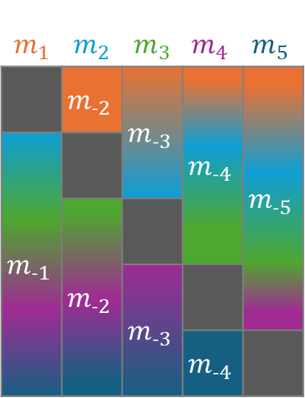
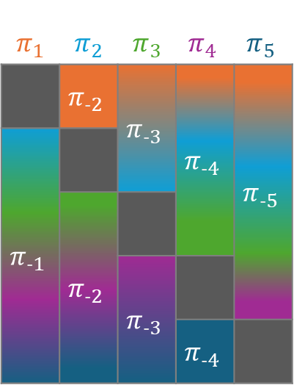
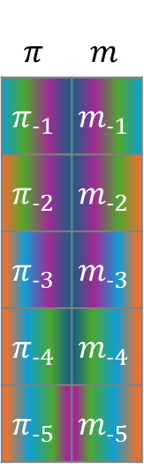
Cross-fitting/Cross-validation
$$π_{1}$$ | $$π_{2}$$ | $$π_{3}$$ | $$π_{4}$$ | $$π_{5}$$
 | $$π_{‐2}$$ | $$π_{‐3}$$ | $$π_{‐4}$$ | $$π_{‐5}$$
$$π_{‐1}$$
 | $$π_{‐2}$$
 |  | $$π_{‐3}$$
 |  |  | $$π_{‐4}$$
$$m_{1}$$ | $$m_{2}$$ | $$m_{3}$$ | $$m_{4}$$ | $$m_{5}$$
 | $$m_{‐2}$$ | $$m_{‐3}$$ | $$m_{‐4}$$ | $$m_{‐5}$$
$$m_{‐1}$$
 | $$m_{‐2}$$
 |  | $$m_{‐3}$$
 |  |  | $$m_{‐4}$$
$$π$$ | $$m$$
$$π_{‐1}$$ | $$m_{‐1}$$
$$π_{‐2}$$ | $$m_{‐2}$$
$$π_{‐3}$$ | $$m_{‐3}$$
$$π_{‐4}$$ | $$m_{‐4}$$
$$π_{‐5}$$ | $$m_{‐5}$$
$$X_{1}$$ | $$A_{1}$$ | $$Y_{1}$$
$$X_{2}$$ | $$A_{2}$$ | $$Y_{2}$$
$$X_{3}$$ | $$A_{3}$$ | $$Y_{3}$$
$$X_{4}$$ | $$A_{4}$$ | $$Y_{4}$$
$$X_{5}$$ | $$A_{5}$$ | $$Y_{5}$$
Fit folds
Out-of-sample prediction

