Slide 1
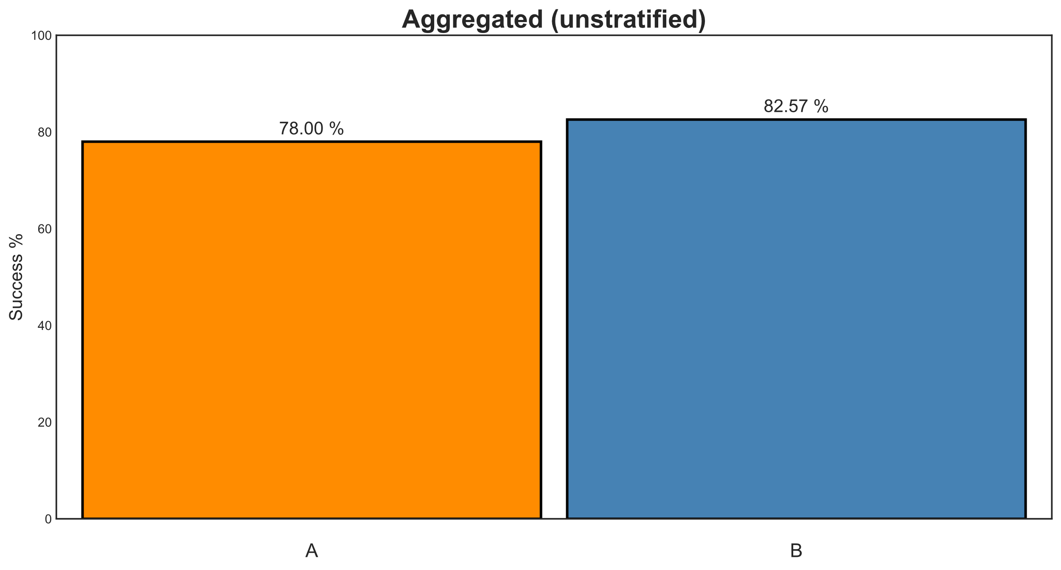

Slide 2
Width represents number of subjects

Slide 3
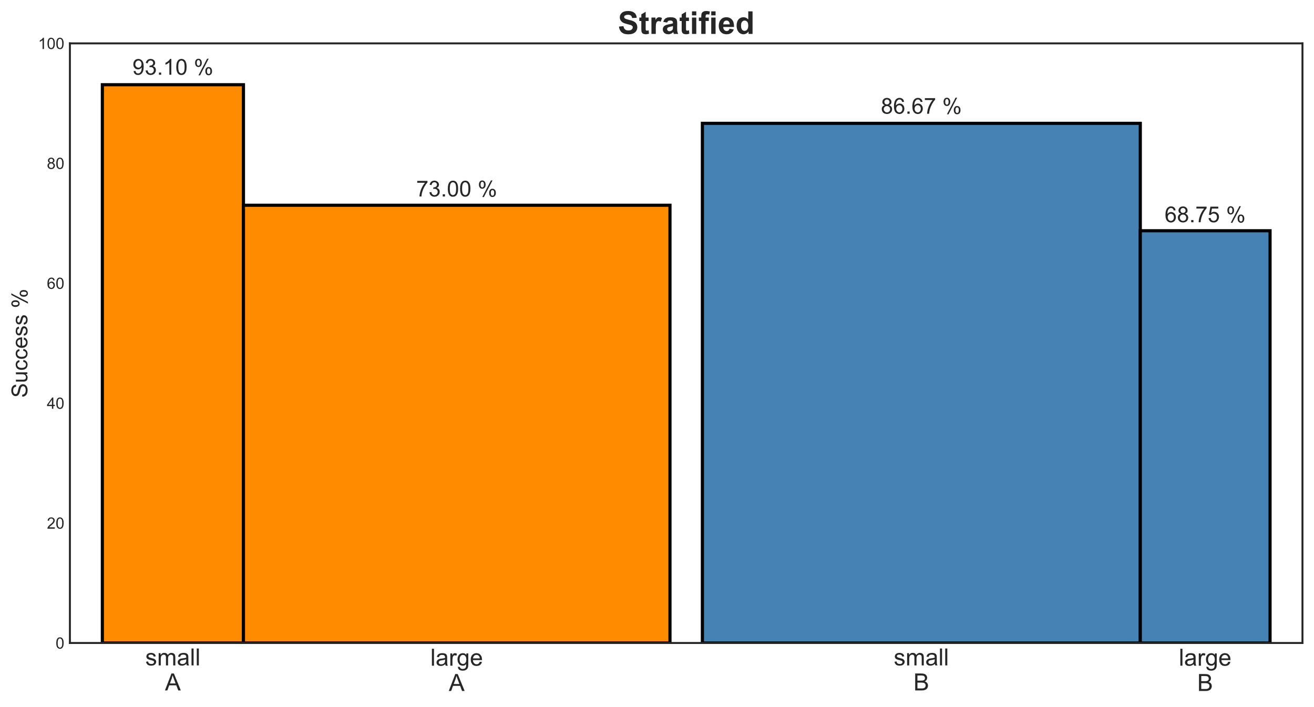

Slide 4
Place confounders next to each other

Slide 5
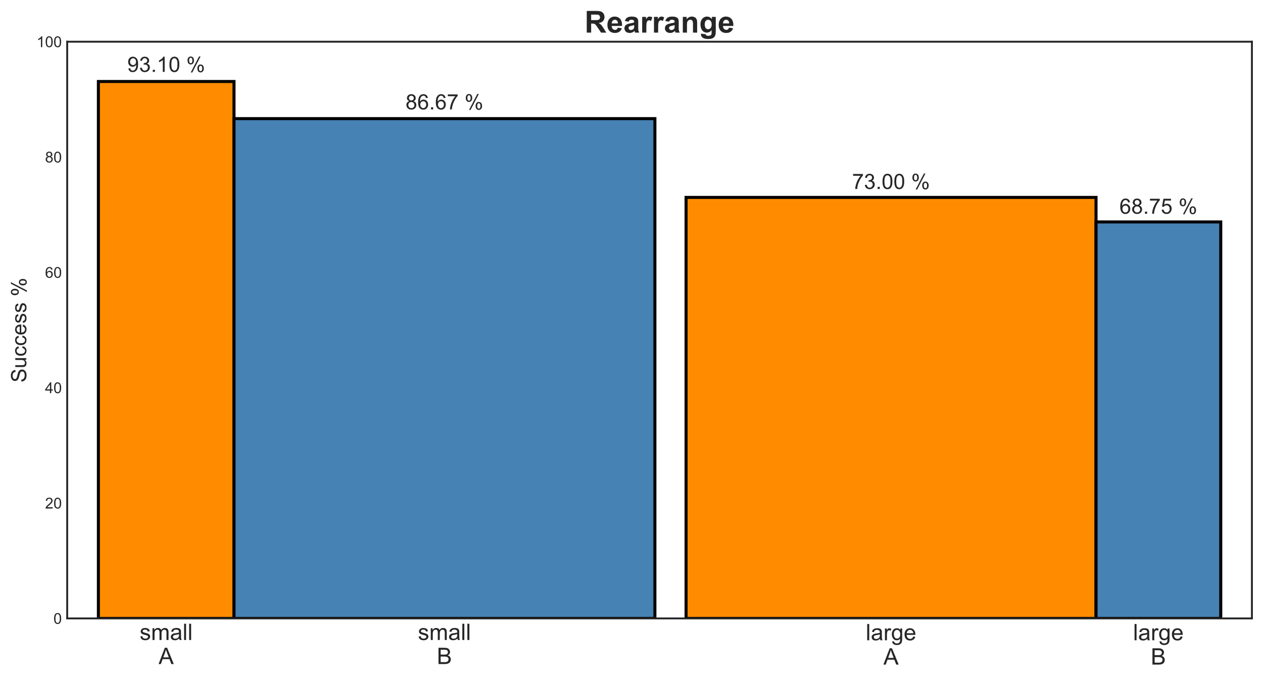

Slide 7
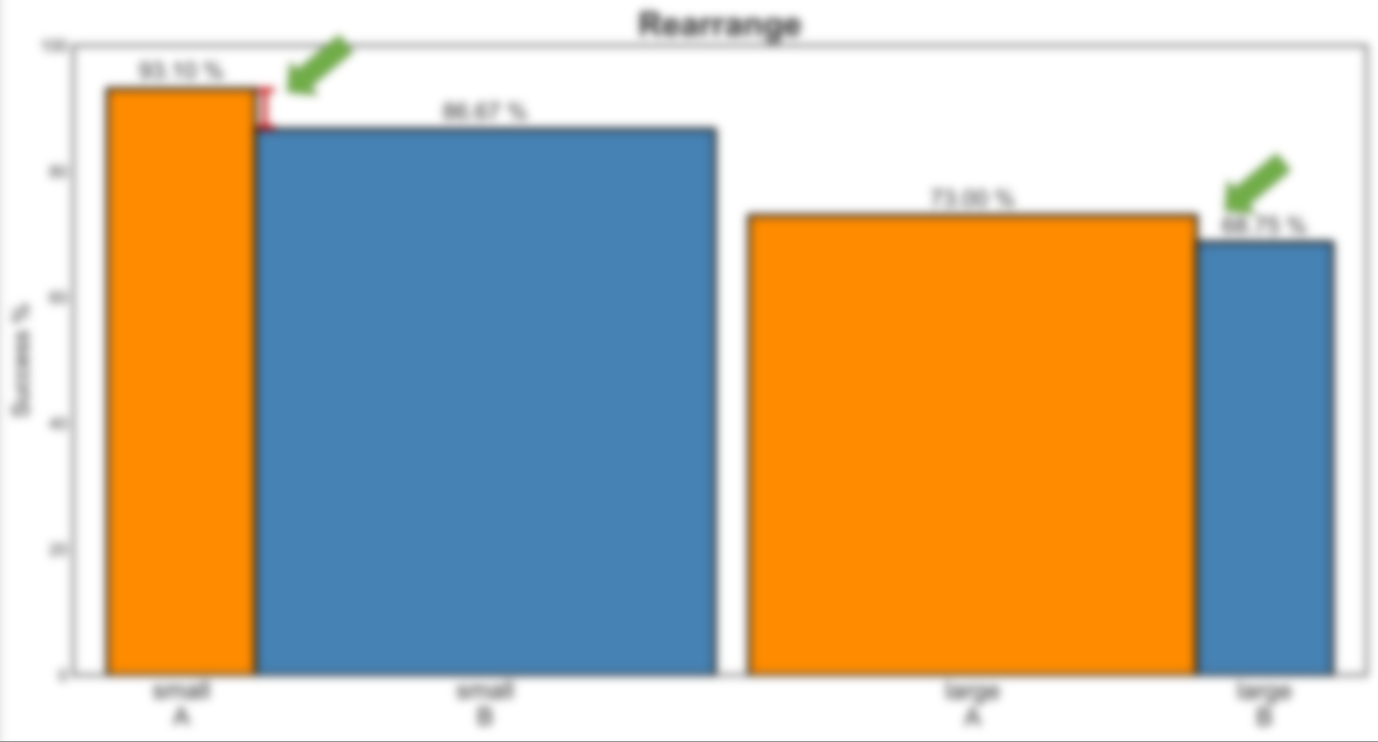
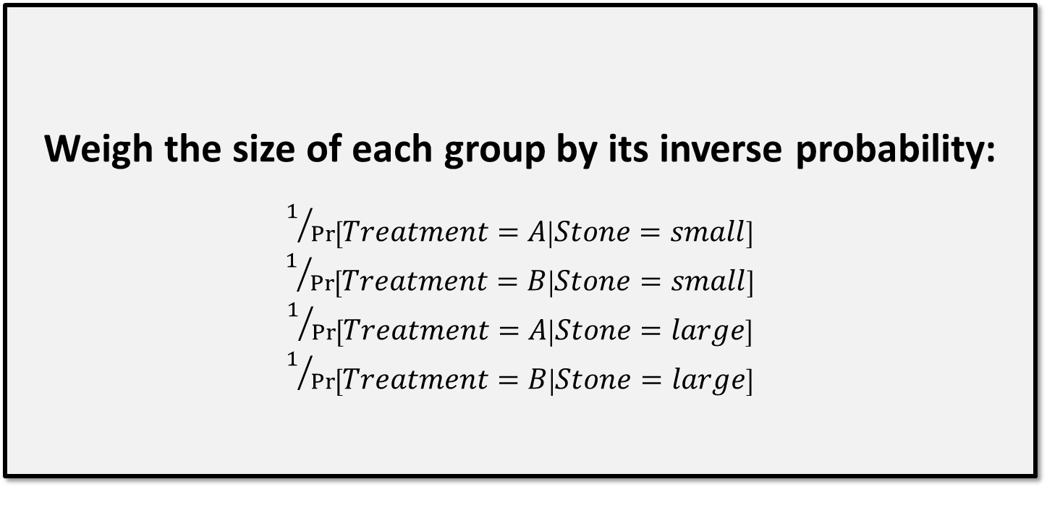
Weigh the size of each group by its inverse probability:
$1/{\operatorname{Pr}\left[Treatment=A | Stone=small\right]}$
$1/{\operatorname{Pr}\left[Treatment=B | Stone=small\right]}$
$1/{\operatorname{Pr}\left[Treatment=A | Stone=large\right]}$
$1/{\operatorname{Pr}\left[Treatment=B | Stone=large\right]}$

Slide 8
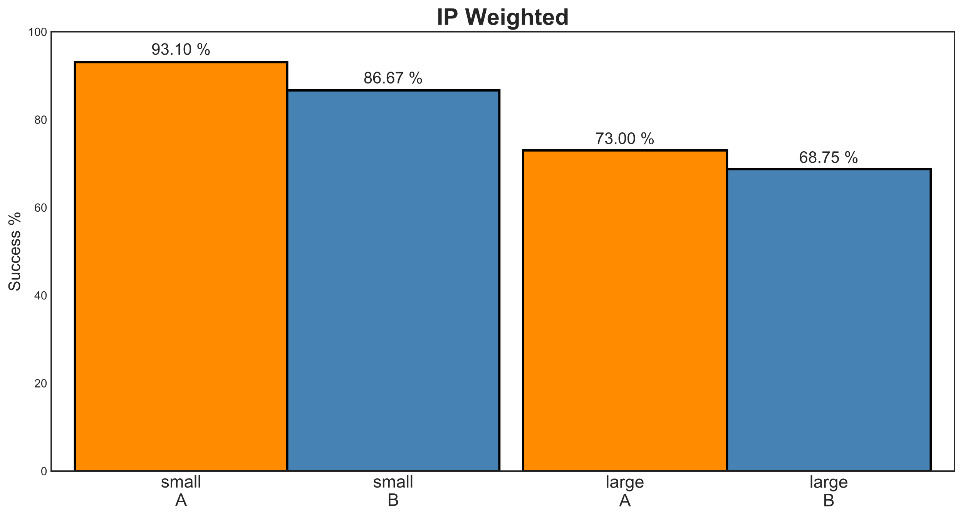

Slide 9
Equal width
Equal width

Slide 10

Equal width
Equal width

Slide 11
Equal width
Equal width
Place treatments next to each other

Slide 12
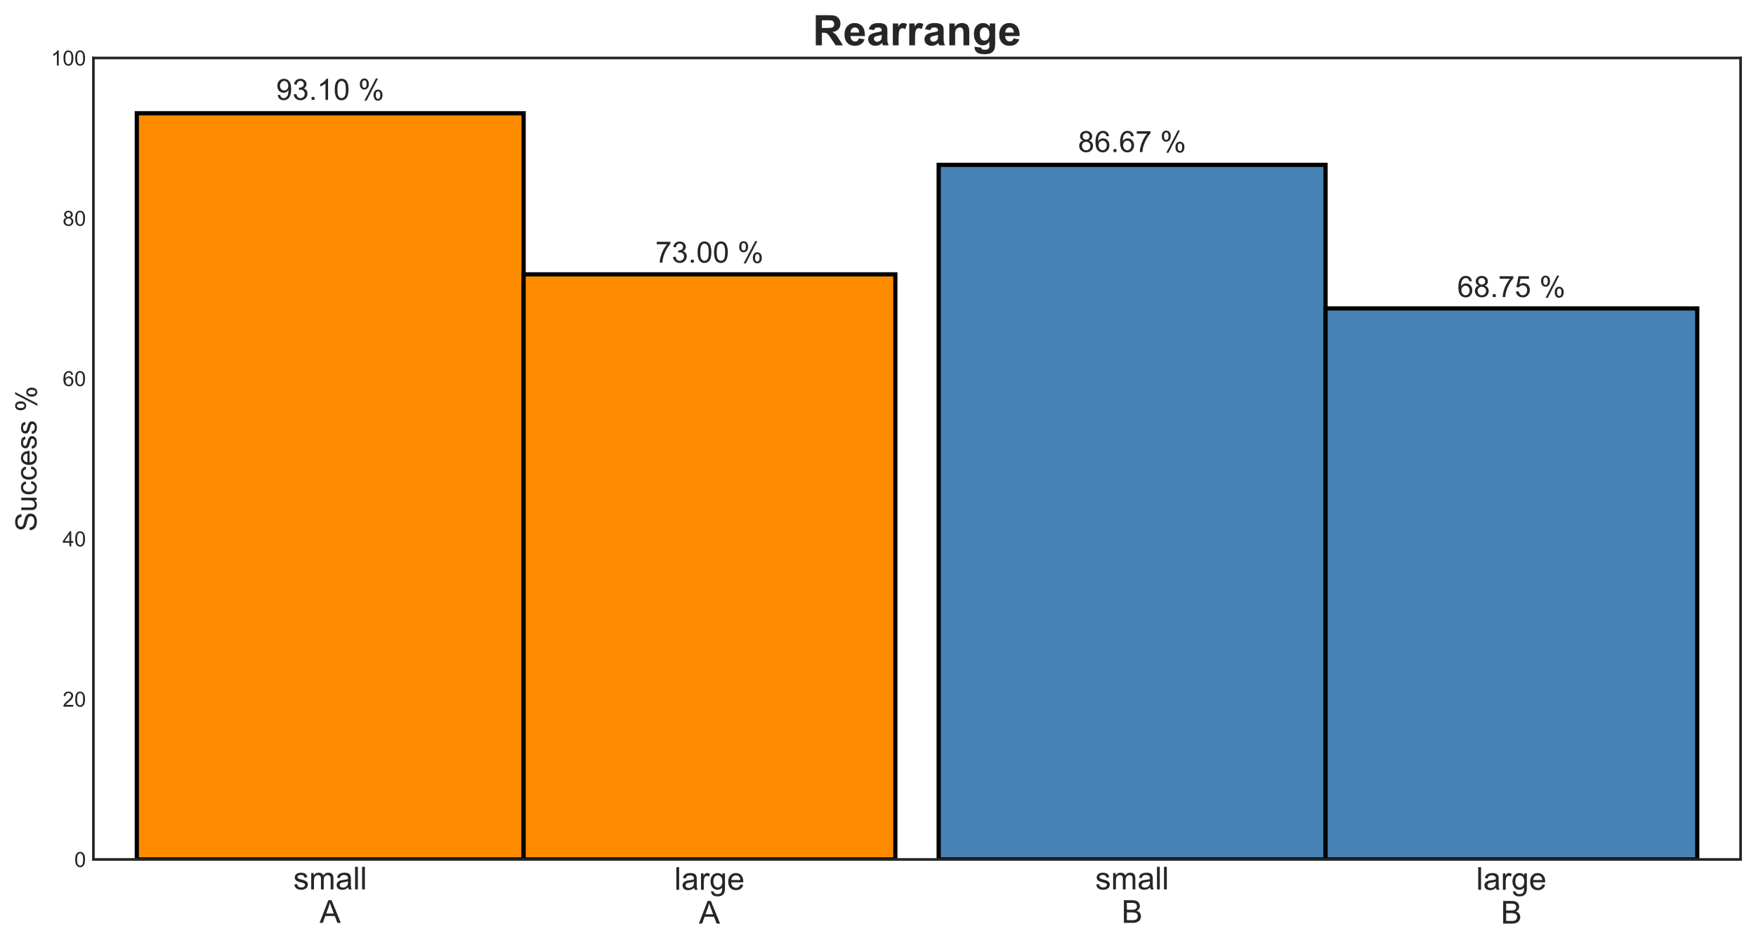

Slide 13
