Slide 1
Predicting risk is not enough

Slide 2
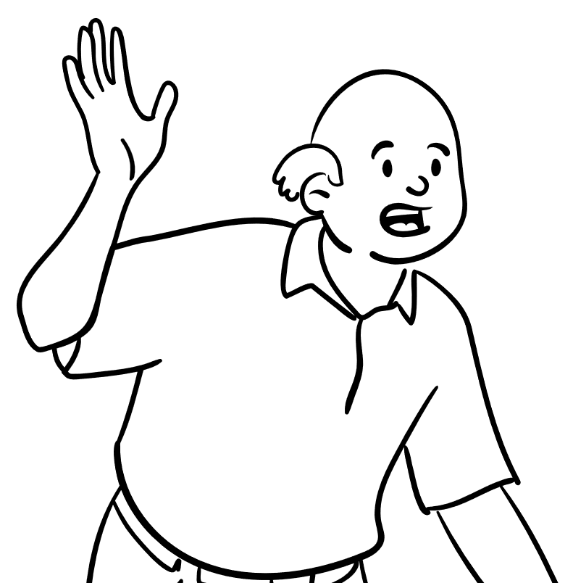
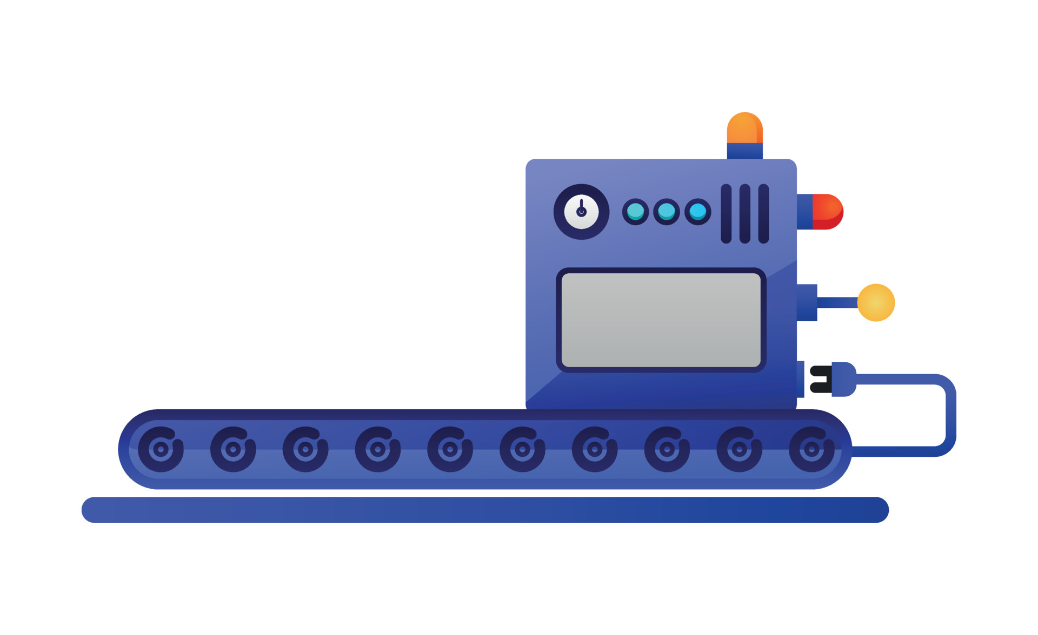


Predicting risk is not enough
Brrrr…
70% for stroke in the next year
Machine Learning
85% for churn in the coming week
vecteezy.com
Notes:
But before I do, let’s start with what causal inference is. And Causal inference comes into play when machine learning is not enough.
Jon here visits the clinic, and we have his medical records. We can pass him through this machine learning machine, that crunches the data and outputs a prediction: high risk for a stroke event in the next year.
Which is frightening, so what do we do next? How can we reduce the risk?
And this is where ML fails us. it leaves us to panic without informing us what can be done to mitigate or avoid its fearsome prediction.
But as humans we at least want to try to change the future if we don’t like it.

Slide 3

Predicting risk is not enough
30% for stroke if you take statins
Brrrr…
40% for stroke if you exercise
35% for stroke if you quit smoking
Causal Inference
15% for churn if you send coupons
35% for churn if you pop a notification
vecteezy.com
Notes:
And this is where we introduce a new machine, the causal inference machine. We gives it the same data, but now we get a different prediction.
We get the risk for a stroke event if Jon will take statins, or exercise, or quit smoking.
Causal inference can predict the Jon’s risk if he does any of these actions and can hint how best to mitigate the frightening ML prediction

