Slide 1
Aircraft Analysis
Ethan Huffman
3/04/25

Slide 2
Summary
Our company have been looking to expand into the aviation industry, and we require an aircraft that can go national and international without any safety concerns for our future customers
I will be showing aircrafts from Boeing, McDonnell Douglas, Embraer, and Airbus and comparing them with each other to determine the safest aircraft

Slide 3
Outline
Business Problem
Data
Conclusions

Slide 4
Business Problems
Find an aircraft with minimum 15+ years of flying data
Find an aircraft that can fly internationally
Figure out which aircrafts preform best in different weather scenarios

Slide 5
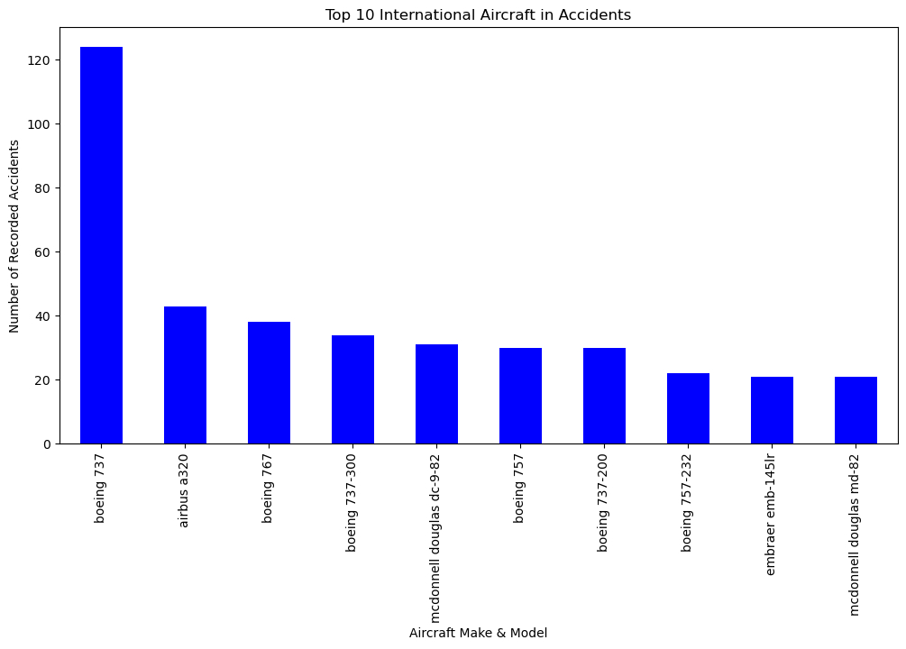
Data
This data displays the top international aircrafts and their respective accident histories (minimum 15+ years of flying).
The models with the larger amount we will be skipping entirely as they may pose to much of a threat to our future customers

Slide 6
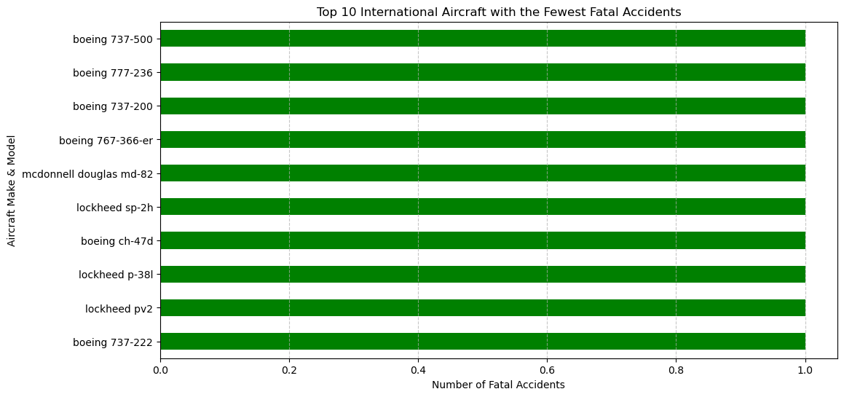
Data
As we can see in this graph these are the safest of the aircrafts showing that each one has only had 1 accident since they hit the runway.
Any one of these Aircrafts would be a safe pick to ensure the safety of our future customers.

Slide 7
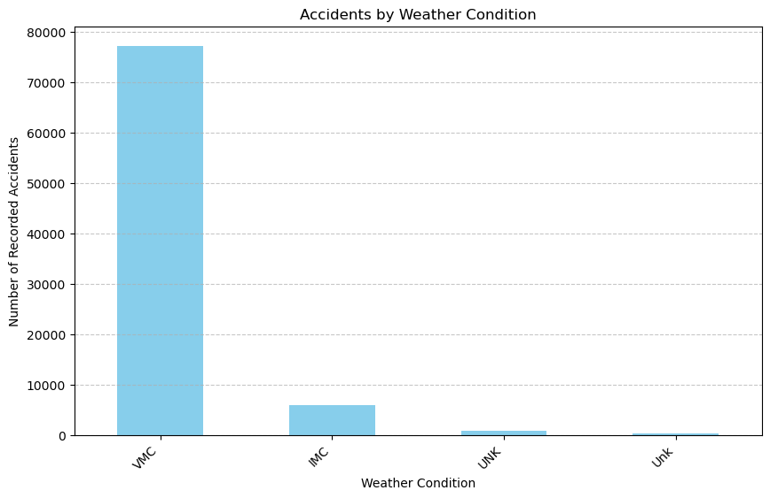
Weather Data
Weather is a major safety concern when flying that can set many passengers on edge. This graph shows how visibility from a storm can affect a pilot and the aircraft
IMC (Instrument Meteorological Conditions): This refers to weather conditions where visibility and cloud ceilings are below certain thresholds (typically a ceiling less than 1,000 feet). Under IMC
VMC (Visual Meteorological Conditions): These conditions are when the weather meets or exceeds the minimum thresholds

Slide 8
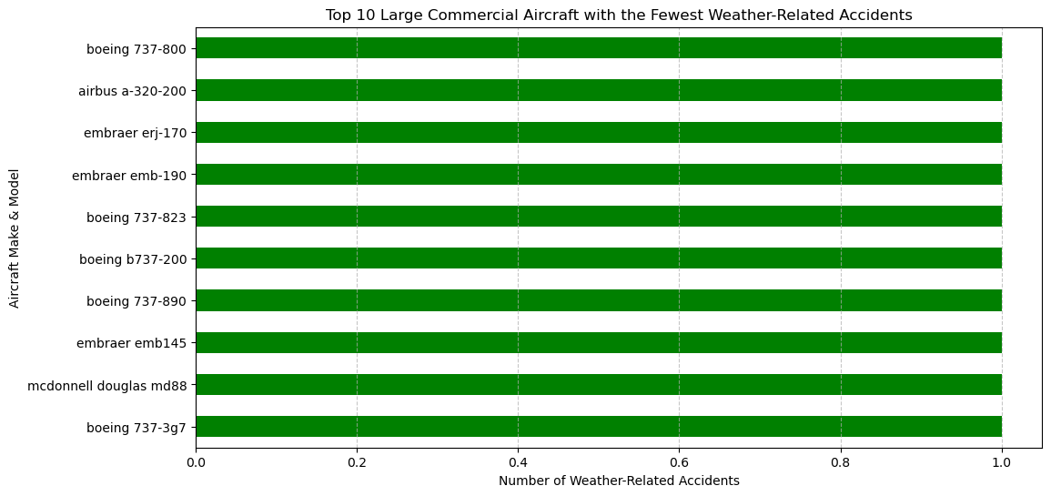
Weather Data
The data here shows the best performers during weather related accidents with only 1 accident recorded.

Slide 9
Conclusion
The most Accident-Prone Aircraft Models were The Boeing 737 and Airbus A310. McDonnell Douglas and Embraer models also showed recurring patterns of incidents. Older aircraft models with over 15+ years of operation, exhibited higher accident rates. Aircrafts such as the Boeing 777 and Lockheed models showed resilience with fewer fatal incidents. The majority of weather-related accidents occurred in Instrument Meteorological Conditions (IMC), indicating visibility and flight control challenges. The Boeing 737-200, Airbus A310, and McDonnell Douglas MD-82 were more involved in accidents linked to bad weather. In conclusion I think the best choice for the company would be any of the models under the fewest accident category.

