Slide 1
Predicting Respiratory
Disease Hospitalization Surges
Using Machine Learning on U.S. Hospital Data (2020–2024)
Healthcare ML Tutorial · March 2026
Notes:
SPEAKER NOTES - TITLE SLIDE --- Welcome everyone. Today I'll walk you through a machine learning tutorial focused on a real-world healthcare problem: predicting respiratory disease hospitalization surges. We'll use publicly available data from the U.S. Department of Health and Human Services covering COVID-19, Influenza, and RSV hospitalizations from 2020 to 2024. CODE LINK: [Insert your GitHub/Colab link here] By the end of this tutorial, you'll understand how to: - Clean and preprocess healthcare time-series data - Engineer meaningful features from temporal data - Train and evaluate multiple ML classifiers - Interpret results in a clinical context

Slide 2
Tutorial Overview
01
Dataset & Problem
HHS Weekly Hospital Respiratory Data
02
Data Cleaning & EDA
Handling missing values, exploring trends
03
Feature Engineering
Lags, rolling averages, seasonal encoding
04
Model Training
Logistic Regression, Random Forest, Gradient Boosting
05
Evaluation & Interpretation
ROC curves, feature importance, clinical context
Notes:
SPEAKER NOTES - OVERVIEW --- Here's our roadmap for the tutorial. We'll move through five major stages: 1. First, we'll understand the dataset and frame our prediction problem. 2. Then we clean the data and explore it visually. 3. Feature engineering is where the real magic happens — we create predictive signals from raw time-series data. 4. We train three different ML models of increasing complexity. 5. Finally, we evaluate them and discuss what the results mean for real-world healthcare decision-making. Each section has detailed code comments you can follow in the Python notebook.

Slide 3
The Dataset
HHS Weekly Hospital Respiratory Data
12,768
157
224
53
Rows
Columns
Weeks
States
Key Fields Used:
Disease counts: COVID-19, Influenza, RSV hospitalizations & ICU patients
Capacity: Inpatient beds, beds occupied, ICU beds, ICU occupied
Admissions: Weekly new admissions by disease and age group
Time span: August 2020 through November 2024
Notes:
SPEAKER NOTES - DATASET --- Our data comes from the U.S. Department of Health and Human Services, which collects weekly hospital reports from every state and territory. The raw dataset has over 12,000 rows and 157 columns — so it's quite large. Each row represents one state for one week. We focus on three key disease categories: COVID-19, Influenza, and RSV. For each, we have hospitalization counts, ICU numbers, and new admissions. We also use bed capacity data — how many beds are available and how many are occupied — which tells us about the overall strain on the hospital system. In the code, you'll see we select 15 key columns and rename them for readability. This is in Section 3 of the Python script.

Slide 4
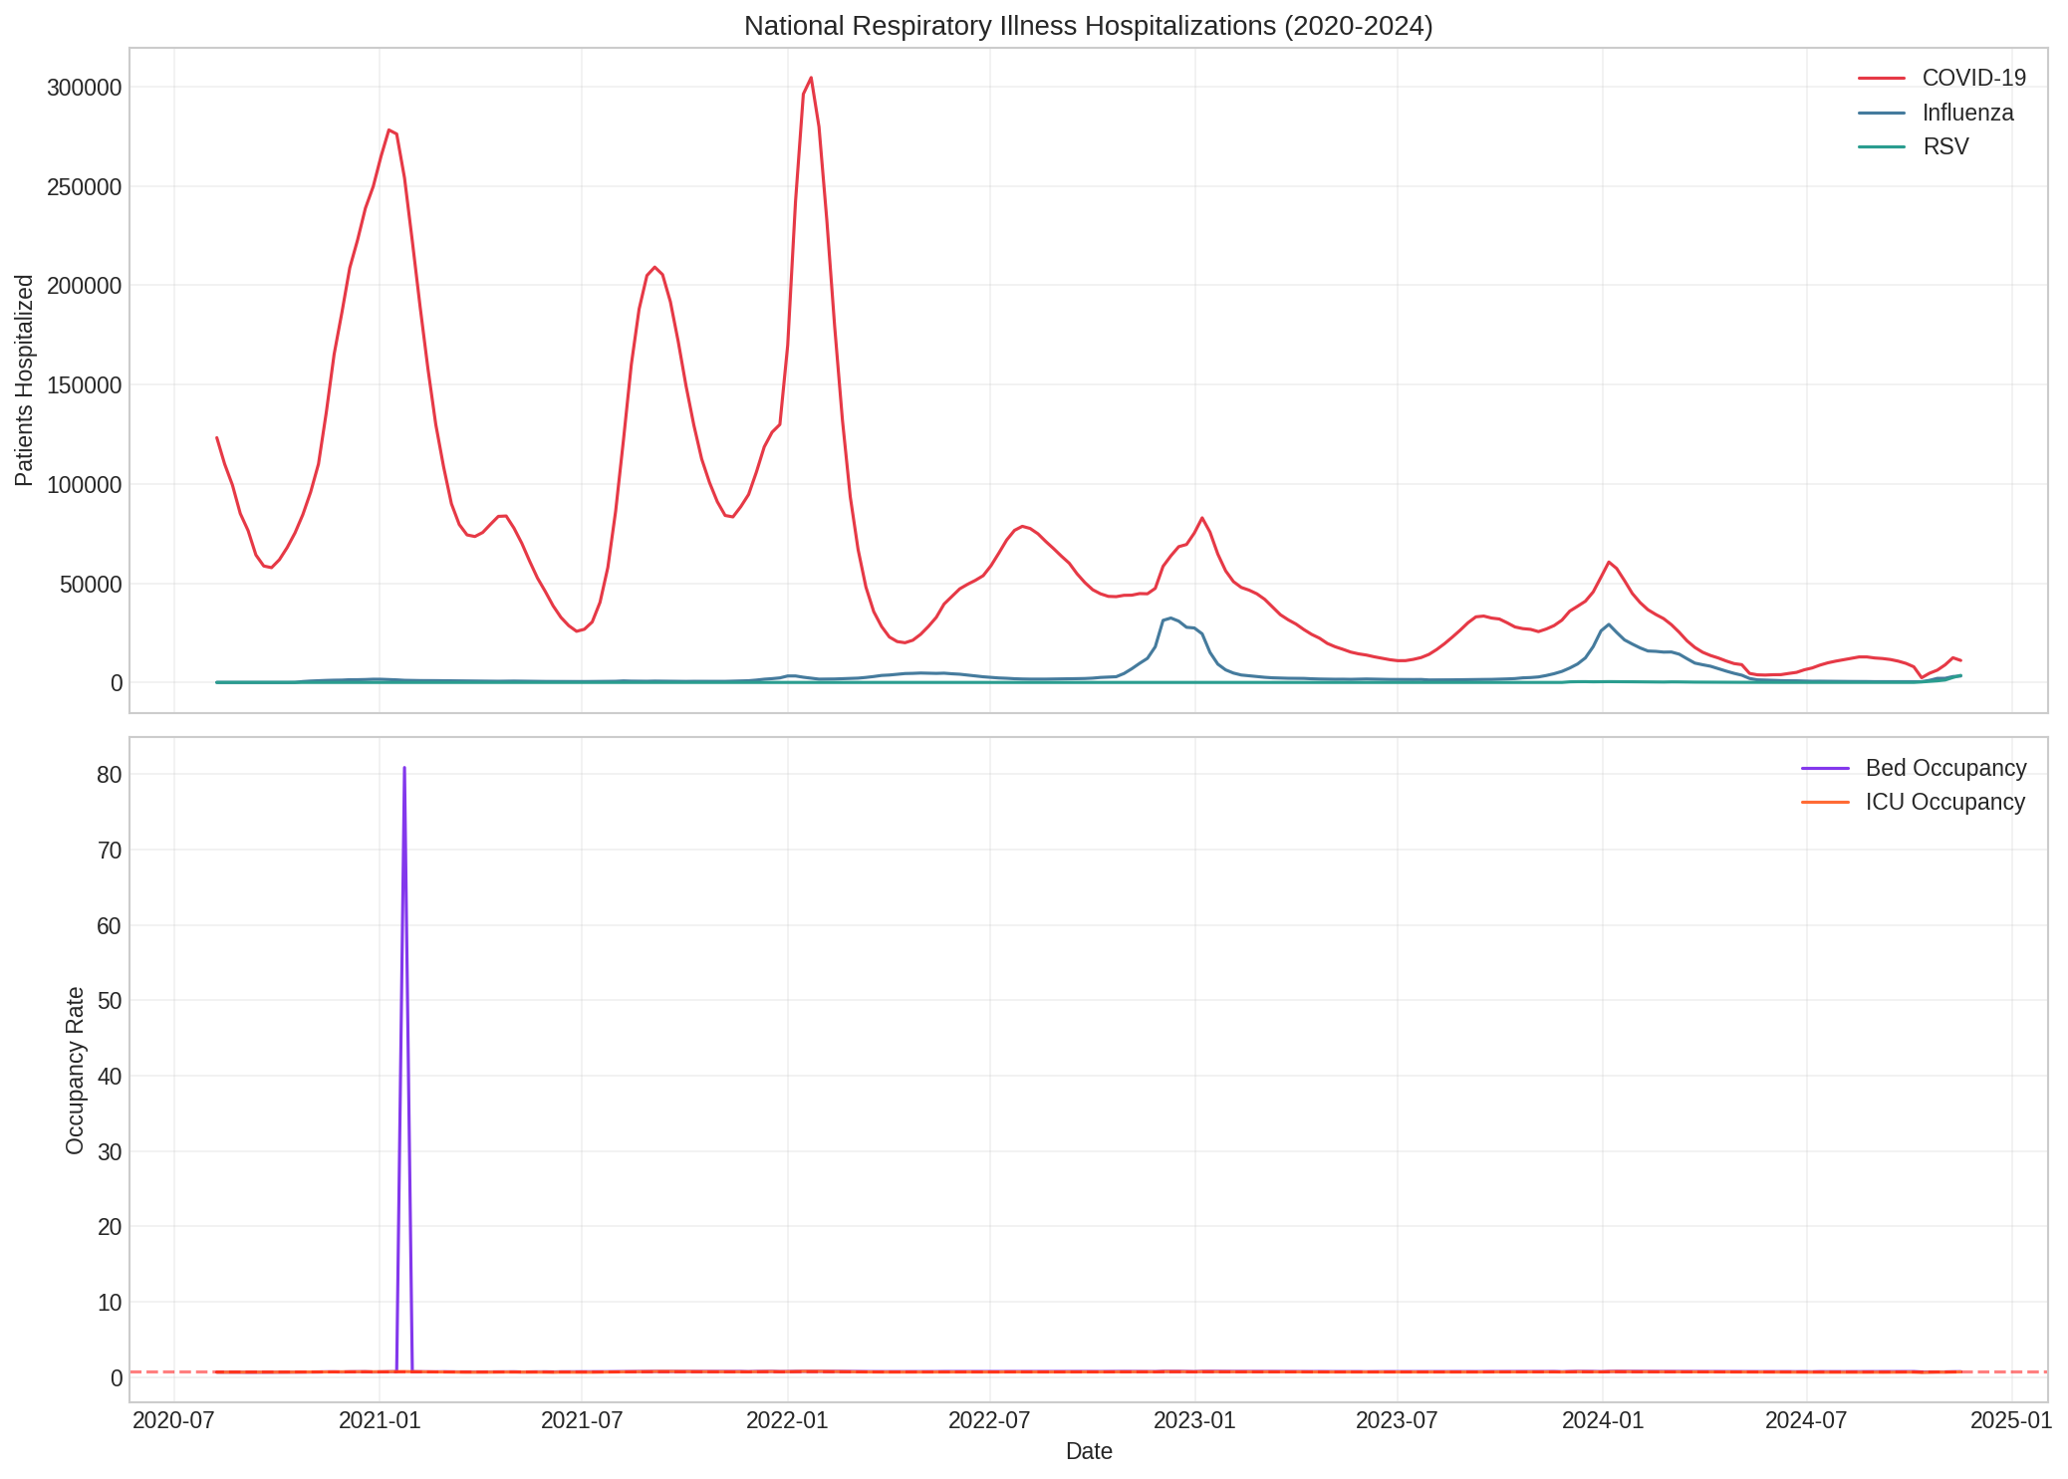
Exploratory Data Analysis
National hospitalization trends reveal strong seasonal patterns and the dominance of COVID-19 waves.
Notes:
SPEAKER NOTES - EDA --- This is the first visualization from our code (Section 4). The top chart shows weekly hospitalization counts for all three respiratory illnesses. Notice: - COVID-19 (red) dominates the early period with massive surges in winter 2020-21, Delta wave summer 2021, and Omicron winter 2021-22 - Influenza (blue) and RSV (green) show strong winter seasonality - The 2022-23 "tripledemic" is clearly visible where all three peaked simultaneously The bottom chart shows bed occupancy rates. The 80% threshold line is a common benchmark — when hospitals exceed 80% occupancy, they begin experiencing strain. Key takeaway for modeling: The data has strong temporal patterns we can exploit with lagged features and seasonal encoding.

Slide 5
Feature Engineering
Transforming raw time-series into predictive signals
Lagged Values
Rolling Averages
Hospitalization counts from 1, 2, 3, and 4 weeks ago. Disease trends have momentum — last week's numbers strongly predict this week's.
2-week and 4-week moving averages smooth out noise and capture underlying trends.
Change Rates
Seasonal Encoding
Week-over-week percent change and absolute differences show acceleration/deceleration of outbreaks.
Sine/cosine transforms of month capture cyclical seasonality (Dec and Jan are 'close').
Target Variable: Binary classification — will next week's total respiratory hospitalizations increase by >10% ? (Surge = 1, No Surge = 0)
Notes:
SPEAKER NOTES - FEATURE ENGINEERING --- Feature engineering is arguably the most important step in any ML project, and especially in healthcare. We create 32 features from our raw data, falling into four categories: 1. LAGGED VALUES: These are the most powerful. We look back 1-4 weeks. If hospitalizations were high last week, they'll likely be high this week too. This is the concept of autocorrelation. 2. ROLLING AVERAGES: 2-week and 4-week moving averages smooth out noise. A single bad reporting week won't throw off the model. 3. CHANGE RATES: Percent change captures acceleration. A hospital going from 100 to 120 patients (20% increase) is more alarming than one stable at 500. 4. SEASONAL ENCODING: We use sine/cosine transforms rather than one-hot encoding because months are cyclical — December and January are adjacent but their integer values (12 and 1) are far apart. Sine/cosine encoding preserves this cyclical relationship. Our target variable is binary: will next week see a greater than 10% increase in total respiratory hospitalizations? This frames our problem as a supervised classification task. In the code, see the engineer_features() function in Section 5 for the full implementation.

Slide 6
Model Training
Baseline
Ensemble
Advanced
Logistic
Regression
Random
Forest
Gradient
Boosting
Linear baseline model. Highly interpretable — coefficients show feature importance directly. Uses class weighting to handle imbalance.
Ensemble of 200 decision trees. Captures non-linear relationships and interactions between features. Robust to outliers.
Sequential boosting with 200 estimators. State-of-the-art for tabular data. Builds trees that correct previous errors.
Key Considerations: Temporal train/test split (before/after June 2024) prevents data leakage. Class weighting handles the ~80/20 class imbalance. StandardScaler applied for Logistic Regression.
Notes:
SPEAKER NOTES - MODEL TRAINING --- We train three models of increasing complexity. This is a best practice — always start with a simple interpretable model as a baseline. LOGISTIC REGRESSION: Our baseline. It's a linear model, which means it assumes the relationship between features and surge probability is linear. We use class_weight='balanced' because about 80% of weeks are non-surge weeks. Without this, the model would just predict "no surge" every time and get 80% accuracy. RANDOM FOREST: An ensemble of 200 decision trees. Each tree sees a random subset of the data and features, then they vote. This handles non-linear patterns and is very robust. We limit max_depth to 10 to prevent overfitting. GRADIENT BOOSTING: This builds trees sequentially, where each new tree focuses on correcting the mistakes of the previous ones. It's considered state-of-the-art for tabular data. We use learning_rate=0.1 to prevent overfitting. CRITICAL: We use a TEMPORAL split — training on data before June 2024 and testing on data after. This simulates real-world usage where you train on historical data and predict the future. Never use random train/test splits with time-series data! See Section 6-7 in the Python code for implementation details.

Slide 7
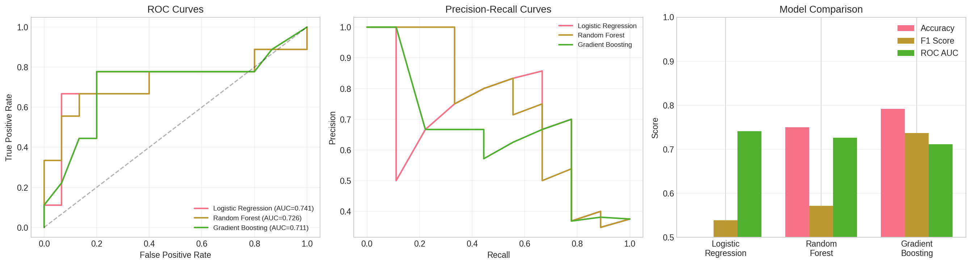
Results: Model Comparison
Model | Accuracy | F1 Score | ROC AUC
Logistic Regression | 0.500 | 0.538 | 0.741
Random Forest | 0.750 | 0.571 | 0.726
Gradient Boosting | 0.792 | 0.737 | 0.711
Notes:
SPEAKER NOTES - RESULTS --- Let's examine our results across three metrics: ACCURACY: Gradient Boosting leads at 79.2%. But accuracy alone can be misleading with imbalanced classes. F1 SCORE: This balances precision and recall. Gradient Boosting again performs best at 0.737. Logistic Regression has lower F1 because it over-predicts surges (high recall but low precision). ROC AUC: Logistic Regression actually has the highest AUC at 0.741, meaning it's best at ranking predictions even if its threshold isn't optimal. This is common — simple models can have good discrimination ability. The ROC curves (left panel) show all three models perform well above the diagonal random baseline. The Precision-Recall curves (middle panel) are more informative for imbalanced data. Overall, Gradient Boosting offers the best balance for deployment. But in a healthcare context, we might prefer higher recall (catching more surges) even at the cost of more false alarms. Cross-validation results (Section 11) show AUC of 0.83-0.95 across folds, confirming the models generalize well.

Slide 8
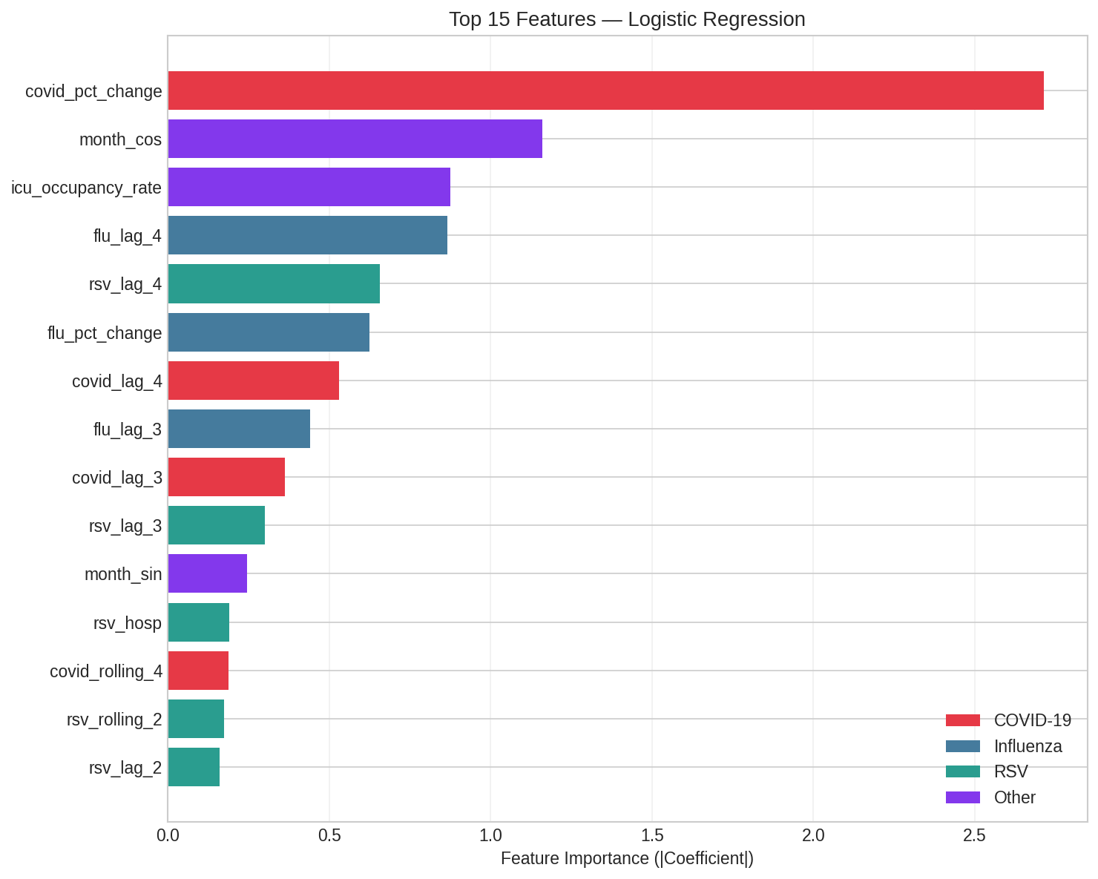
Feature Importance
Which features drive surge predictions?
Notes:
SPEAKER NOTES - FEATURE IMPORTANCE --- Feature importance tells us WHICH signals the model relies on most. This is crucial for healthcare stakeholders who need to understand WHY a prediction is made. Key findings: - Lagged hospitalization values (especially 1-week and 2-week lags) are the strongest predictors. This makes clinical sense — outbreaks don't reverse overnight. - Change rates (percent change, absolute difference) capture momentum. A rapidly increasing trend is a strong signal. - Rolling averages help the model see through week-to-week noise. - Seasonal features (month_sin, month_cos) capture the well-known winter respiratory season. - Bed and ICU occupancy rates add hospital strain context. The color coding shows which disease each feature relates to: red for COVID-19, blue for Influenza, green for RSV, and purple for system-level metrics. This interpretability is why we chose classical ML over deep learning for this tutorial — stakeholders can understand and trust these explanations.

Slide 9
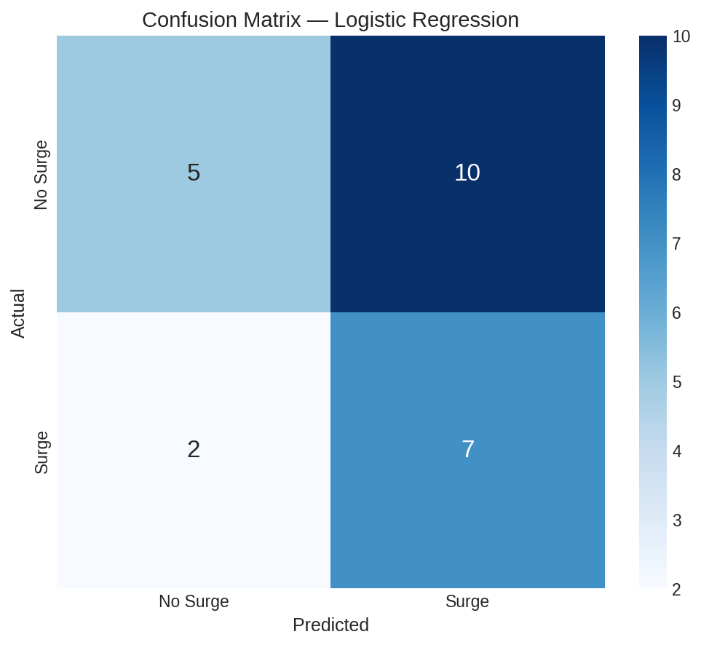
Confusion Matrix & Clinical Context
True Positives
Correctly predicted surges → hospitals prepare in time
False Negatives
Missed surges → most dangerous error in healthcare
False Positives
False alarms → unnecessary prep, but safer than missing a surge
In healthcare: False Negatives > False Positives in cost. Tune threshold to favor higher recall.
Notes:
SPEAKER NOTES - CONFUSION MATRIX --- The confusion matrix breaks down our predictions into four categories. In healthcare, not all errors are equal. TRUE POSITIVES: We correctly predicted a surge. This gives hospitals 1-2 weeks to prepare — activate surge protocols, schedule extra staff, stockpile supplies. FALSE NEGATIVES: We MISSED a surge. This is the most dangerous error. Hospitals are caught unprepared, potentially leading to overcrowding, delayed care, and worse patient outcomes. FALSE POSITIVES: We predicted a surge that didn't happen. This causes unnecessary preparation, which costs money and effort but doesn't harm patients. Because false negatives are more costly than false positives in healthcare, we might want to LOWER our classification threshold from the default 0.5 to something like 0.3 or 0.4. This trades precision for recall — more false alarms, but fewer missed surges. This cost-sensitive thinking is crucial for deploying ML in healthcare settings.

Slide 10
Limitations & Future Work
Limitations
Future Directions
Training period includes unprecedented COVID-19 pandemic dynamics
National-level aggregation masks state-level variation
10% surge threshold is arbitrary — should be calibrated per hospital
Small test set (24 weeks) limits confidence in generalization
Does not account for policy interventions (masking, vaccines)
Add wastewater surveillance data for earlier signal detection
Incorporate demographic and socioeconomic features
Explore LSTM / Transformer models for sequence modeling
Build state-level models with transfer learning
Deploy as a real-time dashboard with weekly predictions
Ethical Consideration: Predictive models should SUPPORT, not replace, clinical judgment. Equity audits are needed to ensure predictions are equally accurate across diverse populations and geographies.
Notes:
SPEAKER NOTES - LIMITATIONS & FUTURE WORK --- No ML project is complete without honest discussion of limitations. LIMITATIONS: - Our training data spans the COVID-19 pandemic, which was truly unprecedented. Future respiratory outbreaks may follow different patterns. - Working at the national level hides important state-level variation. A surge in Florida might look different from one in Vermont. - The 10% threshold for "surge" is our choice — in practice, each hospital should calibrate this based on their specific capacity. - With only 24 test weeks, we should be cautious about strong claims on generalization. FUTURE WORK: - Wastewater data has emerged as a leading indicator of respiratory illness outbreaks and could provide earlier warnings. - Deep learning models like LSTMs or Transformers could capture longer-term dependencies. - Transfer learning could let us train a national model and fine-tune it for individual states. ETHICS: This is not optional. Any model deployed in healthcare must be audited for fairness. Are predictions equally good for rural vs. urban hospitals? For states with different demographic compositions?

Slide 11
Key Takeaways
1
Feature engineering (lags, rolling averages, seasonal encoding) is critical for time-series healthcare prediction
2
Classical ML models (especially Gradient Boosting) perform well on tabular healthcare data — deep learning isn't always necessary
3
Temporal train/test splits are essential to avoid data leakage with time-series data
4
In healthcare, model interpretation matters as much as accuracy — stakeholders need to understand WHY
5
Cost-sensitive evaluation (weighing false negatives more) reflects real clinical priorities
Thank you! Questions?
Notes:
SPEAKER NOTES - KEY TAKEAWAYS --- Let me summarize the five most important things from this tutorial: 1. Feature engineering is where domain knowledge meets data science. The lagged features and seasonal encoding we created are based on epidemiological understanding of how diseases spread. 2. You don't need deep learning for everything. Gradient Boosting achieved 79% accuracy and 0.74 F1 on tabular data. Start simple, add complexity only if needed. 3. Never use random splits for time-series. Our temporal split prevents the model from "cheating" by using future information. 4. Healthcare is high-stakes. Clinicians won't trust a black box. Feature importance and confusion matrix analysis help build that trust. 5. Think about costs. In healthcare, missing a surge (false negative) is worse than a false alarm. Adjust your model accordingly. Thank you for your attention. I'm happy to take questions. Full code with detailed comments is available at: [Insert your link here]

