Slide 1
Receptionist Project Overview
Perception System
Face recognition (match faces with existing faces)
Speech recognition (Speech to text, language and accent recognition)
Decision System
API.AI conversational chat engine
Amazon Lex conversation bot (powered by Alexa)
Potentially can make custom engines (e.g. using knowrob ontology)
Action System
Ever robot head from Korea
Speech synthesis (Speech to text, language specific)
Entire system should be made modular so it is easy to test different implementations

Slide 2
System Diagram
Separate modules
Core interface/framework
Separate modules
Procrob functional
Google Speech to Text
Perception System
OR
AWS Rekognition
API.AI
Decision System
OR
Amazon Lex
Action System
Ever Robot

Slide 3
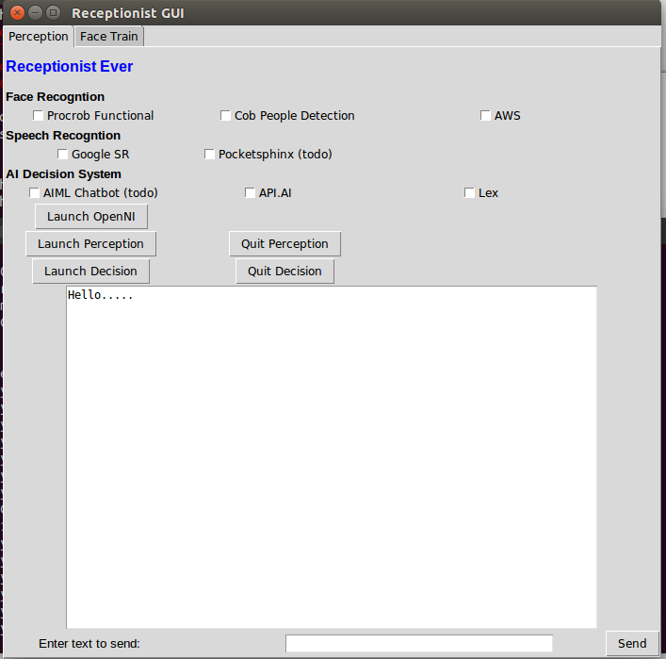
GUI
Choose which modules to use
Start and stop the perception/decision system
Text area for visualising responses
Test the decision engine via text field

Slide 4
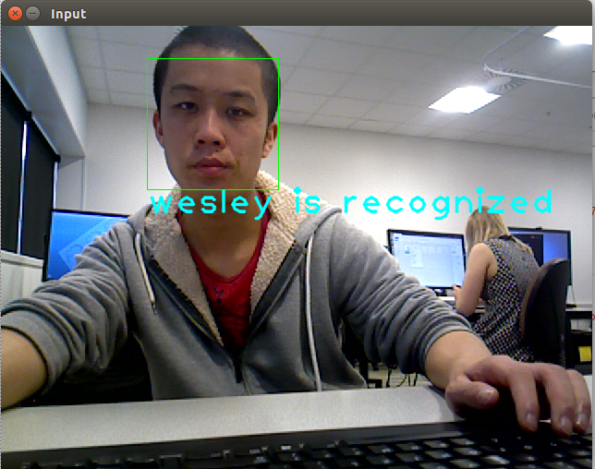
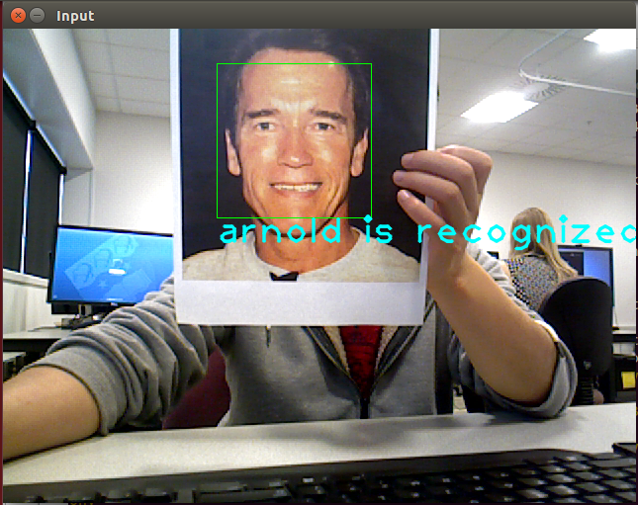
Procrob Functional
ROS package
Local, offline
OpenCV based, uses haarcascades
Fairly fast and accurate but prone to false detection
All of these modules use Kinect Camera via OpenNI

Slide 5
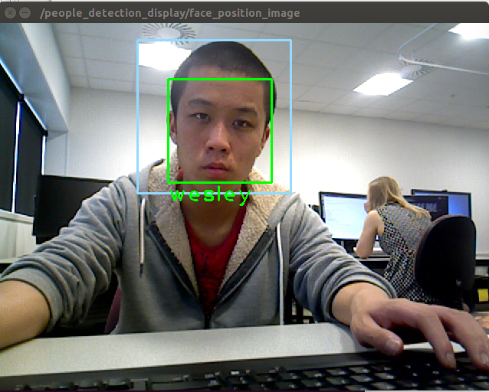
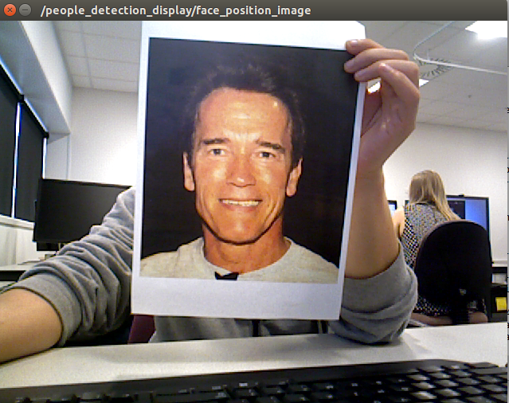
Cob People Detection
ROS package
Local, offline
Detects head and face
Uses OpenCV with Eigenfaces
Doesn't work on photos
Slower but less false detections

Slide 6
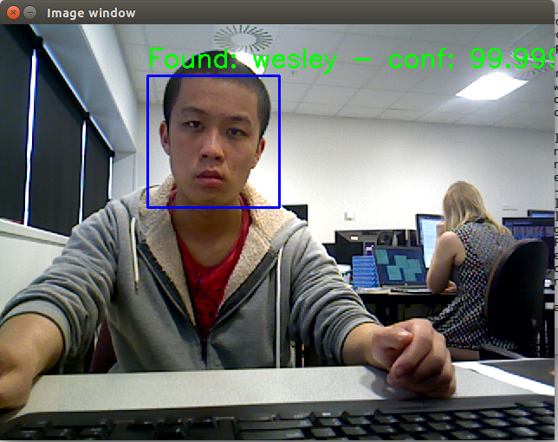
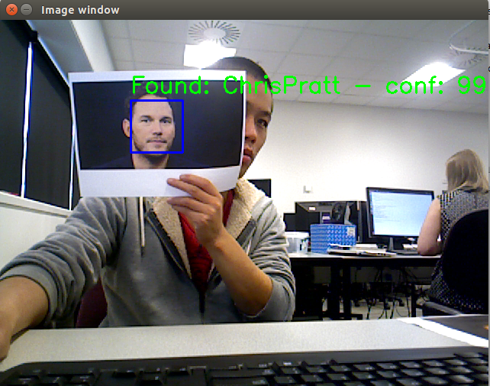
AWS Rekognition
Online via python boto3 sdk
High accuracy
Slower response time
Extra information e.g. gender, estimated age
Separate API call for training

Slide 7
ETRI Face Recognition
Has a Linux SDK
Will make a ROS module to test it

Slide 8
Speech Recognition
Google Speech to Text
Currently set on English (NZ accent)
Other accents (e.g. Korean) are not as good
Currently the response time is a bit delayed. Will try to improve using streaming rather than async
Amazon Speech Recognition
To do
Not sure if its possible to de-couple Amazon ASR from Lex service
Pocketsphinx ROS package
Offline
Significantly less accurate

Slide 9
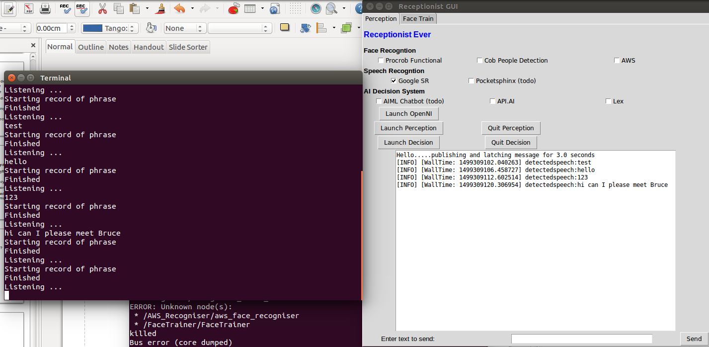
Google SR Example

Slide 10
Decision System
Amazon Lex
Uses boto3 python sdk to send requests inside a ROS package
AWS lambda function processes logic
API.AI
Works similar to Lex but not as flexible
Offline ROS module
E.g. Using knowrob (prolog)
Lot of work required to get it working, difficult to implement without strong background knowledge

Slide 11
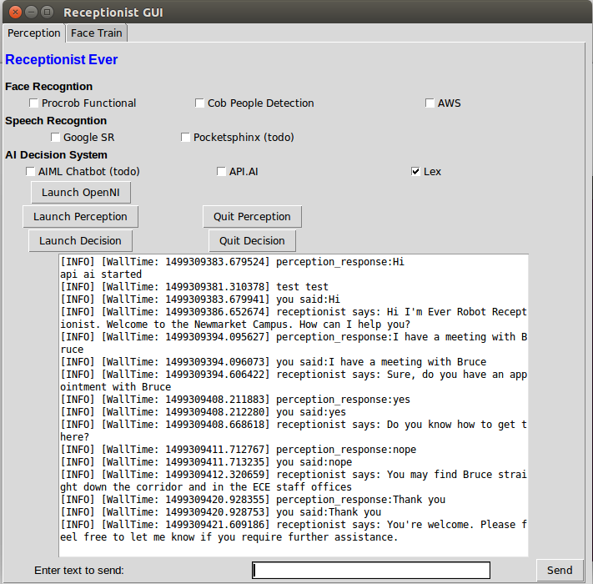
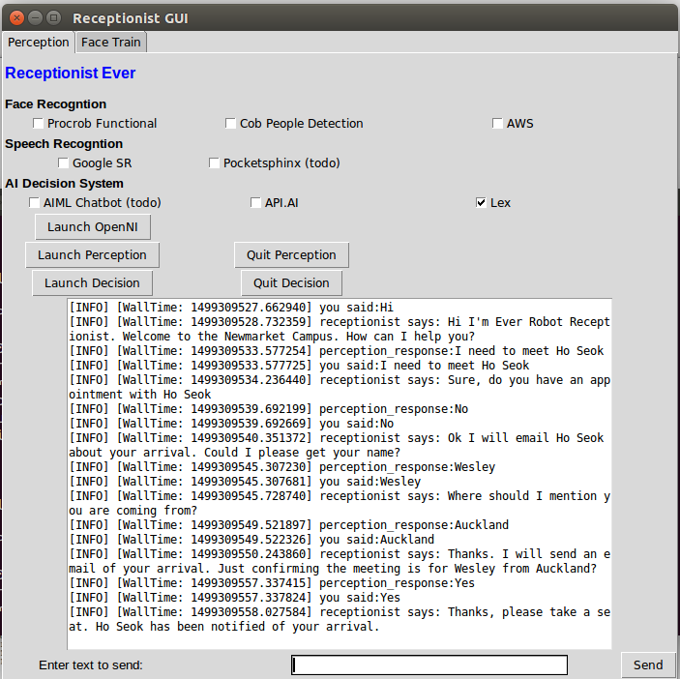
Amazon Lex Example

Slide 12
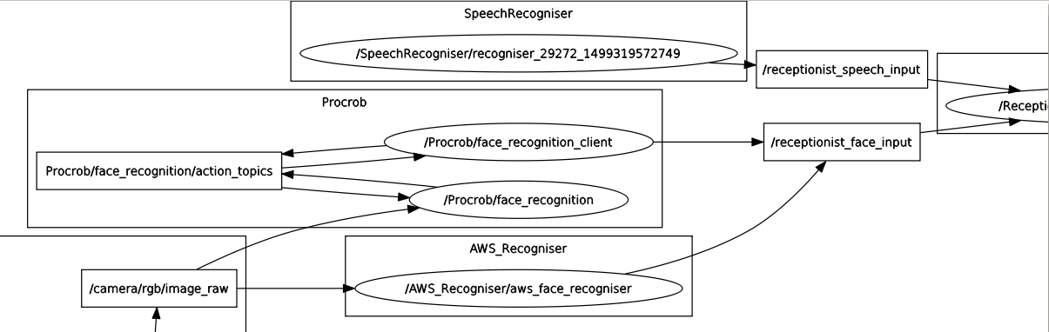
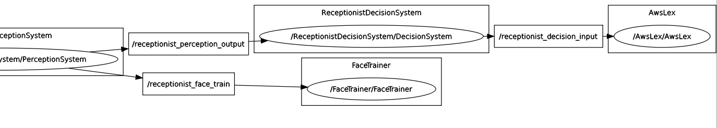
Perception System
Camera Input
Decision System

