Slide 1
OpsReplay
75%
Good engineers practise bad days.
of new code at Google is generated with AI
Practise production incidents in a real lab, then replay your decisions.
When something goes wrong, can an agent find the fault all the time?
Lee Hao Zhe
Neeraj Kumbar
Neo Qi Hao
Poh Yu Wen
See Yang Zhi
Teo Kai Xiang
Google Cloud Next, April 2026
Notes:
Speaker 1 (Yang Zhi) | 0:00 to 0:35 | Slide 1 of 21
Think of the last change an AI agent wrote for you.
Who decided whether it was safe to ship?
In April, Google reported that AI generated three quarters of its new code which engineers reviewed and approved.
Now imagine a large AI shipped change goes live for your SaaS, but an important feature: placing of orders no longer works. Where would you look first?

Slide 2


Keeping an evolving codebase working
100
Fewer than 1 in 4
maintenance tasks
Each came from a repository history averaging 233 days and 71 consecutive commits.
Share of tasks that stayed free of regressions through every round of changes (average of all models tested)
SWE-CI · Alibaba Group and Sun Yat-sen University · April 2026
Notes:
Speaker 1 (Yang Zhi) | 0:35 to 1:15 | Slide 2 of 21
In 2026, Researchers at Alibaba and Sun Yat-sen University tested agents on 100 maintenance tasks on real long-running repositories.
However, only about one in four tasks were free of regressions through every round of changes, regardless of models tested
This raises an important question: For every change suggested by AI, what else relied on the behaviour we just changed, and how reliable is the fix?

Slide 3

When an agent has to find the fault
The page loads. Orders fail. Which service would you check first?
47%
59
Best AI score on incident diagnosis
incident tasks
100%
ITBench-AA · IBM and Artificial Analysis · May 2026
Notes:
Speaker 1 (Yang Zhi) | 1:15 to 1:55 | Slide 3 of 21
Unfortunately, it is not feasible to always locate bugs before shipping, and that is why fast incident response is a skill of itself.
IBM and Artificial Analysis gave agents snapshots of 59 reliability incidents, but the best diagnosis score was a mere 47%.
To score well, an agent had to identify all the responsible components without creating regressions.
However, it often fails to do so, which leaves the engineer as the sole layer on deciding whether a fix actually works in production.

Slide 4



Who needs incident practice?
Computing students
Junior software engineers
Site reliability engineers
A first chance to troubleshoot a failing service before graduation
A rehearsal for the first time they carry the on-call phone
Additional practice for first responders: what to check first when something goes wrong
Notes:
Speaker 1 (Yang Zhi) | 1:55 to 2:30 | Slide 4 of 21
This brings us to our target audience: The current and future tech engineers of our society.
Our first users are computing students preparing for their interviews and junior engineers preparing for their first on-call shift.
Moreover, even seasoned Reliability engineers can also rehearse unfamiliar incidents and sharpen their skills outside of actual production issues.
I will now pass over the time to Kai Xiang to talk about how people learn.

Slide 5

How developers build a “Mental Model”
17
The Mental Model
“
debugging tasks
The page loaded. Did the order reach the next service? Which log would tell me?
Developers revised their picture of the system as they traced code and ran it.
Li and Coblenz · 12 developers working in their own codebases · FSE 2026
Notes:
Speaker 2 (Kai Xiang) | 2:30 to 3:05 | Slide 5 of 21
To properly teach incident response skills, we first need to understand how people learn.
Li and Coblenz watched 12 developers tackle 17 debugging tasks.
What they found is that developers had a “mental model” of the system as they traced code and ran it
Think of it as a visualisation of how a request moves through a system, from the client, to the load balancer, through the belly of your infrastructure and finally back.
This mental model allows engineers to know exactly which part of the system failed, and get a rough model of how the fix should look like

Slide 6
What incident practice can teach
In a cybersecurity exercise, 50 students scored higher on the post-test. OpsReplay applies the idea of hands-on practice to service outages.
Glas, Vielberth and Pernul · University of Regensburg · CHI 2023
Notes:
Speaker 2 (Kai Xiang) | Hidden · untimed | Slide 6 of 21
In a cybersecurity exercise with 50 students, mean test scores rose from 62% before training to 83% afterwards. The scores were specific to that exercise. For OpsReplay, the design idea is straightforward: give the learner a failure, let them choose a first check, and let them see what happened. Here’s how a Challenge puts that into practice.
Source note: Glas, Vielberth and Pernul, Train as you Fight, CHI 2023 (https://epub.uni-regensburg.de/54029/1/3544548.3581046.pdf). The study measured scores immediately before and after a cybersecurity exercise.

Slide 7



Inside an OpsReplay Challenge
01
02
03
Investigate
Repair
Replay
Work from the symptoms in production-like real services
Make a change and check whether customers can place an order
Revisit the evidence, then try a different approach in a fresh lab
Retry in a fresh lab AND review your attempts
Notes:
Speaker 2 (Kai Xiang) | 3:05 to 3:45 | Slide 7 of 21
OpsReplay plays heavily into drilling how to create this “mental model” of any system
OpsReplay starts with a client-facing symptom with real production-like service containers, where learners are thrown into the deep end of a simulated production issue
They have to choose what to inspect, make a repair and check whether the problem is solved reliably.
Learners can then replay their decisions alongside the service signals and try a different approach in a fresh lab if they failed

Slide 8
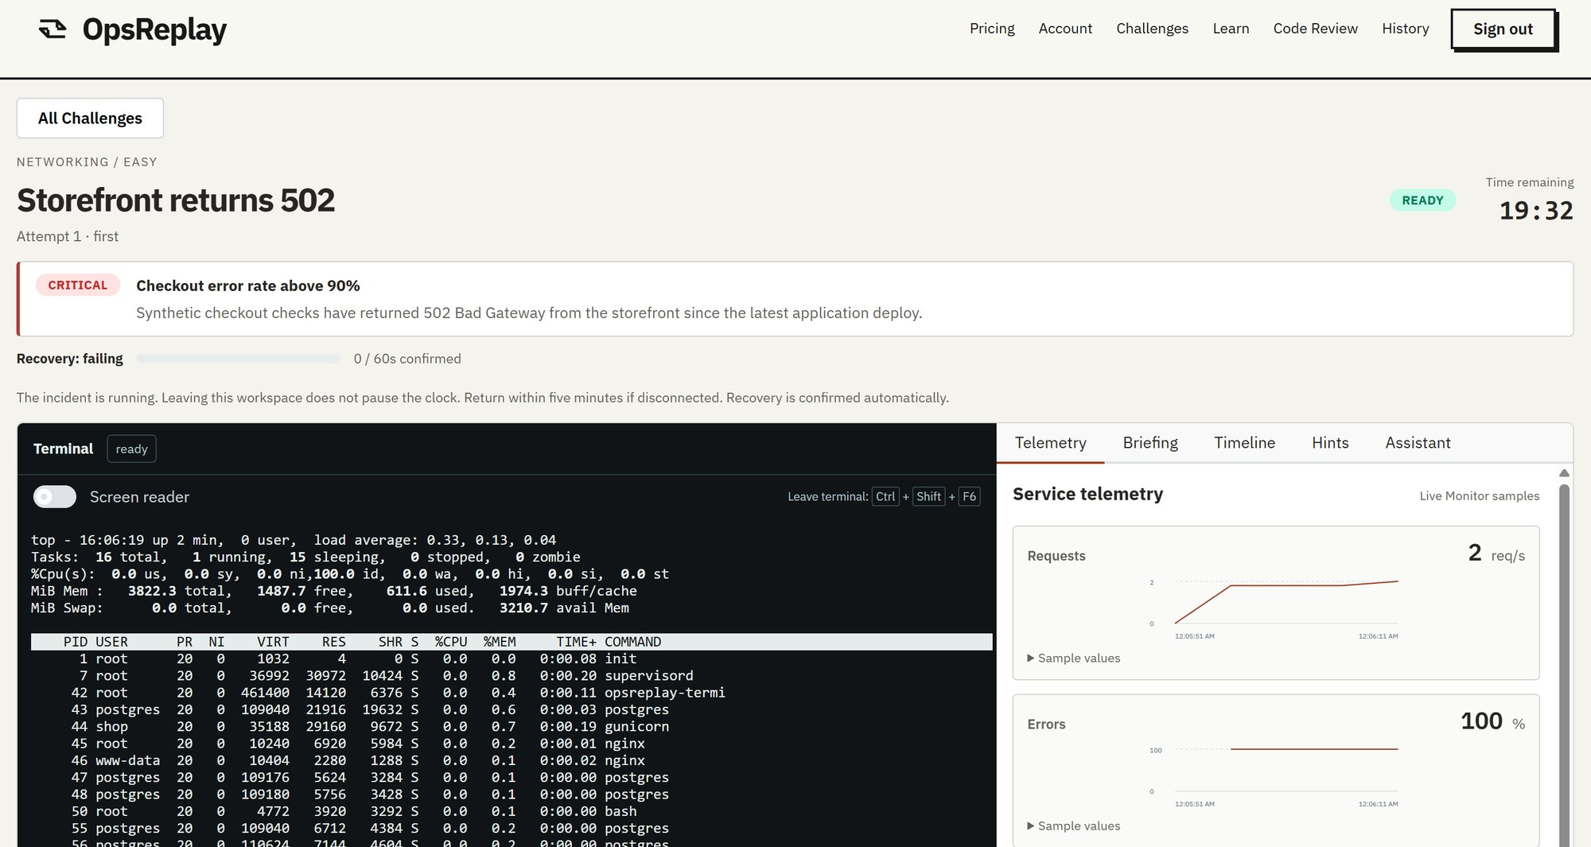
Why did checkout fail?
opsreplay · Storefront returns 502
Use the terminal and service signals to cdiagnose and fix the issue
1
Symptom: orders fail
1
2
A real linux terminal to investigate
3
2
3
Live service signals
Notes:
Speaker 2 (Kai Xiang) | 3:45 to 4:15 | Slide 8 of 21
This is a screenshot of how a lab in OpsReplay looks like
We can see that there’s an existing error (where the checkout page returns a 502 error) and failed client requests are piling in.
Learners are given a real linux terminal and service signals such as error rate and latency at the side to diagnose and fix the issue.
After fixing the issue, the learner has to ensure it is a reliable fix, which you can see in the live demo later.

Slide 9
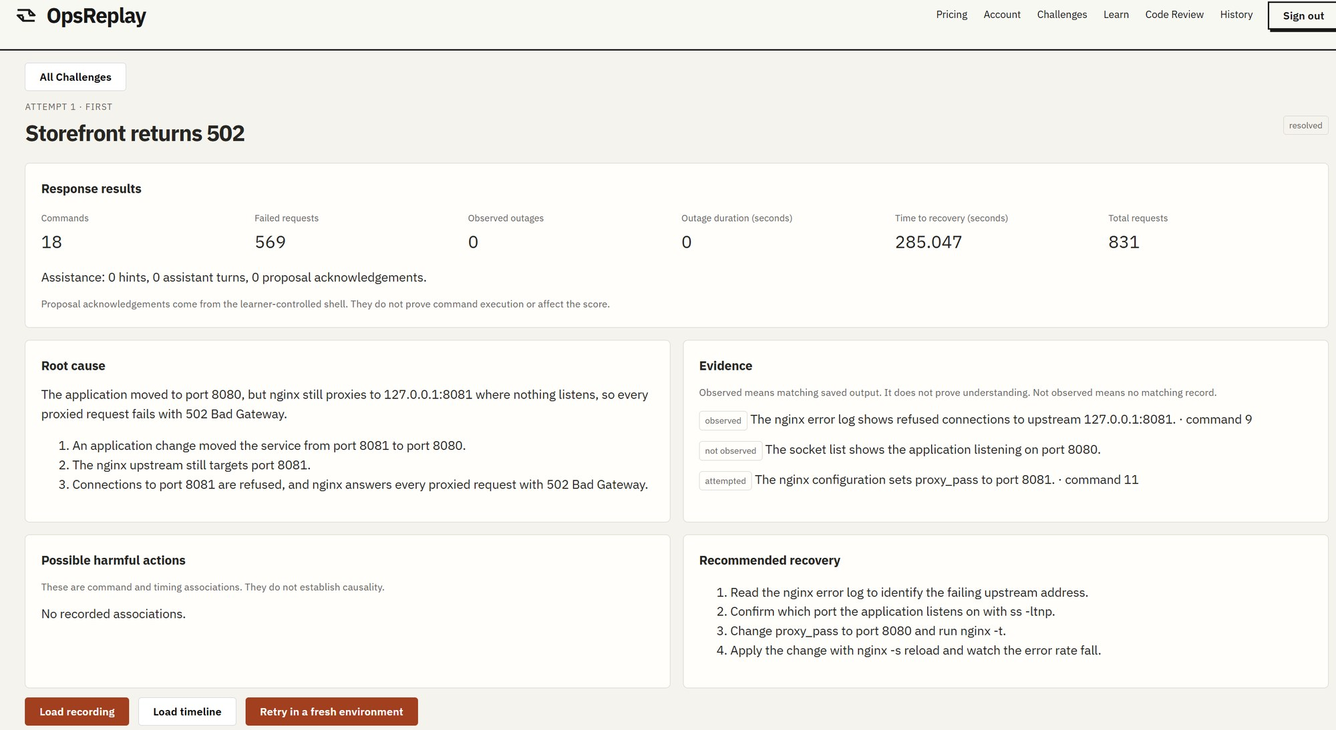
Did the fix work?
opsreplay · debrief
Review the outcome, then replay what happened around the repair
1
1
569 failed requests
285 seconds to recover
2
2
The root cause and the evidence you checked
3
Replay the attempt, or retry fresh
3
Notes:
Speaker 2 (Kai Xiang) | 4:15 to 4:40 | Slide 9 of 21
After the lab is solved, they are brought to the “review page”
Here we can see that the Checkout feature recovered in about 285 seconds after 569 requests failed.
The root cause panel allows learners to see how close their diagnosis is to the actual defect
The “Evidence” section also allows learners to revisit which signals they acted upon, and the “Possible harmful actions” list shows any steps that caused a regression in the feature instead.
Finally, a learner can replay the full attempt, and retry in a fresh lab with their new insights.

Slide 10
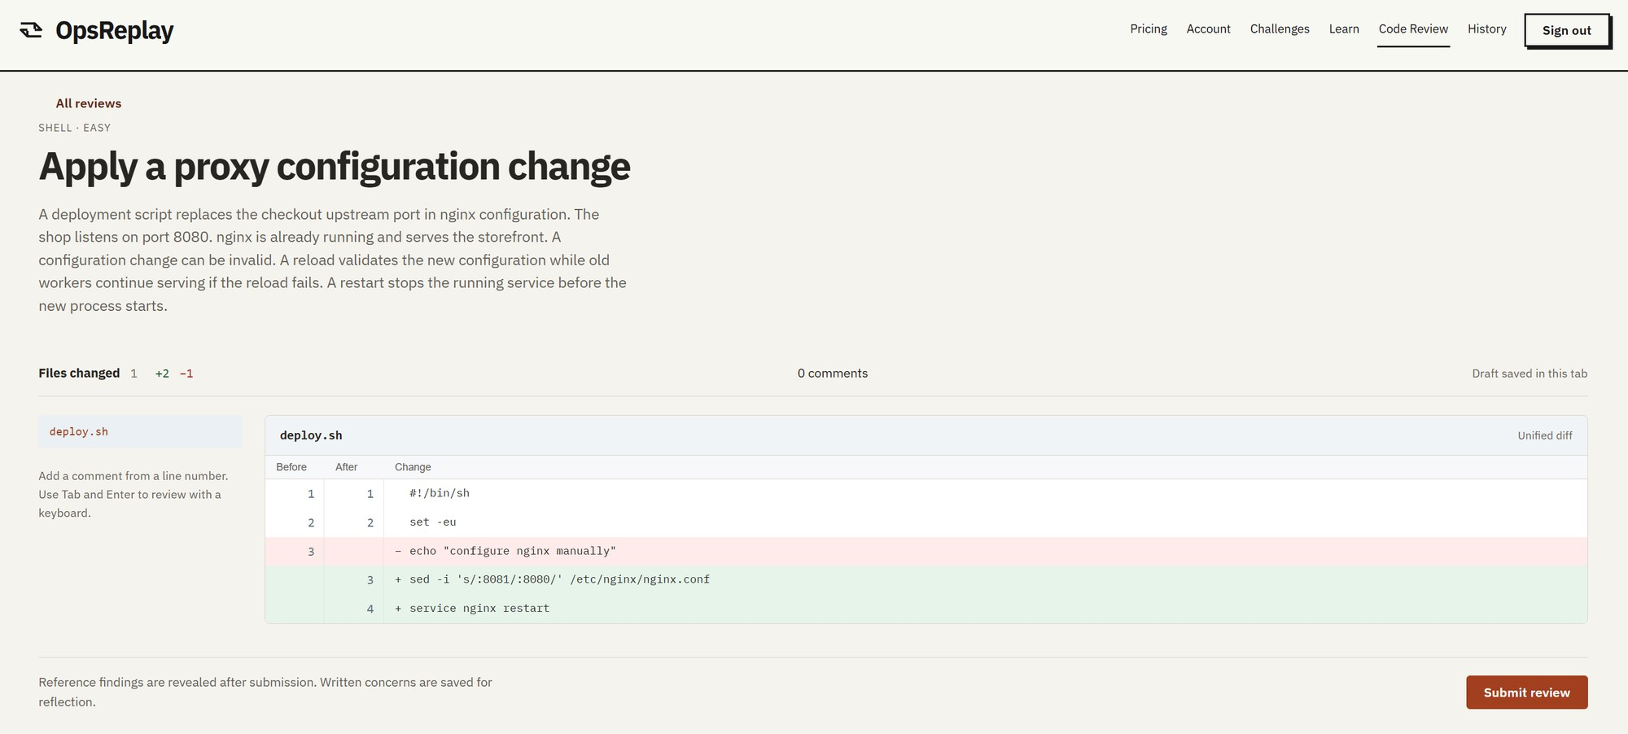
Code Review Challenges
Practise reviewing configuration changes.
opsreplay · Code Review
1
Flag the risky line and explain why
2
Compare with the reviewed findings
1
2
Notes:
Speaker 2 (Kai Xiang) | 4:40 to 5:00 | Slide 10 of 21
Another feature of OpsReplay is Code Review Challenges.
Before a change ships, you review it like a teammate would, flagging the line you think is risky and explaining why.
Then you compare your review with the ground truth
This helps train engineers spot mistakes before they make it into production.
I will now pass over the time to Neeraj for a live demo

Slide 11


Demo
ORDER
0:00
Show the symptom
From the first sign of failure to implementing the fix that ensures checkout recovered
0:15
Choose the first check
A private lab running real services
0:40-2:00
Apply the repair and watch 60 seconds of recovery
A customer-facing check decides recovery
A replay of the decisions that mattered
2:00
Debrief and replay
Notes:
Speaker 3 (Neeraj) | 5:00 to 7:30 | Slide 11 of 21
Thank you Kai Xiang
I will now pass over the time to Hao Zhe to talk about OpsReplay’s competitive advantages

Slide 12
Two repairs can restore checkout
How many orders failed along the way?
Path A
ORDERS FAILED
Checkout restored
Checks where the request stopped, then repairs
Path B
ORDERS FAILED
Checkout restored
Restarts a healthy service first, then repairs
OpsReplay measures failed requests and time to recovery. Learners can explain the customer impact of the path they took.
Illustration: bar lengths show the idea, not measured results
Notes:
Speaker 4 (Hao Zhe) | 7:30 to 8:20 | Slide 12 of 21
Thank you for the live demo Neeraj, now, what unique advantages does OpsReplay provide?
Imagine two candidates who both got it working. One restored the service quickly without harmful steps. The other restarted a healthy service first which caused more orders to fail while they investigated
Both solved the issue successfully.
However, path A is clearly the “better” behaviour since it minimised the number of failed orders.
OpsReplay records various metrics to measure the customer impact.
This allows candidates to use these observations to explain the cost of their approach and improve on their methodology in the future.

Slide 13
Where OpsReplay fits
OpsReplay
SadServers
KodeKloud
Review customer impact, align terminal actions with service signals, then retry with the first result preserved.
Live troubleshooting scenarios, progressive hints and solution checks.
DevOps tasks in live labs, with automated validation and repeat attempts.
Sources · SadServers labs and KodeKloud 100 Days of DevOps
Notes:
Speaker 4 | 8:20 to 9:10 | Slide 13 of 21
We also identified existing competitors to our product
SadServers has live troubleshooting, progressive clues and a solution check.
KodeKloud offers validated DevOps tasks and repeat attempts.
However, both of these solutions focus too much on merely solving a problem.
OpsReplay’s focus is on training engineers to understand what worked, what didn’t and their impact on production. Learners can inspect customer impact, revisit the signals available when they made a choice, and try a different recovery to fix issues without impacting production as much as possible.

Slide 14


What replay adds
Replay
A fresh second attempt
Commands, logs and metrics share one timeline.
Keep the first result, change one decision, and compare failed requests and recovery time.
COMMANDS
LOGS
Attempt 1
METRICS
Attempt 2, one decision changed
OpsReplay Challenge debrief, playback and retry
Notes:
Speaker 4 | 9:10 to 10:00 | Slide 14 of 21
A big part of what enables this is the Replay functionality.
Did the errors start before the learner ran that command? Had requests already begun to recover when the learner changed the configuration? Or did the learner’s actions unintentionally cause more harm?
The command, logs and service metrics share a timeline, so the learner can inspect their sequence to learn what helped and what didn’t
Learners can then retry in a new lab environment to improve on their previous attempt.
I will now pass over the time to Mark o talk about OpsReplay’s growth, pricing and costs.

Slide 15



A free first incident
Free
Pro
Institutional
S$0
S$11.99/month
Future
Introductory content, full debrief, playback and fresh retries.
Placeholder price for more published exercises and longer lab sessions.
Per-seat access for courses and training cohorts.
S$11.99 is a placeholder; no payments have been collected
Notes:
Speaker 5 (Mark) | 10:00 to 10:30 | Slide 15 of 21
Thank you Hao Zhe,
Here is our pricing plan
A free learner can launch basic challenges end to end: which means the ability to fix a production-like incident, review the debrief, replay the timeline and retry the challenge.
We will have a Pro plan at S$11.99 per month which includes more exercises and longer sessions. This is similar to how LeetCode prices its challenges.
We also plan to offer institutional and enterprise pricing in the future.

Slide 16
How many learners could we reach?
Reach university computer science students through courses and interview-prep groups with one free checkout incident.
1,300
325
1,625
+
=
direct sign-ups
new sign-ups from referrals
estimated sign-ups
25 new users a week × 52 weeks
One referral per four direct users
Each referred user counted once
Scenario · acquisition assumptions we would track against actual sign-ups
Notes:
Speaker 5 | 10:30 to 11:10 | Slide 16 of 21
Here we model how many students we could reach with OpsReplay
Our plan is to start with university computer science students, offering one free incident challenge through systems courses and interview-prep groups.
Our scenario assumes 25 new direct users each week which leads to 1,300 sign-ups over 52 weeks.
Say every four bring in one new classmate through word-of-mouth, we get another 325 referrals, giving us 1,625 users.

Slide 17



What those sign-ups could earn
244
S$2,926
S$35,107
paying subscribers
per month
projected annualised run rate
Assume 15% of 1,625 sign-ups are active Pro subscribers at year-end.
At S$11.99 per subscriber
Year-end monthly subscription revenue × 12
Year-end scenario · first-year receipts depend on when subscribers join and how long they stay
Notes:
Speaker 5 | 11:10 to 11:46 | Slide 17 of 21
Suppose 15% of those 1,625 sign-ups are active paid subscribers eventually.
That gives about 244 subscribers.
At S$11.99 per month, their subscription revenue would be about S$2,926 a month. Holding that level for twelve months gives a projected annualized run rate of S$35,107. But of course these depend heavily on the actual situation

Slide 18
Would that cover our costs?
82
paying subscribers
would cover the S$972 monthly budget at S$11.99 contribution per subscriber.
S$1,953.56 Revenue
Budget includes shared infrastructure, content, support and acquisition. Engineering payroll excluded.
Notes:
Speaker 5 | 11:46 to 12:30 | Slide 18 of 21
Finally, for our operations costs, we estimate about 82 paying subscribers to cover everything.
After that, each paying subscriber contributes about S$11.99. At 244 paying subscribers from our previous growth model, the monthly revenue we expect to make is about S$2,925. This leaves roughly S$1,953 in profits per month.
I will now pass over the time to Yu Wen to talk about our prototype and close off.

Slide 19
Six AWS attempts produced six complete recordings
6
41
Multiple
Recordings
Exported objects
Runs at once
All six attempts produced a debrief and playback. Hosted tests also verified retry in a fresh lab.
All 41 matched their stored checksums, verifying the exported data.
The team ran multiple challenges at once to ensure concurrency and isolation between challenges is maintained
Source: OpsReplay final report, hosted functional and reliability tests, 1 November 2026.
Notes:
Speaker 6 (Yu Wen) | 12:30 to 13:20 | Slide 19 of 21
Thank you Mark
Here is what we tested on our MVP
On 7th November, the team ran six attempts on AWS, with up to multiple challenge containers running to ensure we can scale to a large amounts of users
All six recordings were recorded and playback successfully.
We also checked that all 41 exported objects such as failure metrics, command logs and failed actions all matched their checksums.
Across the hosted challenges, we verified actual recovery of the scenario, replayed an attempt, and checked that retries worked properly

Slide 20



An interview answer you can defend
01
02
03
Trace the request
Defend the repair
Verify recovery
Which part of checkout still worked? Where did the request stop?
Which clue changed your mind, and why did it justify your next action?
Could a customer place an order again? What evidence shows it?
Three prompts for explaining a real Challenge attempt
Notes:
Speaker 6 | 13:20 to 14:10 | Slide 20 of 21
Say you are in an interview and you have solved the challenge, however, the interviewer wants to know your thought process.
Questions such as “where did the request stop? which clue made you change that service?” Are all common follow-up questions
In OpsReplay, those questions connect to specific moments in your attempt and help to refine that “mental model” of the entire system. For example, I first checked the nginx logs since that is the reverse proxy in-front of the service. These help justify your actions cleanly to any potential interviewers and colleagues you work with.

Slide 21
Checkout is down.
What do you check first?
Practise that decision before a customer is waiting.
Thank you. Questions?
github.com/ehz0ah/OpsReplay
Notes:
Speaker 6 | 14:10 to 15:00 | Slide 21 of 21
Picture that interview. The interviewer asks, the frontend loads, but every customer checkout action fails.
“What do you check first?” With OpsReplay, you can answer from an incident you actually worked through. You can describe what you saw, which dependency you tested, and how you knew the customer could buy again.
Now picture your first on-call shift. It’s the same question, and this time real customers is waiting. Hundreds of requests pile in in seconds. What would you check first?
Thank you and this is OpsReplay.

Slide 22
Audience and alternatives
Who would try OpsReplay first?
Why use this if SadServers and KodeKloud already offer labs?
A student preparing for a systems interview or a junior engineer approaching a first on-call shift. One free incident gives them a concrete decision to explain.
OpsReplay lets learners line up their own commands with failed requests and recovery time, then try a different repair while preserving the first result.
Notes:
Hidden appendix | Slide 22
Who would try OpsReplay first?
A student preparing for a systems interview or a junior engineer approaching a first on-call shift. One free incident gives them a concrete decision to explain. We would start with interview-preparation groups. A useful demand signal is whether someone voluntarily starts a second incident.
Why use this if SadServers and KodeKloud already offer labs?
OpsReplay lets learners line up their own commands with failed requests and recovery time, then try a different repair while preserving the first result. SadServers offers live troubleshooting and KodeKloud offers structured tasks and checks. Our case for interview preparation is that the learner can show the reasoning behind a specific repair.

Slide 23
Demand and pricing
Where do the 25 weekly users and 15% paid uptake come from?
What would justify paying S$11.99 a month?
Both are planning assumptions. The scenario starts with 1,300 direct sign-ups in a year, adds 325 distinct referrals and assumes 244 users are paying at year-end.
Free includes one complete incident with debrief, replay and retry. Pro is a proposed offer for learners who want more incidents and longer sessions.
Notes:
Hidden appendix | Slide 23
Where do the 25 weekly users and 15% paid uptake come from?
Both are planning assumptions. The scenario starts with 1,300 direct sign-ups in a year, adds 325 distinct referrals and assumes 244 users are paying at year-end. The referral assumption is one additional user per four direct users, counted once. The 15% figure includes both upgrades and retention through year-end.
What would justify paying S$11.99 a month?
Free includes one complete incident with debrief, replay and retry. Pro is a proposed offer for learners who want more incidents and longer sessions. We would measure the share who start another case, upgrade and remain subscribed. The prototype demonstrates access levels and has collected no subscription revenue.

Slide 24

Revenue and costs
How much of the S$35,107 would we actually earn in year one?
What happens if far fewer people pay?
S$35,107 annualizes one projected month at 244 subscribers. First-year receipts depend on when each subscriber joins and how long they stay.
The pitch model needs 106 paying subscribers to cover its S$972 monthly budget. At 5% uptake, about 81 subscribers would leave a shortfall of roughly S$229 a month.
Notes:
Hidden appendix | Slide 24
How much of the S$35,107 would we actually earn in year one?
S$35,107 annualizes one projected month at 244 subscribers. First-year receipts depend on when each subscriber joins and how long they stay. At the S$11.99 placeholder, 244 subscribers would generate S$2,925.56 per month. Multiplying by twelve gives an exit run rate of S$35,106.72.
What happens if far fewer people pay?
The pitch model needs 106 paying subscribers to cover its S$972 monthly budget. At 5% uptake, about 81 subscribers would leave a shortfall of roughly S$229 a month. This sensitivity uses 1,625 sign-ups and S$9.1775705 contribution per paid subscriber. It holds usage and costs fixed. Heavy lab use would lower contribution, and the budget excludes engineering payroll.

Slide 25

Recovery and AI
How do you know the learner fixed the incident?
Could the AI assistant solve or grade the exercise?
A separate monitor tests the customer-facing operation. In the checkout exercise, recovery requires successful checkouts for 60 consecutive seconds.
It can explain visible evidence and suggest a command. The learner confirms the exact command before it runs. The monitor determines recovery, and the learner can complete the lab with AI off.
Notes:
Hidden appendix | Slide 25
How do you know the learner fixed the incident?
A separate monitor tests the customer-facing operation. In the checkout exercise, recovery requires successful checkouts for 60 consecutive seconds. The check can accept a valid alternative repair. Terminal output alone cannot establish recovery. The debrief reports time to recovery, failed requests and observed actions.
Could the AI assistant solve or grade the exercise?
It can explain visible evidence and suggest a command. The learner confirms the exact command before it runs. The monitor determines recovery, and the learner can complete the lab with AI off. The optional model sees public evidence. Hidden faults, validators and unreleased hints stay outside its context. Scores come from the platform’s recorded evidence.

Slide 26

Safety and scale
Why give a learner a real shell?
What has been tested, and could a whole class use it?
Commands need real consequences. Each attempt runs in a private Fargate task without a task IAM role or internet route. Only the Gateway can connect to the task.
The report documents six hosted attempts with at most two concurrent. All six recordings finalized. Capacity for a full class remains unmeasured.
Notes:
Hidden appendix | Slide 26
Why give a learner a real shell?
Commands need real consequences. Each attempt runs in a private Fargate task without a task IAM role or internet route. Only the Gateway can connect to the task. The Gateway validates the terminal ticket, relays the shell traffic and records evidence outside the learner’s writable environment. The following diagram shows the access path.
What has been tested, and could a whole class use it?
The report documents six hosted attempts with at most two concurrent. All six recordings finalized. Capacity for a full class remains unmeasured. The November campaign verified recovery, playback and cleanup. Replacing one Gateway also disrupted another active attempt, an observed reliability limit. Hosted checks show the workflow ran. Learning gains and classroom capacity remain unmeasured.

Slide 27
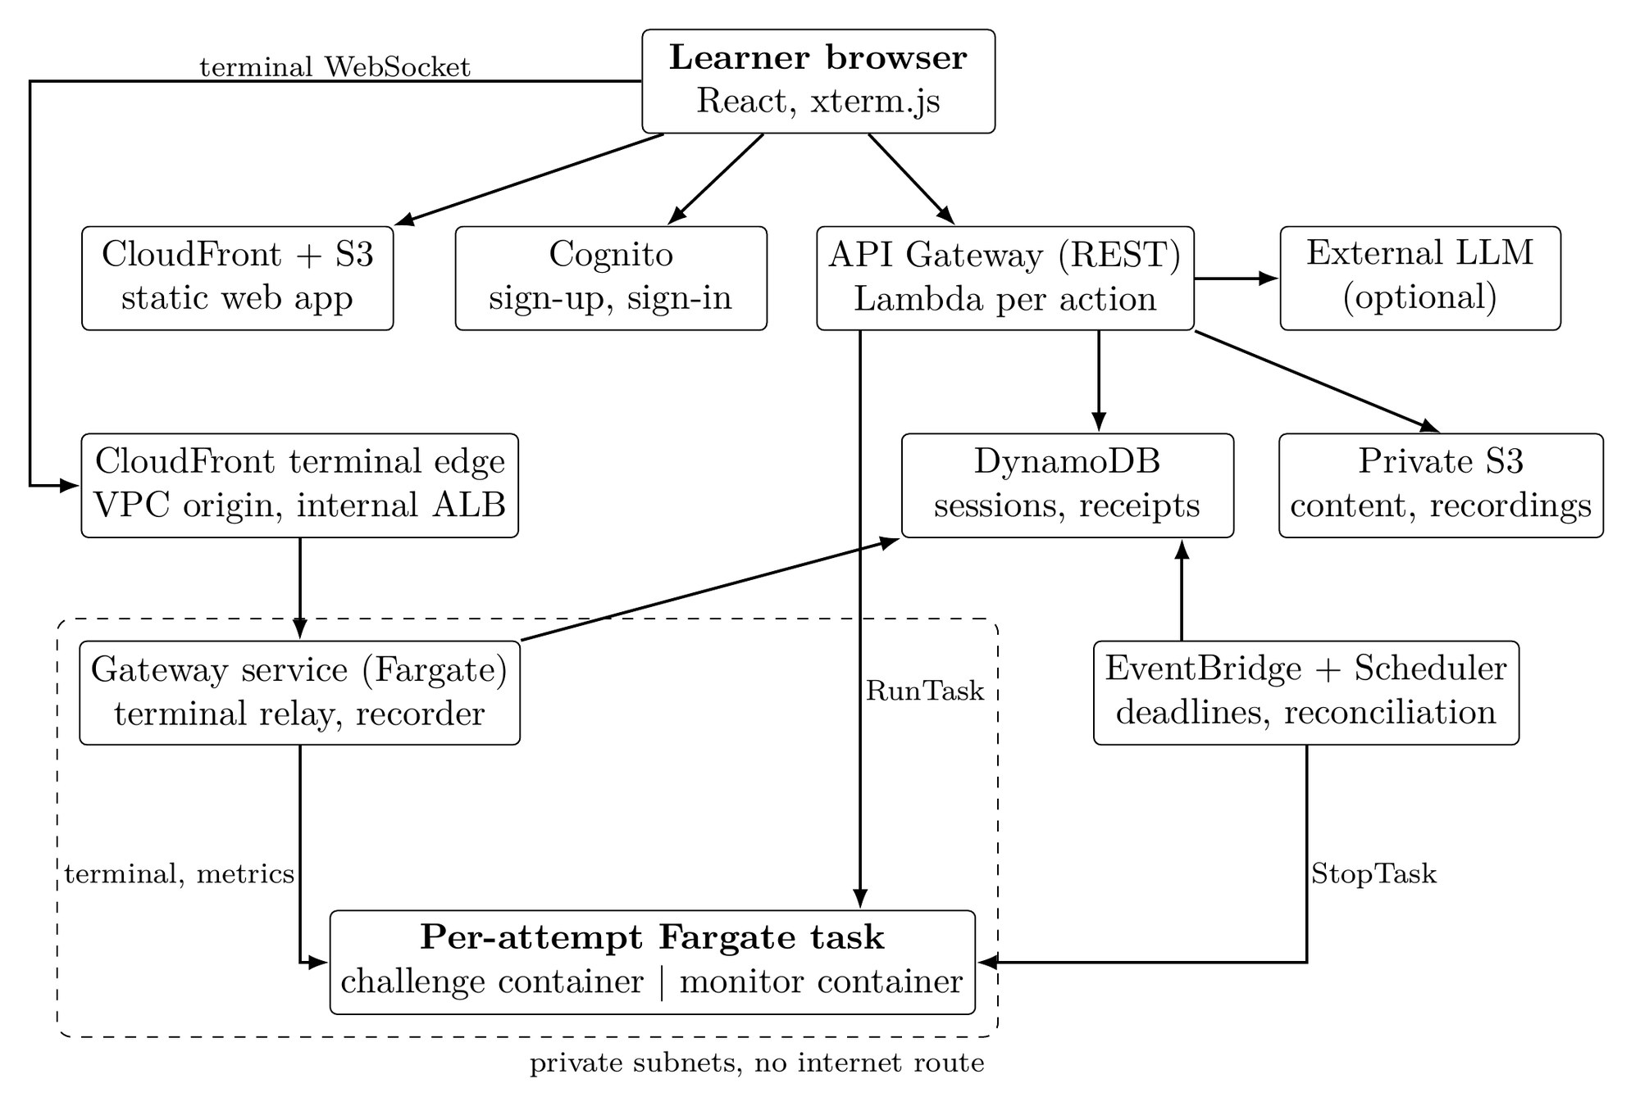
One task per attempt
The challenge and monitor run together. The Gateway controls terminal access and records the session.
Final report, Figure 2, page 5
Notes:
Hidden appendix | Slide 27
The slide reproduces Figure 2 from page 5 of the final report (https://github.com/ehz0ah/OpsReplay/blob/2cd24a5cb9b2766fe72160646f3e5fe628bb0cfb/docs/reports/final/Final.pdf#page=5). Follow the terminal connection from the browser through CloudFront to the Gateway and then to the per-attempt task.

