Slide 1
Customer &
Product Insights
Where the Next Growth Comes From

Slide 2
€29.35M from bikes, built on one-time buyers
€29.35M
96.5%
Revenue from 27,657 orders and 18,482 customers
Of revenue delivered by bikes
63%
8.9%
Of customers bought once; repeat buyers drive 77% of revenue
Of customers are VIPs, generating 36.7% of revenue
Customer & Product Insights: Where the Next Growth Comes From
2

Slide 3
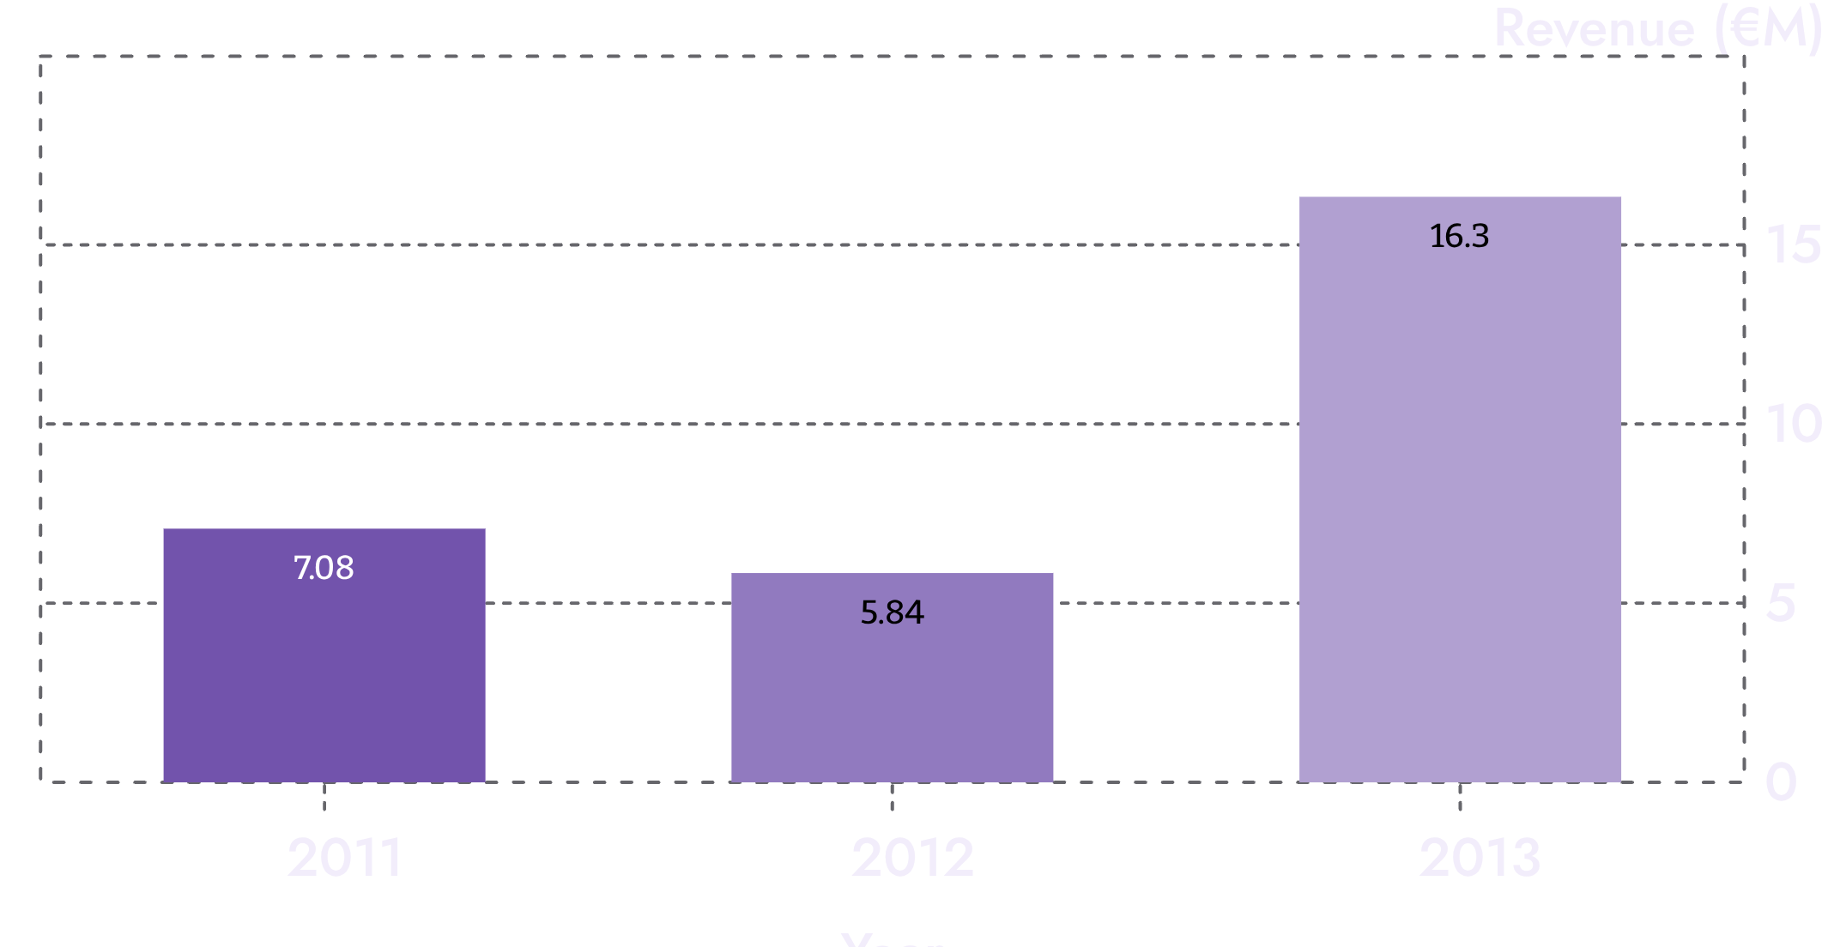
2013 grew 2.8x, and the business changed shape
+551%
Orders in 2013
Accessories and Clothing launched at scale, about €1.0M in 2013.
Average revenue per order fell from about €3,200 (2011) to about €770 (2013).
Revenue rose from €5.84M (2012) to €16.34M (2013).
Customer & Product Insights: Where the Next Growth Comes From
3

Slide 4
Customers

Slide 5
Most customers are new, and most buy once
62.9%
77.0%
Ordered exactly once
Revenue from repeat customers
5,454 ordered twice.
Repeat customers are 37.1% of the base.
79% are “New” because most joined in 2013, so the repeat opportunity is large.
Customer & Product Insights: Where the Next Growth Comes From
5

Slide 6
VIPs buy bigger baskets, not more often
1,653
€10.76M
€6,510
VIP customers
VIP revenue
VIP average spend
Measure | VIP | Regular
Order value | €2,633 | €1,682
Orders | 2.5 | 2.1
Growing VIPs means moving customers into higher-priced bikes.
Top 10% of customers earn 40.3% of revenue; the largest customer is only €13,294, so no whale dependency.
Customer & Product Insights: Where the Next Growth Comes From
6

Slide 7
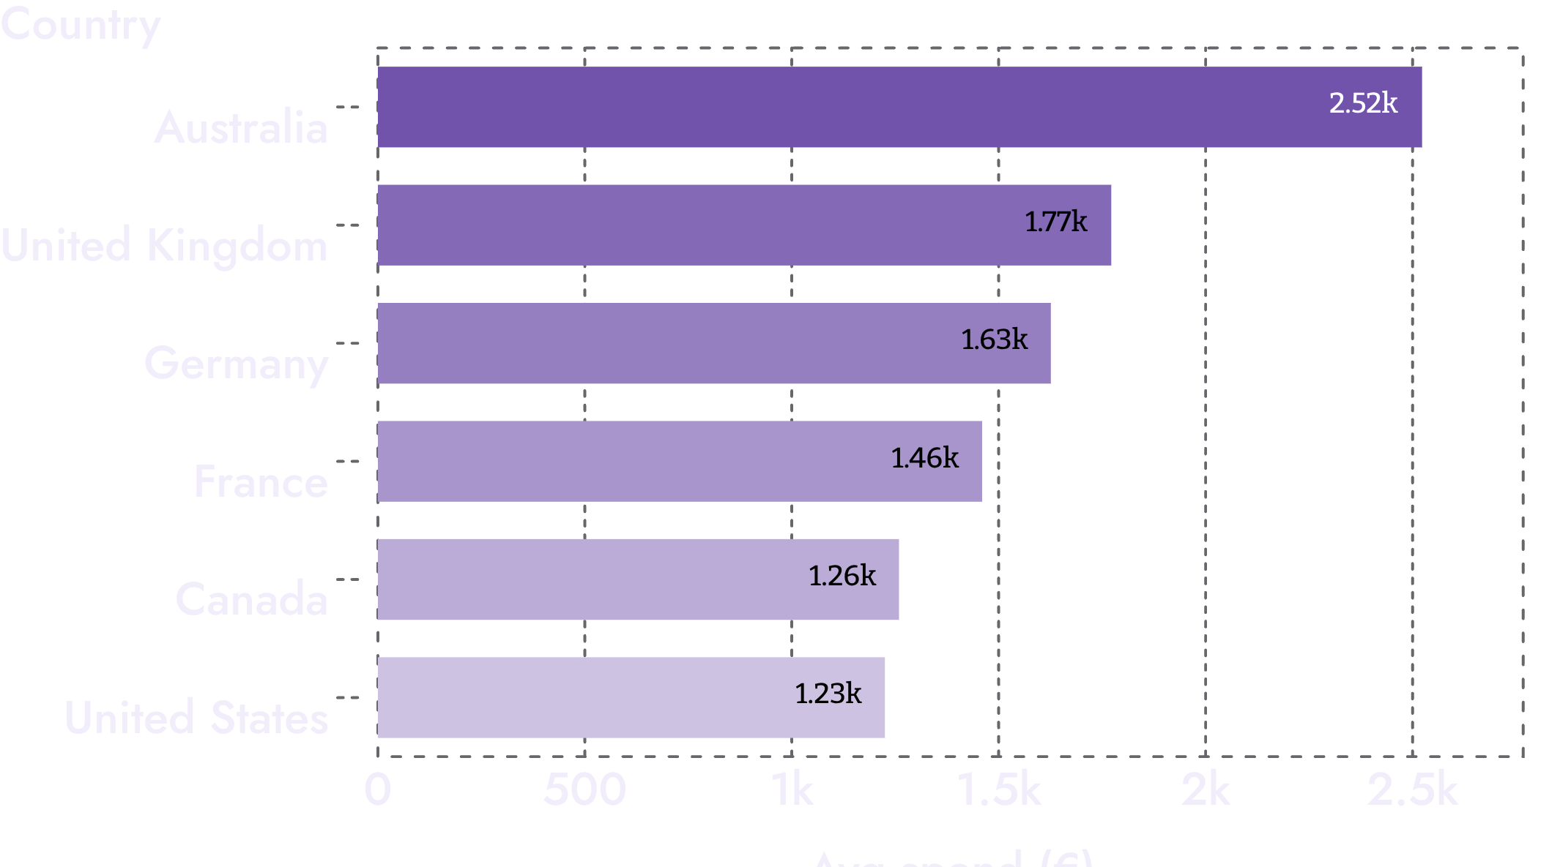
Australia is the most valuable market per customer
Australia
19% of customers, 31.1% of revenue; €2,523 average spend.
US
40% of customers, 31.5% of revenue; €1,225 average spend.
VIP share: Australia 19.9%, US 4.9%, Canada 2.7%.
US and Canada hold the largest upside.
Customer & Product Insights: Where the Next Growth Comes From
7

Slide 8
A hidden loyal segment: 35 frequent, low-ticket buyers
35
16–28
€48
Customers
Orders each
About, per order
Loyal accessory and clothing buyers that a spend-based VIP rule never captures.
Customers aged 40+ are about 99% of the base; gender is balanced.
Customer & Product Insights: Where the Next Growth Comes From
8

Slide 9
Products

Slide 10
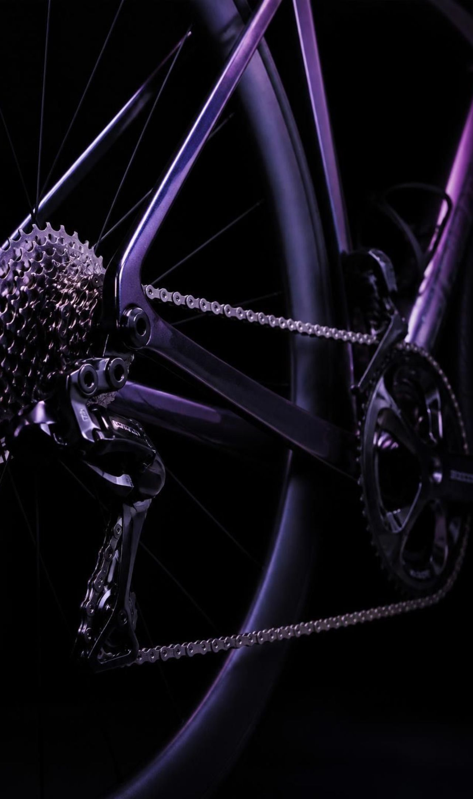
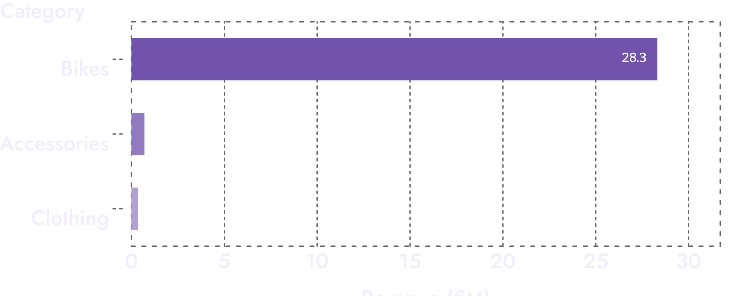
Bikes carry the revenue; accessories carry the volume
Bikes generate €28.31M, 96.5% of revenue from 88 products.
Road Bikes 49.5%, Mountain 33.9%, Touring 13.1% of total revenue.
Accessories sell 2.4x more units than bikes but earn 2.4% of revenue.
Customer & Product Insights: Where the Next Growth Comes From
10

