Slide 1

THE BIMSMITH
About us What we do Our Work Contact us
Are looking to enhance your project efficiency without stretching your budget? Welcome to THE BIMSMITH, a dynamic BIM modeling startup based in India, ready to partner with you.
Let’s Build Something Great Together…
Ready to elevate your projects with high-quality BIM modeling? Let’s connect and explore how our services can add value to your business. Why Choose Us?
Expertise and Experience
Competitive Pricing
Flexible and Responsive
Cutting-Edge Technology
Dedicated Support
Enquiry <link to contact us page>

Slide 2

THE BIMSMITH
About us What we do Our Work Contact us
We are a team of Architects and Interior designers, based in India Over a decade of experience in providing BIM services to international AECO firms for: DESIGN DEVELOPMENT & DIGITAL ENGINEERING.
Our Services <link to “WHAT WE DO” page>

Slide 3
THE BIMSMITH
About us What we do Our Work Contact us
What makes us different? Our mission is to optimize BIM outsourcing service at every step and pass on the benefit to our Customers. This is achieved through the following measures:
# We focus on our core competence and believe in optimizing our efforts. This leads to an efficient process and cost savings.
# We are asset-light and work completely remotely. # We work with a pool of talented individuals with specialized skillset.
# Quality is at the core of our service. We believe in building quality into the service at in process itself. # We have thorough Quality Assurance and Quality Control process to ensure

Slide 4
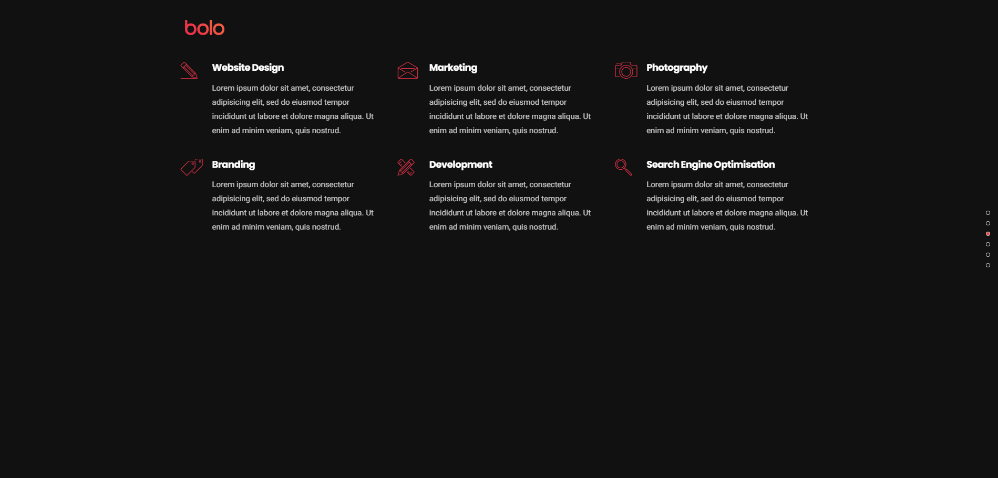
THE BIMSMITH
About us What we do Our Work Contact us
DESIGN DEVELOPMENT You design. We finalize… Architecture & Interior Design Turn sketches, concepts, mockups... into plans, elevations, sections, details, schedules... ready for construction.
Schematic Design.
Design Development.
Construction Documentation.
models, drawings, schedules, renders, videos, simulations... 3000% BIM-based, in Revit
DIGITAL ENGINEERING Your BIM/Digital partner… Scans/CADs to BIMs Turn laser scans into BIM models, in Revit

Slide 5
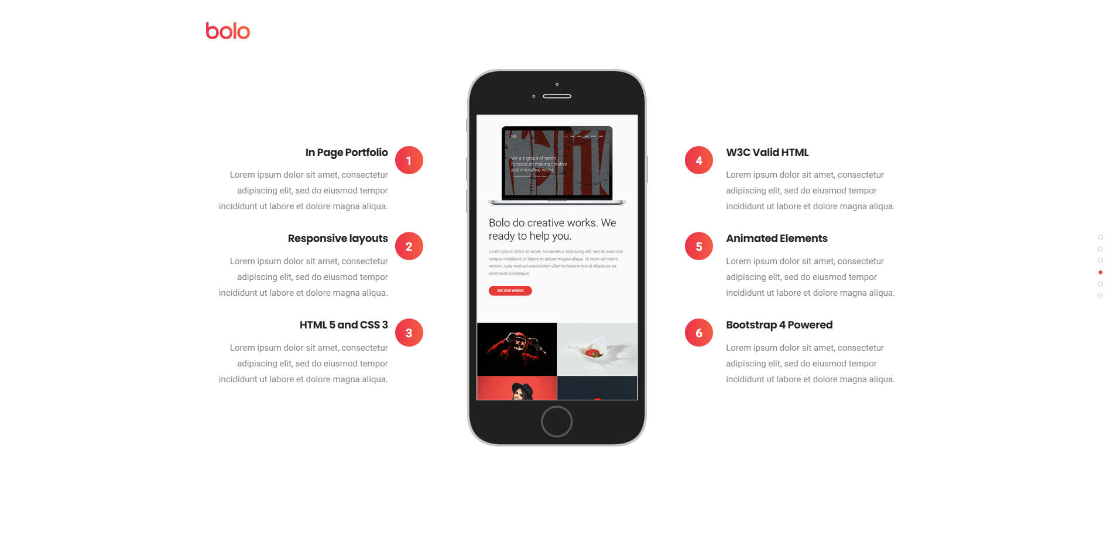
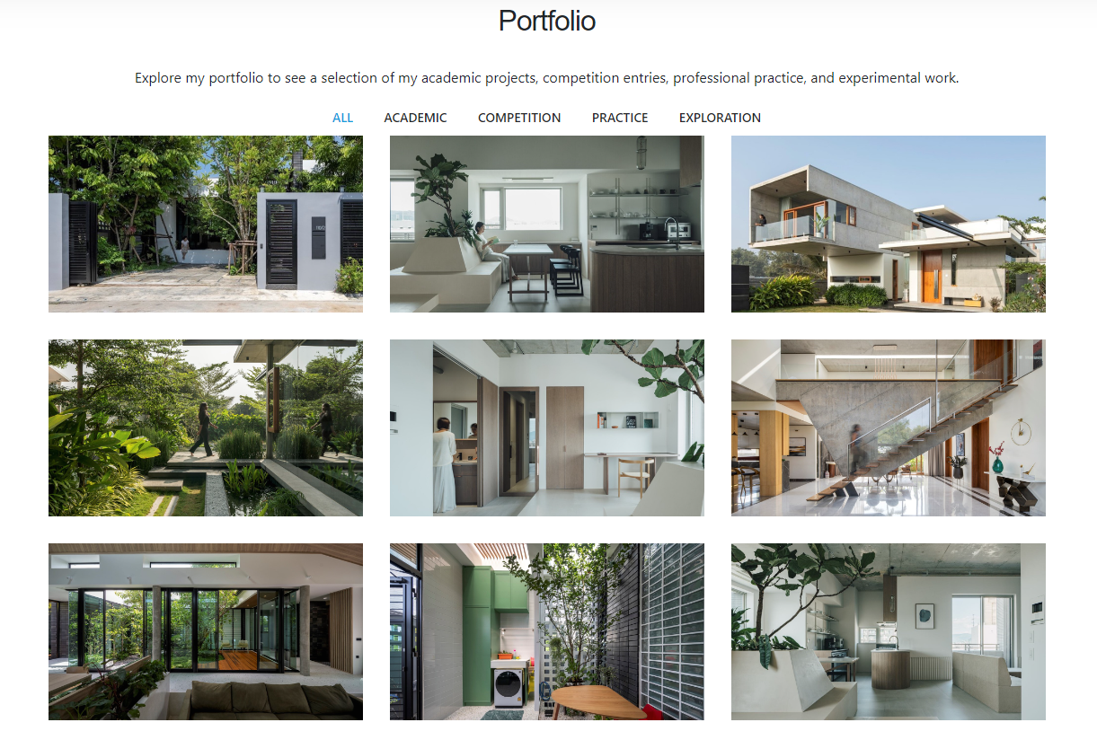
THE BIMSMITH
About us What we do Our Work Contact us
Design Development Cad to BIM Scan to BIM

Slide 6

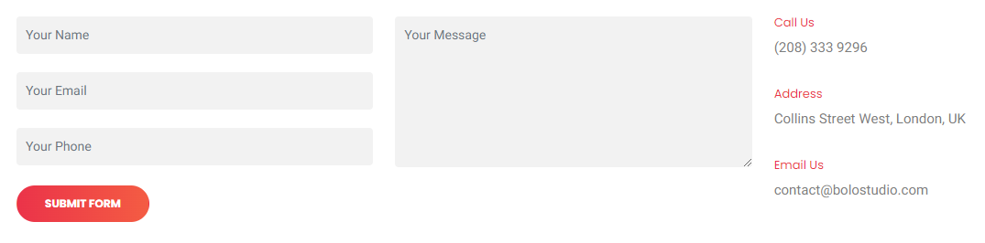
THE BIMSMITH
About us What we do Our Work Contact us
Founder: Kanchan Yadav Architect, Urban Planner
Footer

