Slide 1
tracerutils
An R package for EM tracers

Slide 2


How to get it
https://github.com/fmlove/tracerutils
if (!require("devtools")) install.packages("devtools") devtools::install_github("fmlove/tracerutils") library(tracerutils)
The current version is 0.6.1.
If you have other packages loaded in R when you do this, you might get a warning message along the lines of lazy-load database '/Library/Frameworks/R.framework/
Versions/3.5/Resources/library/catmaid/R/catmaid.rdb' is corrupt. If this happens, just go to Session > Restart R, and reload the packages.

Slide 3
check_duplicate_synapses | Check a neuron for potential duplicate synapses
find_glomeruli | Finds the glomerulus associated with a PN
glomerular.valence | Valence information for olfactory glomeruli
new_3d_plot | Open a new 3D plot and plot a brain surface
plot_catmaid | Quickly plot neurons from CATMAID
sample_connections | Randomly sample synapses or connections of a neuron
simple_catmaid_url | Generate a CATMAID URL for a node or connector
split_neuron_local | Split a neuron and return 'downstream' section
synapses_per_neuropil | Count the number of synapses one or more neurons make in each neuropil volume
tagged_nodes | Generate URLs for specifically tagged nodes on a neuron

Slide 4
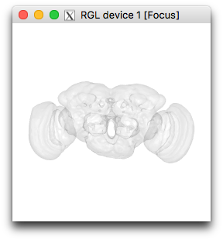
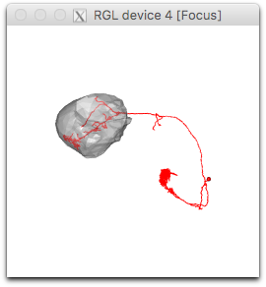
Plotting
new_3d_plot()
Essentially a shortcut for
nat::nopen3d()
plot3d(elmr::FAFB.surf, col = “gray”, alpha = 0.1)
nat::nview3d(“frontal”)
Gives you a brain volume in a pan-enabled window, which you can then plot CATMAID neurons onto. Includes optional parameters so you can adjust what volume is plotted (e.g. plot a single neuropil, or a different template brain) and features like colour.
plot_catmaid(skid)
Reads one or more neurons from CATMAID and plots them in your current RGL window if there is one, and in a new window if there isn’t. You can optionally specify a CATMAID volume to plot with the neuron, and adjust colours/alpha values. Also returns the neuron or neuronlist read in from CATMAID, as with read_neuron_catmaid or read_neurons_catmaid.
> plot_catmaid(23829, “LH_R”)

Slide 5
Working with PNs
find_glomeruli(skids)
Returns the glomerulus (or multiple glomeruli) for each PN skid in a vector. This is based on annotations, so the neurons must be annotated with glomerulus __ for this to work.
> find_glomeruli(c(23829, 38885, 46105))
[1] "DL4" "DA2" "VP1m/VP1/VP5"
glomerular.valence
This one is a variable, not a function. It’s a named vector containing our best guess at the behavioural valence (e.g. aversive, pheromonal, food-related, etc.) for each olfactory glomerulus.
> glomerular.valence["DA2"]
DA2
"Aversive"
> glomerular.valence[c("DA2", "DL4", "DA1")]
DA2 DL4 DA1
"Aversive" "Aversive" "Pheromonal"

Slide 6
Sampling
sample_connections(neuron)
Based on my initial sampling script, but more flexible and (hopefully) easier to use. Has parameters to accommodate different types of sampling, neuron subsetting, and output.
neuron | A CATMAID neuron object (e.g. from read_neuron_catmaid). This is the only required input.
number | The number of units (connections or synapses) to return, if not all. Usually you will want all of them, but you might want a smaller subset if e.g. you want to complete a set number of synapses to estimate the average number of postsynapses.
type | The type of unit to sample. Options are "downstream" (outgoing connections), "upstream" (incoming connections), and "connector" (outgoing synapses). Defaults to "downstream", since this is what we use most often.
fileout | The function will write your result to a CSV file if you specify a path here, so you can easily use it elsewhere (e.g. import to a Google Sheet).
node.id | The id of a treenode where the neuron should be cut, if you want to limit the sample to up-/downstream portion of the neuron.
node.direction | If node.id is specfied, the section of cut neuron to retain. Options are "downstream" (i.e. distal to the cut point) or "upstream" (proximal to the cut point). Defaults to "downstream".
volume | The name of a FAFB neuropil that the sample should be constrained to, if you only want to sample within a particular neuropil.
plot | Since you can cut a neuron and/or limit to a particular neuropil, setting this to TRUE will give you a 3D plot so you can check that you’ve gotten the correct portion of your neuron.

Slide 7
Sampling
#get neuron and find points in LH
neuron = read.neuron.catmaid(23829)
neuron.distal = distal_to(neuron, neuron$tags$SCHLEGEL_LH)
neuron.distal.points = neuron$d[neuron.distal,]
#select connectors in LH
connectors = neuron$connectors[neuron$connectors$treenode_id
%in% neuron.distal.points$PointNo,]
#for downstream partners - outgoing connections only
connectors.outgoing = connectors[connectors$prepost == 0,]
connectors.incoming = connectors[connectors$prepost == 1,]
#get connections for each synapse
connections =
catmaid_get_connectors(connectors.outgoing$connector_id)
connections.xyz = do.call("rbind",
lapply(connections$connector_id, function(x){
connectors.outgoing[connectors.outgoing$connector_
id == x, c("x", "y", "z")] }))
connections.full = cbind(connections, connections.xyz)
connections.perm =
connections.full[sample(nrow(connections.full)),]
#—URL generator—
connector_URL <- function(dfrow){
base = "https://neuropil.janelia.org/tracing/fafb/v13"
catmaid_url = paste0(base, "?pid=1")
catmaid_url = paste0(catmaid_url, "&zp=", dfrow[,"z"])
catmaid_url = paste0(catmaid_url, "&yp=", dfrow[,"y"])
catmaid_url = paste0(catmaid_url, "&xp=", dfrow[,"x"])
catmaid_url = paste0(catmaid_url, "&tool=tracingtool")
catmaid_url = paste0(catmaid_url,
"&active_skeleton_id=23829")
catmaid_url = paste0(catmaid_url, "&active_node_id=",
dfrow[,"connector_id"])
catmaid_url = paste0(catmaid_url, "&sid0=9&s0=0")
invisible(catmaid_url)
}
#———
# connections.perm$URL = sapply(1:nrow(connections.perm), function(x){ connector_URL(connections.perm[x,], skid = connections.perm[x,"post"], nodevar = NULL) })
# write.csv(connections.perm, file = "DL4_random_conn.csv")
neuron = read.neuron.catmaid(23829)
connections.perm =
sample_connectons(neuron = neuron,
node.id = neuron$tags$SCHLEGEL_LH,
fileout = "DL4_random_conn.csv")

Slide 8
Interacting with CATMAID
tagged_nodes(neuron, tag)
Given a neuron or skeleton ID and a tag (e.g. “backbone”), this will return a data frame (optionally written to a CSV) with the node IDs, coordinates, and CATMAID URLs
check_duplicate_synapses(neuron)
It’s not uncommon for different tracers in CATMAID to accidentally mark a synapse twice. Given a neuron or skeleton ID, this will look for connectors within adjustable distance thresholds (defaults to 200μm in X-Y or Z directions) that could be duplicates. Returns a data frame (and optionally CSV) with IDs of the identified connector pairs, their distances, and URLs to the connectors in CATMAID.
simple_catmaid_URL(dfrow, skid)
Admittedly not actually that simple. This is mostly used by other package functions to generate URLs, but I made it externally available in case anyone else would like to use it. It is designed to work with a row from a data frame (e.g. those returned by functions in the catmaid R package), and other arguments are used to specify which columns correspond to which URL parameters.

Slide 9
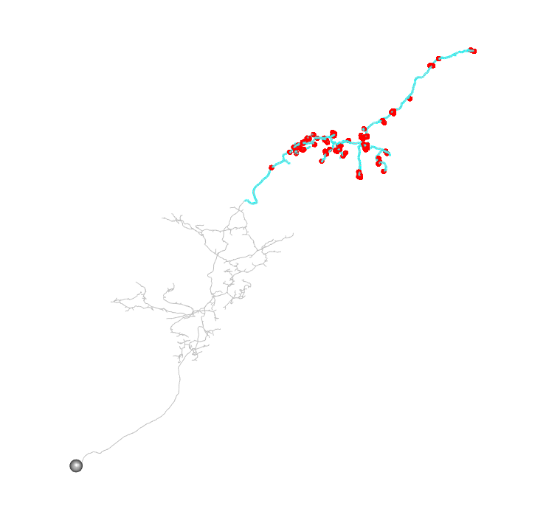
Other
synapses_per_neuropil(neurons)
Calculates the number of incoming and outgoing synapses in each neuropil for a list of neurons or skeleton IDs. Returns a list with one data frame for each neuron, in which each neuropil is a row and there are columns for outgoing/incoming synapses.
split_neuron_local(neuron, node)
Allows you to cut a neuron at a particular node and keep either the upstream or downstream section. Works with the subset.neuron and distal_to functions from nat and elmr, but also keeps tags and connectors for the split portion of the neuron.
> n = read.neuron.catmaid(1812610)
> n.split = split_neuron_local(neuron = n,
node = n$tags$test_2)

Slide 10
Bugs and new features
https://github.com/fmlove/tracerutils/issues
I try to keep this page up-to-date with any features I’m planning to add.
If there are any that you particularly want, comment on the issue!
Submit issues if you find a bug, or have an idea for a function you’d like.

