Slide 1
Rapid Device Support Development Using Hardware Abstraction Server and P4P
EIC Controls
Andrei Sukhanov, application architect, C-AD, BNL

Slide 2
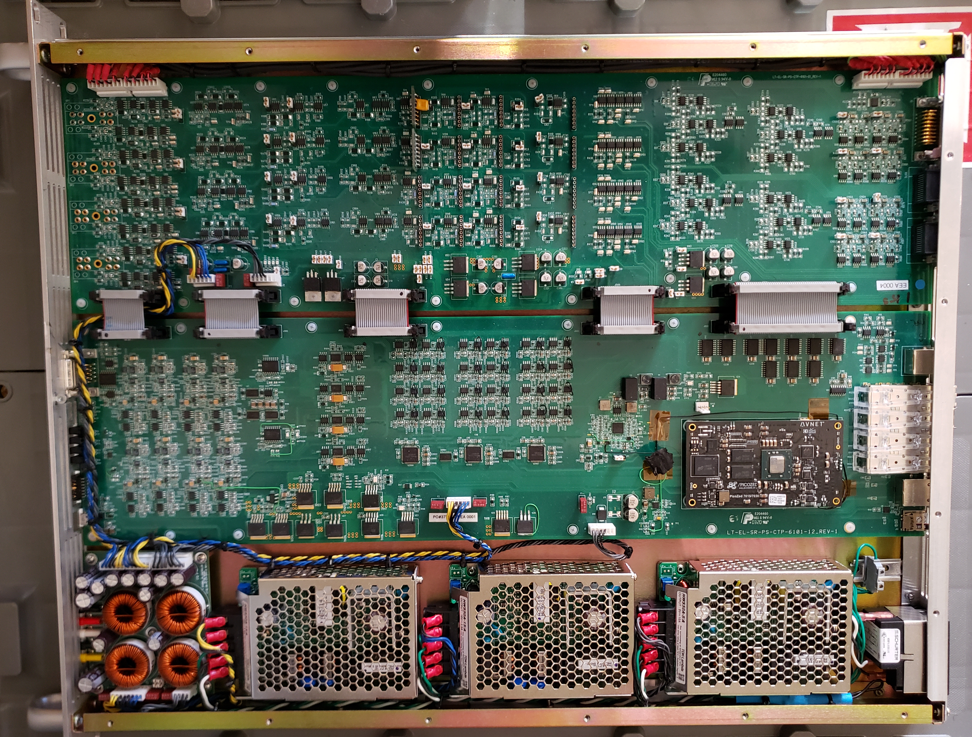
Rapid Device Support Development Using Hardware Abstraction Server
HABS
parameter
IOC
Hardware
Abstraction
Server
parameter
parameter
parameter
parameter
Requests served:
info
get
set
run
To start/stop
continuous
measurements

Slide 3
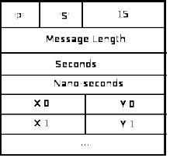
Traditional approach
pscdrv toolchain
Gate
ware
IOC
CS
Studio
TCPIP
PV
records
Firmware
pscrdv
Board
Workstation
record(waveform, “wf:X”) {
field(“DTYP”,”PSC Block I16 In”)
field(“SCAN”,”I/O Intr”)
field(“FTVL”,”DOUBLE”)
field(“NELM”,”1024”)
field(“INP”,”NAME 15 8 4”)
info(“TimeFromBlock”,”0”)
}
Record example
Message frame
requires in-depth knowledge of
EPICS device drivers,
database records,
IOC toolchain and
EPICS GUI
Color coding:
Developer's code
Provided code

Slide 4
HABS toolchain
Two types of implementation.
Board
Workstation
Gate
ware
TCPIP
IPC
CS
Studio
HABS
HABS-
IOC
Firmware
Auto
GUI
Option1: Closed firmware,
off-the-shelf devices
Board
Workstation
Gate
ware
CS
Studio
Firmware
TCPIP
HABS
HABS-
IOC
or
RS232
Auto
GUI
Option2: Open firmware
Color coding:
Developer's code
Provided code

Slide 5
HABS
Transport
protocols supported:
IPC Message Queue
In development:
TCP-IP
RS232
HABS
Trans-
port
HABS provides set of C++ functions and headers.
init(): to initialize the set of published parameters and bind them to program variables.
update(): called in the main loop to update parameters and respond to requests.
Data format of client communication is CBOR:
binary JSON,
self describing,
very compact,
standardized (RFC 8949),
widely used in IOT,

Slide 6
Software components
Headers:
pv.h - creation of parameters
Functions:
p2plant.cpp - message parsing
transport.cpp - communication with client
Library:
libtinycbor.a - CBOR encoding. Public release from Intel.
Demo: https://github.com/Asukhanov/P2Plant
- make

Slide 7
Code Example
Create 3 parameters: run, adc_reclen, 2D vector adcs,
and bind them to program variables
// Mandatory PVs
static PV pv_run = {"run",
"Start/Stop the streaming of measurements", T_str, F_WED};
pv_run.legalValues = (char*)"start,stop";
pv_run.set("stop");
// ADC-related PVs
#define ADC_Max_nSamples 2000
static PV pv_adc_reclen = {"adc_reclen",
"Record length. Number of samples in each channel", T_u2, F_WE};
pv_adc_reclen.opLow = 10;
pv_adc_reclen.opHigh = 10000;
pv_adc_reclen.set(ADC_Max_nSamples);
static uint16_t adc_samples[ADC_Max_nChannels*ADC_Max_nSamples];
static PV pv_adcs = {"adcs",
"Two-dimentional array[adc#][samples]",T_u2ptr, F_RM, "counts"};
pv_adcs.set(adc_samples);
type
features
add a property
binding
add properties
binding
binding
continuous
measurement

Slide 8
Python interface to HABS
It simplifies debugging of the device
>>> from p2plantaccess import Access as dev
>>> dev.init(); dev.start()
>>> info = dev.request(['info', ['*']])
>>> reply = dev.request([
'get', ['version','run'],
'set',[('adc_gains',[0.5,1,2,4]),
('run',['start']),
'get',['adc_amplitude[2]'],
])
Several requests
could be combined
in one transaction
Request
returns a
dictionary
>>> print(info)
{'*':{
'version': {'desc': 'simulatedADCs version',
'type': 'char*', 'shape': [1], 'fbits':'R'},
'run': {'desc': 'Start/Stop the streaming of measurements',
'type': 'char*', 'shape': [1], 'fbits': 'WRDsrE', 'legalValues': 'start,stop'},
'debug': {'desc':
…
}

Slide 9
HABS-IOC
Universal softIocPVA, communicating to any HABS, written in python using p4p wrapper for PVAccess.
Module: p2plant_ioc, to install:
pip install p2plant_ioc
To run
python -m p2plant_ioc -l
Companion modules:
pypeto: to automatically create tabular control page,
pvplot: plotting tool,
apstrim: logging of time-series data.

Slide 10
Summary
Development of device support is greatly simplified using HABS.
No EPICS expertise required, only:
basic C/C++
basic Python (for device debugging).
HABS could be embedded in device firmware (microcontroller or FPGA soft core), or run at a separate host.
Multiple transport protocols: IPC Message Queues, TCP-IP, RS232.
Full introspection.
IOC is generated automatically.
Binary object streaming is based on well-established standard (CBOR).
Network traffic is significantly reduced due to combined requests.
Simplicity: point-to-point communication, only 4 request types, fixed subscriptions.

Slide 11
References:
HABS: https://github.com/ASukhanov/P2Plant
HABS-IOC: https://github.com/ASukhanov/P2Plant_ioc
Python access: https://github.com/ASukhanov/p2plantAccess

