Slide 1
Phoebus Tools and Services
Kunal Shroff – NSLS2
Kay Kasemir – SNS
Georg Weiss – ESS
Ivan Finch - ISIS
Tynan Ford – ALS
Ralph Lange – ITER

Slide 2
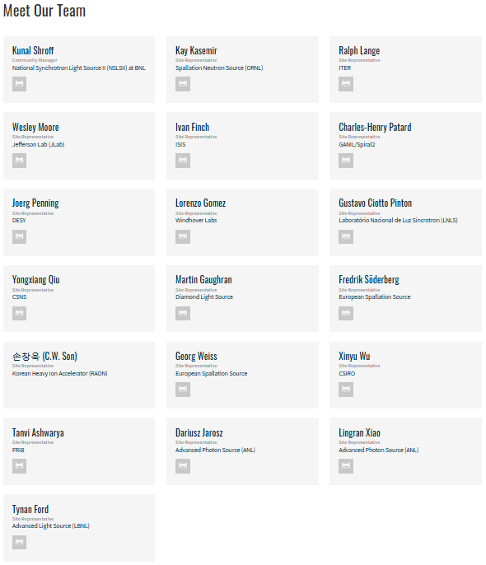
Phoebus / CS-Studio Collaboration
Multiple sites participating in the development of one or more of the EPICS services
(NSLS2, SNS, ESS, FRIB, ALS, ITER, DLS, ISIS, CEA, NSRCC, KEK, FZB, DESY, CSNS, LNLS, ROAN, JLAB,…)

Slide 3
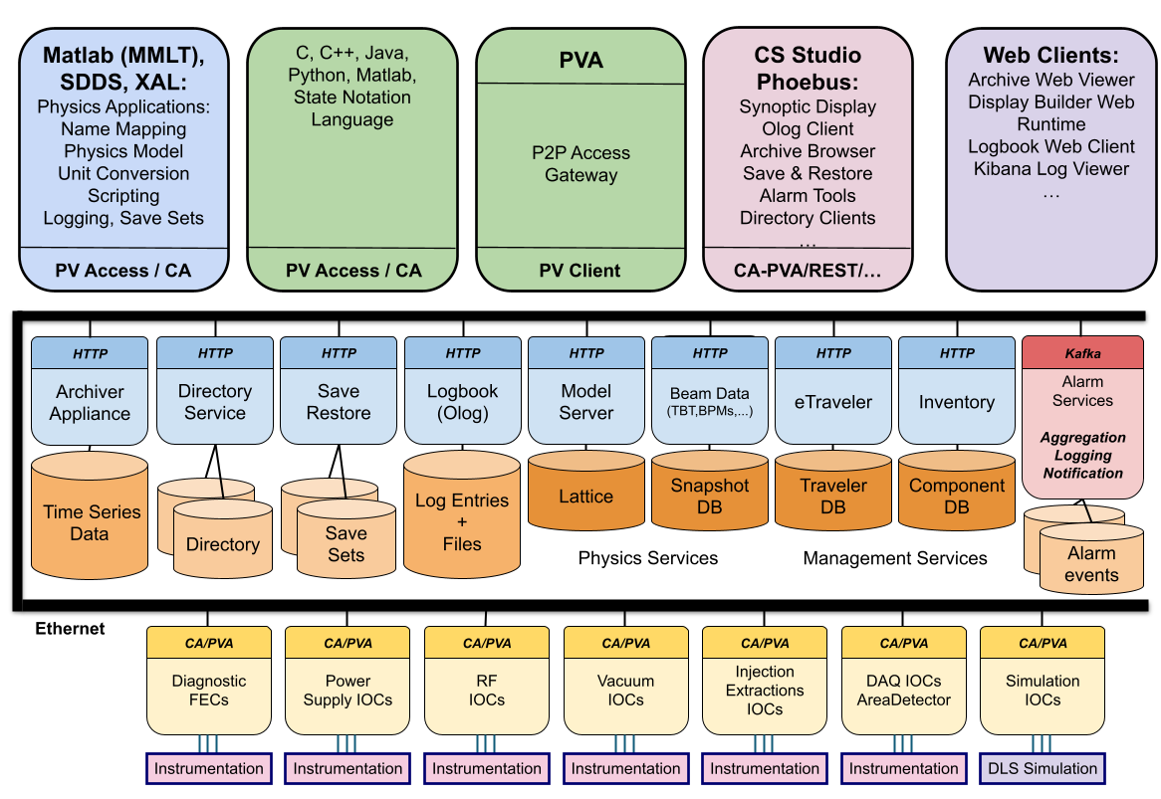
Phoebus in the EPICS Controls Ecosystem
Operator-facing toolkit for integrated workflows
A group of middle layer micro services
A Framework for building tools and services
Notes:
Phoebus is more than just a collection of applications. It’s a technology stack. For operators, it provides a unified toolkit of workflows. Underneath, it offers a suite of microservices that handle alarms, logbooks, archiving, and configuration. And for developers, it’s a framework to build new tools and services on top of EPICS.

Slide 4

CS-Studio & Phoebus
EPICS Tools Phoebus CS-Studio
EPICS Service Archiver, ChannelFinder Save Restore, Olog, Alarm …
Notes:
Explain each of the modules

Slide 5
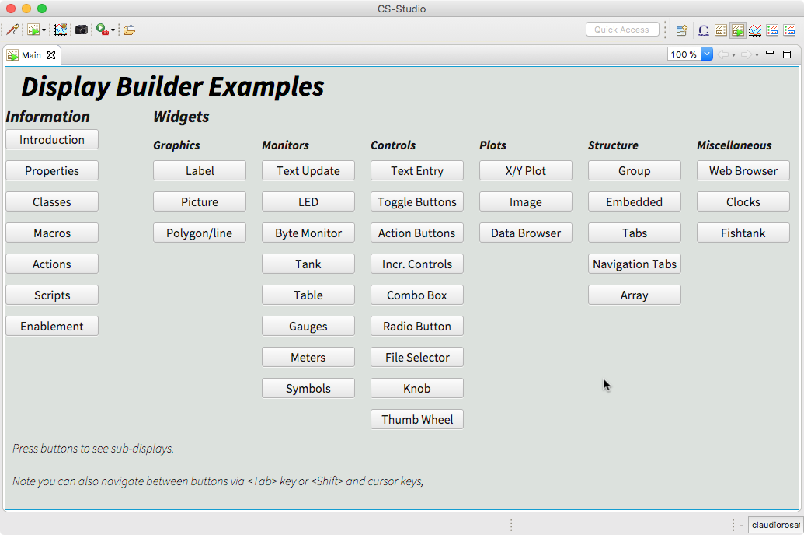
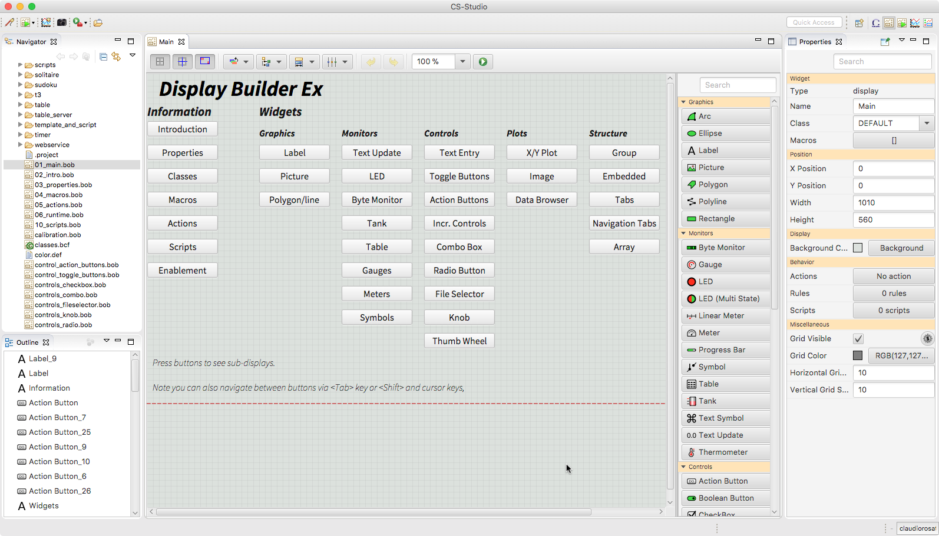
Display Builder
runtime
editor

Slide 6
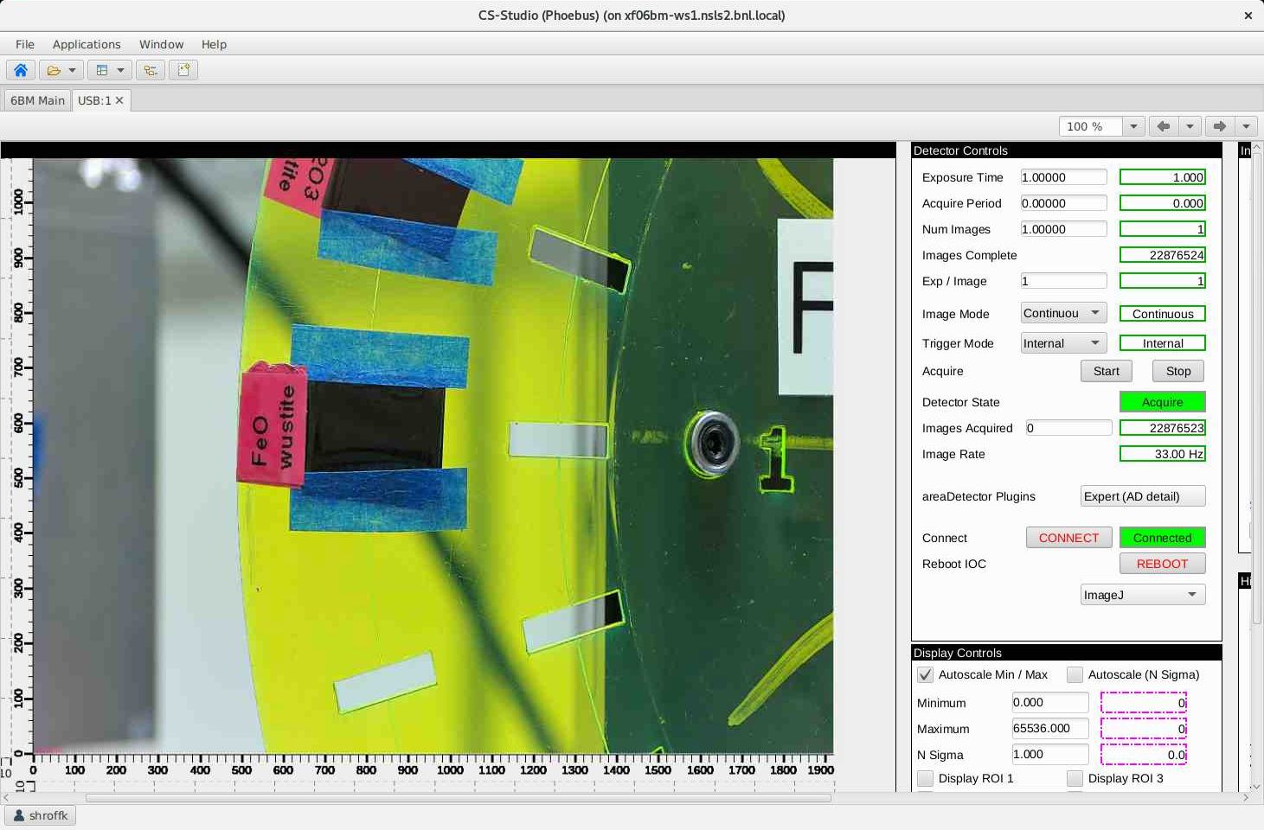
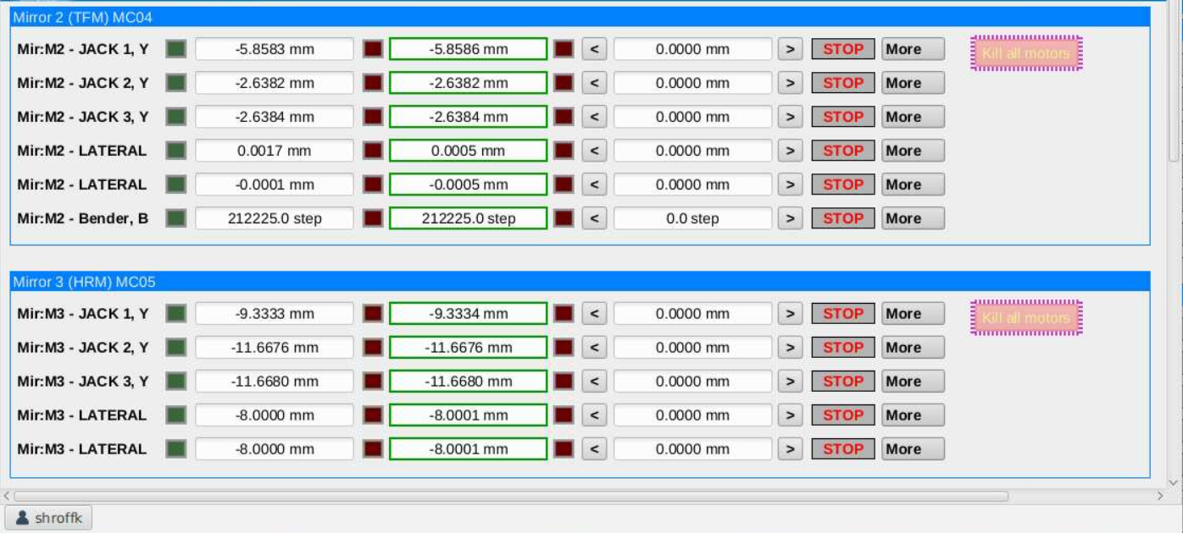
Notes:
Case 2: manually fixing the converted screens e.g. 1 Image / Camera opis

Slide 7
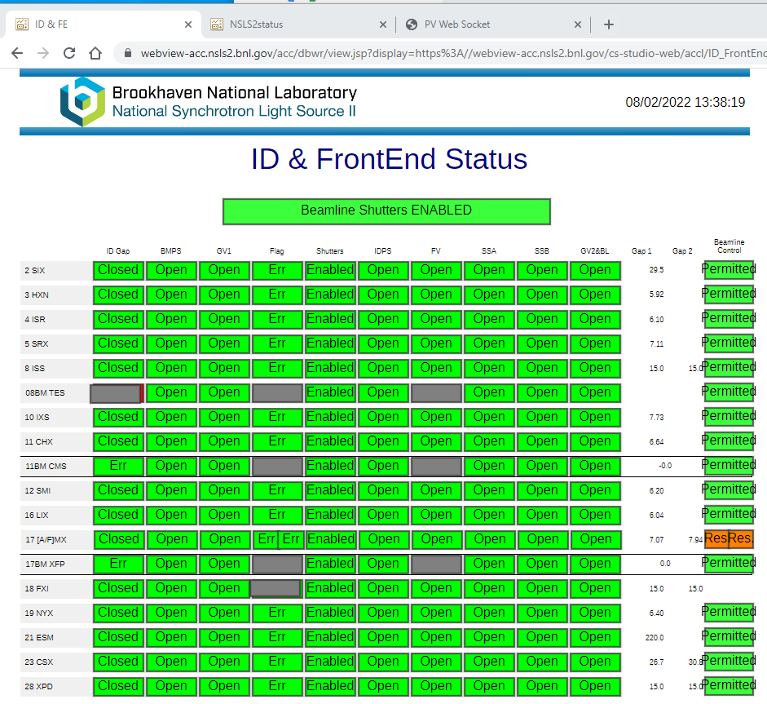
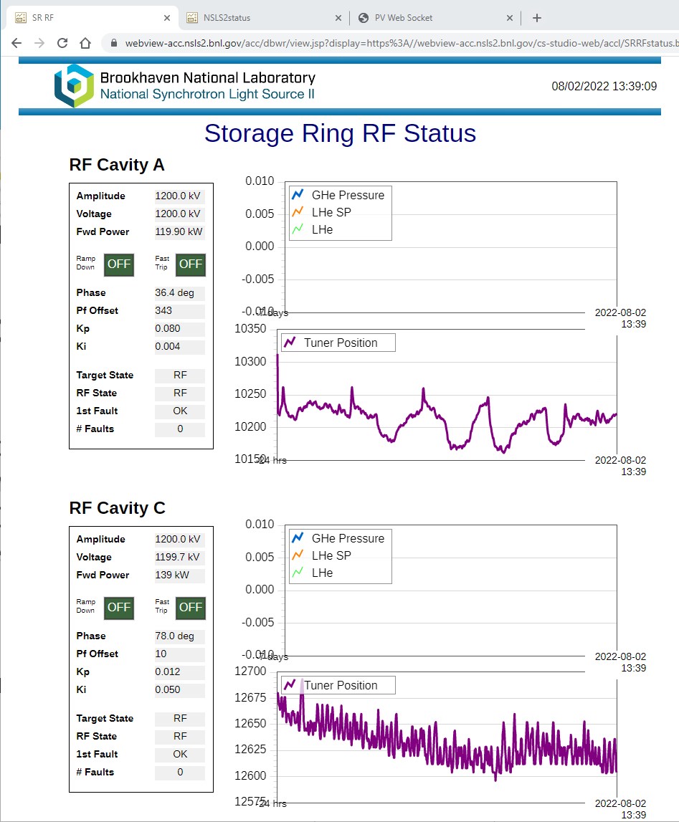
Phoebus on the web
Help support remote operations by bringing OPI screens to the web
.bob files converted to web runtime OPI’s
Notes:
Converted screens used in webruntime

Slide 8
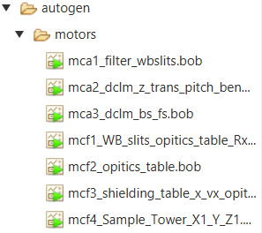

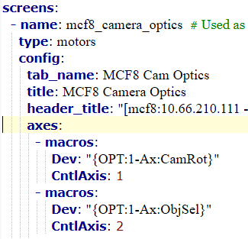
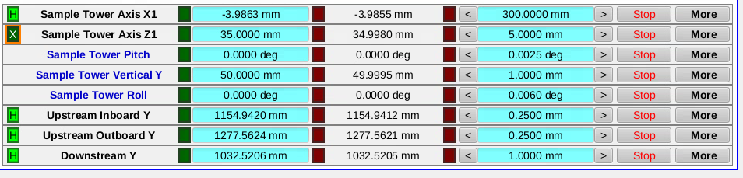
Converted screens…but better ALS Phoebusgen
autogen.py
phoebusgen
Notes:
- name: mcf8_camera_optics # Used as file name. Must contain no spaces
type: motors
config:
tab_name: MCF8 Cam Optics
title: MCF8 Camera Optics
header_title: "[mcf8:10.66.210.111 - xf27id1-ioc1:5011] Camera Optics, Sample Tower Ry1, Rx1, Rz1"
directory: motors
margin_top: 20
margin_bottom: 20
margin_left: 15
margin_right: 15
axes_all:
controller: PowerPMAC
widget_desc_width: 200
widget_val_width: 150
show_home_status: true
macros:
Sys: "XF:27IDF-OP:1"
CntlSys: "XF:27IDF-CT"
CntlDev: "MC:08"
Mtr: "Mtr"
axes:
- macros:
Dev: "{OPT:1-Ax:CamRot}"
CntlAxis: 1
- macros:
Dev: "{OPT:1-Ax:ObjSel}"
CntlAxis: 2
- macros:
Dev: "{OPT:1-Ax:Focus2}"
CntlAxis: 3
- macros:
Dev: "{OPT:1-Ax:Focus1}"
CntlAxis: 4
- macros:
Dev: "{OPT:2-Ax:Focus}"
CntlAxis: 5
- macros:
Dev: "{OPT:2-Ax:CamRot}"
CntlAxis: 6
- macros:
Dev: "{SMPL:1-Ax:Ry1}"
CntlAxis: 7

Slide 9
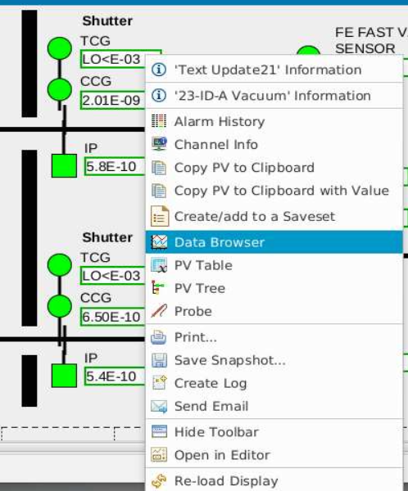
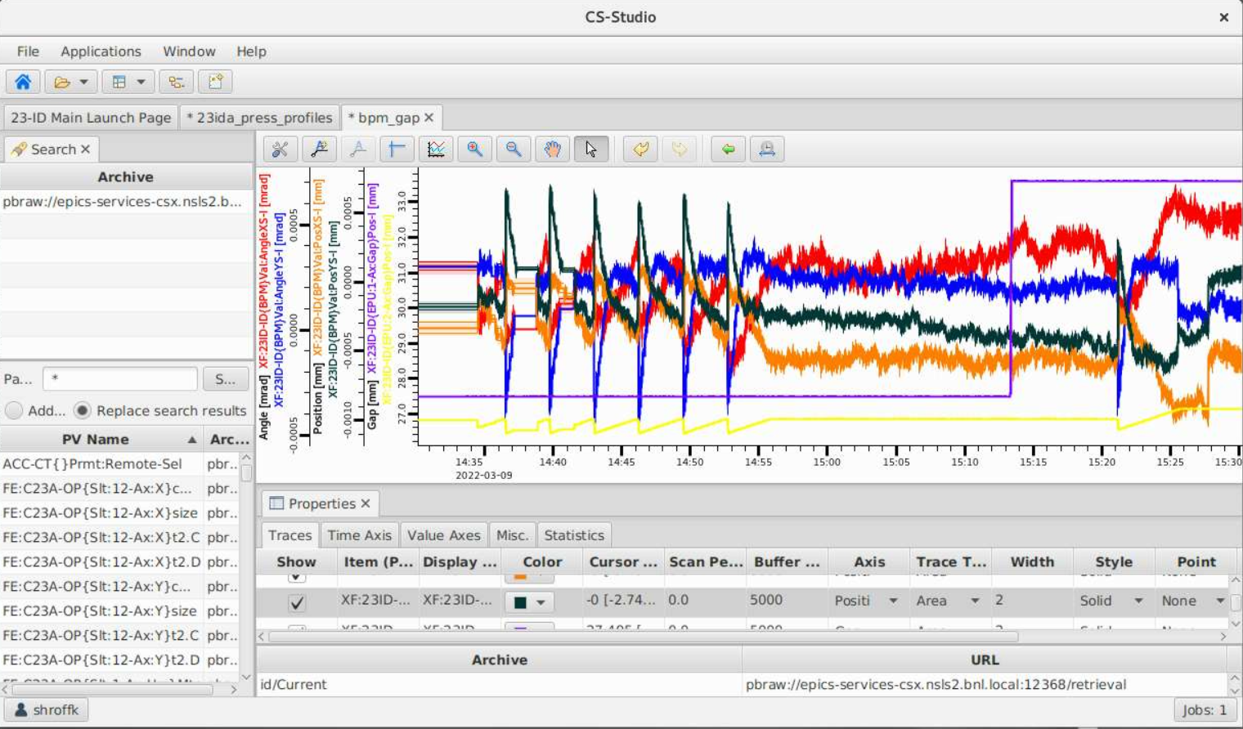
Data Browser
Accessing the PV's History

Slide 10
Phoebus Applications
Alarm UI – hierarchical alarm trees, active alarm tables, annunciator; alarm awareness built into all tools
Logbook – integrated operator logs with context capture; backend-agnostic (Olog, elog, …)
Save & Restore – snapshot/restore groups of PVs; supports scaling/merging snapshots
Channel Finder Clients – fast PV search enriched with metadata (IOC host, record type, tags)
PV Utilities –
Probe: detailed PV introspection
PV Table: monitor/save groups of PVs
PV Tree: visualize EPICS record linkages
Notes:
Beyond Display Builder and Data Browser, Phoebus offers a rich suite of applications. The Alarm UI provides dedicated views for managing alarms, while logbook clients integrate seamlessly for recording operations. Save & Restore lets operators snapshot and restore system states. Channel Finder clients enable PV discovery with metadata, and smaller utilities like Probe, PV Table, and PV Tree support diagnostics and day-to-day operations. All of these applications share context, so operators move fluidly between them without duplication of effort

Slide 11
Phoebus Middle Layer Services
EPICS Tools Phoebus CS-Studio
EPICS Service Archiver, ChannelFinder Save Restore, Olog, Alarm …
Notes:
Explain each of the modules

Slide 12
Phoebus Services
Modular microservices extend the EPICS control system
Designed for scalability, resilience, and maintainability
Support modern practices: CI/CD, containerization, observability
Built on common libraries (VTypes, CorePV) for consistent data models
Standardized Spring Boot services + a few specialized high-throughput services
Notes:
Phoebus provides a family of middle-layer services that extend EPICS. They are implemented as modular microservices, which means they can scale independently, are resilient to failures, and integrate well with modern practices like CI/CD and containerized deployments. Many of them share a common foundation — for example, CorePV and VTypes — so data flows consistently between services and applications.

Slide 13
Phoebus Services (Alarms & Discovery)
Alarm Server – monitors configured PVs, generates events
Alarm Logger – records alarm history and operator actions
Alarm Configuration Manager – versioned alarm configuration history
Together: resilient alarm ecosystem supporting real-time ops + long-term optimization
ChannelFinder – searchable PV directory with metadata (IOC, record type, tags)
Notes:
The Alarm system is implemented as three cooperating services: the Alarm Server monitors PVs and issues events, the Alarm Logger records history and operator actions, and the Alarm Configuration Manager tracks versioned configurations. Alongside this, ChannelFinder acts as a searchable directory of PVs, enriched with metadata like IOC host and record type, supporting discovery and navigation in large systems.

Slide 14
Phoebus Services (Persistence & Logging)
Save & Restore – capture and recover system snapshots; stored in Elasticsearch; REST API for integration
Phoebus Olog – operator logbook; Elastic + MongoDB; accessible via Phoebus client, web, and mobile apps
Archiver Engine – integrates with RDB backends (Postgres + TimescaleDB); straightforward deployment
Notes:
Other services handle persistence and logging. Save & Restore lets operators capture and restore system states. Olog is a logbook built on Elastic and MongoDB, with clients in Phoebus and the web. For archiving, the Archive Engine offers simplicity and relational DB integration, while the Archiver Appliance scales to millions of PVs using distributed clustering and protocol-buffer storage.

Slide 15
Under the hood
EPICS Tools Phoebus CS-Studio
EPICS Service Archiver, ChannelFinder Save Restore, Olog, Alarm …
Notes:
Explain each of the modules

Slide 16
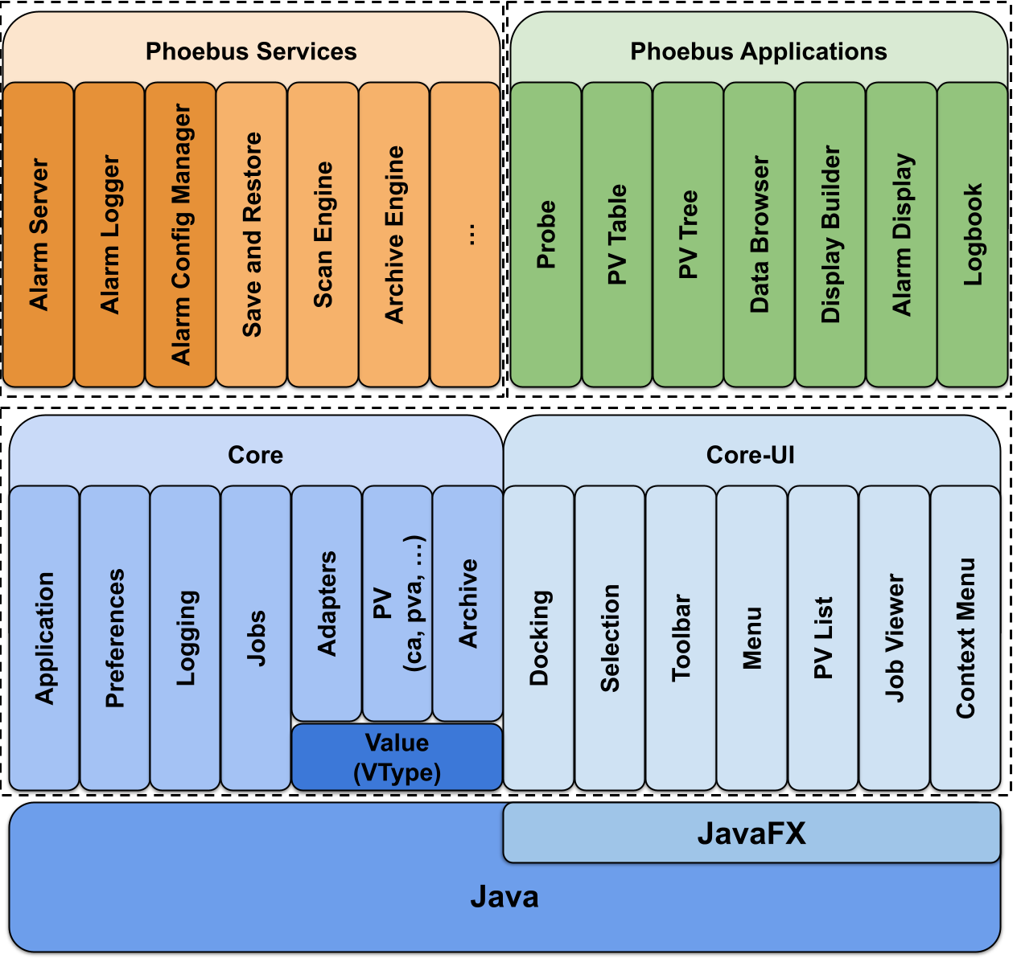
Architecture
Modular framework 🡪 built on Java + JavaFX (no Eclipse RCP)
Core modules: PV access, VTypes, adapters, logging, jobs
Core-UI modules: docking, menus, selection services
Applications: operator-facing tools (Display Builder, Data Browser, etc.)
Services: alarm, save/restore, archiving, logbook, …
Notes:
Phoebus builds directly on the Java Development Kit (JDK), using only standard Java and JavaFX. By avoiding Eclipse RCP, we keep the runtime lightweight, portable across platforms, and easier to maintain, while still benefiting from the stability of long-term support JDK releases
Phoebus is organized as a modular stack. At the bottom, we rely only on standard Java and JavaFX, not Eclipse RCP. On top of this, the core and core-UI modules provide reusable libraries: PV access, VTypes, docking, menus, selection, logging. These support both the applications that operators use and the services that provide alarms, logbooks, save/restore, and archiving. Thanks to the SPI extension mechanism, sites can plug in their own protocols, clients, or applications, keeping the system both stable and flexible.
Foundation for both applications and microservices

Slide 17
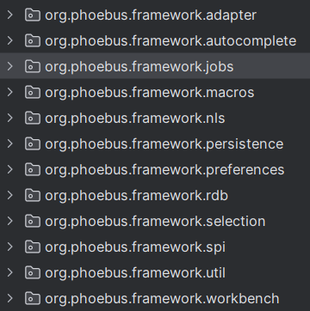
Architecture (details)
Jobs & scheduling – run tasks off the UI thread for responsiveness
Connection management – pooled, reusable PV and REST clients
VTypes – canonical value model
Protocol-agnostic, not tied to memory layout
Immutable and safe to share
Formula functions – efficient, thread-safe data processing pipelines
Selection services – share user-selected data cleanly across applications
Adapter services – enable runtime integration between loosely coupled apps
Preferences & layouts
Notes:
Under the hood, Phoebus is made up of small, focused modules. Jobs and connection management ensure responsiveness and efficient resource use. VTypes provide a canonical, immutable value model that decouples data from protocol or memory representation. Formula functions enable lightweight, thread-safe data processing off the UI thread. Preferences and layouts guarantee a consistent user experience across deployments
In addition, the Selection and Adapter services are crucial for integration. The Selection Service lets applications publish what the user has selected — like a PV or an alarm — and other tools can immediately act on it. The Adapter Service allows Phoebus applications to interoperate at runtime without tight coupling, so they remain modular but still feel seamlessly connected.
Selection Services
The Selection Service provides a clean and
powerful mechanism for allowing Phoebus
applications to share the user selected data.
• Adapter Service
The Adapter services provided by the framework
is a means for Phoebus applications to provide
runtime integration between loosely coupled
applications.
• Jobs
CancellableJob A helper class which provides the
framework for running tasks in the background while
still monitoring for cancel requests
Some applications may need to prompt the user for credentials, e.g. when interacting with a protected remote service. One such example would be the electronic logbook. Further, Phoebus may be configured to store the credentials entered by the user to avoid repeated prompts. In order to also support an explicit logout capability, the Credentials Management application offers means to remove stored credentials.

Slide 18
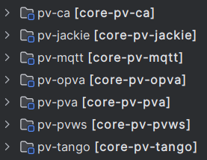
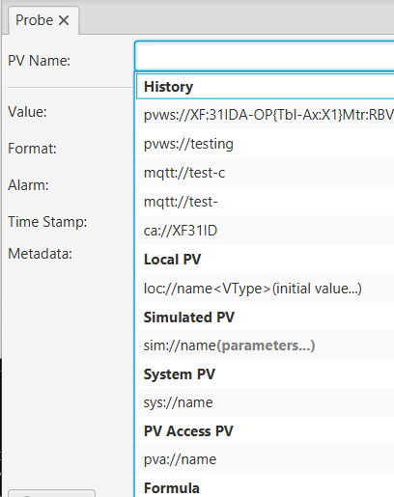
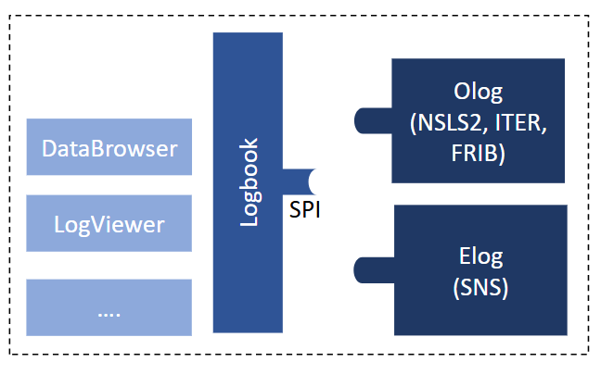
Extensibility
Extensible via Java SPI (Service Provider Interface)
New data sources & protocols (CA, PVA, MQTT, Tango, …)
Clients for middle-layer services (Olog, elog, …)
New applications & file handlers
UI extensions (menus, toolbars, context menus)
Notes:
Extensibility is built in through Java’s Service Provider Interface. Sites can add new data sources and protocols, integrate with different services, or provide their own applications and UI extensions. Because extensions are loosely coupled, the core stays stable while deployments remain flexible and site-specific.
Datasources SPI (core-pv)
Provides a pluggable interface for accessing data as Process Variables (PVs) across multiple data sources and control protocols.
Channel Access (ca://) & PVAccess (pva://) 🡪 Connect to live EPICS PVs.
Simulated (sim://) 🡪 Generate test signals (sine, noise, ramp, etc.).
Archive Data Source (archive://), Replay Data Source (replay://)
MQTT (mqtt://) & Tango (tga://, tgc://) 🡪 Access MQTT & Tango control system data.
Logbook Clients SPI
Provide pluggable interface for integrating multiple lobook services
Olog 🡪 client to create/retrieve logs from olog
Elog 🡪 client to create/retrieve logs from elog
core-pv
Provides a pluggable/extendable interface for accessing data as Process Variables (PVs) across multiple data sources and control protocols.
Data Sources define how to:
Subscribe (CA, PVA, Sim, Sys, MQTT, PVWS, …)
Read/Monitor (value + metadata updates)
Write (when permitted)
Vtype mapping
Example Data Sources:
Channel Access (ca://) & PVAccess (pva://) → Connect to live EPICS PVs.
Simulated (sim://) → Generate test signals (sine, noise, ramp, etc.).
Archive Data Source (archive://), Replay Data Source (replay://)

Slide 19
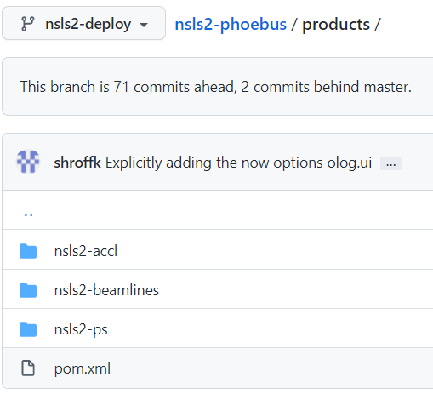
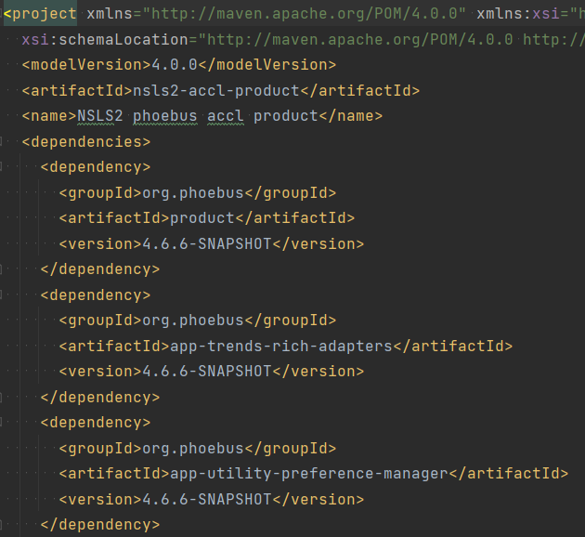
Site Specific Products
The extensible and modular nature of the Phoebus framework allows for developers to assemble their own products.
Include site specific
Applications
Adapters
Datasources
Configurations
Branding
Address the needs of a particular organization or workflow.
Notes:
Because Phoebus is modular, facilities can assemble their own products. Each distribution is a curated set of applications, protocols, and services, packaged with site defaults and branding. This makes it possible to tailor Phoebus to different facilities’ workflows, while keeping deployment lightweight and secure.

Slide 20
Collaboration
EPICS Tools Phoebus CS-Studio
EPICS Service Archiver, ChannelFinder Save Restore, Olog, Alarm …
Notes:
Explain each of the modules

Slide 21
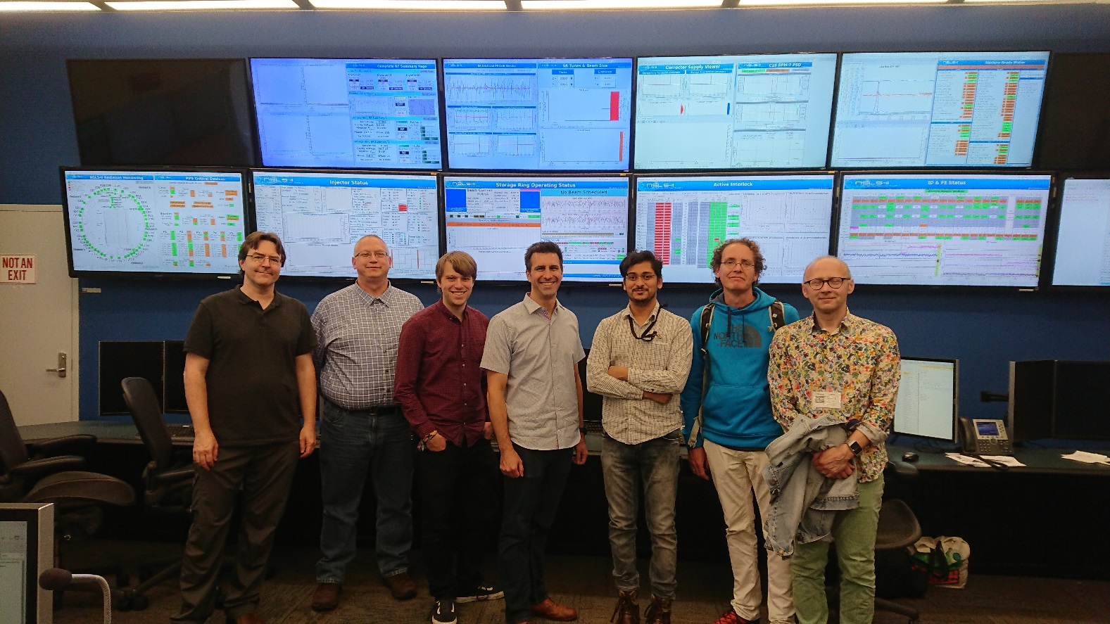
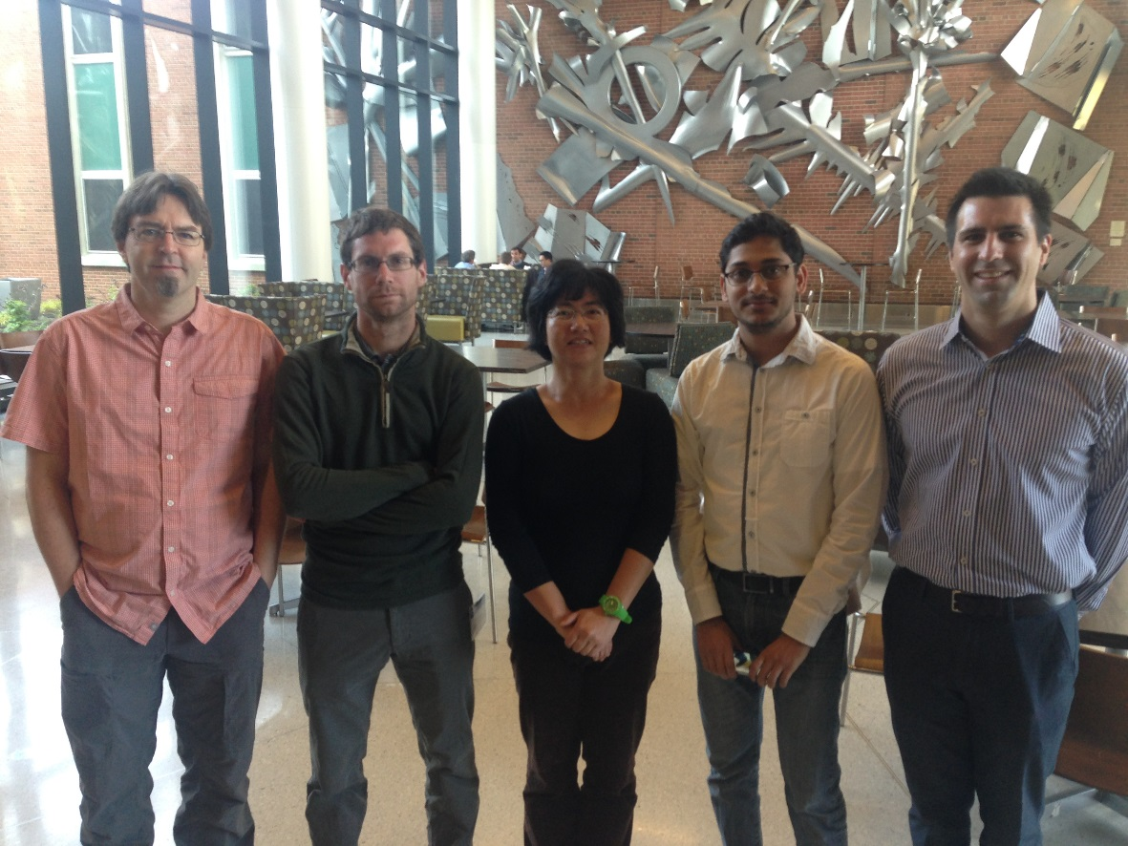
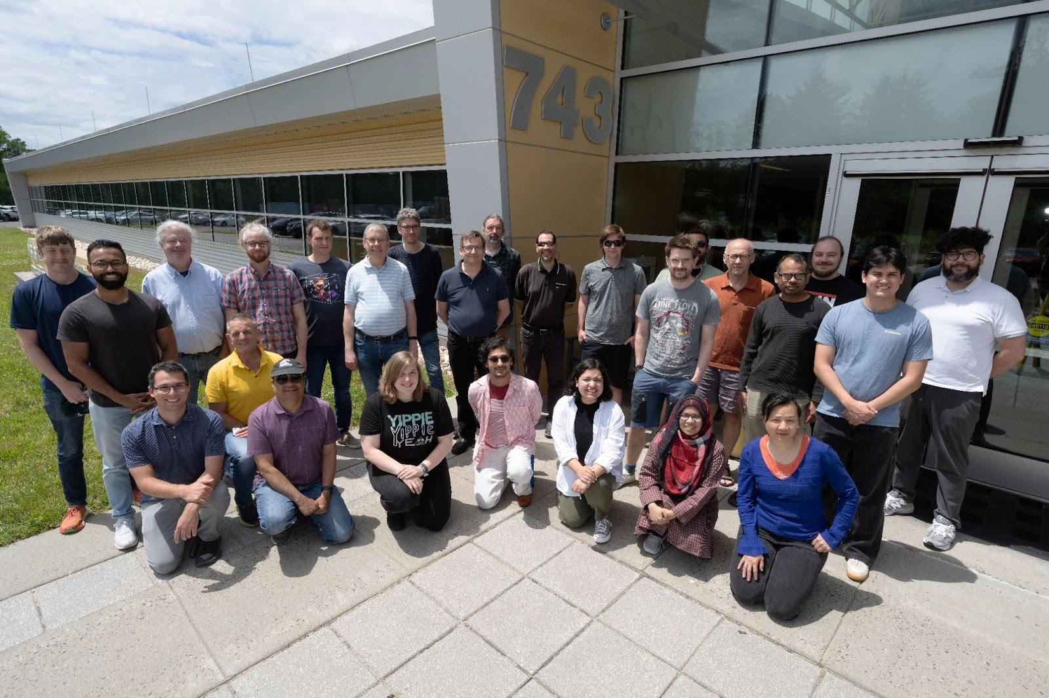


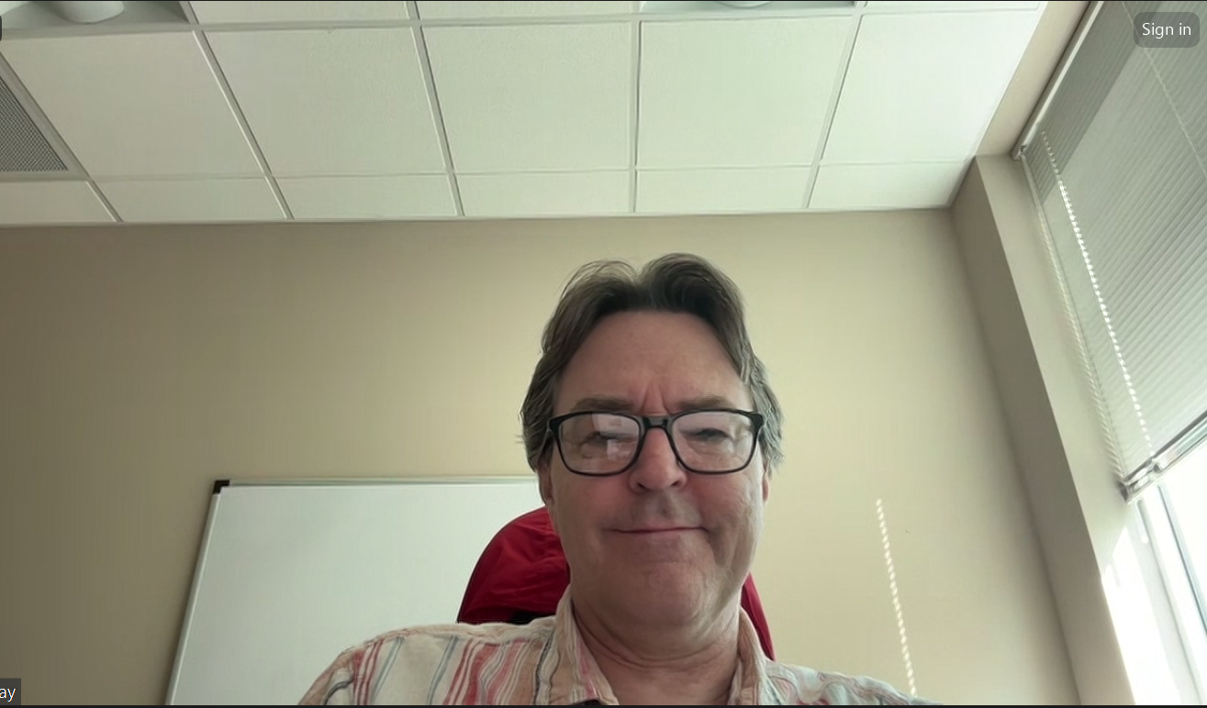
Phoebus Collaboration

Slide 22
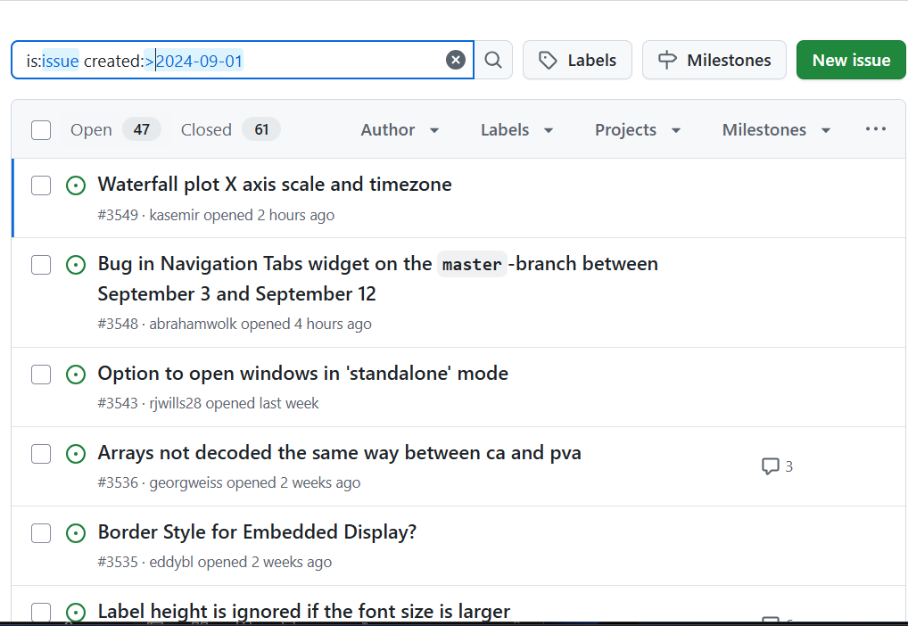
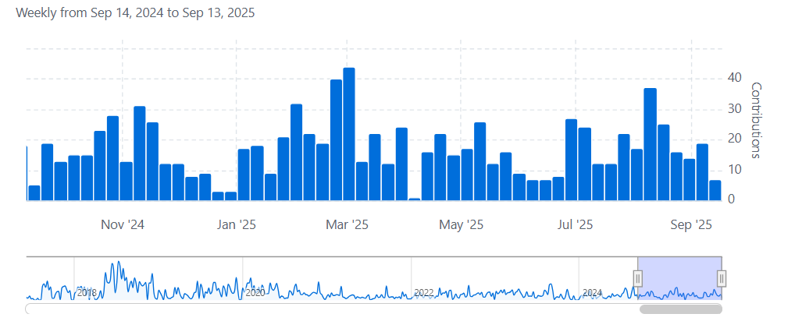
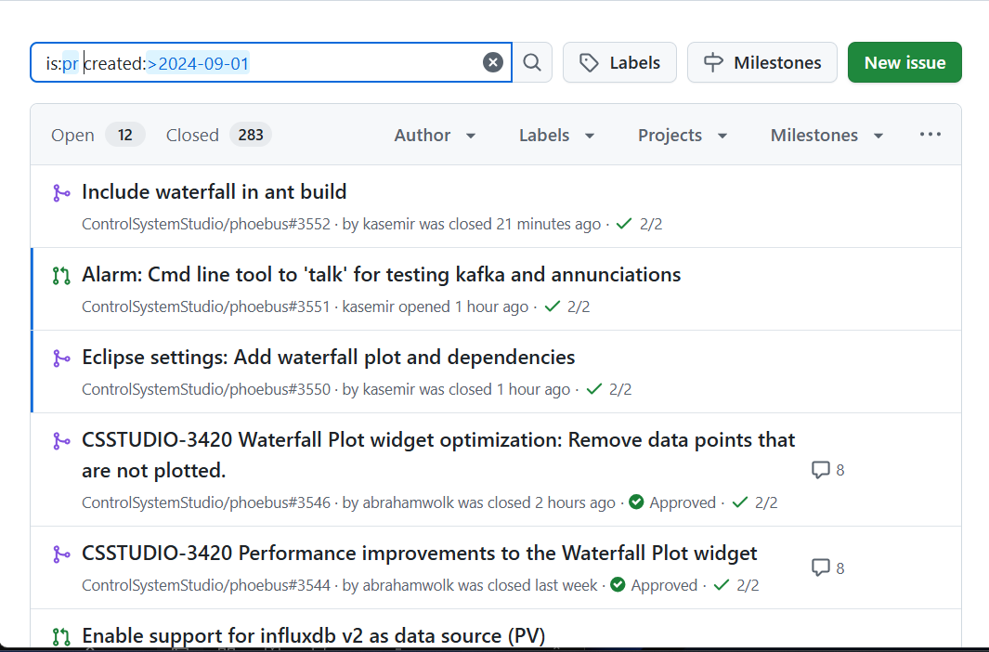
Phoebus Collaboration
Phoebus
~300 PR’s
~100 Issue
ChannelFinder
Phoebus-Olog

Slide 23
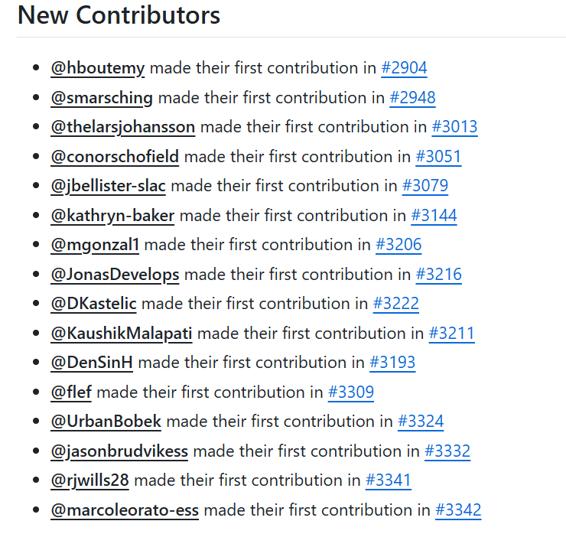
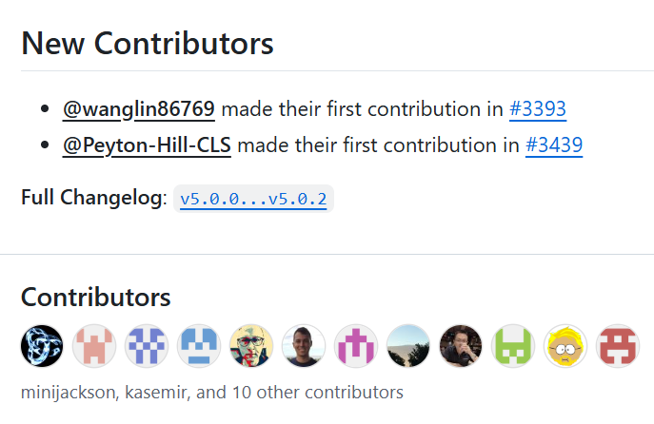
How to contribute
GitHub Issues
Monthly meetings on the 2nd Wednesday of each month.
Participate in codeathon / documentathon
Location to be announced soon

Slide 24
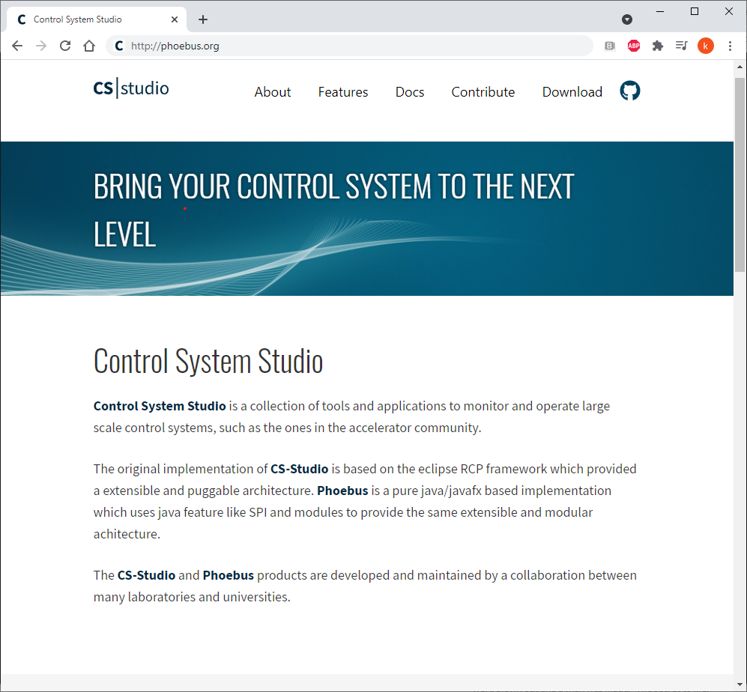
Useful links
http://phoebus.org
Fork us on github https://github.com/ControlSystemStudio
ChannelFinder http://channelfinder.github.io/
Olog https://github.com/Olog
SaveRestore, Alarm Services, Scan Server https://github.com/ControlSystemStudio/phoebus/tree/master/services

Slide 25
Questions

Slide 26
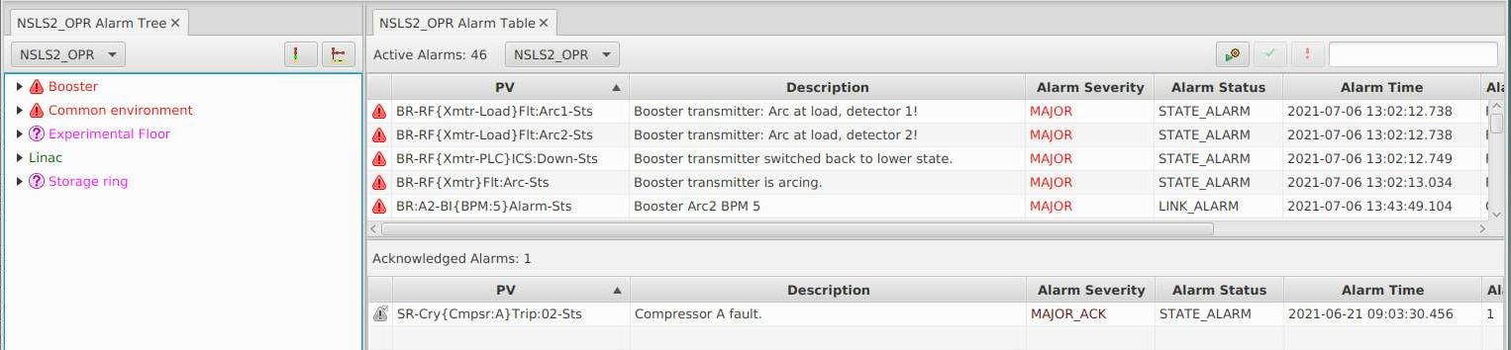
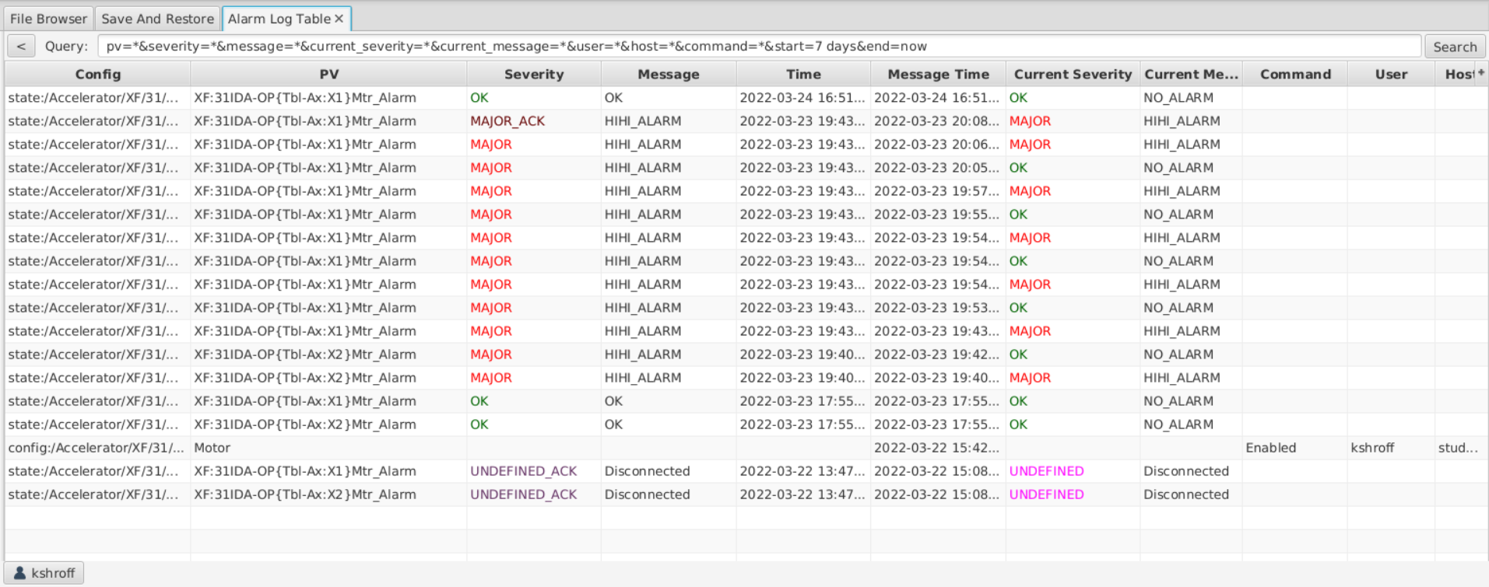
Alarm
Phoebus Alarm clients
Alarm Tree
Alarm Table
Alarm Panel
Alarm History

Slide 27
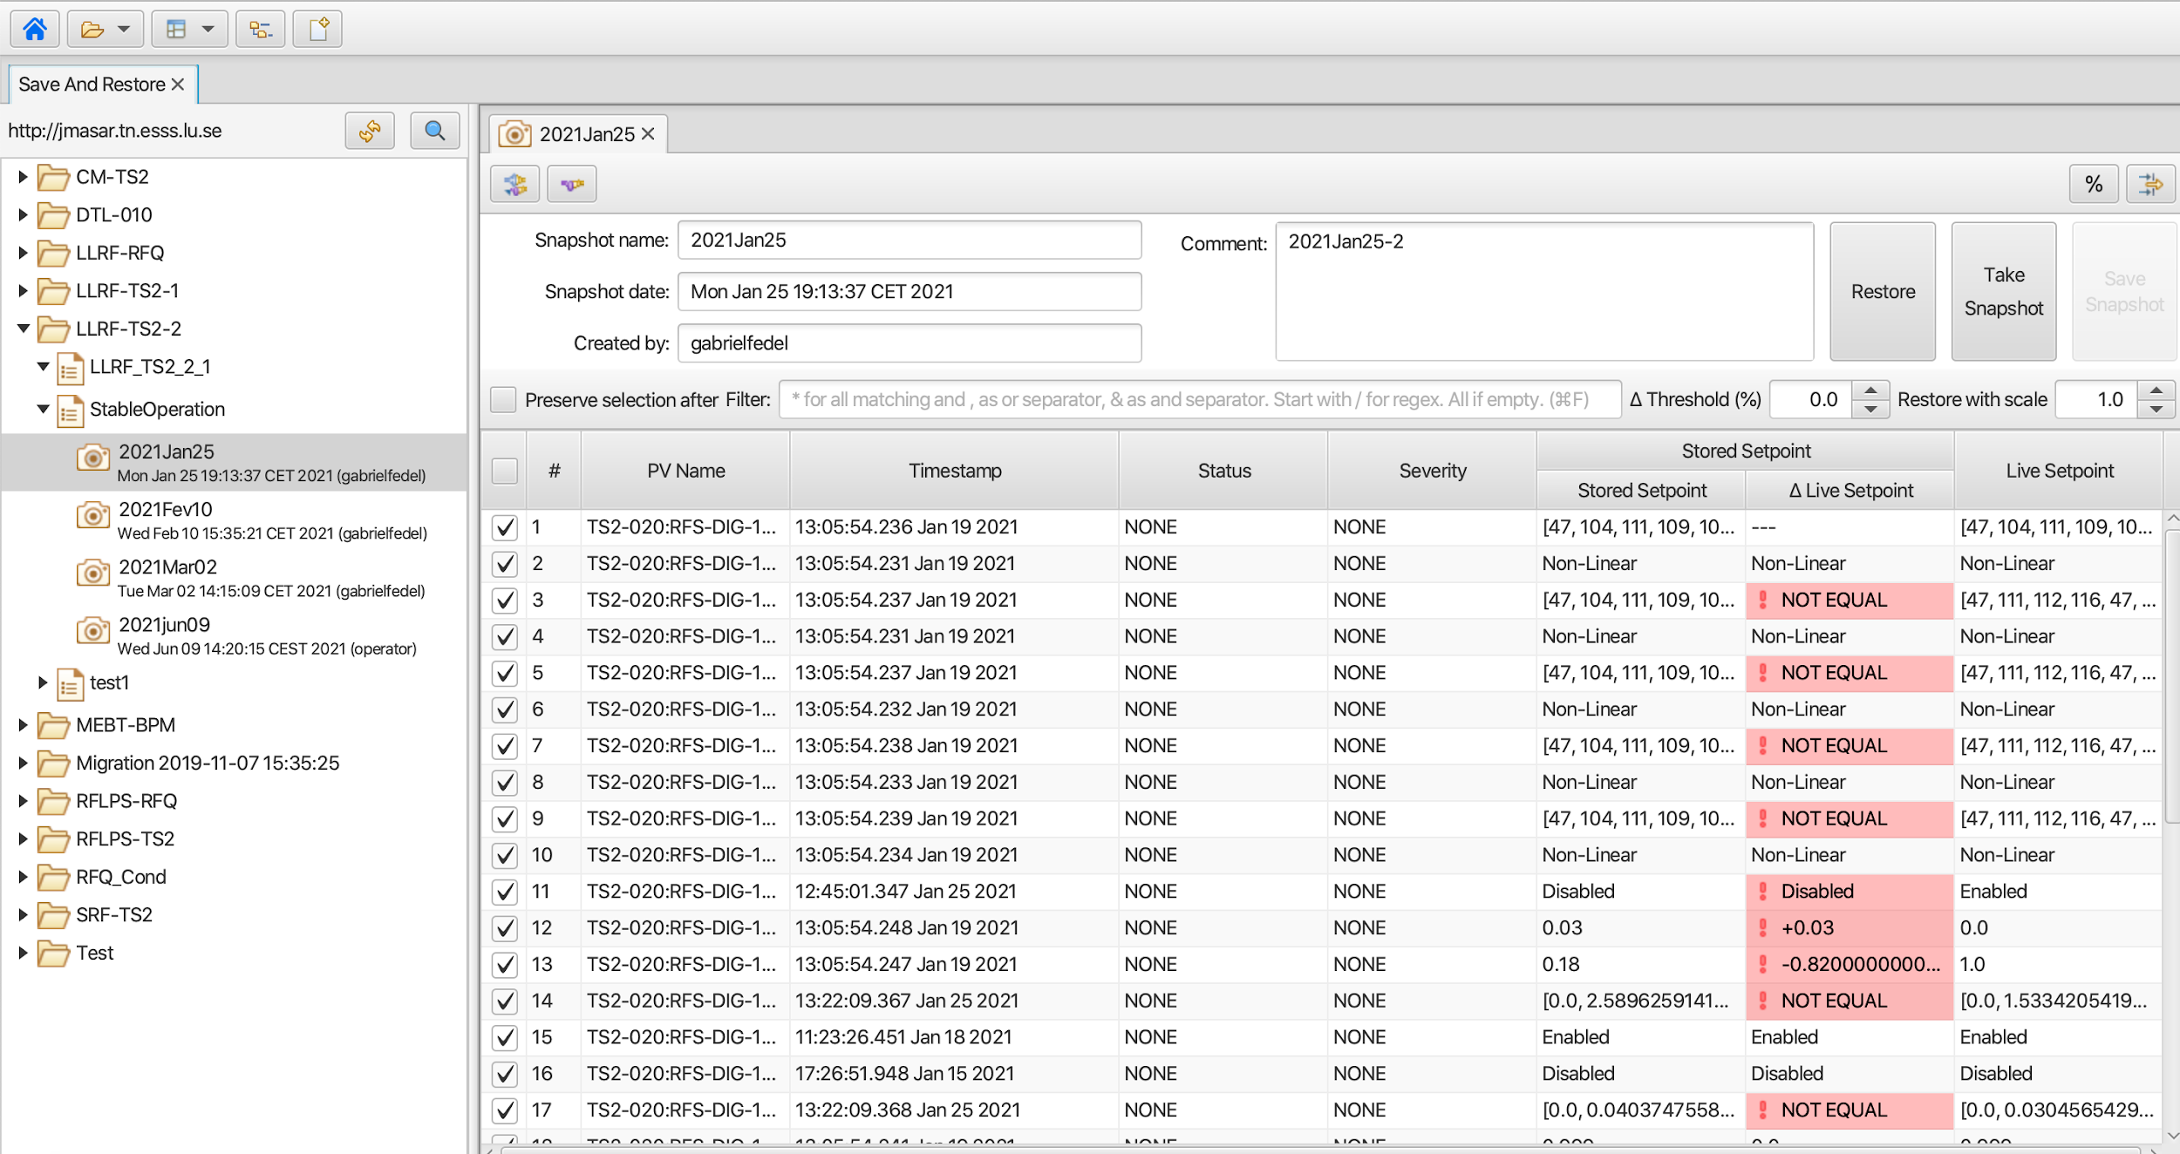
Save Restore

Slide 28
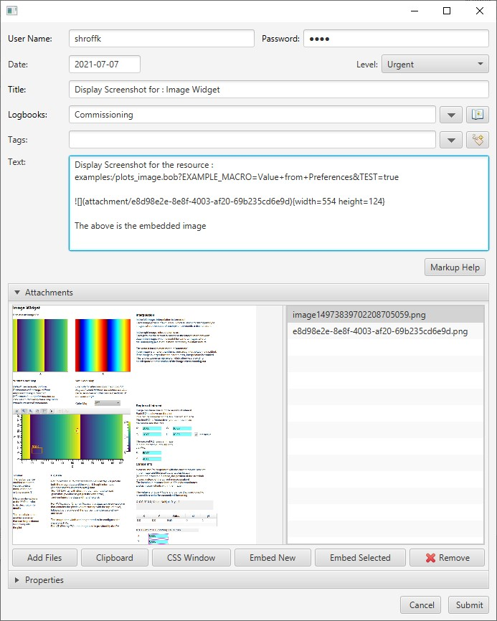
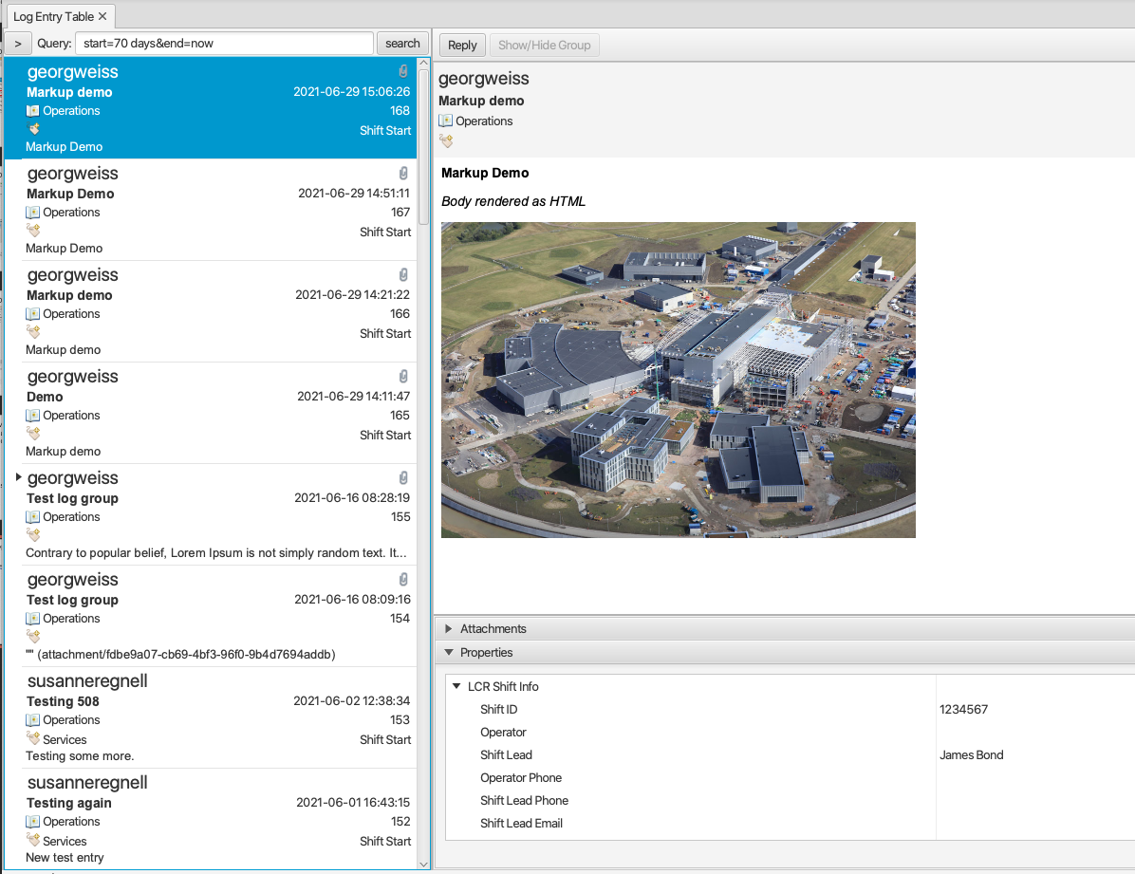
Logbook
Supported for multiple logbook services
Olog
Phoebus Olog
SNS logbook
elog

Slide 29
VTypes: Type definitions
Java interfaces for values
Not tied to protocol or implementation (i.e. we can read them from databases, epics protocol, file, …)
Not tied to memory representation (i.e. they can come directly from the network buffer, can be lazily calculated, …)
Immutable
It’s the “just give me some value from somewhere that is safe to read”
Notes:
Java interfaces for values
Not tied to protocol or implementation (i.e. we can read them from databases, epics protocol, file, …)
Not tied to memory representation (i.e. they can come directly from the network buffer, can be lazily calculated, …)
Immutable
It’s the “just give me some value from somewhere that is safe to read”
Alarm, Time, Display, … through composition (not inheritance)
Expanding vtype and Vimage su PVA clients do receive the description within the NTScalar, at least with QSRV. CA clients on the other hand don't get that with any dbr_.. type for a record "xx" unless they create a separate channel to "xx.DESC", which would double the number of channels and fail for non-IOC CA servers.pport On an IOC, it's perfectly fine to only set an analog record's HIGH limit to say 100 but not the LOW limit

Slide 30
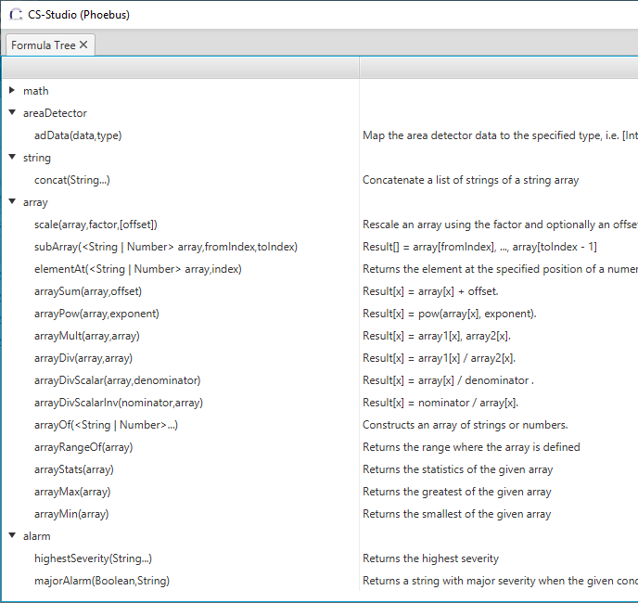
Formula Functions
An efficient way to support data processing
No Scripts & Rules
Data processing happening off the UI thread
Thread safe access to data
Connection management

