Slide 1
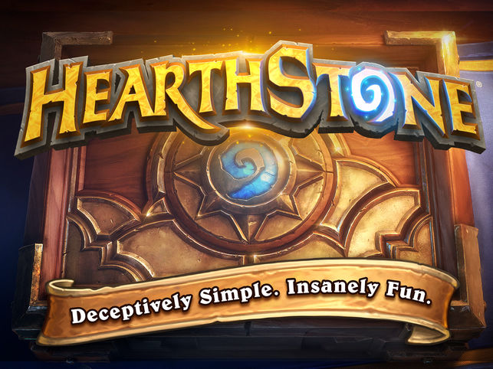
Eidan Jacob
Dec 5, 2018
Hearthstone:
An online, collectible trading card game with over 100 million players worldwide.

Slide 2
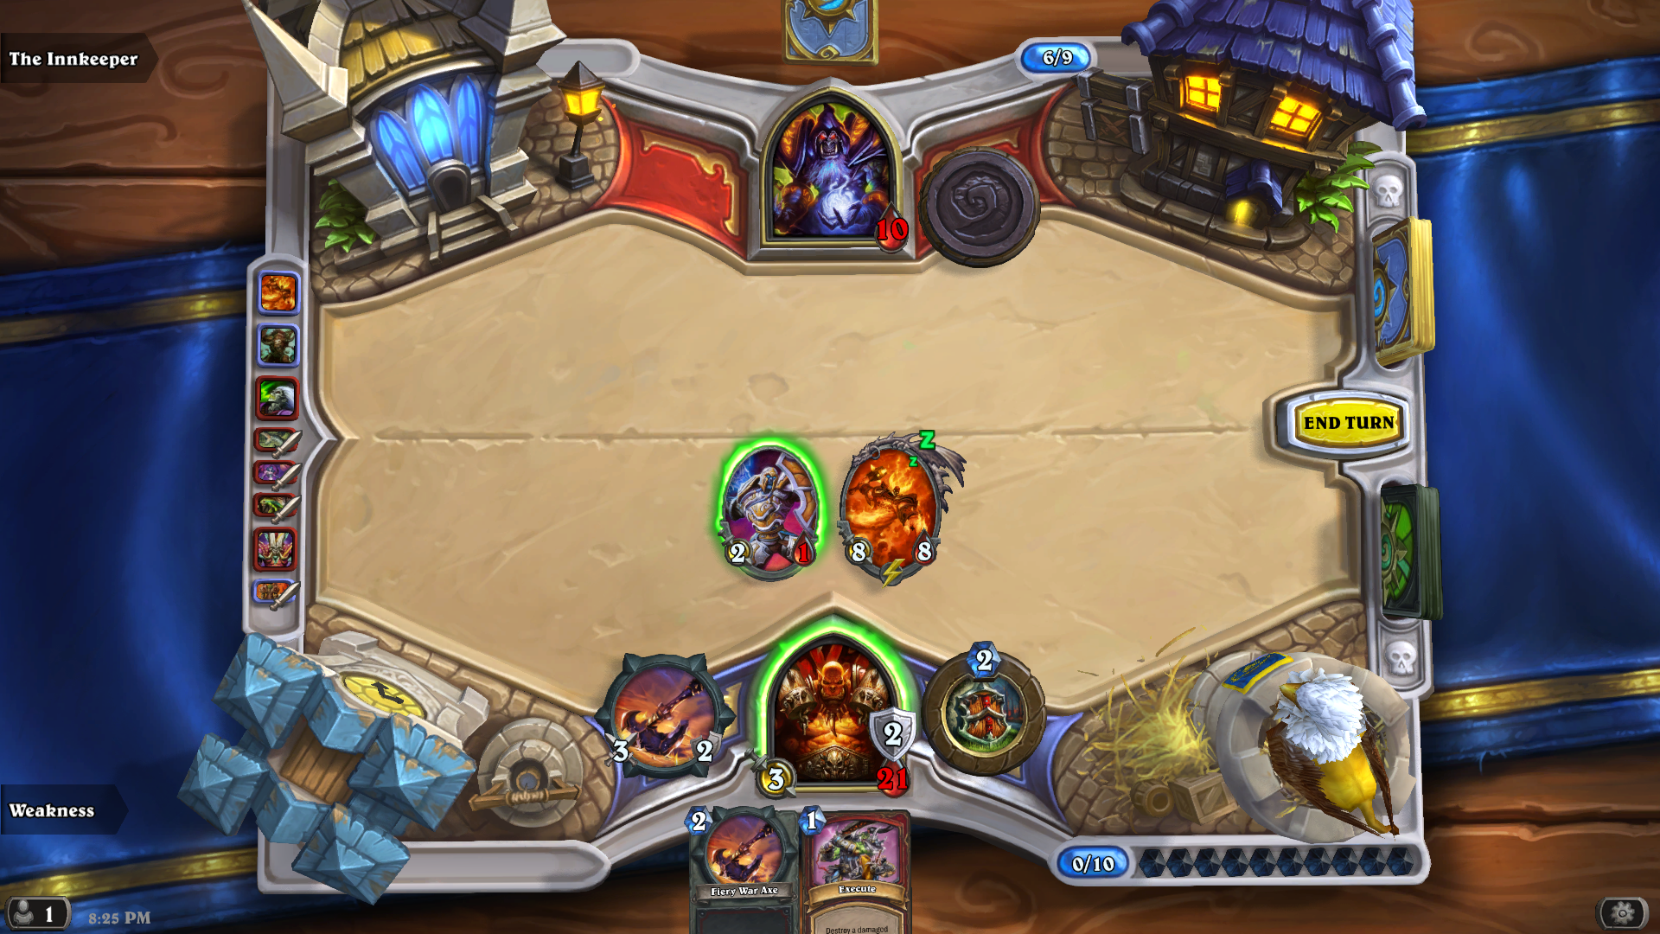
HS 101

Slide 3
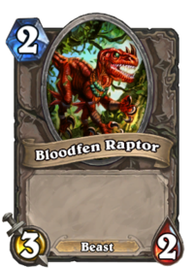
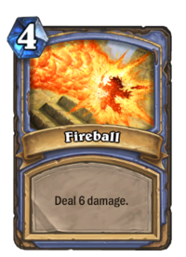
HS 101
Minions
Spells

Slide 4
Data
All the cards in the game
Game-related stats: cost, attack, health
Class
Type
Effects/Mechanics
User-submitted decks on fan website(s)
Included cards
Ratings, comments, views, etc.

