Slide 2
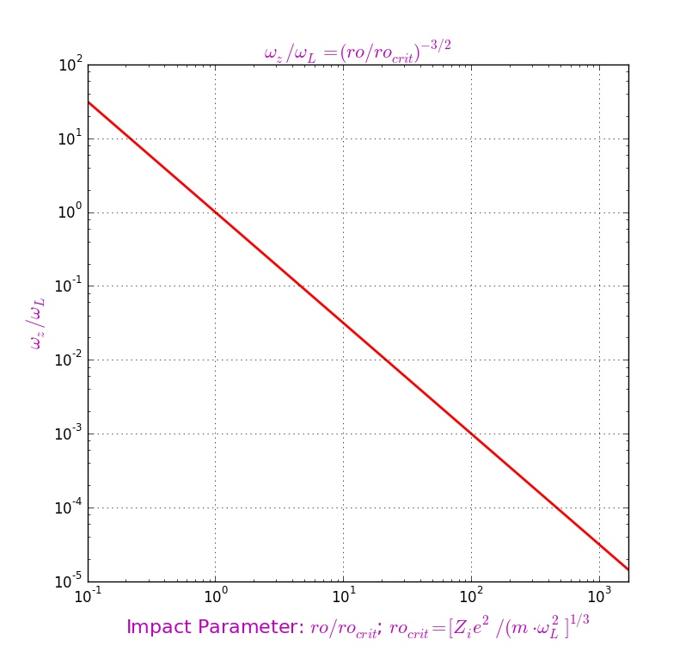
”Magnetization” Area

Slide 3
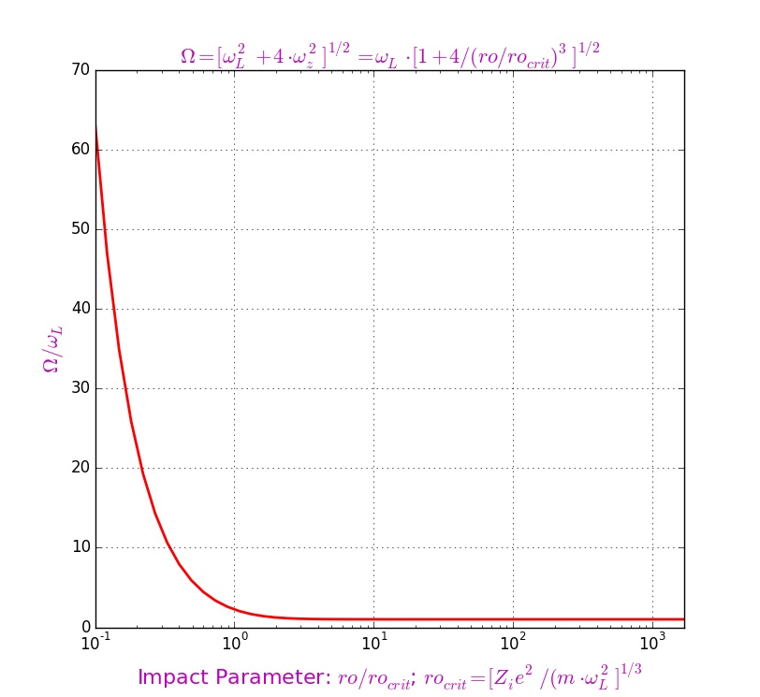
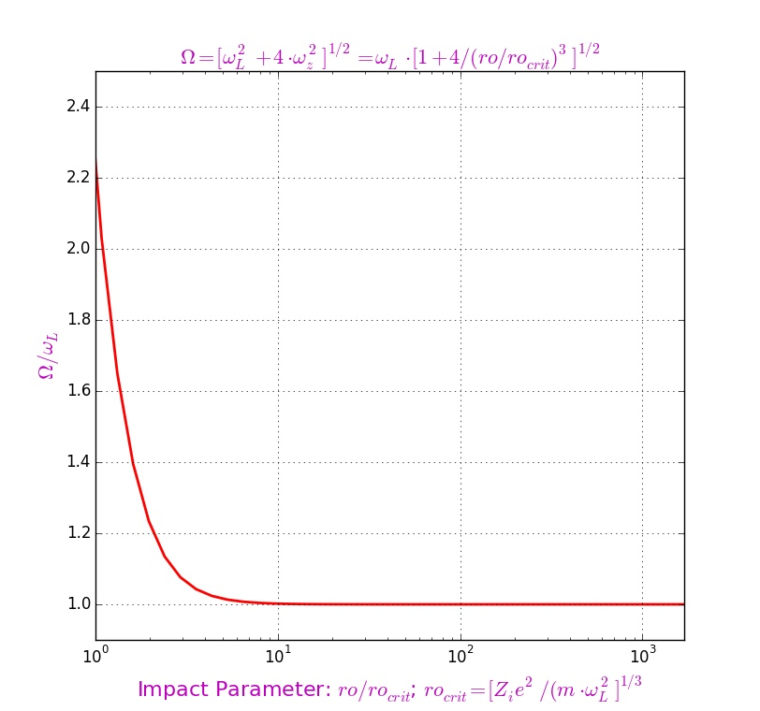

Slide 4
For each ion with velocity cycles over electrons
Cycle over transversal velocity with the step
Cycle over impact parameter with the step
Cycle over longitudinal velocity with the step
Cycle over time with the step
“Pull” electron with step in the magnetic field;
“Pull” ion with step in the drift gap;
“Pull” electron with step in the interaction area;
“Pull” ion with step in the interaction area;
“Pull” electron with step in the magnetic field;
“Pull” ion with step in the drift gap;
Change in the ion momentum for this step over ;
Increment of the ion momentum for this step over ;
Increment of the ion momentum for this step over ;
Increment of the ion momentum for this step over ;
Friction force

Slide 5
