Slide 1

OPENSHIFT AI
AI Agent on OpenShift
An intelligent, autonomous monitoring and incident analysis platform built for enterprise-grade OpenShift clusters — delivering real-time observability, anomaly detection, and AI-generated insights at scale.

Slide 2

The Operational Challenge
Modern OpenShift clusters generate massive volumes of logs and alerts. Manual monitoring cannot keep pace — leading to delayed responses and costly downtime.
Alert Overload
Thousands of alerts and log events daily, with no intelligent prioritisation
Slow Root-Cause Analysis
Manual investigation delays MTTR and increases operational risk
Delayed Incident Response
Human-driven workflows cannot match the speed of modern failures
No Automated Remediation
Scalable, intelligent monitoring with automated workflows is absent

Slide 3
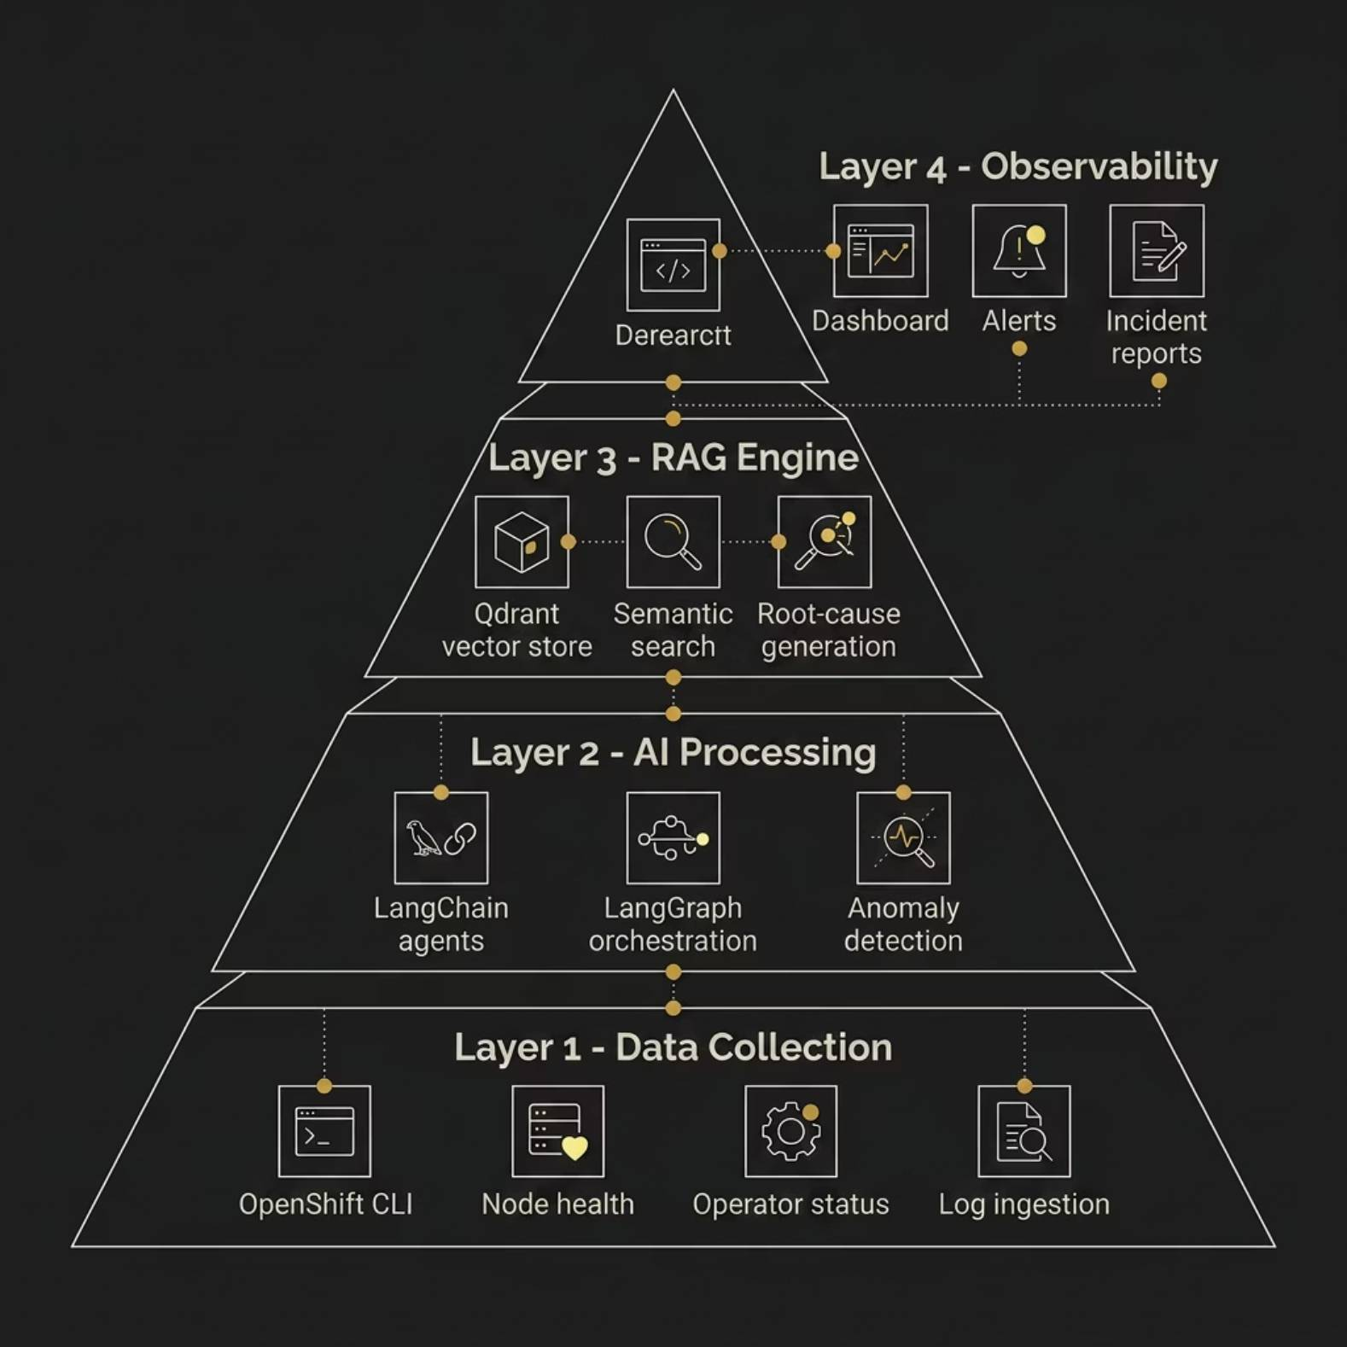

Solution Architecture
A unified AI-powered platform orchestrates multi-agent workflows, real-time data ingestion, and RAG-based analysis — delivering end-to-end cluster observability with automated alerting and summarisation.
AI-powered monitoring platform with multi-agent orchestration
Real-time data ingestion pipeline
RAG-based incident analysis
Automated alerting and summarisation
Dashboard-driven observability

Slide 4
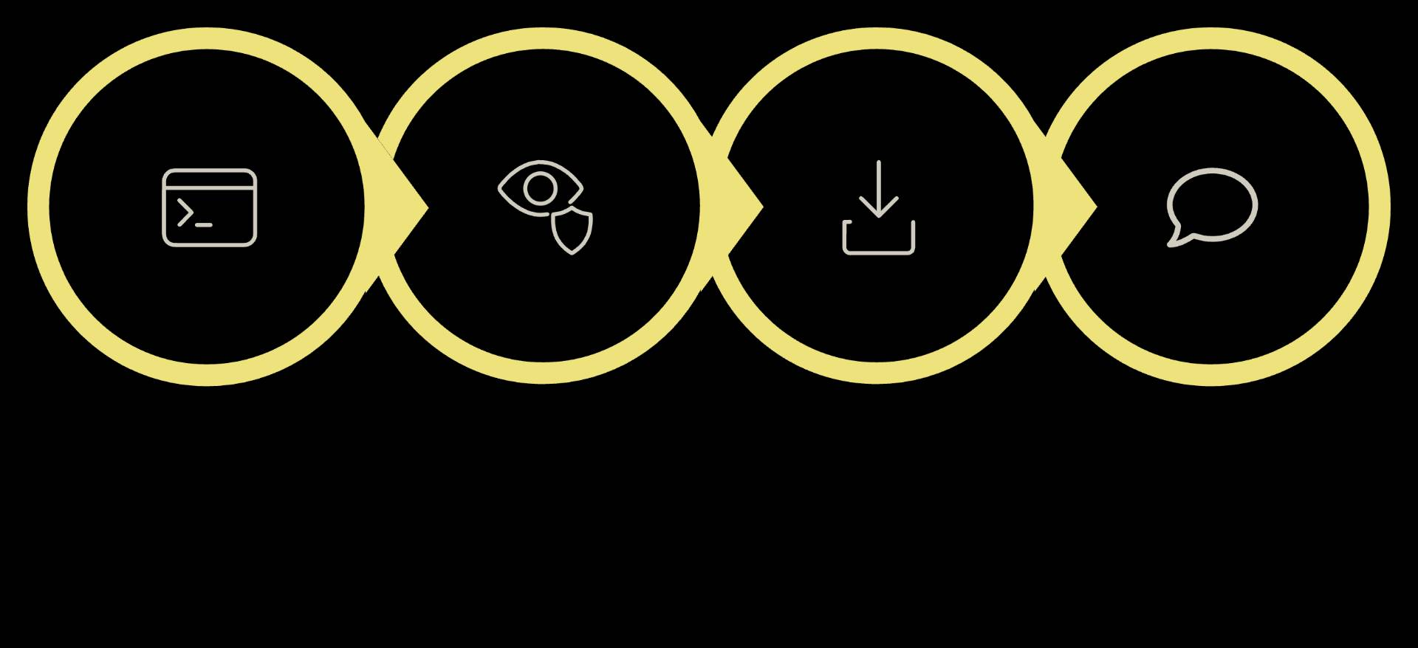
Data Collection Pipeline
oc CLI
Monitoring
Ingestion
Postgres
The pipeline connects directly to OpenShift clusters via the oc CLI, continuously tracking node health, operator status, and pod metrics. All events are ingested in real time and persisted in PostgreSQL for structured querying and historical analysis.

Slide 5
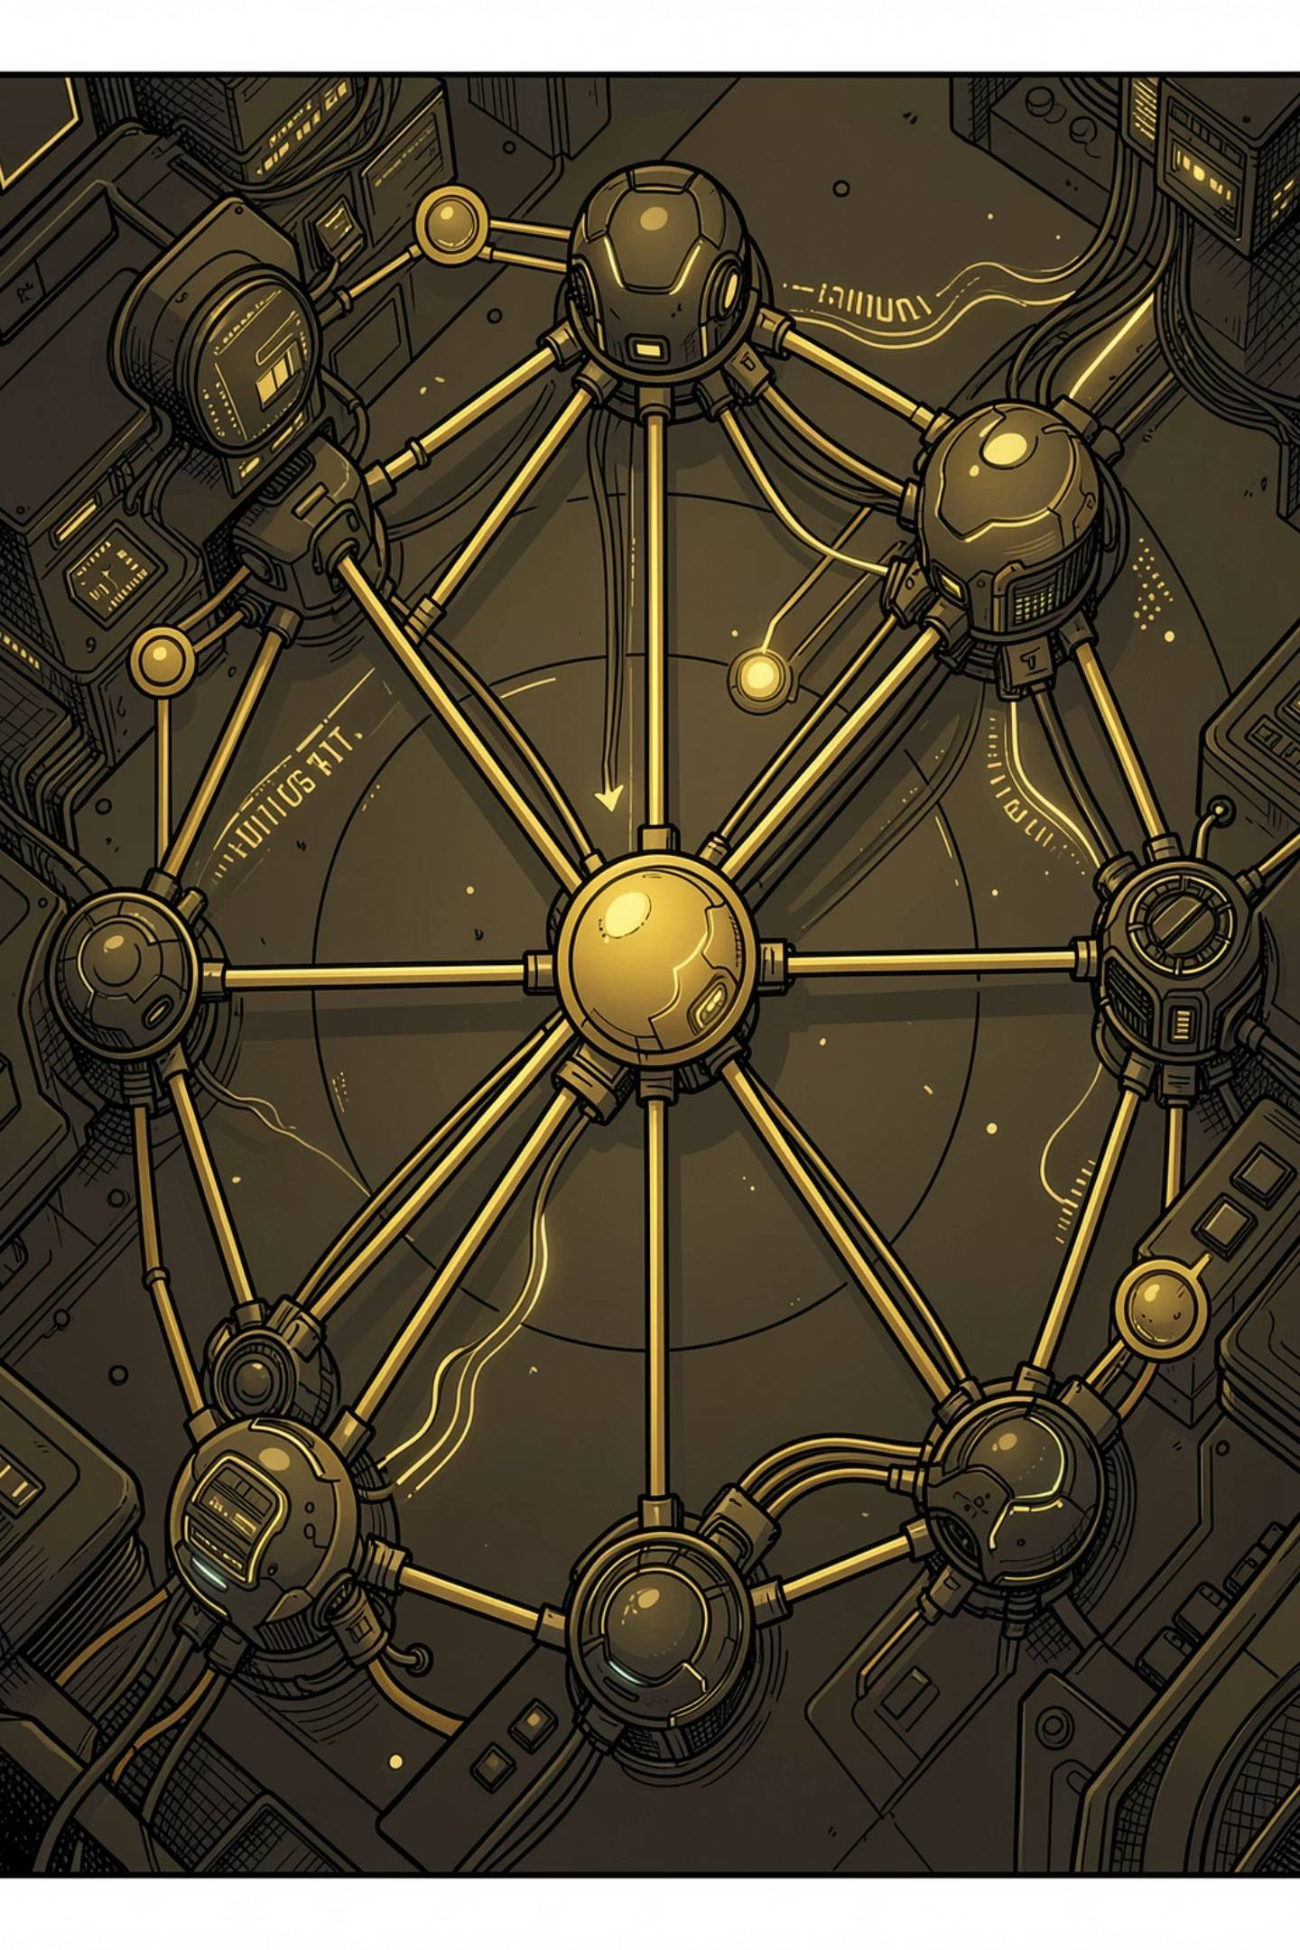

LangChain Agent Pipeline
Multi-Step Workflow
Sequential agent steps execute autonomously — from data retrieval to incident summarisation
Tool-Calling Architecture
Agents invoke specialised tools for cluster queries, log parsing, and metric analysis
Anomaly Detection Engine
Statistical and pattern-based detection identifies deviations before they escalate
Incident Summarisation
LLM-generated summaries provide concise, actionable incident reports for on-call engineers

Slide 6
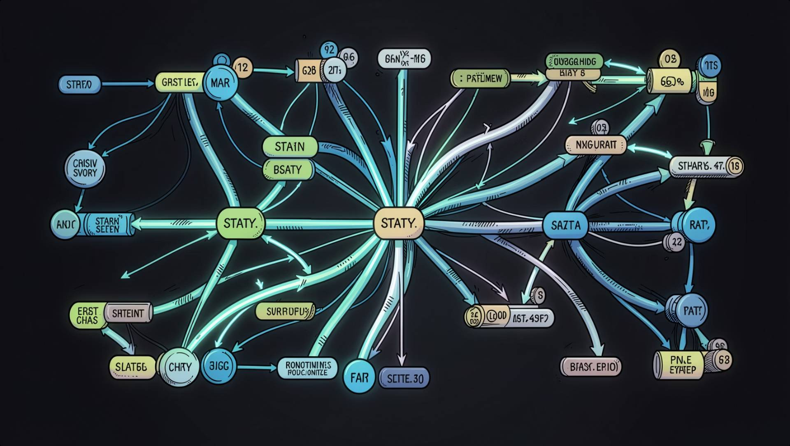
LangGraph Orchestration
Stateful, Resilient Workflows
LangGraph provides a StateGraph-based orchestration layer enabling complex multi-agent coordination with built-in resilience.
StateGraph Workflows
Conditional Routing
Parallel Detection
Reflection & Retry
Typed state management across all agent steps
Dynamic branching based on anomaly severity and context
Concurrent agent execution for faster analysis
Self-correcting loops ensure reliable outcomes

Slide 7
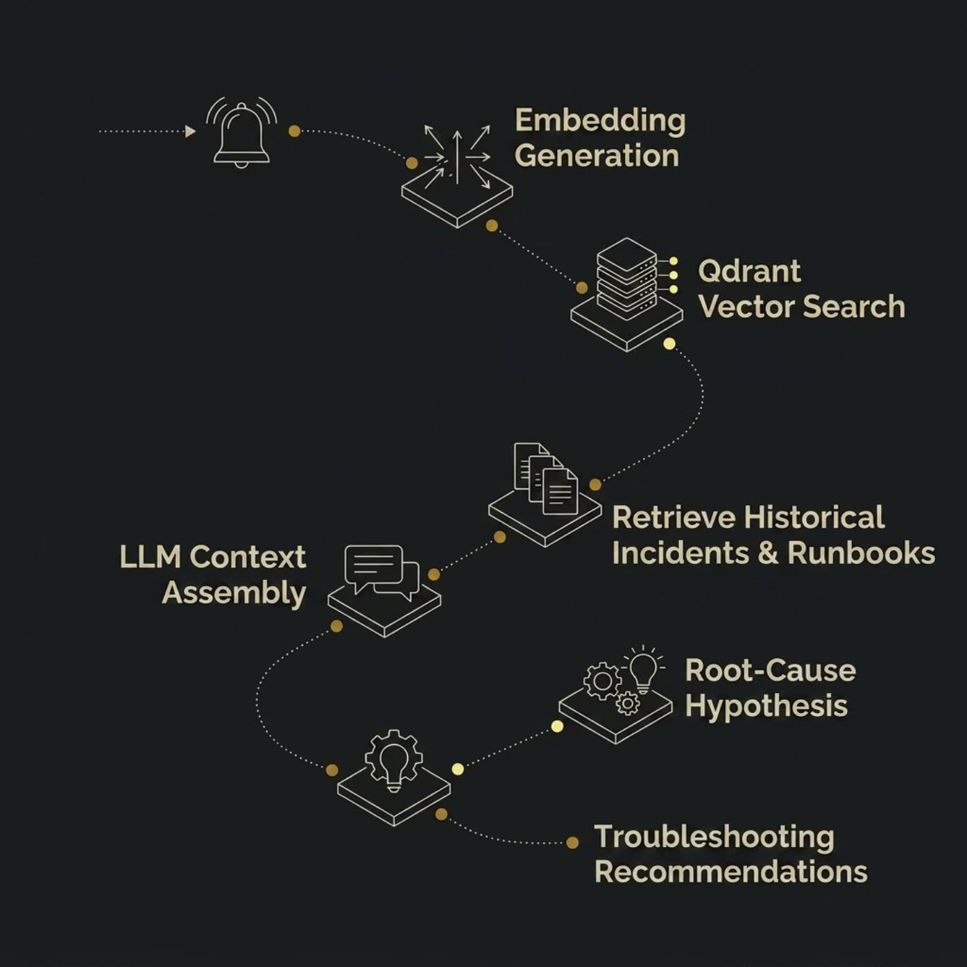

RAG & Root-Cause Analysis
Context-Aware Intelligence
The RAG engine leverages Qdrant, a high-performance vector database, to retrieve historical incidents and runbooks. Semantic similarity search matches current anomalies against known patterns, enabling the LLM to generate precise root-cause hypotheses and troubleshooting guidance.
Vector Store
Semantic Search
AI Insights
Qdrant with dense embeddings
Similarity matching over incidents
Generated troubleshooting steps

Slide 8
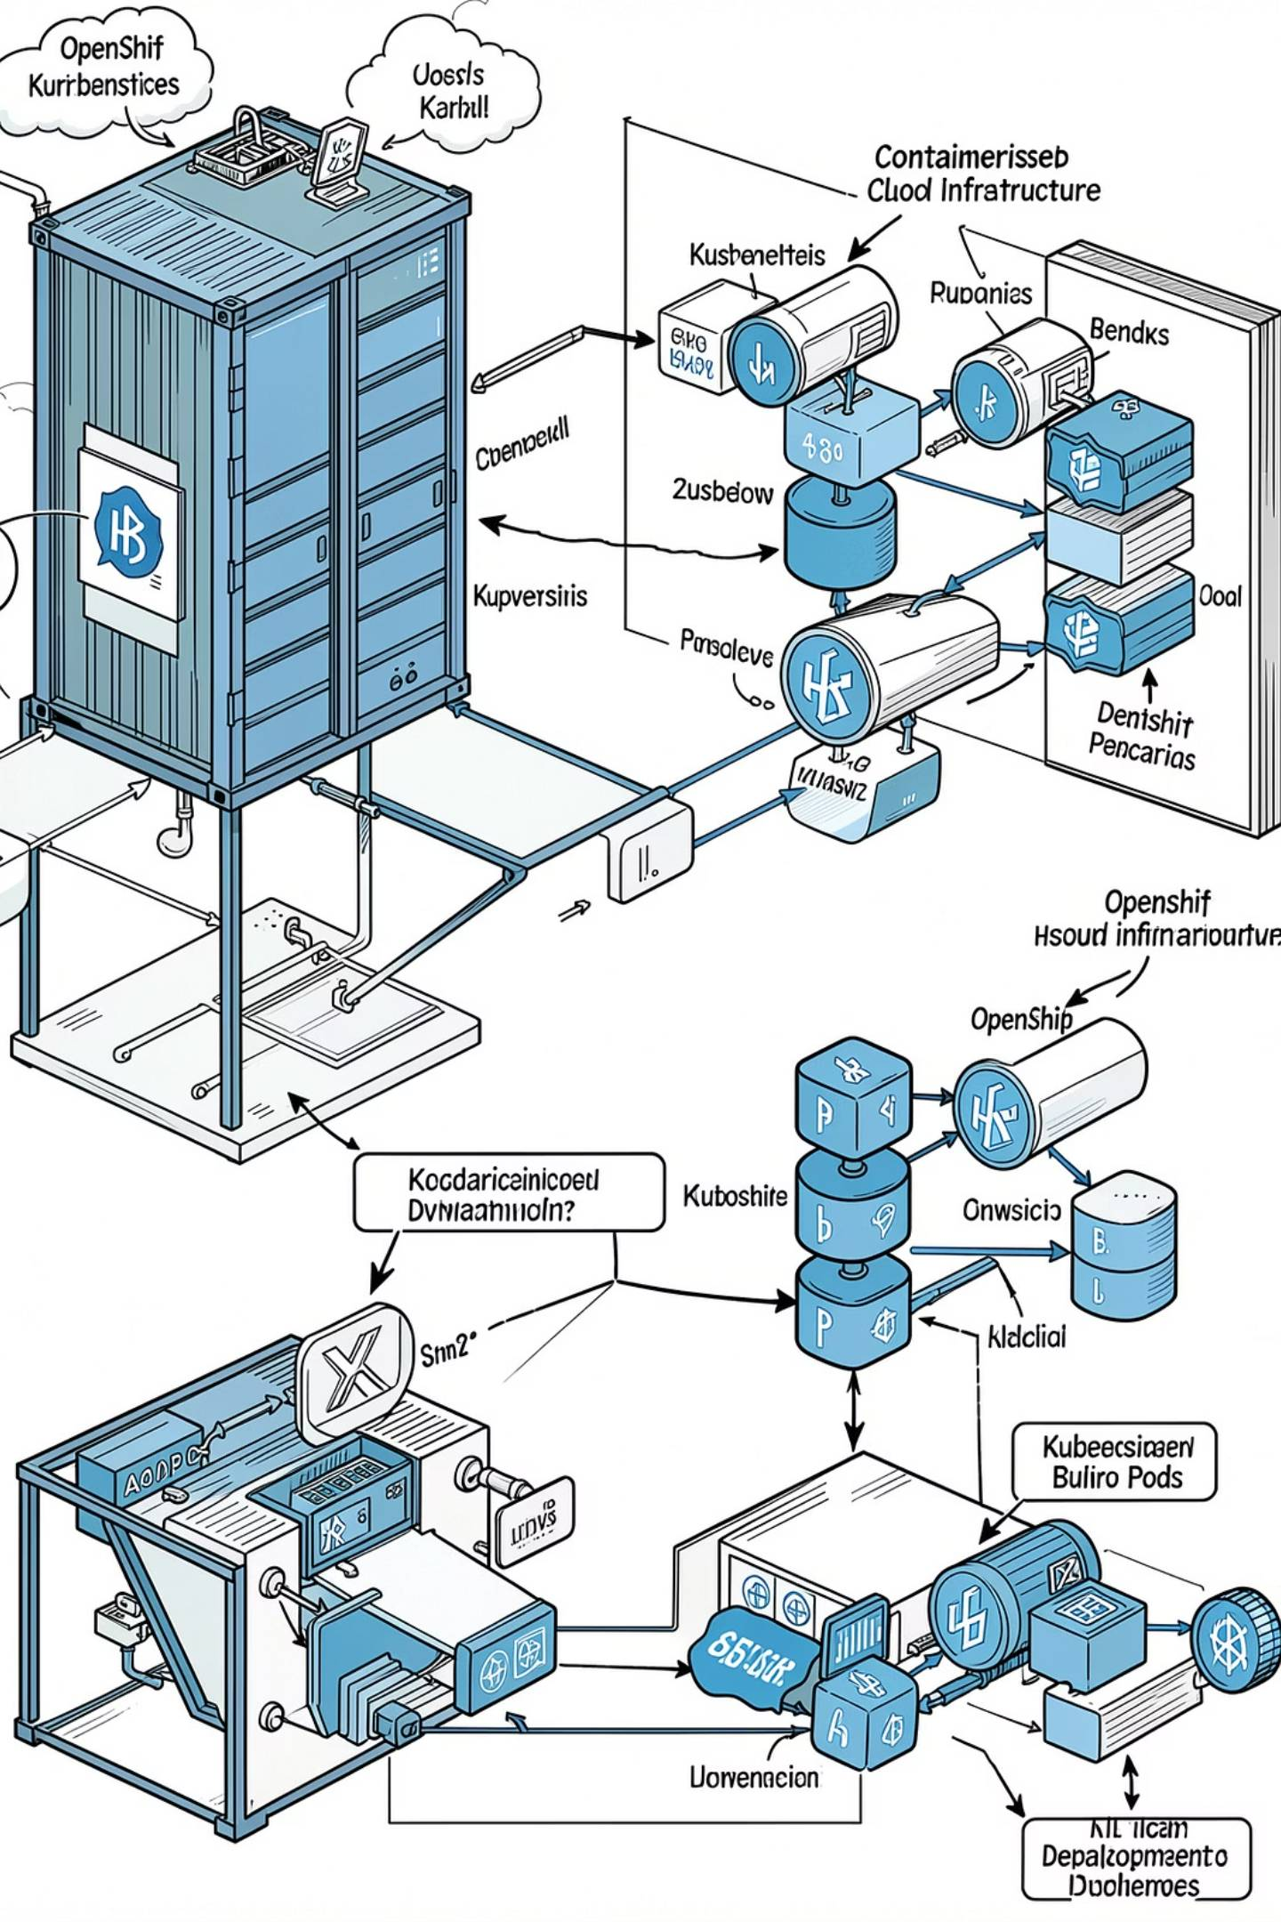

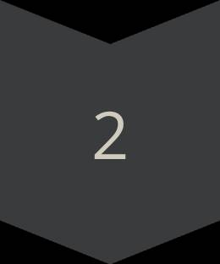
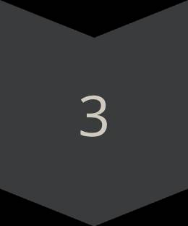


Deployment & Infrastructure
Docker
Containerised agent services with isolated dependencies
Kubernetes
Orchestrated deployment with auto-scaling and health probes
OpenShift
YAML-configured workloads, Routes, and SecurityContextConstraints
OpenShift AI
On-premise LLM inference with GPU acceleration support
The architecture is production-ready, supporting air-gapped deployments and on-premise LLM inference for data-residency compliance.

Slide 9
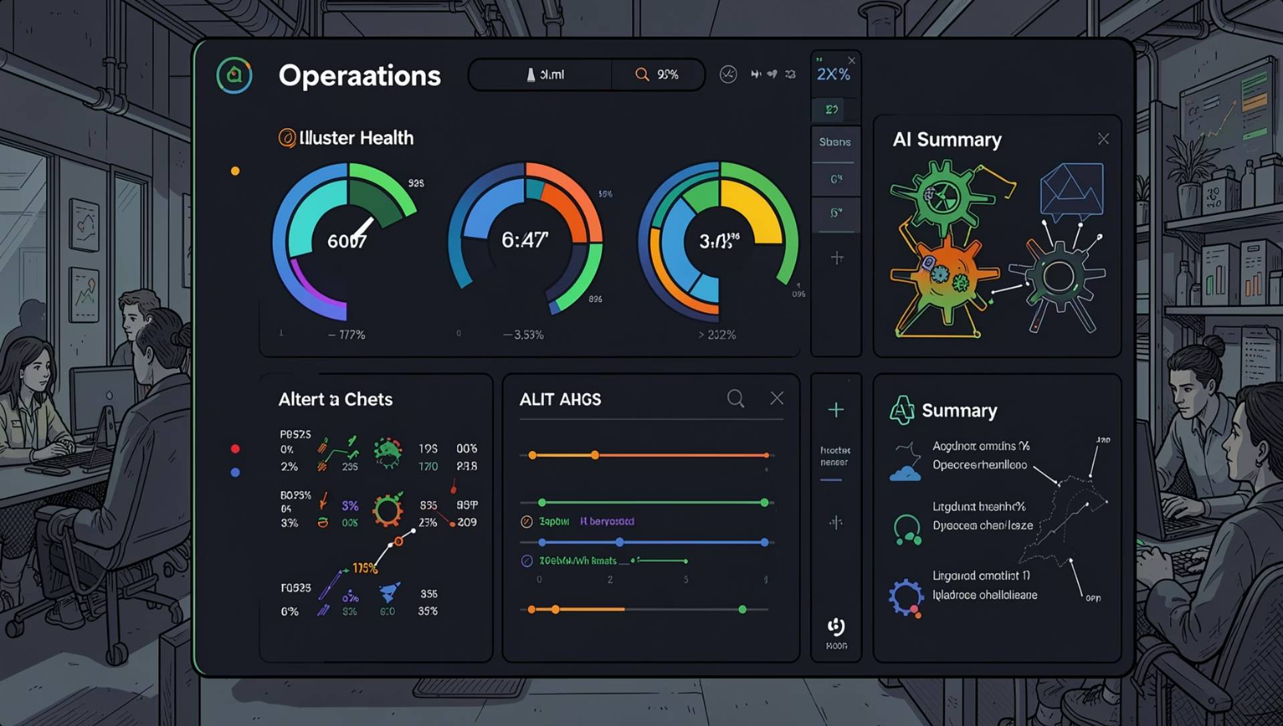
Dashboard & Monitoring
Operational Visibility
A unified dashboard surfaces real-time cluster health, AI-generated incident summaries, and alert visualisations — giving SRE and platform teams a single pane of glass for decision-making.
Live Cluster Health
AI-Generated Summaries
Incident Tracking
Real-time node, operator, and workload status
Natural-language incident briefs for rapid triage
End-to-end lifecycle management with analytics

Slide 10
Tech Stack & Outcomes
Technologies Used
Project Outcomes
LangChain
LangGraph
Faster Detection
Automated Workflows
AI-driven anomaly detection reduces mean time to detect
LlamaIndex
Qdrant
End-to-end monitoring pipelines eliminate manual toil
PostgreSQL
OpenShift AI
Better Root-Cause Analysis
Scalable Enterprise AI
Docker & Kubernetes
Python
RAG-powered insights accelerate MTTR significantly
Production-grade architecture ready for large-scale OpenShift fleets

