Slide 1
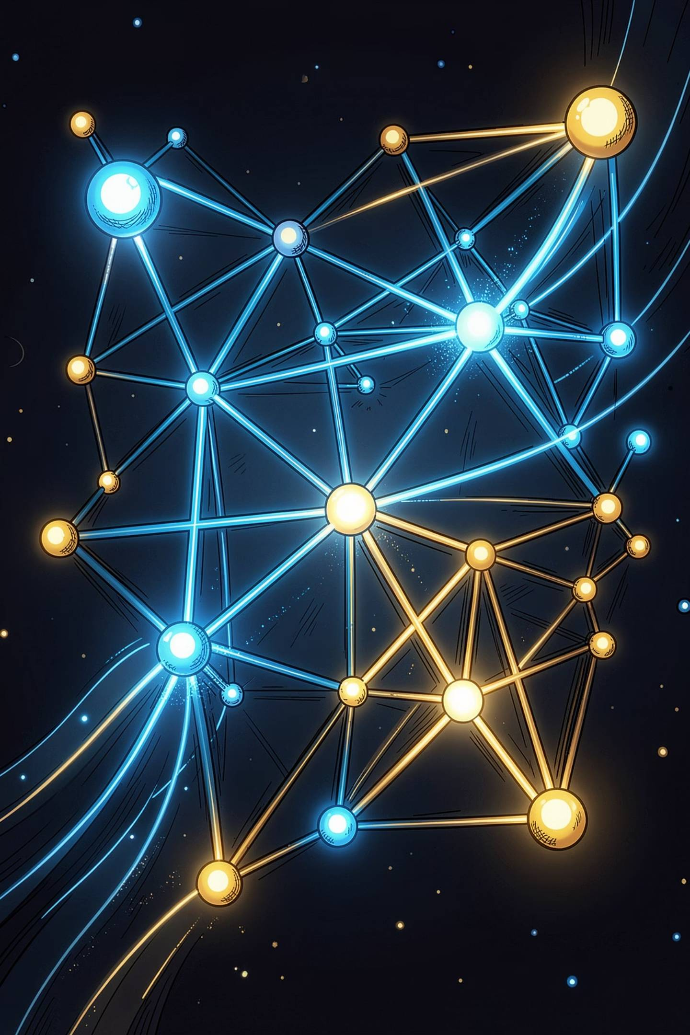
LANGCHAIN ECOSYSTEM
Building Stateful AI Workflows with LangGraph
LangGraph is a library for building stateful, multi-actor applications with LLMs. Unlike linear chains, LangGraph models workflows as directed graphs — enabling cycles, branching, memory, and human intervention. It is purpose-built for complex, enterprise-grade AI systems that demand reliability, observability, and control.

Slide 2
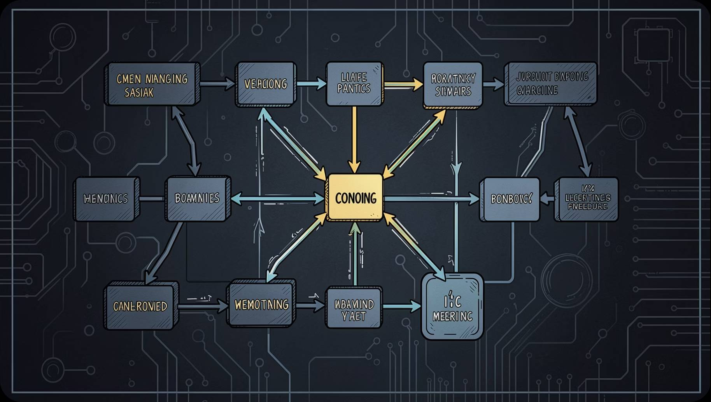
CORE CONCEPTS
The Building Blocks of LangGraph
StateGraph
The central container. Holds all nodes, edges, and the shared state schema for the entire workflow.
Nodes
Discrete units of work — functions that read from and write to the shared state.
Edges
Define execution flow between nodes. Can be static, conditional, or dynamic based on state.
State
A typed, shared dictionary that flows through the graph, carrying all context and data.

Slide 3

GETTING STARTED
Building Your First Graph Workflow
Create Nodes
Connect Edges
Implement functions that read and write state.
Link nodes in order with add_edge calls.
Define State
Compile & Execute
Create a TypedDict schema for shared state.
Run the graph via graph.stream or graph.invoke.
Every LangGraph workflow follows this pattern. State is the contract between nodes — each node consumes and produces a well-defined slice of the shared state object, making the graph predictable and testable.

Slide 4
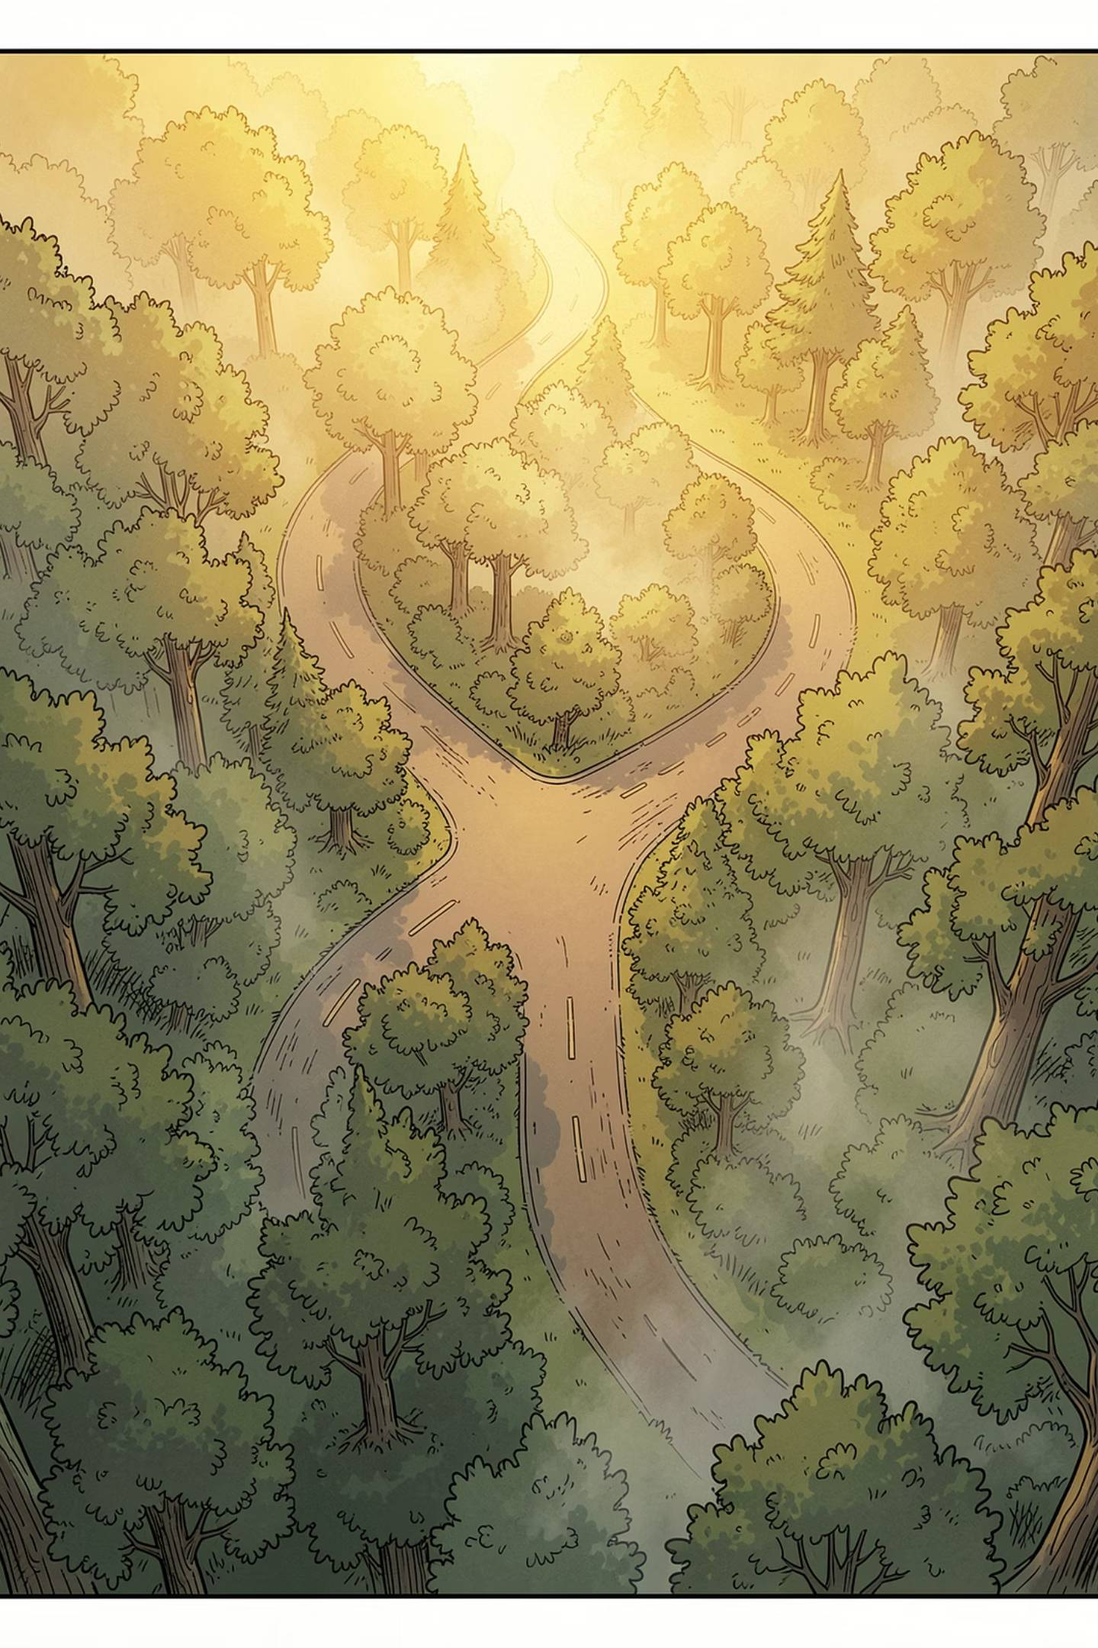
ROUTING
Conditional Routing: Dynamic Workflow Paths
LangGraph's add_conditional_edges() enables intelligent branching. A router function inspects the current state and returns the next node — allowing workflows to adapt dynamically to LLM outputs, user input, or external signals.
Router Function
Conditional Edge
Returns a string key matching the target node based on state conditions.
Registered via add_conditional_edges() — evaluated at runtime on every traversal.
Adaptive Flow
Enables retry branches, escalation paths, and context-aware routing without hardcoding logic.

Slide 5
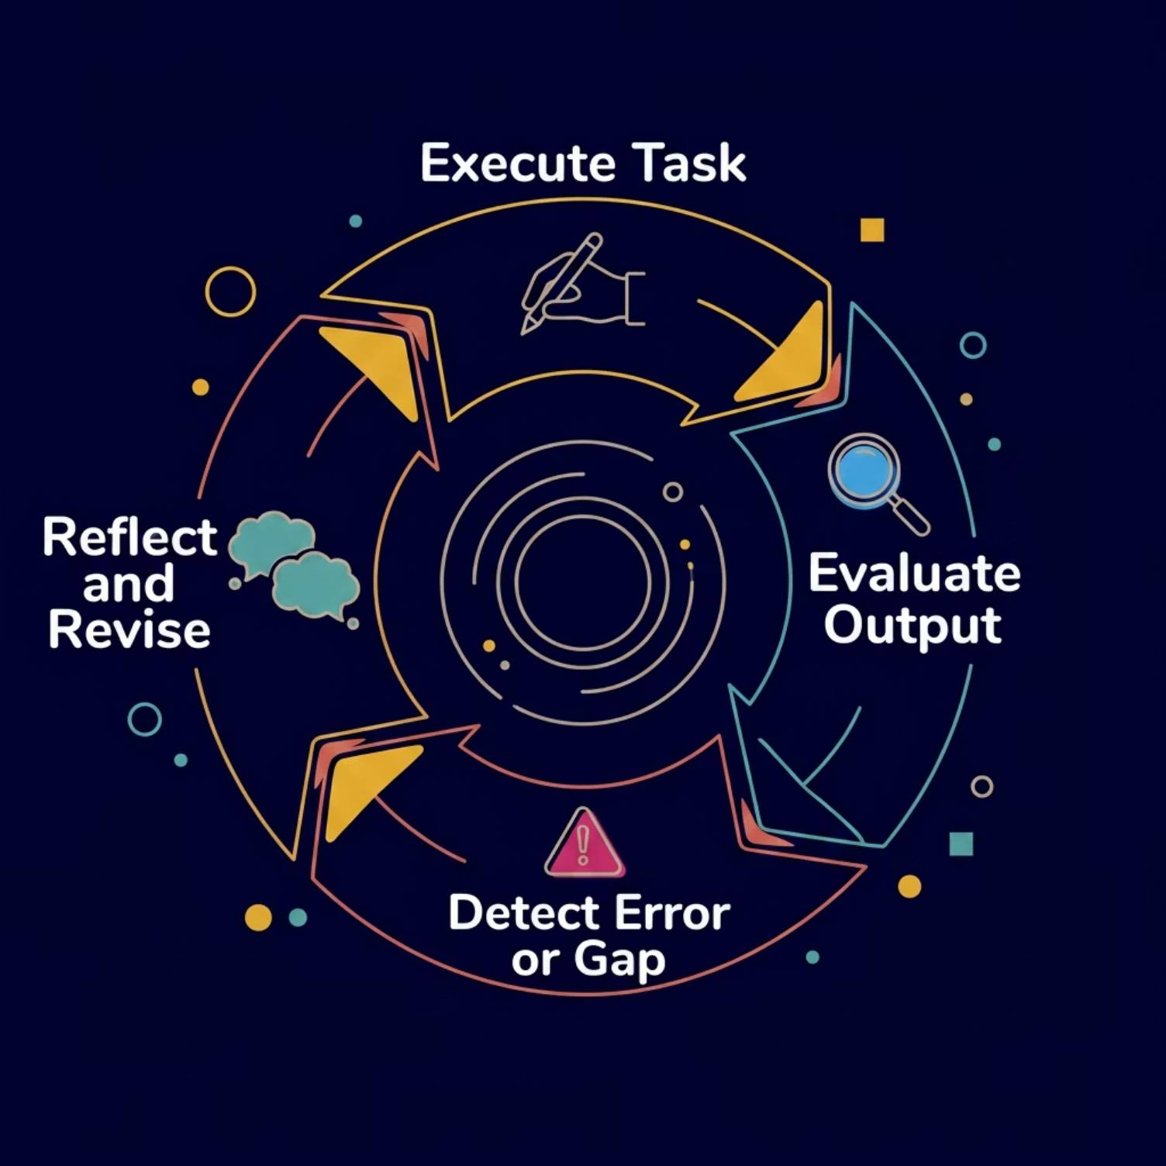

RESILIENCE
Loops & Self-Correction
Why Loops Matter
LLMs are probabilistic. LangGraph embraces this by allowing graphs to cycle back — retrying, reflecting, or refining outputs until a quality threshold is met.
Retry logic with max iteration guards
Reflection nodes that critique and revise outputs
Error recovery through fallback branches
Feedback-driven workflows that improve over time

Slide 6


PERSISTENCE
Memory & State Persistence
LangGraph's checkpointing system persists workflow state at every step — enabling long-running processes, session recovery, and time-travel debugging.
Checkpointing
State is saved after every node. Interrupted workflows resume exactly where they left off.
Session Recovery
Reload a prior state snapshot to replay, debug, or branch from any point in execution.
Durable Storage
Pluggable checkpointer backends (SQLite, Postgres, Redis) support production-grade persistence.

Slide 7

HUMAN OVERSIGHT
Human-in-the-Loop (HITL)
Critical workflows — approvals, compliance checks, sensitive decisions — require human validation. LangGraph's interrupt mechanism pauses execution at designated nodes, waits for human input, then resumes with the updated state.
Interrupt Before a Node
Human Approves or Edits
Graph Resumes
Pause execution and surface the current state for review.
Operator validates, modifies state, or rejects the path.
Execution continues from the interrupt point with the updated state.

Slide 8
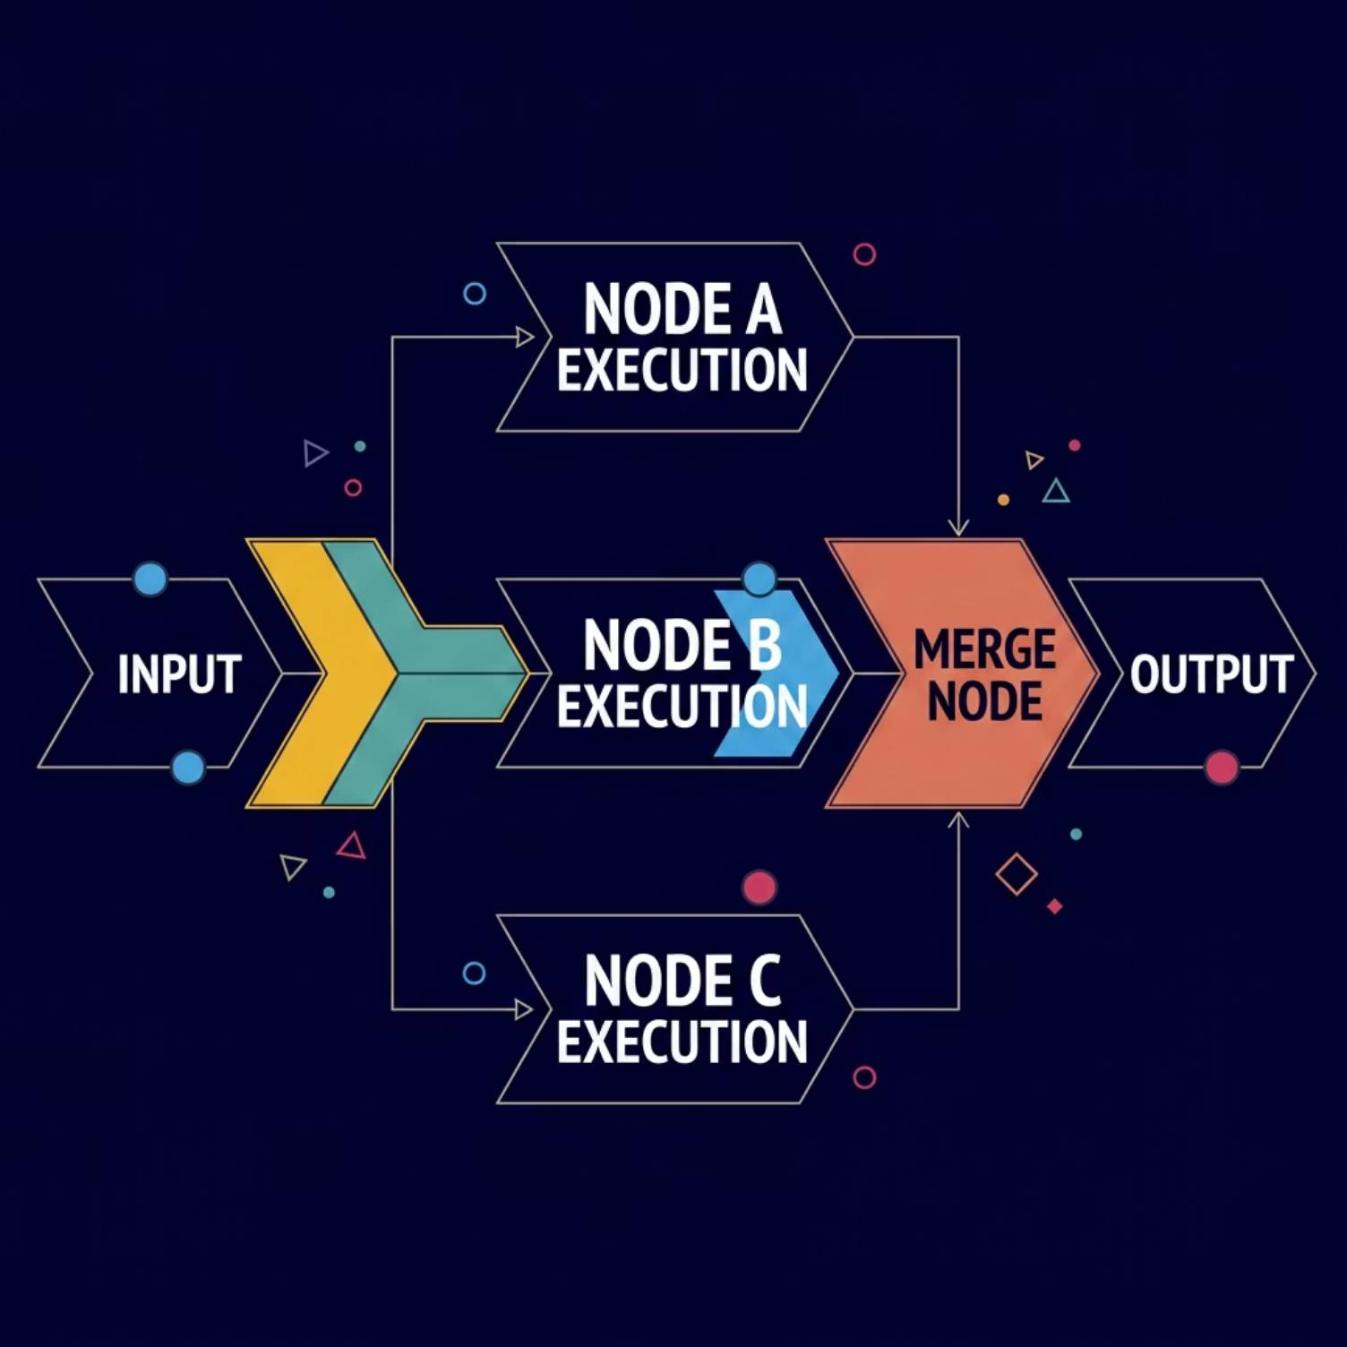
PERFORMANCE
Streaming & Parallel Execution
Real-Time Output with graph.stream()
Instead of waiting for the full graph to complete, stream() yields output chunk-by-chunk — token by token from LLM calls, or node by node from the workflow.
Token streaming for low-latency UX
Node-level streaming for progress indicators
Parallel node execution for independent tasks
Backpressure handling for high-throughput systems

Slide 9
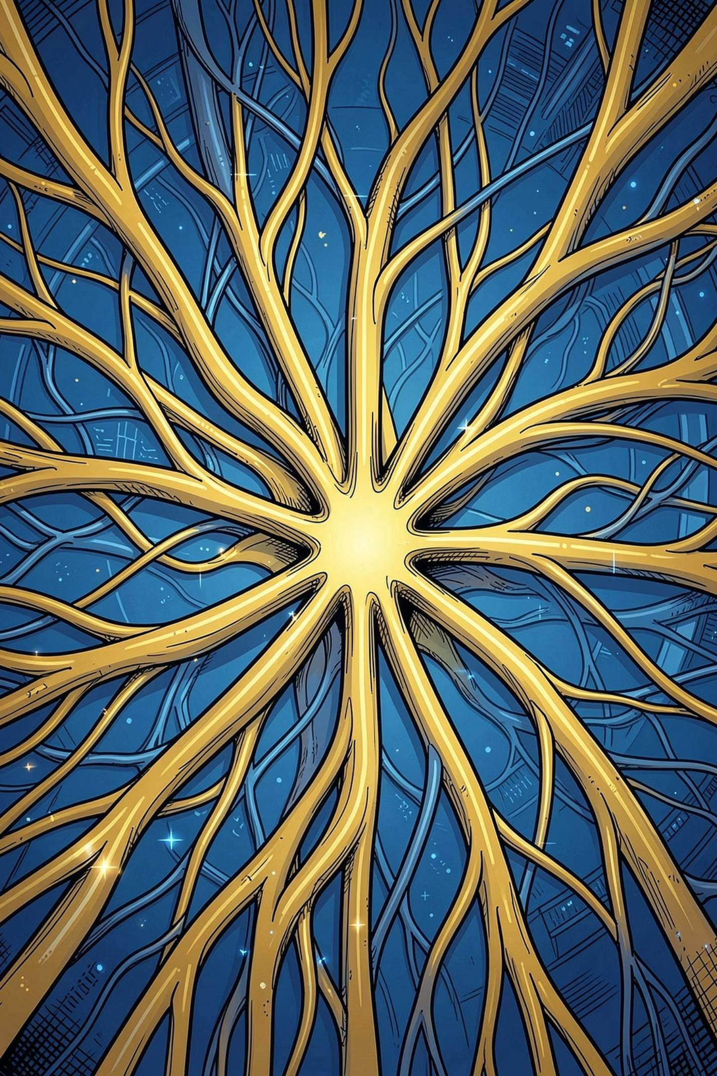
SCALABILITY
Fan-Out & Multi-Task Processing
LangGraph supports fan-out/fan-in architecture — spawning parallel sub-tasks, processing them concurrently, then aggregating results. Ideal for research, classification, and batch processing workflows.
Fan-Out
Concurrent Execution
Dispatch multiple parallel tasks from a single node — e.g., query 5 sources simultaneously.
Tasks run in parallel via async node execution, dramatically reducing wall-clock time.
Fan-In
A reduction node collects and aggregates all parallel outputs into a unified result.

Slide 10



ADVANCED PATTERNS
Multi-Agent Systems in LangGraph
LangGraph enables collaborative multi-agent architectures where specialised agents share state, delegate tasks, and route work through a supervisor — all within a single, observable graph.
Manager Agent
Researcher Agent
Summarizer Agent
Orchestrates the workflow, delegates sub-tasks, and makes routing decisions based on global state.
Executes information gathering, tool calls, and data retrieval in parallel across sources.
Consolidates findings from multiple researchers into a coherent, structured final output.

