Slide 1
Validation and parameter selection for GREIT
GREIT: Graz Consensus Reconstruction Algorithm for EIT
Andy Adler, John Arnold, Richard Bayford, Andrea Borsic, Brian Brown, Paul Dixon, Theo J.C. Faes, Inéz Frerichs, Hervé Gagnon, Yvo Gärber, Bartlomiej Grychtol, Günter Hahn, William R B Lionheart, Anjum Malik, Janet Stocks, Andrew Tizzard, Norbert Weiler, Gerhard Wolf

Slide 2

What problem are we trying to solve?
EIT useful to image regional lung air flow. But, we can't compare regions unless
  Consistent response:
    Air volume in two
    places must show
    the same image
  Accurate positions
  No strange shapes
R1
R2
R3
R4
Our main goal is consistency

Slide 3


Requirements
Amplitude
Reconstructed
Image ( )
Set ¼-Max
Amplitude ( )
Position Error
r_{t}
r_{q}
Resolution
Simulation
Target
Shape
Deformation
Ringing
Inverted image

Slide 4
Consensus Ranking
Amplitude
#1. Requirement: uniform
#2. Requirement: uniform and small
#4. Requirement: uniform
#6. Requirement: small
#5. Requirement: small
#3. Requirement: small
Position Error
Resolution
Shape
Deformation
Ringing

Slide 5
Formulation: Training data
GR
Amplitude
Simulation
Target
Desired image
- based on
requirements
Reconstructed
image
- to be optimized

Slide 6
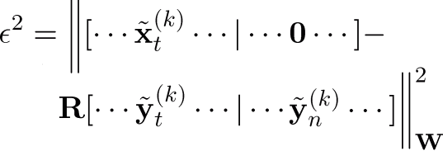
Type of Signal | Training Inputs (measurements) | Desired Output (reconstructed images)
Conductivity targets
Noise - electronic noise - electrode movement
Circular
PSF
k+1
0 outside
PSF
k
k–1
Desired image for noise
input is zero
Minimize:
GREIT Reconstruction Matrix
Notes:
\begin{align*}
\epsilon^2 = \bigg\|
&[\cdots\tilde{\bf x}_t^{(k)}
\cdots
|
\cdots
{\bf 0}
\cdots] -
\\
{\bf R}&[\cdots\tilde{\bf y}_t^{(k)}
\cdots
|
\cdots
\tilde{\bf y}_n^{(k)}
\cdots]
\bigg\|^2_{\bf W}
\end{align*}

Slide 7









Example Images
Backproj | NOSER | GREIT
i

Slide 8
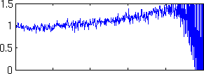

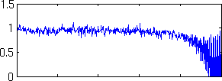

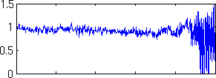

Performance Measures
Amplitude Response (AR) Position Error (PE)
GREIT NOSER Backproj

Slide 9
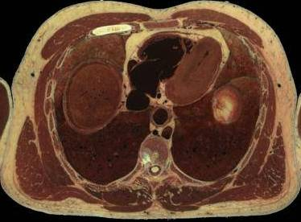
GREIT Variants
Body shape
Lung
conductivity
Fat thickness
Image from 6-7th intercostal
space: male visual human
How important?
How many models?

Slide 10
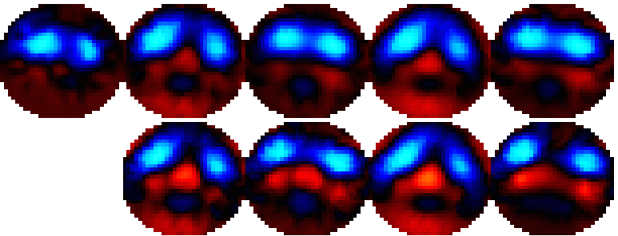
Example: reference conductivity
Backproj
GREIT
Lung σ
% of other
tissue
100%
30%
3D model
2D model
Normalized
Difference
Lung injured piglet at 10cmH₂O. Data from Frerichs et al (2003)

Slide 11
“Roadmap”
Step 1: Agree on “ingredients” and “requirements”
Step 2: Develop an algorithm framework
  Physiol. Meas. 30:S35-S55, 2009
Step 3: Distribute tools
  Publish software (EIDORS 3.4)
  Analysis tools (including online)
Step 4: Validate
  Experience using GREIT
  Systematic evaluation with “real” data
June 09
Oct. 09

Slide 12
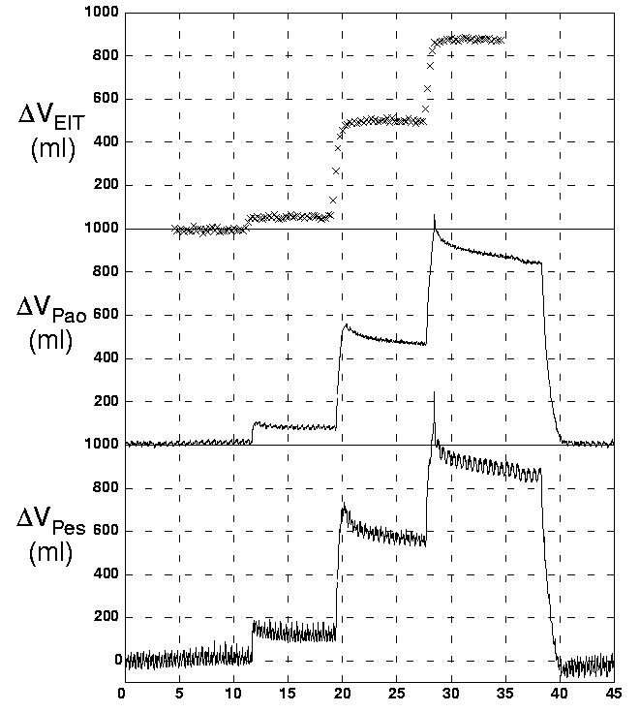
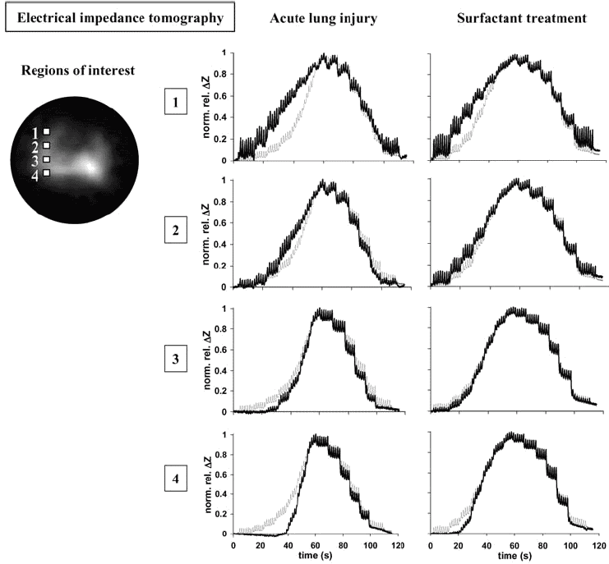
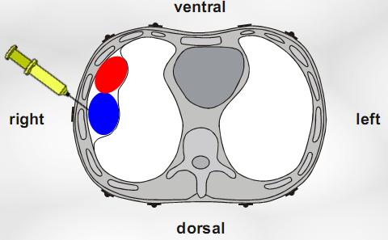
Calibrated animal tests
Adler et al (1996)
Frerichs et al (2003)
Hahn et al (2006)
To Do: Design tests
based on these data
Notes:
7

Slide 13
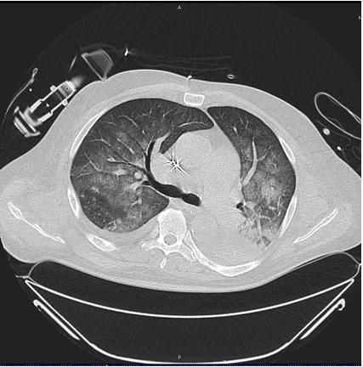
Clinical data
Patient data male 59 yrs 188 cm 120 kg
Current diagnosis Sepsis with acute lung injury Acute renal failure (continuous dialysis) Atelectasis left lower lung lobe
Medical history Implantation of cardiac pacemaker Arterial hypertension
EIT measurements performed in the ICU
Mode Continuous positive airway pressure ventilation with assisted spontaneous breathing (CPAP/ASB)
F_{I}O₂ 0.5 PEEP 9 cmH2O Frequency 25 breaths/min Minute ventilation 15.1 l/min
During the EIT measurement of 180 s duration approx. after 60 s PEEP was reduced from 9 to 5 cmH2O and after 120 s increased to 13 cmH2O.
P_{peak} 20 cmH₂O P_{mean} 13 cmH₂O at PEEP 9 cmH₂O SO₂ 97 %
P_{peak} 16 cmH₂O P_{mean} 9 cmH₂O at PEEP 5 cmH₂O SO₂ 92 %
P_{peak} 24 cmH₂O P_{mean} 16 cmH₂O at PEEP13 cmH₂O SO₂ 97 %
To Do: Design tests
based on these and other clinical data

