Slide 1

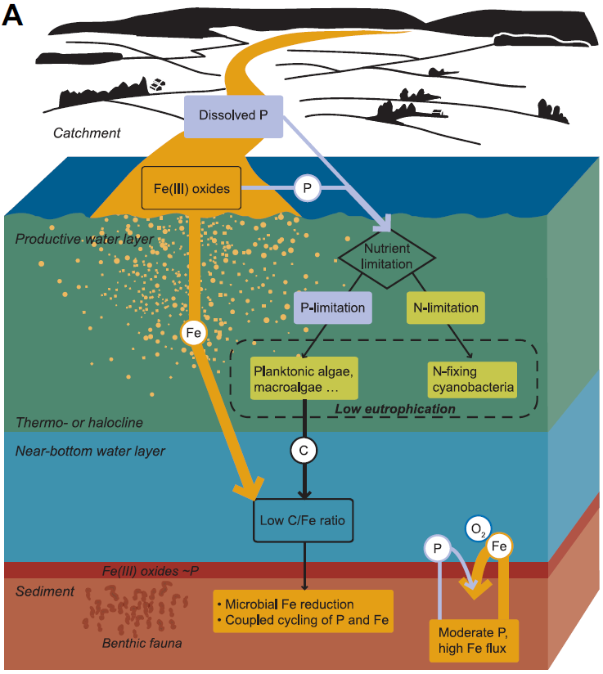
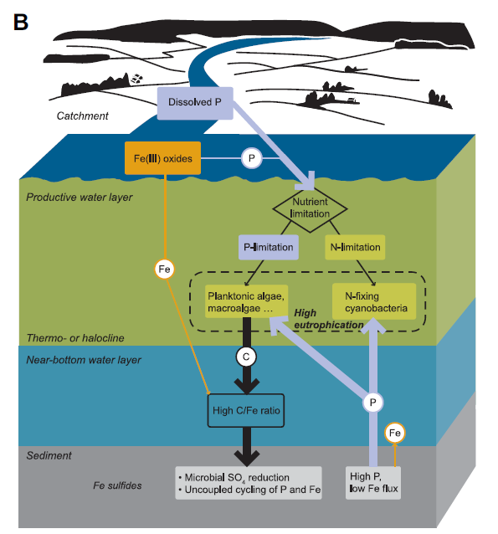
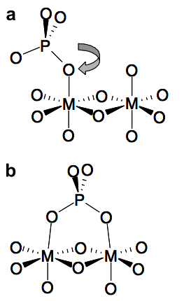
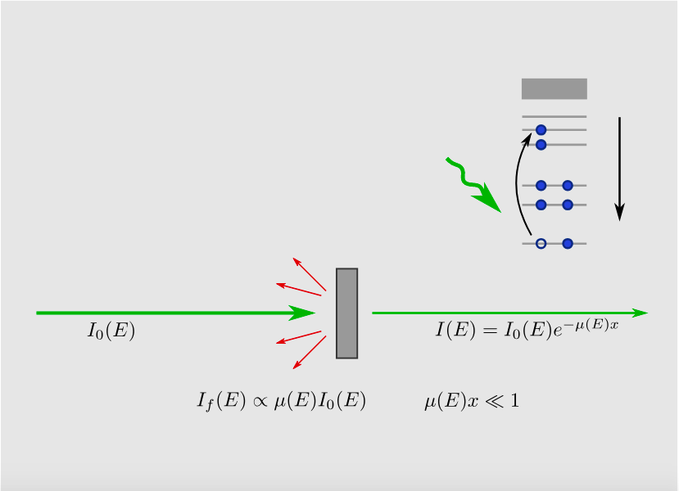
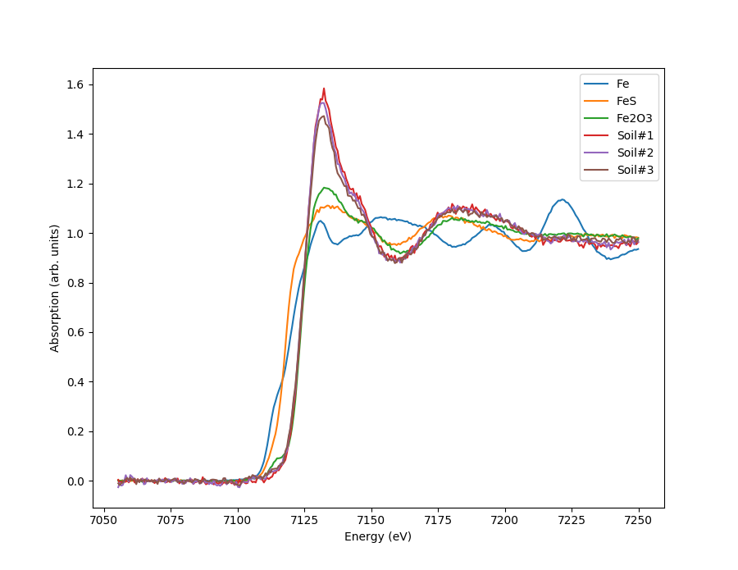
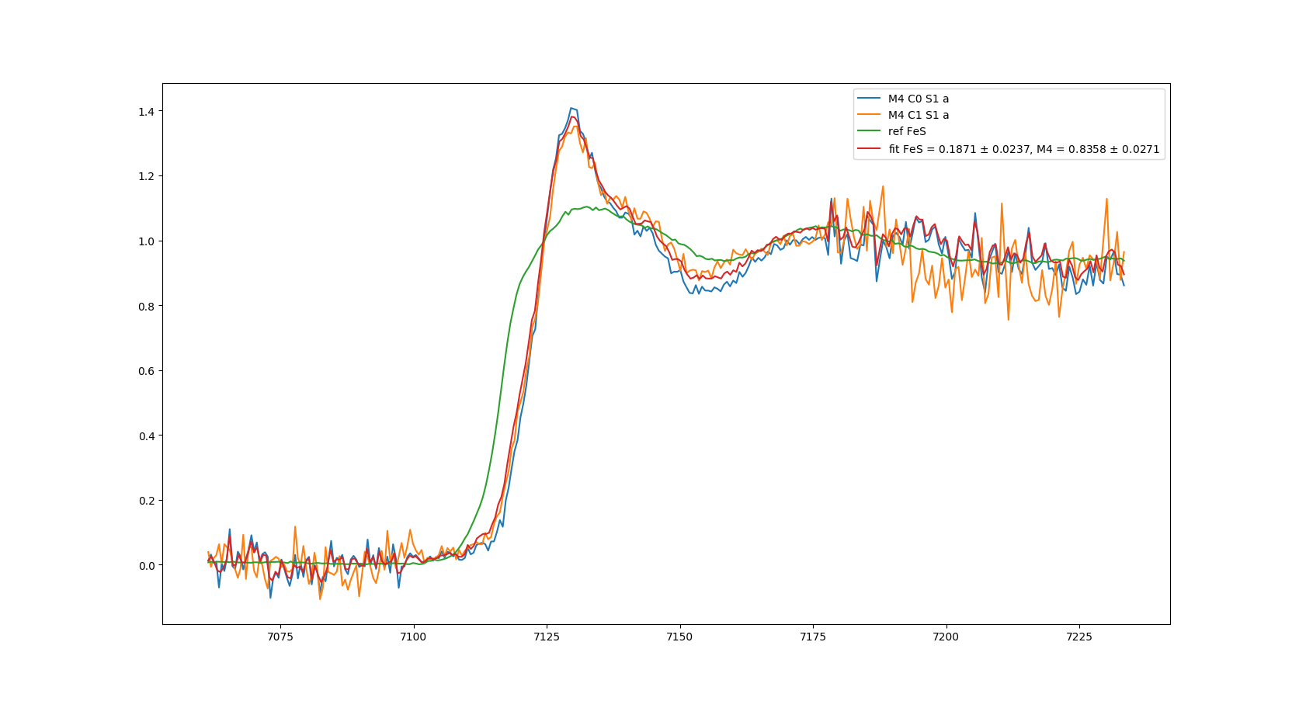
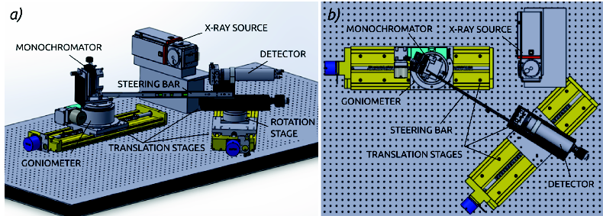
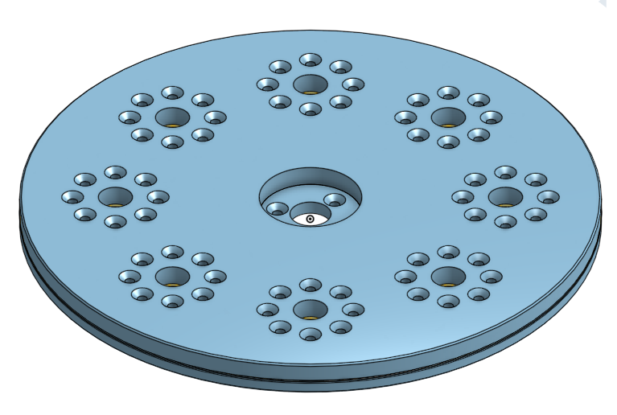
THE CHEMICAL PATH OF FIELD SOIL FORM FIELD TO THE BOTTOM SEDIMENT WITH K-EDGE XANES
Antti-Jussi Kallioª, Simo Huotariª, Petri Ekholm^{b}, Jouni Lehtoranta^{b}
a Department of Physics, University of Helsinki, Finland b Finnish Environmental Institute
Eutrophication is a global challenge, where chemical processes in bottom sediments play a key role. Yet, eutrophication science lacks understanding of the role of terrestrial matter on the processes that mobilize or immobilize phosphorus, a central algal nutrient, in sediments. During burial the sediment microbial processes change the redox-conditions which affect the chemistry of settled soil.
Here, methods were developed to follow the evolution of the chemical state of soil during burial with iron K-edge X-ray absorption near edge spectroscopy, with a novel home laboratory-based spectrometer. The chemical state of the sediment, and especially the chemistry of iron is linked to the release and binding of phosphorus in the bottom sediments.
ABSTRACT
OUTLINE OF EUTROPHICATION: CHEMISTRY OF IRON IS LINKED TO THE RELEASE AND BINDING OF PHOSPHORUS
Much of the phosphorus (P) from erosive soils is transported to water bodies together with eroded soil. Aquatic Microbiology has revealed that the cycling of P is coupled with common electron acceptors, Fe oxides and SO4, through mineralization in sediments. Eroded soil is rich in Fe oxides, and their effect on the coupled cycling of C, Fe, S and P, has been neglected in eutrophication control guidelines.
In sediments Fe oxides are reduced by two mechanisms:
(1) via microbial dissimilatory Fe reduction, in which microbes use the oxides as terminal electron acceptors
(2) chemically by sulfides (H2S, HS-) formed in microbial SO4 reduction.
Fe reduction is able to bind P, where as SO4 redection will bind S, resulting in release of P into the surrounding water.
The erosion control measures affect the incoming flux Fe and P, and the following out line is the basis of our research:
If estuary receives high amount of Fe oxides and a modest level of dissolved P, we can expect moderate level of eutrophication. This results in low C/Fe ratio in the settling flux, and with aerobic conditions, is ideal for microbial Fe reduction.
When erosion control measures are applied the near bottom water layer has high C/Fe ratio, and combined with anaerobic conditions, the microbial SO4 reduction is expected to take place, resulting in release of phosphorus.
X-RAY ABSORPTION NEAR EDGE SPECTROSCOPY:
TOOL TO FOLLOW THE EVOLUTION OF CHEMICAL STATE
MEASUREMENTS OF VARIOUS SOILS:
THE RELEASE OF PHOSPHORUS WAS HIGHER IN ANAEROBIC CONDITIONS
X-ray Absorption
In a XAS measurement the basic physical quantity to measure is the x-ray absorption coefficient μ(E), which describes the probability for x-rays to be absorbed as a function of the photon energy. Typically μ(E) decreases smoothly as energy is increases. However there are sudden jumps in the absorption cross-section at certain energies. These jumps are characteristic to the elements and they occur when the x-ray photon has an equal energy to that of the binding energy of a core-level electron, and they are called absorption edges.
Measurements were done with a novel laboratory scale X-ray absorption spectrometer found in X-ray Laboratory of University of Helsinki.
The instrument is designed for XAS studies in the 5-20 keV range which covers most K edges of 3d transition metals L edges of 5d transition metals and actinides. Measurements can be performed in transmission, fluorescence, and imaging modes.
Due to instruments simple and modular design it can be upgraded with additional components and complex sample environments can be used.
The chemical path of field soil was simulated with chemical incubations, where soil was mixed with sea water and carbon and/or sulfate was added to match various conditions faces in sea bottom
We used five different soils in our measurements. First the dry soil samples were measured. Their spectra were similar to each other, and they mainly consist of iron(III)hydroxides.
The XANES portion of the spectra is typically within 30 eV of the main absorption edge and the spectra is essentially a chemical fingerprint.
After 24 hours of incubation the spectra was measured again. As expected there were no changes in the chemical state
After two months were started to see changes. The sulfate and addition of organic carbon enhanced the formation of iron sulfides, causing iron bound phosphorus to be released to water. As expected the release of phosphorus was higher in anaerobic conditions than in aerobic conditions. The addition of organic carbon and sulfate enhanced the formation of iron sulfides, causing iron bound phosphorus to be released to the aquatic system.
For our measurements we designed a new sample environment for anaerobic measurements. It consists of two disks with 8 slots, Kaptan® windows and rubber seals. The sample holder was motorized in order to automate the measurements of larger sample sets.
XAS measurements require uniform and homogeneous samples. In order to answer these requirements, we developed a method to make a gel out of our soil-water-mixes with agar agar. The sample preparation was done both in aerobic and anaerobic conditions.
A set of reference samples of known Fe compounds was measured to help identify the iron species in our samples, and they were also used to quantify the changes of chemical state.
The results shed light on iron chemistry in anoxic sediments, which can be used in management of eutrophication. The measurement method can also be used to measure much larger set of various soils in many diffirent water types to form even better picture of chemical processes in bottom sediments.
REFERENCES:
[1] A.-P. Honkanen, S. Ollikkala, T. Ahopelto, A.-J. Kallio, M. Blomberg, S. Huotari, Johann-type laboratory-scale X-ray absorption spectrometer with versatile detection modes, arXiv:1812.01075, December 2018
[2] P. Ekholm, J. Lehtoranta, Does control of soil erosion inhibit aquatic eutrophication?, Journal of Environmental Management 93:140-6, January 2012
HELSINGIN YLIOPISTO MATEMAATTIS-LUONNONTIETEELLINEN TIEDEKUNTA HELSINGFORS UNIVERSITET MATEMATISK-NATURVETENSKAPLIGA FAKULTETEN UNIVERSITY OF HELSINKI FACULTY OF SCIENCE

