Slide 1

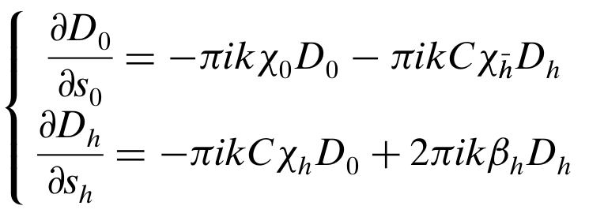


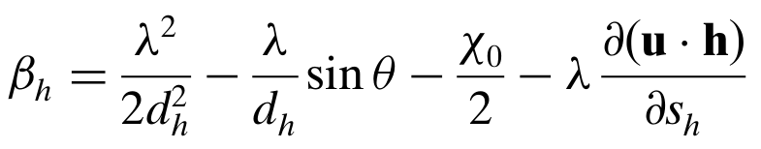

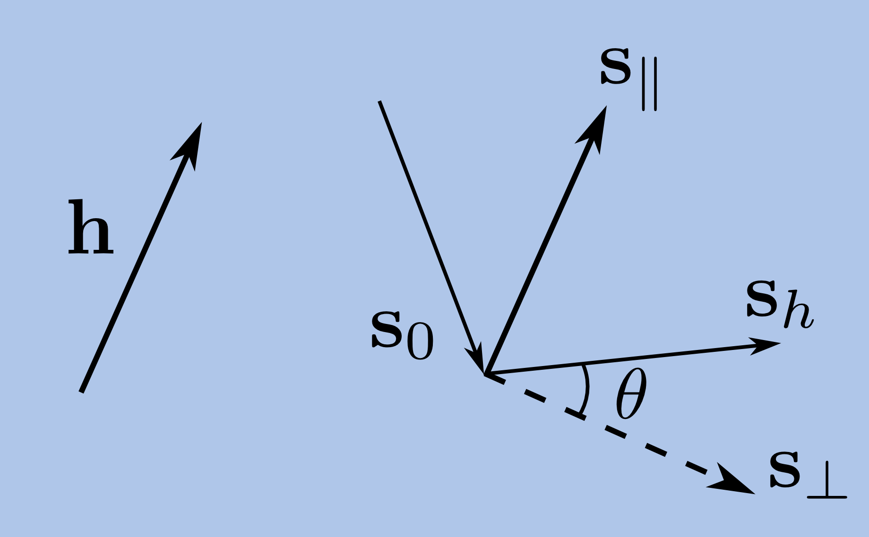

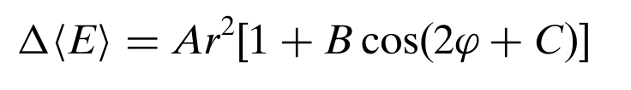
COMPUTATIONALLY EFFICIENT METHOD TO PREDICT
DIFFRACTION CURVES OF LARGE BENT CRYSTALS
Ari-Pekka Honkanenª, Roberto Verbeni^{b}, Laura Simonelli^{c,b}, Marco Moretti Sala^{b},
Ali Al-Zein^{d,b}, Michael Krisch^{b}, Giulio Monaco^{e,b} and Simo Huotariª
a Department of Physics, University of Helsinki, Finland b ESRF – The European Synchrotron, Grenoble, France
c ALBA, Cerdanyola del Vallès, Spain d Beirut Arab University, Lebanon e Physics Department, University of Trento, Italy
Crystal optics form the basis for most of the modern high energy resolution X-ray spectrometers in the hard X-ray regime. The diffraction of X-rays by deformed crystals is described by the Takagi-Taupin equations whose numerical solving for a large crystal poses a computational challenge.
ABSTRACT
We present the theoretical foundation for an approximative method to solve the diffraction curve of a large, deformed crystal in the presence of a slowly varying component of the strain field. Such a component often arises due to the bending or thermal deformation of the crystal.
The method is demostrated to accurately predict the reflectivity curves of spherically bent Johann type analyser crystals. In addition, a measurement/data-analysis scheme is presented to improve the energy resolution of such crystals.
TAKAGI-TAUPIN THEORY: CONSTANT STRAIN DOES NOT ALTER THE SHAPE OF THE DIFFRACTION CURVE
In the usual two-beam case, the amplitudes D₀ and D_{h} of the incident and the diffracted waves, respectively, are described by the partial differential equations
Turns out that if u·h contains a term that is approximately linear in terms of s_{h} , i.e. the strain field has a constant term in it, we can find constant shifts δλ or δθ to the wavelength or incidence angle of the beam, respectively, in order to negate the change in β_{h} in the first-order.
This means that the solution to TT-equations in the presence of a constant strain component is the same as without it but with replacing λ → λ + δλ or θ → θ + δθ, where
where k is the wave number of the radiation, s₀ and s_{h} are the directions of the incident and diffracted beams, respectively, χ_{k} are Fourier components of susceptivity, and C is the polarization factor. The deviation from the Bragg angle θ_{B} is accounted in
The strain components are defined as:
The validity of the derived shifts were tested by solving the TT-equations numerically with a Python code for Si(660) for constant strains up to 0.001. Apart from near-backscattering conditions where expression for δθ ceases to be valid, the simulated diffraction curves look the same as for zero-strain case but with shifted λ and θ, which agree well with the derived expressions.
where λ is the wavelength of the radiation, d_{h} is the separation of the Bragg planes, θ is the angle of incidence and u·h is the dot product of the displacement and the reciprocal vectors.
Theory also predicts small, in most cases negligible changes in the widths of the diffraction curves.
DIFFRACTION CURVE OF A LARGE CRYSTAL:
THE CASE OF THE SPHERICALLY BENT ANALYSER
IMPROVING THE ENERGY RESOLUTION:
PIXELWISE COMPENSATION
The diffraction curve of a large crystal can be calculated using the derived result if the strain field of the crystal can be separated into two components:
a) depth-dependent component that can vary rapidly in terms of the extinction length, and
b) a laterally slowly varying component.
The invariability of the shape of the diffraction curve due to the slowly varying strain component allows us to compenstate its effect to the overall resolution function of the crystal.
By measuring the different areas of the crystal separately, we obtain a number of diffraction curves that are of the same shape but at slightly different centroid λ or θ. The centroids of the individual curves can be computed and corrected for. Therefore it is possible to compensate the effect of the slowly varying strain component and improve the overall λ or θ resolution without an intensity loss.
If such a division can be made then the curve can be obtained with the following procedure:
I) Solve the 1D Takagi-Taupin equation for the depth-dependent strain component
II) Divide the crystal surface into a dense grid
III) For each grid point, compute the shift in λ or θ due to the slowly varying strain
IV) Apply these shifts to the solved depth-dependent curve at each point
V) Obtain the curve of the whole crystal by summing up the shifted curves assigned to the grid points
With a Johann-type spectrometer utilizing spherically bent analyser crystals, such a measurement can be performed with a position sensitive detector e.g. Maxipix.
By moving the detector off focus, each pixel records the spectrum only over a small part of the surface. From elastic line measurment, the spectral shifts can be determined and they can be compensated pixelwise in order to achieve better energy resolution.
As shown on the left, when a flat wafer is bent on a spherical surface, an arbitrary circle with the radius l has to shorten down to l'. Therefore also its circumference has to change from 2πl to 2πl'. It can be shown that this angular compression causes a slowly varying strain component, that locally shifts the energy of the diffraction curve by
where constants A, B, and C depend on the elastic parameters of the crystal anisotropically.
On the right are shown reflectivity curves of three different Si(660) analysers produced and tested at the former ESRF beamline ID16. Three sets of curves correspond to measurement with full surface (100 mm diameter) and and two lead masks (60 and 30 mm apertures).
The theoretical calculations of the resolution functions reproduce the experimental results accurately. Also Si(533) analysers were tested with similar precision.
The method was tested at the ESRF beamline ID20 by measuring non-resonant inelastic X-ray scattering spectrum of non-dipolar 4d → 4f transitions of La³⁺ ion in LaPO₄. Two Si(660) analysers were used.
Applying the pixelwise compensation improved the energy resolution of the analyser from 1.0 eV to 0.46 eV determined from quasielastic line (not shown). The La spectra showed a bit less of an improvement to 0.65 eV which indicates that the natural linewidth of the sample was of the same order as the gained resolution.
HELSINGIN YLIOPISTO MATEMAATTIS-LUONNONTIETEELLINEN TIEDEKUNTA HELSINGFORS UNIVERSITET MATEMATISK-NATURVETENSKAPLIGA FAKULTETEN UNIVERSITY OF HELSINKI FACULTY OF SCIENCE

