Slide 1
TEI for Manuscript Description
Huw Jones, Cambridge University Library
5th July 2017

Slide 2
<msDesc> is a module for ‘description of a single identifiable manuscript or other text-bearing object’
It (usually) goes in the <teiHeader>

Slide 3
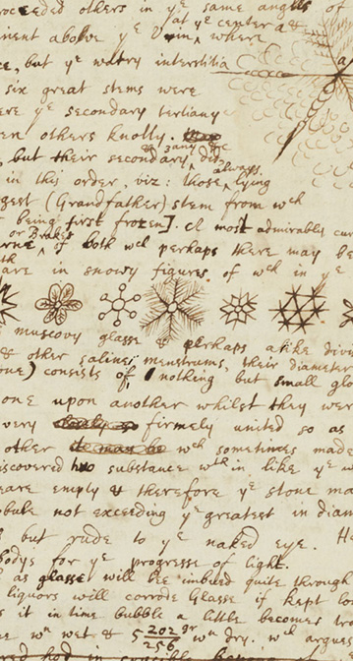
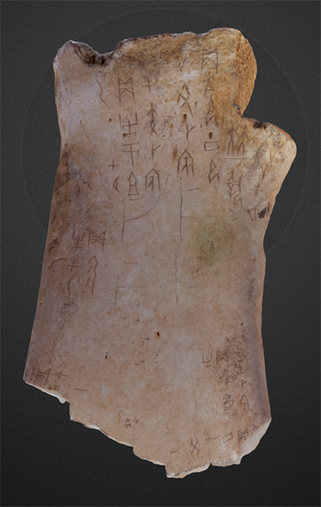
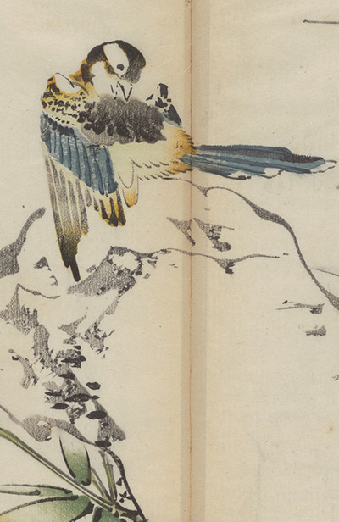

Slide 4
Background
Introduced in TEI P5 (2007)
Developed from MASTER (1999-2001) and TEI Medieval Manuscript Description Work Group (1998-2000)
All the history: M. J. Driscoll, ‘P5-MS: A general purpose tagset for manuscript description’, Digital Medievalist 2 (2006) http://journal.digitalmedievalist.org/articles/10.16995/dm.12/

Slide 5
A range of possibilities
Lewis-Gibson L-G Misc. 117
https://cudl.lib.cam.ac.uk/view/MS-LG-MISC-00117/1
Equatorie of the Planetis
https://cudl.lib.cam.ac.uk/view/MS-PETERHOUSE-00075-00001/12

Slide 6
Very widely used
  Digital Walters
  e-codices
  Parker Library
  Manuscriptorium
  Fihrist
  Digital Bodleian
  Cambridge Digital Library

Slide 7
Used by …
Libraries and other heritage institutions to create catalogues of manuscript holdings, often with digital images
Academics to publish research on manuscripts, and/or to create datasets of manuscript descriptions to answer their research questions e.g. Casebooks
Increasingly, the basis of collaborative projects between researchers and libraries

Slide 8
Work in progress …
Mainly developed for Western manuscripts – need manuscript scholars of other traditions to contribute back to the TEI
  Fihrist – Arabic
  Sanskrit
  Genizah
TEI community open to new developments – e.g. <msFrag>

Slide 9
Other standards are available
MARC, EAD
Geared towards archival material and printed books, and towards catalogues/finding aids
Not sophisticated enough to record detailed information produced by manuscript scholars
<msDesc> as the basis of collaborative work between researchers, librarians, archivists
The problem of home-grown metadata

Slide 10
Points of discussion
Retro conversion vs creation of new records
Research questions and markup, display vs analysis
Different approaches, different possibilities – e.g. examples at: http://www.tei-c.org/release/doc/tei-p5-doc/en/html/MS.html#msov
What decisions need to be made when deciding what to mark up?
The TEI record as an evolving, collaborative document
Flexibility vs interoperability – development of ODDs to manage differences in practice

Slide 11
New to manuscript description?
Matthew Holford, “Reading a manuscript description”, Teaching the Codex (2017) https://teachingthecodex.wordpress.com/2017/04/08/reading-a-manuscript-description/

Slide 12
<msDesc> - the basics
Lives within <sourceDesc>
6 main structural elements
  <msIdentifier>
  <head>
  <msContents>
  <physDesc>
  <history>
  <additional>
Only <msIdentifier> is compulsory

Slide 13
<msDesc> - the basics
Additional phrase-level elements:
  <catchwords>
  <dimensions>
  <heraldry>
  <locus>
  <locusGrp>
  <material>
  <watermark>
  <objectType>
  <origDate>
  <origPlace>
  <secFol>
  <signatures>

Slide 14
Structural vs Phrase-level elements
<physDesc>
<handDesc>
<handNote scope="major">
<p>Written in <term>Gothic textualis</term></p>
</handNote>
</handDesc>
<bindingDesc>
<p><material>Alum-tawed goatskin</material> dyed red with Brazil wood over oak boards sewn on four supports. </p>
</bindingDesc>
</physDesc>

Slide 15
<msDesc>
  <msIdentifier>
  <head>
  <msContents>
  <physDesc>
  <history>
  <additional>
</msDesc>

Slide 16
<msIdentifier>
Uniquely identifying the manuscript

Slide 17
<msIdentifier>
<repository>Cambridge University Library</repository>
<idno>FH.910.83-98</idno>
</msIdentifier>
The only compulsory element!

Slide 18
<msIdentifier>
<region type="county">Cambridgeshire</region>
<institution>Cambridge University</institution>
<repository>Cambridge University Library</repository>
<idno>FH.910.83-98</idno>
<altIdentifier type=“previous”>
<idno>MS Add.2565</idno>
</altIdentifier>
</msIdentifier>
NB. When identifying the manuscript, expect the record to be used outside your own systems

Slide 19
Examples
Isaac Newton, Trinity College Notebook
https://cudl.lib.cam.ac.uk/view/MS-ADD-03996/3
Moore Psalter
https://cudl.lib.cam.ac.uk/view/MS-EE-00004-00024/3

Slide 20
<msDesc>
  <msIdentifier>
  <head>
  <msContents>
  <physDesc>
  <history>
  <additional>
</msDesc>

Slide 21
<head>
General heading information for the manuscript as a whole, e.g. overall title etc.

Slide 22
<head>
<title>The Breviary of Marie de Saint Pol</title>
</head>
NB. Useful for general titles of composite manuscripts

Slide 23
<msDesc>
  <msIdentifier>
  <head>
  <msContents>
  <physDesc>
  <history>
  <additional>
</msDesc>

Slide 24
<msContents>
The intellectual content of the manuscript
Textual stuff
Where titles, rubrics, incipits, authors, editors go

Slide 25
<msContents>
<summary>
<!--prose description of the whole ms-->
</summary>
<msItem>
<!-- the whole manuscript-->
<!--the contents of the manuscript (if present)-->
<msItem></msItem>
<msItem></msItem>
<msItem></msItem>
</msItem>
</msContents>

Slide 26
<summary>A fourteenth-century English <hi rend=“italic”>Book of Hours</hi>, according to the Sarum Rite, stunningly illustrated with several full-page saints' portraits opening the work and the main text accompanied by a dazzling flurry of borders, marginalia and initials. Some saints' names featuring in the calendar with which the book opens suggest that it may have been originally produced according to practice local to the East Midlands, perhaps Lincoln, but the additions made to the calendar very early on in its life locate it firmly in East Anglia, and particularly, perhaps, around Ely and Huntingdon. The names of owners, Alice de Reydon, and John and Matilda Stranle, with their birth and death dates added alongside those saints, tell a story of continual spiritual practice and personal devotion as it passed from hand to hand.</summary>

Slide 27
<msItem>
<msItem>
<title>Book of Hours (Sarum Use)</title>
<textLang mainLang="lat">Latin</textLang>
<msItem>
    <locus from="13r" to="18v">13r-18v</locus>
    <title>Calendar</title>
    <rubric>Pridies mensis autem VII truncat ut ensis</rubric>
    <incipit>Circumcisio Domini</incipit>
    <explicit>Sancti Siluestri</explicit>
</msItem>
<msItem>
<!-- second item in contents -->
</msItem>
</msItem>

Slide 28
Examples
Book of Hours (Sarum use)
https://cudl.lib.cam.ac.uk/view/MS-DD-00004-00017/12
Red Book of Thorney
https://cudl.lib.cam.ac.uk/view/MS-ADD-03020/17

Slide 29
<msDesc>
  <msIdentifier>
  <head>
  <msContents>
  <physDesc>
  <history>
  <additional>
</msDesc>

Slide 30
<physDesc>
Physical description of the manuscript - codicology

Slide 31
<physDesc>
<objectDesc>
<handDesc>
<decoDesc>
<bindingDesc>
<sealDesc>
<accMat>
</physDesc>

Slide 32
<objectDesc form="codex">
<supportDesc material="paper">
<support>Paper</support>
<extent>244 ff.
    <dimensions type="leaf" unit="cm">
      <height>35</height>
      <width>24</width>
    </dimensions>
</extent>
</supportDesc>
<layoutDesc>
<layout columns="1" writtenLines="17">17 lines to the page</layout>
</layoutDesc>
<collation><!-- see over --></collation>
<foliation>Foliated in the upper right corner of each recto in pencil</foliation>
</objectDesc>

Slide 33
<collation>
<p>The MS consists of 5 quires as follows:
<list>
<item>4 modern paper flyleaves</item>
<item>Quire 1<hi rend="superscript">6</hi> (fols. 1-3 in the order 6, 2, 5; leaves 1, 3, and 4 are missing)</item>
<item>Quire 2<hi rend="superscript">2</hi> (fols. 4-5)</item>
<item>Quire 3<hi rend="superscript">12</hi>(fols. 6-7)</item>
<item>Quire 4<hi rend="superscript">12</hi>(fols. 18-29)</item>
<item>Quire 5<hi rend="superscript">10</hi>(fols. 30-39; 39 is a stub)</item>
<item>4 modern paper flyleaves</item>
</list>
</p>
</collation>
NB. Can be done with <formula> but fewer options to structure the content

Slide 34
Examples
The cosmography of Qazwini
https://cudl.lib.cam.ac.uk/view/MS-NN-00003-00074/458
Cambridge Juvencus
https://cudl.lib.cam.ac.uk/view/MS-FF-00004-00042/53

Slide 35
<physDesc>
<objectDesc>
<handDesc>
<decoDesc>
<bindingDesc>
<sealDesc>
<accMat>
</physDesc>

Slide 36
<handDesc>
<handNote scope="sole" script="nepālākṣarā" medium="goldenink">Nepālākṣarā in golden ink.
</handNote>
</handDesc>

Slide 37
Example
Kalāpustaka
https://cudl.lib.cam.ac.uk/view/MS-ADD-00864/132

Slide 38
<physDesc>
<objectDesc>
<handDesc>
<decoDesc>
<bindingDesc>
<sealDesc>
<accMat>
</physDesc>

Slide 39
<decoDesc>
<decoNote type="miniature">Full-page miniatures: tinted in yellow and
orange (now much darkened), and framed by bars, often filled with
geometric patterns and interlace:
<list>
<item>Four figures, lower two with
satchels, arranged around cross with star/flower in circle at
intersection (<locus from="1v" to="1v">1v</locus>)</item>
<item>Bearded, seated
figure (head partially effaced by staining) holding sword and
flanked by two small figures (<locus from="4v" to="4v">4v</locus>)</item>
<!-- etc -->
</list>
</decoNote>
<decoNote type="initial">Ornamental and minor initials: initials (2-5
lines) formed of black interlocking stripes, with geometric infill,
tinted in yellow and orange, and human and animal heads projecting
from finials
</decoNote>
</decoDesc>

Slide 40
Example
Book of Deer
https://cudl.lib.cam.ac.uk/view/MS-II-00006-00032/103

Slide 41
<physDesc>
<objectDesc>
<handDesc>
<decoDesc>
<bindingDesc>
<sealDesc>
<accMat>
</physDesc>

Slide 42
<bindingDesc>
<p>Seventeenth-century limp <material>parchment</material>
wrapper, from an old legal document, very worn and stained</p>
</bindingDesc>
NB. Can use multiple <binding> elements for multiple bindings

Slide 43
Examples
Lund Library Catalogue
https://cudl.lib.cam.ac.uk/view/MS-ADD-10139/2
Isaac Newton’s ‘Waste Book’
https://cudl.lib.cam.ac.uk/view/MS-ADD-04004/1

Slide 44
<physDesc>
<objectDesc>
<handDesc>
<decoDesc>
<bindingDesc>
<sealDesc>
<accMat>
</physDesc>

Slide 45
<sealDesc>
<seal type="pendant" contemporary="true">
<p>Bears a Great Seal (incomplete and repaired) on silk strings</p>
</seal>
</sealDesc>

Slide 46
Example
Charter of Edward I confirming the privileges of the University of Cambridge
https://cudl.lib.cam.ac.uk/view/MS-UA-LUARD-00007-AST/1

Slide 47
<physDesc>
<objectDesc>
<handDesc>
<decoDesc>
<bindingDesc>
<sealDesc>
<accMat>
</physDesc>

Slide 48
<accMat>
Enclosed inside a small wooden pagoda
</accMat>

Slide 49
Example
Hyakumantō darani
https://cudl.lib.cam.ac.uk/view/PR-FG-00870/1

Slide 50
<msDesc>
  <msIdentifier>
  <head>
  <msContents>
  <physDesc>
  <history>
  <additional>
</msDesc>

Slide 51
<history>
Where it comes from, where it’s been, and how it ended up here

Slide 52
<history>
<origin>
<origDate></origDate>
<origPlace></origPlace>
</origin>
<provenance></provenance>
<acquisition></acquisition>
</history>

Slide 53
<origin>
<origDate calendar="Gregorian" when="1775">ca 1775</origDate>
<origPlace>London</origPlace>
</origin>
<origin>
<p>Probably copied in the <origDate calendar="Gregorian" notBefore="1100" notAfter="1199">12th century</origDate> in <origPlace>London</origPlace></p>
</origin>

Slide 54
Example
A correct globe with the new discoveries
https://cudl.lib.cam.ac.uk/view/MS-ORCS-00001-00001/1

Slide 55
<provenance>The exact movements of Samuel Ward's papers after his death has not yet been ascertained with complete certainty. The following, tentative summary of their provenance is drawn from Margo Todd's 1985 article; MS Ward B may well have followed this route into the archives at Sidney Sussex College, though as yet we lack definitive proof.</provenance>
<provenance>In his will, Ward instructed that, 'for the ordering of my study and the disposal of my notes, papers, manuscripts and all my writings, I do wholly entrust <name type="person" ref="http://viaf.org/viaf/23226169" subtype="fmo">Raph Bishop of Exeter</name> now Master of Catherine Hall with them.'</provenance>

Slide 56
Example
Samuel Ward Notebook
https://cudl.lib.cam.ac.uk/view/MS-WARD-B/5

Slide 57
<msDesc>
  <msIdentifier>
  <head>
  <msContents>
  <physDesc>
  <history>
  <additional>
</msDesc>

Slide 58
<additional>
All the other stuff … admin, bibliography, availability

Slide 59
<additional>
<adminInfo>
<recordHist></recordHist>
<availability></availability>
<custodialHist></custodialHist>
</adminInfo>
<surrogates></surrogates>
<listBibl></listBibl>
</additional>

Slide 60
<adminInfo>
<recordHist>
<source>This catalogue entry draws on the introduction to the facsimile volume of <hi rend="italic">The Moore Bede</hi> by Peter Hunter Blair (Copenhagen: Rosenkilde and Bagger, 1959) and an article by Jayne Ringrose 'The Royal Library: Moore and his Books', in <hi rend="italic"> Cambridge University Library: The Great Collections</hi> (Cambridge, 1998), edited by Peter Fox</source>
</recordHist>
<availability status="restricted">
<p>Entry to read in the Library is permitted only on presentation of a valid reader's card for admissions procedures contact <ref target="http://www.lib.cam.ac.uk/cgi-bin/eligibility.cgi/">Cambridge University Library Admissions</ref>). Contact the Manuscripts Department for further information on the availability of this manuscript.</p>
</availability>
</adminInfo>

Slide 61
Example
Moore Bede
https://cudl.lib.cam.ac.uk/view/MS-KK-00005-00016/13

Slide 62
<listBibl>
<bibl>Clemente, Michela, Hildegard Diemberger and Mark Elliott (eds), <hi rend=“italic”>Buddha's Word. The Life of Books in Tibet and Beyond</hi> (Cambridge: Museum of Archaeology and Anthropology University of Cambridge, 2014).</bibl>
<bibl>Williams, Paul, <hi rend=“italic”>Mahāyāna Buddhism. The Doctrinal Foundations</hi> 2nd, Library of religious beliefs and practices (New York: Routledge, 2009). </bibl>
</listBibl>

Slide 63
Example
Prajñāpāramitāstotra
https://cudl.lib.cam.ac.uk/view/MS-ADD-01464/2

Slide 64
Other options
<msPart> - for composite manuscripts
Like having multiple <msDesc> elements in one TEI record
<msFrag> - to bring together fragments of the same manuscript
Each <msFrag> can contain a complete description of the fragment
<correspDesc> - specific elements for the description of correspondence

Slide 65
Standards and vocabularies
2/3 letter language codes
<textLang mainLang="en" otherLangs="la"> Predominantly in English with Latin glosses</textLang>
Getty Thesaurus of Geographic Names
<origPlace ref="http://vocab.getty.edu/tgn/7011984">Thorney, Cambridgeshire</origPlace>
VIAF
<name type="person" ref="http://viaf.org/viaf/23226169" subtype="fmo">Raph Bishop of Exeter</name>

