Slide 1
Chapter 7: Pipelines
Python for Data Scientists

Slide 2
Chapter Objectives
In this chapter, we will:
Explore how to use pipelines to improve performance and chain together multiple steps in the ML process

Slide 3
Chapter Concepts
Pipelines
Chapter Summary
Notes:
Highlight the topic that follows this page, and place the delta arrow next to it by moving vertically, but maintain the horizontal placement.
If there are too many topics to fit on the page, reduce the line spacing to fit.

Slide 4
Problem with Existing Techniques
Most transformation occur on one column at a time in a DataFrame
Because the data are partitioned among many nodes it means that wide operations have to shuffle around a lot of data to process that one column
Then you do a transformation on another column and the whole process starts all over again
If you have a lot of categorical columns to OneHotEncode, each one is done sequentially after the other, then you do the same thing again to scale the numeric features, and again to bundle them all up into a Vector
Pipelines allow a more elegant and efficient mechanism to chain together many transformation steps so that they can be optimized and run together in parallel instead of sequentially

Slide 5
Steps to Pipeline
Create a Python list of the steps you want to do in the order you want them done
Create a pipeline object and pass it the list of stages
Call fit and transform on the pipline object
Watch the performance improvement
As always a custom helper function makes things easier to use instead of building it from scratch each time

Slide 6
Pipeline Example
tokenizer = Tokenizer(inputCol="text", outputCol="words")
hashingTF = HashingTF(inputCol=tokenizer.getOutputCol(), outputCol="features")
lr = LogisticRegression(maxIter=10, regParam=0.001)
pipeline = Pipeline(stages=[tokenizer, hashingTF, lr])
# Fit the pipeline to training documents.
model = pipeline.fit(training)
# Prepare test documents, which are unlabeled (id, text) tuples.
# Make predictions on test documents and print columns of interest.
prediction = model.transform(test)

Slide 7
Preparing the Data
Let’s look at some data first, and use this with several different algorithms
The dataset is whether borrowers defaulted on a loan or not
Let's keep the following numerical and categorical features and try to predict whether they default yes/no
tokenizer = Tokenizer(inputCol="text", outputCol="words")
hashingTF = HashingTF(inputCol=tokenizer.getOutputCol(), outputCol="features")
lr = LogisticRegression(maxIter=10, regParam=0.001)
pipeline = Pipeline(stages=[tokenizer, hashingTF, lr])
# Fit the pipeline to training documents.
model = pipeline.fit(training)
# Prepare test documents, which are unlabeled (id, text) tuples.
test = spark.createDataFrame([
(4, "spark i j k"),
(5, "l m n"),
(6, "spark hadoop spark"),
(7, "apache hadoop")
], ["id", "text"])
# Make predictions on test documents and print columns of interest.
prediction = model.transform(test)
numeric_features = ['age','balance', 'duration', 'pdays']
categorical_features = ['job', 'marital', 'education', 'housing', 'loan', 'contact', 'campaign', 'poutcome', 'deposit']
target_label = 'default'
df = dfRawFile.select(numeric_features + categorical_features + [target_label])

Slide 8
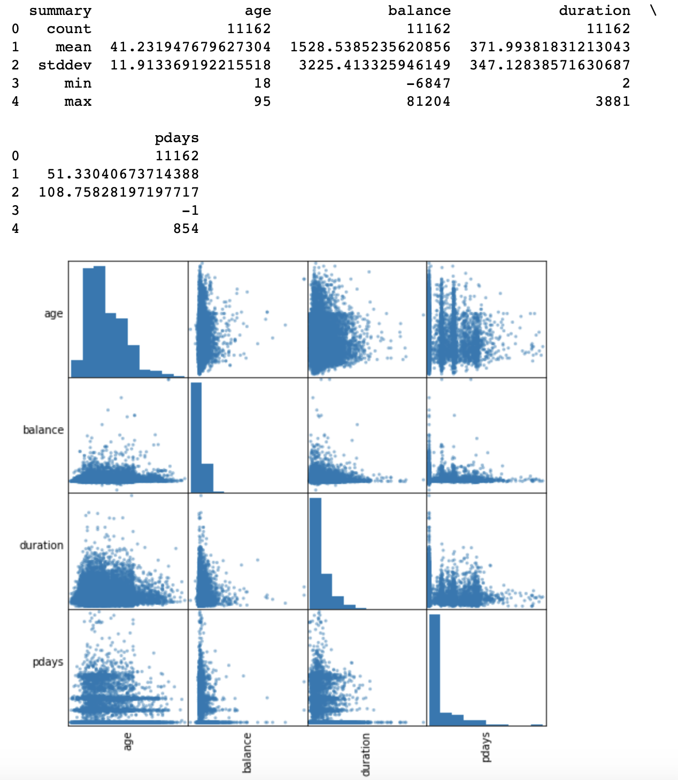
Explore Numerical Features
Scatter plots are helpful to explore the numerical data
pyh.describe_numeric_features(df, numeric_features)
pyh.scatter_matrix(df, numeric_features)

Slide 9
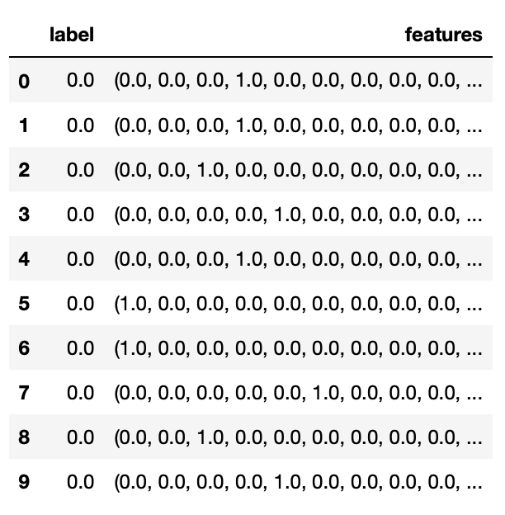
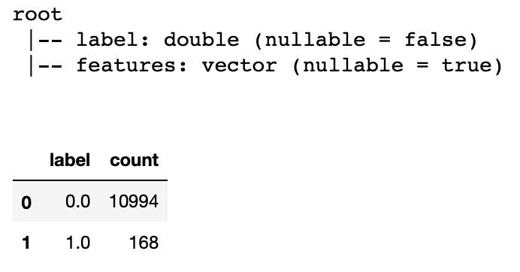
Change Categorical Column
Use the helper function we saw earlier in the regression chapter
dfML = pyh.MakeMLDataFrame(df, categorical_features, numeric_features, target_label)
display(dfML)
dfML.printSchema()
display(dfML.groupBy('label').count())

Slide 10
Saving Processed Data
If you want you can save the newly structured DataFrame for future use
libsvm is a good format choice for vectorized data
# write
dfML.write.format('libsvm').save('testsave')
# read
dfML = spark.read.format('libsvm').load('testsave')
x.printSchema()
display(x)

Slide 11
Splitting the Data
Split the data into training and testing sets using the randomSplit function
train, test = dfML.randomSplit([.7,.3], seed = 1000)
print (f'Training set row count {train.count()}')
print (f'Testing set row count {test.count()}')

Slide 12
Chapter Concepts
Classification Model
Algorithms
Chapter Summary
Notes:
Highlight the topic that follows this page, and place the delta arrow next to it by moving vertically, but maintain the horizontal placement.
If there are too many topics to fit on the page, reduce the line spacing to fit.

Slide 13
Decision Trees
Data is split up based on some factor among the independent variables, then evaluated for how good a job it did
Recursively keeps applying this algorithm over and over until it comes up with a good set of rules
Pros
It’s easy
Performs well with categorical data and continuous data
Transparency lets you see how it made its choices
Cons
Calculations take a lot longer as you add more and more columns
Becomes difficult to understand the decision tree as it gets larger

Slide 14
Apply Decision Tree
Load the module, create a model and train it
You can save the results of the trained model for future use
from pyspark.ml.classification import DecisionTreeClassifier
dt = DecisionTreeClassifier(featuresCol = 'features', \ labelCol = 'label', maxDepth = 3)
dtModel = dt.fit(train)
filename1 = filename.replace('.','_') + '_DT_trainedModel'
dtModel.write().overwrite().save(filename1)
# load a saved trained model
dtModel2 = DecisionTreeClassifier.load(filename1)

Slide 15
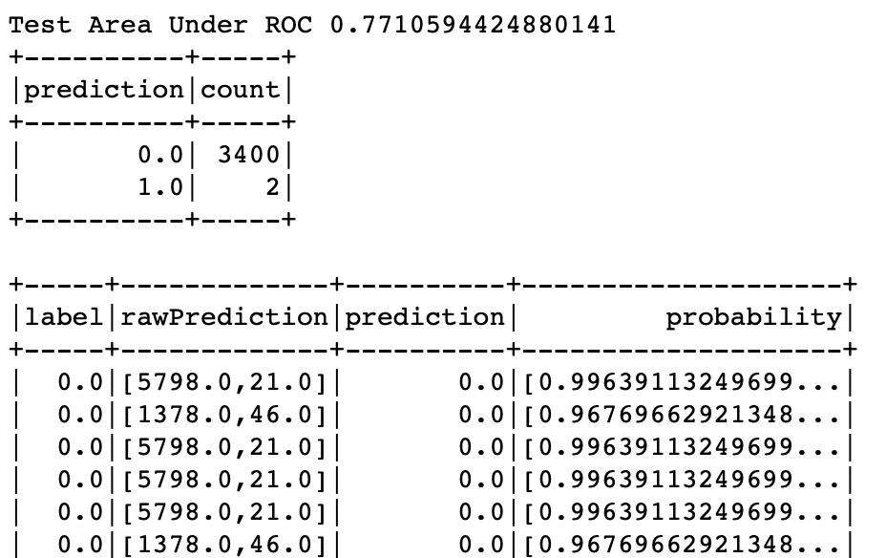
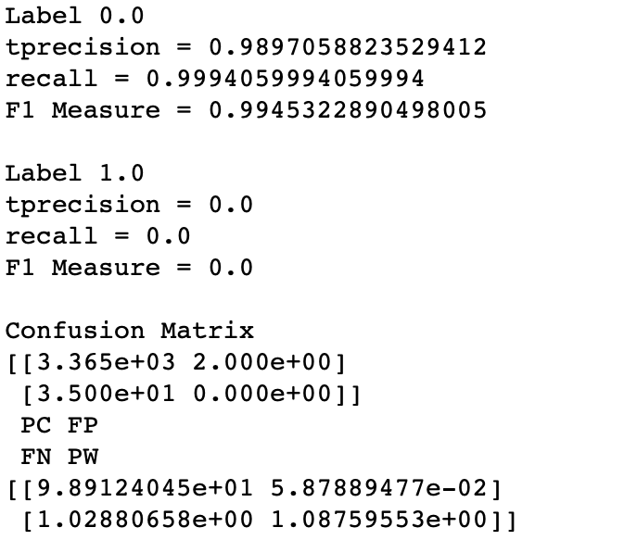
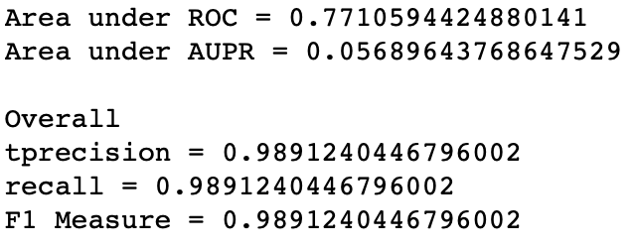
Interpret the Results
After you train the model you want to make predictions on the reserved test set and compare them to the known labels to see how well it did
predictions = model.transform(test)
There are a lot of measures to see how good of a job it did
for convenience we have wrapped them into a helper function in the pyspark_helpers package
predict_and_evaluate will return the predicted results and show how well it did
dtPredictions, dtLog = pyh.predict_and_evaluate(dtModel, test)

Slide 16
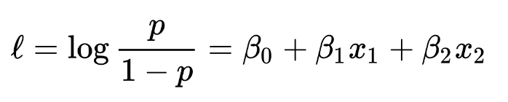
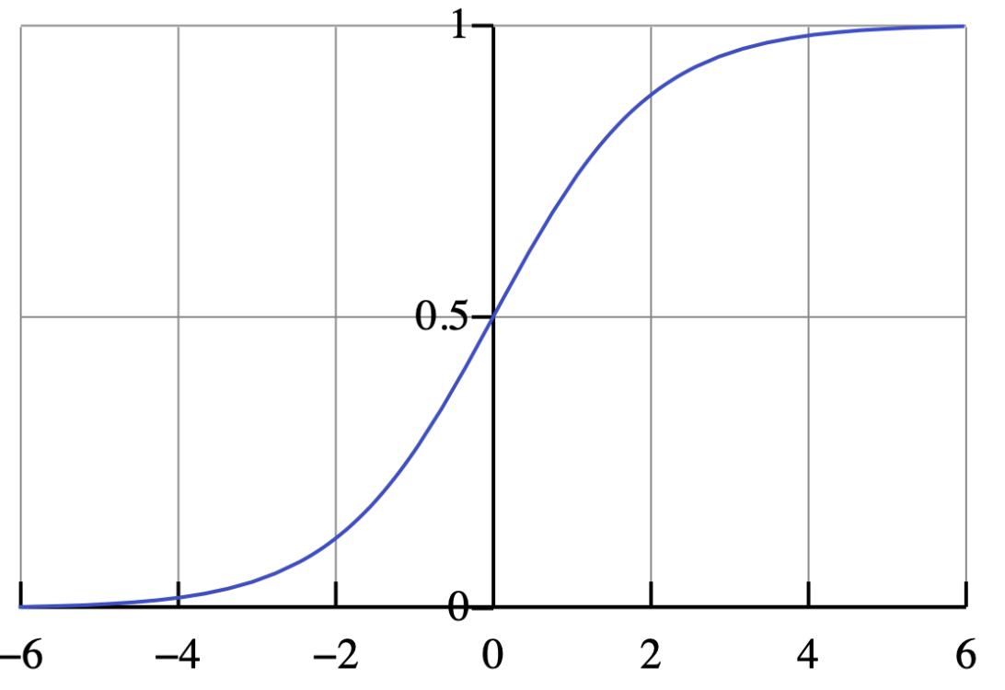
Logistic Regression
Another alternative to categorizing, but with a twist
Not only predicts a value but predicts the probability of its occurrence
Allows you to change a probability threshold to favor false positives or false negatives
The math behind it involves logarithms and finding coefficients of the independent variables

Slide 17
Logistic Regression (continued)
Data needs to be dummy encoded skipping one value as a reference value
Pros
Works better in cases with low signal to noise ratio
Allows for tweaking of false positives and false negatives
Transparency lets you see how it made its choices
Cons
Does not perform well with too many features (independent variables)
Not good with large number of categorical values within a feature because of dummy encoding

Slide 18
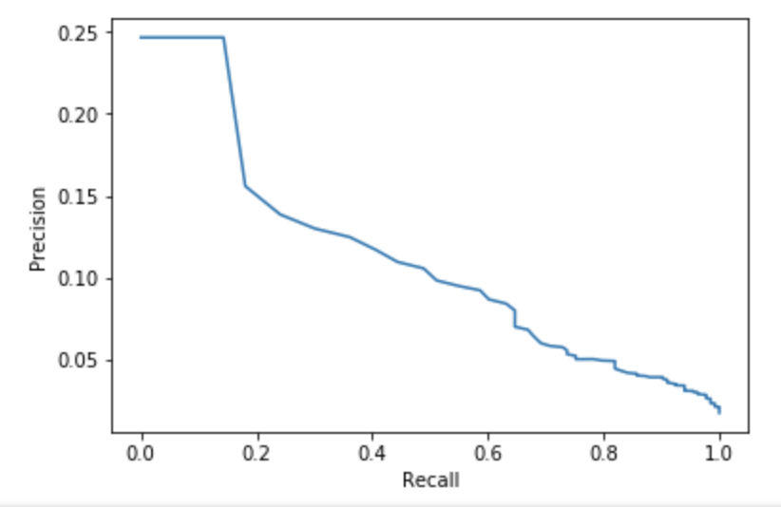
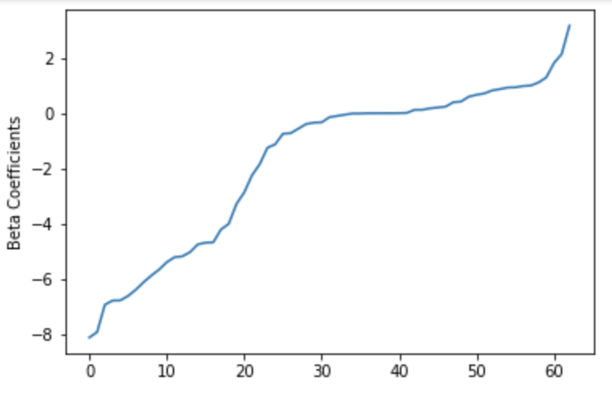
Apply Logistic Regression
Has some additional measurements to see how well it did
from pyspark.ml.classification import LogisticRegression
lr = LogisticRegression(featuresCol = 'features', \ labelCol = 'label', maxIter=10)
lrModel = lr.fit(train)
lrPredictions, lrLog = pyh.predict_and_evaluate(lrModel, test)

Slide 19
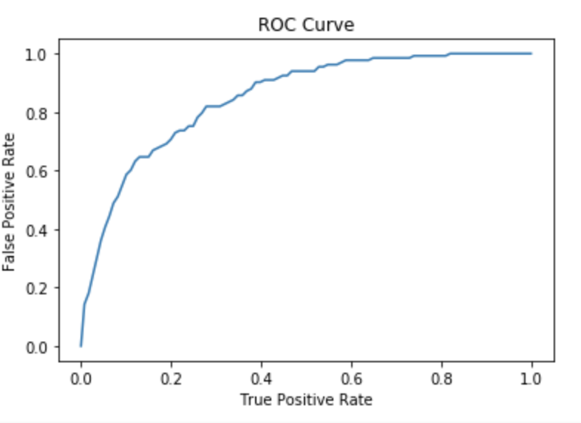
ROC Curve
Shows the tradeoff between accuracy and sensitivity in adjusting the False Positives
The closer the curve is to the left or top border, the more accurate it is
The closer to the 45 degree line, the less accurate it is

Slide 20
Random Forest
Creates Decision Trees on randomly selected samples of the training set
Performs multiple iterations and gets prediction results
Votes on the best random sample
Pros
Often highly accurate due to the strength of multiple predictions
Usually does not suffer from overfitting
Can see the relative feature importance which is useful in revising the model
Cons
Slow to generate because of multiple iterations
Compared to a Decision Tree you cannot really see the path of the tree

Slide 21
Apply Random Forest
Load the module, create a model and train it
from pyspark.ml.classification import RandomForestClassifier
rf = RandomForestClassifier(featuresCol = 'features', \ labelCol = 'label')
rfModel = rf.fit(train)

Slide 22
Neural Networks
Simulates the way the human brain solves
Uses a perceptron, algorithm, or function run in multiple layers
Not only predicts a value but predicts the probability of its occurrence
Allows you to change a probability threshold to favor false positives or false negatives
Pros
Often perform better than others which can be important where accuracy is desired (predicting cancer)
Good for unusual data like image, video, audio
Cons
Black box, you don’t know how it made its decision
Not appropriate in cases where transparency is important
Require a lot more data to train than other models
Computationally expensive
Cool visualization of Neural Network from Google
https://playground.tensorflow.org/

Slide 23
Neural Network Visualized
Input Layer
Hidden Layer
Output Layer
Data

Slide 24
Apply Neural Network
Need to dummy encode categorical features
from pyspark.ml.classification import MultilayerPerceptronClassifier
from pyspark.ml.evaluation import MulticlassClassificationEvaluator
# specify layers for the neural network:
# input layer of size 13 (features), two intermediate of size 5 and 4
# and output of size 2 (classes)
layers = [13, 5, 4, 2]
nn = MultilayerPerceptronClassifier(maxIter=100, layers=layers, blockSize=128, seed=1234)
nnModel = nn.fit(train)

Slide 25
Chapter Concepts
Classification Model
Algorithms
Chapter Summary
Notes:
Highlight the topic that follows this page, and place the delta arrow next to it by moving vertically, but maintain the horizontal placement.
If there are too many topics to fit on the page, reduce the line spacing to fit.

Slide 26
Classification Review
Classification is one of the most widely used models
It is supervised
Good at predicting either/or or multiple-choice categories
Lots of algorithms
No one algorithm is best for all situations so often it involves running many of them, documenting the results, and choosing the best for your data and business case
Can save the results of a lengthy training to a file and reload it for use with the predict function when needed

Slide 27
Next Steps
Classification is one of the most useful models
We have explored several different algorithms here and there are tons more, each with its own strengths and weaknesses

Slide 28
Chapter Summary
In this chapter, we have:
Understood the use cases for Classification models
Discussed and compared various algorithms
Naive Bayes
Decision Tree
Logistic Regression
Neural Network

