Slide 1
Changing boundaries of geographic units
Applied work often uses data with a spatial component
Counties
Commuting zones
Congressional districts
…
Either you want to
have consistent spatial units over time (e.g. changing county boundaries across Census years)
combine data from different spatial units (e.g. construct variables for congressional districts using county-level information)

Slide 2
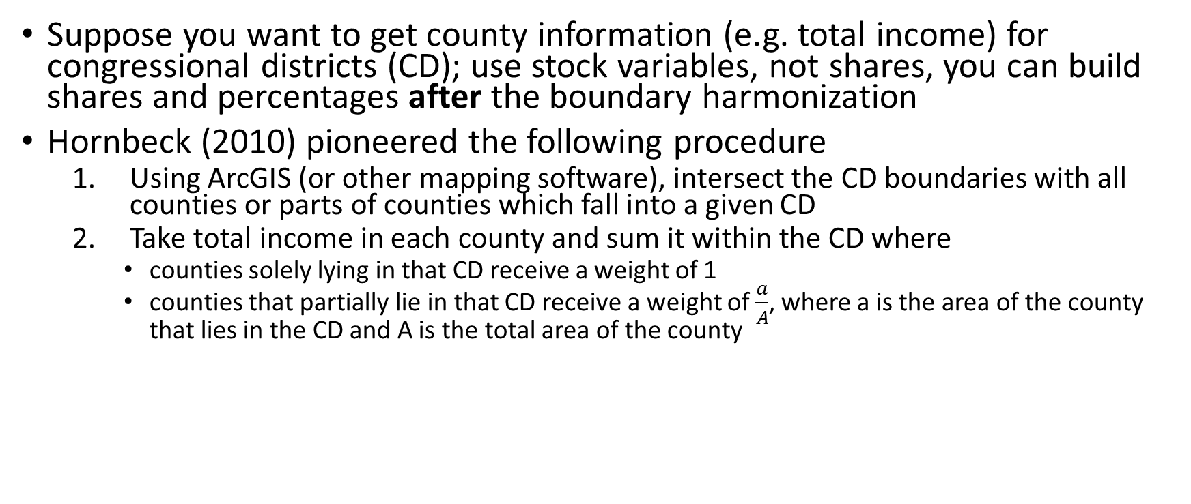
Area-based harmonization methods
Suppose you want to get county information (e.g. total income) for congressional districts (CD); use stock variables, not shares, you can build shares and percentages after the boundary harmonization
Hornbeck (2010) pioneered the following procedure
Using ArcGIS (or other mapping software), intersect the CD boundaries with all counties or parts of counties which fall into a given CD
Take total income in each county and sum it within the CD where
counties solely lying in that CD receive a weight of 1
counties that partially lie in that CD receive a weight of $\frac{a}{A}$, where a is the area of the county that lies in the CD and A is the total area of the county
The last step assumes that total income is uniformly distributed across the county area
this does not hold I the presence of urbanization or other agglomeration economies!

Slide 3
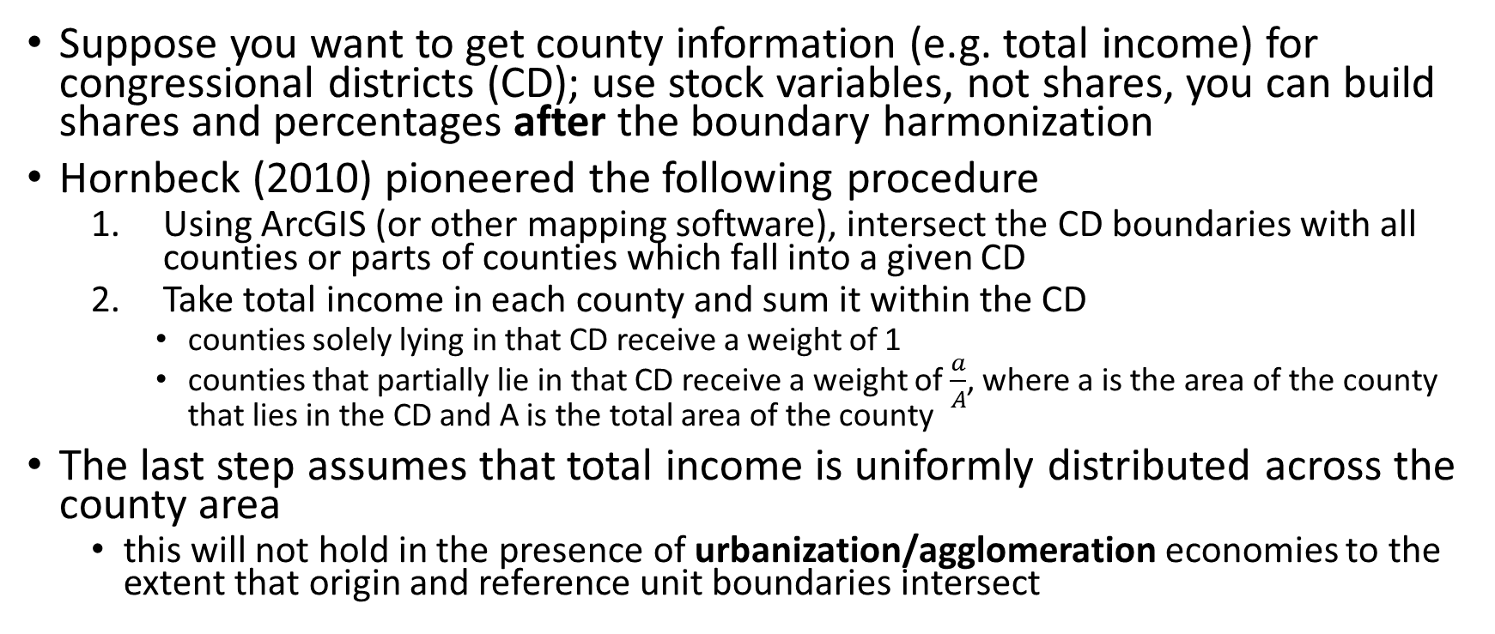
Area-based harmonization methods
Suppose you want to get county information (e.g. total income) for congressional districts (CD); use stock variables, not shares, you can build shares and percentages after the boundary harmonization
Hornbeck (2010) pioneered the following procedure
Using ArcGIS (or other mapping software), intersect the CD boundaries with all counties or parts of counties which fall into a given CD
Take total income in each county and sum it within the CD
counties solely lying in that CD receive a weight of 1
counties that partially lie in that CD receive a weight of $\frac{a}{A}$, where a is the area of the county that lies in the CD and A is the total area of the county
The last step assumes that total income is uniformly distributed across the county area
this will not hold in the presence of urbanization/agglomeration economies to the extent that origin and reference unit boundaries intersect

Slide 4
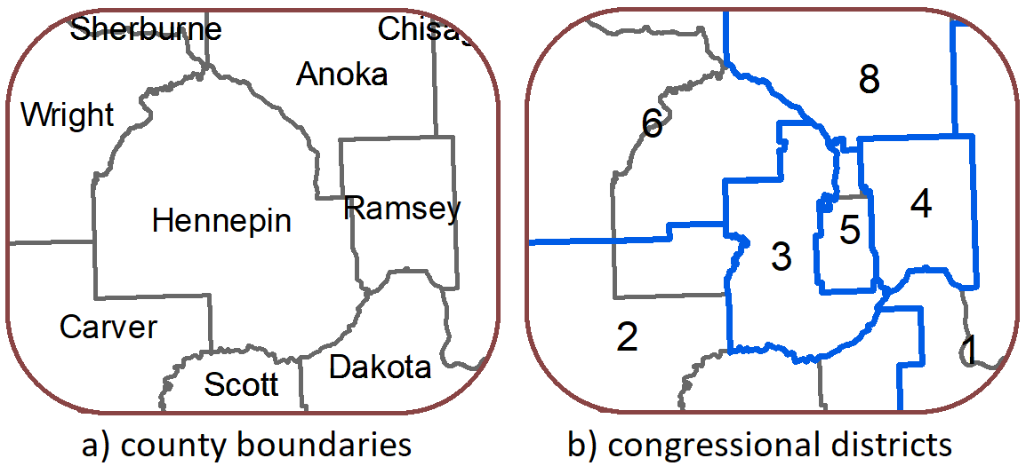
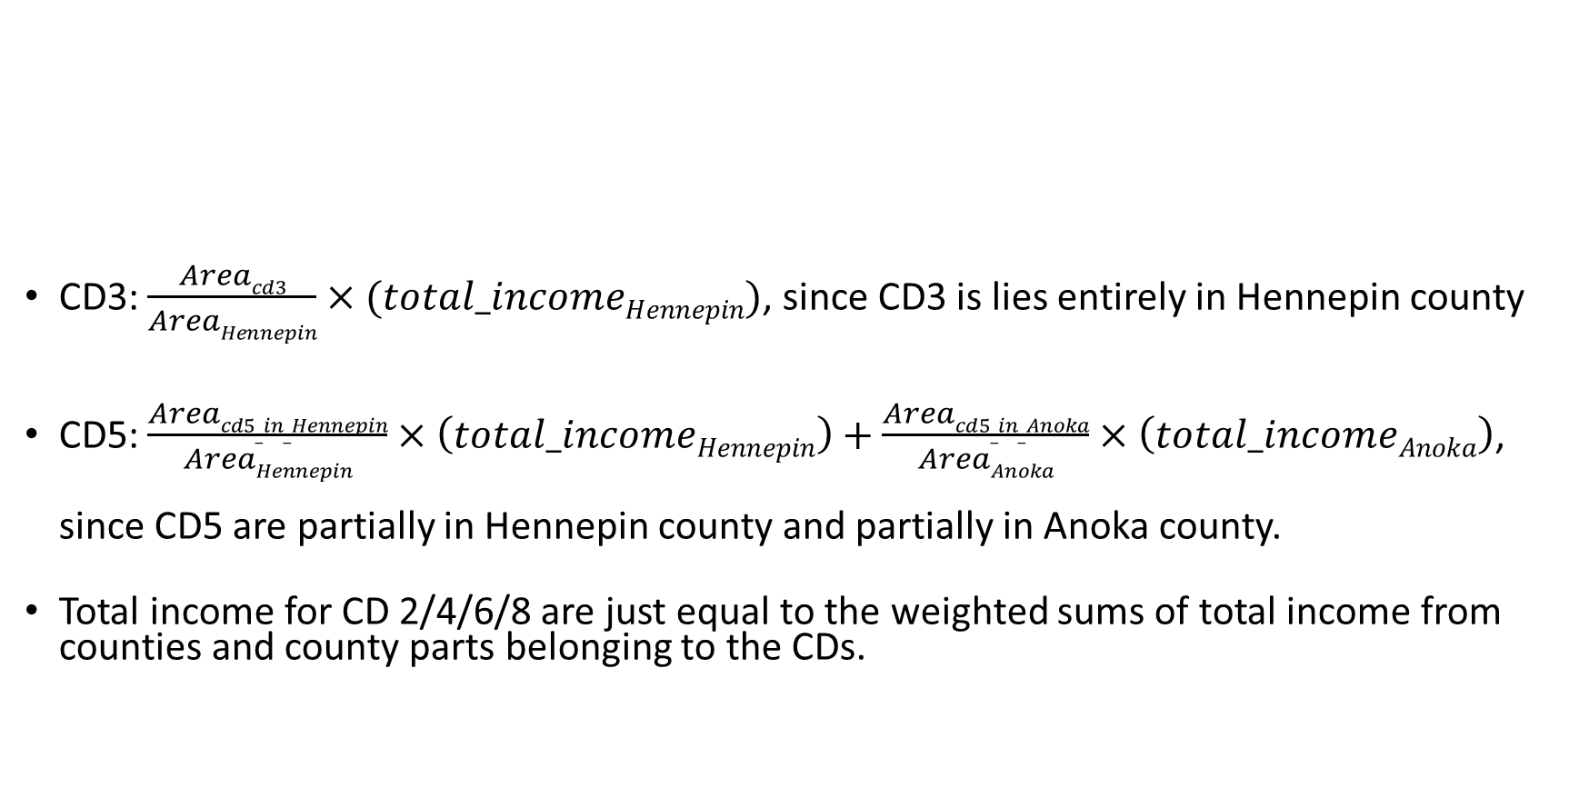
CD3: $\frac{Areacd3}{AreaHennepin}×(total_incomeHennepin)$, since CD3 is lies entirely in Hennepin county
CD5: $\frac{Areacd5_in_Hennepin}{AreaHennepin}×\left(total_incomeHennepin\right)+\frac{Areacd5_in_Anoka}{AreaAnoka}×\left(total_incomeAnoka\right)$, since CD5 are partially in Hennepin county and partially in Anoka county.
Total income for CD 2/4/6/8 are just equal to the weighted sums of total income from counties and county parts belonging to the CDs.

Slide 5
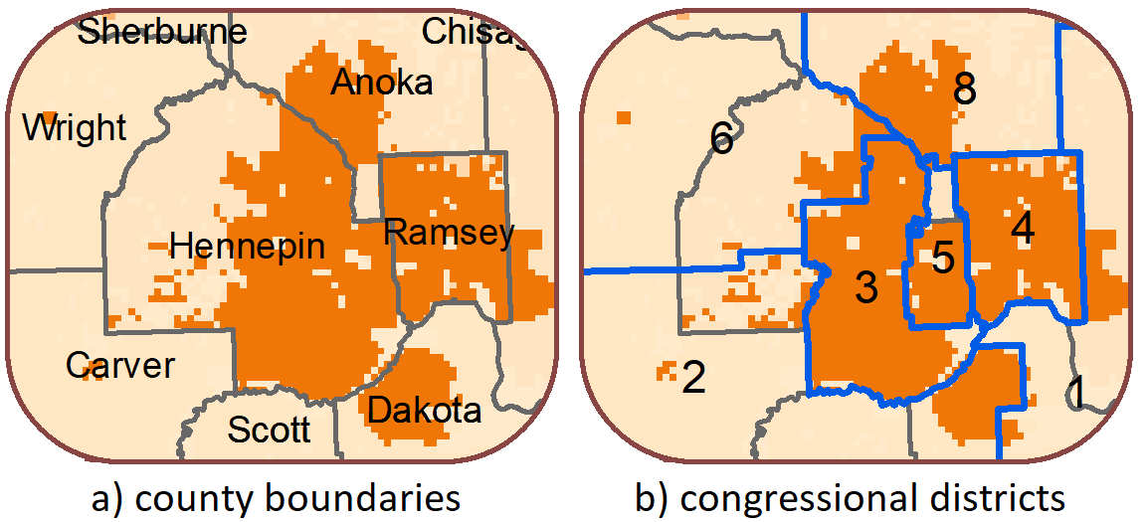
But new population data by Fang and Jawitz (2018) shows that population is not uniformly distributed within counties
they develop different spatial models for 1x1km grid cell population distributions from 1790 to 2010
yellow and orange are approximately above/below mid-range population (for simplicity)

Slide 6
New population-based crosswalks
Using this new population data, Ferrara, Testa, and Zhou (2021) provide a complementary approach to Hornbeck (2010) with new crosswalks for
counties-to-counties over time (Census decades)
counties-to-congressional districts
from 1790 to 2020 using population-based weights instead of area-
based weights. The crosswalks can be downloaded at
https://doi.org/10.3886/E150101
How much does adjusting for population distribution matter?

Slide 7
Comparison with actual CD-level data
Ferrara, Testa and Zhou (2021) take official Census data for CDs which exist for 1960, 1970, 1980 and 1980
They generate CD-level variables from county-level data using
area-based weights (model M1)
population-based weights (models M2-4)
(slight differences between M2-4 in how the sub-county population distribution is generated; in practice it makes little difference)
And then they compare how closely the different crosswalks can replicate the official data (next slide)
relative to M1, M2-4 have a 20% higher correlation with the official CD data

Slide 8
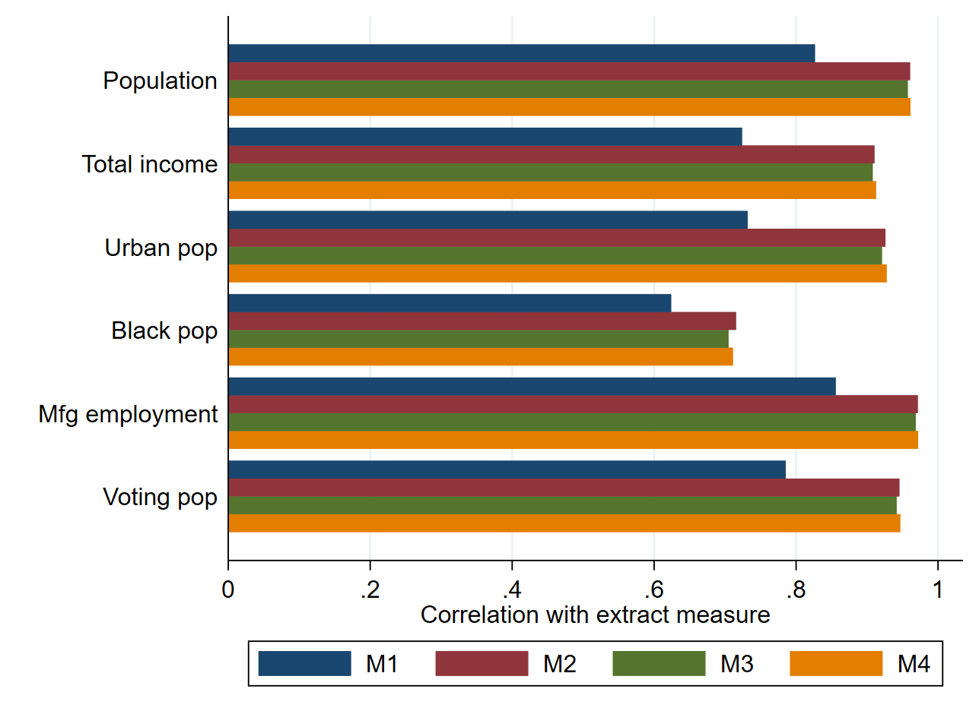

Slide 9
Assumptions and caveats
Of course, there are still some assumptions and caveats
Fang and Jawitz (2018) still rely on uniformity within defined urban and rural areas (though this is relaxed further in M4)
earlier Census years increasingly rely on mathematical assumptions about urban extents over official Census data from the year 2000; this may not be unreasonable given that city population growth tends to follow certain power distributions (see Chen, 2015), but it is important to pick a reference year that pre-dates any “treatment”
population-based approaches work well for stock variables that are correlated with population, like income, number of workers, etc. If a variable is inversely correlated with population, say air quality, then population-based weights can be worse than area-based ones
Solution: turn variable into something that correlates with population (e.g. use air pollution instead of air quality)

Slide 10
How to apply the crosswalks
Suppose you want to harmonize county level data on the stock of Mexican-born population in 1960 to the 88th CDs
Get the county-level data for 1960 for the total number of persons born in Mexico. It is critical to harmonize only county-level stock variables for weights to be appropriate
Given some set of county identifiers (e.g. FIPS or NHGIS codes), merge the 1960 county file with the 1960 to 88th Congress crosswalk file
Multiply the number of persons born in Mexico with the provided weights
Finally, collapse (i.e. sum) the weighted counts for each variable by CD identifiers. Round or mark as missing any cell as needed. The unit of observation is now the CD level

Slide 11
References
Chen, Y. “The distance-decay function of geographical gravity model: Power law or exponential law?”, Chaos, Solutions & Fractals, Vol. 77, pp. 174-189.
Fang, Y. and Jawitz, J.W. (2018) “High-resolution reconstruction of the United States human population distribution, 1790 to 2010”, Scientific Data, Vol. 5, https://doi.org/10.1038/sdata.2018.67.
Ferrara, A., Testa, P., and Zhou, L. (2021) “New Area- and Population-based Geographic Crosswalks for U.S. Counties and Congressional Districts, 1790-2020”, CAGE Working Paper No. 588.
Hornbeck, R. (2010) “Barbed Wire: Property Rights and Agricultural Development”, Quarterly Journal of Economics, Vol. 125(2), pp. 767-810.

